Slide 1
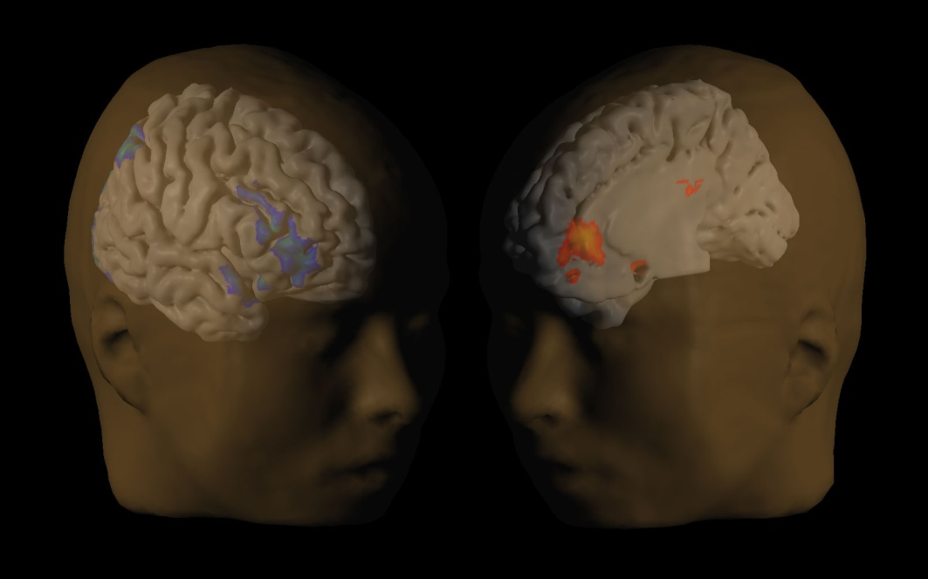
Can We Control Our Selves?
David Laibson
Robert I. Goldman Professor of Economics
Harvard University
March 27, 2013

Slide 2
Thirsty subjects
1 sip now 2 sips in 5 minutes
1 sip in 20 minutes 2 sips in 25 minutes
60%
40%
30%
70%
McClure, Ericson, Laibson, Loewenstein and Cohen (2007)

Slide 3


Choosing fruit vs. chocolate
Choosing Today
Eating Next Week
Time
If you were
deciding today,
would you choose
fruit or chocolate
for next week?
Read and van Leeuwen (1998)

Slide 4
Patient choices for the future:
Choosing Today
Eating Next Week
Time
Today, subjects
typically choose
fruit for next week.
74%
choose
fruit

Slide 5
Impatient choices for today:
Choosing and Eating
Simultaneously
Time
If you were
deciding today,
would you choose
fruit or chocolate
for today?

Slide 6
Impatient choices for today:
Choosing and Eating
Simultaneously
Time
70%
choose
chocolate

Slide 7
Present bias
Immediate events get full weight.
Everything else gets half weight.
Phelps and Pollak (1968), Laibson (1997)

Slide 8
Procrastination
Exercise has effort cost 6
Delayed health benefit of 8
Exercise Today: -6 + ½ [8] = -2
Exercise Tomorrow: 0 + ½ [-6 + 8] = 1
Akerlof (1991), O’Donoghue and Rabin (1999)

Slide 9
Joining a Gym
Cost of membership: $75 per month
Number of visits: 4
Cost per visit: $19
Cost of “pay per visit”: $10
Della Vigna and Malmendier (2006)

Slide 10
What else are we planning to do tomorrow?
Invest in financial capital (e.g., cut credit card debt, refinance mortgage, obtain better insurance rates, join 401(k) plan).
Invest in human capital (education, skill acquisition)
Invest in social capital (children, family, friends).
Invest in health capital (exercise, nutrition, smoking, substance abuse)

Slide 11
Saving intentions vs. saving behavior
Out of every 100 surveyed employees
68 self-report saving too little
24 plan to raise savings rate in next 2 months
3 actually follow through
Choi, Laibson, Madrian, Metrick (2002)

Slide 12

Opt-in enrollment
Opt-out enrollment (auto-enrollment)
PROCRASTINATION
UNDESIRED BEHAVIOR:
Non-participation
DESIRED BEHAVIOR:
participation
START HERE
Madrian and Shea 2001

Slide 13
Active Choice
PROCRASTINATION
UNDESIRED BEHAVIOR:
Non-participation
DESIRED BEHAVIOR:
participation
Must choose for oneself
START HERE
Carroll, Choi, Laibson,
Madrian, and Metrick (2009)

Slide 14
Quick enrollment
PROCRASTINATION
UNDESIRED BEHAVIOR:
Non-participation
DESIRED BEHAVIOR:
participation
START HERE
Beshears, Choi, Laibson, Madrian, and Metrick (2008)

Slide 15

Quick enrollment
PROCRASTINATION
UNDESIRED BEHAVIOR:
Non-participation
DESIRED BEHAVIOR:
participation
START HERE
Beshears, Choi, Laibson, Madrian, and Metrick (2008)

Slide 16
Improving 401(k) participation
Opt-in enrollment
40%
Quick Enrollment
(“check a box”)
50%
Active choice (requirement to choose)
70%
Opt-out
90%
Participation Rate (1 year tenure)

Slide 17
Three frontiers
Health care applications
Neural foundations
Self-commitment

Slide 18
Home Delivery Utilization for All Drug Classes (including ineligible classes)
%
Beshears, Choi, Madrian, Laibson, Sakong (2011)
Notes:
This graph displays the fraction of prescriptions that are filled through Home Delivery in a given month. The universe is all prescription refills in a given month. Note that Home Delivery prescriptions need to be refilled less often, since the supply of medicine goes up to 90 days. The supply limit for a retail prescription fill is 30 days. The Select Home Delivery program was in effect during the time period marked by the red vertical lines (November 2008-October 2009). In November 2009, a more aggressive approach to increasing take-up of home delivery was adopted by the company which accounts for the increase in home delivery utilization in this period. We do not analyze this second program in this paper.

Slide 19
Neural foundations
Stay on your diet
(Executive function in analytic cortex
dlPFC)
I want a donut
(impulsivity in dopamine reward system)
McClure, Laibson, Loewenstein, Cohen (2004)
McClure, Ericson, Laibson, Loewenstein, Cohen (2007)
Hare, Camerer, Rangel (2009)
Figner, Knoch, Johnson, Krosch, Lisanby, Fehr, Weber (2010)
Albrecht, Volz, Sutter, Laibson, von Cramon (2011)

Slide 20
How to design a commitment contract
Participants divide $$$ between:
Freedom account (22% interest)
Goal account (22% interest)
  withdrawal restriction
Beshears, Choi, Madrian, Laibson, Sakong (2011)

Slide 21
Initial investment in goal account
Goal Account
10% penalty
35%
Freedom
Account
65%
Goal account
20% penalty
43%
Freedom
Account
57%
Goal account
No withdrawal
56%
Freedom
Account
44%

Slide 22
Now participant can divided their money across three accounts:
(i) freedom account
(ii) goal account with 10% penalty
(iii) goal account with no withdrawal
50.1% allocated to freedom account
16.2% allocated to 10% penalty account
33.9% allocated to no withdrawal account
Beshears, Choi, Laibson, Madrian, Sakong (2012)

Slide 23
Future policy questions
Why are there 300 flavors of ice cream and only one kind of retirement savings account?
Why aren’t households able to choose their own way of managing temptation?
  10% penalty IRA
  Lock-box IRA
How can we help people align their good intentions with their actions?
In the last decade, solving problems of self-regulation has been low hanging fruit. Can we do more?

