Slide 1
The Age of Reason
David Laibson
Harvard University
Robert I. Goldman Professor of Economics
June 2011
View in slideshow mode to skip hidden slides

Slide 2
Behavioral Economics aka Psychology and Economics
Analysis of the psychological factors that influence economic choices.
Asset pricing: e.g., bubbles
Corporate finance: e.g., C-suite psychology
Household finance: e.g., return chasing
Today: the aging individual investor

Slide 3
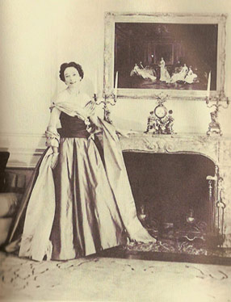
Brooke Astor, Age 51, 1953
National Medal of Arts (1988) and Presidential Medal of Freedom (1998)
Anthony Marshall, her son, found guilty of grand larceny 2 years after her death.

Slide 4
Distribution of wealth
Survey of Consumer Finances (2007)
(Dollars in 1,000’s)
 |  | Average |  | Percent |  | Percent
Age |  | Net Worth |  | of families |  | of wealth
<35 |  | $ 106.0 |  | 23.2 |  | 4.7%
35-44 |  | $ 325.6 |  | 23.3 |  | 14.4%
45-54 |  | $ 661.2 |  | 19.2 |  | 24.1%
55-64 |  | $ 935.8 |  | 12.8 |  | 22.8%
65-74 |  | $ 1,015.2 |  | 11.2 |  | 21.6%
75+ |  | $ 638.2 |  | 10.2 |  | 12.4%

Slide 5
Balance Sheet of U.S. Households
Federal Reserve Flow of Funds (2009)
(Dollars in Trillions)
Assets | $ 67.2
Tangible | $ 24.8
Financial | $ 42.4
Liabilities | $ 14.1
Net Worth | $ 53.1

Slide 6
Net worth of older adults (65+)
34% of $53.1 trillion
= $18.1 trillion

Slide 7
Outline
The $18 trillion question
Cognitive performance over the lifecycle
Dementia
Elder Abuse
The selection problem
Economic consequences
Psychological barriers
Advice
Regulation
Planning for cognitive decline
  Durable power of attorney
  Living revocable trust

Slide 8
2. Cognitive performance over the lifecycle
Cognitive function comes in two key categories:
Crystallized intelligence (skills, knowledge, experience)
Fluid intelligence (ability to solve new problems)
Crystallized intelligence rises until the 60’s
Fluid intelligence starts falling quickly at age 20
Source: Cattell (1987)

Slide 9
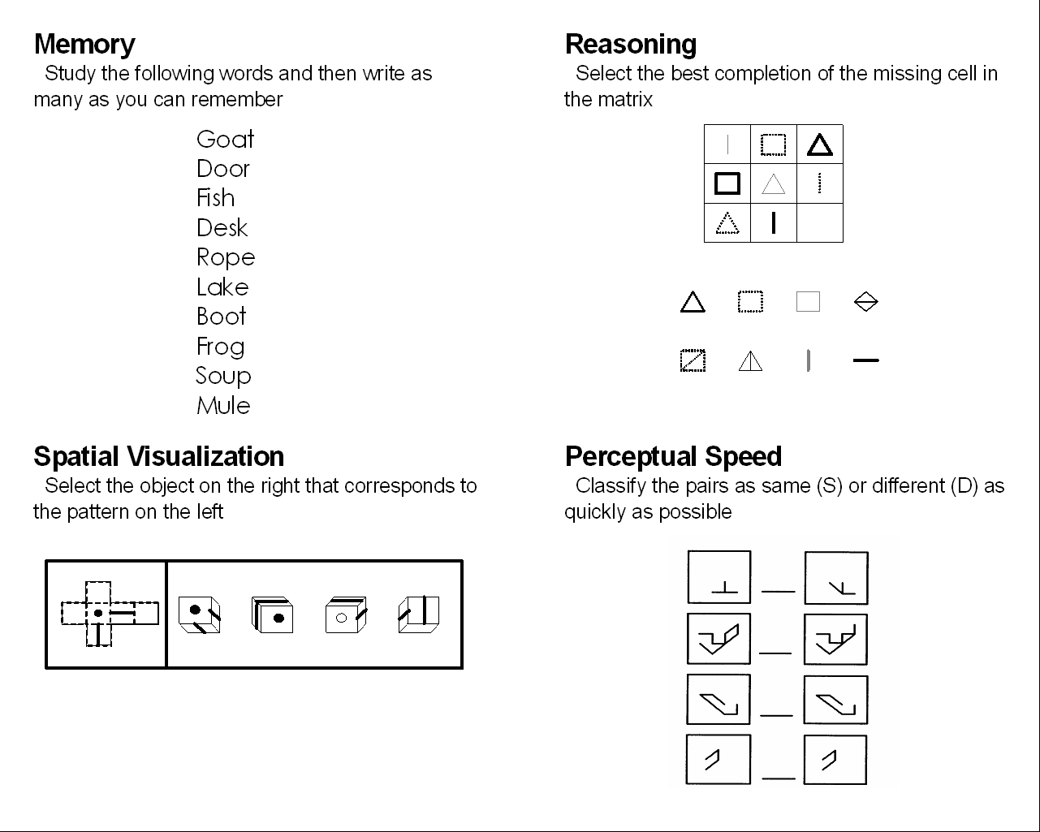
D
D
S
S

Slide 10
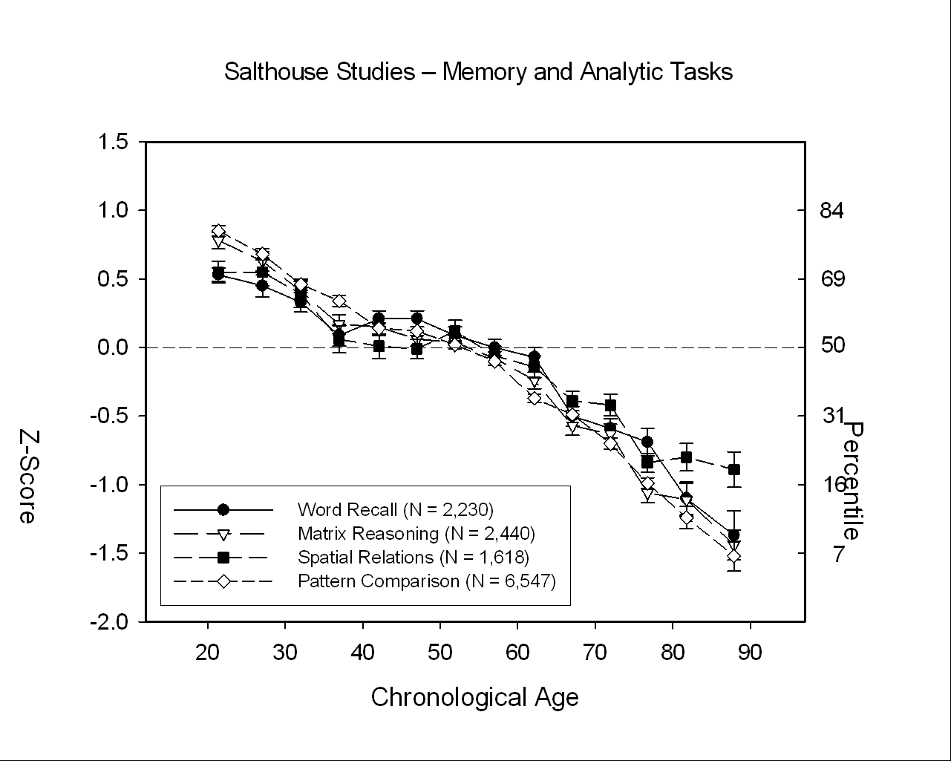
Percentile
73rd
percentile
16th
percentile
Source: Salthouse forthcoming

Slide 11
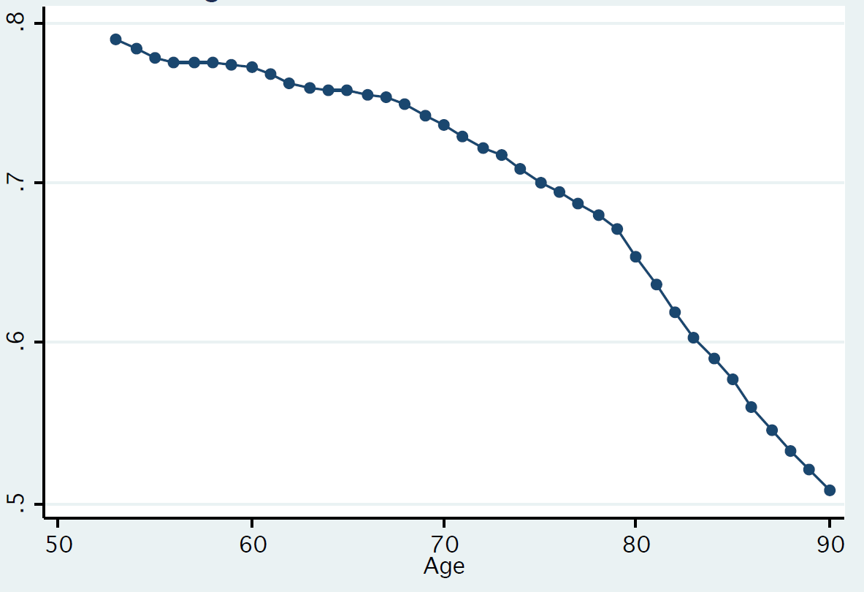
“If the chance of getting a disease is 10 percent, how many people out of 1,000 would be expected to get the disease?”
Fraction of people who answer “100”
Source: HRS; Agarwal, Driscoll, Gabaix, Laibson (2009)

Slide 12
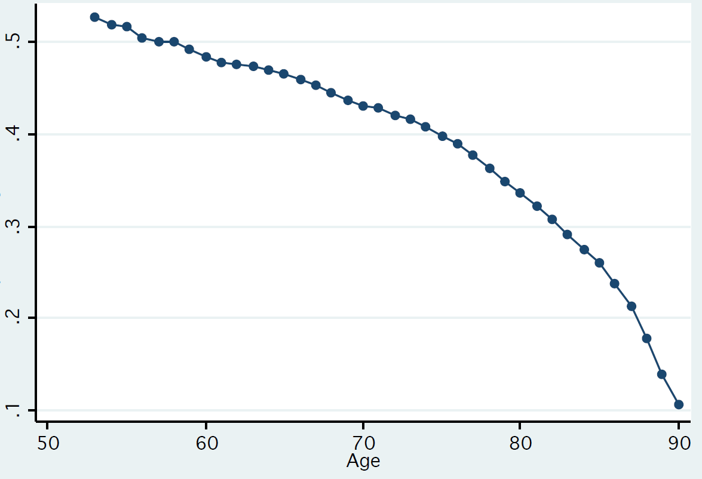
“If 5 people all have the winning numbers in the lottery and the prize is two million dollars, how much will each of them get?”
Fraction of people who answer “400,000”
Source: HRS; Agarwal, Driscoll, Gabaix, Laibson (2009)

Slide 13
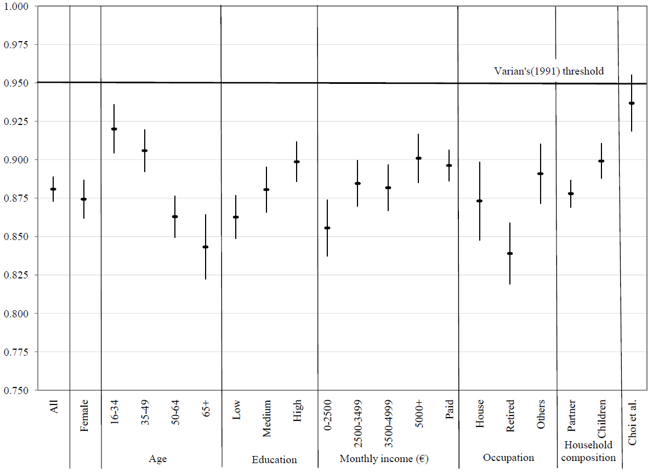
Economic Problem Solving
Choi, Kariv, Müller, and Silverman, 2011

Slide 14
Economic Problem Solving
Choi, Kariv, Müller, and Silverman, 2011

Slide 15
Economic Problem Solving
Choi, Kariv, Müller, and Silverman, 2011

Slide 16
But I’ve only emphasized one kind of cognitive function…
We’ve talked about fluid intelligence
(solving a new problem)
What about crystallized intelligence?
(solving a familiar problem)

Slide 17
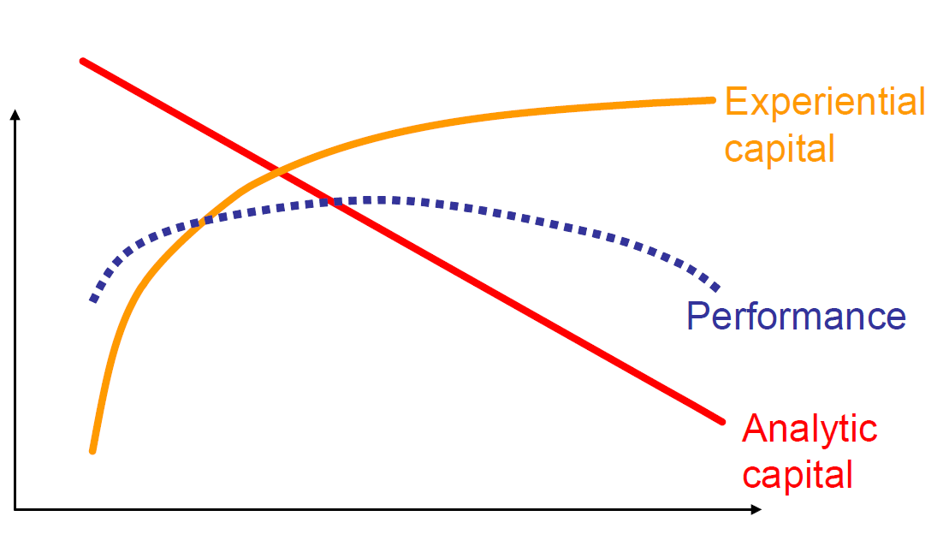
Cognitive function
Crystallized
intelligence
Fluid
intelligence
53
Age

Slide 18
Performance peaks
Late 20s: Baseball (James 2003)
Early 30s: Mathematicians, theoretical physicists, lyric poets: (Simonton 1988)
Mid-30s: Chess players (Charness and Bosnian 1990)
Early 40s: Autocratic rulers (Simonton 1988)
50: Novelists (Simonton 1988)
50s: Financial decisions

Slide 19
3. Dementia
Prevalence of Dementia in North America (%)
60-64 0.8 %
65-69 1.7 %
70-74 3.3 %
75-79 6.5 %
80-84 12.8 %
85+ 30.1 %
× 2.1
× 1.9
× 2.0
× 2.0
× 2.4
Source: Ferri et al 2006

Slide 20
Cognitive impairment without dementia
71-79 16.0 %
80-89 29.2 %
90+ 38.8 %
Source: Plassman et al 2006

Slide 21
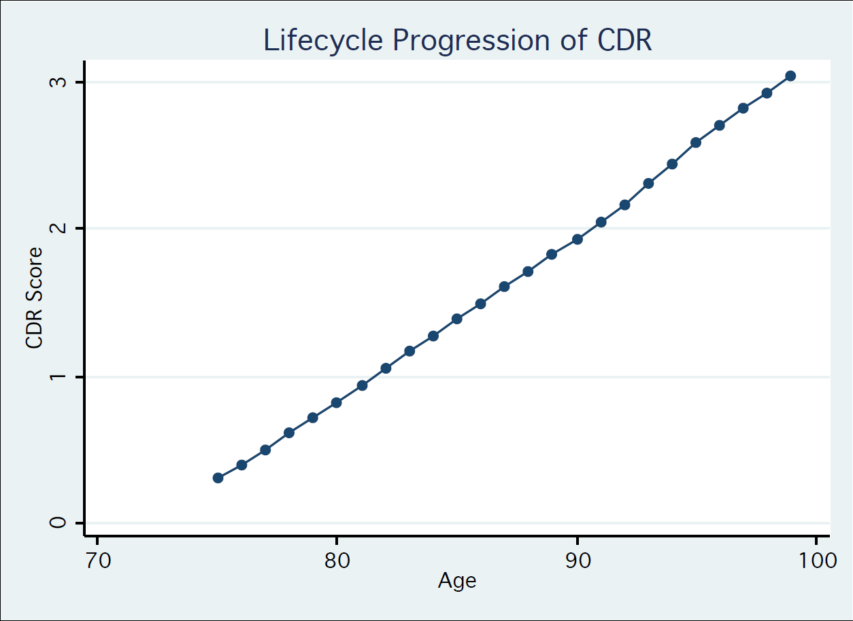
Average Clinical Dementia Rating (0-4 scale)
severe dementia
moderate dementia
mild dementia
very mild
dementia
healthy
Source: HRS; Agarwal, Driscoll, Gabaix, Laibson (2009)

Slide 22
Adding it up
10,000,000 American have CIND or Dementia
2,000,000 new American cases every year

Slide 23
4. Elder abuse
6% of older adults report significant abuse in the last month
25% of vulnerable adults report significant levels of psychological abuse
17% of professional care staff report committing psychological abuse and 10% physical abuse
Over 80% of care staff report observing abuse
Cooper, Selwood, and Livingston (2008)

Slide 24
5. The selection problem
People with cognitive decline tend to be less visible than other older adults
It’s an issue of both supply and demand.
Supply: Who is in the supermarket, at the ball game, on the airplane?
Demand: Would you rather watch a documentary about Killer Whales or Alzheimer’s Disease?

Slide 25
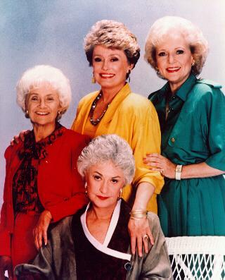

Two faces of aging

Slide 26
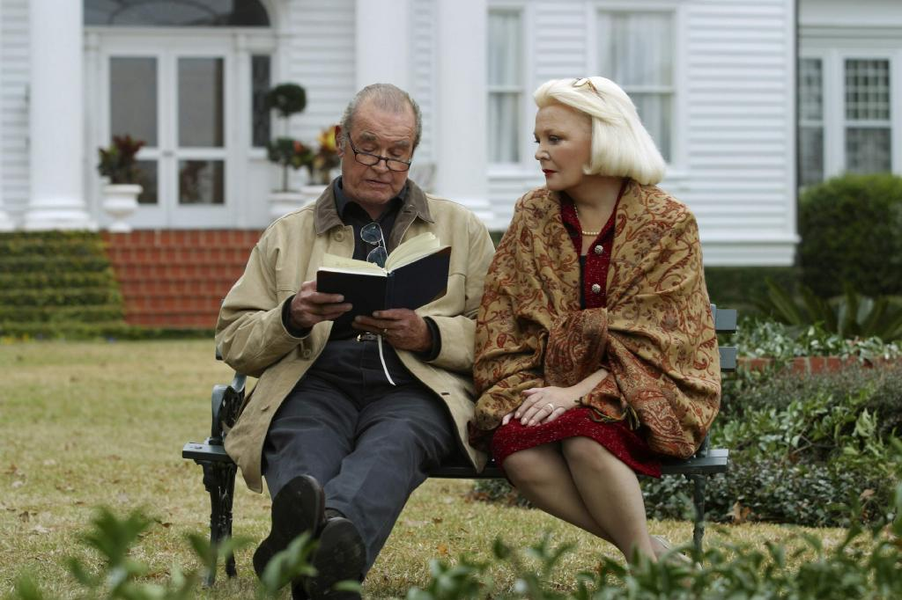
The Notebook, starring James Garner and Gena Rowlands, 2004

Slide 27
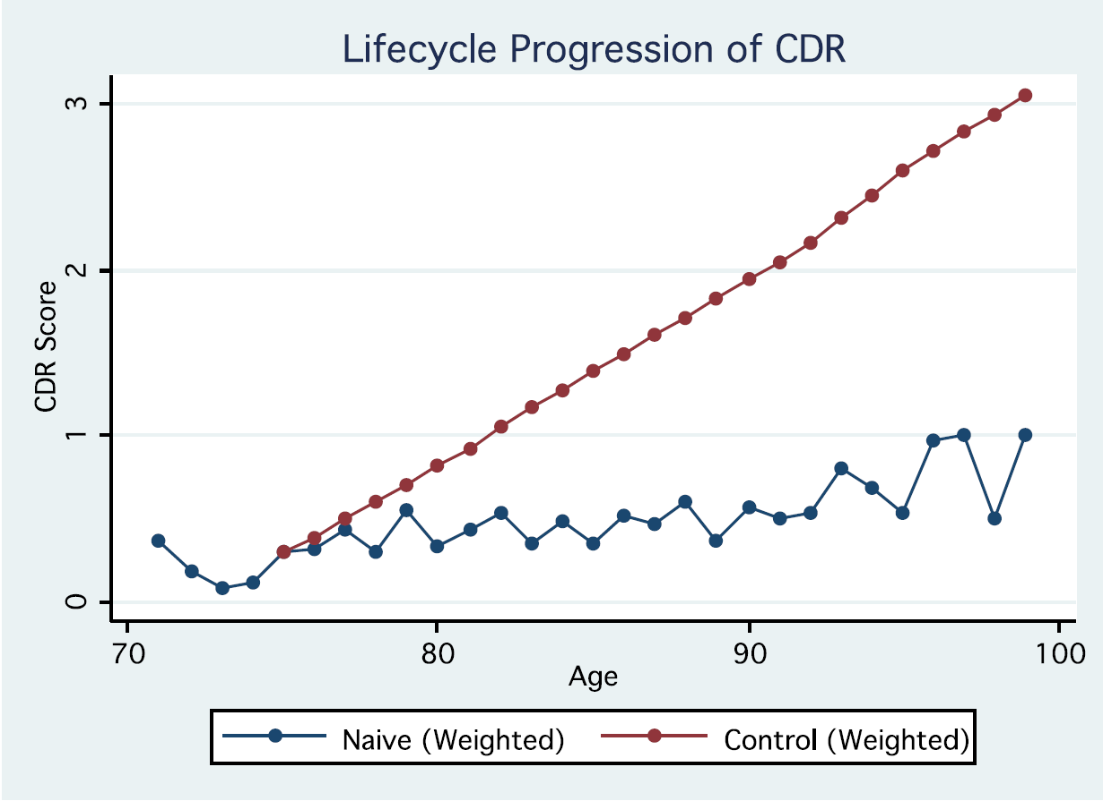
Average Clinical Dementia Rating (0-4 scale)
severe dementia
Adjusting for
attrition
moderate dementia
Raw scores
mild dementia
Source: HRS; Agarwal, Driscoll, Gabaix, Laibson (2009)

Slide 28
Fraud
Recent law enforcement action in Vermont, uncovered a criminal network that was defrauding older adults.
The office of the Vermont Attorney General then checked to see what fraction of the victims had reported the fraud to law enforcement agencies.
Answer: 1% of the cases.

Slide 29
6. Standard economic behavior
Interest rates
Credit cards
Investing

Slide 30
Survey evidence
Twenty percent of Americans aged 65 or older report that they have “been taken advantage of financially in terms of an inappropriate investment, unreasonably high fees for financial services, or outright fraud.”
Source: Investor Protection Trust

Slide 31
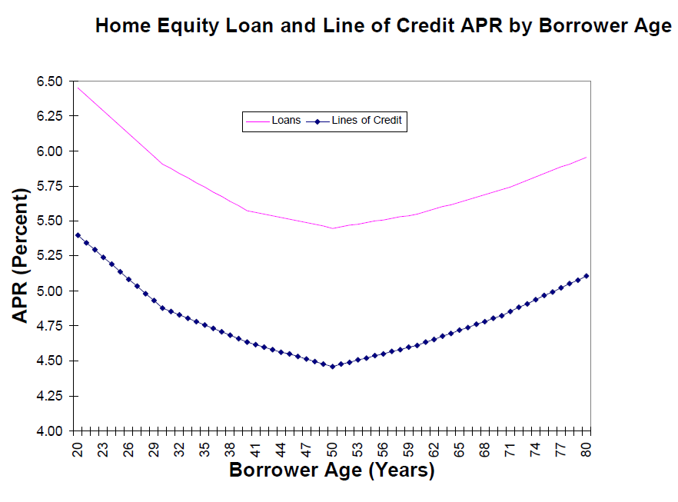
Home equity loan and line of credit APR by Borrower Age
Loans
Lines of credit
Source: Agarwal, Driscoll, Gabaix, and Laibson 2009

Slide 32
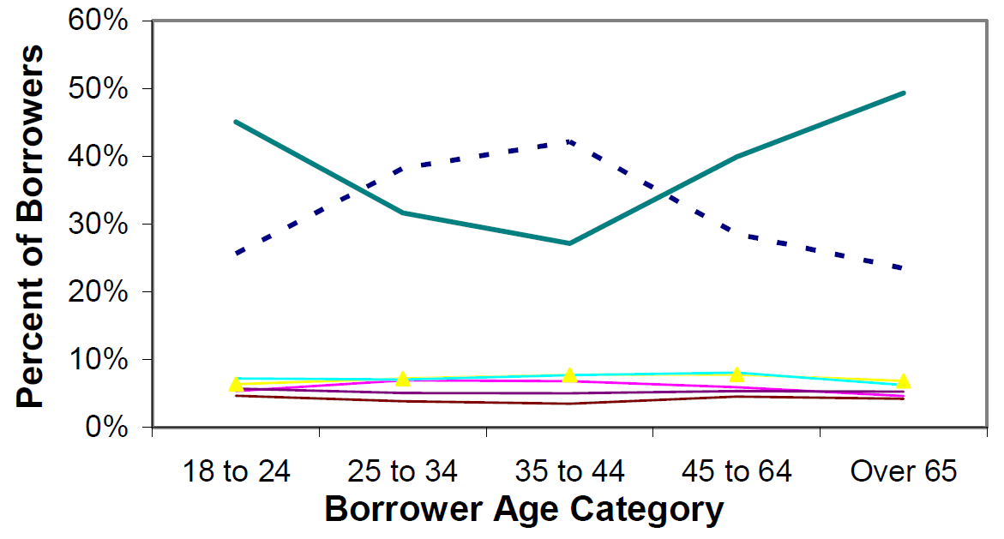
Balance Transfer Ploy
Those who never
figure it out
Those who figure it out right away
Source: Agarwal, Driscoll, Gabaix, and Laibson (2009)

Slide 33
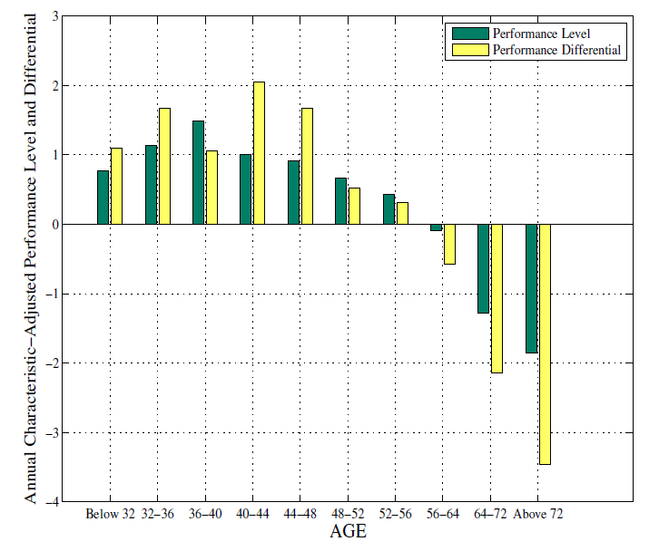
Investment performance
Korniotos and Kumar (2009)

Slide 34
7. Planning for cognitive decline
Durable power of attorney (springing?)
Living revocable trust
Advanced medical directives
  Health care power of attorney (health care proxy)
  Living will
And, of course, a Will

Slide 35
7. Psychological resistance to planning for cognitive decline
Lack of meta-cognition: My memory is fine.
Need for control: I want to keep driving.
Over-optimism: I won’t have dementia.
Procrastination: I’ll do it next month.
Aversion to complexity: A living revocable trust?
Aversion to annuitization: All of the above.
Over-confidence: The future is predictable.
In addition, planning for cognitive decline is costly.

Slide 36
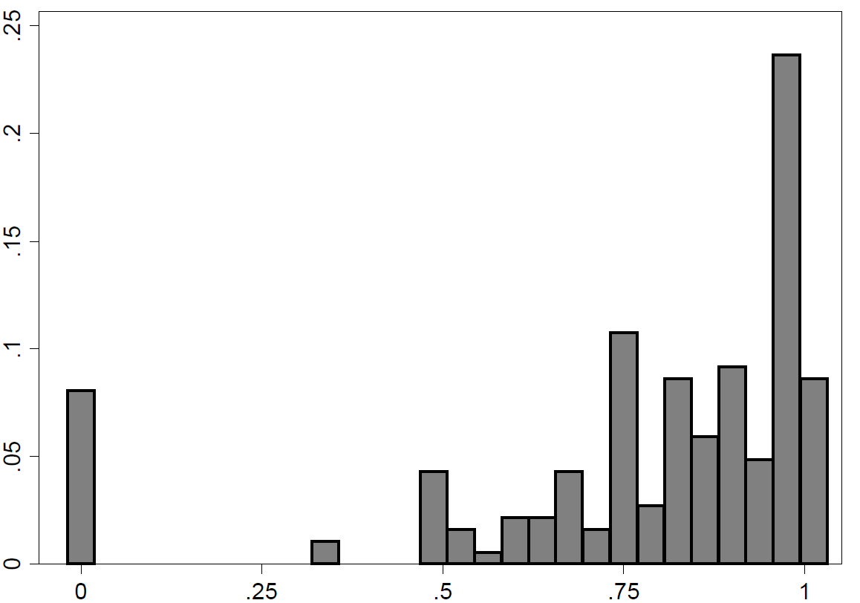
In six months, would you like $10 for sure, or $13.33 if you remember to click?
Actual click rate
Perceived probability that I’ll remember to click
Ericson (2009)

Slide 37
Resistance to annuities
Warner and Pleeter (2001)
The US government offered retiring armed forces service members a choice between a term annuity and a lump sum
Here’s a typical example for officers:
  Lump sum of $46,219 (52%)
  Annuity with NPV of $82,908 (48%)
Here’s a typical example for enlisted soldiers:
  Lump sum of $22,283 (95%)
  Annuity with NPV of $39,972 ( 5%)
Lump-sums have much lower NPV’s but nevertheless are chosen more often

Slide 38
Resistance to annuities
Approximately 75% of defined benefit pensions are now elected to be received as lump-sum payments.
Less than 5% of defined contribution pensions are transformed into annuities.

Slide 39
Planning for cognitive decline
Durable power of attorney (or springing)
Living revocable trust
Living will
Healthcare proxy
(and, of course, a Will)
Discuss long-term strategies when the client is still cognitively healthy

Slide 40
Nudges
Estate planning is the default for every 65 year old
  “It’s not about you.”
Regular check-ups (e.g., update trustee list, verify that beneficiaries have been appropriately designated)
Each check-up ends with an “appointment” for the next check-up (“June 2013”)
  This legitimates future nudges
Family involvement is encouraged (but not required)

Slide 41
Older adults
Novel problems may be hard
Memory may be failing
Client and their family may be in denial
Emotions and trust will matter more as analytic cognitive functions decline
Passivity is common (unopened mail)
Take action on the spot (be ready to do this)
Keep it simple (one-dimensional choice)
Build fail-safe systems (market-timing is not OK)
But still give clients a sense of control

Slide 42
Regulatory Proposals
After age 65, require durable power of attorney or springing power of attorney.
  Provide an inexpensive option (regulated and offered by the private market) for those who don’t want a family member, friend, or attorney to take this role.
  Increase oversight and criminal penalties for attorneys-in-fact

Slide 43
Regulatory Proposals
Establish a fiduciary duty for IRA advisers and asset management companies
  Use 401(k)/DC regulations as model
  Retirees should be as least as well protected as middle-aged adults
  Alternatively, encourage/require assets to remain in DC plans instead of rolling over to IRA’s.

Slide 44
Regulatory Proposals
Create a class of safe harbor financial products.
  Diversified low-fee funds with an automatic monthly drawn-down mechanism after age 70.
  Low-fee annuities and deferred annuities.
  Other retirement products approved by regulator
  Analogous to QDIA’s in DC plans.
  Safe harbor for fiduciaries (advisers and asset managers).
  DC Rollovers would be defaulted into this safe harbor.
  Large withdrawals/transfers from safe harbor would require notarized signature of asset owner, physician, spouse, and relevant fiduciaries.
  In the event of mental incompetence, signature of attorney-in-fact would also be required.

Slide 45
Business opportunity
Solve the decumulation challenge
  Protect assets from mischief
  Convert wealth into consumption
  Insure against longevity risk
  Insure against inflation risk
  Give aging investors a sense of control
The market is $10+ trillion in AUM

Slide 46
Three facts to remember:
About half of the population in their 80’s suffers from significant cognitive impairment, effectively rendering them incapable of making important financial choices.
Nevertheless, our existing fiduciary protections are far greater for 50 year olds than 90 year olds.
There is $18 trillion at stake.

Slide 47
Estate planning
Estate planning is not just tax planning or bequest planning
Planning for cognitive decline is just as important
The principal may be incapacitated for decades
Who can manage their affairs when they can’t?
Need a committee of trustees that is trustworthy, knowledgeable, and competent. A committee is often a good solution when there are conflicts of interest.

Slide 48
Communication strategy:
“I’ve noticed that you are having some memory problems and that made me think that we should have a conversation about a living revocable trust.” (wrong)
“I ask every client I advise to set up a living revocable trust before age 65, which is long before cognitive decline is an issue.” (right)
The conversation should be triggered by age-based rules, far in advance of the 70’s.

Slide 49
Application to estate planning
We should make estate planning easy
Switch to an opt-out philosophy (e.g. everyone should be required to have durable power of attorney, unless individual opts out)
Start early (40+)

Slide 50
Application to Estate Planning
Create automatic mechanisms that determine when control is passed to trustees/attorney-in-fact (pre-scheduled annual family/physician meeting)
Set up these transition mechanisms no later than the 60’s (pre-commitment)
Pre-commit investment strategy of trustees so principal retains indirect control (so transfer of control is less psychologically difficult)
Give principal as much control as possible, even with diminished capacity

Slide 51
Conclusion
The $18 trillion question
Cognitive performance over the lifecycle
Dementia
Elder Abuse
The selection problem
Economic consequences
Planning for cognitive decline
  Durable power of attorney
  Living revocable trust
Psychological resistance

Slide 52
Opportunities
Current institutions are unsatisfactory
Transitions are problematic
Little or no middle ground
Little psychological sophistication
Little traction beyond high net worth

Slide 53
Notes:
Durable power of attorney (appoint two and two replacements)
Exploit checks and balances: attorney-in-fact should have reporting obligations
Select young trustees (and young replacements)

