Slide 1
How are preferences revealed?
John Beshears, David Laibson, Brigitte Madrian
Harvard University
James Choi
Yale University
June 2009

Slide 2
Revealed preferences:
  The choices that people make
Normative preferences:
  The choices that they should make

Slide 3
Revealed Preferences ≠ Normative Preferences
One example:
In 401(k)’s with employer stock as an option, approximately a third of retirement savings is invested in employer stock.
This choice reveals many things, among them, confusion about the risk characteristics of employer stock.
On average, US workers report that their employer’s stock is less risky than a diversified mutual fund.

Slide 4
$100 bills on the sidewalk
Choi, Laibson, Madrian (2004)
Employer 401(k) match is an instantaneous, riskless return
Particularly appealing if you are over 59½ years old
  Can withdraw money from 401(k) without penalty
On average, half of employees over 59½ years old are not fully exploiting their employer match
Educational intervention has no effect

Slide 5
Education and Disclosure
Choi, Laibson, Madrian (2007)
Experimental study with 400 subjects
Subjects are Harvard staff members
Subjects read prospectuses of four S&P 500 index funds
Subjects allocate $10,000 across the four index funds
Subjects get to keep their gains net of fees

Slide 6
Data from Harvard Staff
Control Treatment
Fees salient
$518
$494
Fees from
random
allocation
$431
3% of Harvard staff
in Control Treatment
put all $$$
in low-cost fund

Slide 7
Data from Harvard Staff
Control Treatment
Fees salient
$518
$494
Fees from
random
allocation
$431
3% of Harvard staff
in Control Treatment
put all $$$
in low-cost fund
9% of Harvard staff
in Fee Treatment
put all $$$
in low-cost fund

Slide 8
When are revealed preferences likely to deviate from normative preferences?
Passive choice:
Complexity:
Limited personal experience:
Third-party marketing:
Intertemporal choice:

Slide 9
1. Passive choice
Decision-makers have an overwhelming tendency to adopt defaults.

Slide 10
Madrian and Shea (2001)
Choi, Laibson, Madrian, Metrick (2004)
Automatic
enrollment
Standard
enrollment

Slide 11
Employees enrolled under automatic enrollment cluster at default contribution rate.
Fraction of Participants at different contribution rates:
Default contribution
rate under automatic
enrollment

Slide 12
2. Complexity
Three channels of distortion:
Complexity delays choice, increasing the fraction of consumers who adopt default options (O’Donoghue and Rabin, 2004).
Complexity biases choice, since people tend to avoid complex options (Shafir and Tversky, 1994; Iyengar and Kamenica, 2006).
Complexity adds noise to choice, since complex options are not as transparent and well-understood as simple options. Hence, some consumers will choose a complex option because they misestimate its value (Gabaix, Laibson, and Li, 2006).

Slide 13
Simplification
Beshears, Choi, Laibson, Madrian (2006)
2005
2004
2003

Slide 14
3. Limited personal experience
People learn primarily through direct personal experience, not through indirect passive channels.
For example, the lessons of Enron, Worldcom, and Global Crossing were not heeded by workers outside of these firms (Choi et al 2005).
  Even new workers at other firms failed to avoid employer stock.
  Even new workers at other Houston firms failed to avoid from employer stock.

Slide 15
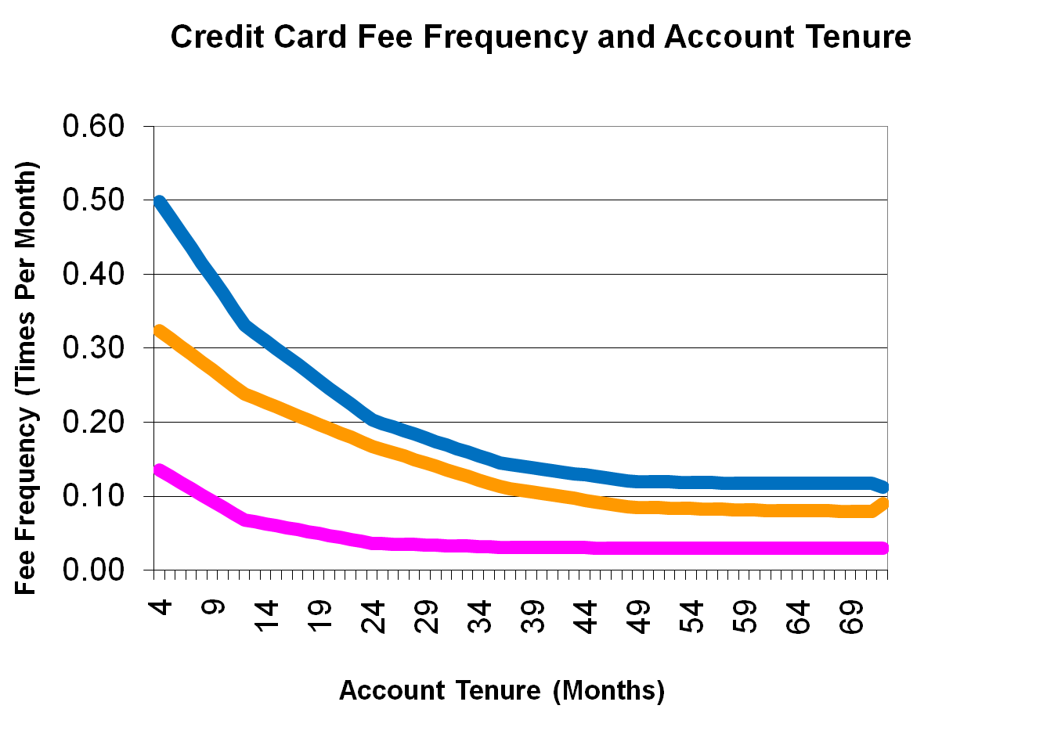
Agarwal, Driscoll, Gabaix, and Laibson (2006)
Cash advance
Late fee
Limit fee

Slide 16
4. Third-party marketing
Explicit Persuasion
Implicit Persuasion
  Shrouding (Gabaix and Laibson, 2006)
Examples of shrouded attributes:
  Cost of printer ink
  Bank account fees
  Credit card fees
  Mutual fund fees

Slide 17
5. Intertemporal choice
Which set of preferences is valid?
  Today’s decision to exercise tomorrow?
  Or my decision tomorrow, not to exercise after all?
Good intentions inconsistent with subsequent actions
  Diet
  Savings
  Human capital investment
  Safe sex
  Medical adherence

Slide 18


Choosing fruit vs. chocolate
Read and van Leeuwen (1998)
Choosing Today
Eating Next Week
Time
If you were
deciding today,
would you choose
fruit or chocolate
for next week?

Slide 19
Patient choices for the future:
Choosing Today
Eating Next Week
Time
Today, subjects
typically choose
fruit for next week.
74%
choose
fruit

Slide 20
Impatient choices for today:
Choosing and Eating
Simultaneously
Time
If you were
deciding today,
would you choose
fruit or chocolate
for today?

Slide 21
Time Inconsistent Preferences:
Choosing and Eating
Simultaneously
Time
70%
choose
chocolate

Slide 22
The desire for instant gratification
Read, Loewenstein & Kalyanaraman (1999)
Choose among 24 movie videos
Some are “low brow”: Four Weddings and a Funeral
Some are “high brow”: Schindler’s List
Picking for tonight: 66% of subjects choose low brow.
Picking for night two weeks away: 29% choose low brow.

Slide 23
A Behavioral Approach to
Revealed Preference:
Choices partially reveal both normative preferences and decision-making biases.

Slide 24
How can we measure normative preferences using behavioral data?
Structural estimation
Active decisions
Asymptotic choice
Aggregated revealed preferences
Reported preferences
Expert opinion/informed preferences

Slide 25
1. Structural Estimation
Econometrically estimate a model that includes both psychological biases and normative preferences

Slide 26
Laibson, Repetto, and Tobacman (2004)
Use MSM to estimate discounting parameters, including present bias:
  Substantial illiquid retirement wealth: W/Y = 3.9.
  Extensive credit card borrowing in US:
    68% didn’t pay their credit card in full last month
    Average credit card interest rate is 14%
    Credit card debt averages 13% of annual income
  Consumption-income comovement:
    Marginal Propensity to Consume = 0.25
    (i.e. consumption tracks income)

Slide 27
LRT Simulation Model
Stochastic Income
Lifecycle variation in labor supply (e.g. retirement)
Social Security system
Life-cycle variation in household dependents
Bequests
Illiquid asset
Liquid asset
Credit card debt
Numerical solution (backwards induction) of 90 period lifecycle problem.

Slide 28
LRT Results:
U_{t} = u_{t} + β [δu_{t+1} + δ²u_{t+2} + δ³u_{t+3} + ...]
β = 0.70 (s.e. 0.11)
δ = 0.96 (s.e. 0.01)
Null hypothesis of β = 1 rejected (t-stat of 3).
Specification test accepted.
Moments:
Empirical Simulated (Hyperbolic)
%Visa: 68% 63%
Visa/Y: 13% 17%
MPC: 23% 31%
f(W/Y): 2.6 2.7

Slide 29
2. Active Decisions
If passivity, inertia, and procrastination are problems, then forcing agents to make active choices will reveal their normative preferences.
Tools for active decision-making:
  Deadlines
  Forced choices (with compliance incentives)
  Tied choices
At least for savings behavior, Choi et al (2006) find that active savings choices produce distributions of outcomes that are identical after three months to the distributions that would normally take workers three years to converge to.

Slide 30
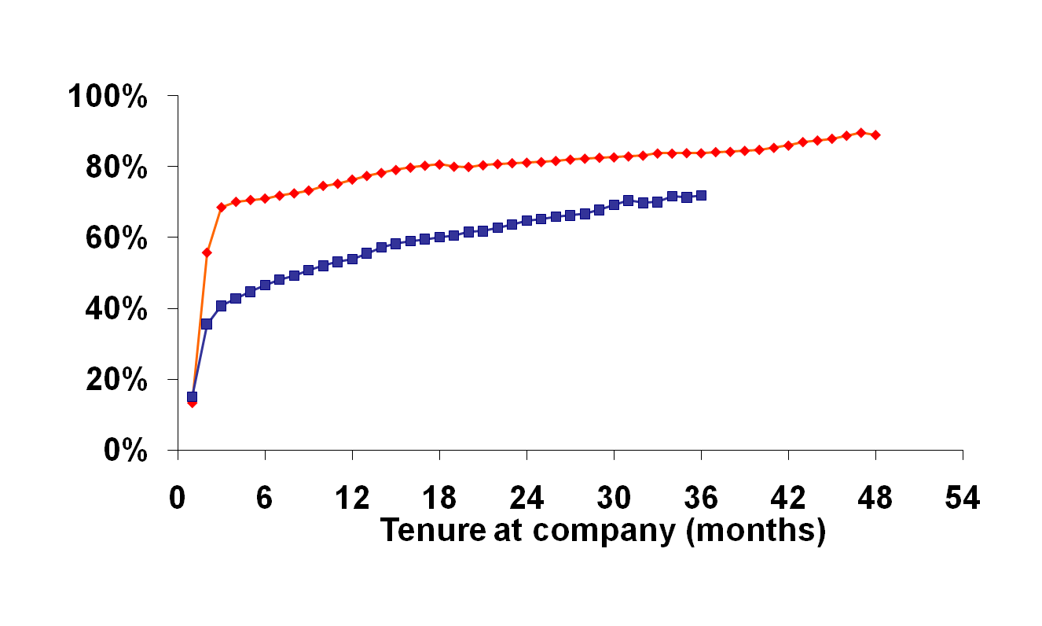
401(k) participation rate increases under active decisions
Active decision cohort
Standard enrollment cohort

Slide 31
3. Asymptotic Choice
In standard 401(k) plans, short-run passivity gives way to long-run action.
At six months of tenure, enrollment rates range from 20%-50%.
At four years of tenure, enrollment rates range from 50%-80%.

Slide 32
Employees move slowly from an old match threshold to a new match threshold.

Slide 33
4. Aggregated Revealed Preferences
Median and average savings rates and asset allocations are quite sensible.
For example, the dollar weighted average allocation to equities is 68% (Investment Company Institute 2006).
At TIAA-CREF, the dollar weighted average allocation to equities is 58%.
However, individual portfolios vary widely.
Benartzi and Thaler (2002) find that most retirement plan participants prefer the median asset allocation to their own asset allocation.

Slide 34
5. Reported Preferences
Reported preferences have the liability that talk is cheap and often designed to please the interviewer.
On the other hand, reported preferences can express long-term goals that may be undermined by short-term self-defeating behaviors (like procrastination or inertia).
Reported preferences also enable us to engage a host of well-being measures, including life satisfaction measures and moment based measures.

Slide 35
Procrastination and Under-saving
Choi, Laibson, Madrian, Metrick (2002)
Survey
Mailed to a random sample of employees
Matched to administrative data on actual savings behavior

Slide 36
Typical breakdown among 100 employees
Out of every 100 surveyed employees
68 self-report saving too little
24 plan to raise savings rate in next 2 months
3 actually follow through

Slide 37
Self-reports after a financial education seminar
 | Seminar attendees |  | Non-attendees
 | Percent planning to make change | Percent actually made change | Percent actually made change
“Will enroll in 401(k)” | 100% | 14% | 7%

Slide 38
Do workers like automatic enrollment?
97% of employees in auto-enrollment firms approve of auto-enrollment.
Even among workers who opt out of automatic enrollment, approval is 79%.

Slide 39
6. Expert Opinion/Informed Preferences
Naturally, we may wish to place special emphasis on the views of experts or “educated” consumers.
Examples include:
  Expert systems (like ESPlanner, Financial Systems)
  Expert advisors (CFP, financial economists)
  Normative models (lifecycle asset allocation models)
  Focus groups with an educational component

Slide 40
Conclusion:
Choices reveal both normative preferences and decision-making biases. Hence, revealed preferences are not the same as normative preferences.
Tools for measuring normative preferences
  Structural estimation
  Active decisions
  Asymptotic choice
  Aggregated revealed preferences
  Reported preferences
  Expert opinion/informed preferences

