Slide 1
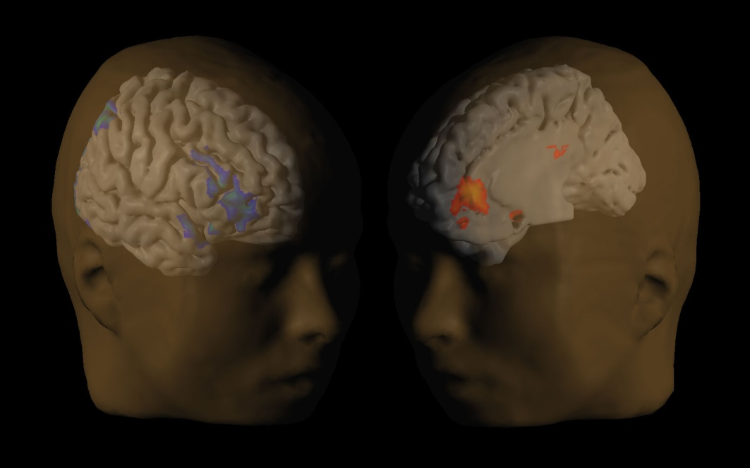
The Economics of Instant Gratification
NIH Behavior Change Conference
David Laibson
Harvard University and NBER
June 15-16, 2009
Bethesda, Maryland

Slide 2
Basic model of time preferences:
Quasi-hyperbolic discounting
Present gets full weight
Future gets weight β ~ 1/2
Strotz (1957), Herrnstein (1966), Phelps and Pollak (1968), Laibson (1997)

Slide 3
Application:
Exercise
Suppose exercise generates 6 units of immediate cost
Suppose exercise generates 8 units of delayed benefits
Will you exercise?
Exercise Today: -6 + ½ [8] = -2
Exercise Tomorrow: 0 + ½ [-6 + 8] = +1
Agent would like to relax today and exercise tomorrow.
Agent won’t follow through without commitment.

Slide 4
Key ideas
Immediate costs/benefits have disproportionate weight
Consequently, people tend to avoid and/or delay investment behaviors
  Human capital formation (education)
  Exercise
  Diet
  Sexual abstinence
  Smoking abstinence
  Medical Adherence
  Saving

Slide 5
Three interventions in savings
Pilot interventions in health

Slide 6
Automatic Enrollment
Automatic
enrollment
Standard
enrollment
Madrian and Shea (2001), Choi, Laibson, Madrian, Metrick (2004)

Slide 7
Active Decisions and Deadlines
Active Decision Cohort
Standard enrollment cohort
Carroll, Choi, Laibson, Madrian, Metrick (2004)

Slide 8
Simplified enrollment
2005
2004
2003
Beshears, Choi, Laibson, Madrian (2006)

Slide 9
Extensions to health domain
Default appointments (e.g. colonoscopy)
Default nutrition (e.g. workplace cafeteria, vending)
Default & active decision immunization (e.g. flu shots)
Active decisions for good health behaviors (e.g. HD of chronic medications)
Default medical procedures (e.g. diabetics: stents vs. drugs)

Slide 10
Neural mechanisms
Stay on your diet
(analytic cortex)
I want a donut
(meso-limbic dopamine)
McClure, Laibson, Loewenstein, Cohen (2004)
McClure, Ericson, Laibson, Loewenstein, Cohen (2007)
Hare, Camerer, Rangel (2009)

