Slide 1
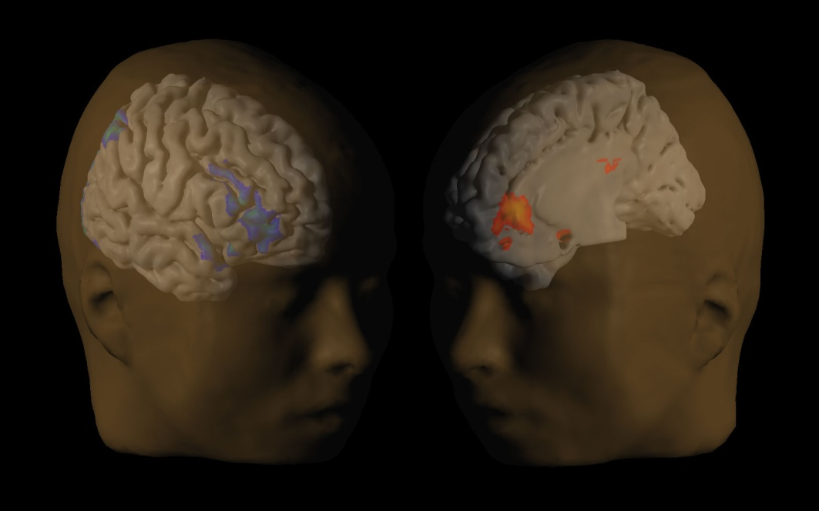
Instant Gratification, Multiple Selves, & Self-Control: How to Control Your Selves
David Laibson
Harvard University
November 2010

Slide 2
1. Motivating Experiments
A Thought Experiment
Would you like to have
15 minute massage now
or
B) 20 minute massage in an hour
Would you like to have
C) 15 minute massage in a week
or
D) 20 minute massage in a week and an hour

Slide 3


Read and van Leeuwen (1998)
Choosing Today
Eating Next Week
Time
If you were
deciding today,
would you choose
fruit or chocolate
for next week?

Slide 4
Patient choices for the future:
Choosing Today
Eating Next Week
Time
Today, subjects
typically choose
fruit for next week.
74%
choose
fruit

Slide 5
Impatient choices for today:
Choosing and Eating
Simultaneously
Time
If you were
deciding today,
would you choose
fruit or chocolate
for today?

Slide 6
Time Inconsistent Preferences:
Choosing and Eating
Simultaneously
Time
70%
choose
chocolate

Slide 7
Read, Loewenstein & Kalyanaraman (1999)
Choose among 24 movie videos
Some are “low brow”: Four Weddings and a Funeral
Some are “high brow”: Schindler’s List
Picking for tonight: 66% of subjects choose low brow.
Picking for next Thursday: 37% choose low brow.
Picking for second Thursday: 29% choose low brow.
Tonight I want to have fun… next week I want things that are good for me.

Slide 8
Extremely thirsty subjects
McClure, Ericson, Laibson, Loewenstein and Cohen (2007)
Choosing between, juice now or 2x juice in 5 minutes 60% of subjects choose first option.
Choosing between juice in 20 minutes or 2x juice in 25 minutes 30% of subjects choose first option.
We estimate that the 5-minute discount rate is 50% and the “long-run” discount rate is 0%.
Ramsey (1930s), Strotz (1950s), Herrnstein (1960s), and Ainslie (1970s) were the first to understand that discount rates are higher in the short run than in the long run.

Slide 9
Conceptual Outline
People are not internally consistent decision-makers
Internal conflicts can be modeled and measured
Early understanding of the neural foundations
Scalable, inexpensive policies can transform behavior

Slide 10
Outline
Motivating experimental evidence
Theoretical framework
Empirical evidence
Neuroscience foundations
Neuroimaging evidence
6. Policy analysis

Slide 11
2. Theoretical Framework
Classical functional form: exponential functions.
D(t) = δ^{t}
D(t) = 1, δ, δ², δ³, ...
U_{t} = u_{t} + δ u_{t+1} + δ² u_{t+2} + δ³ u_{t+3} + ...
But exponential function does not show instant gratification effect.
Discount function declines at a constant rate.
Discount function does not decline more quickly in the short-run than in the long-run.

Slide 12
Constant rate of decline
Now
1 year
2 years
3 years
4 years
5 years
-D'(t)/D(t) = rate of decline of a discount function

Slide 13
Slow rate of decline
in long run
Rapid rate
of decline
in short run
Now
1 year
2 years
3 years
4 years
5 years

Slide 14
An exponential discounting paradox.
Suppose people discount at least 1% between today and tomorrow.
Suppose their discount functions were exponential.
Then 100 utils in t years are worth 100*e^{(-0.01)*365*t} utils today.
What is 100 today worth today? 100.00
What is 100 in a year worth today? 2.55
What is 100 in two years worth today? 0.07
What is 100 in three years worth today? 0.00

Slide 15
An Alternative Functional Form
Quasi-hyperbolic discounting
(Phelps and Pollak 1968, Laibson 1997)
U_{t} = u_{t} + δu_{t+1} + δ²u_{t+2} + δ³u_{t+3} + ... Exponential
U_{t} = u_{t} + β [δu_{t+1} + δ²u_{t+2} + δ³u_{t+3} + ...] Quasi-hyperbolic
β evenly discounts all future periods.
exponentially discounts all future periods.
For continuous time: see Barro (2001), Luttmer and Marriotti (2003), and Harris and Laibson (2009)

Slide 16
Building intuition
To build intuition, assume that β = ½ and δ = 1.
Discounted utility function becomes
U_{t} = u_{t} + ½ [u_{t+1} + u_{t+2} + u_{t+3} + ...]
Discounted utility from the perspective of time t+1.
U_{t+1} = u_{t+1} + ½ [u_{t+2} + u_{t+3} + ...]
Discount function reflects dynamic inconsistency: preferences held at date t do not agree with preferences held at date t+1.

Slide 17
Application to massages β = ½ and δ = 1
NPV in
current minutes
15 minutes now
10 minutes now
7.5 minutes now
10 minutes now
A 15 minutes now
B 20 minutes in 1 hour
C 15 minutes in 1 week
D 20 minutes in 1 week plus 1 hour

Slide 18
Application to massages β = ½ and δ = 1
NPV in
current minutes
15 minutes now
10 minutes now
7.5 minutes now
10 minutes now
A 15 minutes now
B 20 minutes in 1 hour
C 15 minutes in 1 week
D 20 minutes in 1 week plus 1 hour

Slide 19
Exercise
Assume that β = ½ and δ = 1.
Suppose exercise (current effort 6) generates delayed benefits (health improvement 8).
Will you exercise?
Exercise Today: -6 + ½ [8] = -2
Exercise Tomorrow: 0 + ½ [-6 + 8] = +1
Agent would like to relax today and exercise tomorrow.
Agent won’t follow through without commitment.

Slide 20
Self-regulation
Reduce cost of investment: -6 becomes -1
  walk to work
  stand instead of sitting at a seminar
  conduct walking office hours
Mix in immediate pleasures: -6 becomes -6+5=-1
  watch low-brow movies on your treadmill
Commitment: creating “binding” plans
  make a weight-loss bet with co-workers (cf AA, NA)
  remove unhealthy foods from house (icecream, cookies)
  get a personal trainer
  exercise with friends (see you at 8 AM on the courts)
  sign up for a regular exercise class
  form study groups (we’ll meet at 10 AM on Saturday morning)
  agree to give a paper that you haven’t finished

Slide 21
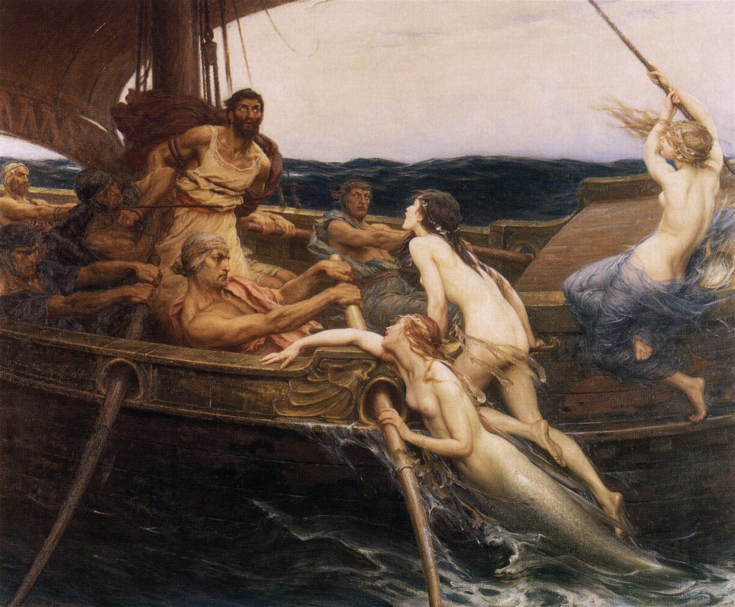
Commitment is an old idea
Bound to mast
Wax-filled ears
“Ulysses and the Sirens”, Herbert James Draper

Slide 22
Evidence from the field

Slide 23
Choi, Laibson, Madrian, Metrick (2002)
Self-reports about undersaving.
Survey mailed to employees of US firm
Matched to administrative data on actual savings behavior

Slide 24
Typical breakdown among 100 employees
Out of every 100 surveyed employees
68 self-report saving too little
24 plan to raise savings rate in next 2 months
3 actually follow through over the next four months

Slide 25
Laibson, Repetto, and Tobacman (2010)
Use MSM to estimate discounting parameters:
  Substantial illiquid retirement wealth: W/Y = 3.9.
  Extensive credit card borrowing:
    68% didn’t pay their credit card in full last month
    Average credit card interest rate is 14%
    Credit card debt averages 13% of annual income
  Consumption-income comovement:
    Marginal Propensity to Consume = 0.23
    (i.e. consumption tracks income)

Slide 26
LRT Simulation Model
Stochastic Income
Lifecycle variation in labor supply (e.g. retirement)
Social Security system
Life-cycle variation in household dependents
Bequests
Illiquid asset
Liquid asset
Credit card debt
Numerical solution (backwards induction) of 90 period lifecycle problem.

Slide 27
LRT Results:
U_{t} = u_{t} + β [δu_{t+1} + δ²u_{t+2} + δ³u_{t+3} + ...]
β = 0.70 (s.e. 0.11)
δ = 0.96 (s.e. 0.01)
Null hypothesis of β = 1 rejected (t-stat of 3).
Specification test accepted.
Moments:
Empirical Simulated (Hyperbolic)
%Visa: 68% 63%
Visa/Y: 13% 17%
MPC: 23% 31%
f(W/Y): 2.6 2.7

Slide 28
LRT Intuition
Long run discount rate is –ln(δ) = 4%, so save in long-run (illiquid) assets.
Short-run discount rate is –ln(βδ) = 40%, so borrow on your credit card today.
Indeed, you might even borrow on your credit card so you can “afford” to save in your 401(k) account.

Slide 29
Dellavigna and Malmendier (2004, 2006)
Average cost of gym membership: $75 per month
Average number of visits: 4
Average cost per vist: $19
Cost of “pay per visit”: $10

Slide 30
Shapiro (2005)
For food stamp recipients, caloric intake declines by 10-15% over the food stamp month.
To be resolved with exponential discounting, requires an annual discount rate of 77%
Survey evidence reveals rising desperation over the course of the food stamp month, suggesting that costless intertemporal substitution is not a likely explanation
Households with more short-run impatience (estimated from hypothetical intertemporal choices) are more likely to run out of food sometime during the month.

Slide 31
The data can reject a number of alternative hypotheses.
Households that shop for food more frequently do not display a smaller decline in intake over the month, casting doubt on depreciation stories.
Individuals in single-person households experience no less of a decline in caloric intake over the month than individuals in multi-person households.
Survey respondents are not more likely to eat in another person’s home toward the end of the month.
The data show no evidence of learning over time

Slide 32
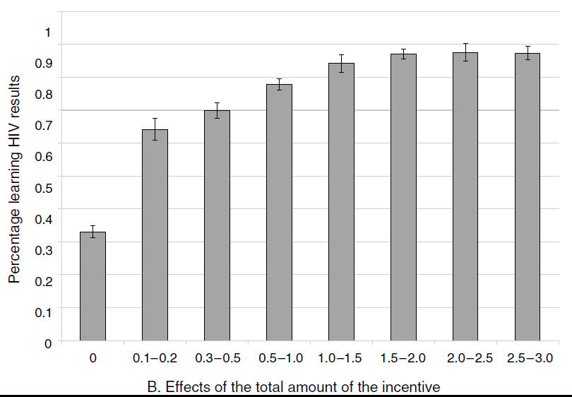
Willingness to pick up HIV test results: Thornton (2008)
Immediate dollar reward for picking up results

Slide 33
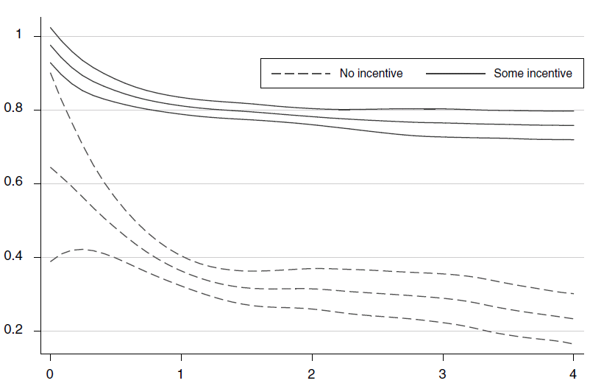
Small immediate costs: Thornton (2005)
Fraction picking up info on HIV status
Randomized distance (miles) to pick up info

Slide 34
Other papers:
Oster and Scott-Morton (2004)
  People sold on the news stand at a high price relative to subscription
  Foreign Affairs sold on the news stand at a low price relative to subscription
  But People is sold disproportionately on the news stand and Foreign Affairs is sold disproportionately by subscription.
Wertenbroch (1998): consumers buy temptation goods in small packages, foregoing volume discounts.

Slide 35
Evidence for Commitment

Slide 36
Ariely and Wertenbroch (2002)
Several proofreading tasks: “Sexual identity is intrinsically impossible," says Foucault; however, according to de Selby[1], it is not so much sexual identity that is intrinsically impossible, but rather the dialectic, and some would say the satsis, of sexual identity. Thus, D'Erlette[2] holds that we have to choose between premodern dialectic theory and subcultural feminism imputing the role of the observor as poet.”
Three arms in study:
Evenly spaced deadlines ($20)
Self-imposed deadlines ($13)
  subjects in this condition could self-impose costly deadlines ($1 penalty for each day of delay) and 37/51 do so.
End deadline ($5)

Slide 37
Kaur, Kremer, and Mullainathan (2010):
Compare two piece-rate contracts:
  Linear piece-rate contract (“Control contract”)
    Earn w per unit produced
  Linear piece-rate contract with penalty if worker does not achieve production target T (“Commitment contract”)
    Earn w/2 for each unit produced if production < T
    Jump up at T (jump is T*w/2)
    Thereafter, earn w for each unit produced if production ≥ T, earn
Earnings
Never earn more under commitment contract
May earn much less
Production
T
Notes:
Consider an employee working on a simple piece rate activity – like a repetitive task done many times
Many examples like this: supermarket checkout / cashier, assembly line worker, delivery person, salesperson, data entry operator, just to name a few.
Compare 2 types of contracts the employee could be offered:
Give the employee wage w for every unit of work that she does (blue line on the graph)
Give the employee w if she meets some production target T, give her w/2 if she falls below target (red line on the graph)
- Notice the employee can never earn more under the commitment contract, and may earn much less if she fails to meet target

Slide 38
Kaur, Kremer, and Mullainathan (2009):
Demand for Commitment (non-paydays)
  Commitment contract (Target>0) chosen 39% of the time
  Workers are 11 percentage points more likely to choose commitment contract the evening before
Effect on Production (non-paydays)
  Being offered contract choice increases average production by 5 percentage points relative to control
  Implies 13 percentage point productivity increase for those that actually take up commitment contract
  No effects on quality of output (accuracy)
Payday Effects (behavior on paydays)
  Workers 21 percentage points more likely to choose commitment (Target>0) morning of payday
  Production is 5 percentage points higher on paydays
Notes:
These are coefficient estimates from regressions with controls
Demand for commitment regression – evening/morning inference:
chose_commitment = const + eve_choice_dummy + lag_prodn + lag_prodn*eve_choice + {controls including FE for employees, day of week, week #}
Effect on production regression – effect on output:
production = const + choice_dummy + lag_prodn + lag_prodn*choice + {controls including FE for employees, day of week, week #}
Payday results:
Overall, there is not a huge difference in average demand for commitment contracts on paydays vs non-paydays.
However, there is a big difference in the likelihood of picking in the morning/evening on paydays vs. non-paydays. Basically, on non-paydays, people are more likely to choose commitment in advance (i.e. the evening before). However, the opposite is true on paydays – if people know Tuesday is their payday, they are much more likely to choose a commitment contract for Tuesday on Tuesday morning than on Monday evening.

Slide 39
Ashraf, Karlan, and Yin (2006)
Offered a commitment savings product to randomly chosen clients of a Philippine bank
28.4% take-up rate of commitment product
More hyperbolic subjects were more likely to take up the product
After twelve months, average savings balances increased by 81% for those clients assigned to the treatment group relative to those assigned to the control group.

Slide 40
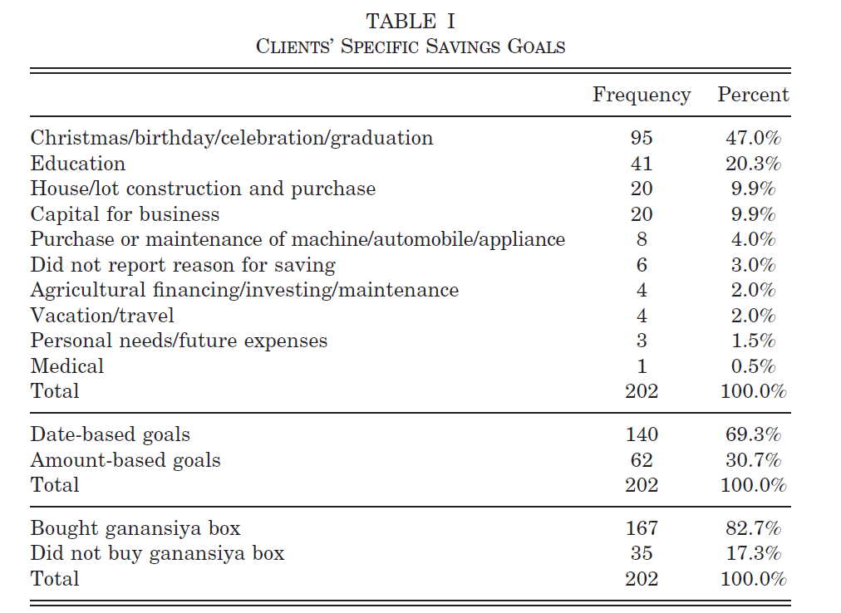

Slide 41
Gine, Karlan, Zinman (2009)
Tested a voluntary commitment product (CARES) for smoking cessation.
Smokers offered a savings account in which they deposit funds for six months, after which take urine tests for nicotine and cotinine.
If they pass, money is returned; otherwise, forfeited
11% of smokers offered CARES take it up, and smokers randomly offered CARES were 3 percentage points more likely to pass the 6-month test than the control group
Effect persisted in surprise tests at 12 months.

Slide 42
Other studies
Della Vigna and Paserman (2005): job search
Duflo (2009): immunization
Duflo, Kremer, Robinson (2009): commitment fertilizer
Meier and Sprenger (2010): correlation with credit card borrow
Milkman et al (2008): video rentals return sequencing
Oster and Scott-Morton (2005): magazine marketing/sales
Sapienza and Zingales (2008,2009): procrastination
Shui and Ausubel (2006): credit cards
Trope & Fischbach (2000): commitment to medical adherence
Wertenbroch (1998): individual packaging

Slide 43
Some other field evidence
Ashraf and Karlan (2004): commitment savings
Della Vigna and Paserman (2005): job search
Duflo (2009): immunization
Duflo, Kremer, Robinson (2009): commitment fertilizer
Karlan and Zinman (2009): commitment to stop smoking
Milkman et al (2008): video rentals return sequencing
Oster and Scott-Morton (2005): magazine marketing/sales
Sapienza and Zingales (2008,2009): procrastination
Thornton (2005): HIV testing
Trope & Fischbach (2000): commitment to medical adherence
Wertenbroch (1998): individual packaging

Slide 44
4. Neuroscience Foundations
What is the underlying mechanism?
Why are our preferences inconsistent?
Is it adaptive?
How should it be modeled?
Does it arise from a single time preference mechanism (e.g., Herrnstein’s reward per unit time)?
Or is it the resulting of multiple systems interacting (Shefrin and Thaler 1981, Bernheim and Rangel 2004, O’Donoghue and Loewenstein 2004, Fudenberg and Levine 2004)?

Slide 45
Shiv and Fedorikhin (1999)
Cognitive burden/load is manipulated by having subjects keep a 2-digit or 7-digit number in mind as they walk from one room to another
On the way, subjects are given a choice between a piece of cake or a fruit-salad
Processing burden | % choosing cake
Low (remember only 2 digits) | 41%
High (remember 7 digits) | 63%

Slide 46
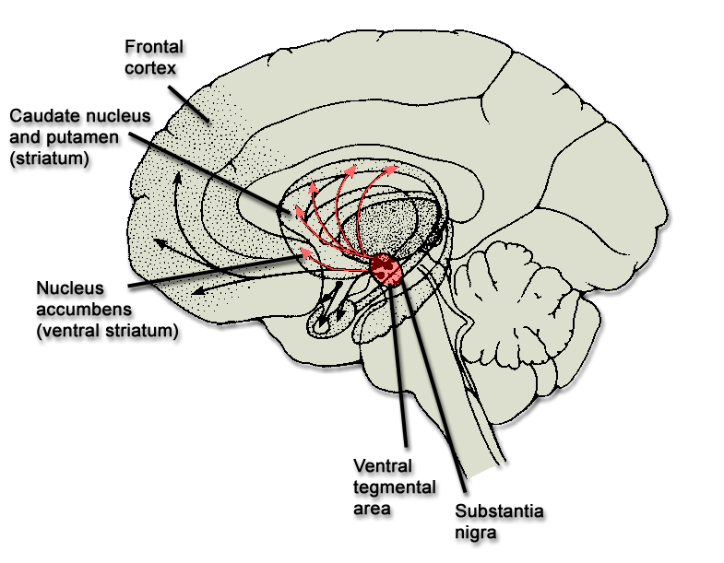
Affective vs. Analytic Cognition
Frontal
cortex
Parietal
cortex
mPFC
mOFC
vmPFC
Mesolimbic dopamine
reward system

Slide 47
Relationship to quasi-hyperbolic model
Hypothesize that the fronto-parietal system is patient
Hypothesize that mesolimbic system is impatient.
Then integrated preferences are quasi-hyperbolic
 |  | now | t+1 | t+2 | t+3
PFC |  | 1 | 1 | 1 | 1 | …
Mesolimbic |  | 1 | 0 | 0 | 0 | …
Total |  | 2 | 1 | 1 | 1 | …
Total normed |  | 1 | 1/2 | 1/2 | 1/2 | …

Slide 48
Relationship to quasi-hyperbolic model
Hypothesize that the fronto-parietal system is patient
Hypothesize that mesolimbic system is impatient.
Then integrated preferences are quasi-hyperbolic
U_{t} = u_{t} + β [δu_{t+1} + δ²u_{t+2} + δ³u_{t+3} + ...]
(1/β)U_{t} = (1/β)u_{t} + δu_{t+1} + δ²u_{t+2} + δ³u_{t+3} + ...
(1/β)U_{t} =(1/β−1)u_{t} + [δ⁰u_{t} + δ¹u_{t+1} + δ²u_{t+2} + δ³u_{t+3} + ...]
limbic fronto-parietal cortex

Slide 49

Hypothesis:
Limbic system discounts reward at a higher rate than does the
prefrontal cortex.
1.0
mesolimbic system
prefrontal cortex
discount value
0.0
time

Slide 50
5. Neuroimaging Evidence
McClure, Laibson, Loewenstein, and Cohen (2004)
Do agents think differently about immediate rewards and delayed rewards?
Does immediacy have a special emotional drive/reward component?
Does emotional (mesolimbic) brain discount delayed rewards more rapidly than the analytic (fronto-parietal cortex) brain?

Slide 51
Choices involving Amazon gift certificates:
Time
delay d>0 d’
Reward R R’
Hypothesis: fronto-parietal cortex.
delay d=0 d’
Reward R R’
Hypothesis: fronto-parietal cortex and limbic.
Time

Slide 52




McClure, Laibson, Loewenstein, and Cohen (2004)
Emotional system responds only to immediate rewards
7
T₁₃
0
x = -4mm
y = 8mm
z = -4mm
VStr
MOFC
MPFC
PCC
Neural activity
Seconds
Earliest reward available today
Earliest reward available in 2 weeks
0.4%
Earliest reward available in 1 month
2s

Slide 53


Analytic brain responds equally to all rewards
VCtx
PMA
RPar
x = 44mm
DLPFC
VLPFC
LOFC
0.4%
x = 0mm
2s
0
T₁₃
15
Earliest reward available today
Earliest reward available in 2 weeks
Earliest reward available in 1 month

Slide 54

Brain Activity in the Frontal System and Emotional System Predict Behavior
(Data for choices with an immediate option.)
0.05
Frontal
system
Brain Activity
0.0
Emotional
System
-0.05
Choose
Smaller
Immediate
Reward
Choose
Larger
Delayed
Reward

Slide 55
Conclusions of Amazon study
Time discounting results from the combined influence of two neural systems:
  Mesolimbic dopamine system is impatient.
  Fronto-parietal system is patient.
These two systems are separately implicated in ‘emotional’ and ‘analytic’ brain processes.
When subjects select delayed rewards over immediately available alternatives, analytic cortical areas show enhanced changes in activity.

Slide 56
Open questions
What is now and what is later?
  Our “immediate” option (Amazon gift certificate) did not generate immediate “consumption.”
  Also, we did not control the time of consumption.
How does the limbic signal decay as rewards are delayed?
Would our results replicate with a different reward domain?
Would our results replicate over a different time horizon?
Experiment on primary rewards: Juice
McClure, Ericson, Laibson, Loewenstein, Cohen
(Journal of Neuroscience, 2007)

Slide 57
Subjects water deprived for 3hr prior to experiment
From:
Subject: I hate you
To: dardenne@Princeton.edu
Cc: smmcculre@Princeton.edu
I’m already thirsty! It’s 4:00!
(subject scheduled for 6:00)

Slide 58
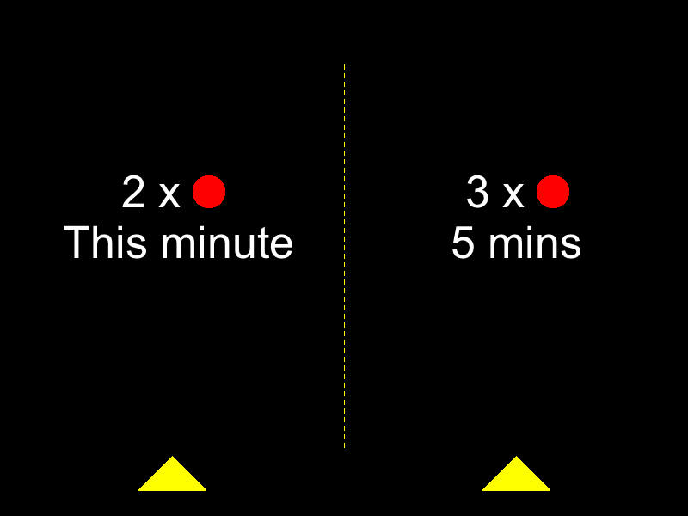
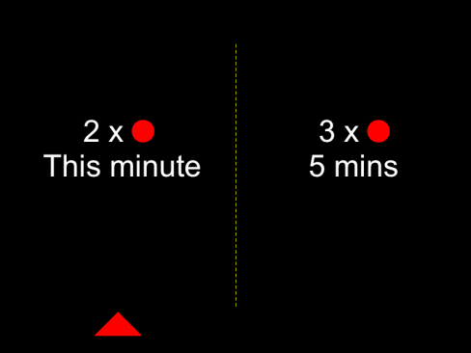


A
15s
10s
5s
Time
i
ii
iii
…
iv. Juice/Water squirt (1s )
B
(i) Decision Period
(ii) Choice Made
(iii) Pause
(iv) Reward Delivery
Free (10s max.)
2s
Variable Duration
Free (1.5s Max)
15s
Figure 1

Slide 59
Experiment Design
d
d'-d
(R,R')
∈ { This minute, 10 minutes, 20 minutes }
∈ { 1 minute, 5 minutes }
∈ {(1ml, 2ml), (1ml, 3ml), (2ml, 3ml)}
d = This minute
d'-d = 5 minutes
(R,R') = (2ml, 3ml)

Slide 60
Behavioral evidence for
non-exponential discounting
0.8
0.6
P(choose early)
0.4
0.2
0
This
minute
10
minutes
20
Minutes
Delay to early reward (d)

Slide 61
Behavioral evidence for
non-exponential discounting
0.8
0.8
d’-d = 1 min
d’-d = 5 min
0.6
0.6
P(choose early)
0.4
0.4
0.2
0.2
0
0
This
minute
10
minutes
20
Minutes
This
minute
10
minutes
20
minutes
Delay to early reward (d)
Delay to early reward (d)

Slide 62
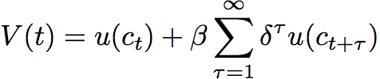
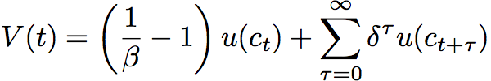
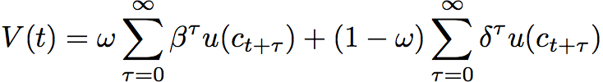
Discount functions fit to behavioral data
β = 0.53 (se = 0.041)
δ = 0.98 (se = 0.014)
Limbic
Cortical
= 0.47 (se = 0.101)
δ = 1.02 (se = 0.018)
Evidence for two-system model
Can reject restriction to a single exponential: t-stat > 5
Double exponential generalization fits data best

Slide 63








Neuroimaging data
Areas that respond primarily to immediate rewards
PCu
ACC
PCu
ACC
NAcc
PCC
NAcc
SGC
MOFC/SGC
x = -12mm
x = -2mm
x = -8mm
z = -10mm
Areas that show little discounting
PCC
SMA/PMA
BA10
BA9/44
BA46
PPar
11
Vis Ctx
Ant Ins
x = 0mm
x = 40mm
x = -48mm
T
0
Figure 4

Slide 64








Comparison with Amazon experiment:
Impatient areas (p<0.001)
Impatient areas (p<0.01)
x = 0mm
y = 8mm
x = -4mm
y = 12mm
Patient areas (p<0.001)
Patient areas (p<0.01)
x = 0mm
x = -48mm
x = 0mm
x = -48mm
Juice
only
Amazon
only
Both
Figure 5

Slide 65
Measuring discount functions using neuroimaging data
Impatient voxels are in the emotional (mesolimbic) reward system
Patient voxels are in the analytic (prefrontal and parietal) cortex
Average (exponential) discount rate in the impatient regions is 4% per minute.
Average (exponential) discount rate in the patient regions is 1% per minute.

Slide 68


Hare, Camerer, and Rangel (2009)
Health Session
Taste Session
Decision Session
4s
food item
presentation
Rate Health
Rate Taste
Decide
+
+
+
?-?s
fixation
Rate Health
Rate Taste
Decide
Notes:
Subjects fast for 3 hours
Come and first rate health and taste for each food (counterballanced)
One reference item that is neutral on both scales is identified
Subjects shown the reference food
Then shown each food item again and must decide whether or not to eat what is currently on the screen or the reference item
One trial randomly selected and the choice implemented

Slide 69
Rating Details
Taste and health ratings made on five point scale:
  -2,-1,0,1,2
Decisions also reported on a five point scale: SN,N,0,Y,SY
“strong no” to “strong yes”
Notes:
On slide

Slide 70
What is self-control?
Rejecting a good tasting food that is not healthy
Accepting a bad tasting food that is healthy

Slide 71
Subjects
SC (self-control) group = 19 dieting subjects who showed self-control during the decision phase
NSC (no self-control) group = 18 comparison subjects who did not exhibit self-control during the decision phase
Notes:
Sc group 19 (14 female) mean age 26 ± 4 yrs
NSC group 18 (6 female) mean age 24 ± 5 yrs

Slide 72
Who is classified as a self-controller: SC?
(must meet all criteria below)
Use self-control on > %50 of trials in which self-control is required (decline Liked-Unhealthy items or choose Disliked-Healthy ones)
Decision = β₁HR + β₂LR + ε
  β₁> β₂
R² for HR > R² for LR
Notes:
Walk through criteria

Slide 73
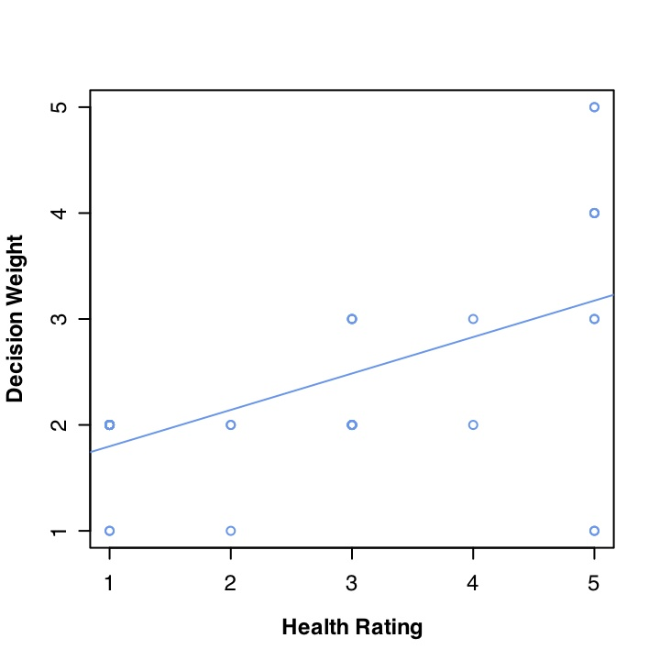
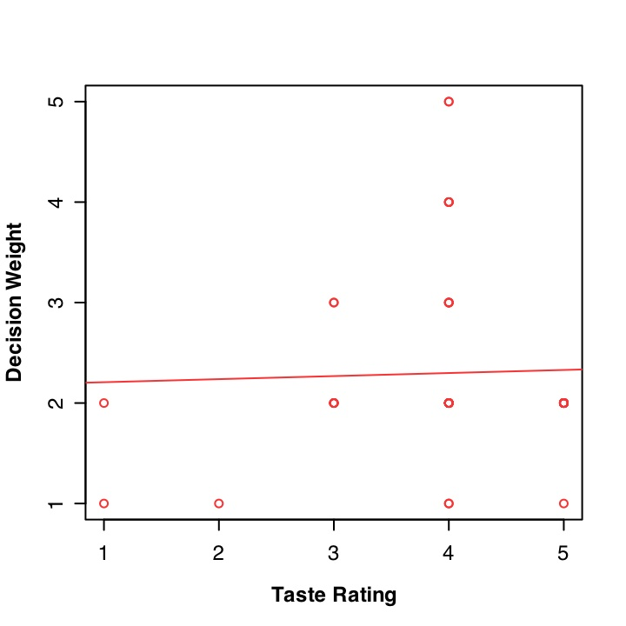
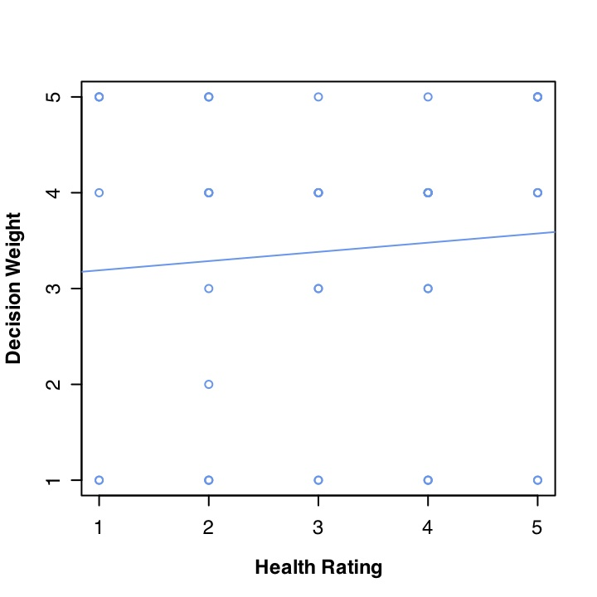
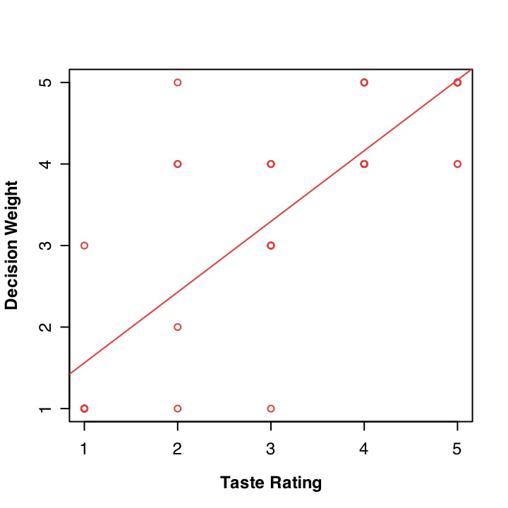
Examples of individual behavioral fits
Self-controller
Non-
self-controller
Notes:
Walk through graphs

Slide 74
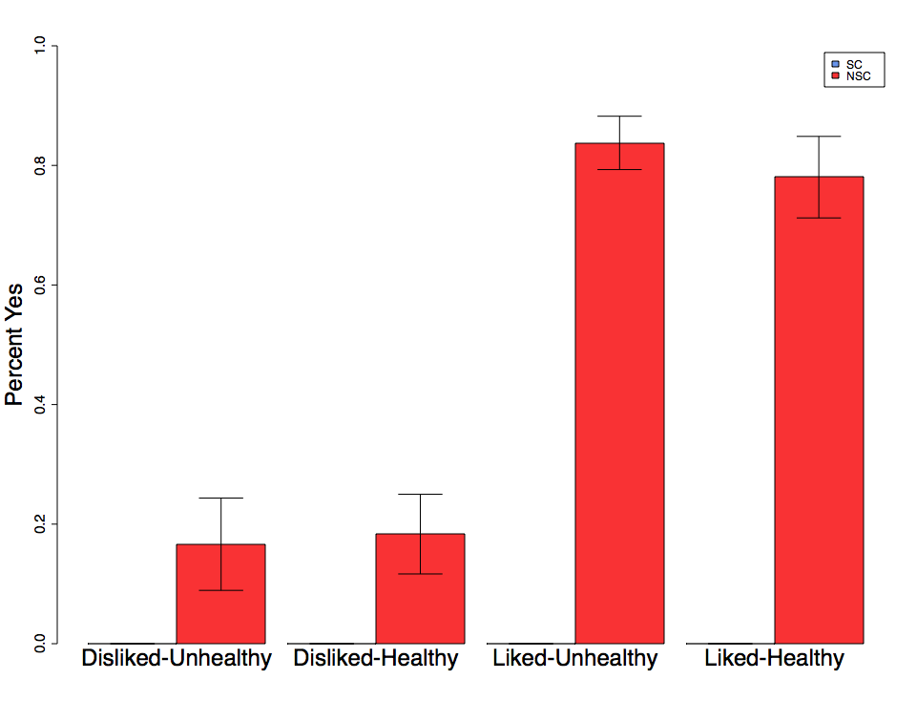
Result: NSC group chose based on taste
Percent Yes
Disliked
Unhealthy
Disliked
Healthy
Liked
Unhealthy
Liked
Healthy
Notes:
Non-control subjects choose based on taste only

Slide 75
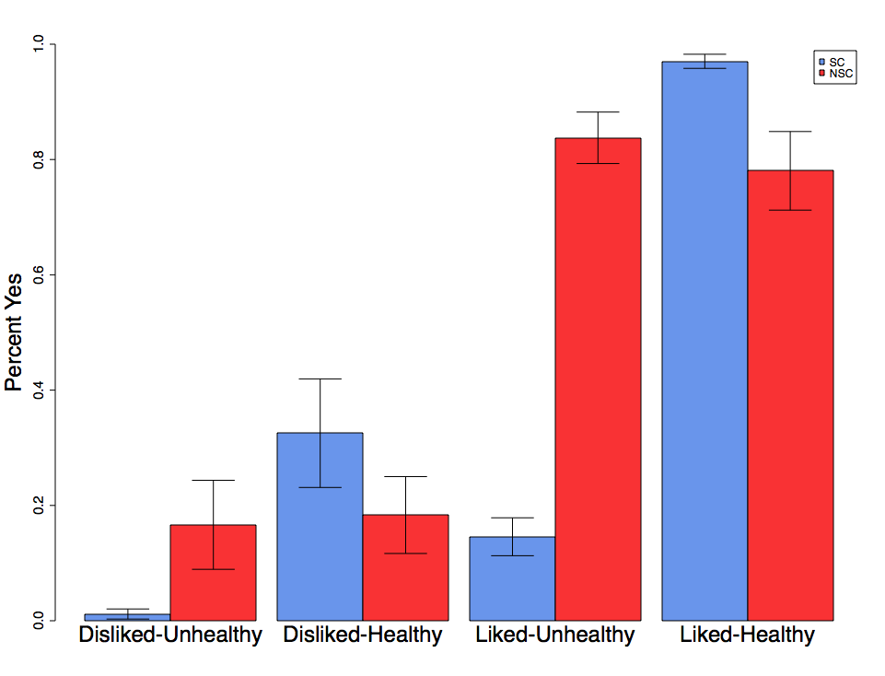

Result: SC group chose based on taste and health
*
*
Percent Yes
Disliked
Unhealthy
Disliked
Healthy
Liked
Unhealthy
Liked
Healthy
Notes:
In contrast SC group chooses based on both health and taste
No significant difference for either disliked pair ( Liked-Unhealthy t=12.5, p=1e-13 ) (Liked-Healthy t=2.7, p=.013)

Slide 76
SC group versus NSC group
*
*
Percent Yes
Disliked
Unhealthy
Disliked
Healthy
Liked
Unhealthy
Liked
Healthy
Notes:
Stark difference for liked but unhealthy items

Slide 77
Question: Is there evidence for a single valuation system?
Neuroimaging Results
Notes:
On slide

Slide 78
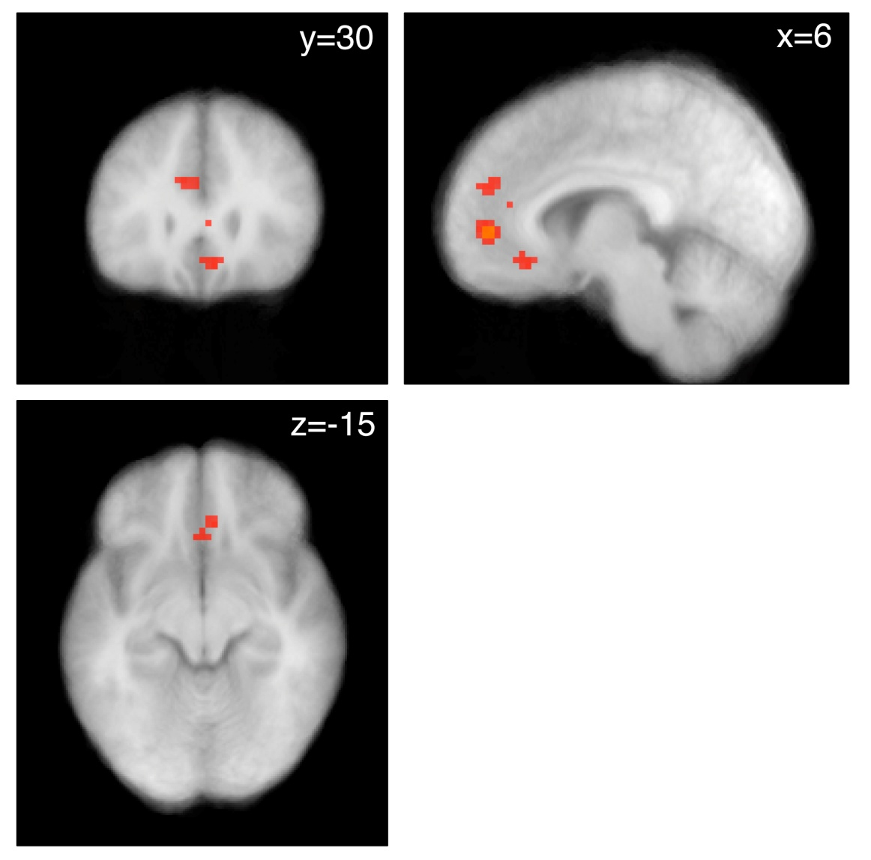
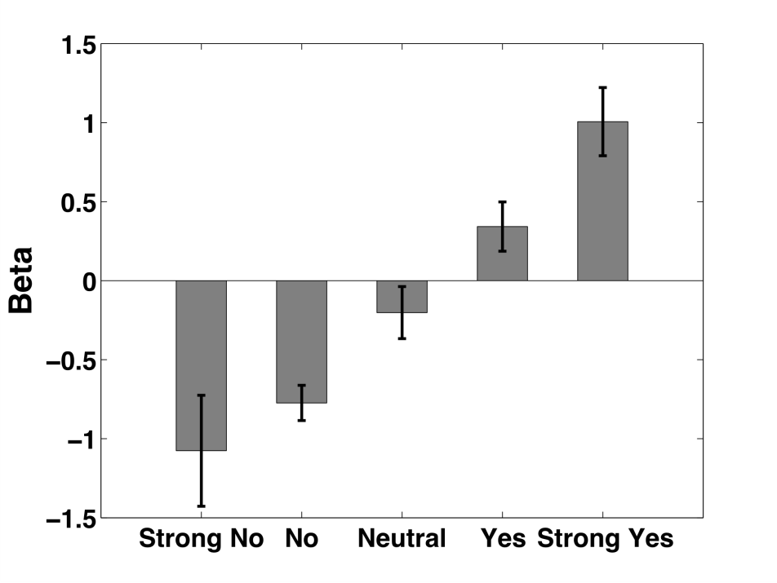
Activity in vmPFC is correlated with a behavioral measure of decision value (regardless of SC)
L
p < .001
p < .005
Notes:
vmPFC regions are correlated with decision value or weight using the strong no, no, neut, yes, strong yes scale
Model: R1= image onset, M1 = decision strength;
Contrast of M1 in Decision session - LR session
Red = .005
Yellow = .001
No MC correction applied to current image, but survives SVC based on Plassmann07 and Hare08

Slide 79
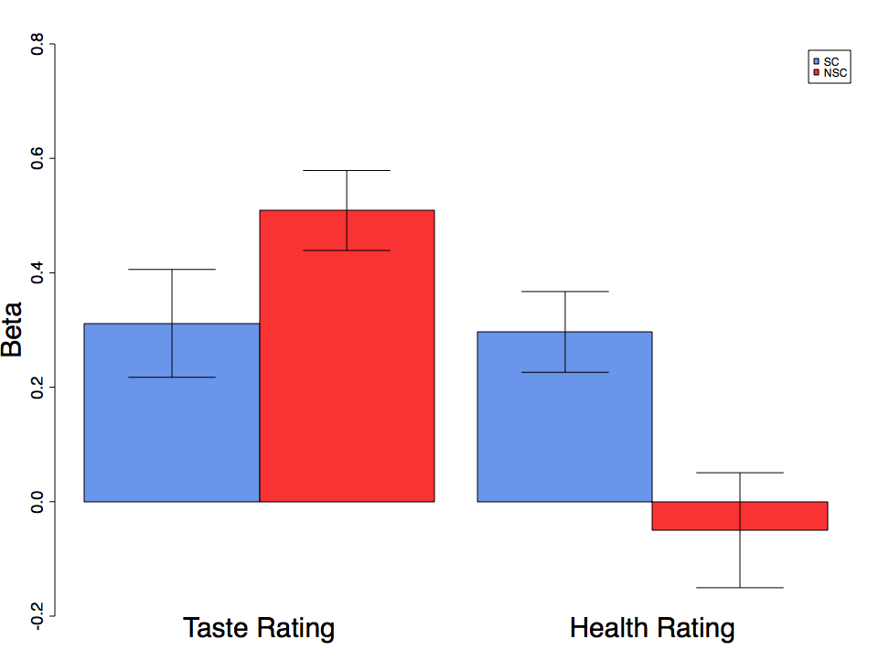
vmPFC BOLD signal reflects both taste and health ratings
*
*
*
Beta
Taste Rating
Health Rating
Notes:
At peak decision voxel, NSC group activity is correlated with taste only
SC group activity is correlated with both health and taste and those two combine to make up the decision value
Parametric regressors for taste (liking) and health ratings at the peak decision voxel for each subject.
Betas from model where R1= image onset, M1 = HR, M2=LR
Peaks selected from model where R1= image onset, M1 = decision strength; Contrast of M1 in Decision session - LR session
Peaks drawn from the combination of ROIs for SCgroup, NSC group, and all subs for M1 in decision session - liking session.
NSC taste = p=1.2819e-06
NSC health = p=.626
SC taste = p<.004
SC health = p <.0006

Slide 80
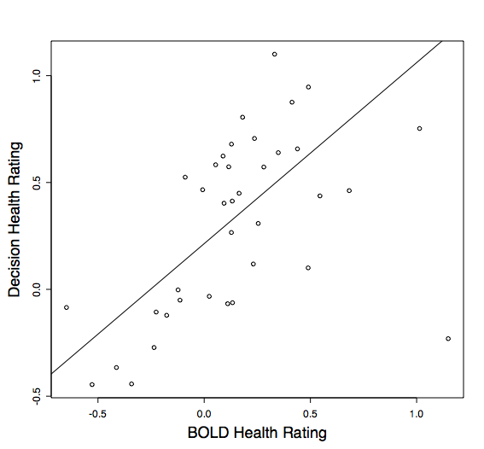
The effect of Health Rating in the vmPFC is correlated with its effect on behavior
Robust reg
Coef = .847
Decision Health Rating Beta
BOLD Health Rating Beta
Notes:
Strong correspondence between the weight for health ratings on neural activity and the variance in decisions explained by health ratings.
When BOLD beta is used to explain the Decision beta robust regression coefficient = .847.
Robust regression done in R using rlm function with MM estimation
Pearson correlation is .512
BOLD beta from health rating taken from model where R1 = image onset, M1 = HR, M2 =LR (ie HR beta with full variance)

Slide 81
Neuroimaging Results
Question: Does self-control involve DLPFC modulation of the vmPFC valuation network?

Slide 82
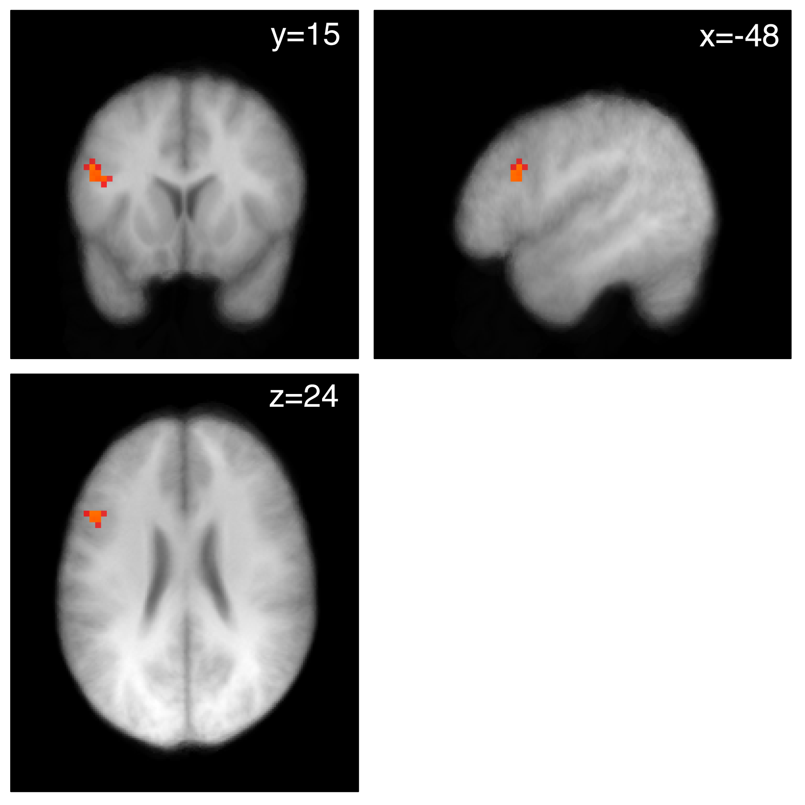
More activity in DLPFC in trials with successful self control than in trials with unsuccessful self-control
L
p < .001
p < .005
Notes:
Model: R1 = SC trials, R2 = Non SC trials, R3 = Failed SC trials
Contrast: SC group R1 - NSC group R1
Masked by Contrast of SC group R1+ FWE corrected to .05 -could also think of it as a conjunction (dlpfc only)
Current image MC corrected to P< .05 at cluster level using CorrClus from Tom Nichols (21 voxels at p=.005)
Red = .005
Yellow = .001

Slide 83
Figner, Knoch, Johnson, Krosch, Lisanby, Fehr and Weber (2010)
Disruption of left lateral prefrontal cortex (LPFC) with repetitive transcranial magnetic stimulation (rTMS) increases choice of immediate rewards over larger delayed rewards.
rTMS did not change choices involving only delayed rewards or valuation judgments of immediate and delayed rewards.
Causal evidence for a neural lateral-prefrontal cortex–based self-control mechanism in intertemporal choice.

Slide 84
Albrecht, Volz, Sutter, Laibson, and von Cramon (2010)
An immediate reward in a choice set elevates activation of the ventral striatum, pregenual anterior cingulate cortex and anterior medial prefrontal cortex.
These dopaminergic reward areas are also responsive to the identity of the recipient of the reward.
Even an immediate reward does not activate these dopaminergic regions when the decision is being made for another person.
Results imply that participants show less affective engagement (i) when they are making choices for themselves that only involve options in the future or (ii) when they are making choices for someone else.
Also find that behavioral choices reflect more patience when choosing for someone else.

Slide 85
Summary of neuroimaging evidence
One system associated with midbrain dopamine neurons (mesolimbic dopamine system) discounts at a high rate.
Second system associated with lateral prefrontal and posterior parietal cortex responsible for self-regulation (shows relatively little discounting)
Combined function of these two systems accounts for decision making across choice domains, including non-exponential discounting regularities.

Slide 86
Outline
Experimental evidence for dynamic inconsistency.
Theoretical framework: quasi-hyperbolic discounting.
Field evidence: dynamic decisions.
Neuroscience:
  Mesolimbic Dopamine System (emotional, impatient)
  Fronto-Parietal Cortex (analytic, patient)
Neuroimaging evidence
  Study 1: Amazon gift certificates
  Study 2: juice squirts
  Study 3: choice of snack foods
  Study 4: rTMS
  Study 5: intertemporal choices for others
6. Policy

Slide 87

Opt-in 401(k) enrollment
Opt-out enrollment (auto-enrollment)
PROCRASTINATION
UNDESIRED BEHAVIOR:
Non-participation
DESIRED BEHAVIOR:
participation
START HERE

Slide 88
6. Policy
Defaults in the savings domain
Welcome to the company
If you don’t do anything
  You are automatically enrolled in the 401(k)
  You save 2% of your pay
  Your contributions go into a default fund
Call this phone number to opt out of enrollment or change your investment allocations

Slide 89
Madrian and Shea (2001)
Choi, Laibson, Madrian, Metrick (2004)
Opt-out
enrollment
Opt-in
enrollment

Slide 90
Employees enrolled under automatic enrollment cluster at default contribution rate.
Fraction of Participants at different contribution rates:
Default contribution
rate under automatic
enrollment

Slide 91
Participants stay at the automatic enrollment defaults for a long time.
Fraction of Participants Hired Under Automatic Enrollment
who are still at both Default Contribution Rate and Asset Allocation
Company B
Company C
Company D
Fraction of Participants
Tenure at Company (Months)

Slide 92
Survey given to workers who were subject to automatic enrollment:
“You are glad your company offers automatic enrollment.”
Agree? Disagree?
Do people like a little paternalism?
Enrolled employees: 98% agree
Non-enrolled employees: 79% agree
All employees: 97% agree
Source: Harris Interactive Inc.

Slide 93
Active Choice
PROCRASTINATION
UNDESIRED BEHAVIOR:
Non-participation
DESIRED BEHAVIOR:
participation
Must choose for oneself
START HERE

Slide 94
The power of deadlines: Active decisions
Carroll, Choi, Laibson, Madrian, Metrick (2009)
Active decision mechanisms require employees to make an active choice about 401(k) participation.
Welcome to the company
You are required to submit this form within 30 days of hire, regardless of your 401(k) participation choice
If you don’t want to participate, indicate that decision
If you want to participate, indicate your contribution rate and asset allocation
Being passive is not an option

Slide 95
Active Choice Cohort
Opt-in cohort
Carroll, Choi, Laibson, Madrian, Metrick (2009)

Slide 96
Quick enrollment
PROCRASTINATION
UNDESIRED BEHAVIOR:
Non-participation
DESIRED BEHAVIOR:
participation
START HERE

Slide 97

Quick enrollment
PROCRASTINATION
UNDESIRED BEHAVIOR:
Non-participation
DESIRED BEHAVIOR:
participation
START HERE

Slide 98
Simplified enrollment raises participation
Beshears, Choi, Laibson, Madrian (2008)
2005
2004
2003

Slide 99
Improving participation in 401K plans
(for a typical firm)
Default non-enrollment (financial incentives alone)
40%
Quick Enrollment
(“check a box”)
50%
Active choice (perceived req’t to choose)
70%
Default enrollment (opt out)
90%
Participation Rate (1 year of tenure)

Slide 100
Extensions to health domain
Use automaticity and deadlines to nudge people to make better health decisions
One early example: Home delivery of chronic meds (e.g. maintenance drugs for diabetes and CVD)
Pharmaceutical adherence is about 50%
One problem: need to pick up your meds
Idea: use active decision intervention to encourage workers on chronic meds to consider home delivery
Early results: HD take up rises from 15% to 50%
Cost savings during first six months: $4 million
Long-run health improvement?

Slide 101
The science of self-regulation
Can we design new methods for self-regulation?
Can we improve the menu of options for commitment?

Slide 102
What kind of commitment do people want?
Beshears, Choi, Laibson, Madrian, Sakong (2010)
Give subjects a budget ($50, $100, or $500) and ask them to allocate between:
  Freedom account (22% interest)
  Commitment account (22% interest): restrictions on withdrawal before self-selected goal date, about 100 days in the future
Economically speaking, the Freedom account dominates the Commitment account (Freedom account has greater liquidity)

Slide 103
Proportion invested in commitment account
Beshears, Choi, Laibson, Madrian, Sakong (2010)

Slide 104
Outline
Motivating experimental evidence
Theoretical framework
Field evidence
Neuroscience foundations
Neuroimaging evidence
Policy discussion
  Defaults
  Deadlines
  Simplicity
  New tools for self-regulation and commitment
A copy of these slides is available on my website.

