Slide 1
Bubble Economics
David Laibson
Econometric Society Meetings
Boston University
June 4, 2009

Slide 2
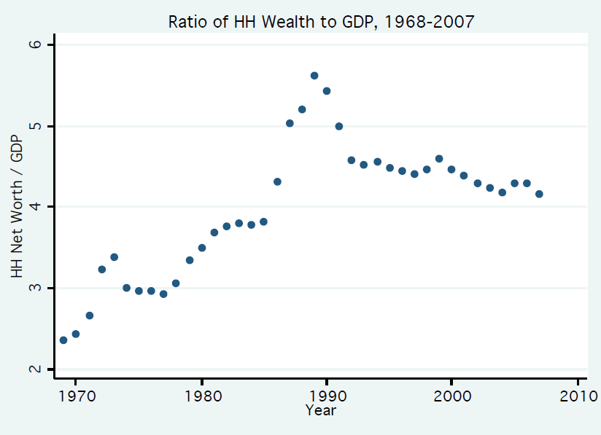
The Japanese Bubble

Slide 3
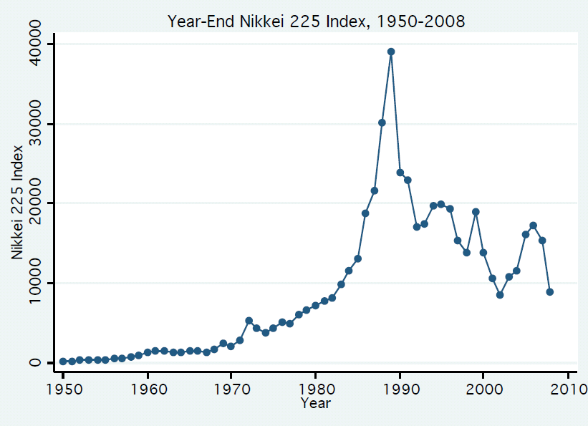

Slide 4
Bubble
Definition: A bubble occurs when an asset trades above its fundamental value.
Another way of saying it: A bubble occurs when the discounted value of cash flow received by the owners is less than the price of the asset

Slide 5
Bubbles
Neo-classical economic view:
  Bubbles don’t exist
  Bubbles only appear to exist because of hindsight bias (fundamentals sometimes unexpectedly deteriorate)
  Rational bubbles may exist in special circumstances (Tirole, 1985)
I’ll argue that:
  bubbles are (at least partially) not rational
  bubbles explain macro dynamics
  bubbles may generate large welfare costs

Slide 6
Macroeconomic dynamics
Consumption booms and busts
International flows (current account deficits)
Household leverage cycles
Banking leverage cycles
Financial crises

Slide 7
Outline
The Greenspan Bubble: 1995-2008
Short-run consequences: 1995-2007
Intermediate consequences: 2008-2010
Long-run equilibrium: 2011+
Welfare costs of the Greenspan Bubble
Narrative is preliminary, data-driven, and informal.
I welcome your feedback, now or later.

Slide 8
1. Bubbles form: 1995-2007
I’ll focus on the US, since this was the epicenter
Related bubbles existed in many other countries
The US bubble had two main components:
  Prices of publicly traded companies
  Prices of residential real estate
And many minor contributors:
  Prices of private equity
  Commodities
  Hedge funds

Slide 9
Fundamental Catalysts: 1990’s
End of the cold war
Deregulation
High productivity growth
Weak labor unions
Low energy prices ($11 per barrel avg. in 1998)
IT revolution
Low nominal and real interest rates
Congestion and supply restrictions in coastal cities

Slide 10
P/E ratios: Cambell and Shiller (1998a,b)
Real index value divided by 10-year average of real earnings
Dec 1999
Sept
1929
Jan
1966
Jan
1881
Dec
1920
July
1982
March
2009
Average: 16.34
Source: Robert Shiller web page

Slide 11
Dot com bubble
Lamont and Thaler (2003)
March 2000
3Com owns 95% of Palm and lots of other net assets, but...
Palm has higher market capitalization than 3Com
$Palm > $3Com
= $Palm + $Other Net Assets

Slide 12
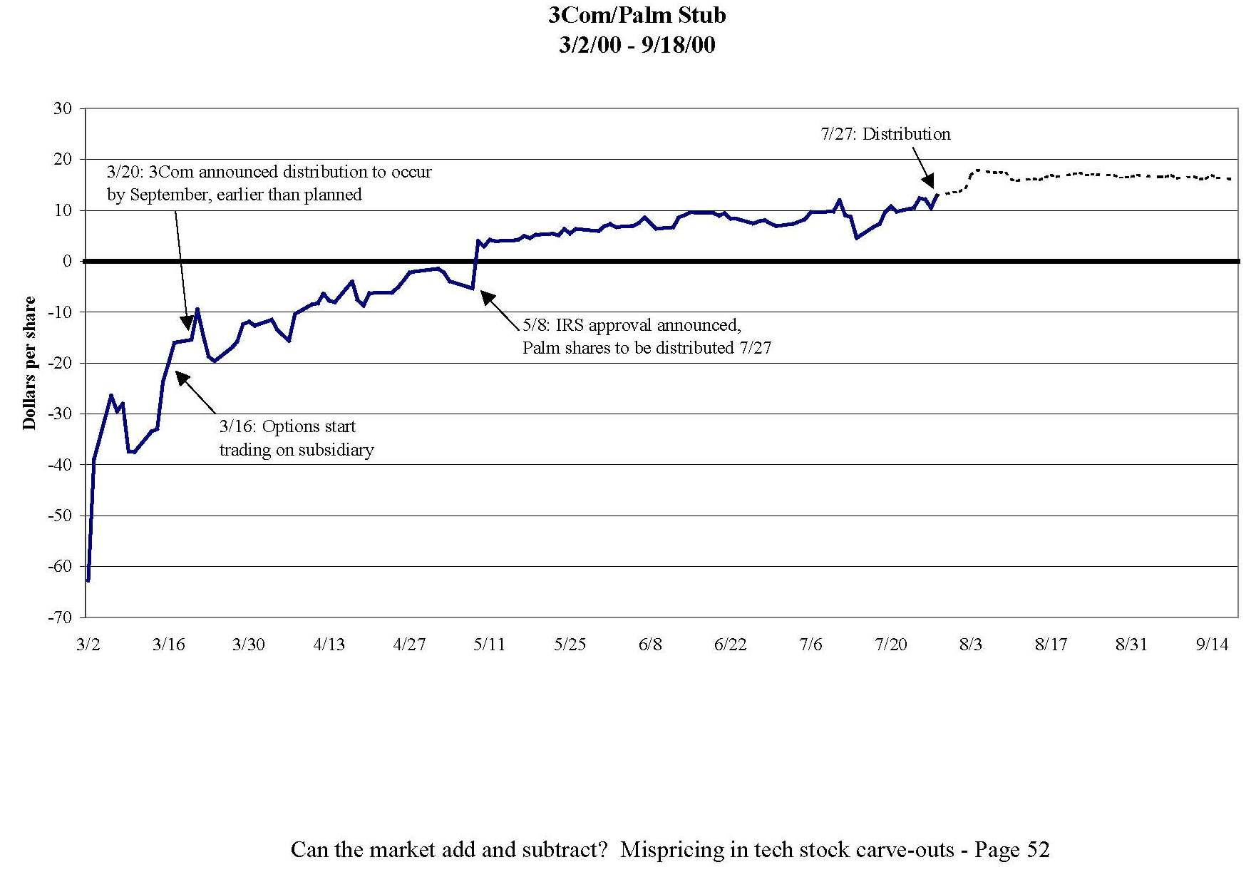
-$63 = (Share price of 3Com) - (1.5)*(Share price of Palm)

Slide 13
P/E ratios
Real index value divided by 10-year average of real earnings
Dec 1999
Sept
1929
Jan
1966
Jan
1881
Dec
1920
July
1982
March
2009
Average: 16.34
Source: Robert Shiller web page

Slide 14
Real Estate in Phoenix and Las Vegas
Jan 1987 – December 2008

Slide 15

Long-run horizontal supply curve
Phoenix

Slide 16
Long-run horizontal supply curve
Phoenix

Slide 17
Long-run horizontal supply curve
8 miles

Slide 18
Long-run horizontal supply curve
Bubble
Demand
SR Supply
Price
Demand
LR Supply
Quantity
Arbitrage: Buy your house now for $400,000 or in 3 years at $200,000

Slide 19
“Over-shooting”
Bubble
Demand
SR Supply
Price
Demand
LR Supply
DWL
Quantity
Arbitrage: Buy your house now for $400,000 or in 3 years at $100,000

Slide 20
S&P 500 Case-Shiller Index
January 1987-January 2009

Slide 21
Housing Prices
Source: Robert Shiller web data

Slide 22
Household net worth divided by GDP
1952 Q1 – 2008 Q4
Source: Flow of Funds, Federal Reserve Board ; GDP, BEA ; and authors calculations

Slide 23
Estimates of magnitude
(using aggregate Flow of Funds data)
One extra unit of GDP is equal to $14.2 trillion.
But this is an underestimate, since net worth would have been even higher if households hadn’t started spending some of their new-found wealth
This spending effect amounts to at least 0.3 units of GDP: $4.3
We also probably have further to fall in the housing market: 10% of $15 trillion = $1.5 trillion
Total magnitude of the bubble: $20 trillion

Slide 24
Estimates of magnitude
(using decomposition)
Stock market 2007 P/E was 27.3 and long-run historical average is 16.3. A 1/3 decline in the value of the (2007) stock market is $5 trillion.
Housing price index has fallen from 226.29 to 150. A 1/3 decline in the value of the (2006) housing stock is $7 trillion.
Another 10% decline is expected in housing: -$1.5 trillion
Total magnitude of the bubble: $13.5 trillion
This is a lower bound, since we are neglecting other asset classes (commercial real estate, privately held businesses, etc.)

Slide 25
Estimates of magnitude
Balance sheets for households and non-profits record a decrement in value of $12,885 billion from 2007 q3 to 2008 q4.
Add another $1.5 trillion of declining housing wealth and realize a total decline of $14.4 trillion

Slide 26
How can we be sure these were bubbles?
We can’t.
But recall Palm and 3Com
And recall Phoenix/Las Vegas house prices.

Slide 27
Psychological foundations of bubbles
Extrapolation
Return chasing
Herding (rational and irrational)
Overconfidence
Over-optimism

Slide 28
Psychological foundations of bubbles
Extrapolation – it’s a generally useful heuristic
LaPorta (2003)
Companies with high historical earnings growth have negative earnings surprises
Companies with low historical earnings growth have positive earnings surprises

Slide 29
Psychological foundations of bubbles
Return chasing
One standard deviation increase in an investor’s idiosyncratic 401(k) rate of return during the current year increases her 401(k) savings rate at year-end by 0.13 percentage points (Choi, Laibson, Madrian, and Metrick, 2009)
Depression babies avoid stocks in the 1960’s and “Oil shock babies” avoid stocks in the 1990’s (Malmendier and Nagel, 2009)
Brokerage investors repurchase individual stocks they previously sold for a gain while shunning individual stocks they previously sold for a loss (Barber, Odean, and Strahilevetz, 2004)
Finnish investors are more likely to subscribe to future IPOs if they experienced high returns in their prior IPO subscriptions (Kaustia and Knüpfer, 2008)

Slide 30
Psychological foundations of bubbles
Wishful thinking
e.g., Weinstein (1980)
Believe optimistic scenarios if they are plausible
70% of drivers believe they are in the top 30%
Good economic news is viewed uncritically and bad economic news is viewed skeptically

Slide 31
Social proof:
It must be right, if everyone else is doing it e.g., Asch (1954)
Psychological foundations of bubbles
Solomon Asch paradigm
7 male college students in the room
“task involving visual judgment”
One card contains a single line
Another card contains three lines

Slide 32
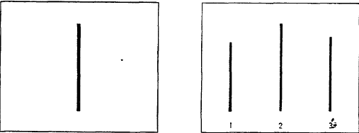
Social proof continued
a.
b.
c.
Which line on the left is the same as the line on the right?

Slide 33
Social proof continued
Task: pick out the matching line
Easy task: error rate for a lone subject is <1%
In actual experiment, 6 of the 7 subjects are fakes
In some trials the fakes respond erroneously
Error rate of real subject during such trials is 36.8%

Slide 34
Overconfidence
Psychological foundations of bubbles
Overconfidence (2nd moment)
Alpert and Raiffa (1982)
How many births occurred in these randomly chosen states in 2004?
  California, Illinois, Mississippi, North Carolina, Texas, Wyoming
Now provide a 99% confidence interval for each state.
In other words, for each state pick two numbers (low and high) so that there is a 99% chance that the true value of the number of births lies in that interval.

Slide 35
Number of births in 2004
CA | IL | MI | NC | TX | WY
545,071 | 180,934 | 42,810 | 119,851 | 384,389 | 6,807

Slide 37
Asset pricing

Slide 38
Rational asset pricing
Agents should have recognized two things:
Lower steady state inflation would produce a lower steady state rate of house price appreciation.
Positive economic events in the 1990’s would not permanently raise the real rate of housing appreciation.

Slide 39
2. Short-run consequences
1995-2007
A simple model of consumption
Assume: no uncertainty & perfect capital markets

Slide 40
Manipulate expressions to yield consumption function

Slide 41
Special cases

Slide 42
Calibrate
Discount rate (-lnδ)? 1%-10%
Risk-free real interest rate (-lnR)? 2%-5%
Coefficient of relative risk aversion (γ)? 0.5-5
Let’s pick a benchmark case:
  δ = 0.95
  γ = 1
So λ = 0.05 (marginal propensity to consume)

Slide 43
2. Short-run consequences
1995-2007
A simple model of consumption
Assume: no uncertainty & perfect capital markets

Slide 44
Consequences for consumption
Bubble reaches a peak of about $20 trillion
With an MPC of 0.05, consumption should rise by $1 trillion
Another way of thinking about this is in units of GDP.
Consumption as a share of GDP should rise by

Slide 45
Total consumption (C+G) over GDP
1952:1 to 2008:4
1998.1

Slide 46
US trade deficit supports the higher level of consumption
Trade balance over GDP 1952.1 – 2008.4

Slide 47
A match between the consumption boom and the trade deficit
Let’s use 1998:1 as the beginning of the boom
Accumulated consumption boom is 42% of 2008 GDP
Accumulated trade deficits are 43% of 2008 GDP

Slide 48
Note that consumption did not need to absorb the capital inflows
US investment divided by GDP 1952:1 to 2008:4
1998:1
0.175

Slide 49
Alternative explanation:
Bernanke’s (2005) global savings glut?
A large increase in desired savings in the developing world was the cause of the trade imbalances and the consumption boom.
In my view, the “global savings glut” theory does not make sense.
Three critiques.

Slide 50
Ln utility predicts that a savings glut would have been 100% channeled into investment (not consumption).
  Predicts investment boom not consumption boom
Whether or not utility is logarithmic, investment was not affected by the savings glut, so the interest rate channel was not active.
It’s strange to argue that foreign capital flows played a key role in bidding up the price of residential real estate (e.g., Phoenix).

Slide 51
Housing prices and trade deficits
OECD data (excluding US)
Accumulated trade deficit normed by GDP:
1998-2008
Germany
Real housing price appreciation: 1998-2006
Japan
Turkey
Iceland

Slide 52
Technical slide
Accumulated excess consumption: take 1998:1 as benchmark C/GDP ratio. Then take all future excesses (using the ratio as the predicted level) and accumulate. Then divide by GDP in 2008.
Trade deficits are just summed up.

Slide 53
3. Intermediate term consequences
2008-2010
Household leverage
Leverage in financial sector

Slide 54
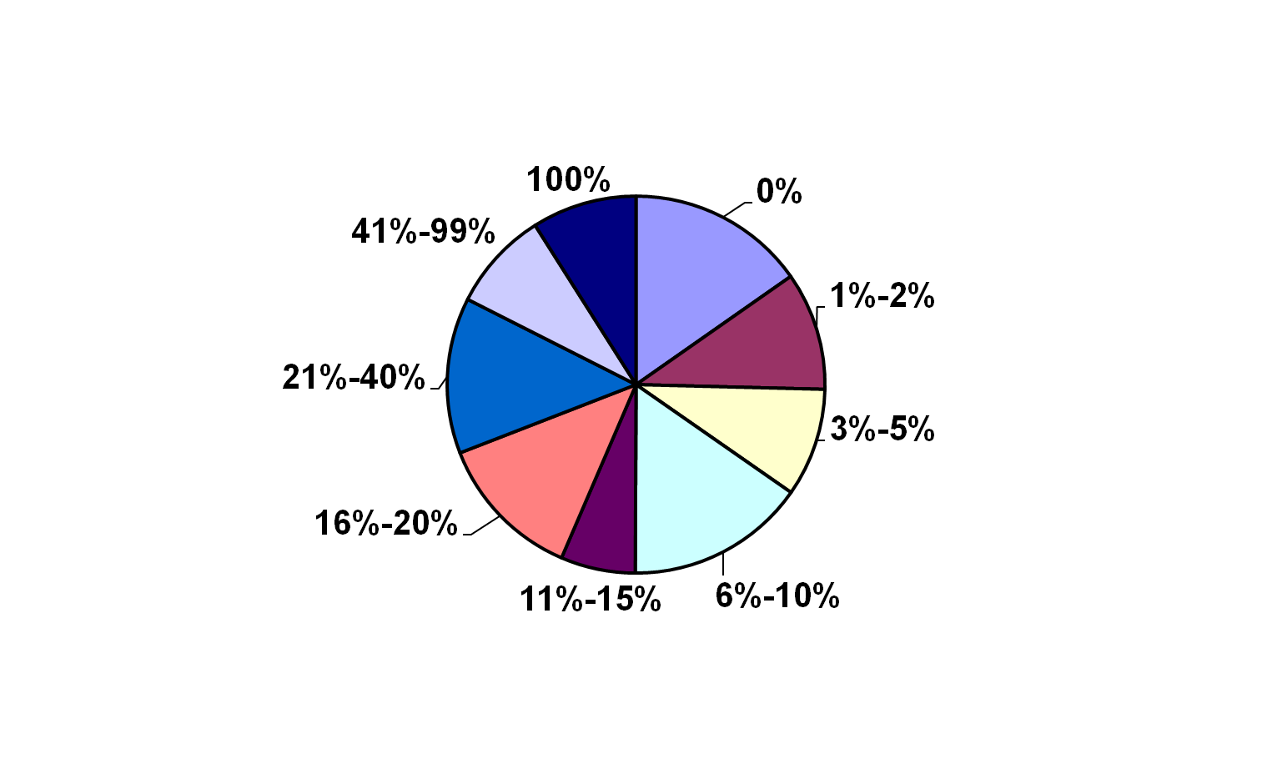
Down payments
(New construction in last 4 years)
Half of down payments are less than 10% of purchase price
Size of down payment
Source: American Housing Survey 2007

Slide 55
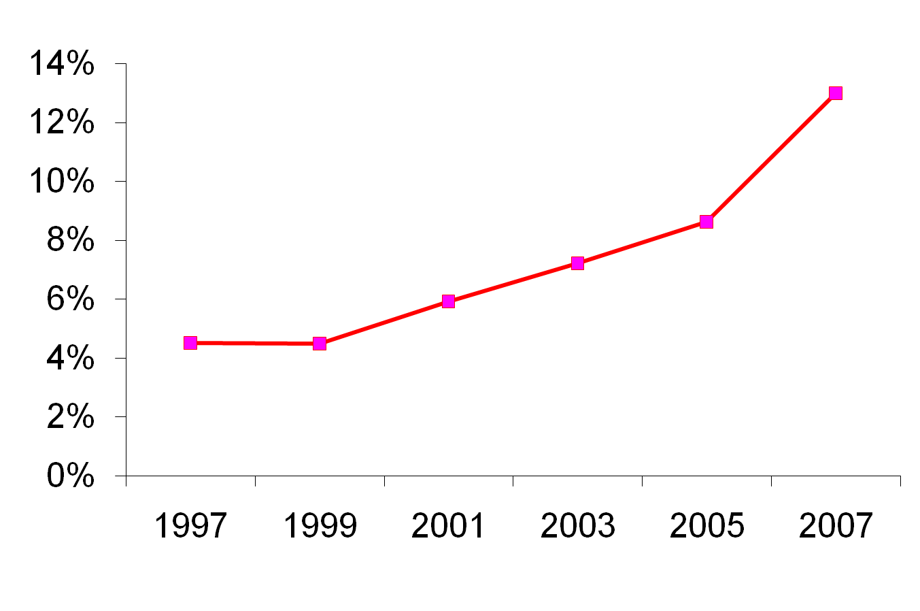
Household leverage:
Fraction of home buyers with no downpayment
(New construction in last 4 years)
Source: American Housing Survey

Slide 56
Household mortgages divided by GDP
1952 Q1 – 2008 Q4

Slide 57
Financial sector leverage
Gross Leverage Ratios exceeded 30:1 at
Merrill Lynch
Lehman Brothers
Morgan Stanley
Bear Sterns
Only Goldman Sachs has stayed below this threshold with a maximum leverage ratio of 24.

Slide 58
Why so much leverage?
Why were households so leveraged?
  Belief that housing would appreciate
  Natural channel to fund consumption boom
Why were banks so leveraged?
  Belief that tranched asset-backed securities were really AAA (e.g., CDO’s)
  Implicit belief that national housing prices would appreciate (or at least stabilize)

Slide 59
Alan Greenspan
“While local economies may experience significant speculative price imbalances, a national severe price distortion seems most unlikely in the United States, given its size and diversity.” (October, 2004)
If home prices do decline, that “likely would not have substantial macroeconomic implications.” (June, 2005)
Though housing prices are likely to be lower than the year before, “I think the worst of this may well be over.” (October, 2006)
See also Gerardi et al (BPEA, 2008)

Slide 60
4. Long-run equilibrium
Model characterizes household response to a bubble’s arrival and then to the bubble’s collapse
Same model as above
  No liquidity constraint
  Certainty (for simplicity)
  CRRA

Slide 61
Special case
Interest rate = discount rate
Three assets: human capital, real assets, debt
Households fund consumption boom by borrowing from ROW
All assets appreciate at required rate of return until bubble collapses

Slide 62
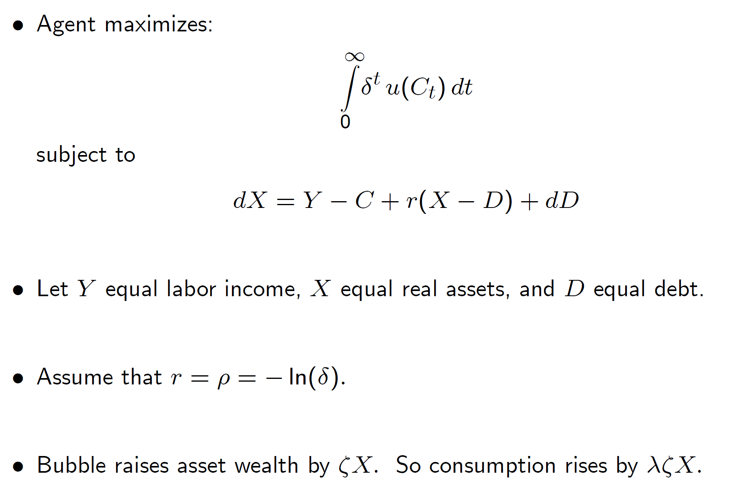

Slide 63
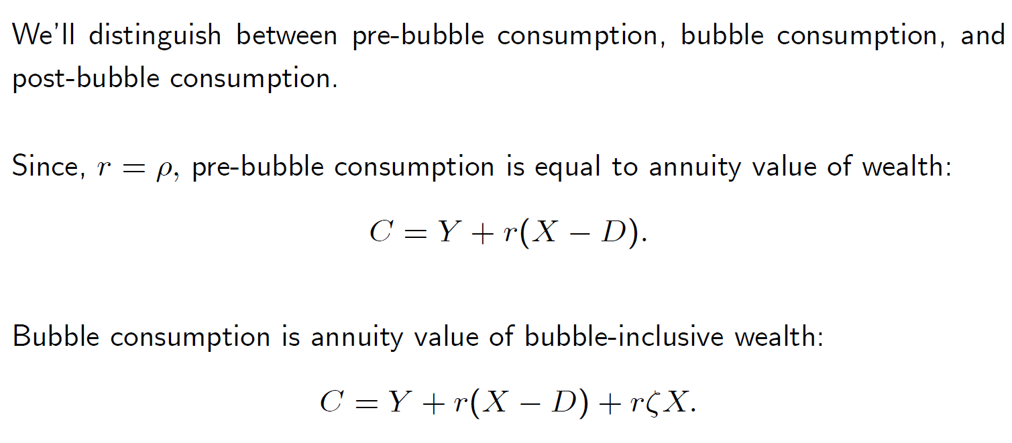

Slide 64
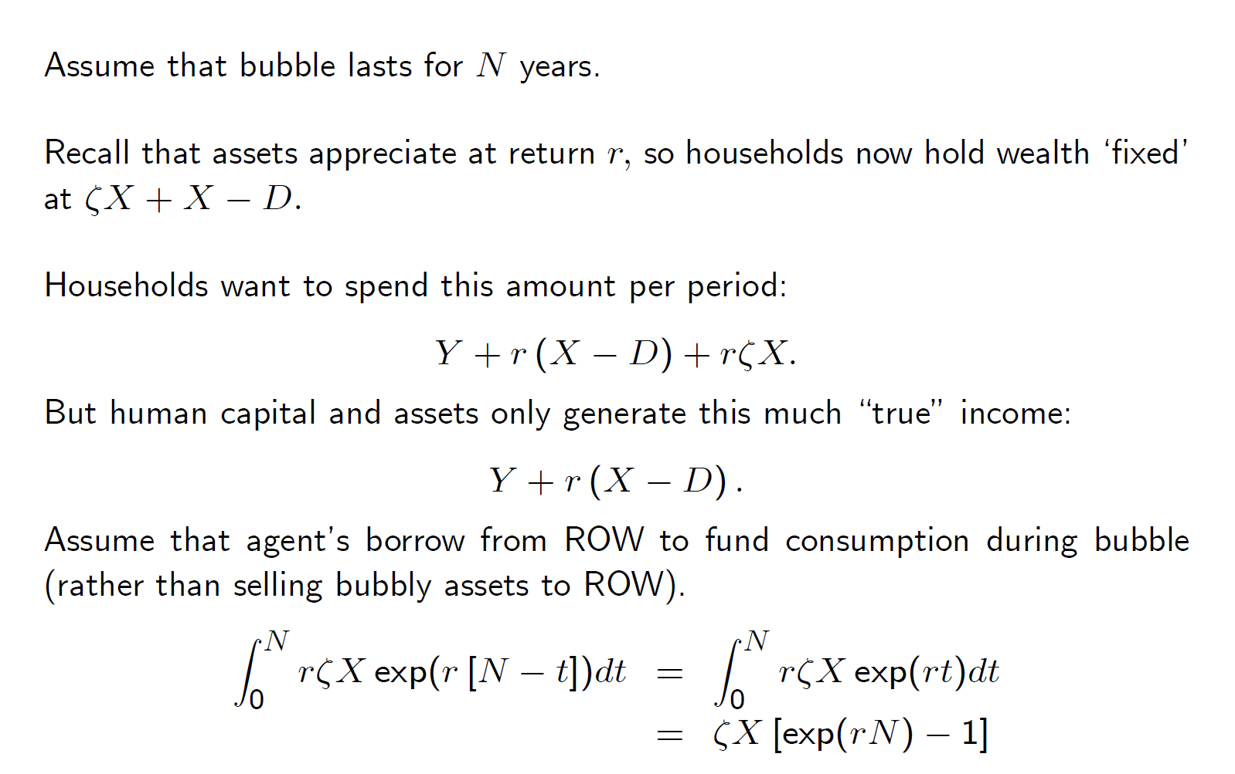

Slide 65
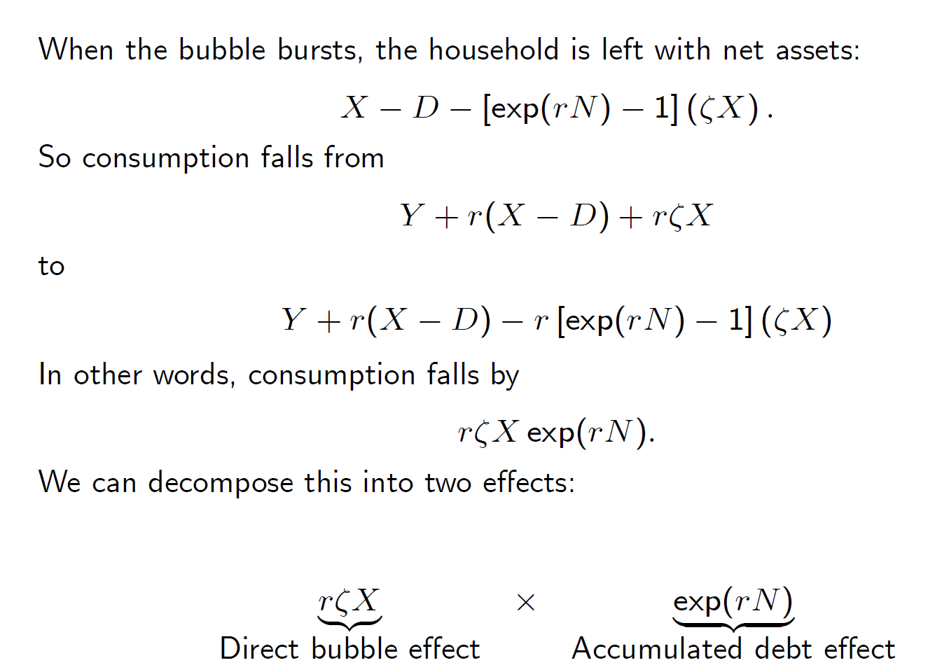

Slide 66
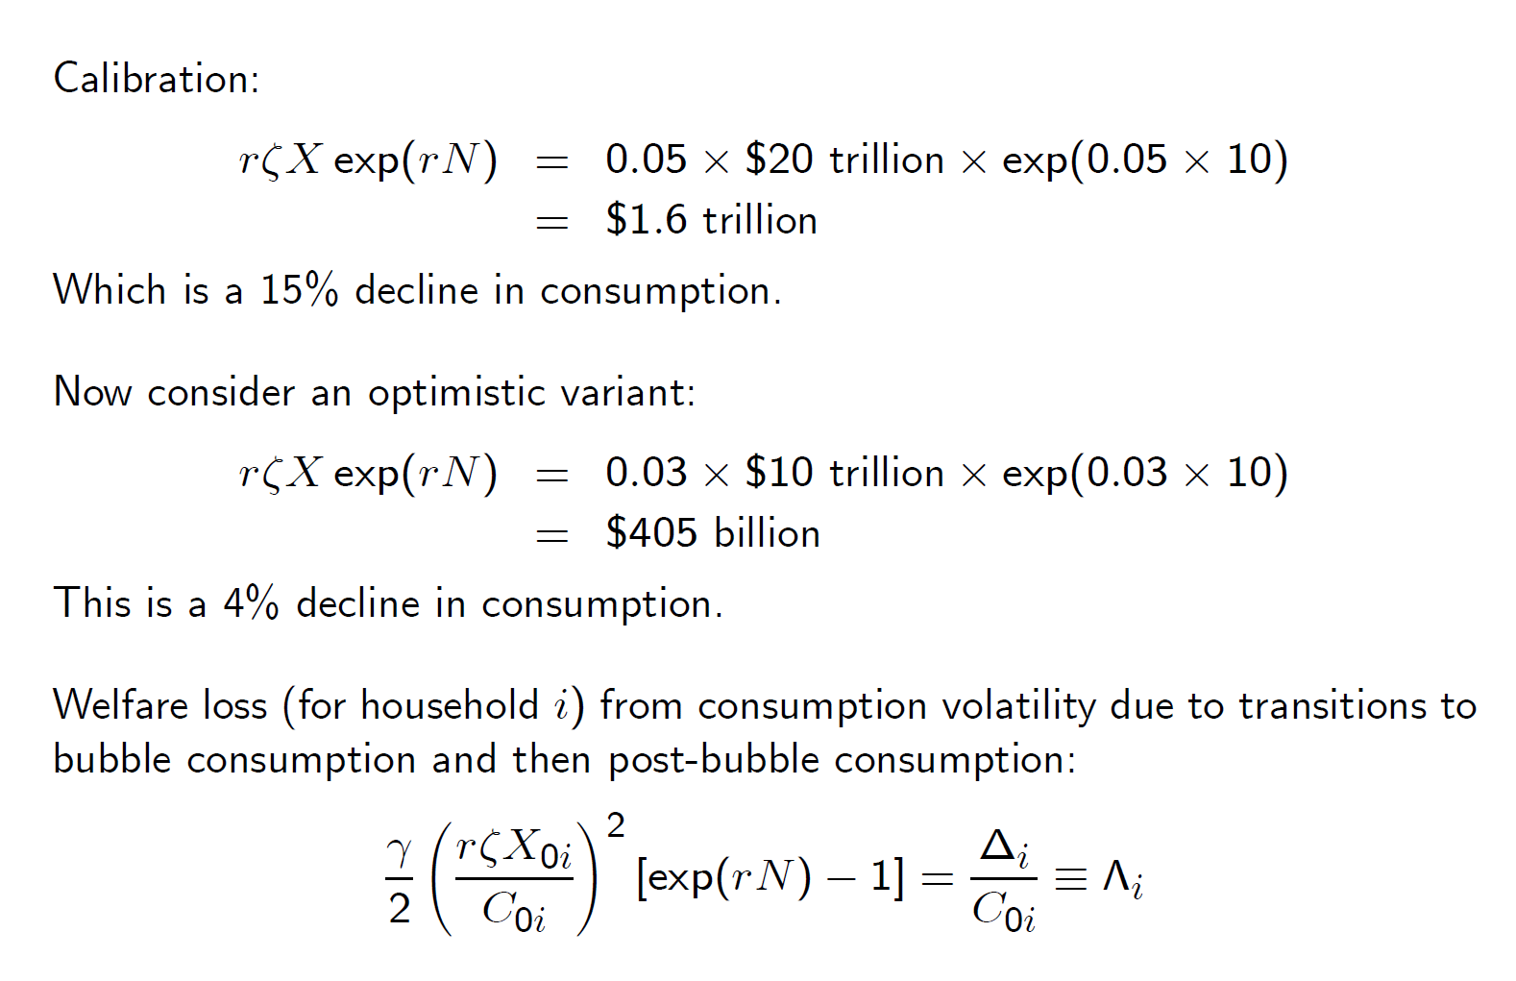

Slide 67
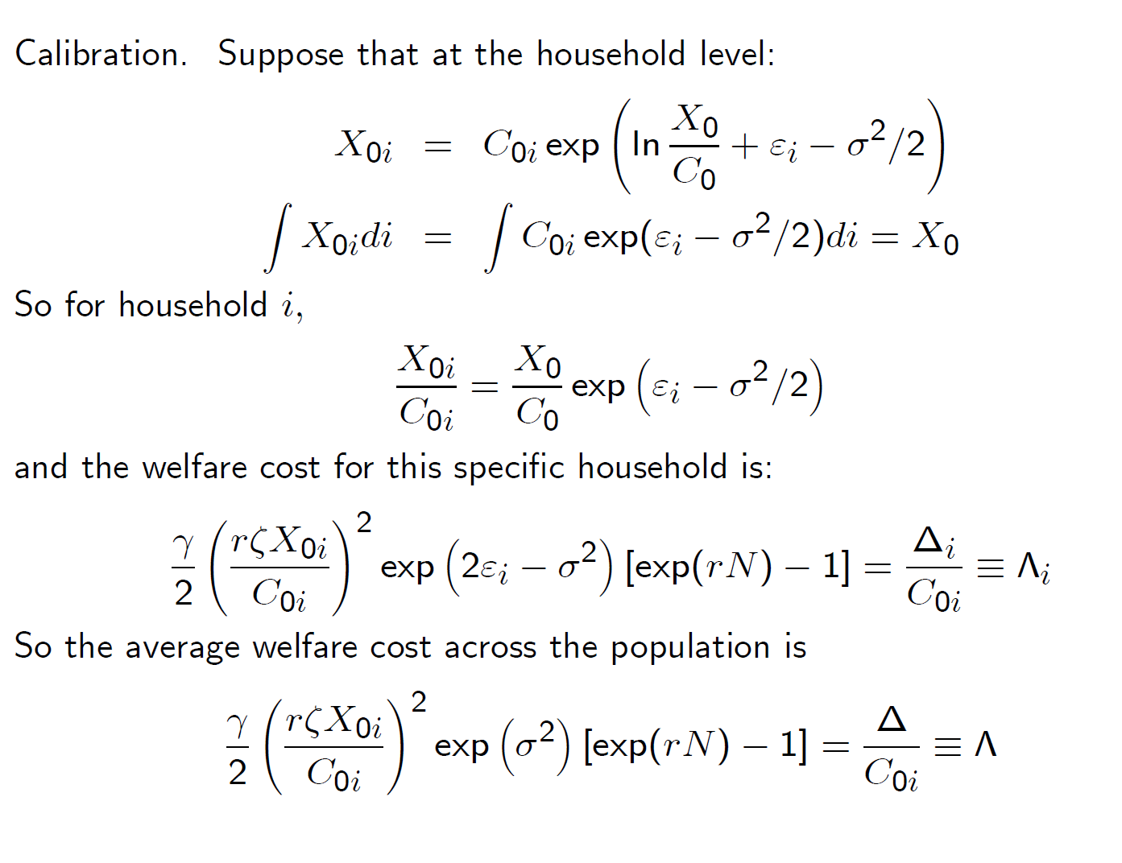

Slide 68
5. Welfare costs in US
Resource underutilization: $3.5 trillion
Inefficient investment: <$0.25 trillion
Consumption volatility: $1.8 trillion
Total social cost: $5.5 trillion
(Not the decline in asset values: $18.5 trillion.)

Slide 69
Welfare costs from consumption variation expressed as fraction of consumption
 | Optimistic | Baseline | Pessimistic
CRRA | 1 | 3 | 5
Sigma | 0.75 | 1.00 | 1.25
r | 0.03 | 0.04 | 0.05
C (trillions) | $10 | $10 | $10
Bubble (trillions) | $10 | $15 | $20
N | 8 | 10 | 12
Annual cost | 0.02% | 0.72% | 9.81%
NPV cost | 0.71% | 18.05% | 196.11%

Slide 70
Growth forecast

Slide 71
Output path relative to potential

Slide 72
GDP loss
Discounting at a 3% (real) rate
Losses are equivalent to 25% of current GDP
(0.25)($14 trillion) = $3.5 trillion

Slide 73
Why might a Madoff victim be angry, even if she lost no money?

Slide 74
Total U.S. Housing Stock
(1000s of units)
Housing units

Slide 75
Total U.S. Housing Stock
(1000s of units)
Housing units

Slide 76
Homes for Sale
(thousands of units)
2226

Slide 77
Dead-weight loss
Bubble Demand
Demand

Slide 78
Dead-weight loss
Price
Bubble Demand
Demand
Quantity

Slide 79
Dead-weight loss
Price
Bubble Demand
Demand
DWL
Quantity

Slide 80
Dead-weight loss
Price
DWL
Quantity

Slide 81
Dead-weight loss
Price
Quantity

Slide 82
Dead-weight loss
Price
1 million * $200,000
+1 million *$100,000 * 1/2
$250 billion
$100,000
$200,000
1,000,000
Quantity

Slide 83
Three themes
Bubble economics may provide a cohesive explanation of the economic events of the past decade
  More cohesive than the “savings glut” narrative
The welfare costs are large
  But don’t come from excessive capital formation

