Slide 1
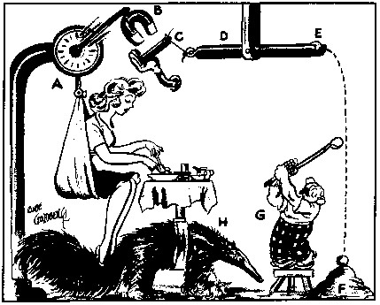
Behavioral Mechanism Design
(Behavioral Welfare Economics)
David Laibson
July 2, 2016

Slide 2
How Are Preferences Revealed?
Beshears, Choi, Laibson, Madrian (2008)
Revealed preferences (decision utility)
Normative preferences
Why might revealed ≠ normative preferences?
  Cognitive errors
  Passive choice
  Complexity
  Shrouding
  Limited personal experience
  Intertemporal choice
  Third party marketing

Slide 3
How Are Preferences Revealed?
Beshears, Choi, Laibson, Madrian (2008)
How to identify normative preferences?
Experts
Experienced agents; Asymptotic behavior
Educated agents
Long-run preferences
Preferences revealed when attributes are unshrouded
Choices of altruistic third parties
Structural models that partial out biases

Slide 4
Behavioral mechanism design
Specify a positive theory of consumer/firm behavior (consumers and/or firms may not behave optimally).
Specify a social welfare function, i.e. normative preferences (not necessarily based on revealed preference)
Solve for the institutional regime that maximizes the social welfare function, conditional on the theory of consumer/firm behavior (and info assymetries).

Slide 5
  Laibson, Repetto, Tobacman (1998)
  Laibson (1998)
  O’Donoghue and Rabin (1999)
  Camerer, Issacharoff, Loewenstein, O‘Donoghue, & Rabin (2003)
  Choi, Laibson, Madrian, Metrick (2003)
  O’Donoghue and Rabin (2005)
  Amador, Werning, and Angeletos (2006)
  Beshears, Choi, Laibson, Madrian (2008)
  Choi, Laibson, Madrian, and Metrick (2009)
  Alcott and Taubinksy (2015)
  Lockwood (2016)
  Farhi and Gabaix (2015)
  Beshears, Choi, Harris, Laibson, Madrian, Sakong (2015)
  Beshears, Choi, Clayton, Harris, Laibson, Madrian (2016)

Slide 6
Today:
Three examples of behavioral mechanism design
  A. Optimal defaults: what default should an enlightened planner set?
  B. Optimal illiquidity: how illiquid should retirement savings be?
  C. How should we tax/subsidize wage earners?

Slide 7
A. Optimal Defaults – public policy
Mechanism design problem in which policy makers set a default for agents with present bias
Carroll, Choi, Laibson, Madrian and Metrick (2009)

Slide 8
Basic set-up of problem
Specify behavioral model of households
  Flow cost of staying at the default
  Effort cost of opting-out of the default
  Effort cost varies over time → option value of waiting to leave the default
  Present-biased preferences → procrastination
Specify (dynamically consistent) social welfare function of planner (e.g., set β=1)
Planner picks default to optimize social welfare function

Slide 9
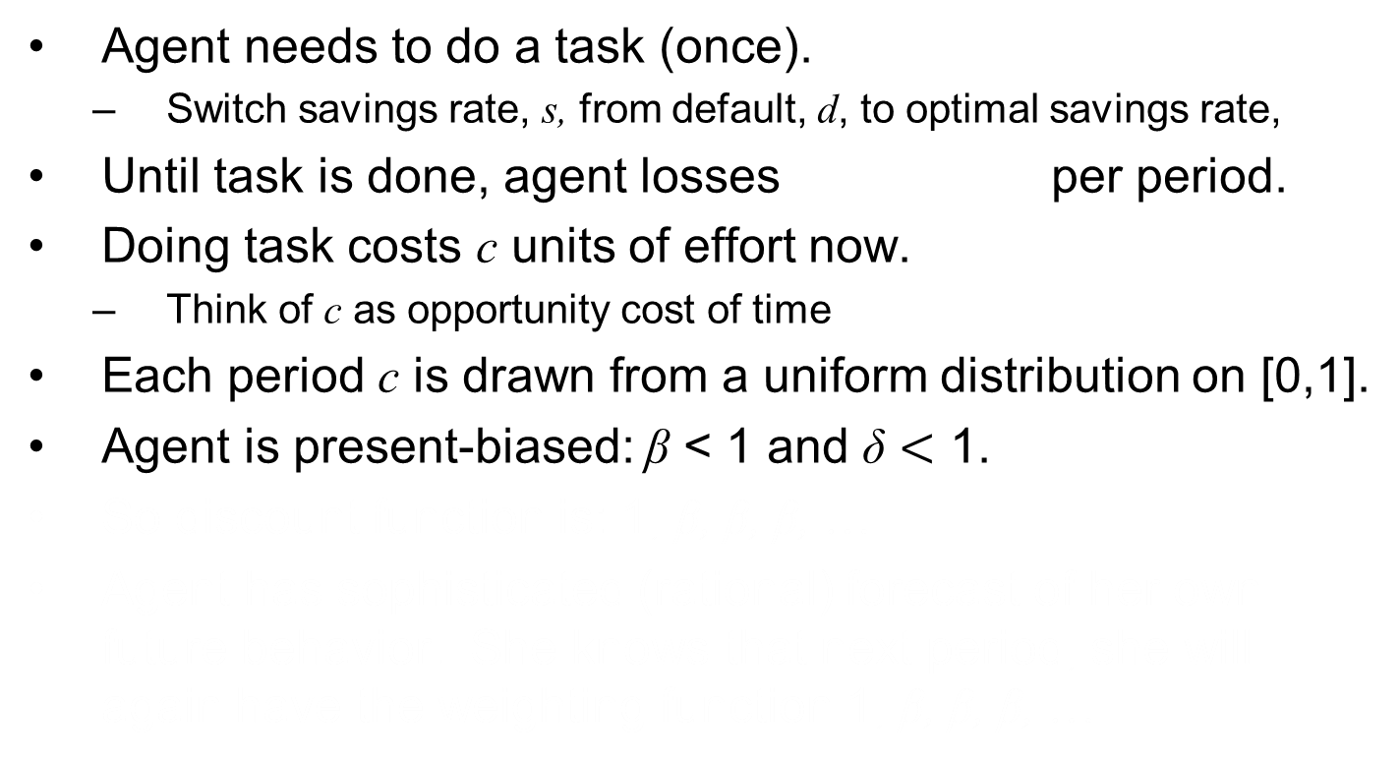
Specific Details
Agent needs to do a task (once).
  Switch savings rate, s, from default, d, to optimal savings rate,
Until task is done, agent losses per period.
Doing task costs c units of effort now.
  Think of c as opportunity cost of time
Each period c is drawn from a uniform distribution on [0,1].
Agent is present-biased: β < 1 and δ $<$ 1.
So discount function is: 1, β, β, β, …
Agent has sophisticated (rational) forecast of her own future behavior. She knows that next period, she will again have the weighting function 1, β, β, β, …

Slide 10
Timing of game
Period begins (assume task not yet done)
Pay cost θ (since task not yet done)
Observe current value of opportunity cost c (drawn from uniform distribution)
Do task this period or choose to delay again?
It task is done, game ends.
If task remains undone, next period starts.
Pay cost θ
Observe current value of c
Do task or delay again
Period t-1
Period t
Period t+1

Slide 11
Sophisticated procrastination
There are many equilibria of this game.
Let’s study the stationary equilibrium in which sophisticates act whenever c < c*. We need to solve for c*.
Let V represent the expected continuation payoff function if the agent decides not to do the task at the end of the current period t:
Likelihood of doing it in t+1
Likelihood of not doing it in t+1
Cost you’ll pay for certain in t+1, since job not yet done
Expected cost conditional on drawing a low enough c* so that you do it in t+1
Expected cost starting in t+2 if project was not done in t+1

Slide 12
In equilibrium, the sophisticate needs to be exactly indifferent between acting now and waiting.
Solve for c*.
Expected delay is:

Slide 14
How does introducing β < 1 change the expected delay time?
If β=2/3, then the delay time is scaled up by a factor of
In other words, it takes times longer than it “should” to finish the project

Slide 15
V vs. V hat

Slide 16
A model of procrastination: naifs
Same assumptions as before, but…
Agent has naive forecasts of her own future behavior.
She thinks that future selves will act as if β = 1.
So she (mistakenly) thinks that future selves will pick an action threshold of

Slide 17
In equilibrium, the naif needs to be exactly indifferent between acting now and waiting.
To solve for V, recall that:

Slide 18
Substituting in for V:
So the naif uses an action threshold (today) of
But anticipates that in the future, she will use a higher threshold of

Slide 19
So her (naïve) forecast of delay is:
And her actual delay will be:
Being naïve, scales up her delay time by an additional factor of 1/β.

Slide 20
Summary
If β = 1, expected delay is
If β < 1 and sophisticated, expected delay is
If β < 1 and naïve, anticipated delay is
If β < 1 and naïve, true delay is

Slide 21
Behavioral mechanism design
Specify a positive theory of consumer/firm behavior (consumers and/or firms may not behave optimally).
Specify a social welfare function, i.e. normative preferences (not necessarily based on revealed preference)
Solve for the institutional regime that maximizes the social welfare function, conditional on the theory of consumer/firm behavior.

Slide 22
We’ve provided a theory of consumer behavior.
Now solve for government’s optimal policy.
We need to solve for the optimal default, d.
The government’s objective is exponentially weighted, since it uses V as the welfare criterion.
The government doesn’t know the optimal level of savings, s* , for each individual (info asymmetry).

Slide 23
Three reasons for the planner to use a social welfare function with β=1.
This is the preference of all past selves for today.
  Including self zero.
  Including the planner at date zero.
  This is the long-run perspective.
This is the restriction that eliminates “present bias.”
However, this is a normative assumption.
This is an ‘if, then’ analysis.
If the planner has a social welfare function with β=1, then the following policies are socially optimal.

Slide 24

Total expected costs as a function of s* - d
Case of β = 1
Always act immediately
Always act immediately
Wait to act until a low cost period
$$\overline{c}$$
0
0
s* - d

Slide 25
Total expected costs as a function of s* - d
Case of β = 1
Always act immediately
Always act immediately
Wait to act until a low cost period
$$\overline{c}$$
0
0
s* - d

Slide 26
Total expected costs as a function of s* - d
Case of β < 1
Always act immediately
Always act immediately
$$\overline{c}$$
0
0
0
s* - d

Slide 27
Total expected costs as a function of s* - d
Case of β < 1
$$\overline{c}$$
0
0
-10
+10
s* - d
Automatic enrollment with a center default

Slide 28
Total expected costs as a function of s* - d
Case of β < 1
$$\overline{c}$$
0
0
-3
s* - d
+17
Automatic enrollment with an offset default

Slide 29
Optimal ‘Defaults’
Two classes of optimal defaults emerge from this calculation
  Automatic enrollment
    Optimal when employees have relatively homogeneous savings preferences (e.g. match threshold) and relatively little propensity to procrastinate
  Active Choice — require individuals to make a choice (eliminate the option to passively accept a default)
    Optimal when employees have relatively heterogeneous savings preferences and relatively strong tendency to procrastinate
Key point: sometimes the best default is no default.

Slide 30
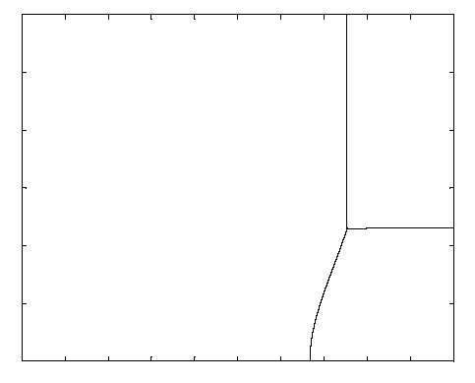
Preference Heterogeneity
30%
Low Heterogeneity High Heterogeneity
Offset
Default
Active Choice
Center
Default
0%
0
Beta
1

Slide 31
Lessons from theoretical analysis of defaults
  Defaults should be set to maximize average well-being, which is not the same as saying that the default should be equal to the average preference.
  Endogenous opting out should be taken into account when calculating the optimal default.
  The default has two roles:
    causing some people to opt out of the default (which generates costs and benefits)
    implicitly setting savings policies for everyone who sticks with the default

Slide 32
When might active choice be socially optimal?
Defaults sticky (e.g., present-bias)
Preference heterogeneity
Individuals are in a position to assess what is in their best interests with analysis or introspection
  Savings plan participation vs. asset allocation
The act of making a decision matters for the legitimacy of a decision
  Advance directives or organ donation
Deciding is not very costly

Slide 33
Empirical evidence on active choice
Carroll, Choi, Laibson, Madrian, Metrick (2009)
Active choice mechanisms require employees to make an active choice about 401(k) participation.
Welcome to the company
You are required to submit this form within 30 days of hire, regardless of your 401(k) participation choice
If you don’t want to participate, indicate that decision
If you want to participate, indicate your contribution rate and asset allocation
Being passive is not an option

Slide 35
Active choice in 401(k) plans
Active decision raises 401(k) participation.
Active decision raises average savings rate by 50 percent.
Active decision doesn’t induce choice clustering.
Under active decision, employees choose savings rates that they otherwise would have taken three years to achieve. (Average level as well as the multivariate covariance structure.)

Slide 36
Other active choice interventions
Active choice in asset allocation (Choi, Laibson, and Madrian 2009)
Active choice in home delivery of chronic medications (Beshears, Choi, Laibson, Madrian 2013)

Slide 37
The Flypaper Effect in Individual Investor Asset Allocation (Choi, Laibson, Madrian 2009)
Studied a firm that used several different match systems in their 401(k) plan.
I’ll discuss two of those regimes today:
Match allocated to employer stock and workers can reallocate
  Call this “default” case (default is employer stock)
Match allocated to an asset actively chosen by workers; workers required to make an active designation.
  Call this “active choice” case (workers must choose)
Economically, these two systems are identical.
They both allow workers to do whatever the worker wants.

Slide 38
Consequences of the two regimes
Balances in employer stock
 |  | Match Defaults into Employer Stock | Active choice
 | Own Balance in Employer Stock | 24% | 20%
 | Matching Balance in Employer Stock | 94% | 27%
 | Total Balance in Employer Stock | 56% | 22%

Slide 39
Prescription Drug Home Delivery
Beshears, Choi, Laibson, Madrian (2013)
  90 day fills (vs. 30 day for retail)
  Time saving (no trip to pharmacy)
  Convenient refill system
    Internet or phone
    More timing leeway than for retail fill
  Lower error rate (although error rates low for both channels)
  Lower cost to individuals, PBM, and employer health plan

Slide 40
Prescription Drug Coverage
 | Copay
Type of Prescription Drug | Retail (30 day max) | Home Delivery (90 day max) | Savings (90 day)
Generic | $8 | $20 | $4
Preferred brand, no generic available | $25 | $55 | $20
Preferred brand, generic available | 35% $35 min/$70 max | 35% $70 min/$140 max | $35 min/ $70 max
Non-preferred brand, excl. lifestyle drugs | 35% $70 min/$140 max | 35% $140 min/$280 max | $70 min/ $140 max
Non-preferred brand, lifestyle drugs | 85% | 80% | 5%
Notes:
Table 1. Prescription Drug Copayment Structure
This table summarizes the basic copayment structure in the firm’s prescription drug plan during the time period studied (the years 2007, 2008, and 2009). Some special categories of treatments (e.g., infertility) are omitted. A small number of drugs moved from one category to another during the sample period. Beginning in April 2008, some employees with certain chronic diseases were invited to enroll in a special program that offered reduced copayment amounts and rates, which are not shown. Note that costs in the home delivery column are for 90 day refills, whereas costs for retail are for 30 day costs.

Slide 41
Disadvantages of Prescription Drug Home Delivery (vs. Retail Pharmacy)
  Risk of theft
  Risk of privacy loss
  Reduces personal interaction with pharmacist

Slide 42
What would you choose?

Slide 43
Select Home Delivery: Active Choice for Home Delivery of Prescription Medication
Program designed to increase uptake of prescription drug home delivery
Examine adoption at a large U.S. company
Employees targeted for inclusion:
  Taking a medication on list of targeted long-term maintenance medications
  Not already using home delivery for targeted medication
Targeted employees contacted by e-mail, mail, and telephone starting November 2008
Notes:
Examine how an active choice approach works in the context of enrollment in home delivery for prescription drugs. Large U.S. employers adopts program to encourage employees enrolled in its health plans to make an active choice about whether they want home delivery or pharmacy pick-up for long-term maintenance medications. Program is called “Select Home Delivery” (SHD).

Slide 44
Select Home Delivery: Active Choice and Home Delivery of Prescription Drugs
Active decision approach: those targeted “required” to make active choice about home delivery or retail
  PBM will contact Dr. to get prescription if desired
  Different decisions for individual drugs allowed
Mechanisms to enforce active choice
  Each retail fill ➔ reminder from PBM until active choice is made
  After three retail fills w/o an active choice, payment denied (individual must pay full prescription cost out of pocket)
  Choice could be home delivery or retail pharmacy, but making a choice required for payment
Notes:
Employees do not have to choose home delivery, but they are given a deadline (three retail pharmacy refills) by which time they have to make a yes/no choice about whether they want home delivery. There is no penalty for choosing “NO”. Motivation behind program is a belief that many individuals would prefer home delivery but they simply don’t get around to signing up (procrastination).

Slide 45
Empirical Approach
Two observationally similar cohorts
  2007 cohort (pre-Select Home Delivery)
  2008 cohort (post-Select Home Delivery)
Outcomes of interest
  Participation in home delivery
  Adherence
Sample selection criteria for both cohorts
  Regular, full-time employee as of December 1st
  Employee filled a retail, long-term prescription for a targeted drug between October 12th and November 26th
  Employee did not fill a home delivery prescription for the same drug between May 1st and November 1st
Notes:
Empirical approach: Compare outcomes for targeted employees after SHD implemented with behavior of employees before SHD implemented. Use same targeting criteria to define pre-cohort.

Slide 46
Home Delivery Utilization for All Employees: 2006 to 2010
Notes:
This graph displays the fraction of prescriptions that are filled through Home Delivery in a given month. The universe is all prescription refills in a given month. Note that Home Delivery prescriptions need to be refilled less often, since the supply of medicine goes up to 90 days. The supply limit for a retail prescription fill is 30 days. The Select Home Delivery program was in effect during the time period marked by the red vertical lines (November 2008-October 2009). In November 2009, a more aggressive approach to increasing take-up of home delivery was adopted by the company which accounts for the increase in home delivery utilization in this period. We do not analyze this second program in this paper.

Slide 47
Home Delivery Adoption: Logit Regression (Marginal Effects)
 | No Controls |  | Add Controls
2008 Cohort | 0.338** | (0.004) | 0.348** | (0.004)
Female |  |  | -0.003 | (0.005)
Age |  |  | 0.003** | (0.0002)
Tenure (<2 yrs. Omitted)
2 to <5 yrs. |  |  | -0.022** | (0.006)
5 to <10 yrs. |  |  | -0.025** | (0.006)
10+ yrs. |  |  | -0.041** | (0.007)
Salary (1st quart. Omitted)
Salary 2nd quartile |  |  | 0.009 | (0.006)
Salary 3rd quartile |  |  | 0.026** | (0.006)
Salary 4th quartile |  |  | 0.059** | (0.006)
Number of targeted drugs |  |  | 0.0000 | (0.002)
Past PDC |  |  | 0.001** | (0.0001)
Past PDC missing |  |  | 0.048** | (0.007)
Rough savings ($100) |  |  | 0.008** | (0.003)
Disease class effects | No |  | Yes
Pseudo R² | 0.155 |  | 0.174
Sample size | 49,913 / 94,450 |  | 48,433 / 91,083
Notes:
The observations in this regression are uniquely identified by a combination of individual ID and medication GPI-4 code. In the second regression, standard errors are clustered by individual.

Slide 48
Prescription Drug Home Delivery: Requiring an Active Choice
Active choice ➔ big increase in home delivery: 6% to 40%
Among those who choose, we see a slight preference for home delivery
About 22% don’t make an active choice

Slide 49
Home Delivery, Retail, or No Choice: Multinomial Logit (Marginal Effects):
 | HD | Retail | No Choice
Female | -0.005 | 0.022** | -0.017**
Age | 0.004** | -0.0002 | -0.004**
Tenure (<2 yrs. Omitted)
2 to <5 yrs. | -0.036** | 0.036** | 0.0001
5 to <10 yrs. | -0.034** | 0.051** | -0.018*
10+ yrs. | -0.057** | 0.094** | -0.037**
Salary (1st quart. Omitted)
Salary 2nd quartile | 0.011 | -0.003 | -0.083
Salary 3rd quartile | 0.029** | -0.004 | -0.025**
Salary 4th quartile | 0.076** | -0.033** | -0.043**
Number of targeted drugs | 0.007** | 0.025** | -0.032**
Past PDC | 0.001** | 0.001** | -0.002**
Past PDC missing | 0.036** | 0.026* | -0.062**
Potential savings ($100) | 0.010* | 0.002 | -0.012*
Disease class effects | Yes
Pseudo R² | 0.052
Sample size | N=49,036

Slide 50
Characteristics by Choice Outcome
Home Delivery | Retail | No Choice
 | Female | Male
Older |  | Younger
Lower tenure | Higher tenure | Lower tenure
High paid | Lower paid | Lower paid
 | More drugs | Fewer drugs
High past PDC | High past PDC | Low past PDC
Missing PDC (newer script) | Missing PDC (newer script) | Have PDC (older script)
High savings |  | Low savings

Slide 51
Financial Benefits of Select Home Delivery Program
Annualized Cost Savings
 | Average
Individual | $444,683
Company | $377,981
Total | $822,664
Rough estimate: total annualized savings of
~$822,664 per year
  Does not include savings to PBM
  Not a steady state estimate

Slide 52
B. Optimal illiquidity
  Amador, Werning, and Angeletos. "Commitment vs flexibility." (2006)
  Beshears, Choi, Harris, Laibson, Madrian, Sakong “Self Control and Liquidity: How to Design a Commitment Contract” (2015)
  Beshears, Choi, Clayton, Harris, Laibson, Madrian, “Optimal Illiquidity” (2016)

Slide 53
Is liquidity in the US retirement system socially optimal?
For every $1 that flows into the U.S. defined contribution system (for households 55 and under), $0.40 simultaneously flows out.
  Argento, Bryant, and Sabelhaus (2014)
Is this a good thing or a bad thing?

Slide 54
International comparison of employer-based DC retirement accounts
Beshears, Choi, Hurwitz, Laibson, Madrian (2015)
United States:
  liquidity (10% penalty or no penalty)
Canada, Australia:
  no liquidity, unless long-term unemployed
Germany, Singapore, UK:
  no liquidity (from retirement accounts)
  Who has it right?

Slide 55
To answer these questions, we’re going to employ behavioral welfare economics.
Three ingredients:
A positive theory of human behavior
A normative criterion: planner’s objective
Derivation of the policies/institutions that maximize “2” subject to the constraints imposed by “1.”
Our analysis builds on that of Amador, Werning, Angeletos (2006).

Slide 56
Behavioral mechanism design
(cf. Angeletos, Werning, and Amador 2006)
A positive theory of consumer behavior:
  Quasi-hyperbolic (present-biased) consumers
A normative social welfare function
Solve for the institutions that maximize the social welfare function, conditional on the theory of consumer behavior.

Slide 57
1. A positive theory of consumer behavior
Present-biased preferences
Taste shifters (e.g., medical bills)
N savings accounts

Slide 58
Timing
Period 1.
The household is endowed with savings accounts.
A taste shock is realized and privately observed by households.
Consumption (c₁) is chosen by each household.
Period 2.
Final consumption (c₂) is chosen.

Slide 59
Household Preferences
θ_{1i} u(c₁_{i}) + β_{i} δ u(c₂_{i})

Slide 60
Household budget constraint
Set up by the Planner
N accounts: $x_{1}$, $x_{2}$, …, $x_{N}$
Early withdrawal penalties: $π_{1}$, $π_{2}$, …, $π_{N}$

Slide 61
Behavioral mechanism design
Specify a positive theory of consumer behavior:
  Quasi-hyperbolic (present-biased) consumers
Specify a normative social welfare function
  No present bias
Solve for the institutions that maximize the social welfare function, conditional on the theory of consumer behavior.

Slide 62
Preferences
Houshold θ_{1i} u(c₁_{i}) + β_{i} δ u(c₂_{i})
Planner θ_{1i} u(c₁_{i}) + δ u(c₂_{i})

Slide 63
Behavioral mechanism design
Specify a positive theory of consumer behavior:
  Quasi-hyperbolic (present-biased) consumers
Specify a normative social welfare function
  No present bias
Solve for the institutions that maximize the social welfare function, conditional on the theory of consumer behavior.

Slide 64
3. Institutions that maximize the planner’s social welfare function
Two deviations from autarkic model of Amador, Werning, and Angeletos (2006)
Incorporate externalities: when household pays a penalty, the government can use that penalty to increase the consumption of other agents.
Heterogeneity in present-bias, β.

Slide 65
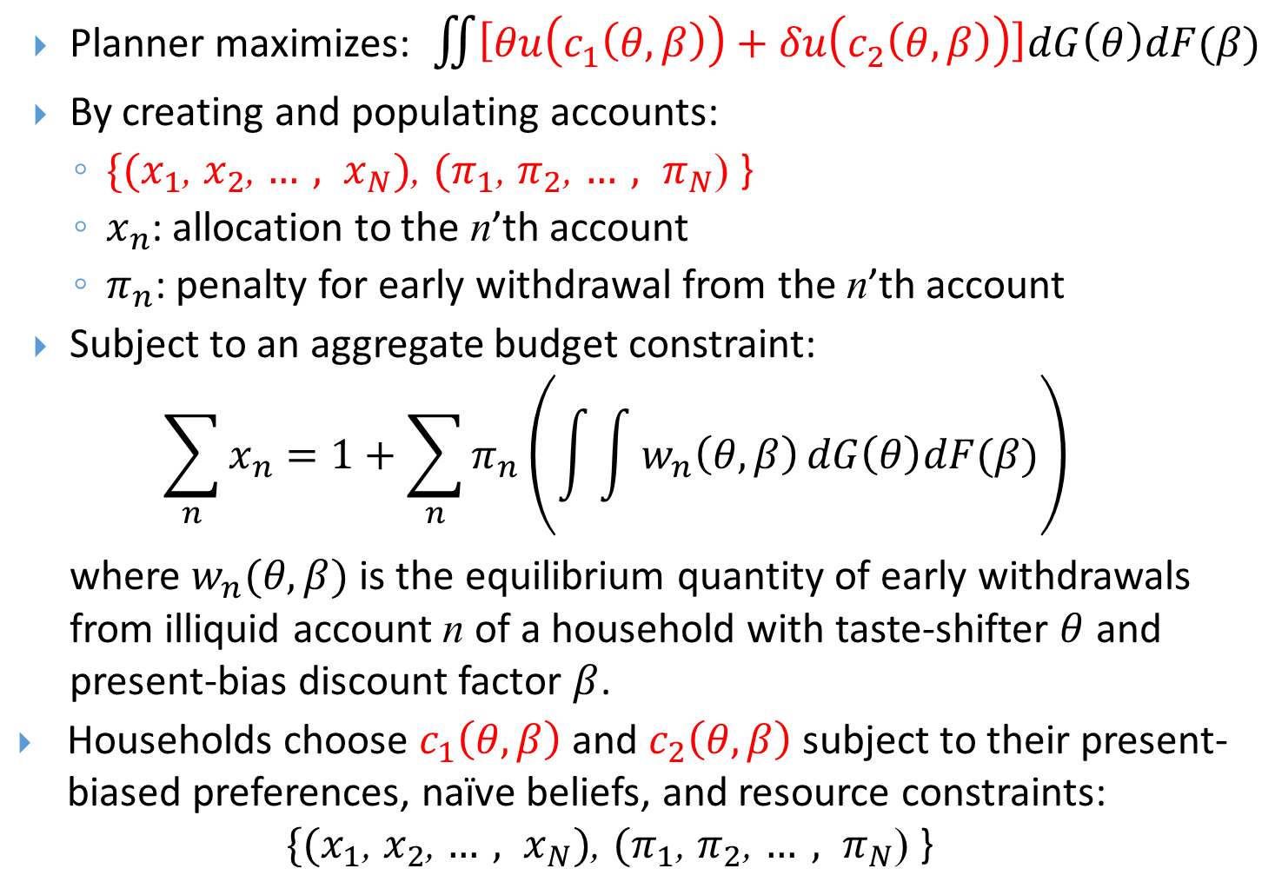
Planner’s optimization problem
Planner maximizes:$\iint{\left[θu\left(c_{1}\left(θ,β\right)\right)+δu\left(c_{2}\left(θ,β\right)\right)\right]dG\left(θ\right)dF(β)}$
By creating and populating accounts:
  $\{{(x}_{1}$, $x_{2}$, $…, x_{N})$, ${(π}_{1}$, $π_{2}$, $…, π_{N}$) }
  $x_{n}$: allocation to the n’th account
  $π_{n}$: penalty for early withdrawal from the n’th account
Subject to an aggregate budget constraint:
$$\sum_{n}{x_{n}=1+\sum_{n}{{π_{n}\left(\int{\int{w_{n}\left(θ,β\right)}dG\left(θ\right)dF(β)}\right)}_{}}}$$
  where $w_{n}(θ,β)$ is the equilibrium quantity of early withdrawals from illiquid account n of a household with taste-shifter $θ$ and present-bias discount factor $β$.
Households choose $c_{1}\left(θ,β\right)$ and $c_{2}\left(θ,β\right)$ subject to their present-biased preferences, naïve beliefs, and resource constraints: $\{{(x}_{1}$, $x_{2}$, $…, x_{N})$, ${(π}_{1}$, $π_{2}$, $…, π_{N}$) }

Slide 66
Sufficient condition for optimality of two accounts with interpersonal transfers.
Theorem:
Let $β∈\left\{0,1\right\},$with arbitrary population weights.
Then the social optimum is a two-account system with
a (completely) liquid account, and
an illiquid account with early withdrawal penalty $π=100\%.$

Slide 67
Intuition:
Start with liquid account and $π=$100% account.
Add an account with $0<π<1$.
The penalty system effectively increases the liquidity of β=0 consumers more than the liquidity of β=1 consumers, which is a perverse welfare effect (that dominates all of the other welfare accounts, including penalty-induced wealth transfers).

Slide 68
Two key properties in this extreme heterogeneous environment
You only need one illiquid account to achieve the (second best) social optimum
That illiquid account should be completely illiquid
These properties won’t hold exactly, as we relax the extreme distributional assumption on β.
But the properties will continue to hold as a good approximation (with heterogeneous β).

Slide 69
$β$uniform on $\left\{.1, .2, .3, .4, .5, .6, .7, .8, .9, 1\right\}$
Start with all money in liquid account: x = 1.
Welfare gain from adding $z_{1}$ with $π_{1}=100\%$:
Welfare gain from adding optimal ${(z}_{2},π_{2}=13\%):$
$$11.01\% wealth$$
0.02% wealth

Slide 70
Subpopulation Expected Utility
$$β=1.0$$
$$β=0.2$$
$$β=0.1$$

Slide 71
Subpopulation Expected Utility
$$β=1.0$$
$$β=0.3$$
$$β=0.3$$
$$β=0.2$$
$$β=0.1$$

Slide 72
Subpopulation Expected Utility
$$β=1.0$$
  See Camerer, Issacharoff, Loewenstein, O’Donoghue & Rabin (2003).
  “Asymmetric Paternalism”
$$β=0.1$$

Slide 73
Population Expected Utility

Slide 74
Allocations and Penalties:

Slide 75
Subpopulation Penalties Paid:

Slide 76
Distribution of self-control: $β$
$$p(β)$$
$$β$$
David
Start with x = 1.
Welfare gain from adding $z_{1}$ with $π_{1}=100\%$: 3.04% wealth
Welfare gain from adding optimal ${(z}_{2},π_{2}=10\%):$0.02% wealth
No self control
Perfect self control

Slide 77
Key findings from calibrated analysis:
Optimal policy is approximated by a two-account system, with one account that is (approximately) completely liquid and a second account that is (approximately) completely illiquid.
Only a small welfare gain is obtained by moving beyond this simple two-account system.
If a third account is added, its optimized early-withdrawal penalty is between 8% and 12%.
In equilibrium, the leakage rate from this (partially illiquid) third account is around 70%.

Slide 78
Table 4: Distribution of $β$
$$p(β)$$
$$β$$
Start with x = 1.
Welfare gain from adding $z_{1}$ with $π_{1}=100\%$: 3.04% wealth
Welfare gain from adding optimal ${(z}_{2},π_{2}=10\%):$0.02% wealth
No self control
Perfect self control

Slide 79
To gain intuition, study the optimal penalty in a system with one fully liquid and one partially illiquid account. We’ll study comparative statics on the partially illiquid account.

Slide 80
Subpopulation Penalties Paid
$$β=0.1$$
$$β=0.2$$
$$β=0.3$$
$$β=0.3$$

Slide 81
Expected utility by type in an economy with one liquid and one partially illiquid account
$$β=1.0$$
$$β=0.3$$
$$β=0.3$$
$$β=0.2$$
$$β=0.1$$

Slide 82
Subpopulation Expected Utility
$$β=1.0$$
  See Camerer, Issacharoff, Loewenstein, O’Donoghue & Rabin (2003).
  “Asymmetric Paternalism”
$$β=0.1$$

Slide 83
Total Population Expected Utility

Slide 84
Allocations and Penalties

Slide 85
Intuitions
Low $β$types have a lot to gain from completely illiquid accounts (consumption smoothing and reduced quantity of penalties paid)
High $β$types have little to lose from completely illiquid accounts (they’ll have smooth consumption no matter what and they won’t pay many penalties no matter what)
For a utilitarian planner, completely illiquid accounts are very appealing.

Slide 86
Robustness illustration
 | Baseline | Low σ(θ) | High σ(θ) | CRRA = 0.5 | CRRA = 2 | High E(β) | Low E(β)
Standard Deviation of θ = σ(θ) | 0.33 | 0.26 | 0.45 | 0.33 | 0.33 | 0.33 | 0.33
Standard Deviation of β = σ(β) | 0.23 | 0.23 | 0.23 | 0.23 | 0.23 | 0.20 | 0.25
Mean of β | 0.73 | 0.73 | 0.73 | 0.73 | 0.73 | 0.79 | 0.70
Welfare Gain From 1st z Account | 3.041 | 3.287 | 2.705 | 3.941 | 1.760 | 1.650 | 4.046
x | 0.539 | 0.524 | 0.565 | 0.577 | 0.519 | 0.547 | 0.535
z=1-x | 0.461 | 0.476 | 0.435 | 0.423 | 0.481 | 0.453 | 0.465
% Penalty on 2nd z Account | 10 | 9 | 9 | 10 | 10 | 9 | 10
Welfare Gain From 2nd z Account | 0.021 | 0.020 | 0.011 | 0.048 | 0.010 | 0.018 | 0.023
x | 0.477 | 0.452 | 0.513 | 0.414 | 0.486 | 0.483 | 0.458
z(1) | 0.081 | 0.081 | 0.058 | 0.185 | 0.038 | 0.074 | 0.088
z(2) | 0.457 | 0.472 | 0.432 | 0.414 | 0.478 | 0.448 | 0.461
Leakage (%) | 57.9 | 66.1 | 48.7 | 59.4 | 57.3 | 51.2 | 62.1
% Illiquid Wealth in 2nd z Account | 15.0 | 14.6 | 11.8 | 30.9 | 7.3 | 14.1 | 15.9

Slide 87
Now add a third account (DC) and measure leakage
 | Baseline | Low σ(θ) | High σ(θ) | CRRA = 0.5 | CRRA = 2 | High E(β) | Low E(β)
σ(θ) | 0.33 | 0.26 | 0.45 | 0.33 | 0.33 | 0.33 | 0.33
σ(β) | 0.23 | 0.23 | 0.23 | 0.23 | 0.23 | 0.20 | 0.25
E(β) | 0.73 | 0.73 | 0.73 | 0.73 | 0.73 | 0.79 | 0.70
Optimal Penalty | 9% | 9 | 9 | 10 | 10 | 9 | 10
Leakage | 74.6% | 66.1 | 48.7 | 59.4 | 57.3 | 51.2 | 62.1
DC/[SS+DC] | 12% | 14.6 | 11.8 | 30.9 | 7.3 | 14.1 | 15.9
Welfare gain from this third account (wealth equivalent) | 0.01%

Slide 88
Some additional questions
“Number” of accounts: 2 vs. N
CRRA
Distribution of β values
Distribution of taste shocks
Functional form of taste shock: θu(c) vs. u(c-θ)
Number of periods: 3 vs. T
Individualization: pooling vs. separation
  See Galperti (2014)
Individualization: is income correlated with β?
And everything else that we did to simplify the problem.
Why do people dislike penalty-based schemes?

Slide 89
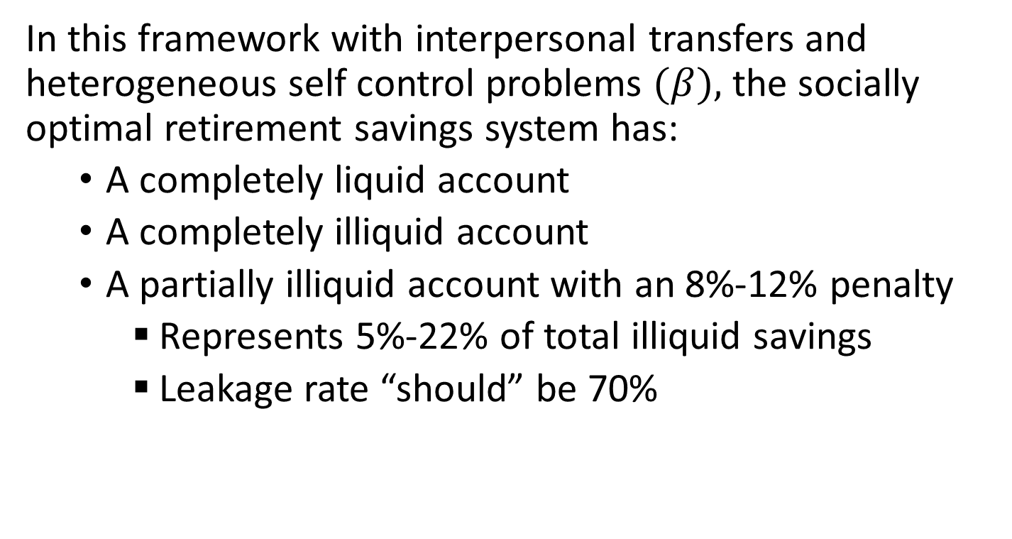
Conclusions
In this framework with interpersonal transfers and heterogeneous self control problems $(β),$ the socially optimal retirement savings system has:
  A completely liquid account
  A completely illiquid account
  A partially illiquid account with an 8%-12% penalty
    Represents 5%-22% of total illiquid savings
    Leakage rate “should” be 70%

Slide 90
In addition:
The calibrated model (with heterogeneous β) implies that the 10% penalty account isn’t important for welfare
Explaining why we don’t see such accounts in the UK
Almost all of the welfare gains come from the existence of fully illiquid retirement accounts
In this analysis, hard paternalism plays the critical role.

Slide 91
We tried to write a normative paper.
  “What is the socially optimal degree of illiquidity in a retirement savings system?”
We ended up with a positive paper.
  “The two types of illiquid accounts in the U.S. system are what you would predict from a perfectly rational planner.”†
  †The US may be getting the types of illiquidity right, but not the volume of illiquid assets.

Slide 92
Two centuries of policy
Laissez Faire (19th century)
Emerging paternalism (early 20th century)
  Defined benefit pensions
Age of Choice (late 20th century)
  Defined contribution pensions
4. Behavioral welfare economics (optimal behavioral policy)
  Laibson, Repetto, Tobacman (1998); Laibson (1998); O’Donoghue and Rabin (1999); Camerer, Issacharoff, Loewenstein, O‘Donoghue, & Rabin (2003); Choi, Laibson, Madrian, Metrick (2003); O’Donoghue and Rabin (2005); Amador, Werning, and Angeletos (2006); Beshears, Choi, Laibson, Madrian (2008); Choi, Laibson, Madrian, and Metrick (2009); Alcott and Taubinksy (2015); Lockwood (2015); Farhi and Gabaix (2015); Beshears, Choi, Clayton, Harris, Laibson, Madrian (2015)

Slide 93
Behavioral welfare economics
A positive theory of human behavior (imperfect rationality, self-control problems, and nudge elasticities are all part of that theory).
A normative criterion: the planner’s welfare function (usually not revealed preferences).
Derivation of the policies/institutions that maximize “2” subject to the constraints imposed by “1.”
Are we willing to go where the analysis takes us?

Slide 94
Third Example: EITC
(Earned Income Tax Credit)
Lockwood (2016)
What is the optimal income tax system?
Can we explain negative income taxes?
Note that standard redistribution motives (without present bias) lead the planner to give low income workers a lump sum transfer, not a negative income tax.

Slide 95
Basic ingredients of the model.
Labor supply is endogenous and ability is unobservable by the government.
Planner is not present-biased.
Households are present biased.
Low income households have the most present bias.

Slide 96
Notation for planner’s problem:
Ability
(unobservable)
Fixed cost of working
Consumption
Income
Planner’s
objective
Welfare
weight
Tax
function
CDF
of ability

Slide 97
Household’s optimization problem
(with present bias).
Present bias at the household level

Slide 98
Heterogeneous present bias

Slide 100
Summary of behavioral mechanism design
Specify a positive theory of consumer/firm behavior (consumers and/or firms may not behave optimally).
Specify a social welfare function (not necessarily based on revealed preference)
Solve for the institutional structure that maximizes the social welfare function, conditional on the theory of consumer/firm behavior.
Examples: Optimal defaults, illiquidity, and taxation.

