Slide 1


Intertemporal Choice Applications
and Behavioral Mechanism Design
or
July 1, 2014
David Laibson
Harvard University and NBER

Slide 2
1. Motivating thought experiment
Would you like to have
15 minute massage now
or
B) 20 minute massage in an hour
Would you like to have
C) 15 minute massage in a week
or
D) 20 minute massage in a week and an hour

Slide 3
Outline
Preference reversals
Commitment
Other types of studies

Slide 4
1. Preference reversals
Quasi-hyperbolic discounters will tend to choose patiently when choosing for the future and impatiently when choosing for the present.

Slide 5
Read, Loewenstein & Kalyanaraman (1999)
Choose among 24 movie videos
Some are “low brow”: Four Weddings and a Funeral
Some are “high brow”: Schindler’s List
Picking for tonight: 66% of subjects choose low brow.
Picking for next Tuesday: 37% choose low brow.
Picking for second Tuesday: 29% choose low brow.
Tonight I want to have fun… next week I want things that are good for me.

Slide 6
Quasi-hyperbolic interpretation
Suppose that “Weddings” has immediate benefit of 7.
Suppose that “Schindler” has immediate benefit of 4 and delayed benefit of 4.

Slide 7
Read and van Leeuwen (1998)
Choosing Today
Eating Next Week
Time
If you were
deciding today,
would you choose
fruit or chocolate
for next week?

Slide 8
Patient choices for the future:
Choosing Today
Eating Next Week
Time
Today, subjects
typically choose
fruit for next week.
74%
choose
fruit

Slide 9
Impatient choices for today:
Choosing and Eating
Simultaneously
Time
If you were
deciding today,
would you choose
fruit or chocolate
for today?

Slide 10
Time Inconsistent Preferences:
Choosing and Eating
Simultaneously
Time
70%
choose
chocolate

Slide 11
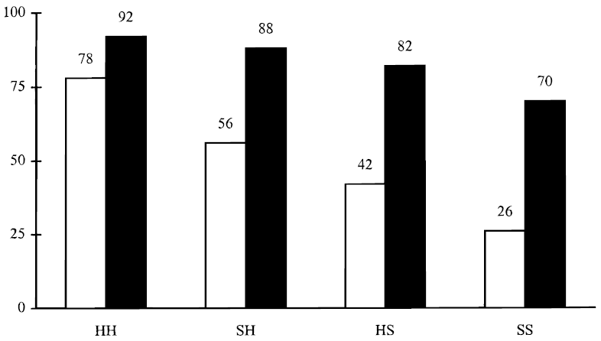
Percentage unhealthy snacks chosen
H = hungry (late afternoon)
S = sated (just after lunch)
immediate
immediate
immediate
immediate
advance
advance
advance
advance

Slide 12
See Badger et al (2007) for a related example with heroin addicts given the time-dated reward of buprenorphine (“bup”), a heroin partial agonist
small sample warning (n=13)

Slide 13
Quasi-hyperbolic interpretation
Suppose that fruit has immediate benefit of 1/2.
Suppose that chocolate has immediate benefit of 1 and delayed cost of 2/3.

Slide 14
Extremely thirsty subjects
McClure, Ericson, Laibson, Loewenstein and Cohen (2007)
Choosing between, juice now or 2x juice in 5 minutes 60% of subjects choose first option.
Choosing between juice in 20 minutes or 2x juice in 25 minutes 30% of subjects choose first option.
We estimate that the 5-minute discount rate is 50% and the “long-run” discount rate is 0%.
Ramsey (1930s), Strotz (1950s), & Herrnstein (1960s) were the first to understand that discount rates are higher in the short run than in the long run.

Slide 15
Recovering heroin addicts and Buprenorphine (BUP)
Badger et al (2007)
Monetary equivalent of an extra does of BUP
 | Immediate | Delayed (+5)
Satiated | $50 | $35
Deprived | $75 | $60
Methodology alert: 13 heroin addicts are the only participants in this study

Slide 16
Recovering heroin addicts
Badger et al (2007)
Monetary equivalent of an extra does of BUP
 | Immediate | Delayed (+5)
Satiated | $50 | $35
Deprived | $75 | $60

Slide 17
A bit of math
If you want to relate a discount factor, δ, to a discount rate, remember that if
then,

Slide 18
Money now vs. money later
Thaler (1981)
Hypothetical rewards (but many experiments use real rewards)
Baseline exponential discounting model: Y = δ ^{t} X
So -lnδ = (1/t) ln [X/Y], remember that t is in units of yrs
What amount makes you indifferent between $15 today and $X in 1 month?
  X = 20
  -lnδ = (1/t) ln [X/15] = 12 ln [X/15] = 345% per year
What amount makes you indifferent between $15 today and $X in ten years?
  X = 100
  -lnδ = (1/t) ln [X/15] = (1/10) ln [X/15] = 19% per year

Slide 19
But … “money earlier vs. money later” (MEL) has so many confounds
(Chabris, Laibson, and Schuldt 2009)
Unreliability of future rewards (trust; bird in the hand; Andreoni and Sprenger 2010)
Investment vs. consumption (money receipt at date t is not time-stamped utils event at date t)
Transaction costs (especially when asymmetric)
Curvature of utility function (see Harrison et al for partial fixes)
Framing and demand characteristics (e.g., response scale; Beauchamp et al 2013)
Sub-additivity (Read, 2001; Benhabib, Bisin, and Schotter 2008)
(Hypothetical rewards)
Psychometric heuristics (Rubinstein 1988, 2003; Read et al 2011; White et al 2014)

Slide 20
Why are money questions unsuited to measuring discounting even in theory?
If an agent is not liquidity constrained, she should maximize NPV when asked about money now vs. money later.
Note that NPV is based on market interest rates, not time preferences.
After maximizing NPV, she should pick her indifference point using time preferences.

Slide 21
Separation theorem: pick payment to maximize NPV, regardless of time preference (then locate along efficient frontier)
Later
$7 later
o
o
slope = -(1+r)
o
$5 now
Now

Slide 22
White, Ericson, Laibson, and Cohen (2014)
(see also Read, Frederick and Scholten 2013)
Proportional reasoning explains inter-temporal choices in MEL tasks much better than discounting models (including present-biased discounting).
Probability of choosing larger, later reward (x₂,t₂) over smaller, earlier reward (x₁,t₁).
Improvement of 6 percentage points of predictive accuracy in cross-validation study (i.e., out of sample prediction)

Slide 23
Augenblick, Niederle, and Sprenger (2012)
“Three period work experiment: 0, 2, 3”
At date 0: How hard do you want at work at 2 and at 3?
At date 2: How hard do you want to work at 2 and at 3?
At date 2, subjects tend to shift work from 2 to 3.
Estimated parameters: β = 0.927; δ = 0.997
Subjects are willing to commit at date 0 (48/80 commit).
For those who commit: β = 0.881; δ = 1.004

Slide 24
Augenblick, Niederle, and Sprenger (2012)
“Three period money experiment: 1, 4, 7”
At date 1: How much money do you want at 4 and at 7?
At date 4: How much money do you want at 4 and at 7?
At date 4, subjects don’t shift money to 4 from 7.
Estimated parameters: β = 0.974; δ = 0.998.

Slide 25
Augenblick, Niederle, and Sprenger (2012)
Limited preference reversals in the domain of money (as predicted by the model of present bias)
Present bias observed in the “consumption” version of the experiment.

Slide 26
Outline
Preference reversals
Commitment
Other evidence

Slide 27

Stickk
Ayres, Goldberg and Karlan: Stickk.com

Slide 28
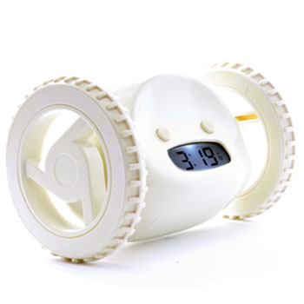
Clocky

Slide 29
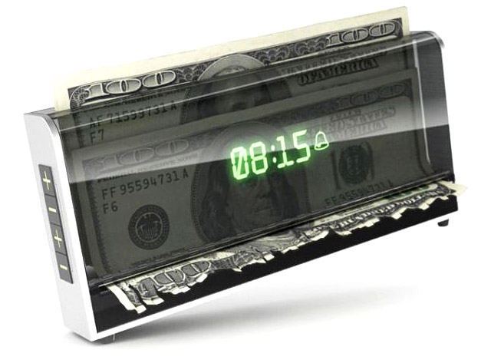
Shreddy™

Slide 30
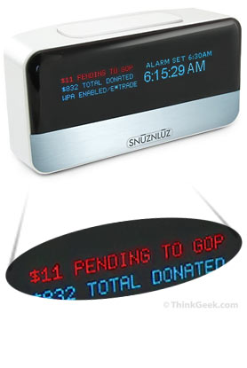
SNUZ N LUZ

Slide 31

Tocky

Slide 32
Ashraf, Karlan, and Yin (2006)
Offered a commitment savings product to randomly chosen clients of a Philippine bank
28.4% take-up rate of commitment product (either date-based goal or amount-based goal)
More “hyperbolic” subjects are more likely to take up the product
After twelve months, average savings balances increased by 81% for those clients assigned to the treatment group relative to those assigned to the control group.

Slide 33
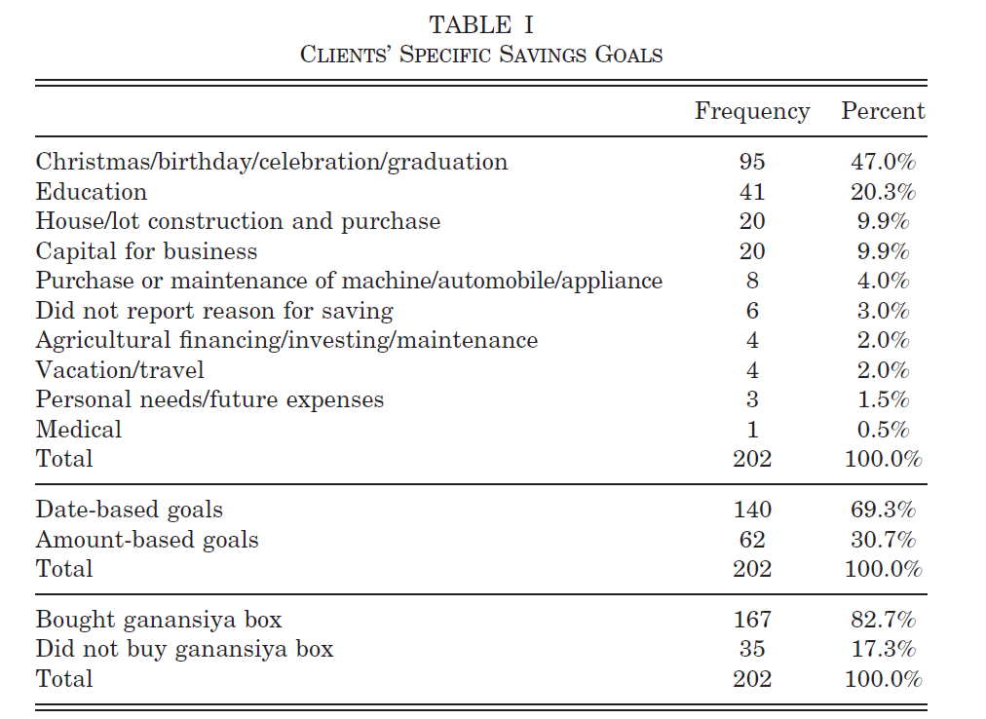

Slide 34
Gine, Karlan, Zinman (2009)
Tested a voluntary commitment product (CARES) for smoking cessation.
Smokers offered a savings account in which they deposit funds for six months, after which take urine tests for nicotine and cotinine.
If they pass, money is returned; otherwise, forfeited
11% of smokers offered CARES take it up, and smokers randomly offered CARES were 3 percentage points more likely to pass the 6-month test than the control group
Effect persisted in surprise tests at 12 months.

Slide 35
Kaur, Kremer, and Mullainathan (2010):
Compare two piece-rate contracts:
  Linear piece-rate: w per unit produced
  Linear piece-rate with penalty if worker does not achieve production target T (“Commitment”)
    Earn w/2 for each unit produced if production < T
    Jump up at T, returning to baseline contract
Earnings
Never earn more under commitment contract
May earn ½ as much
Production
T
Notes:
Consider an employee working on a simple piece rate activity – like a repetitive task done many times
Many examples like this: supermarket checkout / cashier, assembly line worker, delivery person, salesperson, data entry operator, just to name a few.
Compare 2 types of contracts the employee could be offered:
Give the employee wage w for every unit of work that she does (blue line on the graph)
Give the employee w if she meets some production target T, give her w/2 if she falls below target (red line on the graph)
- Notice the employee can never earn more under the commitment contract, and may earn much less if she fails to meet target

Slide 36
Kaur, Kremer, and Mullainathan (2012):
Demand for Commitment: Commitment contract (Target > 0) chosen 35% of the time
Effect on Production: Being offered commitment contract increases average production by 2.3% relative to control
Among all participants, being offered the commitment contract is equivalent (in output effect) to a 7% increase in the piece-rate wage
Participants above the mean pay-day cycle sensitivity are 49% more likely to demand commitment and their productivity increase is 9% (equivalent to a 27% increase in wage)
Notes:
These are coefficient estimates from regressions with controls
Demand for commitment regression – evening/morning inference:
chose_commitment = const + eve_choice_dummy + lag_prodn + lag_prodn*eve_choice + {controls including FE for employees, day of week, week #}
Effect on production regression – effect on output:
production = const + choice_dummy + lag_prodn + lag_prodn*choice + {controls including FE for employees, day of week, week #}
Payday results:
Overall, there is not a huge difference in average demand for commitment contracts on paydays vs non-paydays.
However, there is a big difference in the likelihood of picking in the morning/evening on paydays vs. non-paydays. Basically, on non-paydays, people are more likely to choose commitment in advance (i.e. the evening before). However, the opposite is true on paydays – if people know Tuesday is their payday, they are much more likely to choose a commitment contract for Tuesday on Tuesday morning than on Monday evening.

Slide 37
Houser, Schunk, Winter, and Xiao (2010)
In a laboratory setting, 36.4% of subjects are willing to use a commitment device to prevent them from surfing the web during a work task

Slide 38
Royer, Stehr, and Sydnor (2011)
Commit to go to the gym at least once every 14 calendar days (8 week commitment duration)
Money at stake is choice of participant.
Money donated to charity in event of failure.
Fraction taking commitment contract:
  Full sample: 13%
  Gym Members: 25%
  Gym Non-members: 6%
Average commitment = $63; max = $300, 25th pct = $20; 75th pct = $100.

Slide 39
Ariely and Wertenbroch (2002)
Proofreading tasks: "Sexual identity is intrinsically impossible," says Foucault; however, according to de Selby[1], it is not so much sexual identity that is intrinsically impossible, but rather the dialectic, and some would say the satsis, of sexual identity. Thus, D'Erlette[2] holds that we have to choose between premodern dialectic theory and subcultural feminism imputing the role of the observor as poet.“
Evenly spaced deadlines ($20)
Self-imposed deadlines ($13)
  subjects in this condition could self-impose costly deadlines ($1 penalty for each day of delay) and 37/51 do so.
End deadline ($5)

Slide 40
Alsan, Armstrong, Beshears, Choi, del Rio,
Laibson, Madrian and Marconi (2014)
Voluntary Commitment Arm
Low Hurdle Arm
Get paid $30 per clinical visit, only if you are
medically adherent
Get paid $30 per clinical visit, whether or not you are medically adherent.
Get paid $30 per clinical visit, whether or not you are medically adherent.
32%
68%
small sample warning (n=40)
Notes:
Here is the visual we have been using in the prepilot survey to clarify the two different plans.

Slide 41
Voluntary commitment arm
Low hurdle arm

Slide 42
How to design a commitment contract
Participants divide $$$ between:
Freedom account (22% interest)
Goal account (22% interest)
  withdrawal restriction
Beshears, Choi, Harris, Laibson, Madrian, Sakong (2014)

Slide 43
Initial investment in goal account
Goal Account
10% penalty
35%
Freedom
Account
65%
Goal account
20% penalty
43%
Freedom
Account
57%
Goal account
No withdrawal
56%
Freedom
Account
44%

Slide 44
Now participant can divided their money across three accounts:
(i) freedom account
(ii) goal account with 10% penalty
(iii) goal account with no withdrawal
49.9% allocated to freedom account
16.2% allocated to 10% penalty account
33.9% allocated to no withdrawal account
Beshears, Choi, Harris, Laibson, Madrian, Sakong (2014)

Slide 45
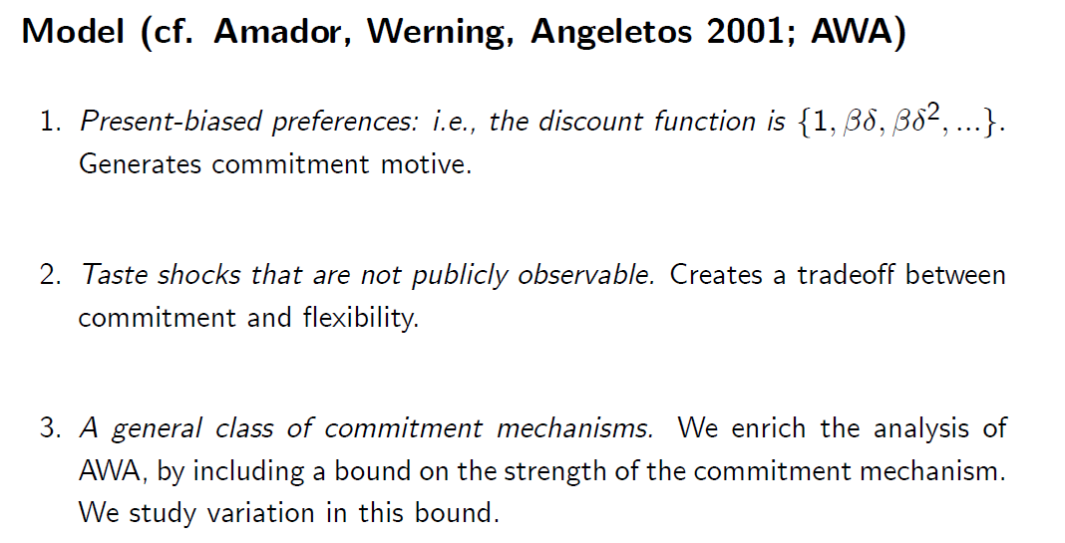
Beshears, Choi, Harris, Laibson, Madrian, Sakong (2012)

Slide 46
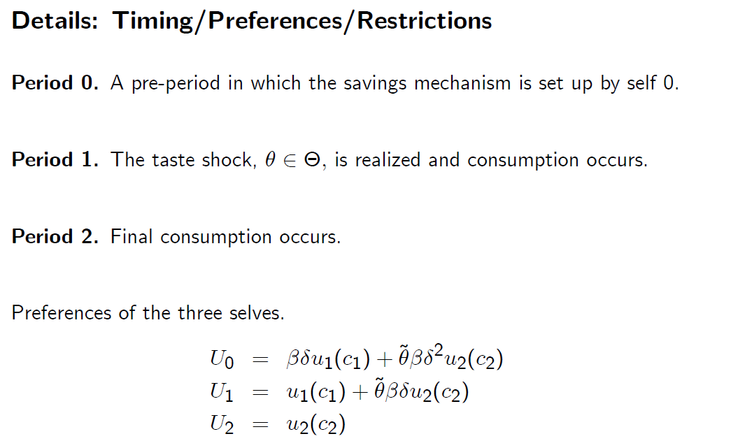
Fix timing

Slide 47
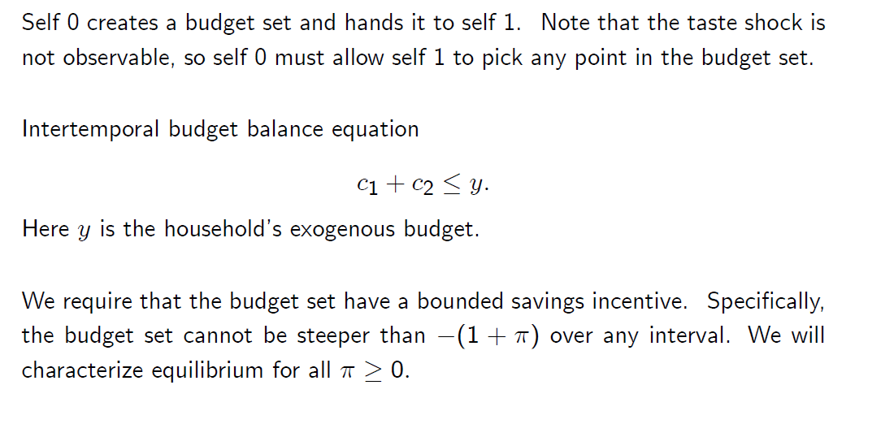

Slide 48
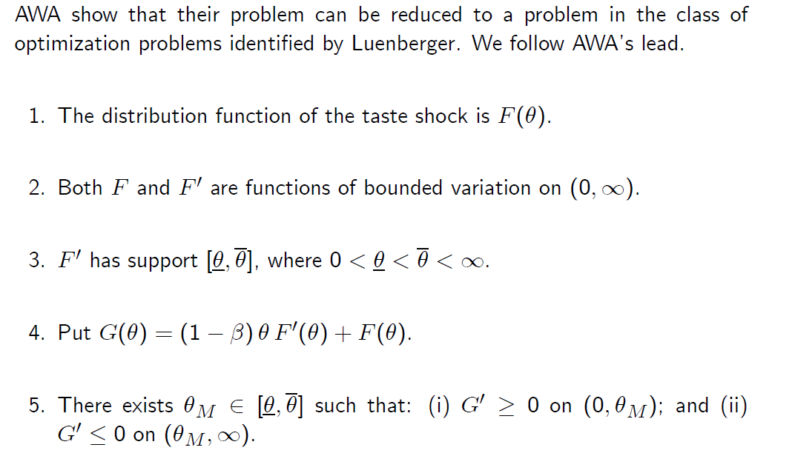

Slide 49
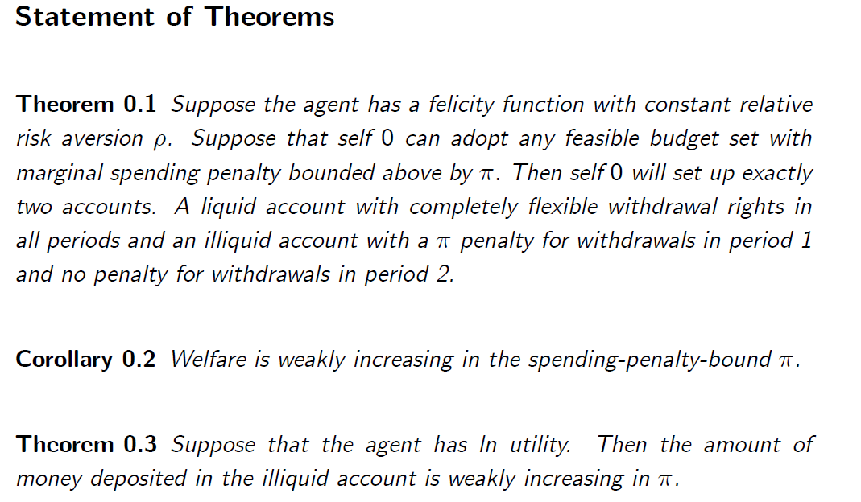

Slide 50
Outline
Preference reversals
Commitment
Other evidence

Slide 51
Dellavigna and Malmendier (2004, 2006)
Average cost of gym membership: $75 per month
Average number of visits: 4
Average cost per vist: $19
Cost of “pay per visit”: $10

Slide 52
Oster and Scott-Morton (2004)
People (and other vice magazines) sold on the news stand at a high price relative to subscription
Foreign Affairs (and other investment magazines) sold on the news stand at a low price relative to subscription
But People (and other vice magazines) sold disproportionately on the news stand and Foreign Affairs (and other investment magazines) sold disproportionately by subscription.

Slide 53
Sampling of other studies
Della Vigna and Paserman (2005): job search
Duflo (2009): immunization
Duflo, Kremer, Robinson (2009): commitment fertilizer
Truck driver study
Milkman et al (2008): video rentals return sequencing
Sapienza and Zingales (2008,2009): procrastination
Trope & Fischbach (2000): commitment to medical adherence
Wertenbroch (1998): individual packaging of temptation goods

Slide 54
Household finance studies
Angeletos, Laibson, Repetto, Tobacman, and Weinberg (2001)
Della Vigna and Paserman (2005): job search
Duflo, Kremer, Robinson (2009): commitment fertilizer
Meier and Sprenger (2010): correlation with credit card borrowing
Shui and Ausubel (2006): credit cards
Shapiro (2005): consumption cycle over month
Mastrobuoni and Weinberg (2009): consumption cycle over the month
Laibson, Repetto, and Tobacman (2012): MSM estimation using wealth and debt moments
Kuchler (2014): credit card debt paydown

Slide 55
Outline
Preference reversals
Commitment
Other types of studies

Slide 56
END LECTURE HERE

Slide 57
Shapiro (2005)
For food stamp recipients, caloric intake declines by 10-15% over the food stamp month.
To be resolved with exponential discounting, requires an annual discount factor of 0.23
Survey evidence reveals rising desperation over the course of the food stamp month, suggesting that a high elasticity of intertemporal substitution is not a likely explanation.
Households with more short-run impatience (estimated from hypothetical intertemporal choices) are more likely to run out of food sometime during the month.

Slide 58
The data can reject a number of alternative hypotheses.
Households that shop for food more frequently do not display a smaller decline in intake over the month, casting doubt on depreciation stories.
Individuals in single-person households experience no less of a decline in caloric intake over the month than individuals in multi-person households.
Survey respondents are not more likely to eat in another person’s home toward the end of the month.
The data show no evidence of learning over time

Slide 59
Social security
Mastrobuoni and Weinberg (2009)
Individuals with substantial savings smooth consumption over the monthly pay cycle
Individuals without savings consume 25 percent fewer calories the week before they receive checks relative to the week afterwards

Slide 60
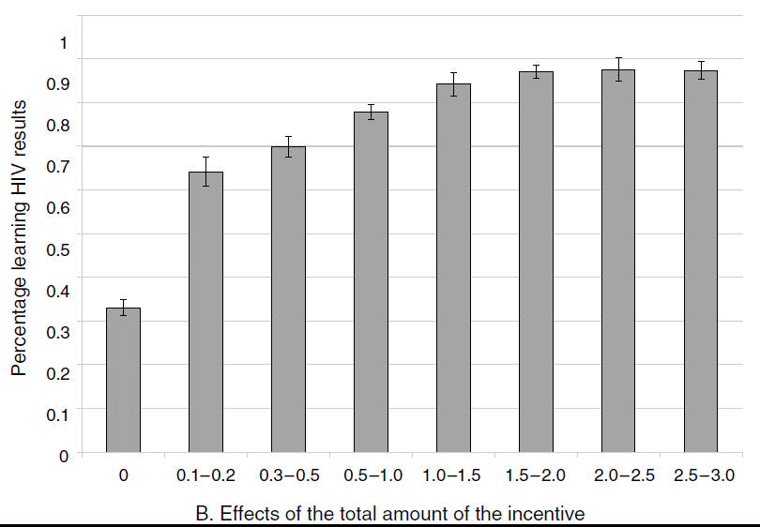
Small immediate rewards: Thornton (2005)
Dollar reward for picking up results

Slide 61
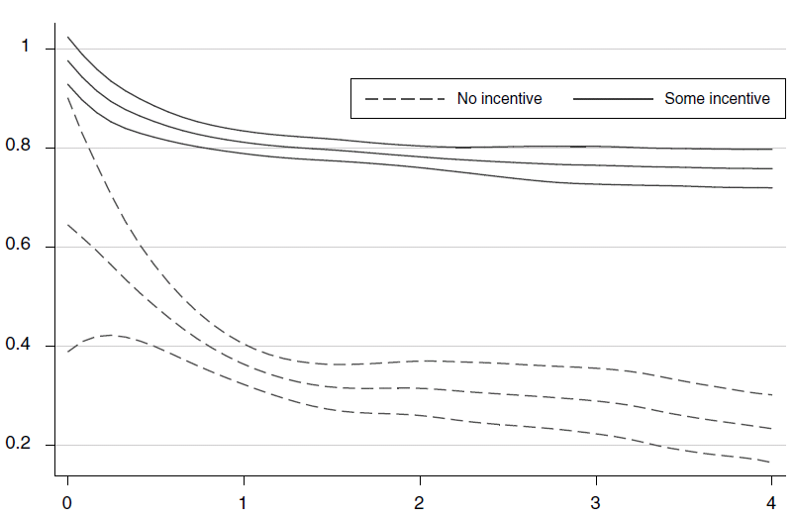
Small immediate costs: Thornton (2005)
Fraction picking up info on HIV status
Randomized distance (miles) to pick up info

Slide 62
Laibson, Repetto, and Tobacman (2007)
Use MSM to estimate discounting parameters:
  Substantial illiquid retirement wealth: W/Y = 3.9.
  Extensive credit card borrowing:
    68% didn’t pay their credit card in full last month
    Average credit card interest rate is 14%
    Credit card debt averages 13% of annual income
  Consumption-income comovement:
    Marginal Propensity to Consume = 0.23
    (i.e. consumption tracks income)

Slide 63
LRT Simulation Model
Stochastic Income
Lifecycle variation in labor supply (e.g. retirement)
Social Security system
Life-cycle variation in household dependents
Bequests
Illiquid asset
Liquid asset
Credit card debt
Numerical solution (backwards induction) of 90 period lifecycle problem.

Slide 64
LRT Results:
U_{t} = u_{t} + β [δu_{t+1} + δ²u_{t+2} + δ³u_{t+3} + ...]
β = 0.70 (s.e. 0.11)
δ = 0.96 (s.e. 0.01)
Null hypothesis of β = 1 rejected (t-stat of 3).
Specification test accepted.
Moments:
Empirical Simulated (Hyperbolic)
%Visa: 68% 63%
Visa/Y: 13% 17%
MPC: 23% 31%
f(W/Y): 2.6 2.7

Slide 65
LRT Intuition
Long run discount rate is –ln(δ) = 4%, so save in long-run (illiquid) assets.
Short-run discount rate is –ln(βδ) = 40%, so borrow on your credit card today.
Indeed, you might even borrow on your credit card so you can “afford” to save in your 401(k) account.

Slide 66
Defaults and Participation
Madrian and Shea (2001): first paper in literature
Beshears et al (2010): below
Notes:
66

Slide 67
Default Stickiness
Notes:
67

Slide 69
Summary: participation in 401K plans
(for a typical firm)
Default non-enrollment (opt in)
40%
Quick Enrollment
(“check a box”)
50%
Active choice (perceived req’t to choose)
70%
Default enrollment (opt out)
90%
Participation Rate (1 year of tenure)

Slide 70
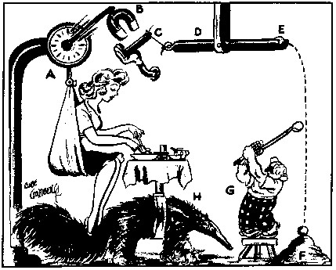
Outline
Preference reversals
Commitment
Other evidence
Behavioral Mechanism Design

Slide 71
Behavioral mechanism design
Specify a social welfare function (not necessarily based on revealed preference)
Specify a theory of consumer/firm behavior (consumers and/or firms may not behave optimally).
Solve for the institutional regime that maximizes the social welfare function, conditional on the theory of consumer/firm behavior.

Slide 72
Today:
Two examples of behavioral mechanism design
  A. Optimal defaults
  B. Optimal illiquidity

Slide 73
A. Optimal Defaults – public policy
Mechanism design problem in which policy makers set a default for agents with present bias
Carroll, Choi, Laibson, Madrian and Metrick (2009)

Slide 74
Basic set-up of problem
Specify (dynamically consistent) social welfare function of planner (e.g., set β=1)
Specify behavioral model of households
  Flow cost of staying at the default
  Effort cost of opting-out of the default
  Effort cost varies over time → option value of waiting to leave the default
  Present-biased preferences → procrastination
Planner picks default to optimize social welfare function

Slide 75
Specific Details
Agent needs to do a task (once).
  Switch savings rate, s, from default, d, to optimal savings rate,
Until task is done, agent losses per period.
Doing task costs c units of effort now.
  Think of c as opportunity cost of time
Each period c is drawn from a uniform distribution on [0,1].
Agent has present-biased discount function with β < 1 and δ = 1.
So discount function is: 1, β, β, β, …
Agent has sophisticated (rational) forecast of her own future behavior. She knows that next period, she will again have the weighting function 1, β, β, β, …

Slide 76
Timing of game
Period begins (assume task not yet done)
Pay cost θ (since task not yet done)
Observe current value of opportunity cost c (drawn from uniform distribution)
Do task this period or choose to delay again?
It task is done, game ends.
If task remains undone, next period starts.
Pay cost θ
Observe current value of c
Do task or delay again
Period t-1
Period t
Period t+1

Slide 77
Sophisticated procrastination
There are many equilibria of this game.
Let’s study the equilibrium in which sophisticates act whenever c < c*. We need to solve for c*.
Let V represent the expected undiscounted cost if the agent decides not to do the task at the end of the current period t:
Likelihood of doing it in t+1
Likelihood of not doing it in t+1
Cost you’ll pay for certain in t+1, since job not yet done
Expected cost conditional on drawing a low enough c* so that you do it in t+1
Expected cost starting in t+2 if project was not done in t+1

Slide 78
In equilibrium, the sophisticate needs to be exactly indifferent between acting now and waiting.
Solving for c*, we find:
Expected delay is:

Slide 80
How does introducing β < 1 change the expected delay time?
If β=2/3, then the delay time is scaled up by a factor of
In other words, it takes times longer than it “should” to finish the project

Slide 81
V vs. V hat

Slide 82
A model of procrastination: naifs
Same assumptions as before, but…
Agent has naive forecasts of her own future behavior.
She thinks that future selves will act as if β = 1.
So she (mistakenly) thinks that future selves will pick an action threshold of

Slide 83
In equilibrium, the naif needs to be exactly indifferent between acting now and waiting.
To solve for V, recall that:

Slide 84
Substituting in for V:
So the naif uses an action threshold (today) of
But anticipates that in the future, she will use a higher threshold of

Slide 85
So her (naïve) forecast of delay is:
And her actual delay will be:
Being naïve, scales up her delay time by an additional factor of 1/β.

Slide 86
Summary
If β = 1, expected delay is
If β < 1 and sophisticated, expected delay is
If β < 1 and naïve, anticipated delay is
If β < 1 and naïve, true delay is

Slide 87
That completes theory of consumer behavior.
Now solve for government’s optimal policy.
Now we need to solve for the optimal default, d.
Note that the government’s objective ignores present bias, since it uses V as the welfare criterion.

Slide 88
Optimal ‘Defaults’
Two classes of optimal defaults emerge from this calculation
  Automatic enrollment
    Optimal when employees have relatively homogeneous savings preferences (e.g. match threshold) and relatively little propensity to procrastinate
  “Active Choice” — require individuals to make a choice (eliminate the option to passively accept a default)
    Optimal when employees have relatively heterogeneous savings preferences and relatively strong tendency to procrastinate
Key point: sometimes the best default is no default.

Slide 89
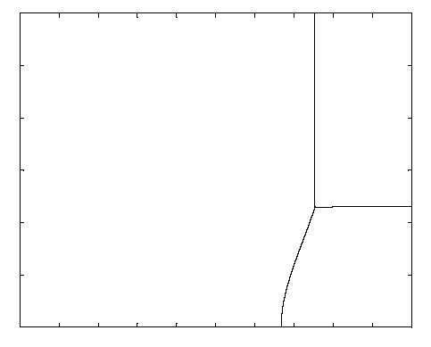
Preference Heterogeneity
30%
Low Heterogeneity High Heterogeneity
Offset
Default
Active Choice
Center
Default
0%
0
Beta
1

Slide 90
Lessons from theoretical analysis of defaults
  Defaults should be set to maximize average well-being, which is not the same as saying that the default should be equal to the average preference.
  Endogenous opting out should be taken into account when calculating the optimal default.
  The default has two roles:
    causing some people to opt out of the default (which generates costs and benefits)
    implicitly setting savings policies for everyone who sticks with the default

Slide 91
Empirical evidence on active choice
Carroll, Choi, Laibson, Madrian, Metrick (2009)
Active choice mechanisms require employees to make an active choice about 401(k) participation.
Welcome to the company
You are required to submit this form within 30 days of hire, regardless of your 401(k) participation choice
If you don’t want to participate, indicate that decision
If you want to participate, indicate your contribution rate and asset allocation
Being passive is not an option

Slide 93
Active choice in 401(k) plans
Active decision raises 401(k) participation.
Active decision raises average savings rate by 50 percent.
Active decision doesn’t induce choice clustering.
Under active decision, employees choose savings rates that they otherwise would have taken three years to achieve. (Average level as well as the multivariate covariance structure.)

Slide 94
Other active choice interventions
Active choice in asset allocation (Choi, Laibson, and Madrian 2009)
Active choice in home delivery of chronic medications (Beshears, Choi, Laibson, Madrian 2011)

Slide 95
The Flypaper Effect in Individual Investor Asset Allocation (Choi, Laibson, Madrian 2009)
Studied a firm that used several different match systems in their 401(k) plan.
I’ll discuss two of those regimes today:
Match allocated to employer stock and workers can reallocate
  Call this “default” case (default is employer stock)
Match allocated to an asset actively chosen by workers; workers required to make an active designation.
  Call this “active choice” case (workers must choose)
Economically, these two systems are identical.
They both allow workers to do whatever the worker wants.

Slide 96
Consequences of the two regimes
Balances in employer stock
 |  | Match Defaults into Employer Stock | Active choice
 | Own Balance in Employer Stock | 24% | 20%
 | Matching Balance in Employer Stock | 94% | 27%
 | Total Balance in Employer Stock | 56% | 22%

Slide 97
Use Active Choice to encourage adoption of Home Delivery of chronic medication
Beshears, Choi, Laibson, and Madrian (2012)
Voluntary
No plan design change
Lower employee co-pay
Time saving for employee
Lower employer cost
Better medication adherence
Improved safety
Member Express Scripts Scientific Advisory Board
(Payments donated to charity by Express Scripts.)
Member Express Scripts Scientific Advisory Board
(All payments donated to charity.)

Slide 98
Results from pilot study on 54,863 employees without home delivery taking chronic medication
Among those making an active choice:
Fraction choosing home delivery: 52.2%
Fraction choosing standard pharmacy pick-up: 47.8%

Slide 99
Results from pilot study at one company
Rxs by Mail*
After
Annual Savings at pilot company
Plan | $350,000+
Members | $820,000+
Total Savings | $1,170,000+
Before
* Annualized

Slide 100
B. Optimal illiquidity
  Beshears, Choi, Harris, Laibson, Madrian, and Sakong (2013)

Slide 101
Basic set-up of problem
Specify (dynamically consistent) social welfare function of planner (e.g., set β=1)
Specify behavioral model of households
  Present-biased consumption and (privately observed) high frequency taste shocks
  Planner can’t distinguish legitimate consumption responding to a taste shock, and illegitimate consumption driven by present bias.
Planner picks default to optimize social welfare function

Slide 102
Theory
Generalization of Amador, Werning and Angeletos (2001), hereafter AWA:
Present-biased preferences
Short-run taste shocks.
A general commitment technology.

Slide 103
Timing
Period 0. An initial period in which a commitment mechanism is set up by self 0.
Period 1. A taste shock, θ, is realized and privately observed. Consumption (c₁) occurs.
Period 2. Final consumption (c₂) occurs.

Slide 104
Preferences
U₀ = βδθ u₁(c₁) + βδ² u₂(c₂)
U₁ = θ u₁(c₁) + βδ u₂(c₂)
U₂ = u₂(c₂)
We restrict the distribution of θ, but this restriction admits all commonly used single-peaked densities.

Slide 105
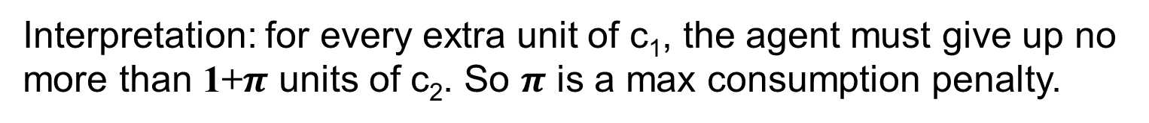
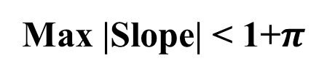
Self 0 hands self 1 a budget set
(subset of blue region)
c₂
y
Max |Slope| < 1+$π$
Budget set
y
c₁
Interpretation: for every extra unit of c₁, the agent must give up no more than 1+$π$ units of c₂. So $π$ is a max consumption penalty.

Slide 106
Two-part budget set
c₂
c₁

Slide 107
Theorem 1
Assume:
Constant relative risk aversion utility
Penalty bounded above by π
Then, self 0 will set up two accounts:
Fully liquid account
Illiquid account with penalty π.

Slide 108
Theorem 2:
Assume log utility.
Then the amount of money deposited in the illiquid account rises with the early withdrawal penalty.

Slide 109
Goal account usage
(Beshears et al 2013)
Goal Account
10% penalty
35%
Freedom
Account
65%
Goal account
20% penalty
43%
Freedom
Account
57%
Goal account
No withdrawal
56%
Freedom
Account
44%

Slide 110
Theorem 3 (AWA):
Assume self 0 can pick any consumption penalty.
Then self 0 will set up two accounts:
fully liquid account
fully illiquid account (no withdrawals in period 1)

Slide 111
Corollary
Assume there are three accounts:
one liquid
one with an intermediate withdrawal penalty
one completely illiquid
Then all assets will be allocated to the liquid account and the completely illiquid account.

Slide 112
When three accounts are offered
Goal account
No withdrawal
Freedom
Account
33.9%
16.2%
49.9%
Goal Account
10% penalty

Slide 113
Potential implications for the design of a retirement saving system?
401(k) plans allow withdrawals (10% tax penalty) – is this the right balance between commitment and liquidity?
How would household respond if 401(k) plans added another option – an illiquid account?
Would they take it up and would this reduce leakage and raise welfare?
What would an optimal system look like if at least some households are naïve?

Slide 114
Summary of behavioral mechanism design
Specify a social welfare function (not necessarily based on revealed preference)
Specify a theory of consumer/firm behavior (consumers and/or firms may not behave optimally).
Solve for the institutional structure that maximizes the social welfare function, conditional on the theory of consumer/firm behavior.
Examples: Optimal defaults and optimal illiquidity.

Slide 115
Theory
Present-biased preferences plus taste shocks:
The allocation to the illiquid asset is increasing in the penalty (log utility).
Welfare is increasing in the penalty (CRRA).
When there are three accounts – one liquid, one with an intermediate withdrawal penalty, and one completely illiquid – all assets will be allocated to the liquid account and the infinite penalty account (concave utility function).

Slide 116
Outline of Lecture
Preference reversals
Commitment
Other evidence
Behavioral Mechanism Design

