Slide 1


Intertemporal Choice Empirics
or
June 29, 2016
David Laibson

Slide 2
1. Motivating thought experiment
Would you like to have
15 minute massage now
or
B) 20 minute massage in an hour
Would you like to have
C) 15 minute massage in a week
or
D) 20 minute massage in a week and an hour

Slide 3
Outline
Preference reversals
Commitment
Other types of studies

Slide 4
1. Preference reversals
Quasi-hyperbolic discounters will tend to choose patiently when choosing for the future and impatiently when choosing for the present.

Slide 5
Read, Loewenstein & Kalyanaraman (1999)
Choose among 24 movie videos
Some are “low brow”: Four Weddings and a Funeral
Some are “high brow”: Schindler’s List
Picking for tonight: 66% of subjects choose low brow.
Picking for 7 days from now: 37% choose low brow.
Picking for 14 days from now: 29% choose low brow.

Slide 6
Quasi-hyperbolic interpretation
Suppose that “Weddings” has immediate benefit of 7.
Suppose that “Schindler” has immediate benefit of 4 and delayed benefit of 4.

Slide 7
Read and van Leeuwen (1998)
(data from sated/sated condition)
Choosing Today
Eating Next Week
Time
If you were
deciding today,
would you choose
fruit or chocolate
for next week?

Slide 8
Patient choices for the future:
Choosing Today
Eating Next Week
Time
Today, subjects
typically choose
fruit for next week.
74%
choose
fruit

Slide 9
Impatient choices for today:
Choosing and Eating
Simultaneously
Time
If you were
deciding today,
would you choose
fruit or chocolate
for today?

Slide 10
Time Inconsistent Preferences:
Choosing and Eating
Simultaneously
Time
70%
choose
chocolate

Slide 11
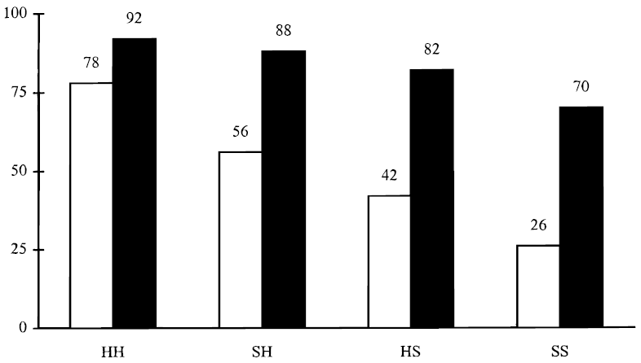
Percentage unhealthy snacks chosen
H = hungry (late afternoon)
S = sated (just after lunch)
immediate
immediate
immediate
immediate
advance
advance
advance
advance
[(state when asked in advance), (state when asked immediately before consumption)]

Slide 12
Percentage unhealthy snacks chosen
H = hungry (late afternoon)
S = sated (just after lunch)
immediate
immediate
immediate
immediate
advance
advance
advance
advance
[(state when asked in advance), (state when asked immediately before consumption)]

Slide 13
See Badger et al (2007) for a related example with heroin addicts given the time-dated reward of buprenorphine (“bup”), a heroin partial agonist
small sample warning (n=13)

Slide 14
Also see related study by Sadoff, Samek, and Sprenger (2015)

Slide 15
Quasi-hyperbolic interpretation
Suppose that fruit has immediate benefit of 1/2.
Suppose that chocolate has immediate benefit of 1 and delayed cost of 2/3.

Slide 16
Extremely thirsty subjects
McClure, Ericson, Laibson, Loewenstein and Cohen (2007)
Choosing between, juice now or 2x juice in 5 minutes 60% of subjects choose first option.
Choosing between juice in 20 minutes or 2x juice in 25 minutes 30% of subjects choose first option.
We estimate that the 5-minute discount rate is 50% and the “long-run” discount rate is 0%.
Ramsey (1930s), Strotz (1950s), & Herrnstein (1960s) were the first to understand that discount rates are higher in the short run than in the long run.

Slide 17
Recovering heroin addicts and Buprenorphine (BUP)
Badger et al (2007)
Monetary equivalent of an extra does of BUP
 | Immediate | Delayed (+5)
Satiated | $50 | $35
Deprived | $75 | $60
Methodology alert: 13 heroin addicts are the only participants in this study

Slide 18
Recovering heroin addicts
Badger et al (2007)
Monetary equivalent of an extra does of BUP
 | Immediate | Delayed (+5)
Satiated | $50 | $35
Deprived | $75 | $60

Slide 19
A bit of math
If you want to relate a discount factor, δ, to a discount rate, remember that if
then,

Slide 20
Money now vs. money later
Thaler (1981)
Hypothetical rewards (but many experiments use real rewards)
Baseline exponential discounting model: Y = δ ^{t} X
So -lnδ = (1/t) ln [X/Y], remember that t is in units of yrs
What amount makes you indifferent between $15 today and $X in 1 month?
  X = 20
  -lnδ = (1/t) ln [X/15] = 12 ln [X/15] = 345% per year
What amount makes you indifferent between $15 today and $X in ten years?
  X = 100
  -lnδ = (1/t) ln [X/15] = (1/10) ln [X/15] = 19% per year

Slide 21
But … “money earlier vs. money later” (MEL) has so many confounds
(Chabris, Laibson, and Schuldt 2009)
Unreliability of future rewards (trust; bird in the hand; Andreoni and Sprenger 2010)
Transaction costs (especially when asymmetric)
Investment vs. consumption (money receipt at date t is not, necessarily a utils event at date t)
Curvature of utility function (see Harrison et al for partial fixes)
Framing and demand characteristics (e.g., response scale; Beauchamp et al 2013)
Sub-additivity (Read, 2001; Benhabib, Bisin, and Schotter 2008)
(Hypothetical rewards)
Psychometric heuristics (Rubinstein 1988, 2003; Read et al 2011; White et al 2014)

Slide 22
Why are money questions unsuited to measuring discounting even in theory?
If an agent is not liquidity constrained, she should maximize NPV when asked about money now vs. money later.
Note that NPV is based on market interest rates, not time preferences.
After maximizing NPV, she should pick her indifference point using time preferences.

Slide 23
Separation theorem: pick payment to maximize NPV, regardless of time preference (then locate along efficient frontier)
Later
$7 later
o
o
slope = -(1+r)
o
$5 now
Now

Slide 24
But … “money earlier vs. money later” (MEL) has so many confounds
(Chabris, Laibson, and Schuldt 2009)
Unreliability of future rewards (trust; bird in the hand; Andreoni and Sprenger 2010)
Transaction costs (especially when asymmetric)
Investment vs. consumption (money receipt at date t is not, necessarily a utils event at date t)
Curvature of utility function (see Harrison et al for partial fixes)
Framing and demand characteristics (e.g., response scale; Beauchamp et al 2013)
Sub-additivity (Read, 2001; Benhabib, Bisin, and Schotter 2008)
(Hypothetical rewards)
Psychometric heuristics (Rubinstein 1988, 2003; Read et al 2011; White et al 2014)

Slide 25
White, Ericson, Laibson, and Cohen (2014)
(see also Read, Frederick and Scholten 2013)
Proportional reasoning explains inter-temporal choices in MEL tasks much better than discounting models (including present-biased discounting).
Probability of choosing larger, later reward (x₂,t₂) over smaller, earlier reward (x₁,t₁).
Improvement of 6 percentage points of predictive accuracy in cross-validation study (i.e., out of sample prediction)

Slide 26
Augenblick, Niederle, and Sprenger (2012)
“Three period work experiment: 0, 2, 3”
At date 0: How hard do you want at work at 2 and at 3?
At date 2: How hard do you want to work at 2 and at 3?
At date 2, subjects tend to shift work from 2 to 3.
Estimated parameters: β = 0.927; δ = 0.997
Subjects are willing to commit at date 0 (48/80 commit).
But they are generally unwilling to pay to commit.
For those who commit: β = 0.881; δ = 1.004

Slide 27
Augenblick, Niederle, and Sprenger (2012)
“Three period money experiment: 1, 4, 7”
At date 1: How much money do you want at 4 and at 7?
At date 4: How much money do you want at 4 and at 7?
At date 4, subjects barely shift money to 4 from 7.
Estimated parameters: β = 0.974; δ = 0.998.

Slide 28
Augenblick, Niederle, and Sprenger (2012)
Limited preference reversals in the domain of money (as predicted by the model of present bias)
Present bias observed in the “consumption” version of the experiment.

Slide 29
Outline
Preference reversals
Commitment
Other evidence

Slide 30

Stickk
Ayres, Goldberg and Karlan: Stickk.com

Slide 31
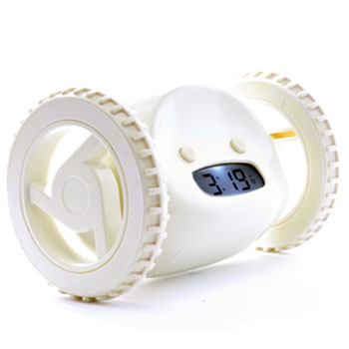
Clocky

Slide 32

Tocky

Slide 33
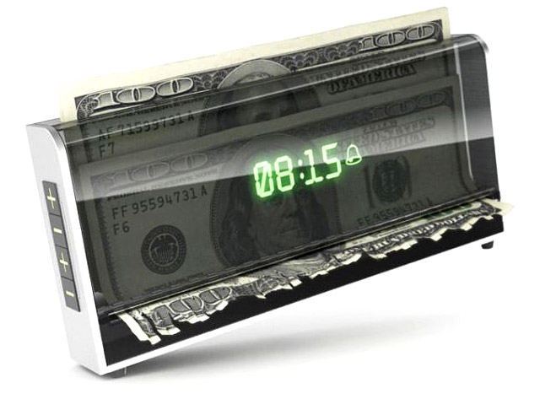
Shreddy™

Slide 34
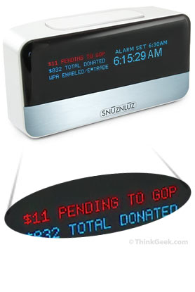
SNUZ N LUZ

Slide 35
“Freedom”
The granddaddy of the Internet restriction programs is Freedom. Set the $10 program and you'll be barred from surfing the net for up to eight hours at a time.
Claim to have 100,000 users.

Slide 36
Ashraf, Karlan, and Yin (2006)
Offered a commitment savings product to randomly chosen clients of a Philippine bank
28.4% take-up rate of commitment product (either date-based goal or amount-based goal)
More “hyperbolic” subjects are more likely to take up the product
After twelve months, average savings balances increased by 81% for those clients assigned to the treatment group relative to those assigned to the control group.

Slide 37
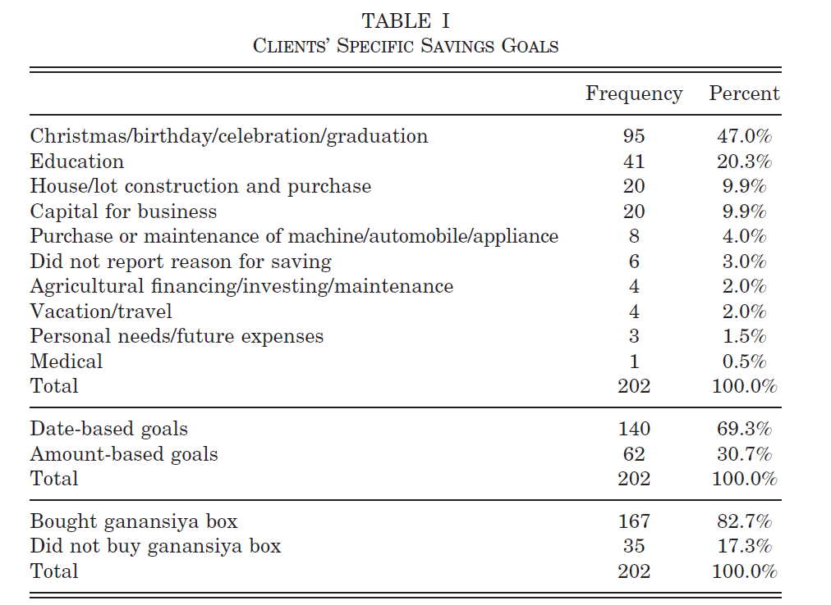

Slide 38
Gine, Karlan, Zinman (2009)
Tested a voluntary commitment product (CARES) for smoking cessation.
Smokers offered a savings account in which they deposit funds for six months, after which take urine tests for nicotine and cotinine.
If they pass, money is returned; otherwise, forfeited
11% of smokers offered CARES take it up, and smokers offered CARES were 3 percentage points more likely to pass the 6-month test than the control group
Effect persisted in surprise tests at 12 months.

Slide 39
Kaur, Kremer, and Mullainathan (2010):
Compare two piece-rate contracts:
  Linear piece-rate: w per unit produced
  Linear piece-rate with penalty if worker does not achieve production target T (“Commitment”)
    Earn w/2 for each unit produced if production < T
    Jump up at T, returning to baseline contract
Earnings
Never earn more under commitment contract
May earn ½ as much
Production
T
Notes:
Consider an employee working on a simple piece rate activity – like a repetitive task done many times
Many examples like this: supermarket checkout / cashier, assembly line worker, delivery person, salesperson, data entry operator, just to name a few.
Compare 2 types of contracts the employee could be offered:
Give the employee wage w for every unit of work that she does (blue line on the graph)
Give the employee w if she meets some production target T, give her w/2 if she falls below target (red line on the graph)
- Notice the employee can never earn more under the commitment contract, and may earn much less if she fails to meet target

Slide 40
Kaur, Kremer, and Mullainathan (2012):
Demand for Commitment: Commitment contract (Target > 0) chosen 35% of the time
Effect on Production: Being offered commitment contract increases average production by 2.3% relative to control
Among all participants, being offered the commitment contract is equivalent (in output effect) to a 7% increase in the piece-rate wage
Participants above the mean pay-day cycle sensitivity are 49% more likely to demand commitment and their productivity increase is 9% (equivalent to a 27% increase in wage)
Notes:
These are coefficient estimates from regressions with controls
Demand for commitment regression – evening/morning inference:
chose_commitment = const + eve_choice_dummy + lag_prodn + lag_prodn*eve_choice + {controls including FE for employees, day of week, week #}
Effect on production regression – effect on output:
production = const + choice_dummy + lag_prodn + lag_prodn*choice + {controls including FE for employees, day of week, week #}
Payday results:
Overall, there is not a huge difference in average demand for commitment contracts on paydays vs non-paydays.
However, there is a big difference in the likelihood of picking in the morning/evening on paydays vs. non-paydays. Basically, on non-paydays, people are more likely to choose commitment in advance (i.e. the evening before). However, the opposite is true on paydays – if people know Tuesday is their payday, they are much more likely to choose a commitment contract for Tuesday on Tuesday morning than on Monday evening.

Slide 41
Houser, Schunk, Winter, and Xiao (2010)
In a laboratory setting, 36.4% of subjects are willing to use a commitment device to prevent them from surfing the web during a work task

Slide 42
Royer, Stehr, and Sydnor (2011)
Commit to go to the gym at least once every 14 calendar days (8 week commitment duration)
Money at stake is choice of participant.
Money donated to charity in event of failure.
Fraction taking commitment contract:
  Full sample: 13%
  Gym Members: 25%
  Gym Non-members: 6%
Average commitment = $63; max = $300, 25th pct = $20; 75th pct = $100.

Slide 43
Ariely and Wertenbroch (2002)
Proofreading tasks: "Sexual identity is intrinsically impossible," says Foucault; however, according to de Selby[1], it is not so much sexual identity that is intrinsically impossible, but rather the dialectic, and some would say the satsis, of sexual identity. Thus, D'Erlette[2] holds that we have to choose between premodern dialectic theory and subcultural feminism imputing the role of the observor as poet.“
Evenly spaced deadlines ($20)
Self-imposed deadlines ($13)
  subjects in this condition could self-impose costly deadlines ($1 penalty for each day of delay) and 37/51 do so.
End deadline ($5)

Slide 44
Alsan, Armstrong, Beshears, Choi, del Rio,
Laibson, Madrian and Marconi (2014)
Voluntary Commitment Arm
No Commitment Arm
Get paid $30 per clinical visit,
only if you are
medically adherent
Get paid $30 per
clinical visit,
whether or not you are medically adherent.
Get paid $30 per
clinical visit,
whether or not you are medically adherent.
32%
68%
small sample warning (n=40)
Notes:
Here is the visual we have been using in the prepilot survey to clarify the two different plans.

Slide 45
Voluntary commitment arm
No commitment arm

Slide 46
Study of rickshaw peddlers who are given access to commitment technologies
Schilbach (2015)
Alcohol commitment (sobriety contingent payments)
Savings commitment (lockbox)

Slide 48
Commitment Technology for
Alcohol Avoidance
Rickshaw cyclers choose either A (contingent payment based on BAC) or B (non-contingent payment)

Slide 49
Option B:

Slide 51
How to design a commitment contract
Participants divide $$$ between:
Freedom account (22% interest)
Goal account (22% interest)
  withdrawal restriction
Beshears, Choi, Harris, Laibson, Madrian, Sakong (2014)

Slide 52
Initial investment in goal account
Goal Account
10% penalty
35%
Freedom
Account
65%
Goal account
20% penalty
43%
Freedom
Account
57%
Goal account
No withdrawal
56%
Freedom
Account
44%

Slide 53
Now participant can divided their money across three accounts:
(i) freedom account
(ii) goal account with 10% penalty
(iii) goal account with no withdrawal
49.9% allocated to freedom account
16.2% allocated to 10% penalty account
33.9% allocated to no withdrawal account
Beshears, Choi, Harris, Laibson, Madrian, Sakong (2014)

Slide 54
Outline
Preference reversals
Commitment
Other evidence

Slide 55
Dellavigna and Malmendier (2004, 2006)
Average cost of gym membership: $75 per month
Average number of visits: 4
Average cost per vist: $19
Cost of “pay per visit”: $10

Slide 56
Shapiro (2005)
For food stamp recipients, caloric intake declines by 10-15% over the food stamp month.
To be resolved with exponential discounting, requires an annual discount factor of 0.23
Survey evidence reveals rising desperation over the course of the food stamp month, suggesting that a high elasticity of intertemporal substitution is not a likely explanation.
Households with more short-run impatience (estimated from hypothetical intertemporal choices) are more likely to run out of food sometime during the month.

Slide 57
The data can reject a number of alternative hypotheses.
Households that shop for food more frequently do not display a smaller decline in intake over the month, casting doubt on depreciation stories.
Individuals in single-person households experience no less of a decline in caloric intake over the month than individuals in multi-person households.
Survey respondents are not more likely to eat in another person’s home toward the end of the month.
The data show no evidence of learning over time

Slide 58
Social security
Mastrobuoni and Weinberg (2009)
Individuals with substantial savings smooth consumption over the monthly pay cycle
Individuals without savings consume 25 percent fewer calories the week before they receive checks relative to the week afterwards

Slide 59
Oster and Scott-Morton (2004)
People (and other vice magazines) sold on the news stand at a high price relative to subscription
Foreign Affairs (and other investment magazines) sold on the news stand at a low price relative to subscription
But People (and other vice magazines) sold disproportionately on the news stand and Foreign Affairs (and other investment magazines) sold disproportionately by subscription.

Slide 60
Sampling of other studies
Della Vigna and Paserman (2005): job search
Duflo (2009): immunization
Duflo, Kremer, Robinson (2009): commitment fertilizer
Burks, Carpenter, Goette, & Rustichini (2009): Truck driver study
Milkman et al (2008): video rentals return sequencing
Sapienza and Zingales (2008,2009): procrastination
Trope & Fischbach (2000): commitment to medical adherence
Wertenbroch (1998): individual packaging of temptation goods

Slide 61
Household finance studies
Angeletos, Laibson, Repetto, Tobacman, and Weinberg (2001)
Della Vigna and Paserman (2005): job search
Duflo, Kremer, Robinson (2009): commitment fertilizer
Meier and Sprenger (2010): correlation with credit card borrowing
Shui and Ausubel (2006): credit cards
Shapiro (2005): consumption cycle over month
Mastrobuoni and Weinberg (2009): consumption cycle over the month
Laibson, Maxted, Repetto, and Tobacman (2016): MSM estimation using wealth and debt moments
Kuchler (2014): credit card debt paydown

Slide 62
Outline
Preference reversals
Commitment
Other types of studies

