Slide 1
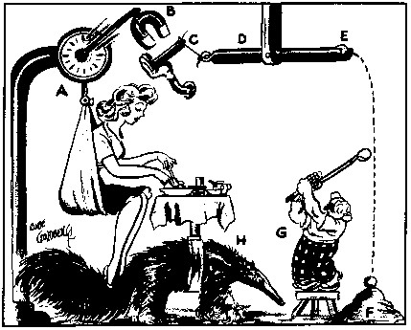
Behavioral Mechanism Design
David Laibson
July 9, 2014

Slide 2
How Are Preferences Revealed?
Beshears, Choi, Laibson, Madrian (2008)
Revealed preferences (decision utility)
Normative preferences (experienced utility)
Why might revealed ≠ normative preferences?
  Cognitive errors
  Passive choice
  Complexity
  Shrouding
  Limited personal experience
  Intertemporal choice
  Third party marketing

Slide 3
Behavioral mechanism design
Specify a social welfare function, i.e. normative preferences (not necessarily based on revealed preference)
Specify a theory of consumer/firm behavior (consumers and/or firms may not behave optimally).
Solve for the institutional regime that maximizes the social welfare function, conditional on the theory of consumer/firm behavior.

Slide 4
Today:
Two examples of behavioral mechanism design
  A. Optimal defaults
  B. Optimal commitment

Slide 5
A. Optimal Defaults – public policy
Mechanism design problem in which policy makers set a default for agents with present bias
Carroll, Choi, Laibson, Madrian and Metrick (2009)

Slide 6
Basic set-up of problem
Specify (dynamically consistent) social welfare function of planner (e.g., set β=1)
Specify behavioral model of households
  Flow cost of staying at the default
  Effort cost of opting-out of the default
  Effort cost varies over time → option value of waiting to leave the default
  Present-biased preferences → procrastination
Planner picks default to optimize social welfare function

Slide 7
Specific Details
Agent needs to do a task (once).
  Switch savings rate, s, from default, d, to optimal savings rate,
Until task is done, agent losses per period.
Doing task costs c units of effort now.
  Think of c as opportunity cost of time
Each period c is drawn from a uniform distribution on [0,1].
Agent has present-biased discount function with β < 1 and δ = 1.
So discount function is: 1, β, β, β, …
Agent has sophisticated (rational) forecast of her own future behavior. She knows that next period, she will again have the weighting function 1, β, β, β, …

Slide 8
Timing of game
Period begins (assume task not yet done)
Pay cost θ (since task not yet done)
Observe current value of opportunity cost c (drawn from uniform distribution)
Do task this period or choose to delay again?
It task is done, game ends.
If task remains undone, next period starts.
Pay cost θ
Observe current value of c
Do task or delay again
Period t-1
Period t
Period t+1

Slide 9
Sophisticated procrastination
There are many equilibria of this game.
Let’s study the stationary equilibrium in which sophisticates act whenever c < c*. We need to solve for c*.
Let V represent the expected undiscounted cost if the agent decides not to do the task at the end of the current period t:
Likelihood of doing it in t+1
Likelihood of not doing it in t+1
Cost you’ll pay for certain in t+1, since job not yet done
Expected cost conditional on drawing a low enough c* so that you do it in t+1
Expected cost starting in t+2 if project was not done in t+1

Slide 10
In equilibrium, the sophisticate needs to be exactly indifferent between acting now and waiting.
Solving for c*, we find:
Expected delay is:

Slide 12
How does introducing β < 1 change the expected delay time?
If β=2/3, then the delay time is scaled up by a factor of
In other words, it takes times longer than it “should” to finish the project

Slide 13
V vs. V hat

Slide 14
A model of procrastination: naifs
Same assumptions as before, but…
Agent has naive forecasts of her own future behavior.
She thinks that future selves will act as if β = 1.
So she (mistakenly) thinks that future selves will pick an action threshold of

Slide 15
In equilibrium, the naif needs to be exactly indifferent between acting now and waiting.
To solve for V, recall that:

Slide 16
Substituting in for V:
So the naif uses an action threshold (today) of
But anticipates that in the future, she will use a higher threshold of

Slide 17
So her (naïve) forecast of delay is:
And her actual delay will be:
Being naïve, scales up her delay time by an additional factor of 1/β.

Slide 18
Summary
If β = 1, expected delay is
If β < 1 and sophisticated, expected delay is
If β < 1 and naïve, anticipated delay is
If β < 1 and naïve, true delay is

Slide 19
That completes theory of consumer behavior.
Now solve for government’s optimal policy.
Now we need to solve for the optimal default, d.
Note that the government’s objective ignores present bias, since it uses V as the welfare criterion.

Slide 20
Optimal ‘Defaults’
Two classes of optimal defaults emerge from this calculation
  Automatic enrollment
    Optimal when employees have relatively homogeneous savings preferences (e.g. match threshold) and relatively little propensity to procrastinate
  Active Choice — require individuals to make a choice (eliminate the option to passively accept a default)
    Optimal when employees have relatively heterogeneous savings preferences and relatively strong tendency to procrastinate
Key point: sometimes the best default is no default.

Slide 21
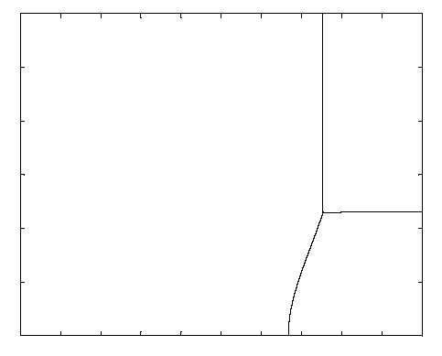
Preference Heterogeneity
30%
Low Heterogeneity High Heterogeneity
Offset
Default
Active Choice
Center
Default
0%
0
Beta
1

Slide 22
Lessons from theoretical analysis of defaults
  Defaults should be set to maximize average well-being, which is not the same as saying that the default should be equal to the average preference.
  Endogenous opting out should be taken into account when calculating the optimal default.
  The default has two roles:
    causing some people to opt out of the default (which generates costs and benefits)
    implicitly setting savings policies for everyone who sticks with the default

Slide 23
When might active choice be socially optimal?
Defaults sticky (e.g., present-bias)
Preference heterogeneity
Individuals are in a position to assess what is in their best interests with analysis or introspection
  Savings plan participation vs. asset allocation
The act of making a decision matters for the legitimacy of a decision
  Advance directives or organ donation
Deciding is not very costly

Slide 24
Empirical evidence on active choice
Carroll, Choi, Laibson, Madrian, Metrick (2009)
Active choice mechanisms require employees to make an active choice about 401(k) participation.
Welcome to the company
You are required to submit this form within 30 days of hire, regardless of your 401(k) participation choice
If you don’t want to participate, indicate that decision
If you want to participate, indicate your contribution rate and asset allocation
Being passive is not an option

Slide 26
Active choice in 401(k) plans
Active decision raises 401(k) participation.
Active decision raises average savings rate by 50 percent.
Active decision doesn’t induce choice clustering.
Under active decision, employees choose savings rates that they otherwise would have taken three years to achieve. (Average level as well as the multivariate covariance structure.)

Slide 27
Other active choice interventions
Active choice in asset allocation (Choi, Laibson, and Madrian 2009)
Active choice in home delivery of chronic medications (Beshears, Choi, Laibson, Madrian 2013)

Slide 28
The Flypaper Effect in Individual Investor Asset Allocation (Choi, Laibson, Madrian 2009)
Studied a firm that used several different match systems in their 401(k) plan.
I’ll discuss two of those regimes today:
Match allocated to employer stock and workers can reallocate
  Call this “default” case (default is employer stock)
Match allocated to an asset actively chosen by workers; workers required to make an active designation.
  Call this “active choice” case (workers must choose)
Economically, these two systems are identical.
They both allow workers to do whatever the worker wants.

Slide 29
Consequences of the two regimes
Balances in employer stock
 |  | Match Defaults into Employer Stock | Active choice
 | Own Balance in Employer Stock | 24% | 20%
 | Matching Balance in Employer Stock | 94% | 27%
 | Total Balance in Employer Stock | 56% | 22%

Slide 30
Prescription Drug Home Delivery
Beshears, Choi, Laibson, Madrian (2013)
  90 day fills (vs. 30 day for retail)
  Time saving (no trip to pharmacy)
  Convenient refill system
    Internet or phone
    More timing leeway than for retail fill
  Lower error rate (although error rates low for both channels)
  Lower cost to individuals, PBM, and employer health plan

Slide 31
Prescription Drug Coverage
 | Copay
Type of Prescription Drug | Retail (30 day max) | Home Delivery (90 day max) | Savings (90 day)
Generic | $8 | $20 | $4
Preferred brand, no generic available | $25 | $55 | $20
Preferred brand, generic available | 35% $35 min/$70 max | 35% $70 min/$140 max | $35 min/ $70 max
Non-preferred brand, excl. lifestyle drugs | 35% $70 min/$140 max | 35% $140 min/$280 max | $70 min/ $140 max
Non-preferred brand, lifestyle drugs | 85% | 80% | 5%
Notes:
Table 1. Prescription Drug Copayment Structure
This table summarizes the basic copayment structure in the firm’s prescription drug plan during the time period studied (the years 2007, 2008, and 2009). Some special categories of treatments (e.g., infertility) are omitted. A small number of drugs moved from one category to another during the sample period. Beginning in April 2008, some employees with certain chronic diseases were invited to enroll in a special program that offered reduced copayment amounts and rates, which are not shown. Note that costs in the home delivery column are for 90 day refills, whereas costs for retail are for 30 day costs.

Slide 32
Disadvantages of Prescription Drug Home Delivery (vs. Retail Pharmacy)
  Risk of theft
  Risk of privacy loss
  Reduces personal interaction with pharmacist

Slide 33
What would you choose?

Slide 34
Select Home Delivery: Active Choice for Home Delivery of Prescription Medication
Program designed to increase uptake of prescription drug home delivery
Examine adoption at a large U.S. company
Employees targeted for inclusion:
  Taking a medication on list of targeted long-term maintenance medications
  Not already using home delivery for targeted medication
Targeted employees contacted by e-mail, mail, and telephone starting November 2008
Notes:
Examine how an active choice approach works in the context of enrollment in home delivery for prescription drugs. Large U.S. employers adopts program to encourage employees enrolled in its health plans to make an active choice about whether they want home delivery or pharmacy pick-up for long-term maintenance medications. Program is called “Select Home Delivery” (SHD).

Slide 35
Select Home Delivery: Active Choice and Home Delivery of Prescription Drugs
Active decision approach: those targeted “required” to make active choice about home delivery or retail
  PBM will contact Dr. to get prescription if desired
  Different decisions for individual drugs allowed
Mechanisms to enforce active choice
  Each retail fill ➔ reminder from PBM until active choice is made
  After three retail fills w/o an active choice, payment denied (individual must pay full prescription cost out of pocket)
  Choice could be home delivery or retail pharmacy, but making a choice required for payment
Notes:
Employees do not have to choose home delivery, but they are given a deadline (three retail pharmacy refills) by which time they have to make a yes/no choice about whether they want home delivery. There is no penalty for choosing “NO”. Motivation behind program is a belief that many individuals would prefer home delivery but they simply don’t get around to signing up (procrastination).

Slide 36
Empirical Approach
Two observationally similar cohorts
  2007 cohort (pre-Select Home Delivery)
  2008 cohort (post-Select Home Delivery)
Outcomes of interest
  Participation in home delivery
  Adherence
Sample selection criteria for both cohorts
  Regular, full-time employee as of December 1st
  Employee filled a retail, long-term prescription for a targeted drug between October 12th and November 26th
  Employee did not fill a home delivery prescription for the same drug between May 1st and November 1st
Notes:
Empirical approach: Compare outcomes for targeted employees after SHD implemented with behavior of employees before SHD implemented. Use same targeting criteria to define pre-cohort.

Slide 37
Home Delivery Utilization for All Employees: 2006 to 2010
Notes:
This graph displays the fraction of prescriptions that are filled through Home Delivery in a given month. The universe is all prescription refills in a given month. Note that Home Delivery prescriptions need to be refilled less often, since the supply of medicine goes up to 90 days. The supply limit for a retail prescription fill is 30 days. The Select Home Delivery program was in effect during the time period marked by the red vertical lines (November 2008-October 2009). In November 2009, a more aggressive approach to increasing take-up of home delivery was adopted by the company which accounts for the increase in home delivery utilization in this period. We do not analyze this second program in this paper.

Slide 38
Home Delivery Adoption: Logit Regression (Marginal Effects)
 | No Controls |  | Add Controls
2008 Cohort | 0.338** | (0.004) | 0.348** | (0.004)
Female |  |  | -0.003 | (0.005)
Age |  |  | 0.003** | (0.0002)
Tenure (<2 yrs. Omitted)
2 to <5 yrs. |  |  | -0.022** | (0.006)
5 to <10 yrs. |  |  | -0.025** | (0.006)
10+ yrs. |  |  | -0.041** | (0.007)
Salary (1st quart. Omitted)
Salary 2nd quartile |  |  | 0.009 | (0.006)
Salary 3rd quartile |  |  | 0.026** | (0.006)
Salary 4th quartile |  |  | 0.059** | (0.006)
Number of targeted drugs |  |  | 0.0000 | (0.002)
Past PDC |  |  | 0.001** | (0.0001)
Past PDC missing |  |  | 0.048** | (0.007)
Rough savings ($100) |  |  | 0.008** | (0.003)
Disease class effects | No |  | Yes
Pseudo R² | 0.155 |  | 0.174
Sample size | 49,913 / 94,450 |  | 48,433 / 91,083
Notes:
The observations in this regression are uniquely identified by a combination of individual ID and medication GPI-4 code. In the second regression, standard errors are clustered by individual.

Slide 39
Prescription Drug Home Delivery: Requiring an Active Choice
Active choice ➔ big increase in home delivery: 6% to 40%
Among those who choose, we see a slight preference for home delivery
About 22% don’t make an active choice

Slide 40
Home Delivery, Retail, or No Choice: Multinomial Logit (Marginal Effects):
 | HD | Retail | No Choice
Female | -0.005 | 0.022** | -0.017**
Age | 0.004** | -0.0002 | -0.004**
Tenure (<2 yrs. Omitted)
2 to <5 yrs. | -0.036** | 0.036** | 0.0001
5 to <10 yrs. | -0.034** | 0.051** | -0.018*
10+ yrs. | -0.057** | 0.094** | -0.037**
Salary (1st quart. Omitted)
Salary 2nd quartile | 0.011 | -0.003 | -0.083
Salary 3rd quartile | 0.029** | -0.004 | -0.025**
Salary 4th quartile | 0.076** | -0.033** | -0.043**
Number of targeted drugs | 0.007** | 0.025** | -0.032**
Past PDC | 0.001** | 0.001** | -0.002**
Past PDC missing | 0.036** | 0.026* | -0.062**
Potential savings ($100) | 0.010* | 0.002 | -0.012*
Disease class effects | Yes
Pseudo R² | 0.052
Sample size | N=49,036

Slide 41
Characteristics by Choice Outcome
Home Delivery | Retail | No Choice
 | Female | Male
Older |  | Younger
Lower tenure | Higher tenure | Lower tenure
High paid | Lower paid | Lower paid
 | More drugs | Fewer drugs
High past PDC | High past PDC | Low past PDC
Missing PDC (newer script) | Missing PDC (newer script) | Have PDC (older script)
High savings |  | Low savings

Slide 42
Financial Benefits of Select Home Delivery Program
Annualized Cost Savings
 | Average
Individual | $444,683
Company | $377,981
Total | $822,664
Rough estimate: total annualized savings of
~$822,664 per year
  Does not include savings to PBM
  Not a steady state estimate

Slide 43
B. Optimal illiquidity
  Self Control and Liquidity:
  How to Design a Commitment Contract
  Beshears, Choi, Harris, Laibson, Madrian, and Sakong (2013)

Slide 44
Net Worth (excluding SS and DB)
Households age 65-74; SCF (2007$)
Median Mean
1983 $123.4 $ 450.4
1992 $142.8 $ 414.6
1995 $150.0 $ 471.4
1998 $186.5 $ 594.2
2001 $207.9 $ 793.5
2004 $208.8 $ 758.8
2007 $239.4 $1,015.7
HRS 2008 $221.7 $ 567.5

Slide 45
SCF (65-74): In 2007, the median holding of
financial assets is $68,100
HRS (65-69): In 2008, the median holding of
financial assets is $12,500
among 1-person households
HRS (65-69): In 2008, the median holding of
financial assets is $111,600
among 2-person households

Slide 46
Dying broke
Venti, Poterba, and Wise (2011)
Single-person households
  57.0% are last observed with less than $10,000 in financial assets
  Of these households, 61.2% also have no home equity
All family pathways
  46.1% are last observed with less than $10,000 in financial assets
  Of these households, 51.7% also have no home equity
Is this a problem, or is it optimal asset stripping?
And what about intra-family insurance?

Slide 47
Maybe the “new” DC system will yield more savings?
Key ingredients
  Matching
  Automatic enrollment (opt-out enrollment)
  Target date funds
  Simplification
  Savings rate escalators
  Education
Let’s take a look at what we can expect
Build a simple simulation framework that is 100% DC and 0% DB

Slide 48
Breakdown of Retirement Assets in
US Market (2010 q3)
Total US Retirement Assets:
$16.6 trillion
Pension plans for
Government Employees:
$4.1 trillion
Private pension plans:
$12.4 trillion
DB Assets:
$2.2 trillion
Other Assets:
$10.2 trillion
IRA: $4.5 trillion
DC: $4.2 trillion
Annuities: $1.5 trillion
Source: ICI 2011

Slide 49
Most Retirement Savings is in
Individual Accounts
Total US Retirement Assets:
$16.6 trillion
All DB Pensions
$5+ trillion
Individual accounts:
$11+ trillion
Source: ICI 2011, and author’s calculations

Slide 50
Pension coverage by type of pension plan among all private sector workers in US
DC Only
Both
DB Only
Source: EBRI and Department of Labor

Slide 51
Assumptions for savings simulation (all real 2011 $)
6.5% guaranteed return
2% inflation rate
6% 401(k) saving rate
100% employer match
No leakage
Start working at age 22
First job: $35,000
Start saving at age 22
1% real wage growth
50% SS replacement
“4% rule” in retirement
At retirement:
103% replacement ratio
$719,275 financial assets
(+ house + SS)

Slide 52
Total Household | Annualized | Replacement
Income | Soc Sec | Ratio
$5,000 | $4,500 | 90%
$10,000 | $9,000 | 90%
$20,000 | $16,756 | 84%
$30,000 | $19,956 | 67%
$40,000 | $23,156 | 58%
$50,000 | $26,356 | 53%
$75,000 | $34,356 | 46%
$100,000 | $42,356 | 42%
$150,000 | $51,147 | 34%
$200,000 | $55,752 | 28%
$500,000 | $55,752 | 11%
$1,000,000 | $55,752 | 6%
Close to a best-case scenario, since these are two-earner (symmetric) households.

Slide 53
Assumptions for calculations in previous table.
2009 Social Security formulae are used
Standard retirement age (66)
Two-earner household
Wage growth for household equals SSA adjustment factor for national nominal wage growth
35 year earnings history
Benefits calculated as:
Min(SSA PIA formula, 2009 max payment)

Slide 54
A little more realism
 |  |  | Replacement | Financial
 |  |  | Ratio | Assets
Original scenario |  |  | 1.03 | $ 719,275
3.5% balance leakage |  |  | 0.72 | $ 302,322
40% don’t have access |  |  | 0.64 | $ 198,021
Match rate is 0.5 |  |  | 0.61 | $ 152,672
Net return is 5.5% |  |  | 0.59 | $ 123,115
20% with access don’t participate |  |  | 0.57 | $ 101,174
Start saving at age 30 |  |  | 0.56 | $ 86,732
SS replacement rate lower |  |  | 0.51 | $ 86,732

Slide 55
Gross savings rates (excludes depreciation)
China | 49%
India | 31%
Russia | 30%
Venezuela | 26%
Argentina | 22%
Chile | 21%
Columbia | 20%
Brazil | 15%
U.S. | 12%

Slide 56
65-74 year old households surveyed in 2007 Survey of Consumer Finances
Median holding of
financial assets is $68,100
HRS: In 2008, the median holding of
financial assets is $12,500
among 1-person households
HRS: In 2008, the median holding of
financial assets is $111,600
among 2-person households

Slide 57
Net National Savings Rate: 1929-2012
Table 5.1, NIPA, BEA

Slide 58
“Leakage” (excluding loans) among households ≤ 55 years old
For every $2 that flows into US retirement savings system $1 leaks out
(Argento, Bryant, and Sabelhouse 2012)
How would savers respond, if these accounts were made less liquid?
What is the structure of an
optimal retirement savings system?

Slide 59
The Senate and the House of Representatives had different views on this question when
ERISA was passed (1974)
The Senate wanted a 30% early withdrawal penalty for the precursor account to the modern 401(k)/IRA.
The House wanted a 10% penalty, and won the day.
These issues were barely discussed when ERISA was passed, since the expansion of the 401(k)/IRA system was not anticipated.
Today I want to reopen this can of worms.

Slide 60

Retirement Plan Leakage
Source: GAO-09-715, 2009

Slide 61
Total leakage in the US
(for non-retired workers)
About 2.5% of $10 trillion = $250 billion per year
For comparison, flows into US retirement accounts:
$500 billion

Slide 62
US Anti-Leakage Strategy
Defined Contribution Pension Schemes
(e.g., 401(k) and IRA)
10% penalty for early withdrawals
Allow loans without penalty
  10% penalty if not repaid
Special categories of penalty-free withdrawals
  Education
  Large health expenditures
  First home purchase

Slide 63
Is a 10% penalty a good idea?
More generally, how much liquidity (and of what type) should one have in a retirement savings system?
Classical answer: liquidity raises welfare and households should prefer more liquidity to less.
Behavioral answer: flexibility is a two-edged sword.

Slide 64
Behavioral Mechanism Design
Specify social welfare function (normative preferences)
Specify behavioral model of households (revealed preferences)
Planner picks regime to optimize social welfare function

Slide 65
Partial Equilibrium Theory
Generalizations of Amador, Werning and Angeletos (2006), hereafter AWA:
Present-biased preferences
Short-run taste shocks.
A general commitment technology.

Slide 66
Timing
Period 0. An initial period in which a commitment mechanism is set up by self 0.
Period 1. A taste shock, θ, is realized and privately observed. Consumption (c₁) occurs.
Period 2. Final consumption (c₂) occurs.

Slide 67
Preferences
U₀ = βδθ u₁(c₁) + βδ² u₂(c₂)
U₁ = θ u₁(c₁) + βδ u₂(c₂)
U₂ = u₂(c₂)

Slide 68
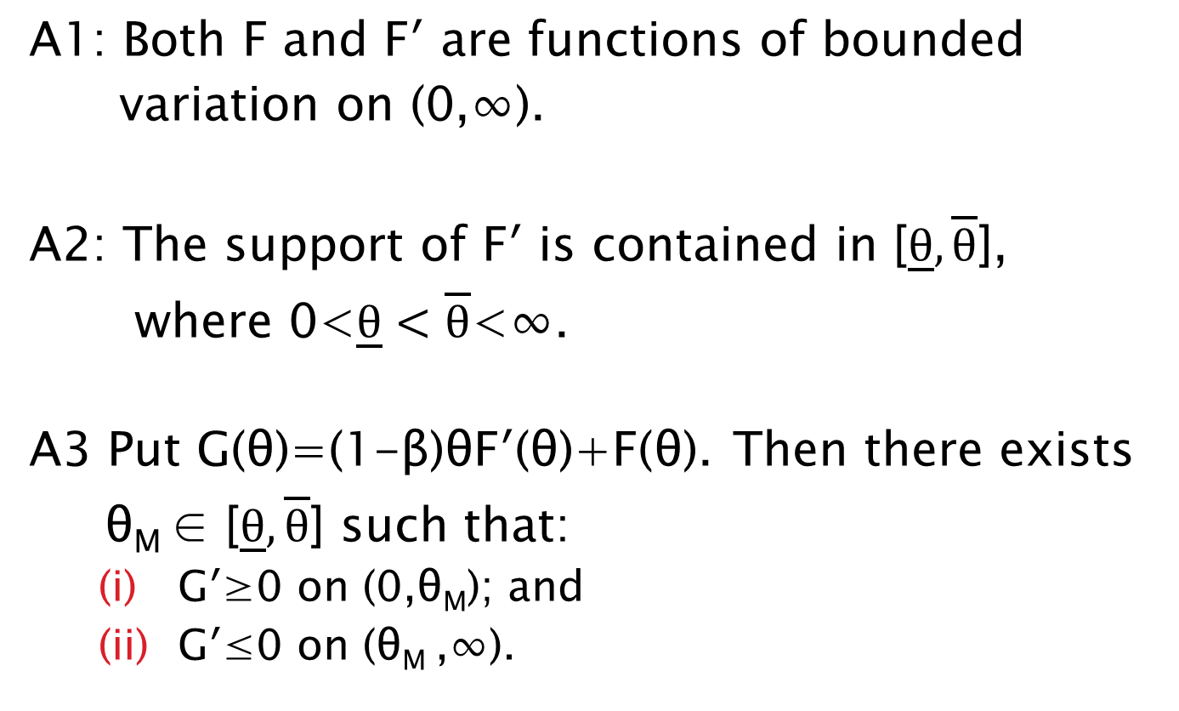
Restricting F(θ), the cdf
A1: Both F and F′ are functions of bounded
variation on (0,∞).
A2: The support of F′ is contained in [$\underline{θ},\overline{θ}$],
where 0<$\underline{θ}<\overline{θ}$<∞.
A3 Put G(θ)=(1-β)θF′(θ)+F(θ). Then there exists
θ_{M} ∈ [$\underline{θ},\overline{θ}$] such that:
    G′≥0 on (0,θ_{M}); and
    G′≤0 on (θ_{M} ,∞).

Slide 69
A1-A3 admit most commonly used densities.
For example, we sampled all 18 densities in two leading statistics textbooks: Beta, Burr, Cauchy, Chi-squared, Exponential, Extreme Value, F, Gamma, Gompertz, Log-Gamma, Log-Normal, Maxwell, Normal, Pareto, Rayleigh, t, Uniform and Weibull distributions.
A1-A3 admits all of the densities except some special cases of the Log-Gamma and some special cases of generalizations of the Beta, Cauchy, and Pareto.

Slide 70
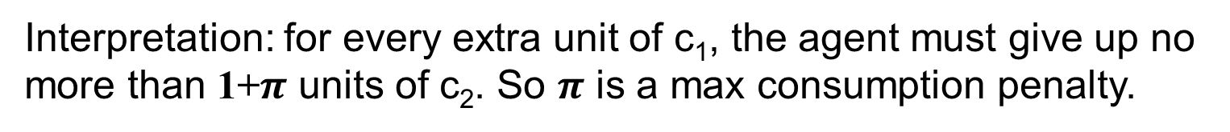
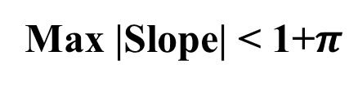
Self 0 hands self 1 a budget set
(subset of blue region)
c₂
y
Max |Slope| < 1+$π$
Budget set
y
c₁
Interpretation: for every extra unit of c₁, the agent must give up no more than 1+$π$ units of c₂. So $π$ is a max consumption penalty.

Slide 71
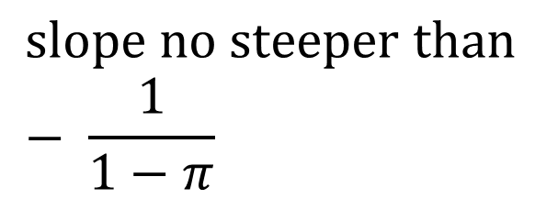
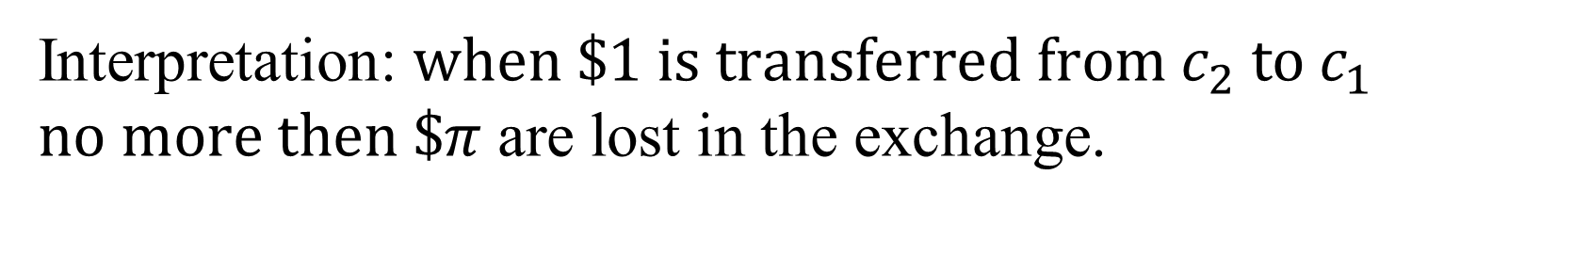
Self 0 hands self 1 a budget set
(subset of blue region)
c₂
y
$$slope no steeper than− \frac{1}{1−π}$$
Budget set
y
c₁
Interpretation: $when \$1 is transferred from c_{2} to c_{1}$
$no more then \$π$ are lost in the exchange.

Slide 72
Two-part budget set
c₂
c₁

Slide 73
Two-part budget set
c₂
c₁

Slide 74
Theorem 1
Assume:
CRRA utility.
Early consumption penalty bounded above by π.
Then, self 0 will set up two accounts:
Fully liquid account
Illiquid account with penalty π.

Slide 75
Theorem 2:
Assume log utility.
Then the amount of money deposited in the illiquid account rises with the early withdrawal penalty.

Slide 76
Goal account usage
(Beshears et al 2013)
Goal Account
10% penalty
35%
Freedom
Account
65%
Goal account
20% penalty
43%
Freedom
Account
57%
Goal account
No withdrawal
56%
Freedom
Account
44%

Slide 77
Theorem 3 (AWA):
Assume self 0 can pick any consumption penalty.
Then self 0 will set up two accounts:
fully liquid account
fully illiquid account (no withdrawals in period 1)

Slide 78
Corollary
Assume there are three accounts:
one liquid
one with an intermediate withdrawal penalty
one completely illiquid
Then all assets will be allocated to the liquid account and the completely illiquid account.

Slide 79
When three accounts are offered
Goal account
No withdrawal
Freedom
Account
33.9%
16.2%
49.9%
Goal Account
10% penalty

Slide 80
Summary so far
Partial equilibrium analysis
Theoretical predictions that match the experimental data

Slide 81
General Equilibrium Extensions
Potential implications for the design of a retirement saving system?
Theoretical framework needs to be generalized:
  Allow penalties to be transferred to other agents
  Heterogeneity in sophistication/naivite
  Heterogeneity in present-bias

Slide 82
Extension: Interpersonal Transfers
If a household spends less than its endowment, the unused resources are given to other households.
E.g. penalties are collected by the government and used for general revenue.
This introduces an externality, but only when penalties are paid in equilibrium.
Now the two-account system with maximal penalties is no longer socially optimal.
AWA’s main result does not generalize.

Slide 83
Formally:
Government picks an optimal triple {x,z,π}:
  x is the allocation to the liquid account
  z is the allocation to the illiquid account
  π is the penalty for the early withdrawal
Endogenous withdrawal/consumption behavior generates overall budget balance.
x + z = 1 + π E(w)
  where w is the equilibrium quantity of early withdrawals.

Slide 84
Socially optimal penalty on illiquid account
(truncated Gaussian taste shocks)
CRRA = 2
CRRA = 1
Present bias parameter: β

Slide 85
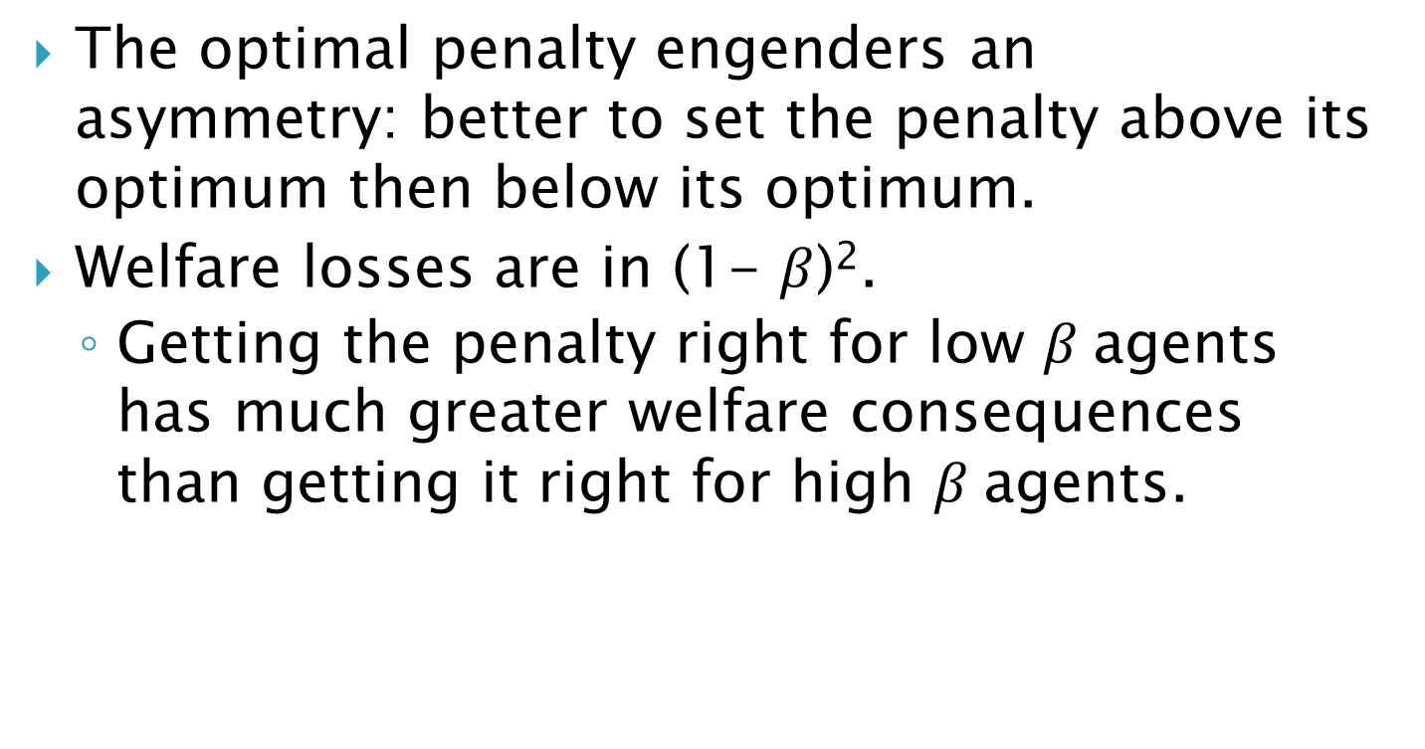
Two key properties
The optimal penalty engenders an asymmetry: better to set the penalty above its optimum then below its optimum.
  Welfare losses are in (1- $β$)².
  Getting the penalty right for low $β$agents has much greater welfare consequences than getting it right for high $β$agents.

Slide 86
Expected Utility (β=0.7)
Penalty for Early Withdrawal

Slide 87
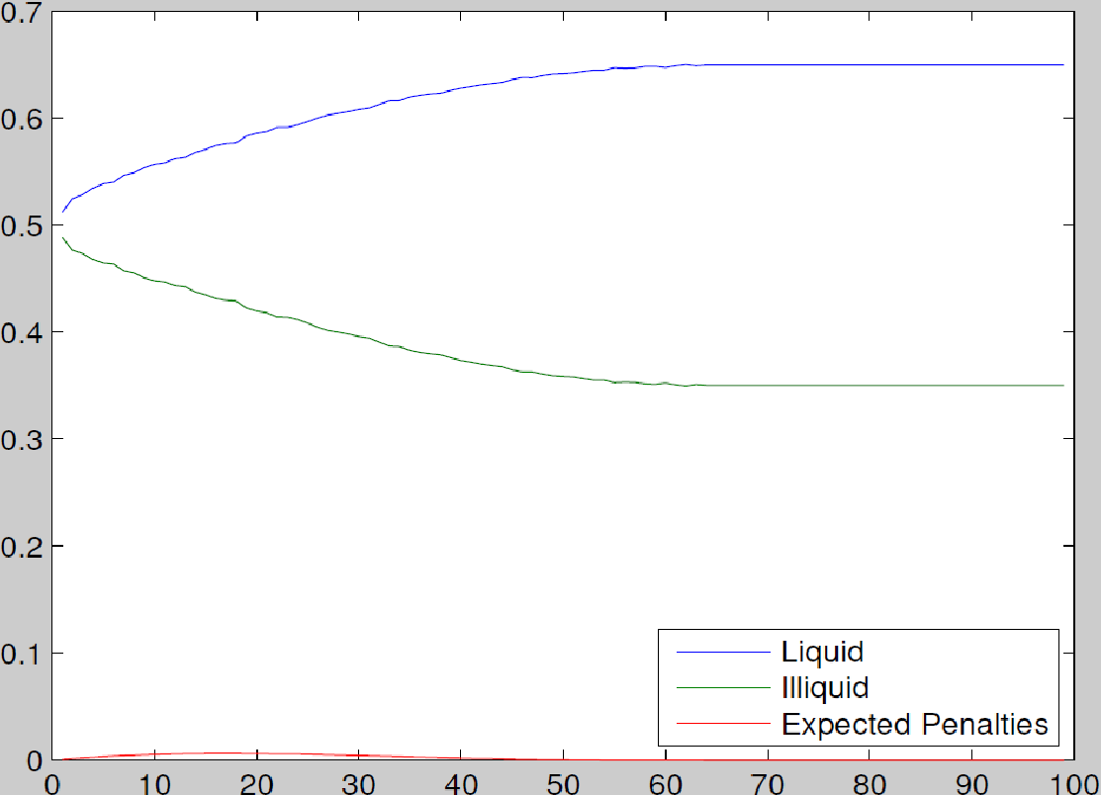
Account Allocations and Expected Penalties (β=0.7)
Penalty for Early Withdrawal

Slide 88
Expected Utility (β=0.1)
Penalty for Early Withdrawal

Slide 89
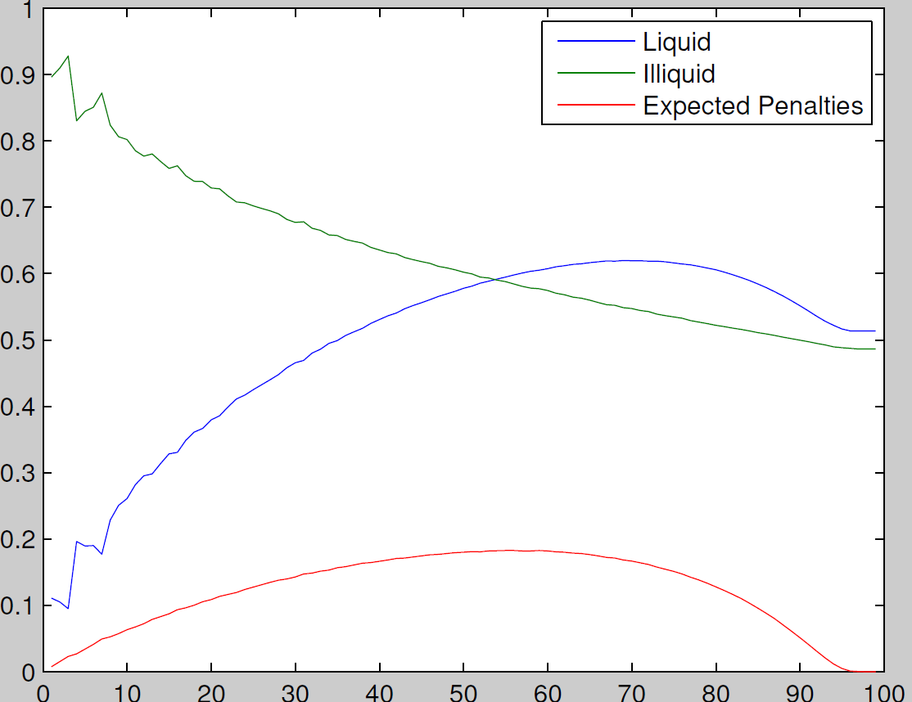
Account Allocations and Expected Penalties (β=0.1)
Penalty for Early Withdrawal

Slide 90
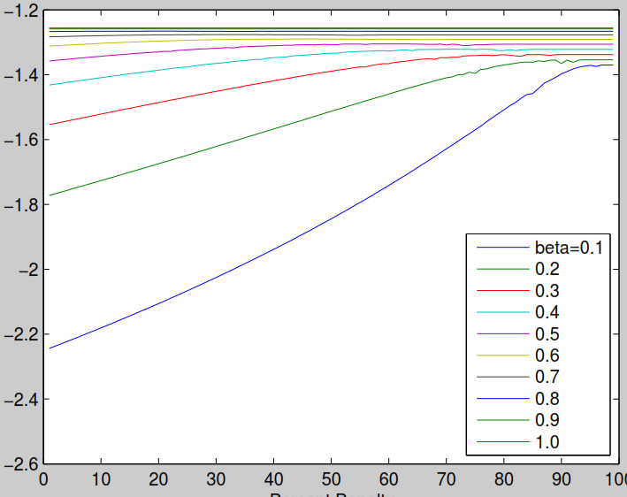
Expected Utility Given A Fixed Penalty Level
β=1.0
β=0.9
β=0.8
β=0.7
β=0.6
β=0.5
β=0.4
β=0.3
β=0.2
β=0.1
100
Penalty for Early Withdrawal

Slide 91
To paraphrase Lucas:
Once you start thinking about low β households, nothing else matters.

Slide 92
Consequently, very large penalties are optimal if there is substantial heterogeneity in β.

Slide 93
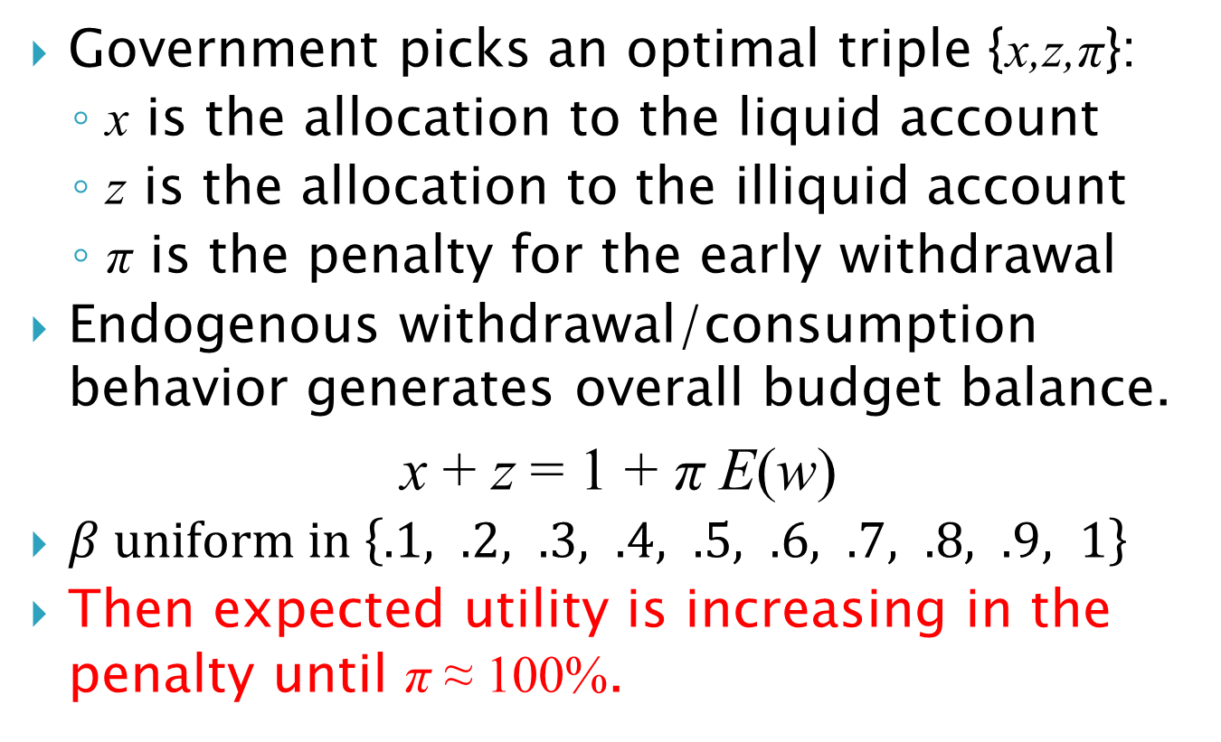
Numerical result:
Government picks an optimal triple {x,z,π}:
  x is the allocation to the liquid account
  z is the allocation to the illiquid account
  π is the penalty for the early withdrawal
Endogenous withdrawal/consumption behavior generates overall budget balance.
x + z = 1 + π E(w)
$β uniform in \left\{.1, .2, .3, .4, .5, .6, .7, .8, .9, 1\right\}$
Then expected utility is increasing in the penalty until π ≈ 100%.

Slide 94
Expected Utility For Each β Type
β=1.0
β=0.9
β=0.8
β=0.7
β=0.6
β=0.5
β=0.4
β=0.3
β=0.2
β=0.1
Penalty for Early Withdrawal

Slide 95
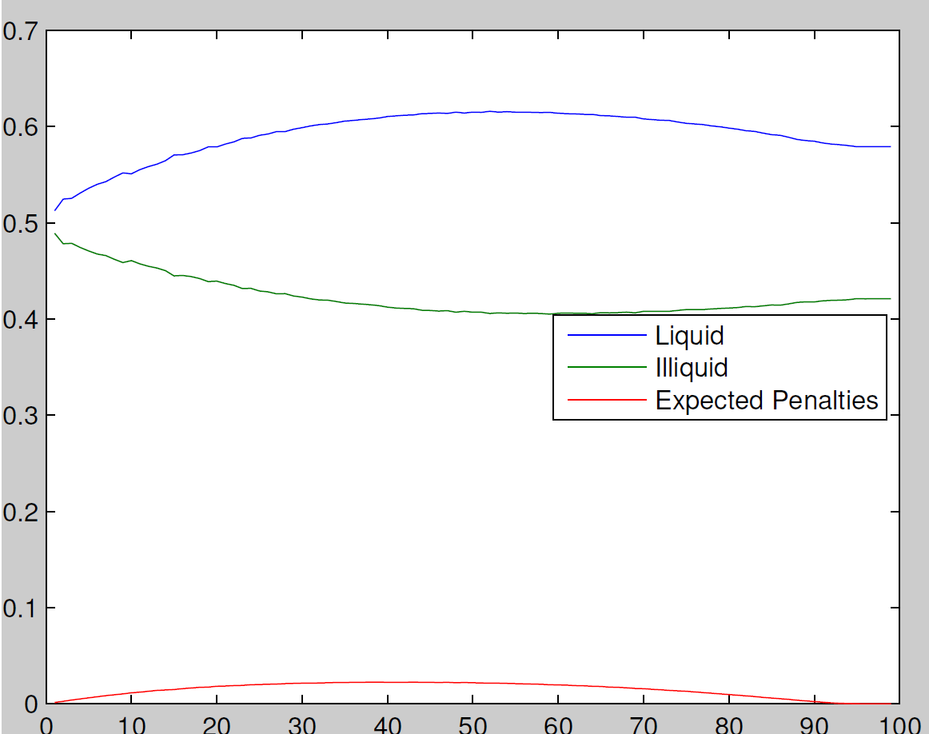
Optimal Account Allocations
Penalty for Early Withdrawal

Slide 96
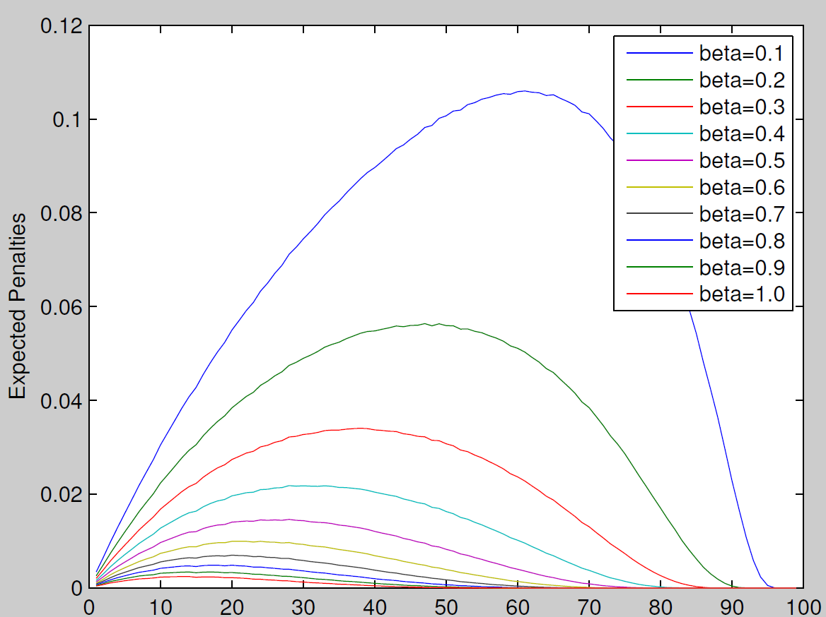
Expected Penalties Paid For Each β Type
Penalty for Early Withdrawal

Slide 97
Expected Utility For Total Population
Penalty for Early Withdrawal

Slide 98
Regulation for Conservatives: Behavioral Economics and the Case for “Asymmetric Paternalism
Colin Camerer, Samuel Issacharoff, George Loewenstein, Ted O’Donoghue & Matthew Rabin. 2003. "Regulation for Conservatives: Behavioral Economics and the Case for “Asymmetric Paternalism”. 151 University of Pennsylvania Law Review 101: 1211–1254.

Slide 99
Conclusions and extensions
Our three-period model and experimental evidence suggest that optimal retirement systems are characterized by a highly illiquid retirement account.
Almost all countries in the world have a system like this: A public social security system plus illiquid supplementary retirement accounts (either DB or DC or both).
The U.S. is the exception – defined contribution retirement accounts that are essentially liquid.

Slide 100
Summary of behavioral mechanism design
Specify a social welfare function (not necessarily based on revealed preference)
Specify a theory of consumer/firm behavior (consumers and/or firms may not behave optimally).
Solve for the institutional structure that maximizes the social welfare function, conditional on the theory of consumer/firm behavior.
Examples: Optimal defaults and optimal illiquidity.

Slide 101
Outline of Lecture
Behavioral Mechanism Design
Optimal Defaults
Commitment Savings

