Slide 1

Household finance
David Laibson
July 8, 2014

Slide 2
Nine claims about household finance
Households:
Have low levels of financial literacy
Have very few liquid assets (live hand to mouth)
Have substantial illiquid wealth
Have a high MPC out of liquid wealth and liquidity
Have a low MPC out of illiquid wealth
Don’t choose optimal financial service products
Barely change their behavior after financial education interventions
Have misaligned financial intentions and financial actions
Make financial choices that are easy to manipulate

Slide 3
Nine claims about household finance
Households:
Have low levels of financial literacy
Have very few liquid assets (live hand to mouth)
Have substantial illiquid wealth
Have a high MPC out of liquid wealth and liquidity
Have a low MPC out of illiquid wealth
Don’t choose optimal financial service products
Barely change their behavior after financial education interventions
Have misaligned financial intentions and financial actions
Make financial choices that are easy to manipulate

Slide 4
Assessing Literacy: Numeracy
Compound Interest
“Suppose you had $100 in a savings account and the interest rate was 2% per year. After 5 years, how much do you think you would have in the account if you left the money to grow?”
    i) More than $102;
    ii) Exactly $102;
    iii) Less than $102;
    iv) Don’t know (DK);
    v) Refuse to answer.
Source: Annamarai Lusardi

Slide 5
Assessing Literacy: Inflation
Inflation
“Imagine that the interest rate on your savings account was 1% per year and inflation was 2% per year. After 1 year, would you be able to buy with the money in this account:”
    i) More than today;
    ii) Exactly the same;
    iii) Less than today;
    iv) DK;
    v) Refuse to answer.

Slide 6
Assessing Literacy: Risk Diversification
Risk Diversification
“Do you think the following statement is true or false? Buying a single company stock usually provides a safer return than a stock mutual fund.”
    i) True;
    ii) False;
    iii) DK;
    iv) Refuse to answer.

Slide 7
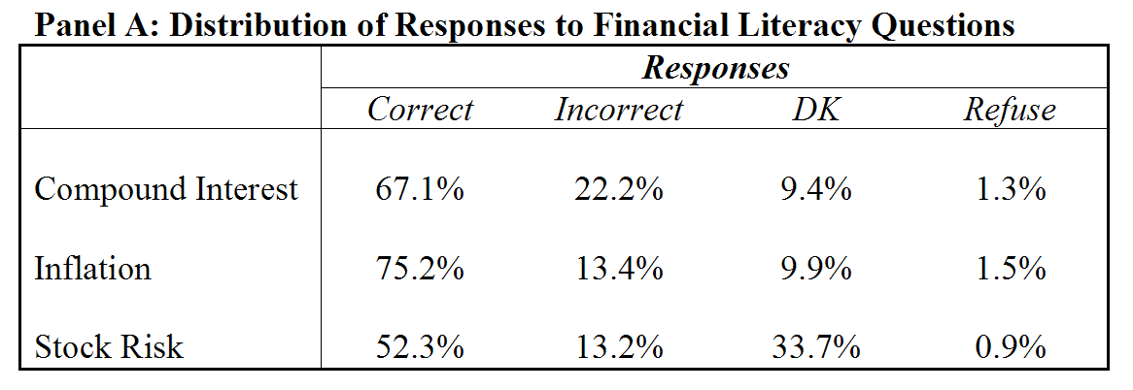
How much do older people (ages 50+) know?
34% correctly answer all 3 questions

Slide 8
Correct responses: By Gender

Slide 9
Financial Literacy and Age

Slide 10
Financial Literacy and Education
Percent answering risk diversification correctly
Source: Health and Retirement Study, 2004

Slide 11
Financial Literacy among the Young (23-27). NLSY: Percentage of correct responses
Interest rate: 79.2%
Inflation: 53.9%
Risk diversification: 46.6%

Slide 12
Two Takeway Points
Financial literacy should not be taken for granted
  Illiteracy is widespread
Financial literacy varies a lot among demographic groups

Slide 13
Financial literacy matters
Financial literacy affects financial decisions: Those with low literacy:
  are less likely to calculate how much they need for retirement
  are less likely to participate in the stock market
  are more likely to have difficulties paying off debt

Slide 14
More on the power of interest compounding (TNS)
Suppose you owe $1,000 on your credit card and the interest rate you are charged is 20% per year compounded annually. If you didn’t pay anything off, at this interest rate, how many years would it take for the amount you owe to double?
    2 years
    Under 5 years
    5 to 10 years
    More than 10 years
    Do not know
    Prefer not to answer

Slide 15
Payment options: Loaning money to the retailer (TNS)
  You purchase an appliance which costs $1,000. To pay for this appliance, you are given the following two options: a) Pay 12 monthly installments of $100 each; b) Borrow at a 20% annual interest rate and pay back $1,200 a year from now. Which is the more advantageous offer?
    Option (a)
    Option (b)
    They are the same
    Do not know
    Prefer not to answer

Slide 16
Who has lower debt literacy? Differences between men and women
  Percent answering credit card question correctly or “do not know” by gender
Notes:
16

Slide 17
People who make errors have “difficulties paying off debt.”
Grossly underestimate compounding
Gives free loan to retailer
35%
30%
25%
20%
Percentage with "too much debt"
15%
10%
5%
0%
Option a
Option b
Choose two payment options

Slide 18
Lusardi and Mitchell (2010)
‘I understand the stock market reasonably well’
‘An employee of a company with publicly traded stock should have a lot of his retirement savings in the company’s stock’
‘It is best to avoid stock of foreign companies’
‘If the interest rate falls, bond prices will rise’
  Sophisticated/correct answer to all questions: 5.8%

Slide 19
Lusardi and Mitchell (2010)
(30% agree): ‘I understand the stock market reasonably well’
(52% disagree) ‘An employee of a company with publicly traded stock should have a lot of his retirement savings in the company’s stock’
(51% disagree): ‘It is best to avoid stock of foreign companies’
(40% agree) : ‘If the interest rate falls, bond prices will rise’
  Sophisticated/correct answer to all questions: 5.8%

Slide 20
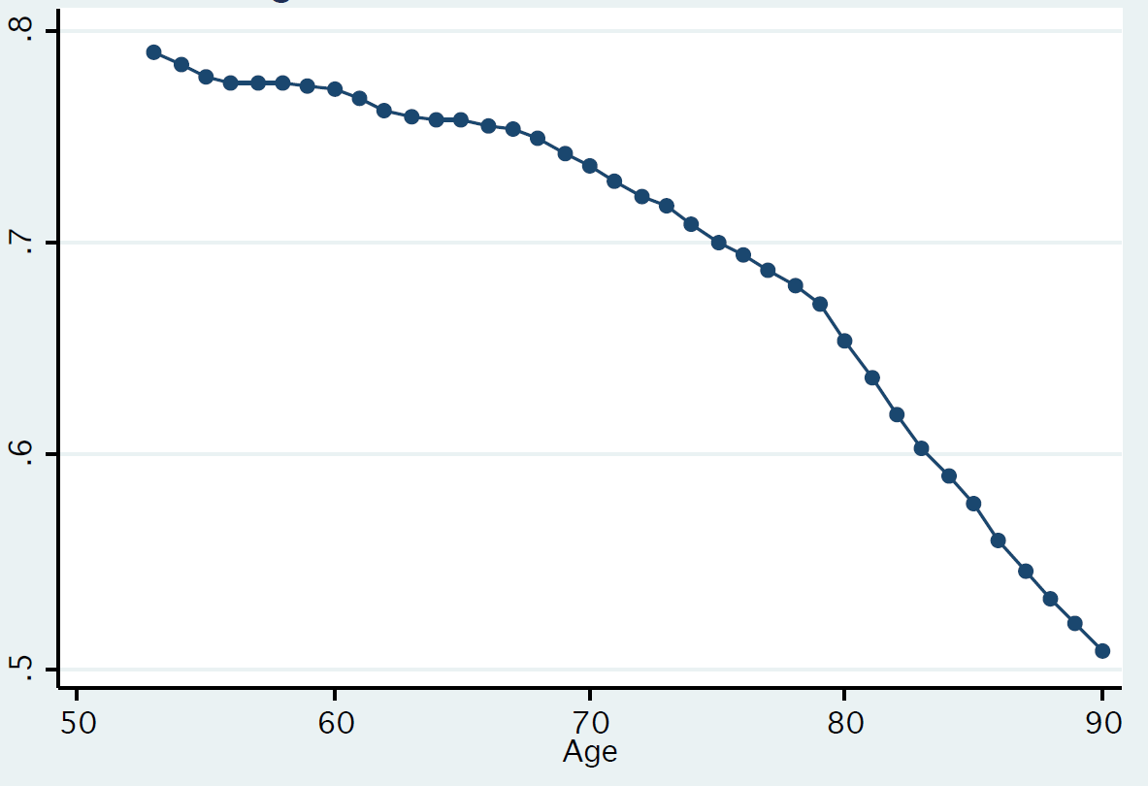
“If the chance of getting a disease is 10 percent, how many people out of 1,000 would be expected to get the disease?”
Fraction of people who answer “100”
Source: HRS; Agarwal, Driscoll, Gabaix, Laibson (2009)

Slide 21
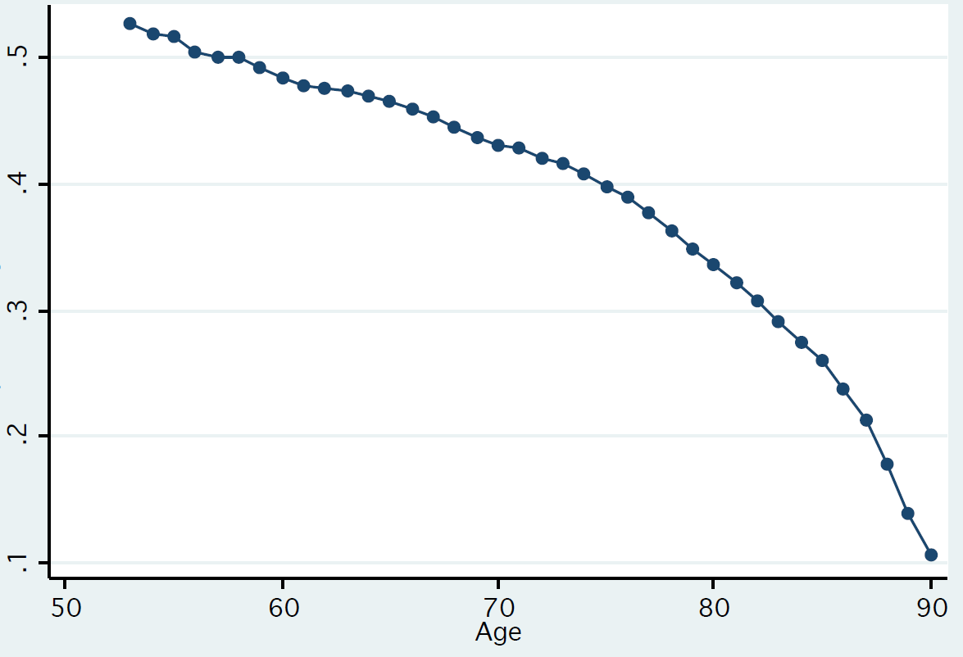
“If 5 people all have the winning numbers in the lottery and the prize is two million dollars, how much will each of them get?”
Fraction of people who answer “400,000”
Source: HRS; Agarwal, Driscoll, Gabaix, Laibson (2009)

Slide 22
Nine claims about household finance
Households:
Have low levels of financial literacy
Have very few liquid assets (live hand to mouth)
Have substantial illiquid wealth
Have a high MPC out of liquid wealth and liquidity
Have a low MPC out of illiquid wealth
Don’t choose optimal financial service products
Barely change their behavior after financial education interventions
Have misaligned financial intentions and financial actions
Make financial choices that are easy to manipulate

Slide 23
Households live hand to mouth
Lusardi and Tufano (2009)
How confident are you that you could come up with $2,000 if an unexpected need arose within the next month?
  I am certain…I could
  I could probably…
  I probably could not…
  I am certain…I could not
  Do not know.
47%
53%

Slide 24
SCF (age 65-74): In 2007, the median holding of
financial assets is $68,100
HRS (age 65-69): In 2008, the median holding of
financial assets is $12,500
among 1-person households
HRS (age 65-69): In 2008, the median holding of
financial assets is $111,600
among 2-person households

Slide 25
65-74 year old households
Survey of Consumer Finances
In 2007, the median holding of
financial assets
including personal retirement accounts
is $68,100

Slide 26
(Poterba, Venti, and Wise 2013; HRS 2008 wave)

Slide 27
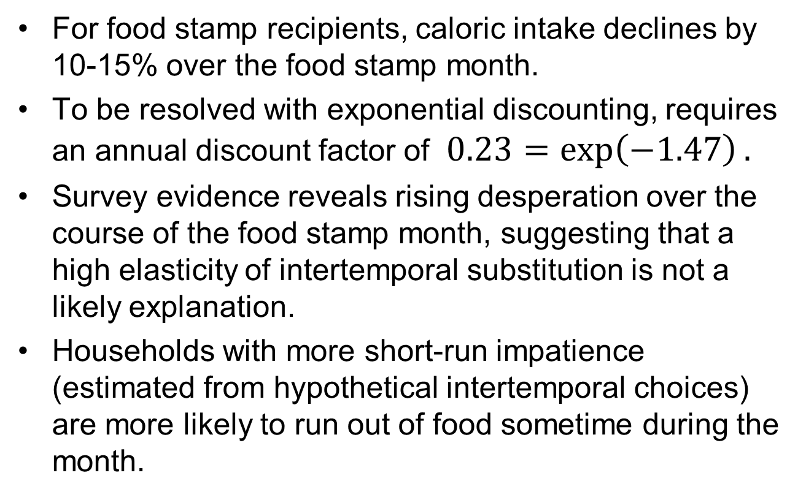
High MPC’s out of liquid wealth
Shapiro (2005)
For food stamp recipients, caloric intake declines by 10-15% over the food stamp month.
To be resolved with exponential discounting, requires an annual discount factor of $0.23=\exp\left(−1.47\right).$
Survey evidence reveals rising desperation over the course of the food stamp month, suggesting that a high elasticity of intertemporal substitution is not a likely explanation.
Households with more short-run impatience (estimated from hypothetical intertemporal choices) are more likely to run out of food sometime during the month.

Slide 28
The data can reject a number of alternative hypotheses.
Households that shop for food more frequently do not display a smaller decline in intake over the month, casting doubt on depreciation stories.
Individuals in single-person households experience no less of a decline in caloric intake over the month than individuals in multi-person households.
Survey respondents are not more likely to eat in another person’s home toward the end of the month.
The data show no evidence of learning over time

Slide 29
High MPC’s out of Social security
Mastrobuoni and Weinberg (2009)
Individuals with substantial savings smooth consumption over the monthly pay cycle
Individuals without savings consume 25 percent fewer calories the week before they receive SS checks relative to the week after

Slide 30
Lifecycle simulations (Angeletos et al 2001)
Mortality
Dependents
Retirement/Social Security
Three educational groups: NHS, HS, COLL
Stochastic labor income
Credit limit: (.30)(permanent income)
3 state variables: liquid and illiquid wealth, income.
2 choice variables: liquid and illiquid wealth investment

Slide 31
Preferences
Constant relative risk aversion = 2
For exponential discounting economy:
  β=1
  δ=0.94 (match median ‘W/Y’ of 3.9 ages 50-59)
For quasi-hyperbolic discounting economy:
  β=0.7
  δ=0.96 (match median ‘W/Y’ of 3.9 ages 50-59)

Slide 32
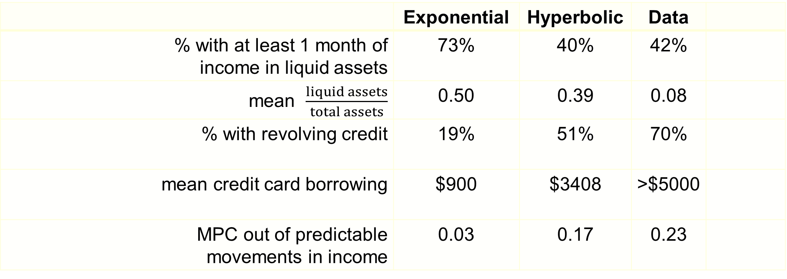
Predictions (HS education)
 | Exponential | Hyperbolic | Data
% with at least 1 month of income in liquid assets | 73% | 40% | 42%
mean $\frac{liquid assets}{total assets}$ | 0.50 | 0.39 | 0.08
% with revolving credit | 19% | 51% | 70%
mean credit card borrowing | $900 | $3408 | >$5000
MPC out of predictable movements in income | 0.03 | 0.17 | 0.23

Slide 33
LRT Simulation Model
Stochastic Income
Lifecycle variation in labor supply (e.g. retirement)
Social Security system
Life-cycle variation in household dependents
Bequests
Illiquid asset
Liquid asset
Credit card debt
Numerical solution (backwards induction) of 90 period lifecycle problem.

Slide 34
Laibson, Repetto, and Tobacman (2012)
Use MSM to estimate discounting parameters:
  Substantial voluntarily accumulated illiquid wealth: W/Y = 3.9.
  Extensive credit card borrowing:
    68% didn’t pay their credit card in full last month
    Average credit card interest rate is 14%
    Credit card debt averages 13% of annual income
  Consumption-income comovement:
    Marginal Propensity to Consume = 0.23
    (i.e. consumption tracks income)

Slide 35
LRT Results:
U_{t} = u_{t} + β [δu_{t+1} + δ²u_{t+2} + δ³u_{t+3} + ...]
β = 0.70 (s.e. 0.11)
δ = 0.96 (s.e. 0.01)
Null hypothesis of β = 1 rejected (t-stat of 3).
Specification test accepted.

Slide 36
…. have a low MPC out of illiquid wealth
Because households have little liquid wealth, and the illiquid wealth is hard to access
Though note that illiquid assets sometimes become liquid in large lumps (e.g., cash-out refinancing)
Also, note that idiosyncratic wealth shocks to illiquid retirement savings accounts lead agents to increase their savings rate (Choi, Laibson, Madrian, Metrick 2009)
  Return chasing effect

Slide 37
Nine claims about household finance
Households:
Have low levels of financial literacy
Have very few liquid assets (live hand to mouth)
Have substantial illiquid wealth
Have a high MPC out of liquid wealth and liquidity
Have a low MPC out of illiquid wealth
Don’t choose optimal financial service products
Barely change their behavior after financial education interventions
Have misaligned financial intentions and financial actions
Make financial choices that are easy to manipulate

Slide 38
Financial illiteracy in mutual fund choice
Choi, Laibson, Madrian (2011)
Subjects allocate $10,000 among four funds
Randomly choose two subjects to receive any positive portfolio return during the subsequent year
Eliminate variation in pre-fee returns
  Choose among S&P 500 index funds
Unbundle services from returns
  Experimenters pay out portfolio returns, so no access to investment company services

Slide 39
One year of index fund fees on a $10,000 investment

Slide 40
Experimental conditions
Control
  Subjects receive only four prospectuses
  Prospectuses are often the only information investors receive from companies
Fees transparency treatment
  Eliminate search costs by also distributing fee summary sheet (repeats information in prospectus)
Returns treatment
  Highlight extraneous information by distributing summary of funds’ annualized returns since inception (repeats information in prospectus)

Slide 41
Fees paid by control groups (prospectus only)
Maximum
Possible
Fee
$443: average fee with random fund allocation
Minimum
Possible
Fee
N = 83
N = 30
6% of MBA Controls put all funds in minimum-fee fund
0% of College Controls put all funds in minimum-fee fund
t-test: p=0.5086

Slide 42
Ranking of factor importance
MBA controls
Fees
1-year performance
Performance since inception
Investment objectives
Desire to diversify among funds
Brand recognition
Performance over different horizon
Past experience with fund companies
Quality of prospectus
Customer service of fund
Minimum opening balance
College controls
1-year performance
Performance since inception
Desire to diversify among funds
Investment objectives
Quality of prospectus
Performance over different horizon
Brand recognition
Fees
Customer service of fund
Minimum opening balance
Past experience with fund companies

Slide 43
Effect of fee treatment
(prospectus plus 1-page sheet highlighting fees)
**
N = 83
N = 85
N = 30
N = 29
19% of MBA treatment put all funds in minimum-fee fund
10% of College treatment put all funds in minimum-fee fund
t-tests:
MBA: p=0.0000
College: p=0.1451

Slide 44
Ranking of factor importance
MBA fee treatment
Fees
1-year performance
Performance since inception
MBA controls
Fees
1-year performance
Performance since inception
College fee treatment
Fees
1-year performance
Performance since inception
College controls
1-year performance
Performance since inception
Desire to diversify among funds

Slide 45
Returns treatment effect on average returns since inception
**
**
N = 83
N = 84
N = 30
N = 28
t-tests
MBA: p=0.0055
College: p=0.0000

Slide 46
Returns treatment effect on fees
**
N = 83
N = 84
N = 30
N = 28
t-tests
MBA: p=0.0813
College: p=0.0008

Slide 47
Ranking of factor importance
MBA return treatment
1-year performance
Performance since inception
Fees
MBA controls
Fees
1-year performance
Performance since inception
College return treatment
Performance since inception
1-year performance
Desire to diversify among funds
College controls
1-year performance
Performance since inception
Desire to diversify among funds

Slide 48
Lack of confidence and fees
(all revealed preferences are not created equal)
*
N = 64
N = 136
N = 50
N = 46
N = 36
N = 5
t-tests: MBA 1 vs. 2, p=0.2013; MBA 1 vs. 3, p=0.0479;
College 1 vs. 2, p=0.2864; College 1 vs. 3, p=0.3335

Slide 49
We conducted one version with Harvard staff as subjects
400 subjects (administrators, faculty assistants, technical personal, but not faculty)
We give every one of our subjects $10,000 and rewarded them with any gains on their investment
  $4,000,000 short position in stock market

Slide 50
Data from Harvard Staff
Control Treatment
$518
Fees from
random
allocation
$431
3% of Harvard staff
in Control Treatment
put all $$$
in low-cost fund

Slide 51
Data from Harvard Staff
Control Treatment
Fee Treatment
$518
Fees from
random
allocation
$431
$494
3% of Harvard staff
in Control Treatment
put all $$$
in low-cost fund
9% of Harvard staff
in Fee Treatment
put all $$$
in low-cost fund

Slide 52
$100 bills on the sidewalk
Choi, Laibson, Madrian (2009)
Employer match is an instantaneous, riskless return on investment
Particularly appealing if you are over 59½ years old
  Have the most experience, so should be savvy
  Retirement is close, so should be thinking about saving
  Can withdraw money from 401(k) without penalty
We study seven companies and find that on average, half of employees over 59½ years old are not fully exploiting their employer match
  Average loss is 1.6% of salary per year
Educational intervention has no effect

Slide 53
Financial education
Choi, Laibson, Madrian, Metrick (2004)
Seminars presented by professional financial advisors
Curriculum: Setting savings goals, asset allocation, managing credit and debt, insurance against financial risks
Seminars offered throughout 2000
Linked data on individual employees’ seminar attendance to administrative data on actual savings behavior before and after seminar

Slide 54
Effect of education is positive but small
 | Seminar attendees |  | Non-attendees
 | % planning to make change | % actually made change | % actually made change
Those not in 401(k)
Enroll in 401(k) Plan | 100% | 14% | 7%
Those already in 401(k)
Increase contribution rate | 28% | 8% | 5%
Change fund selection | 47% | 15% | 10%
Change asset allocation | 36% | 10% | 6%

Slide 55
Effect of education is positive but small
 | Seminar attendees |  | Non-attendees
 | % planning to make change | % actually made change | % actually made change
Those not in 401(k)
Enroll in 401(k) Plan | 100% | 14% | 7%
Those already in 401(k)
Increase contribution rate | 28% | 8% | 5%
Change fund selection | 47% | 15% | 10%
Change asset allocation | 36% | 10% | 6%

Slide 56
Effect of education is positive but small
 | Seminar attendees |  | Non-attendees
 | % planning to make change | % actually made change | % actually made change
Those not in 401(k)
Enroll in 401(k) Plan | 100% | 14% | 7%
Those already in 401(k)
Increase contribution rate | 28% | 8% | 5%
Change fund selection | 47% | 15% | 10%
Change asset allocation | 36% | 10% | 6%

Slide 57
Financial education effects are small
Seminar attendees have good intentions to change their 401(k) savings behavior, but most do not follow through
Financial education alone will not dramatically improve the quality of 401(k) savings outcomes
Choi et al (2005) study the effect of the Enron, Worldcom, and Global Crossing scandals on employer stock holding
  No net sales of employer stock in reaction to these news stories
  These scandals did not affect the asset allocation decisions of new hires.
  These hires did not affect the asset allocation decisions of new hires at other Houston firms.

Slide 58
Information and disclosure generally don’t do much on their own
Example
New York City calorie disclosure
(Elbel et al 2009)
Calories from
fast food purchases
 | Before | After
NYC (intervention city) | 825 | 846
Newark (control city) | 823 | 826

Slide 59
Social marketing and peer effects
Beshears, Choi, Laibson, Madrian, Milkman (2014)
How does information about your peers affect savings behavior?

Slide 60
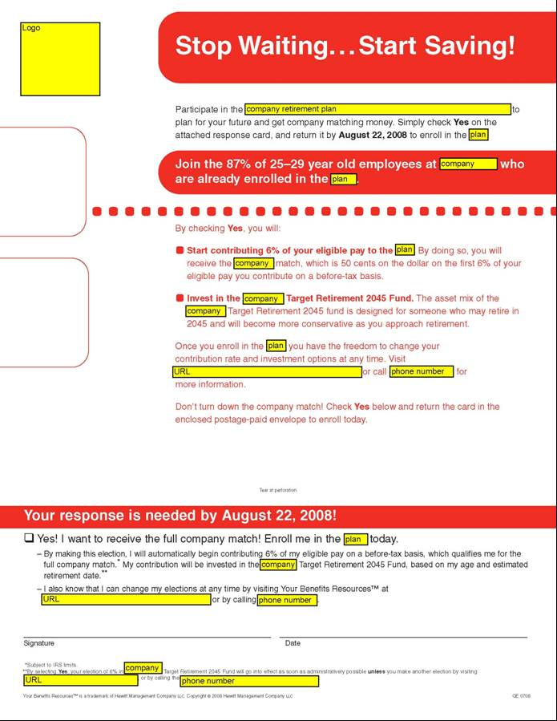
Notes:
60

Slide 61
Variation in peer information has no net impact on savings behavior
Small perverse effects for unionized workers
Small positive effect for non-unionized workers
Sources of variation of peer information:
  Exclusion vs. inclusion of peer information
  Variation in peer success (due to variation in comparison group)
All sources of variation generate consistent findings.

Slide 62
Nine claims about household finance
Households:
Have low levels of financial literacy
Have very few liquid assets (live hand to mouth)
Have substantial illiquid wealth
Have a high MPC out of liquid wealth and liquidity
Have a low MPC out of illiquid wealth
Don’t choose optimal financial service products
Barely change their behavior after financial education interventions
Have misaligned financial intentions and financial actions
Make financial choices that are easy to manipulate

Slide 63
Procrastination in retirement savings
Choi, Laibson, Madrian, Metrick (2002)
Survey
  Mailed to 590 employees (random sample)
  195 usable responses
  Matched to administrative data on actual savings behavior

Slide 64
Typical breakdown among 100 employees
Out of every 100 surveyed employees
68 self-report saving too little
24 plan to raise savings rate in next 2 months
3 actually follow through

Slide 65
Credit card pay down
Kuchler (2013)
Data from on-line financial management service ReadyForZero, which gives users help in managing their debt.
Median credit card debt at sign-up: $10,669.
When users sign up for the site, they plan to reduce their debt significantly.
Median plan over first 90 days: $1,947
Most users reduce their debt levels by very little
Median pay down over first 90 days: $234.

Slide 66
Nine claims about household finance
Households:
Have low levels of financial literacy
Have very few liquid assets (live hand to mouth)
Have substantial illiquid wealth
Have a high MPC out of liquid wealth and liquidity
Have a low MPC out of illiquid wealth
Don’t choose optimal financial service products
Barely change their behavior after financial education interventions
Have misaligned financial intentions and financial actions
Make financial choices that are easy to manipulate

Slide 67

Opt-in enrollment
Opt-out enrollment (auto-enrollment)
PROCRASTINATION
UNDESIRED BEHAVIOR:
Non-participation
DESIRED BEHAVIOR:
participation
START HERE
Madrian and Shea (2001); Choi, Laibson, Madrian, and Metrick (2002)

Slide 68
Active Choice
PROCRASTINATION
UNDESIRED BEHAVIOR:
Non-participation
DESIRED BEHAVIOR:
participation
Must choose for oneself
START HERE
Carroll, Choi, Laibson, Madrian, Metrick (2009)

Slide 69
Quick enrollment
PROCRASTINATION
UNDESIRED BEHAVIOR:
Non-participation
DESIRED BEHAVIOR:
participation
START HERE
Beshears, Choi, Laibson, Madrian (2013)

Slide 70

Quick enrollment
PROCRASTINATION
UNDESIRED BEHAVIOR:
Non-participation
DESIRED BEHAVIOR:
participation
START HERE
Beshears, Choi, Laibson, Madrian (2013)

Slide 71
Participation in 401K plans
(for a typical firm)
Default non-enrollment (opt in)
40%
Quick Enrollment
(“check a box”)
50%
Active choice (perceived req’t to choose)
70%
Default enrollment (opt out)
90%
Participation Rate (1 year of tenure)

Slide 72
Gauging employee attitudes to automatic enrollment
In surveys, 97% of employees in auto-enrollment firms report that they approve of auto-enrollment.
Even among employees who opt out of automatic enrollment, 79% report that they approve of auto-enrollment

Slide 73
Save More Tomorrow (SMarT)
Benartzi and Thaler (2004)
People pre-commit to saving more in the future.
Saving increases are synchronized with salary increases.
People remain in the plan unless they drop out.

Slide 74
Save More Tomorrow (SMarT)
Benartzi and Thaler (2004)
  Manufacturing firm hired a financial consultant to advise employees on how much to save
  Financial consultant typically advised 5% increases
  If participants did not accept the advice, they were offered the SMarT program

Slide 75
The First SMarT Program (cont.)
  Participants precommit to increase their saving rate by 3% per year
  Saving increases synchronized with pay raises
  The increases continue unless the participant opts out or hits the plan max

Slide 76
Participation Data

Slide 77
Saving Rates
Source: Brian Tarbox

Slide 78
Lessons from SMarT
Throw the kitchen sink at the problem.
  Upside: likely to work
  Downside: not sure what things matter
Subsequent studies reveal that linking to pay raises is nice but not essential.
Ease of sign up is essential.

Slide 79
Should Choice Architecture Influence Economic Outcomes?
Standard neoclassical theory: If transactions costs are small and stakes are large, choice architecture should not influence rational consumers.
In practice, defaults make an enormous difference:
  Organ donation (Johnson and Goldstein 2003)
  Car insurance
  Car purchase options
  Consent to receive e-mail marketing
  Savings
  Asset allocation

Slide 80
Outline
Seemingly minor nudges affect all saving and asset allocation outcomes
At least four psychological factors jointly contribute to these effects
  Financial illiteracy
  Endorsement
  Complexity and transaction costs (bounded rationality)
  Present-bias
  (Status quo bias/Loss Aversion)
The surprising weakness of incentive- and information-based interventions
Extensions to health domain

Slide 81
1. Seemingly minor nudges affect saving and asset allocation
i. Participation
ii. Contribution rates
iii. Asset allocation
iv. Pre-retirement distributions
v. Decumulation / annuitization

Slide 82
Participation,
Contribution rates, and
Asset Allocation
Automatic Enrollment in a US 401(k) plan
Welcome to the company
If you don’t do anything…
  You are automatically enrolled in the 401(k)
  You save 2% of your pay
Call this phone number to opt out of enrollment or change your investment allocations
First study: Madrian and Shea (2001)

Slide 83
Defaults and Participation
Beshears, Choi, Laibson, and Madrian (2010)
Notes:
83

Slide 84
Default Stickiness
Notes:
84

Slide 85
Choi, Laibson, Madrian, Metrick (2004)
Hired during AE
Hired before AE
Hired after AE ended

Slide 86
Employees enrolled under auto-enrollment cluster at the default contribution rate.
Default contribution
rate under automatic
enrollment

Slide 87
Participants stay at the automatic enrollment defaults for a long time.

Slide 88
Automatic enrollment: Summary
Automatic enrollment dramatically increases 401(k) participation
Participants hired under automatic enrollment tend to stay at the automatic enrollment defaults
Similar default effects are observed for auto-escalation otherwise known as SMART (Save More Tomorrow; Benartzi and Thaler, 2004)
  Has two flavors: opt-out auto-escalation and opt-in auto-escalation (it’s the opt-out version that works – very few opt-in on their own)
Also observe default effects for…
  cash distributions at separation
  saving rates at changing match thresholds

Slide 89
Gauging employee attitudes to automatic enrollment
In firms with standard 401(k) plans (no auto-enrollment), 2/3 of workers say that they should save more
Opt-out rates under automatic enrollment are typically only 5%-10% (opt-out rates rarely exceed 20%)
Under automatic enrollment employers report “no complaints” in 401(k) plans
In surveys, 97% of employees in auto-enrollment firms report that they approve of auto-enrollment.
Even among employees who opt out of automatic enrollment, 79% report that they approve of auto-enrollment
The US government has adopted automatic enrollment.

Slide 90
Additional evidence on Asset Allocation
Private account component of Swedish Social Security system (Cronqvist and Thaler, 2004)
  At inception, one-third of assets are invested in the default fund
  Subsequent enrollees invest 90% of assets in the default fund
Company match in employer stock (Choi, Laibson and Madrian, 2005b, 2007)

Slide 91
Active Choice
PROCRASTINATION
UNDESIRED BEHAVIOR:
Non-participation
DESIRED BEHAVIOR:
participation
Must choose for oneself
START HERE

Slide 92
The Flypaper Effect in Individual Investor Asset Allocation (Choi, Laibson, Madrian 2009)
Studied a firm that used several different match systems in their 401(k) plan.
I’ll discuss two of those regimes today:
Match allocated to employer stock and workers can reallocate
  Call this “default” case (default is employer stock)
Match allocated to an asset actively chosen by workers; workers required to make an active designation.
  Call this “active choice” case (workers must choose)
Economically, these two systems are identical.
They both allow workers to do whatever the worker wants.

Slide 93
Consequences of the two regimes
Balances in employer stock
 |  | Match Defaults into Employer Stock | Active choice
 | Own Balance in Employer Stock | 24% | 20%
 | Matching Balance in Employer Stock | 94% | 27%
 | Total Balance in Employer Stock | 56% | 22%

Slide 94
Cash Distributions
What happens to savings plan balances when employees leave their jobs?
Employees can request a cash distribution or roll balances over into another account
  Balances >$5000: default leaves balances with former employer
  Balances <$5000: default distributes balances as cash transfer
Vast majority of employees accept default (Choi et al. 2002, 2004a and 2004b)
When employees receive small cash distributions, balances typically consumed (Poterba, Venti and Wise 1998)

Slide 95
Post-Retirement Distributions
Social Security
  Joint and survivor annuity (reduced benefits)
Defined benefit pension
  Annuity
  Lump sum payout if offered
Defined contribution savings plan
  Lump sum payout
  Annuity if offered

Slide 96
Defined Benefit Pension Annuitization
Annuity income and economic welfare of the elderly
  Social Security replacement rate relatively low on average
  17% of women fall into poverty after the death of their spouse (Holden and Zick 2000)
For married individuals, three distinct annuitization regimes
  Pre-1974: no regulation
  ERISA I (1974): default joint-and-survivor annuity with option to opt-out
  ERISA II (1984 amendment): default joint-and-survivor annuity, opting out required notarized permission of spouse

Slide 97
Defined Benefit Pension Annuitization
Effect of joint-and-survivor default on annuitization
  Pre-1974: Less than half of married men have joint-and-survivor annuity
  Post-ERISA (I + II): joint-and-survivor annuitization increases 25 percentage points (Holden and Nicholson 1998)
  Post-1984 amendments: joint-and-survivor annuitization increases 5 to 10 percentage points (Saku 2001)

Slide 98
However, there are limits to defaults
Many/most households opt out of Defined Benefit annuitization (see Previterro 2010)
Most households generally opt out of aggressive defaults (Beshears, Choi, Laibson, and Madrian 2010)

Slide 99
Plan Details (Beshears et al 2010)
Large UK firm
Employees eligible for DC plan upon hire
Minimum employee contribution rate 4%, with one-for-one employer match on contributions between 12% and 18%
Immediate automatic enrollment at 12%
Study new hires, March 2006 – June 2007
Notes:
99

Slide 100
Opting Out of Default Contribution Rate
N = 900
Notes:
100

Slide 101
Opting Out of Default Contribution Rate
Notes:
101

Slide 102
2. Four mutually compatible psychological factors contribute to default effects
Low levels of financial literacy
Endorsement
Complexity and transaction costs
Present-bias

Slide 103
Who Stays at the Default?
Beshears, Choi, Laibson, and Madrian (2010)
Notes:
103

Slide 104
Sub-population that opts out
Beshears, Choi, Laibson, and Madrian (2010)
Notes:
104

Slide 105
Everyone at company including those at 12% default
Beshears, Choi, Laibson, and Madrian (2010)
Notes:
105

Slide 106
More data on financial illiteracy
John Hancock Financial Services Defined Contribution Plan Survey (2002)
38% of respondents report that they have little or no financial knowledge
40% of respondents believe that a money market fund contains stocks
Two-thirds of respondents don’t know that it is possible to lose money in government bonds
Respondents on average believe that employer stock is less risky than a stock mutual fund
Two-thirds report that they would be better off working with an investment advisor than managing investments solo

Slide 107
Lusardi and Mitchell (2010)
‘I understand the stock market reasonably well’
‘An employee of a company with publicly traded stock should have a lot of his retirement savings in the company’s stock’
‘It is best to avoid stock of foreign companies’
‘If the interest rate falls, bond prices will rise’

Slide 108
Lusardi and Mitchell (2010)
(30% agree): ‘I understand the stock market reasonably well’
(52% disagree) ‘An employee of a company with publicly traded stock should have a lot of his retirement savings in the company’s stock’
(51% disagree): ‘It is best to avoid stock of foreign companies’
(40% agree) : ‘If the interest rate falls, bond prices will rise’
  Sophisticated/correct answer to all questions: 5.8%

Slide 109
Financial illiteracy in mutual fund choice
Choi, Laibson, Madrian (2011)
Subjects allocate $10,000 among four funds
Randomly choose two subjects to receive any positive portfolio return during the subsequent year
Eliminate variation in pre-fee returns
  Choose among S&P 500 index funds
Unbundle services from returns
  Experimenters pay out portfolio returns, so no access to investment company services

Slide 110
One year of index fund fees on a $10,000 investment

Slide 111
Experimental conditions
Control
  Subjects receive only four prospectuses
  Prospectuses are often the only information investors receive from companies
Fees transparency treatment
  Eliminate search costs by also distributing fee summary sheet (repeats information in prospectus)
Returns treatment
  Highlight extraneous information by distributing summary of funds’ annualized returns since inception (repeats information in prospectus)

Slide 112
Fees paid by control groups (prospectus only)
Maximum
Possible
Fee
$443: average fee with random fund allocation
Minimum
Possible
Fee
N = 83
N = 30
6% of MBA Controls put all funds in minimum-fee fund
0% of College Controls put all funds in minimum-fee fund
t-test: p=0.5086

Slide 113
Ranking of factor importance
MBA controls
Fees
1-year performance
Performance since inception
Investment objectives
Desire to diversify among funds
Brand recognition
Performance over different horizon
Past experience with fund companies
Quality of prospectus
Customer service of fund
Minimum opening balance
College controls
1-year performance
Performance since inception
Desire to diversify among funds
Investment objectives
Quality of prospectus
Performance over different horizon
Brand recognition
Fees
Customer service of fund
Minimum opening balance
Past experience with fund companies

Slide 114
Effect of fee treatment
(prospectus plus 1-page sheet highlighting fees)
**
N = 83
N = 85
N = 30
N = 29
19% of MBA treatment put all funds in minimum-fee fund
10% of College treatment put all funds in minimum-fee fund
t-tests:
MBA: p=0.0000
College: p=0.1451

Slide 115
Ranking of factor importance
MBA fee treatment
Fees
1-year performance
Performance since inception
MBA controls
Fees
1-year performance
Performance since inception
College fee treatment
Fees
1-year performance
Performance since inception
College controls
1-year performance
Performance since inception
Desire to diversify among funds

Slide 116
Returns treatment effect on average returns since inception
**
**
N = 83
N = 84
N = 30
N = 28
t-tests
MBA: p=0.0055
College: p=0.0000

Slide 117
Returns treatment effect on fees
**
N = 83
N = 84
N = 30
N = 28
t-tests
MBA: p=0.0813
College: p=0.0008

Slide 118
Ranking of factor importance
MBA return treatment
1-year performance
Performance since inception
Fees
MBA controls
Fees
1-year performance
Performance since inception
College return treatment
Performance since inception
1-year performance
Desire to diversify among funds
College controls
1-year performance
Performance since inception
Desire to diversify among funds

Slide 119
Lack of confidence and fees
(all revealed preferences are not created equal)
*
N = 64
N = 136
N = 50
N = 46
N = 36
N = 5
t-tests: MBA 1 vs. 2, p=0.2013; MBA 1 vs. 3, p=0.0479;
College 1 vs. 2, p=0.2864; College 1 vs. 3, p=0.3335

Slide 120
We conducted one version with Harvard staff as subjects
400 subjects (administrators, faculty assistants, technical personal, but not faculty)
We give every one of our subjects $10,000 and rewarded them with any gains on their investment
  $4,000,000 short position in stock market

Slide 121
Data from Harvard Staff
Control Treatment
$518
Fees from
random
allocation
$431
3% of Harvard staff
in Control Treatment
put all $$$
in low-cost fund

Slide 122
Data from Harvard Staff
Control Treatment
Fee Treatment
$518
Fees from
random
allocation
$431
$494
3% of Harvard staff
in Control Treatment
put all $$$
in low-cost fund
9% of Harvard staff
in Fee Treatment
put all $$$
in low-cost fund

Slide 123
“If the chance of getting a disease is 10 percent, how many people out of 1,000 would be expected to get the disease?”
Fraction of people who answer “100”
Source: HRS; Agarwal, Driscoll, Gabaix, Laibson (2009)

Slide 124
“If 5 people all have the winning numbers in the lottery and the prize is two million dollars, how much will each of them get?”
Fraction of people who answer “400,000”
Source: HRS; Agarwal, Driscoll, Gabaix, Laibson (2009)

Slide 125
ii. Endorsement
A non-zero default is perceived as advice
Evidence
  Elective employee stock allocation in firms that do and do not match in employer stock (Benartzi 2001, Holden and Vanderhei 2001, and Brown, Liang and Weisbenner 2006)
  Asset allocation of employees hired before automatic enrollment (Choi, Laibson, Madrian 2006)

Slide 126
Choi, Laibson, and Madrian (2007)
Asset Allocation Outcomes of Employees Who are Not Subject to Automatic Enrollment
 | Any balances in default fund | All balances in default fund
Company D
Hired before AE, participated before AE | 13% | 2%

Slide 127
Choi, Laibson, and Madrian (2007)
Asset Allocation Outcomes of Employees Who are Not Subject to Automatic Enrollment
 | Any balances in default fund | All balances in default fund
Company D
Hired before, participated before AE | 13% | 2%
Hired before, participated after AE | 29% | 16%

Slide 128
iii. Complexity
Complexity → delay
Psychology literature (Tversky and Shafir 1992, Shafir, Simonson and Tversky 1993, Dhar and Knowlis 1999, Iyengar and Lepper 2000 )
Savings literature: each additional 10 funds produces a 1.5 to 2.0 percentage point decline in participation (Iyengar, Huberman and Jiang 2004)
Also results on complexity generating more conservative asset allocation (Iyengar and Kamenica 2007).
Quick enrollment experiments

Slide 129
Quick enrollment
PROCRASTINATION
UNDESIRED BEHAVIOR:
Non-participation
DESIRED BEHAVIOR:
participation
START HERE

Slide 130
Quick enrollment
PROCRASTINATION
UNDESIRED BEHAVIOR:
Non-participation
DESIRED BEHAVIOR:
participation
START HERE

Slide 131
Complexity and Quick Enrollment
Conceptual Idea
  Simplify the savings plan enrollment decision by giving employees an easy way to elect a pre-selected contribution rate and asset allocation bundle
Implementation at Company D
  New hires at employee orientation: 2% contribution rate invested 50% money market & 50% stable value
Implementation at Company E
  Existing non-participants: 3% contribution rate invested 100% in money market fund

Slide 132
Complexity and Quick Enrollment
Conceptual Idea
  Simplify the savings plan enrollment decision by giving employees an easy way to elect a pre-selected contribution rate and asset allocation bundle
Implementation at Company D
  New hires at employee orientation: 2% contribution rate invested 50% money market / 50% stable value
  Existing non-participants: employee selects contribution rate invested 50% money market / 50% stable value
Implementation at Company E
  Existing non-participants: 3% contribution rate invested 100% in money market fund

Slide 133
Quick Enrollment and
Savings Plan Participation

Slide 134
Simplified enrollment raises participation
Beshears, Choi, Laibson, Madrian (2006)
2005
2004
2003

Slide 135
iv. Present-Biased Preferences
Self control and savings outcomes: Why do today what you can put off until tomorrow? (Akerlof 1991, Laibson 1997; O’Donoghue and Rabin 1999; Diamond and Koszegi 2003, Gruber and Koszegi 2003, Della Vigna and Malmendier 2004, 2006)
Framework: exponential discounting with an additional factor, β<1, that uniformly down-weights the future.
U_{t} = u_{t} + β [δu_{t+1} + δ²u_{t+2} + δ³u_{t+3} + ...]

Slide 136
Lusardi and Tufano (2009)
How confident are you that you could come up with $2,000 if an unexpected need arose within the next month?
  I am certain…I could
  I could probably…
  I probably could not…
  I am certain…I could not
  Do not know.
47%
53%

Slide 137
SCF (age 65-74): In 2007, the median holding of
financial assets is $68,100
HRS (age 65-69): In 2008, the median holding of
financial assets is $12,500
among 1-person households
HRS (age 65-69): In 2008, the median holding of
financial assets is $111,600
among 2-person households

Slide 138
65-74 year old households
SCF: In 2007, the median holding of
financial assets is $68,100
HRS: In 2008, the median holding of
financial assets is $12,500
among 1-person households
HRS: In 2008, the median holding of
financial assets is $111,600
among 2-person households

Slide 139
Laibson, Repetto, and Tobacman (2004)
Use MSM to estimate discounting parameters:
  Substantial illiquid retirement wealth: W/Y = 3.9.
  Extensive credit card borrowing:
    68% didn’t pay their credit card in full last month
    Average credit card interest rate is 14%
    Credit card debt averages 13% of annual income
  Consumption-income comovement:
    Marginal Propensity to Consume = 0.25
    (i.e. consumption tracks income)

Slide 140
LRT Simulation Model
Stochastic Income
Lifecycle variation in labor supply (e.g. retirement)
Social Security system
Life-cycle variation in household dependents
Bequests
Illiquid asset
Liquid asset
Credit card debt
Numerical solution (backwards induction) of 90 period lifecycle problem.

Slide 141
LRT Results:
U_{t} = u_{t} + β [δu_{t+1} + δ²u_{t+2} + δ³u_{t+3} + ...]
β = 0.70 (s.e. 0.11)
δ = 0.96 (s.e. 0.01)
Null hypothesis of β = 1 rejected (t-stat of 3).
Specification test accepted.
Moments:
Empirical Simulated (Hyperbolic)
%Visa: 68% 63%
Visa/Y: 13% 17%
MPC: 23% 31%
f(W/Y): 2.6 2.7

Slide 142
Intuition
Short-run discount rate:
Long-run discount rate:

Slide 143
Procrastination (assume β = ½ , δ = 1).
Suppose you can join the plan today (effort cost $50) to gain delayed benefits $20,000 (e.g. value of match)
Every day you delay, total benefits fall by $10.
What are the discounted costs of joining at different periods?
Join Today: -50 + ½ [0] = -50
Join t+1: 0 + ½ [-50 - 10] = -30
Join t+2: 0 + ½ [-50 - 20] = -35
Join t+3: 0 + ½ [-50 - 30] = -40

Slide 144
Interaction with financial illiteracy
Consider someone with a high level of financial literacy, so effort cost is only $5 (not $50)
As before, every day of delay, total benefits fall by $10.
What are the discounted costs of joining at different periods?
Join Today: -5 + ½ [0] = -5
Join t+1: 0 + ½ [-5 - 10] = -7.5
Join t+2: 0 + ½ [-5 - 20] = -12.5
Join t+3: 0 + ½ [-5 - 30] = -17.5

Slide 145
Interaction with endorsement and complexity
Consider a plan with a simple form, or an endorsed form, so the effort cost is again only $5 (not $50)
As before, every period of delay, total benefits fall by $10.
What are the discounted costs of joining at different periods?
Join Today: -5 + ½ [0] = -5
Join t+1: 0 + ½ [-5 - 10] = -7.5
Join t+2: 0 + ½ [-5 - 20] = -12.5
Join t+3: 0 + ½ [-5 - 30] = -17.5

Slide 146
Procrastination in retirement savings
Choi, Laibson, Madrian, Metrick (2002)
Survey
  Mailed to 590 employees (random sample)
  195 usable responses
  Matched to administrative data on actual savings behavior

Slide 147
Typical breakdown among 100 employees
Out of every 100 surveyed employees
68 self-report saving too little
24 plan to raise savings rate in next 2 months
3 actually follow through

Slide 148
3. Alternative Policies
Paying employees to save
Education/disclosure
Peer marketing

Slide 149
$100 bills on the sidewalk
Choi, Laibson, Madrian (2009)
Employer match is an instantaneous, riskless return on investment
Particularly appealing if you are over 59½ years old
  Have the most experience, so should be savvy
  Retirement is close, so should be thinking about saving
  Can withdraw money from 401(k) without penalty
We study seven companies and find that on average, half of employees over 59½ years old are not fully exploiting their employer match
  Average loss is 1.6% of salary per year
Educational intervention has no effect

Slide 150
Financial education
Choi, Laibson, Madrian, Metrick (2004)
Seminars presented by professional financial advisors
Curriculum: Setting savings goals, asset allocation, managing credit and debt, insurance against financial risks
Seminars offered throughout 2000
Linked data on individual employees’ seminar attendance to administrative data on actual savings behavior before and after seminar

Slide 151
Effect of education is positive but small
 | Seminar attendees |  | Non-attendees
 | % planning to make change | % actually made change | % actually made change
Those not in 401(k)
Enroll in 401(k) Plan | 100% | 14% | 7%
Those already in 401(k)
Increase contribution rate | 28% | 8% | 5%
Change fund selection | 47% | 15% | 10%
Change asset allocation | 36% | 10% | 6%

Slide 152
Effect of education is positive but small
 | Seminar attendees |  | Non-attendees
 | % planning to make change | % actually made change | % actually made change
Those not in 401(k)
Enroll in 401(k) Plan | 100% | 14% | 7%
Those already in 401(k)
Increase contribution rate | 28% | 8% | 5%
Change fund selection | 47% | 15% | 10%
Change asset allocation | 36% | 10% | 6%

Slide 153
Effect of education is positive but small
 | Seminar attendees |  | Non-attendees
 | % planning to make change | % actually made change | % actually made change
Those not in 401(k)
Enroll in 401(k) Plan | 100% | 14% | 7%
Those already in 401(k)
Increase contribution rate | 28% | 8% | 5%
Change fund selection | 47% | 15% | 10%
Change asset allocation | 36% | 10% | 6%

Slide 154
Financial education effects are small
Seminar attendees have good intentions to change their 401(k) savings behavior, but most do not follow through
Financial education alone will not dramatically improve the quality of 401(k) savings outcomes
Choi et al (2005) study the effect of the Enron, Worldcom, and Global Crossing scandals on employer stock holding
  No net sales of employer stock in reaction to these news stories
  These scandals did not affect the asset allocation decisions of new hires.
  These hires did not affect the asset allocation decisions of new hires at other Houston firms.

Slide 155
Information and disclosure generally don’t do much on their own
Example
New York City calorie disclosure
(Elbel et al 2009)
Calories from
fast food purchases
 | Before | After
NYC (intervention city) | 825 | 846
Newark (control city) | 823 | 826

Slide 156
Social marketing and peer effects
Beshears, Choi, Laibson, Madrian, Milkman (2011)
How does information about your peers affect savings behavior?

Slide 157
Notes:
157

Slide 158
Variation in peer information has no net impact on savings behavior
Small perverse effects for unionized workers
Small positive effect for non-unionized workers
Sources of variation of peer information:
  Exclusion vs. inclusion of peer information
  Variation in peer success (due to variation in comparison group)
All sources of variation generate consistent findings.

Slide 159
4. Behavioral mechanism design
Specify a social welfare function (not necessarily based on revealed preference)
Specify a theory of consumer/firm behavior (consumers and/or firms may not behave optimally).
Solve for the institutional structure that maximizes the social welfare function, conditional on the theory of consumer/firm behavior.

Slide 160
Specific example of behavioral mechanism design: optimal defaults
Empirical evidence on active choice

Slide 161
A specific example:
Optimal Defaults – public policy
Mechanism design problem in which policy makers set a default for agents with present bias (Carrol, Choi, Laibson, Madrian and Metrick 2009)

Slide 162
Basic set-up of problem
Specify (dynamically consistent) social welfare function of planner (e.g., set β=1)
Specify behavioral model of households
  Flow cost of staying at the default
  Effort cost of opting-out of the default
  Effort cost varies over time → option value of waiting to leave the default
  Present-biased preferences → procrastination
Planner picks default to optimize social welfare function

Slide 163
Specific Details
Agent needs to do a task (once).
  Switch savings rate, s, from default, d, to optimal savings rate,
Until task is done, agent losses per period.
Doing task costs c units of effort now.
  Think of c as opportunity cost of time
Each period c is drawn from a uniform distribution on [0,1].
Agent has present-biased discount function with β < 1 and δ = 1.
So discount function is: 1, β, β, β, …
Agent has sophisticated (rational) forecast of her own future behavior. She knows that next period, she will again have the weighting function 1, β, β, β, …

Slide 164
Timing of game
Period begins (assume task not yet done)
Pay cost θ (since task not yet done)
Observe current value of opportunity cost c (drawn from uniform distribution)
Do task this period or choose to delay again?
It task is done, game ends.
If task remains undone, next period starts.
Pay cost θ
Observe current value of c
Do task or delay again
Period t-1
Period t
Period t+1

Slide 165
Sophisticated procrastination
There are many equilibria of this game.
Let’s study the equilibrium in which sophisticates act whenever c < c*. We need to solve for c*.
Let V represent the expected undiscounted cost if the agent decides not to do the task at the end of the current period t:
Likelihood of doing it in t+1
Likelihood of not doing it in t+1
Cost you’ll pay for certain in t+1, since job not yet done
Expected cost conditional on drawing a low enough c* so that you do it in t+1
Expected cost starting in t+2 if project was not done in t+1

Slide 166
In equilibrium, the sophisticate needs to be exactly indifferent between acting now and waiting.
Solving for c*, we find:
Expected delay is:

Slide 168
How does introducing β < 1 change the expected delay time?
If β=2/3, then the delay time is scaled up by a factor of
In other words, it takes times longer than it “should” to finish the project

Slide 169
V vs. V hat

Slide 170
A model of procrastination: naifs
Same assumptions as before, but…
Agent has naive forecasts of her own future behavior.
She thinks that future selves will act as if β = 1.
So she (mistakenly) thinks that future selves will pick an action threshold of

Slide 171
In equilibrium, the naif needs to be exactly indifferent between acting now and waiting.
To solve for V, recall that:

Slide 172
Substituting in for V:
So the naif uses an action threshold (today) of
But anticipates that in the future, she will use a higher threshold of

Slide 173
So her (naïve) forecast of delay is:
And her actual delay will be:
Being naïve, scales up her delay time by an additional factor of 1/β.

Slide 174
Summary
If β = 1, expected delay is
If β < 1 and sophisticated, expected delay is
If β < 1 and naïve, anticipated delay is
If β < 1 and naïve, true delay is

Slide 175
That completes theory of consumer behavior.
Now solve for government’s optimal policy.
Now we need to solve for the optimal default, d.
Note that the government’s objective ignores present bias, since it uses V as the welfare criterion.

Slide 176
Optimal ‘Defaults’
Two classes of optimal defaults emerge from this calculation
  Automatic enrollment
    Optimal when employees have relatively homogeneous savings preferences (e.g. match threshold) and relatively little propensity to procrastinate
  “Active Choice” — require individuals to make a choice (eliminate the option to passively accept a default)
    Optimal when employees have relatively heterogeneous savings preferences and relatively strong tendency to procrastinate
Key point: sometimes the best default is no default.

Slide 177
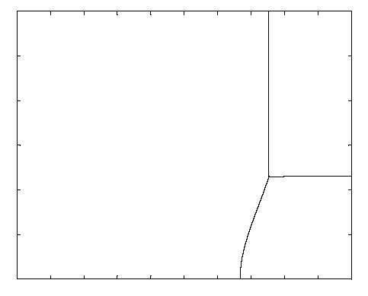
Preference Heterogeneity
30%
Low Heterogeneity High Heterogeneity
Offset
Default
Active Choice
Center
Default
0%
0
Beta
1

Slide 178
Lessons from theoretical analysis of defaults
  Defaults should be set to maximize average well-being, which is not the same as saying that the default should be equal to the average preference.
  Endogenous opting out should be taken into account when calculating the optimal default.
  The default has two roles:
    causing some people to opt out of the default (which generates costs and benefits)
    implicitly setting savings policies for everyone who sticks with the default

Slide 179
Empirical evidence on active choice
Carroll, Choi, Laibson, Madrian, Metrick (2009)
Active choice mechanisms require employees to make an active choice about 401(k) participation.
Welcome to the company
You are required to submit this form within 30 days of hire, regardless of your 401(k) participation choice
If you don’t want to participate, indicate that decision
If you want to participate, indicate your contribution rate and asset allocation
Being passive is not an option

Slide 181
Active choice in 401(k) plans
Active decision raises 401(k) participation.
Active decision raises average savings rate by 50 percent.
Active decision doesn’t induce choice clustering.
Under active decision, employees choose savings rates that they otherwise would have taken three years to achieve. (Average level as well as the multivariate covariance structure.)

Slide 182
Other active choice interventions
Active choice in asset allocation (Choi, Laibson, and Madrian 2009)
Active choice in home delivery of chronic medications (Beshears, Choi, Laibson, Madrian 2011)

Slide 183
Translation to the health domain
Similarities with saving behavior:
Individuals and society have aligned goals
  Improve health and control costs
Individuals want behavior change (just not right now)
  Improve diet
  Increase physical activity
  Stop smoking
  Adhere to therapeutic recommendations
  Utilize wellness programs

Slide 184
Information and disclosure generally don’t do much on their own
Example
New York City calorie disclosure
(Elbel et al 2009)
Calories from
fast food purchases
 | Before | After
NYC (intervention city) | 825 | 846
Newark (control city) | 823 | 826

Slide 185

Flu shot study: Control Condition
Employees informed of the dates/times of
workplace flu clinics

Slide 186

Flu Shot Study: Date Plan Condition
Employees invited
to choose a concrete
DATE for getting
a flu vaccine
Employees informed
of the dates/times of
workplace flu clinics

Slide 187

Date/Time Plan Condition
Employees invited
to choose a concrete
DATE AND TIME for
getting a flu vaccine
Employees informed
of the dates/times of
workplace flu clinics

Slide 188
Flu shot adherence
Milkman, Beshears, Choi, Laibson, and Madrian 2011
Flu shot letter
33.0%
Flu shot letter
+ date plan
34.6%
Flu shot letter
+ date plan
+ time plan
37.2%

Slide 189
Use Active Choice to encourage adoption of Home Delivery of chronic medication
Beshears, Choi, Laibson, and Madrian (in preparation)
Voluntary
No plan design change
Lower employee co-pay
Time saving for employee
Lower employer cost
Better medication adherence
Improved safety
Member Express Scripts Scientific Advisory Board
(Payments donated to charity by Express Scripts.)

Slide 190
Home Delivery Utilization for All Drug Classes
%
Beshears, Choi, Laibson, Madrian (2012)
Notes:
This graph displays the fraction of prescriptions that are filled through Home Delivery in a given month. The universe is all prescription refills in a given month. Note that Home Delivery prescriptions need to be refilled less often, since the supply of medicine goes up to 90 days. The supply limit for a retail prescription fill is 30 days. The Select Home Delivery program was in effect during the time period marked by the red vertical lines (November 2008-October 2009). In November 2009, a more aggressive approach to increasing take-up of home delivery was adopted by the company which accounts for the increase in home delivery utilization in this period. We do not analyze this second program in this paper.

Slide 191
Results from pilot study on 54,863 employees without home delivery taking chronic medication
Among those making an active choice:
Fraction choosing home delivery: 52.2%
Fraction choosing standard pharmacy pick-up: 47.8%

Slide 192
Results from pilot study at one company
Rxs by Mail*
After
Annual Savings at pilot company
Plan | $350,000+
Members | $820,000+
Total Savings | $1,170,000+
Before
* Annualized

Slide 193
Outline
Seemingly minor nudges affect behavior
At least four psychological factors jointly contribute to these effects
  Financial illiteracy
  Endorsement
  Complexity and transaction costs
  Present-bias
  (Status quo bias/Loss Aversion)
The surprising weakness of incentive- and information-based interventions
Extensions to health domain

Slide 194
Nine claims about household finance
Households:
Have low levels of financial literacy
Have very few liquid assets (live hand to mouth)
Have substantial illiquid wealth
Have a high MPC out of liquid wealth and liquidity
Have a low MPC out of illiquid wealth
Don’t choose optimal financial service products
Barely change their behavior after financial education interventions
Have misaligned financial intentions and financial actions
Make financial choices that are easy to manipulate
Bonus material: Translation to health
For Q&A sessions: People by and large don’t like annuities

