Slide 1
Behavioral Labor,
Behavioral Macro and Behavioral Finance
David Laibson
Harvard University
July 7, 2014
This deck contains many hidden slides that were not shown during the summer school.

Slide 2
Outline
Downward nominal wage rigidity
Belief Formation
Asset Pricing Anomalies
Bubbles and fluctuations

Slide 3
Psychological foundations of bubbles
Extrapolation – it’s a generally useful heuristic
LaPorta (2003)
Companies with high historical earnings growth have negative earnings surprises
Companies with low historical earnings growth have positive earnings surprises

Slide 4
Psychological foundations of bubbles
Return chasing
One standard deviation increase in an investor’s idiosyncratic 401(k) rate of return during the current year increases her 401(k) savings rate at year-end by 0.13 percentage points (Choi, Laibson, Madrian, and Metrick, 2009)
Depression babies avoid stocks in the 1960’s and “Oil shock babies” avoid stocks in the 1990’s (Malmendier and Nagel, 2009)
Brokerage investors repurchase individual stocks they previously sold for a gain while shunning individual stocks they previously sold for a loss (Barber, Odean, and Strahilevetz, 2004)
Finnish investors are more likely to subscribe to future IPOs if they experienced high returns in their prior IPO subscriptions (Kaustia and Knüpfer, 2008)

Slide 5
Psychological foundations of bubbles
Wishful thinking
e.g., Weinstein (1980)
Believe optimistic scenarios if they are plausible
70% of drivers believe they are in the top 30%
Good economic news is viewed uncritically and bad economic news is viewed skeptically

Slide 6
Social proof:
It must be right, if everyone else is doing it e.g., Asch (1954)
Psychological foundations of bubbles
Solomon Asch paradigm
7 male college students in the room
“task involving visual judgment”
One card contains a single line
Another card contains three lines

Slide 7
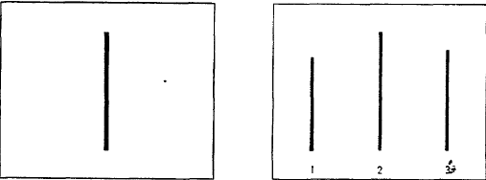
Social proof continued
a.
b.
c.
Which line on the left is the same as the line on the right?

Slide 8
Social proof continued
Task: pick out the matching line
Easy task: error rate for a lone subject is <1%
In actual experiment, 6 of the 7 subjects are fakes
In some trials the fakes respond erroneously
Error rate of real subject during such trials is 36.8%

Slide 9
Overconfidence
Psychological foundations of bubbles
Overconfidence (2nd moment)
Alpert and Raiffa (1982)
How many births occurred in these randomly chosen states in 2004?
  California, Illinois, Mississippi, North Carolina, Texas, Wyoming
Now provide a 99% confidence interval for each state.
In other words, for each state pick two numbers (low and high) so that there is a 99% chance that the true value of the number of births lies in that interval.

Slide 10
Number of births in 2004
CA | IL | MI | NC | TX | WY
545,071 | 180,934 | 42,810 | 119,851 | 384,389 | 6,807

Slide 12
Asset pricing
Agents perceive that the interest rate fell from 0.07 to 0.06 and the rate of housing appreciation rose from 0.03 to 0.04. (Prime variables are the new perceptions.)

Slide 13
Rational asset pricing
Agents should have recognized two things:
Lower steady state inflation would produce a lower steady state rate of house price appreciation.
Positive economic events in the 1990’s would not permanently raise the real rate of housing appreciation.

Slide 14
2. Short-run consequences
1995-2007
A simple model of consumption
Assume: no uncertainty & perfect capital markets

Slide 15
Manipulate expressions to yield consumption function

Slide 16
Special cases

Slide 17
Calibrate
Discount rate (-lnδ)? 1%-10%
Risk-free real interest rate (-lnR)? 2%-5%
Coefficient of relative risk aversion (γ)? 0.5-5
Let’s pick a benchmark case:
  δ = 0.95
  γ = 1
So λ = 0.05 (marginal propensity to consume)

Slide 18
Technical slide
Accumulated excess consumption: take 1998:1 as benchmark C/GDP ratio. Then take all future excesses (using the ratio as the predicted level) and accumulate. Then divide by GDP in 2008.
Trade deficits are just summed up.

Slide 19
The Basic Ingredients of the
Financial Crisis
Bubbles in housing and equities
Leverage in household and financial sectors
Consumption and Investment Cycle

Slide 20
2. Leverage
Household leverage
Leverage in financial sector

Slide 21
Down payments
(New construction from 2003-2007)
Half of down payments are less than 10% of purchase price
Size of down payment
Source: American Housing Survey 2007

Slide 22
Household leverage:
Fraction of home buyers with no downpayment
(New construction in last 4 years)
19%!
Source: American Housing Survey

Slide 23
Household mortgages divided by GDP
1952 Q1 – 2008 Q4

Slide 24
Financial sector leverage
Gross Leverage Ratios exceeded 30:1 at
Merrill Lynch
Lehman Brothers
Morgan Stanley
Bear Sterns
Only Goldman Sachs has stayed below this threshold with a maximum leverage ratio of 24.

Slide 25
Lehman at the start of the financial crisis
Assets (billions $) |  | Liabilities and stockholders' equity (billions $)
Cash | 20 | Short-term borrowing | 546
Securities and other assets | 671 | Long-term debt | 123
 |  | Total Liabilities | 669
 |  | Stockholders' equity | 22
Total assets | 691 | Total Liabilities + Stockholders' equity | 691
Lehman Brothers, November 30, 2007

Slide 26
Why so much leverage?
Why were households so leveraged?
  Belief that housing would appreciate
  Natural channel to fund consumption boom
Why were banks so leveraged?
  Belief that tranched asset-backed securities were really AAA (e.g., CDO’s)
  Implicit belief that national housing prices would appreciate (or at least stabilize)

Slide 27
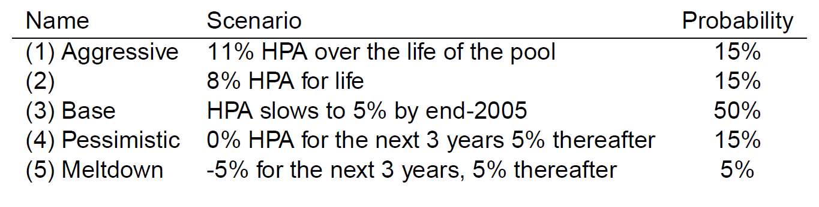
Lehman’s forecasts in 2005
HPA = House Price Appreciation
Source: Gerardi et al (BPEA, 2008)

Slide 28
Alan Greenspan
“While local economies may experience significant speculative price imbalances, a national severe price distortion seems most unlikely in the United States, given its size and diversity.” (October, 2004)
If home prices do decline, that “likely would not have substantial macroeconomic implications.” (June, 2005)
Though housing prices are likely to be lower than the year before, “I think the worst of this may well be over.” (October, 2006)

Slide 29
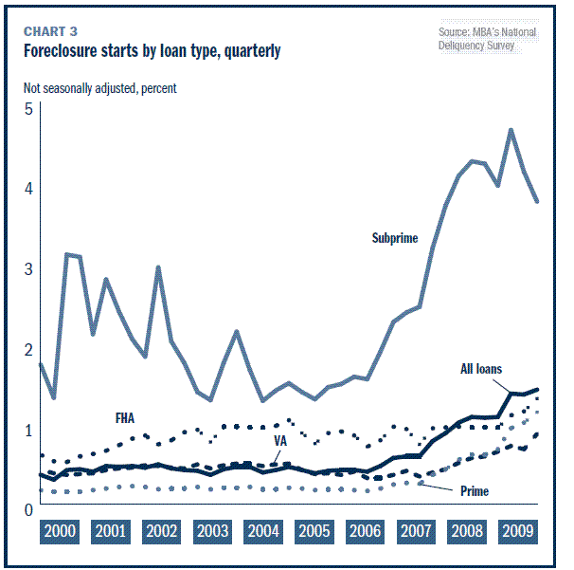
Quarterly rates of foreclosure filings for different categories of mortgage, as well as the aggregate category, which is labeled “All loans”. The annualized rate of foreclose is the sum of the quarterly rates of foreclosure. So a 1.5% quarterly foreclosure rate for four consecutive quarters generates a 6% annual rate of foreclosure.

Slide 30
Consequences for banking sector
Bear Sterns sold in a fire sale to JP Morgan Chase (3/2008)
Lehman Brothers goes bankrupt (9/2008)
WaMu enters receivership and sold to JP Morgan Chase (9/2008)
Wachovia sold in a fire sale to Wells Fargo (9/2008)
Merrill Lynch sold in a fire sale to Bank of America (9/2008)
Citigroup, Bank of America, and Morgan Stanley on the brink of failure/bankruptcy (12/2008)
All together about 400 US banks fail (2007-2012)

Slide 31
Case studies
Four (quick) case studies:
Bear Sterns: Bear was sold (3/16/2008) to JPMorgan Chase.
Lehman Brothers: Lehman filed for Chapter 11 protection (9/15/2008) and was dissolved.
Washington Mutual: WaMu bank was seized by the Office of Thrift Supervision (9/25/2008) and the banking subsidiary was sold to JPMorgan Chase. Washington Mutual, Inc., the holding company, filed Chapter 11.
Citigroup: Citi was protected from failing by the Treasury and the Fed.

Slide 32
Bear
Bear was the first major investment bank to fail during the current crisis
3/16/2008: Under pressure, Bear signs a “merger” agreement with JP Morgan Chase
The final price ends up being $10 per share (95% fall in value for Bear's shareholders)
The Fed makes the deal possible by issuing a non-recourse loan of $29 billion to JP Morgan Chase. The loan is collateralized by toxic assets on Bear's balance sheet. (Maiden Lane portfolio)

Slide 33
Lehman
Fed received criticism for bailing out Bear. Critics argued that there was now a moral hazard problem, since Bear's creditors received no haircut (and even Bear'shareholders walked away with $10/share). In response, the Fed vowed to draw a tougher line next time.
9/15/2008: Lehman Brothers fails to receive support from the Fed and files for Chapter 11 protection.
This is the largest bankruptcy in U.S. history. Lehman's failure generates a "systemic" shock as creditors lose 90 cents on the dollar.

Slide 34
WaMu
WaMu was the largest savings and loan association.
9/2008: bank-run depletes 9% of deposits.
9/25/2008 (a Thursday): OTS seizes Washington Mutual Bank from Washington Mutual, Inc. and places it into FDIC receivership. That night, FDIC sells the bank (minus unsecured debt) to JPMorgan Chase for $1.9 billion. Bank re-opens the next day.
Stripped of its principal asset, the holding company, Washington Mutual, Inc. files Chapter 11 on 9/26/2008. WaMu equity investors are effectively wiped out.

Slide 35
Citi
Citi is often claimed to be “too big to fail”
October 2008: TARP investment of $25 billion
11/24/2008: Treasury provides another $20 billion in TARP funds; Treasury, Fed, and FDIC will cover 90% of the losses on a $335-billion portfolio after Citi absorbs the first $29 billion. Citi gives US $27 billion of preferred shares and warrants to acquire stock. The government dictates mortgage modifications, salary caps, and a dividend cap (1 cent a share).
2/27/2009: US takes a 36% equity stake by converting $25 billion into common shares.
Year-end 2009: Citi repays remaining $20 billion loan (with $3.1 bl interest), terminates its loss-sharing deal, and government starts to sell its common shares.

Slide 36
The Basic Ingredients
Bubbles in housing and equities
Leverage in household and financial sectors
Consumption and Investment Cycle

Slide 37
3. Consumption and Investment Cycle
A simple model of consumption.
Consumption equals annuity value of wealth.
C = 0.05 * wealth

Slide 38
Consequences for consumption
Bubble reaches a peak of at least $12 trillion
With an MPC of 0.05, consumption should rise by $600 billion
Another way of thinking about this is in units of GDP.
Consumption as a share of GDP should rise by

Slide 39
Consumption over GDP
1947:1 to 2010:4

Slide 40
US trade deficit supports the higher level of consumption
Trade balance over GDP 1947.1 – 2010.4

Slide 41
A match between the consumption boom and the trade deficit
Let’s use 1998:1 as the beginning of the boom
And 2008 as the end
Accumulated consumption boom is 42% of 2008 GDP
Accumulated trade deficits are 43% of 2008 GDP

Slide 42
Consequences for consumption
Wealth falls by $14 trillion
With a Marginal Propensity to Consume of 0.05, consumption should fall by $700 billion, which is about 7% of aggregate consumption
So ln(consumption) should fall by 0.07.

Slide 43
Log(Real Consumption)
1947:1 to 2010:4

Slide 45
Investment boom
Think about Tobin’s q
As housing prices go up – a rise in q -- a boom in residential housing construction begins
When housing prices fall – a fall in q – the boom in residential construction ends

Slide 46
Investment ratio
Investment divided by GDP 1947:1 to 2009:4
1998:1
0.17
Total Investment
Residential
Investment

Slide 47
Homes for Sale
(thousands of units)
2226

Slide 48
The Basic Ingredients of the Financial Crisis
Bubbles in housing and equities
Leverage in household and financial sectors
Consumption and investment collapse

Slide 49
Behavioral Labor
Labor economists have long been sympathetic to behavioral economics.
Topics in behavioral labor:
  Incentives and contracts (incompleteness, reference points)
  Organizations (teams, information aggregation)
  Bargaining (reference points, self-serving biases, negotiation)
  Social preferences (reciprocity and gift exchange)
  Intrinsic vs. extrinsic motivations (a fine is a price)
  Peer effects, social networks
  Gender effects (competition)
  Loss aversion and labor supply (daily income targets)
  Efficiency wages (worker morale)
  Discrimination (audit studies)
  Executive compensation
  Wage rigidity (especially downward nominal wage rigidity)

Slide 50
Behavioral Macro
Probably the least developed behavioral field (other than behavioral econometrics)
Why?
  Many degrees of freedom (e.g., assumptions or parameters)
  Relatively little data (quarterly data back to 1947)
  Hard to “reject” rational benchmark
Con: How will you convince macroeconomists?
Pro: Not an over-crowded intellectual space.

Slide 51
Topics in behavioral macro
Animal spirits and consumer confidence
Sticky prices (slow adjustment)
Sticky information, rational inattention, bounded rationality
Sparse dynamic programming (Gabaix)
Consumption (MPC out of windfalls, tax rebates)
Lifecycle savings
Pension schemes and the social security system
Investment (investment incentives)
Fiscal policy
Political economy (voter behavior)
Money illusion
Downward nominal wage rigidity
Bubbles
Rational expectations vs. extrapolative beliefs

Slide 52
Behavioral Finance
The first and, so far, the most successful applied topic in behavioral economics
Why? Data availability.
Economic theories make sharp predictions and when you have lots of good data those predictions can be falsified. This opens the door to alternative models.

Slide 53
Topics in behavioral finance
Household finance
  Credit (payday loans, credit cards, mortgages)
  Asset allocation (company stock, mutual funds, advise industry)
  Savings (retirement, leakage, defaults, auto-escalation)
  Cognitive decline and decision-making among older adults
Corporate finance
  Superstar CEO’s
  Cash-flow sensitivities
  Executive compensation
Asset pricing (anomalies)
  Momentum
  Value
  Small stocks
  IPO underperformance
  Equity premium puzzle

Slide 54
Selected topics in behavioral labor, behavioral macro and behavioral finance
Money illusion
Downward nominal wage rigidity
Belief formation & learning
Asset pricing anomalies
Bubbles and the financial crisis

Slide 55
1. Consumption
Present-bias (e.g., Laibson, Repetto, and Tobacman 2007)
Mistakes/boundedly rational (“sparse”) dynamic programming (e.g., Lusardi, Gabaix)
Animal spirits and consumer sentiment (e.g., Akerlof and Shiller 2010, Carroll 1995)
Reference points (Bowman, Minehart, and Rabin)
Habit formation and Keeping Up with the Joneses (Constantinides 1987, Abel 1990, Campbell and Cochrane 1999)

Slide 56
The Tale of Depression Babies
“I don’t know about you, but my parents were depression babies, and as a result, avoided the stock market and all things risky like the plague.” Source: moneytalks.org
Is it true?
And: Is it true beyond the Great Depression? Will it be true again?
  Does the personal experience of a large stock-market and macro-economic shock have a lasting impact on investors’ risk attitudes?
  If so, does it affect tangible finance and macro variables such as stock market valuation?

Slide 57
Research Question
Do individuals’ “macro/finance histories” affect their risky choices – differently than information about the historical outcomes?
Illustration: stock-market participation rates at age 36-45
Notes:
average for the cohorts born before 1921 contain only ages 44 and 45;
average for the cohorts 1961-70 contains only ages 36-43.
➔ average participation rate for the generation that experienced the 1930s Great Depression as teenagers or adults is 13%, significantly lower than the rates of all other cohorts, which range from 26 to 32%.
➔ 1931-1940 cohort experienced the post-war boom years during their young adult life, has a participation rate at age 36-45 that is more than twice as high.
➔ 1941-50 cohort, the rate dips again, consistent with the fact that this cohort reached age 36-45 just after the depression years of the 1970s.
“In this paper, we test whether these cohort differences persist after controlling for a wide range of demographics.”
PROBLEMS WITH THE GRAPH:
+ The results for that graph are quite sensitive to how one cuts the data (e.g. 1921 - 1930 or 1925 - 1934 etc)
+ our later estimates imply that memory fades away after 30 years or so.
+ we make this big deal about the importance of age and time effects later on, so it's a little funny if we use a figure that shows stuff confounded by age and time effects (the scatter plot we have now addresses both: time effects are eliminated by looking at cross-sectional differences, and age effects would imply that the cross-sectional differences between young and old are the same each year, so one can easily rule those out as well).

Slide 58
Illustration
Average participation rate for the generation that experienced the 1930s Great Depression as teenagers or adults is 13%, significantly lower than the rates of all other cohorts, which range from 26 to 32%.
1931-1940 cohort experienced the post-war boom years during their young adult life, has a participation rate at age 36-45 that is more than twice as high.
1941-50 cohort, the rate dips again, consistent with the fact that this cohort reached age 36-45 just after the depression years of the 1970s.
➔ Do these cohort differences persist after controlling for a wide range of demographics?

Slide 59
1. Money illusion
Treating nominal variables as if they were real variables (i.e., inflation-adjusted)

Slide 60
Shafir, Diamond, Tversky (1997)
Consider two individuals, Ann and Barbara, who graduated from the same college a year apart. Upon graduation, both took similar jobs with publishing firms. Ann started with a yearly salary of $30,000. During her first year on the job there was no inflation, and in her second year Ann received a 2% ($600) raise in salary. Barbara also started with a yearly salary of $30,000. During her first year on the job there was a 4% inflation, and in her second year Barbara received a 5% ($1500) raise in salary.

Slide 61
Ann (+2% real; +2% nominal)
Barbara (+1% real; +5% nominal)
Economic question: As they entered their second year on the job, who was doing better in economic terms?
  Ann (71%) Barbara (29%)
Happiness: As they entered their second year on the job, who do you think was happier?
  Ann (36%) Barbara (64%)
Job dissatisfaction: As they entered their second year on the job, each received a job offer from another firm. Who do you think was more likely to leave her present position for another job?
  Ann (65%) Barbara (35%)

Slide 62
More survey evidence
Kahnenam, Knetsch and Thaler (1986)
Respondents were asked whether a number of different scenarios were fair or unfair.
62% reported that it would be unfair for a company making a small profit to decrease wages by 7% if inflation were 0.
22% reported that it would be unfair for a company making a small profit to increase wages by 5% if inflation were 12%.

Slide 63
More Survey Evidence: Kaur (2011)
Last year, the prevailing wage in a village was Rs. 100 per day. This year, the rains were very bad and so crop yields will be lower than usual.
A) There has been no change in the cost of food and clothing. Farmers decrease this year’s wage rate from Rs. 100 to Rs. 95 per day.
                64% say that this is unfair
B) The price of food and clothing has increased so that what used to cost Rs. 100 before now costs Rs. 105. Farmers keep this year’s wage rate at Rs. 100.
                38% say that this is unfair
C) The price of food and clothing has increased since last year, so that what used to cost Rs. 100 before now costs Rs. 110. Farmers increase this year’s wage rate from Rs. 100 to Rs. 105.
                9% say that this is unfair

Slide 64
Prevalence of money illusion decreases with education
Beshears, Choi, Laibson, Madrian, and Zeldes (2011)
Education group | Fraction with money illusion
Low (HS degree or less) | 45 %
Medium (some college) | 40 %
High (college or higher) | 22 %

Slide 65
2. Downward nominal wage rigidity
Nominal wages don’t fall

Slide 66
Ethnographic evidence
Bewley and Brainard (1993)
Survey of 61 firms in Connecticut in 1992 (immediately following a recession).
11 firms reported nominal wage cuts during the last ten years.
Of these 11 firms, most had done so in response to serious problems. In two cases, the cuts had been rescinded within six months.
Employers reported that morale problems would arise if their firm cut wages, unless the firm was under severe duress – for instance, on the brink of bankruptcy.

Slide 67
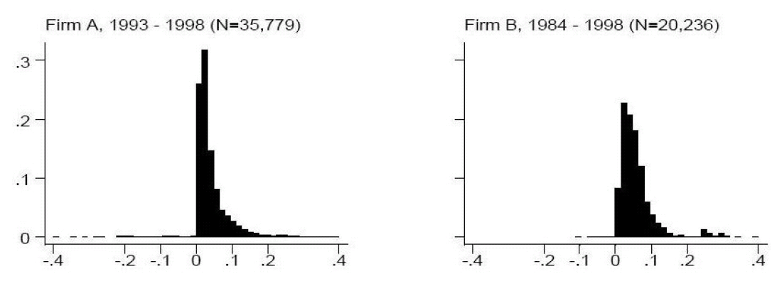
Downward nominal wage rigidity
Cliff at zero for nominal wage changes (%)
Fehr and Goette (2005)

Slide 68
More recent evidence: Hipsman (2013)
Base pay % increase among those employed in 2003 and 2004
58 (0.34%) had cuts, 1,964 (10.18%) had freezes, and 15,091 (88.18%) had raises.

Slide 69
More recent evidence: Hipsman (2013)
Base pay % increase among those employed in 2007 and 2008
46 (0.36%) had pay cuts, 6,913 (54.58%) had pay freezes, and 5,707 (45.06%) had pay raises.

Slide 70
Shift in labor demand without wage rigidity
Real
wage
Labor Supply
Pre-recession
wage
1: Pre-recession
Recession
wage
2: Recession
Pre-recession Labor Demand
Recession Labor Demand
Recession
employment
Pre-recession
employment
Labor

Slide 71
Shift in labor demand with wage rigidity
Real
wage
Labor Supply
Downward rigid
wage
2: Recession
1: Pre-recession
Pre-recession Labor Demand
Recession
Labor Demand
Recession
employment
Unemployment : gap between quantity of labor supplied and quantity of labor demanded at the market wage
Pre-recession
employment
Labor

Slide 72
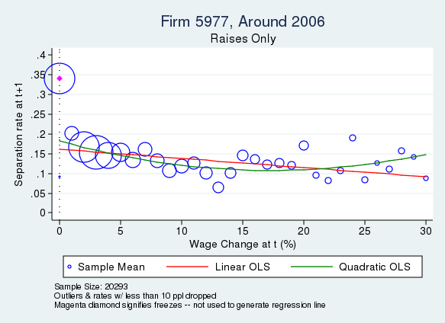
In most cases, wage freezes in year t predicts separations in year t+1

Slide 73
More details

Slide 74
Is downward nominal wage rigidity important for fluctuations in unemployment?
Yes:
  Longitudinal administrative wage data
  Minimal surplus in labor relationship
  No other active margins of adjustment
  Low level of inflation
  Low rate of labor productivity growth
  Rigidities also affect the hiring margin (through fairness norms)
No:
  Longitudinal household wage surveys
  Substantial surplus in labor relationship
  Many other active margins of adjustment (benefits/bonuses)
  High level of inflation
  High rate of labor productivity growth

Slide 75
PAPER (ADMIN DATA) | COHORT | YEARS | DATA | DESCRIPTION | % CUTS
NON-U.S. DATA
Nickell & Quintini (2003) | UK | 1980’s (“High Inflation”) | New Earning Survey (NES) | 1% sample of tax withholding program. Employer survey (usually electronic). Pay is calculated as (pay in week - overtime pay) / (hours in week - overtime hours). | 5 – 10%
“” | “” | 1990’s (“Low Inflation”) | “ ” | “ “ | 10 – 20%
Ingram (1991) | UK | 1979-1989 | CBI Settlements Data | Confederation of British Industry settlements data for the manufacturing sector; about 12,000 settlements over a 10-year period. | Neglible
Bauer et al (2007) | West Germany | 1975-2001 | Social Security Records | From 2% sample from German Soc. Sec. records. Pay is daily pay, aggregating all S.S.-eligible income, calculated from event history data. Only full-time, no extra pay info, censored at very low and very high pay. Only job stayers, by firm and job code. No mention of corrections for paid leave. | Looks like 10-20%
Devicienti (2002) | Italy | 1985-1999 | Social Security Records | Sample from Italian SS data; aggregates all remuneration, excludes hours but includes days worked, does not include paid leave, only firm-stayers but job status unknown | 5-15%
Castellanos, Garcia-Verdu, & Kaplan (2004) | Mexico | 1985-2001 | Social Security Records | Includes all SS-eligible income in daily terms, no hours or days worked info. Only firm-stayers. | 0-10%
Dwyer & Leong (2000) | Australia | 1987-1999 | Pooled Firm Data | Payroll data provided and pooled by a private HR firm. | 3.5%
Fehr & Goette (2005) | Switzerland | 1993-1999 | Service Firm Data | Personnel records from large firm in the service industry. | 1.7%
“” | “” | 1984-1998 | Service Firm Data | Personnel records from a medium-sized firm in the service industry. | 0.4%
Crawford & Harrison (1997) | Canada | 1992-1996 | Union Settlements | Data from union agreements for large bargaining units; cuts analyzed for private sector workers. | 1.7%
Agell & Bennmarker (2002) | Sweden | 1990s | Firm Survey | Survey of 885 Swedish firms about the “crisis years” of the 1990s. 3.2% of firms surveyed report cutting wages during crisis; authors estimate that 1.1% of all workers received a wage cut, making wage cuts as a proportion of pay changes even lower. | < 1.1%
U.S. DATA
Altonji & Devereux (1999) | US | 1996-1997 | Financial Firm Pay Data |  | < 3%
Akerlof et al (1996) | US | 1959-1978 | BLS Current Wage Developments | Reported on union bargaining contracts, but includes non-union data. | < 0.5%
“” | US | 1995 | Phone Survey | Washington D.C. area phone survey of wages changes of 409 applicable respondents. | 2.7%
“” | US | 1970-1994 | BLS Settlements Data | BLS data on contract settlements involving over 1,000 workers. Average over 1970-1994. | 2.3%
Wilson (1999) | US | 1982-1994 | Payroll data | Firm is private service non-profit | < 0.1%
“” | “” | 1969-1988 | Payroll data | Firm is for-profit, service sector | 0.1%
Lebow, Sachs, Wilson (1999) | US | 1981-1998 | ECI Micro-data | Takes average wage within firms for job description, not correcting for composition. | 8-18%

Slide 76
^{[1]} Barwell & Schweitzer (2007) use similar data and arrive at similar results, although they do not explicitly report the percentage of pay changes that are cuts. Carruth and Oswald (1989) use UK union settlements data and claim that nominal pay cuts are generally rare, although the relevant book (“Pay determination and industrial prosperity”) is not available online. Smith (1998) does not use administrative data, but reports a similar number of cuts (17%) among those in a household survey that report actually checking their pay slips.
^{[2]} Knoppik & Beissinger (2001) use similar data and arrive at similar results. They explicitly hypothesize that the high proportion of cuts “mainly reflects changes in working hours and not changes in hourly wages” (11). Bonin & Radowski (2008) also argue that German wages are rarely cut in a firm survey, where they find that about 15% of firms report cutting wages of “some” of their employees in the previous five years.
^{[3]} Fares & Hogan (2000), Crawford (2001), Crawford & Wright (2001), and Christofides & Stengos (2002) use similar data and arrive at similar results. Crawford & Harrison (1997) also include three firm-level surveys that are not individual level, and thus not comparable, but do suggest that rollbacks are generally rare, that non-unionized wages appear more flexible, and that bonus pay adds flexibility to wage changes.
^{[4]} Agell & Lundborg (2003) and Ekberg (2004) corroborate these findings for Sweden.
^{[5]} Table 3 cites further evidence of low proportions of cuts, mostly summarizing their own findings and personal communication with various authors.

Slide 77
A similar table is found in Kuroda & Yamamoto (2007):
http://www.imes.boj.or.jp/english/publication/mes/2007/me25-2-2.pdf
…in Yates (1998):
http://www.bankofengland.co.uk/publications/Documents/workingpapers/wp82.pdf
…in Akerlof et al (2003), Table 3:
http://www.jstor.org/stable/pdfplus/2534646.pdf?acceptTC=true
…and in Camba-Mendez et al, page 104:
https://www.ecb.de/pub/pdf/other/monetarypolicystrategyreview_backgrounden.pdf#page=92
The International Wage Flexibility Project in the mid-2000s -- Dickens et al (2006) -- is a notable attempt to reconcile divergent findings on wage distributions. http://www.econstor.eu/bitstream/10419/60630/1/526661933.pdf
(listing of salary surveys for US & Canada):
http://www.erieri.com/erisalarysurvey/fuses/uscanwage.htm

Slide 78
Money illusion in annuity preferences
Beshears, Choi, Laibson, Madrian, and Zeldes (2011)
Ask subjects to choose between two annuities in X% inflation environment; we’ll vary X across study arms
No money illusion?
  If the real payout streams of the two annuities are held fixed as X is varied (-2% real growth of the annuity vs. 0% real growth of the annuity), the annuity choice should not be affected by the X% rate of inflation
Complete money illusion,
  People treat nominal variables as if they were real
  → If nominal payouts are identical, choices should be the same

Slide 79
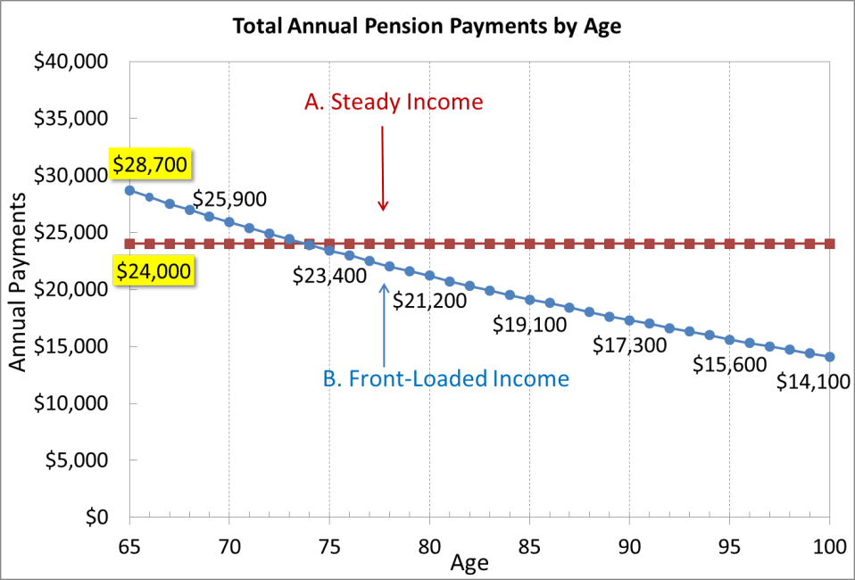
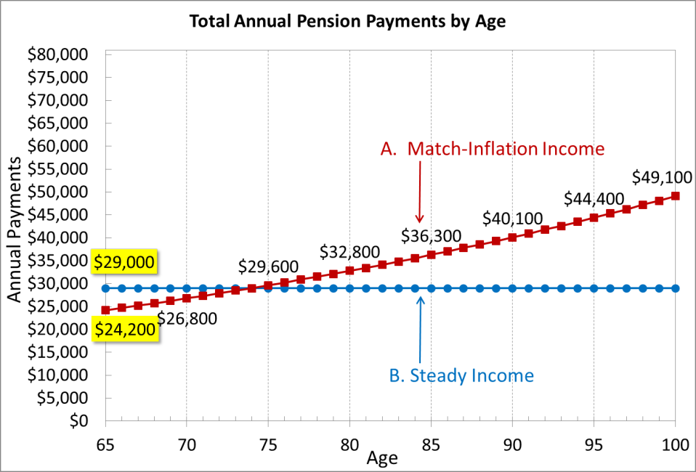
No inflation economy
88% choose flat (red)
12% choose declining (blue)
0% real path
-2% real path
2% inflation economy
72% choose rising (red)
28% choose flat (blue)

Slide 80
Money illusion
Evidence for money illusion
Real slope | No inflation | Inflation
Prefer 2% to 0% | 43% | 55%
Prefer 0% to -2% | 88% | 72%
≠
≠
Notes:
Let’s test this formally.

Slide 81
Prevalence of money illusion decreases with education
Beshears, Choi, Laibson, Madrian, and Zeldes (2011)
Education group | Fraction with money illusion
Low (HS degree or less) | 45 %
Medium (some college) | 40 %
High (college or higher) | 22 %

Slide 82
Estimating the fraction of the population with money illusion
Stylized model: assume two types of people
  Complete money illusion (fraction α of population)
  No money illusion (fraction 1- α of population)
Assume taste for present versus future real consumption uncorrelated (across population) with money illusion

Slide 83

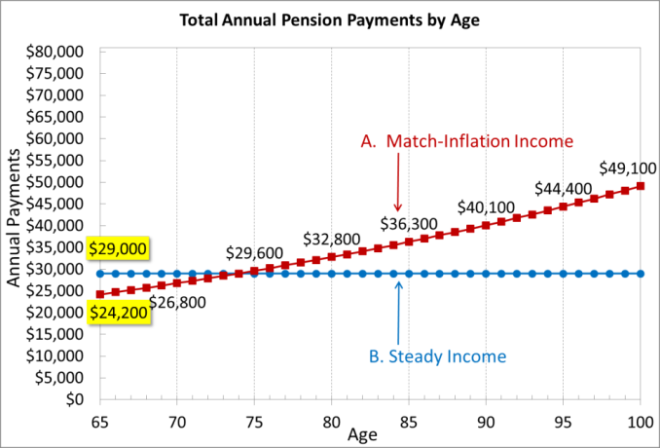
Reality versus perceptions, with and without money illusion
What they are shown (nominal)
What they perceive (real)
No money illusion (1- α)
72% choose rising (red)
Money illusion
(α)
We can use choices in the no-inflation scenario to estimate α

Slide 84
Estimating the fraction of the population with money illusion with money illusion
Money illusion? | Frac of pop | Option | Perceived real growth | % of row predicted to choose A over B | # of people predicted to choose A over B
No | 1-α | A | 0% | 88% | (1-α) * 88%
 |  | B | -2%
Yes | α | A | 2% | 43% | α * 43%
 |  | B | 0%
Total |  |  |  |  | 72%
(1-α) *(88%) + α*(43%) = 72%
α =(88%-72%) / (88% - 43%) = 16%/45% = 37%
Notes:
**NOTE THAT USING 2 DECIMAL PLACES ALPHA = 37%... See Excel

Slide 85
Application
Policy recommendation: Reduce real wages in Southern periphery of Europe by increasing inflation rate in Eurozone.
Contentious issue.
How does this effect the inflation anchor?

Slide 86
Topics in behavioral macro
Asset pricing (discussed earlier)
Belief formation & learning (this lecture)
Money illusion (this lecture)
Downward nominal wage rigidity (this lecture)
Consumption (overview)
Other undeveloped topics: political economy, investment

Slide 87
Definition: Behavioral Economics
Behavioral economics is just like the rest of economics, but also includes psychological factors.
Adds psychology to economics, particularly cognitive psychology, social psychology, and neuroscience

Slide 88
An obnoxious definition
The Guardian (newspaper): The study of “how people actually make decisions rather than how the classic economic models say they make them.”

Slide 89
Definition: continued
Pay special attention to these psychological factors:
  Imperfect rationality
  Imperfect self-control
  Imperfect selfishness (social preferences)
  But this list is only a start (e.g. psychological conceptions of personality)
Emphasize the importance of microfoundations
  Preferences
  Beliefs
  Cognition
Take experimental evidence seriously
  but don’t rely exclusively on it

Slide 90
3. Belief Formation and Learning
Malmendier and Nagel (2010)
How is past experience translated into beliefs/forecasts about future outcomes
Methodology:
  Measure individual investors’ “stock market experience” over their lives so far and relate it to stock market investment
  Measure individual investors’ “bond market experience” over their lives so far and relate it to bond investment

Slide 91
Data
Survey of Consumer Finances
  1983-2007: Triennial, cross-sectional, household-level
  Over-sampling of high-income households
  Detailed data on asset holdings and demographics
Precursor of Survey of Consumer Finances
  Starting 1947, partly annually (with gaps)
  Pre-1960 only 5- to 10-year age brackets
  1960-1977: use all waves with stock- and bond-market participation data (1960, 1962, 1963, 1964, 1967, 1968, 1969, 1970, 1971, 1977, except 1971 for bonds)
Notes:
SCF from 1983 to 2004: obtained from the Board of Governors of the Federal Reserve System [oversampling only in 1983-2004]
SCF precursor: Inter-university Consortium for Political and Social Research at the University of Michigan
Oversampling: helpful for our analysis of relative asset allocation decisions, but may induce selection bias. In our estimation, we include controls for income and wealth and weight with the sampling weights provided in the SCF.
Precursor surveys: start in 1947, partly annually, but with some gaps.

Slide 92
Measures of Risk-Taking
Elicited risk tolerance (1983-2007, except 1986): survey
  1 = “not willing to take any financial risk”
  2 = “willing to take average financial risks expecting to earn average returns”
  3 = “… above av. financial risks .. above av. ret.”
  4 = “… substantial financial risks … substantial returns”
Stock-market participation (1960-2007)
  Stock holdings > $0
Bond-market participation (1960-2007, except 1971)
  Bond holdings > $0
Stock investment (1983-2004, except 1971)
  Share of liquid assets invested in stocks among stock-market participants
Notes:
SCF provides us with 4 types of measures
1971: percentage allocation not available
Liquid assets: stock holdings plus bonds plus cash and cash equivalents (checking accounts, savings accounts, money market mutual funds, certificates of deposit) plus other liquid assets
NOT the cash value of life insurance (missing or questionable)
Do not know the maturity structure of households’ bond positions reported in the SCF, it is reasonable to assume that a significant portion has maturities of several years or more.
➔ “These bond holdings are risky in real terms, because of future unexpected inflation.”
“All four measures are likely to reflect a mixture between risk aversion of the Arrow-Pratt type and beliefs about future payoffs on risky investments.”
Our analysis does not attempt to disentangle the different interpretations. Rather, we ask whether personal experience of stock-market risk predicts willingness to take financial risk.
Liquid assets = cash + bonds (incl. MF) + stocks (incl. MF)
Stock holdings = direct and through mutual funds
Data on split of mutual funds into stock and bond MF available only 1989 – 2004
1983, 1986: money-market MF and tax-free MF holdings are reported separately
➔ remainder counted as stock
pre-1983: money-market MFs just emerging,
MF holdings <<< direct stock, e.g. 40bn vs 631 bn in 1977
➔ everything counted as stock
Retirement account holdings excluded from our main tests (available 1989 and later)
Weighting to adjust for oversampling of high-income households
Descriptive analyses: Weight with SCF sample weights
Statistical analyses: Unweighted and weighted, controls for wealth and income
Inflation
All dollar amounts measured in September 2004 dollars (deflated with CPI)
All returns are real (deflated with CPI)

Slide 93
Estimation: General Approach
Basic regression equation:
y_{it}= α + βA_{it}(λ) + γ′x_{it} + ɛ_{it}
  A_{it}(λ): Life-time (weighted) average stock or bond returns of household i at time t, given weighting parameter λ
  x_{it}: Control variables
  β: Partial effect of life-time average stock or bond returns on dependent variable (coefficient of main interest)
Estimate β and λ simultaneously.
Non-linear estimation
Notes:
example for how we estimate
the weights and
the sensitivity of risk-taking to the life-time average returns calculated with those weights,
consider the following generic regression model, with yit as the dependent variable and weighted-average returns Ait(l) and a vector of control variables xit
Note that Ait(l) is a non-linear function of the weighting parameter l, and hence non-linear estimation is required.
For Probit models, we choose b and lambda to maximize the likelihood.
For regression models, we choose them to minimize the sum of squared errors.

Slide 94
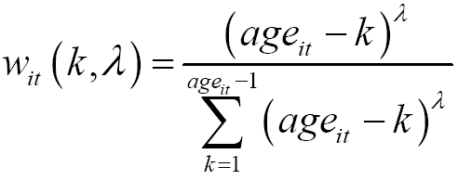
Measures of Experienced Stock Returns
R_{i,t-k}: Annual real returns on S&P500 index from Shiller (2005)
Calculate since birth of household head
Life-time (weighted) average returns of household i at t:
where
and R_{t-k} = return in year t-k (since birth year)
age_{it} = age of household head
k = many years ago the return was realized
➔ weights w_{it} depend on the age and time distance
➔ parameter λ controls shape of the weighting function; estimated from the data.
Notes:
Note:
We start at k=1, since “current year” not yet “experienced.”
We stop at k=age-1, since, for Λ = 0, k=age not defined (0^0)
Also, since for 0<Λ<1, funny “jump” down to zero at k=age.

Slide 95
Weighting Function
Chosen to allow increasing, decreasing, constant weights over time with one parameter.
  Have also used U- and hump-shaped functions; same results.
Illustration for 50-year old household:
Notes:
Λ < 0: the weighting function is always increasing and convex
➔ higher weight closer to birth
Λ = 0: constant weights ➔ A_{it} = simple average of past returns since birth
Λ > 0: weights decreasing in the lag k
➔ concave for Λ < 1, linear for Λ = 1, and convex for Λ > 1

Slide 96
Questions
1. True “experience” of returns
    Depends on investment
    Depends on interest in economic matters
    Depends on other personal circumstances
  Bias?
    Only if such idiosyncratic factors are correlated with the aggregate return measures. Else noise.
  Research question
    Get actual “experience” data
    Issue: control for wealth etc.
Notes:
Before I jump ahead and show you the results, I am sure a number of questions have formed in your minds ..

Slide 97
Questions
Unobserved aggregate effects explaining both stock returns and (aggregate) investment
  E.g. time effects
  E.g. time-varying aggregate risk aversion
➔ Include year dummies
➔ The identification comes from cross-sectional differences in risk-taking and in macroeconomic histories and from changes of those cross-sectional differences over time, not from common variation over time.

Slide 98
Example
Early 1980s: young households had lower stock-market participation, lower allocation to stocks, and reported higher risk aversion than older households.
  Young households experienced the low 1970s stock returns.
  Older households experienced the low 1970s stock returns, but also the high 1950s and 1960s returns.
1990s: pattern flipped: (then) young households had higher rates of stock-market participation, higher allocation to stocks, and lower reported risk aversion than older households.
  Young households experienced the 1990s boom years and, hence, had higher life-time average returns than old households.
Identification: from correlated changes in the age profile of life-time weighted average returns and risk-taking.

Slide 99
More Questions: Identification Issues
Age effects
  Older consumers may reduce risky-asset share (higher risk-aversion or due to lower income in retirement)
  ➔ Age dummies or third-order polynomial in age
Demographics
  ➔ Controls for wealth and income (liquid assets, liquid assets², income, income²), education, retirement, marital status, race
Unobserved wealth effects correlated with both experienced stock returns and risk aversion
➔ Analysis of stock market and bond market
➔ Placebo test of effect of experienced bond returns in stock market and experienced stock returns in bond market

Slide 100
Identification – Previous Literature
Emphasis in previous work:
  Effect of age on individual investment, controlling for cohort fixed effects but (to avoid collinearity) not controlling for time effects. (Poterba, 2001)
  Identify cross-cohort differences in risk-taking, using cohort fixed effects, e.g., Ameriks and Zeldes (2004).
Problem: Cohort cannot be separated from age and time, due to the collinearity of age, time, and cohort (see, e.g., Heckman and Robb 1985, and the discussion in Campbell, 2001).
Our analysis: hypothesis of a specific, signed relationship between macroeconomic experiences and risk-taking.
  Analysis does not require to estimate cohort effects.
  Experience not collinear with age and time.
  Can include age and year effects.
  Can even include cohort, age, and year effects “up to one.”
Notes:
Experimental data …

Slide 101
Table I: Summary Statistics
Notes:
In September 2004 dollars (deflated using the CPI)
38.4% of households participate on average in the stock market in the 1960-2007 period. These rates represent the U.S. population (not the SCF sample) since we apply the SCF sample weights.
To get a sense of the variation in life-time average stock returns for the households in our sample, we calculate the weighted average of returns, Ait(lambda), from Eq. (1),
setting llambda= 1.25 (in the ballpark of the estimates of lambda that we find later).
The 10th and 90th percentile for the experienced (real) stock return are 6.4% and 11.6% and for experienced (real) bond returns -0.2% and 5.0%.
➔ Thus, over our sample period, experienced bond returns are almost as volatile in real terms as experienced stock returns. Overall, there are considerable differences in the returns experienced by different cohorts. The amount of variation in experienced returns is similar for a range of values around the chosen values for l. For example, with l = 1.00 and l = 1.50, boundaries of the interval that contains most point estimates we obtain subsequently in our estimation, we get differences between the 10th and 90th percentile of 4.9 pp and 5.6 pp for real stock-market returns, respectively.

Slide 102
Table I: Summary Statistics (continued)
Notes:
And this looks as follows:
In September 2004 dollars (deflated using the CPI)
Panel B restricts the sample to stock-market participants, i.e., households that have at least $1 in stocks or mutual funds.
Panel C restricts the sample to bond-market participants, i.e., households that have at least $1 directly invested in bonds. (bond holding information only from 1968 onwards)
Comparing Panels B and C, we see that stock-market participants tend to be wealthier. For example, the median holding of liquid assets is $9,820 in the full sample, but $47,676 in the sample of stock-market participants. Panel C shows that bond-market participants are also wealthier, though less than stock-market participants, with median liquid assets of $22,191. The pattern is similar for median income.
However, the early SCF data shows that participation was quite high in the late 1960s (above 30%, comparable to the levels reached in the late 1990s), before falling in the 1970s and early 1980s. The technological improvements story therefore may not be the sole explanation for the recent surge. Our hypothesis that past returns experienced by investors over their lifetime play a role in generating variation in stock-market participation over time and across individuals may help explain this pattern.

Slide 103
Measure 1: Elicited Risk Tolerance
Ordered Probit Model (ML estimation)
Risk aversion categories j = {1, 2, 3, 4}
  A_{it}(λ): Life-time (weighted) average returns of household i at time t, given weighting parameter λ
  x_{it}: Control variables
Notes:
Phi(.) = cumulative standard normal distribution function
Unlike the standard ordered probit model, Phi(.) does not map a linear function of explanatory variables into the response probability P, because Ait(l) is a non-linear function of the weighting parameter l.
the aj = cutoff points that must be estimated (a1 < a2 < a3 < a4 = ∞),
vector xit includes
income controls (log income, log income squared),
demographics controls (a second-order polynomial in the number of children, dummies for retirement, completed high school education, completed college education, marital status, and race, having a DB pension plan) and
Age dummies
year dummies.
We also control for the level of liquid assets held by the household (log liquid assets and log liquid assets squared).

Slide 104
Measure 1: Elicited Risk Tolerance
Ordered Probit Model (ML estimation)
Risk-tolerance categories j ={1, 2, 3, 4}
  Coefficient vector β has no direct economic interpretation.
  We focus on average partial effects of life-time average return on probabilities of being a certain risk-tolerance category.
  Partial effect
  Average partial effect: evaluate the partial effects at each sample observation, given the estimated parameters and observations on x_{it} and A_{it}(λ) and average across sample observations
Notes:
NOTE: there are big differences in the number of households in each risk aversion category, with only about 6% of households are in category 1, 22% in category 2, 44% in category 3, and 28% in category 4
(In previous version we therefore scaled the average partial effects by these unconditional category probabilities to make the interpretation easier.)

Slide 105
Measure 1: Elicited Risk Tolerance (1983-2007)
Notes:
Why do we show a specification without liquid assets?
➔ Possible issue: more risk averse people tend to accumulate more wealth [one could probably build a model that delivers the opposite conclusion, too] and in that case liquid assets are endogenous and correlated with risk aversion (and thus the residual in our estimating equations) and including liquid assets may bias the coefficient on life-time average returns instead of helping to get it right.
(Just leaving it out isn’t a perfect solution either. But it shows that with and without we get roughly similar results.)

Slide 106
Measure 1: Elicited Risk Aversion (1983-2007)
Notes:
I am going to show for a second actual quantitative estimates, and then spend more time interpreting the results.
Average partial effect: evaluate the partial effects at each sample observation, given the estimated parameters and observations on x_{it} and A_{it}(λ) and average across sample observations
Since there are big differences in the number of households in each risk aversion category, with only about 6% of households are in category 1, 22% in category 2, 44% in category 3, and 28% in category 4, we scale the average partial effects by these unconditional category probabilities to make the interpretation easier
higher life-time average returns increase the probability that risk aversion is in the low categories (1 and 2),
have little effect on the probability of being in category 3, and
decrease the probability that the reported risk aversion is in the highest category (category 4)

Slide 107
Interpretation
Average partial effect:
  Sizeable economic magnitude, e.g., going from 10th to 90th percentile of experienced returns implies 10.1 pp. lower probability of being in lowest risk-tolerance category
  Cf. unconditional probability of being in lowest risk-tolerance category = 36.3%
Weighting parameter λ: 1.470 (s.e. 0.294)
  households’ risk aversion most affected by recent returns but also by returns many years in the past.
  declining weights; significantly different from increasing weights ➔ the memory of early experiences fades slowly.
Notes:
Everybody can see already where this is going …
Recall from Table I that the difference between the 10th and 90th percentile of life-time average stock returns is about 5.1%. Applied to the average partial effects in Table III, Column (i), a change from the 10th to the 90th percentile implies a change in the probability of being in the highest risk-aversion category of about -1.210 × 5.1% ≈ -6.2%. Compared with the unconditional frequency 28.77% of this category (see Table II), this is an economically significant effect.

Slide 108
Measure 2: Stock-Market Participation
Probit Model (ML estimation)
Binary indicator y_{it} = 1 if positive stockholdings of household i at time t
  As before, coefficient vector β has no direct economic interpretation.
  Focus on average partial effects of life-time average return on stock market participation:
  Partial effect:
  Average partial effect: Given the estimated β and λ, evaluate this partial effect at every sample observation and average across all observations.

Slide 109
Measure 2: Stock-Market Participation (1960-2007)
Notes:
In September 2004 dollars (deflated using the CPI)
Controlling for liquid assets is particularly important in this context since a standard fixed participation-cost model predicts that stock-market participation is positively related to the level of liquid assets and past stock returns are likely to be positively correlated with current liquid assets.
Columns (i) and (ii) in Table III report the estimates from our probit model. As shown in Column (ii), the life-time average returns have a positive and highly significant effect on stock-market participation.

Slide 110
Interpretation
Average partial effect:
  Change from the 10th to the 90th percentile implies about 14.6 ppt increase in the probability of stock-market participation.
Weighting parameter λ: 1.698 (s.e. 0.206)
  Increasing weights (in time lag) ruled out
  Similarity to estimate from elicited risk-tolerance remarkable given that based on survey versus asset holdings.

Slide 111
Measure 3: Bond-Market Participation
Probit Model (ML estimation)
Binary indicator y_{it} = 1 if positive bond holdings of household i at time t
  As before, coefficient vector β has no direct economic interpretation.
  Focus on average partial effects of life-time average (LT government bond) return on bond market participation:
  Partial effect:
  Average partial effect: Given the estimated β and λ, evaluate this partial effect at every sample observation and average across all observations.

Slide 112
Measure 3: Bond-Market Participation (1960-2007)
Notes:
In September 2004 dollars (deflated using the CPI)
As column (iii) of Table III shows, experienced bond returns have a positive effect on bond-market participation, very similar to the effect of experienced stock returns on stock-market participation. Adding the liquid assets controls in column (iv) slightly increases the coefficient on experienced bond returns.

Slide 113
Interpretation
Average partial effect:
  Change from the 10th to the 90th percentile implies about 15.3 pp increase in the probability of bond-market participation.
Weighting parameter λ: 1.106 (s.e. 0.282)
  Slightly lower than with stock-market measures, but very similar pattern of implied weights
  Remarkable given that previous estimates based on survey (versus asset holdings) or stock data (versus bond data)

Slide 114
Measure 4: Risky-Asset Portion
Non-linear regression:
y_{it}= α + βA_{it}(λ) + γ′x_{it} + ɛ_{it}
  The model is nonlinear, because the life-time average return A_{it}(λ) is a nonlinear function of λ.
Conditional on stock-market participation.
Partial effect A_{it}(λ) is now = β.

Slide 115
Measure 4: Risky Asset Share (1960-2007)
Notes:
In September 2004 dollars (deflated using the CPI)
without the liquid assets controls, the experienced stock return has only a statistically weak positive effect on the proportion of liquid assets invested in stocks.
But when the liquid assets controls are added in column (ii), the effect is stronger, both in terms of statistical significance and economic magnitude.

Slide 116
Interpretation
Average partial effect:
  Difference between the 10th and 90th percentile of life-time average stock returns = 5.2%.
  Change from the 10th to the 90th percentile implies about 1.476 × 5.2pp ≈ 7.7 ppt increase in the proportion allocated to risky assets.
  Noteworthy: In empirical literature on household portfolio choice, it is hard to find any household characteristics among stock-market participants that predict the risky asset share.
Weighting parameter λ: 0.923 (s.e. 0.323)
  Roughly linear weights
  Close to elicited risk-tolerance and bond-market participation
Notes:
Conditional mean risky asset share is 42%

Slide 117
What about “experienced volatility”?
Do differences in life-time experiences of return volatility also lead to differences in risk-taking?
  Repeat analysis with “experienced volatility” of returns, measured by the standard deviation of returns since birth
  Use weighting function as before; fix λ
➔ Small, insignificant, negative coefficient.
Include both experienced return and volatility
➔ Experience coefficient unaffected.
Why?
  Unconditional mean of returns is harder to estimate than the second moment (Merton, 1980), hence presumably more scope for investors to disagree and be influenced by life-time experiences of mean returns rather than volatility.
  Extreme events (rather than SD) might have expl. power, but rare and subjective …

Slide 118
Preferences or Beliefs? – Further Evidence
Does experience affect risk preferences or beliefs about risky-asset payoffs?
Test: UBS/Gallup survey on stock-return expectations (1998-2007, mostly monthly)
Dependent variable:
  expected stock-market return over the next 12 months
  ➔ available only 1998-2003
  expected return on respondent’s own portfolio
  ➔ available 1998-2007
  ➔ downside: does not separate expectations from risk preferences (e.g., risk-averse investor chooses low-risk portfolio and hence expects low return; risk-tolerant investor chooses a high-risk portfolio and expect a high return).

Slide 119
Table VI: Explaining Stock Market Return Expectations with Experienced Returns
Notes:
Fixing lambda:
Unfortunately, the UBS/Gallup survey covers only a much shorter time period than the SCF. This short time span makes it difficult to statistically disentangle the effect of experienced returns from age effects.
To reduce the burden on the estimation, we work with the weighting parameter fixed at the values we obtained in the stock market participation (l = 0.923, Table III) or percentage allocation to stocks (l = 1.698, Table IV) baseline specification.
We weight each observation with sample weights provided by the UBS/Gallup survey.
(i) And (ii): use the expected stock market return over the next 12 months as dependent variable. This variable is only available from 1998 to 2003
(iii) and (iv) own portfolio

Slide 120
Preferences or Beliefs – Results
Stock-market expectations
  1 pp higher experienced return ⇨ 0.4-0.8 pp higher expected return
  Despite very small sample significant for λ=0.9 (marginally significant for λ=1.7).
Own-portfolio expectations
  Both point estimates very similar
  Both point estimates significant

Slide 121
Preferences or Beliefs – Interpretation
Consistent with a belief channel
  But: effect of experiences on risk preferences could exist as well!
Implication: Investors can – in principle and at least partially – be “taught” that beliefs and resulting risk-taking are biased, e.g., by current crisis, and not in their long-run interest.

Slide 122
Illustration: 2007-2009 Financial Crisis
Real return of S&P 500 index in 2008: -36%
  Large negative returns strongly altered investors’ (weighted) life-time average returns
  Effect was strongest for young investors
Compare to counterfactual of 8.2%
  For a 30-year old:
    Experienced returns 4 pp lower
    Participation rate 10 pp lower
  For a 60-year old:
    Experienced returns 2 pp lower
    Participation rate 5 pp lower
Notes:
NOTE: hypothetical counterfactual of “no 2008 market crash” holds everything else equal and does not consider the effect on asset prices in general equilibrium that would arise if the level stock market participation changed. In particular, such changes could feed back into changes in participation rates.

Slide 123
Current Financial Crisis (continued)
How long-lasting is the effect?
    For a 30-year old, weight on 2008 return in 2009: 8.9%
    … in 2019 (then 40-year old): 4.0%
    … in 2039 (then 60-year old): 2.0%.
After 30 years most of the effect faded away.
Notes:
NOTE: hypothetical counterfactual of “no 2008 market crash” holds everything else equal and does not consider the effect on asset prices in general equilibrium that would arise if the level stock market participation changed. In particular, such changes could feed back into changes in participation rates.
That’s a long time … can we do anything before that?

Slide 124
Aggregate Perspective
Do the experience-based changes in risky asset demand influence the dynamics of stock prices?
Exercise:
Set λ=1.25 (roughly average of all estimates)
Compute life-time (weighted) average return for each household and year
Weight household-year observations with liquid assets of the household × SCF weight
Relate to measure of stock market valuation:
P/E ratio from Shiller (2005), which is negatively related to future stock-market returns

Slide 125
Aggregate experienced stock returns and stock market valuations – survey years
Notes:
Positive correlation!
Periods of high stock-market valuation = when investors have high life-time average returns.
Not driven by changes in “liquid assets owned by different age groups” (distribution did not change much!)
We conclude that the movements in the aggregated life-time average returns over time, as shown in Figure 4, come from changes in investors’ life-time return histories rather than compositional changes of age-specific wealth in the population.
Note that this correlation does not simply reflect the well-known correlation between P/E ratios and past returns. We estimated the weighting parameter from cross-sectional microdata on investors’ risk-taking decisions.

Slide 126
Distribution of liquid assets across ages by year
Notes:
1964: very different wealth definition; note that all of our regressions include a dummy for 1964
The relative stability of the liquid asset distribution suggests that we can extend our calculation of the aggregate experienced returns beyond the SCF survey years by making the assumption that the liquid asset distribution in other years was similar to the one in the observed years. We therefore use the average of the liquid asset distribution from the SCF waves from 1968 - 2004 to weight experienced returns across age groups in all years from 1946 – 2004, the longest possible sample given that our stock return data starts in 1871 and we include investors up to age 74.

Slide 127
Aggregate experienced stock returns and stock market valuations – all years 1946-2007
Notes:
extend our calculation of the aggregate life-time average returns before 1964, if we are willing to make the assumption that the liquid asset distribution was stable before 1964, too.
Figure 6 presents the results from this exercise: assuming that the liquid asset distribution in all years from 1946 to 2004 is equal to the average of the liquid asset distributions of the years 1968-2004 in Figure 5.
1946 – 2004, the longest possible sample given that our stock return data starts in 1871 and we include investors up to age 74.

Slide 128
Interpretation
Highly positive correlation between aggregate life-time average returns and stock-market valuation levels.
Implies:
  Our microdata estimates imply plausible time-variation in aggregate demand for risky assets.

Slide 129
Conclusions
Stock return experienced over an individuals' life affects risk attitudes and willingness to take stock risk. Bond return experience affects willingness to take bond risk.
  Individuals put more weight on relatively recent returns, but even very distant ones still have substantial effects.
Departure from standard model (stable risk attitudes); source of heterogeneity
  Systematic departure, unified framework for different measures of risk-aversion.
Potential explanation for variations in stock market valuation and expected returns over time.

Slide 130
Follow-up projects
Inflation experience – see separate slides
Earthquake experience
  “Experience” = exposure on TV, controlling for (unchanged) earthquake risk of own residence
  Outcome = take-up rate of earthquake insurance, home improvement (foundations), housing prices
“Institutional memory”
  Is banks’ risk taking is affected by their “history,” i.e., the environments the institutions and their CEOs have faced in the past?
  Experience: founding year, “life-time bank so far”, age CEO, experience CEO.
  Selection issues, e.g., founding harder during bad times, endogenous firing
Notes:
Both co-authors live in California

Slide 131
Broader research ideas
Relevance of “experience effect” for important economic and financial decisions of households and of firms
  Especially: duration of “crisis effects”
Recent emphasis on “age effects” for economics (see NIH/NIA initiatives) ➔ confound with cohort-specific experience effects?
Notes:
Both co-authors German

Slide 132
4. Asset Pricing
Cross-sectional anomalies
Aggregate (time series) anomalies

Slide 133
Evidence on market efficiency
Almost all economists agree that returns are either completely unpredictable or almost unpredictable.
So the debate is over whether there exists no predictability or a small degree of predictability.
Behavioral finance economists believe that there is a small degree of (unjustified) predictability.

Slide 134
Where is the cross-sectional predictability?
In the cross-section, these kinds of companies seem to have inexplicably high levels of excess returns in year t:
Low excess returns during years t-5, t-4, t-3, t-2.
High ratios of (Book value)/(Market value) at year-end t-1 (these are referred to as value stocks)
Small market capitalizations at year-end t-1
High excess returns at the end of year t-1
See Debondt and Thaler 1985; Fama and French 1992, 1993; Jegadeesh and Titman 1993; Lakonishok, Shleifer, and Vishny 1994; Carhart 1997

Slide 135
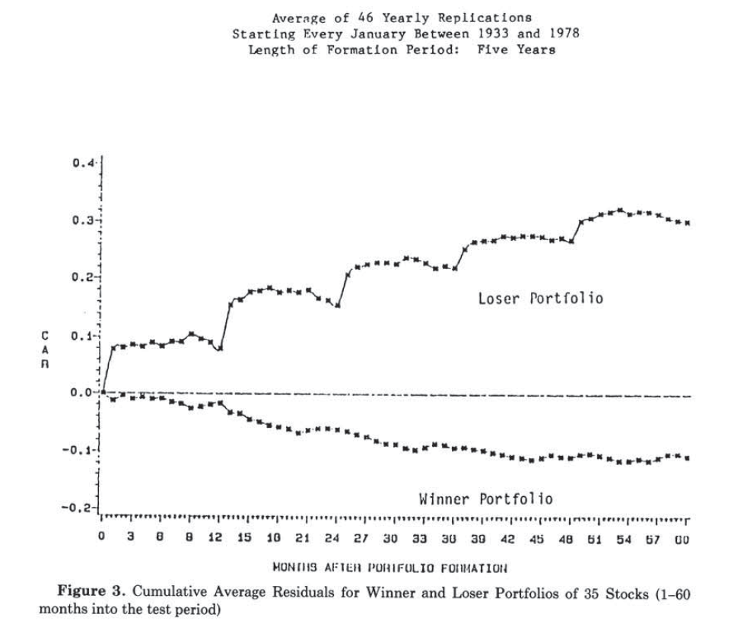
Debondt and Thaler (1985)
Cumulative “excess” return
Months after portfolio formation

Slide 136
Another form of cross-sectional predictability
Initial Public Offerings have low rates of return during their first three years (after the initial price pop on the opening day)
When adjusted for risk and overall market returns, the underperformance is at least 5% per year.
“(1) Investors are periodically overoptimistic about the earnings potential of young growth companies, and (2) firms take advantage of these ‘windows of opportunity.”
(Ritter, 1991)

Slide 137
Where is the aggregate predictability?
The aggregate stock market seems to have high excess returns in year t+2 to t+5 when:
Campbell-Shiller “P/E” low in t :
Excess returns were low in year t.
Consumption growth was low in year t.
In a nutshell, when the economy is doing badly.
See Campbell and Shiller 1987, 1988; Campbell and Cochrane 1998; Lettau and Ludvigson 2001; Fuster, Mendel , Laibson 2010; Fuster, Hebert, and Laibson 2012;

Slide 138
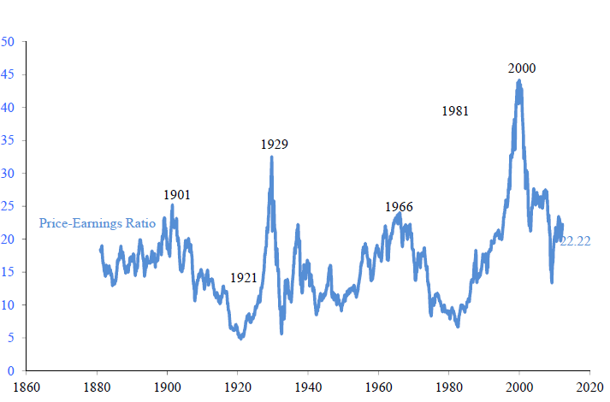
Campbell and Shiller P/E ratio
S&P 500 index price divided by average of last 40 quarters of real earnings

Slide 139
Fuster, Hebert, and Laibson (2011)
Correlation between future equity returns (t+2 to t+5) and current (Campbell-Shiller) P/E ratio is -0.38.
Correlation between future equity returns (t+2 to t+5) and current equity return is -0.22.
Correlation between future equity returns (t+2 to t+5) and current consumption growth is -0.30.

Slide 140
Forecasting the future:
The role of investor sentiment
Baker and Wurgler (2007)
Form an index using:
Closed End Fund Discount (CEFD)
Detrended Log Turnover (TURN)
Number of IPO’s (NIPO)
First Day Return on IPO’s (RIPO)
Dividend Premium (PDND)
Equity Share in New Issues (S)

Slide 141
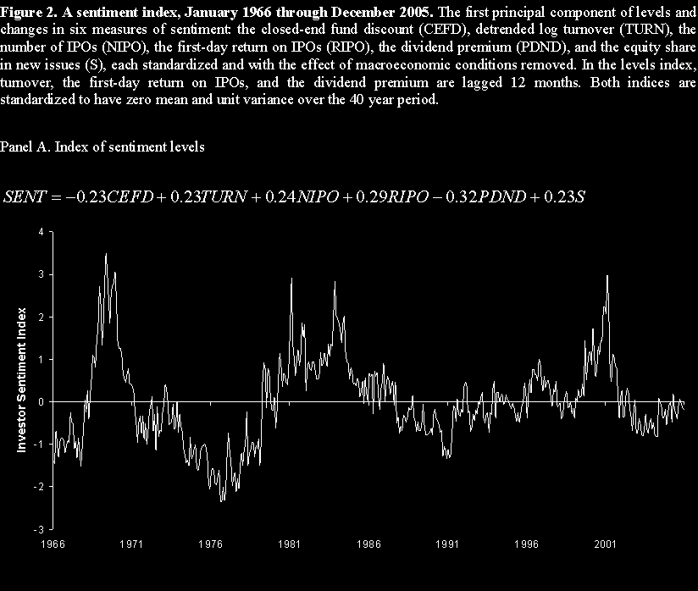

Slide 142
Last month’s sentiment predicts
this month’s market returns
3.0
Equal-weighted
2.0
Value-weighted
Average monthly return
1.0
0.0
-1.0
Bottom 16%
17% to 50%
51% to 84%
Top 16%
Investor sentiment in the preceding month

Slide 143
5. Financial Crisis (2007-2009)
Bubbles in housing and equities
Leverage in household and financial sectors
Consumption and Investment Cycle

Slide 144
Bubbles
Definition: A bubble occurs when an asset trades above its fundamental value.
Another way of saying it: A bubble occurs when the discounted value of cash flow received by the owners is less than the price of the asset

Slide 145
Bubbles
Neo-classical economic view:
  Bubbles usually don’t exist
  Bubbles appear to exist because of hindsight bias (fundamentals sometimes unexpectedly deteriorate)
Behavioral view:
  Bubbles do exist
  Bubbles explain macro dynamics

Slide 146
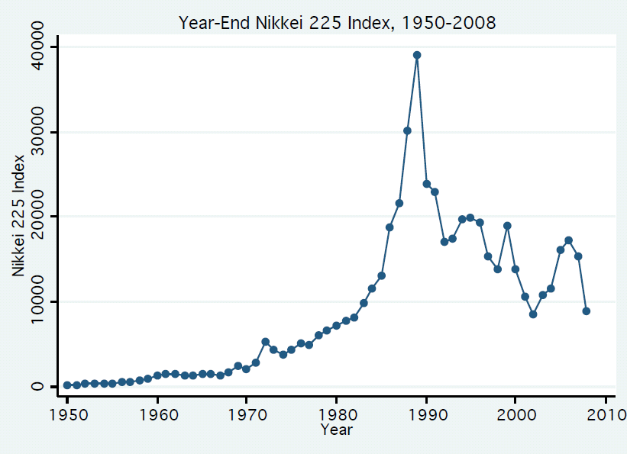

Slide 147
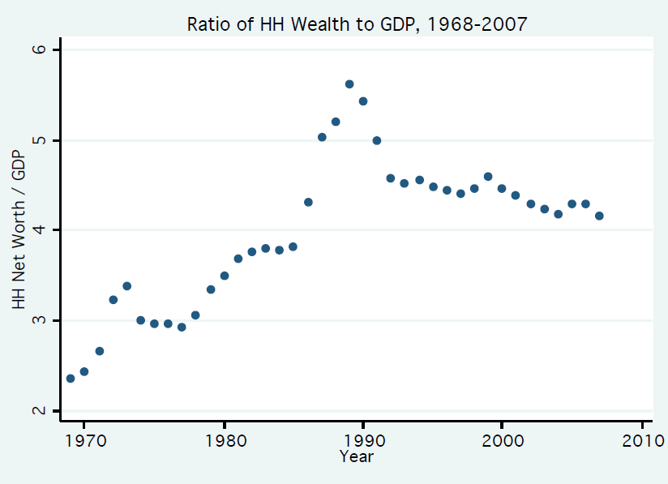
The Japanese Bubble

Slide 148
Bubbles form: 1995-2007
I’ll focus on the US, since this was the epicenter
Related bubbles existed in many other countries
The US bubble had two main components:
  Prices of publicly traded companies
  Prices of residential real estate
And many minor contributors:
  Prices of private equity
  Commodities
  Hedge funds

Slide 149
Fundamental Catalysts: 1990’s
End of the cold war
Deregulation
High productivity growth
Weak labor unions
Low energy prices ($11 per barrel avg. in 1998)
IT revolution
Low nominal and real interest rates
Congestion and supply restrictions in coastal cities

Slide 150
P/E ratio: Cambell and Shiller (1998a,b)
Real index value divided by 10-year average of real earnings
Jan 1881 to April 2011
Source: Robert Shiller
Average: 16.34

Slide 151
Dot com bubble
Lamont and Thaler (2003)
March 2000
3Com owns 95% of Palm and lots of other net assets, but...
Palm has higher market capitalization than 3Com
$Palm > $3Com
= $Palm + $Other Net Assets

Slide 152
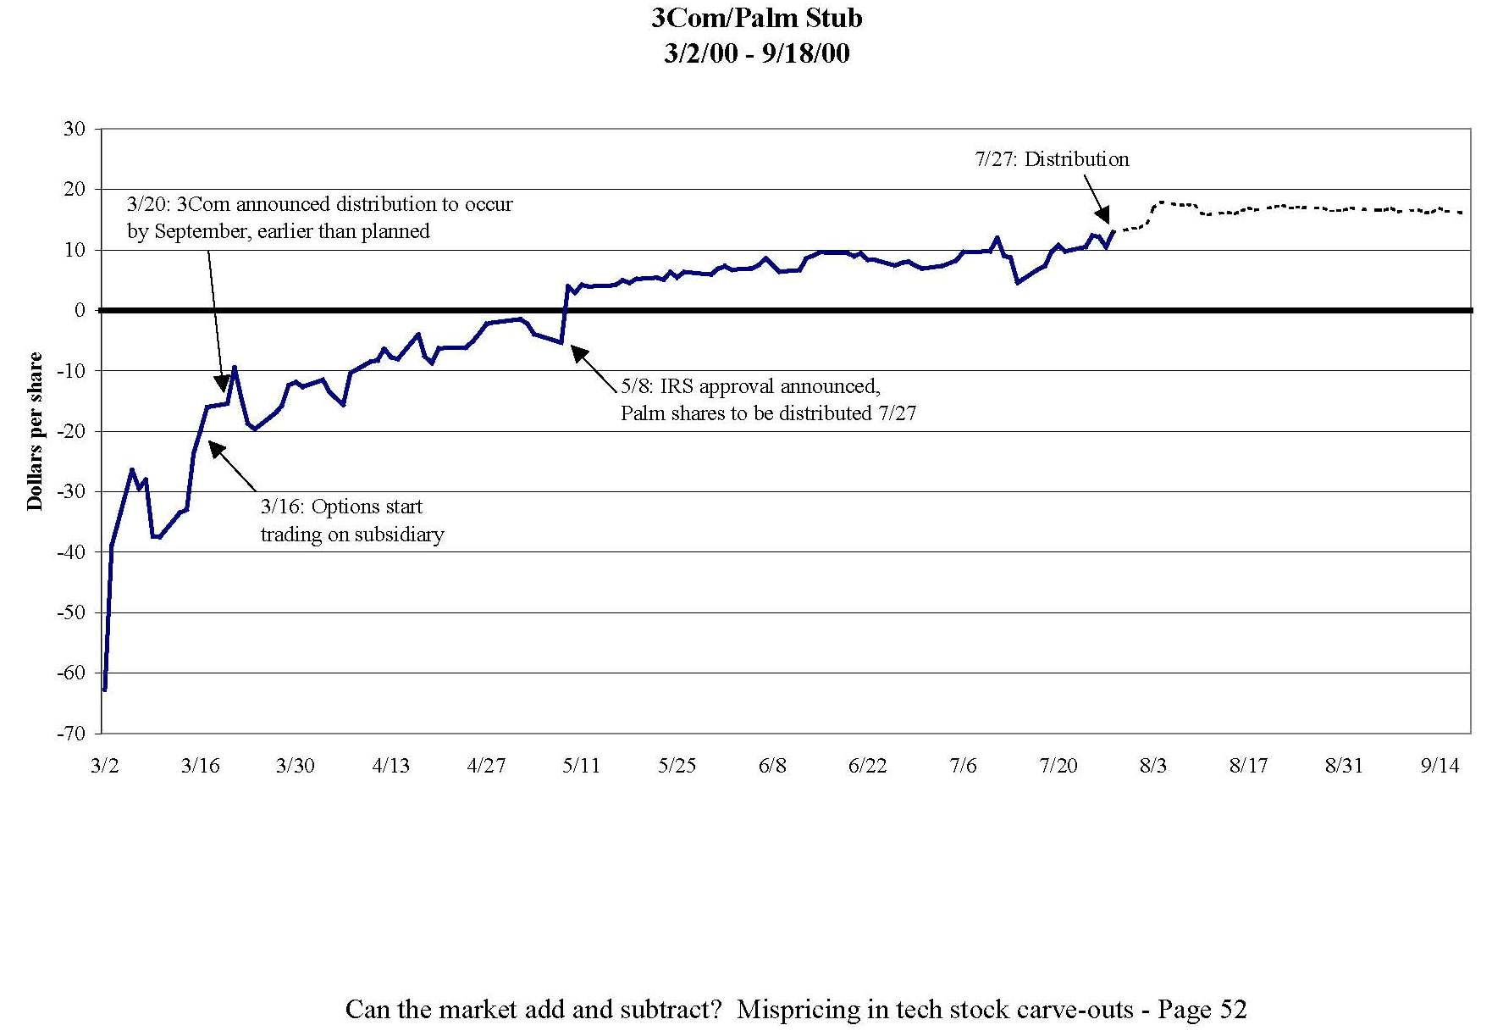
-$63 = (Share price of 3Com) - (1.5)*(Share price of Palm)

Slide 153
Real Estate in Phoenix and Las Vegas
Jan 1987 – January 2010

Slide 154

Long-run horizontal supply curve
Phoenix

Slide 155
Long-run horizontal supply curve
Phoenix

Slide 156
Long-run horizontal supply curve
8 miles

Slide 157
Long-run horizontal supply curve
Bubble
Demand
SR Supply
Price
Demand
LR Supply
Quantity
Arbitrage: Buy your house now for $400,000 or in 3 years at $300,000

Slide 158
“Over-shooting”
Bubble
Demand
SR Supply
Price
Demand
LR Supply
DWL
Quantity
Arbitrage: Buy your house now for $400,000 or in 3 years at $200,000

Slide 159
Case-Shiller (Nominal) Index
January 1987-January 2011
226.8
April
2006
May
2009

Slide 160
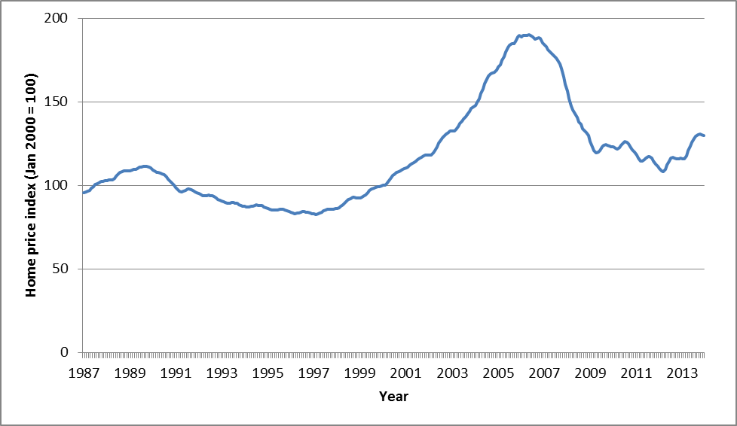
Index of Real Home Prices in Ten Major U.S. Cities (January 1987 – December 2013)
Source: S&P/Case-Shiller home price index and Bureau of Labor Statistics (Consumer Price Index).

Slide 161
Real Housing Prices
Source: Robert Shiller web data

Slide 162
Lehman’s forecasts in 2005
HPA = House Price Appreciation
Source: Gerardi et al (BPEA, 2008)

Slide 163
Household net worth divided by GDP
1952 Q1 – 2008 Q4
Source: Flow of Funds, Federal Reserve Board ; GDP, BEA ; and authors calculations

Slide 164
Estimates of magnitude
Balance sheets for households and non-profits record a decrement in value of $14 trillion from 2007 q3 to 2009 q1.

Slide 165
Estimates of magnitude
(using decomposition)
Stock market 2007 P/E was 27.3 and long-run historical average is 16.3. A 1/3 decline in the value of the (2007) stock market is $5 trillion.
Housing price index has fallen from 226.8 to 150. A 1/3 decline in the value of the (2006) housing stock is $7 trillion.
Total magnitude of the bubble: $12 trillion
This is a lower bound, since we are neglecting other asset classes (commercial real estate, privately held businesses, etc.)

Slide 166
How can we be sure these were bubbles?
We can’t.
But recall Palm and 3Com
And recall Phoenix/Las Vegas house prices.

Slide 167
Basic Ingredients of the
Financial Crisis
Bubbles in housing and equities
Leverage in household and financial sectors
  Gross leverage ratio of 33:1 among investment banks
  Down payments shrink (from 20% to 10%, or less)
Consumption and Investment Cycle
  If US household wealth falls by $14 trillion, then it’s natural that consumption falls by $700 billion.
  Home construction plummets (due to plummeting prices and rising inventories of foreclosed homes); this alone accounts for 4% of GDP

Slide 168
Psychological foundations of bubbles
“Extrapolation”
Return chasing
Herding (rational and irrational)
Overconfidence
Over-optimism (wishful thinking)

Slide 169
Fuster, Hebert, and Laibson (2011)
Two key assumptions
Macro fundamentals are hump-shaped.
  Earnings momentum in the short-run.
  Earnings mean reversion in the long run.
Long-run trajectory
Long-run trajectory
Unit shock
Long-run trajectory
Start here
Time

Slide 170
Second assumption
2. Agents under-estimate the degree of long-run mean reversion.

Slide 171
Illustration:
Dynamics for Fundamentals (Earnings)
Perceived dynamics
True dynamics
Unit shock
Start here
Time

Slide 172
Second assumption
2. Agents under-estimate the degree of long-run mean reversion.
Why? Simple models miss slow mean reversion.

Slide 173
Beshears, Choi, Fuster, Laibson, and Madrian (2013)
 |  | Fast Mean-Reversion | Slow Mean- Reversion
 | Fraction of true mean reversion in forecasts | 59.5% | 0.0%
 | Relationship between rational & actual forecast | β = 0.60 | β = 0.09

Slide 174
Economic reasons for parsimonious models
Tradeoff between model flexibility and over-fitting
To avoid over-fitting limit number of parameters in model, k
Formalizations:
  Akaike Information Criterion (AIC)
  Bayesian (Schwarz) Information Criterion (BIC)

Slide 175
Psychological reasons for picking simple models (which end up missing some of the mean reversion)
Agents maximize efficiency of short-term predictions
  Akaike Information Criterion
  Bayesian (Schwarz) Information Criterion
Recency bias leads agents to act as if they have small samples (Malmendier and Nagel 2011)
Complexity aversion
Preference for tractability

Slide 176
Anchoring and representativeness also lead agents to underestimate long-run mean reversion
Perceived dynamics
True dynamics
Unit shock
Start here
Time

Slide 177
Schematic for Economy
Good news in fundamentals
Agents over-estimate persistence of good news
Asset prices respond to this “persistent” good news
Consumption and investment rise
Unanticipated mean reversion in fundamentals
  asset price falls
  debt overhang
  consumption falls
  (investment falls)

Slide 178
Consequences of simple models that miss some of the low frequency mean reversion:
Agents recognize the short-term momentum in fundamentals but miss some of the long-run mean reversion
  Pro-cyclical excess optimism
Asset returns are excessively volatile and exhibit overreaction
  Returns negatively predicted by lagged returns, P/E, and ΔlnC
Real economic activity has amplified cycles
  ΔlnC negatively auto-correlated in medium run
Equity premium is large, although long-run equity returns covary weakly with long-run consumption growth
  If agents had RE, equity premium nearly vanishes
Rational agents should hold high equity allocations on average
  And follow counter-cyclical asset allocation policy

Slide 179
Related Literature
Adam and Marcet (2011): learning and asset pricing
Barberis, Shleifer, and Vishny (1998): extrapolative dividend forecasts
Barsky and De Long (1993): extrapolation and excess volatility
Benartzi (2001): extrapolation and company stock
Black (1986): noise traders
Campbell and Mankiw (1987): shocks are persistent in low-order ARIMA
Campbell and Shiller (1988a,b): P/E ratio and return predictability
Choi (2006): extrapolation and asset pricing
Choi, Laibson, and Madrian (2009): positive feedback in investment
Cutler, Poterba, and Summers (1991): return autocorrelations
De Long, et al (1990): noise traders and positive feedback
De Bondt (1993): extrapolation bias in surveys and experiments
De Bondt and Thaler (1985, 1989, 1993): over-shooting in asset prices
Gabaix (2010): sparse representations
Hommes (2005, 2008): bubbles in the lab
Hong and Stein (1999): forecasting biases

Slide 180
Some Related Literature
Kahneman and Tversky (1973): representativeness
Keynes (1936): animal spirits
Lansing (2010): extrapolation and asset pricing in a macro model
LaPorta (1996): Growth expectations have insufficient mean reversion
LeBaron, Arthur, and Palmer (1999): agent-based modeling
LeBaron and Tesfatsion (2008): agent-based modeling
Leroy and Porter (1981): excess volatility in stock prices
Lettau and Ludvigson (1991): W/C correlates negatively with future returns
Lo and MacKinlay (1988): variance ratio tests
Loewenstein, O’Donoghue, and Rabin (2003): projection bias
Malmendier and Nagel (2011): Recency bias and role of personal experience
Parker (2001): Cov of returns and ΔlnC rises from short- to medium-run
Piazessi and Schneider (2009): extrapolative beliefs in the housing market
Previtero (2010): extrapolative beliefs and annuity investment
Shiller (1981): excess volatility in stock prices
Summers (1986): power problems in financial econometrics
Tortorice (2010): extrapolative beliefs in unemployment forecasts

Slide 181
Model
CARA habit preferences (Alessie and Lusardi)

Slide 182
Dynamic budget constraint for wealth, w_{t}
Elastic supply of foreign capital with gross return R
Assume foreign agents don’t hold domestic capital
  Home bias
  Moral hazard

Slide 183
Growth in dividends (ΔlnD = Δd) is captured by an auto-regressive model with p lags:
“AR(p)” model in dividend growth

Slide 184
Natural expectations
Data generating process
Natural expectations
We will study cases 1 ≤ p ≤ 40.
Model matches the data for p ≤ 20.

Slide 185
Consumption is a weighted average of c_{t-1} and Y_{t}
Permanent income
Shift term

Slide 186
Value function:
Price of the equity tree:

Slide 187
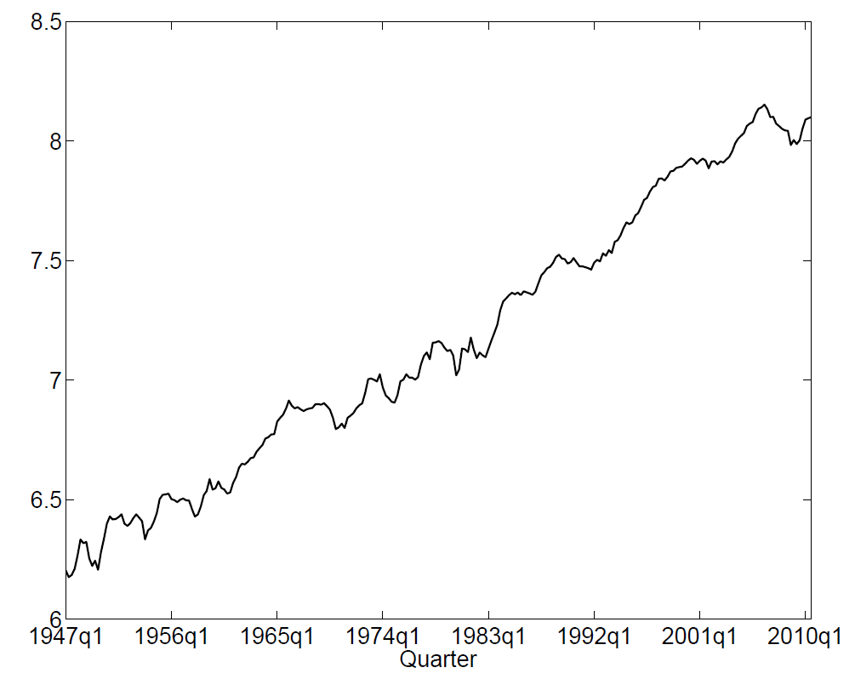
U.S. Log Real Capital Income
(1947q1-2010q3)
U.S. NIPA (BEA): net operating surplus of private enterprises.

Slide 188
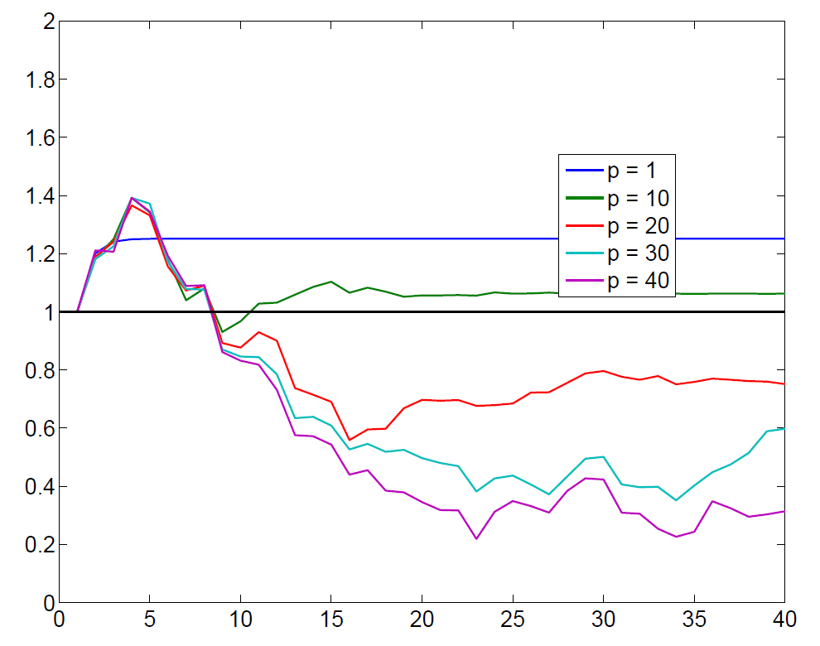
Perceived impulse response functions for real capital income; autoregressive model estimated with p lags
Unit shock
Quarters

Slide 189
Calibration

Slide 190
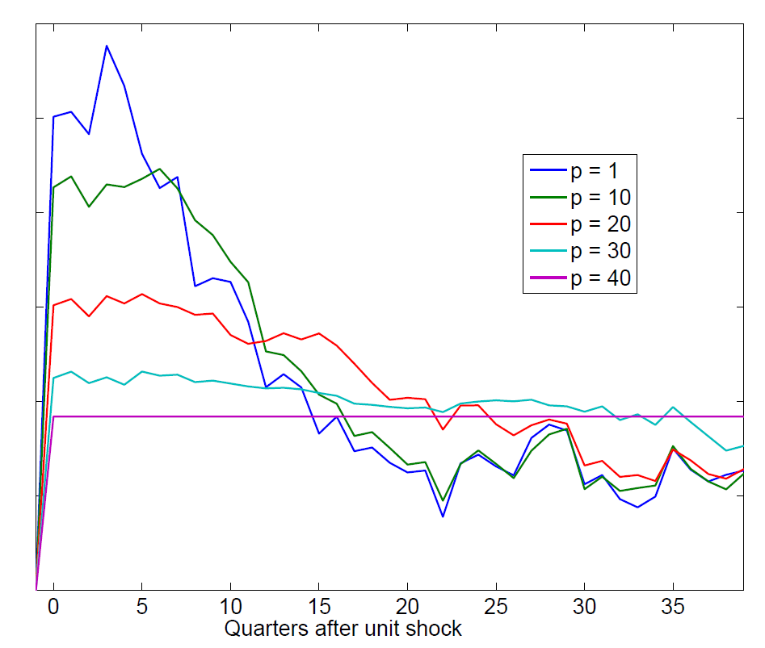
Actual dynamics for cumulative excess returns, assuming agents use p-lag AR model when true AR model has 40 lags

Slide 191
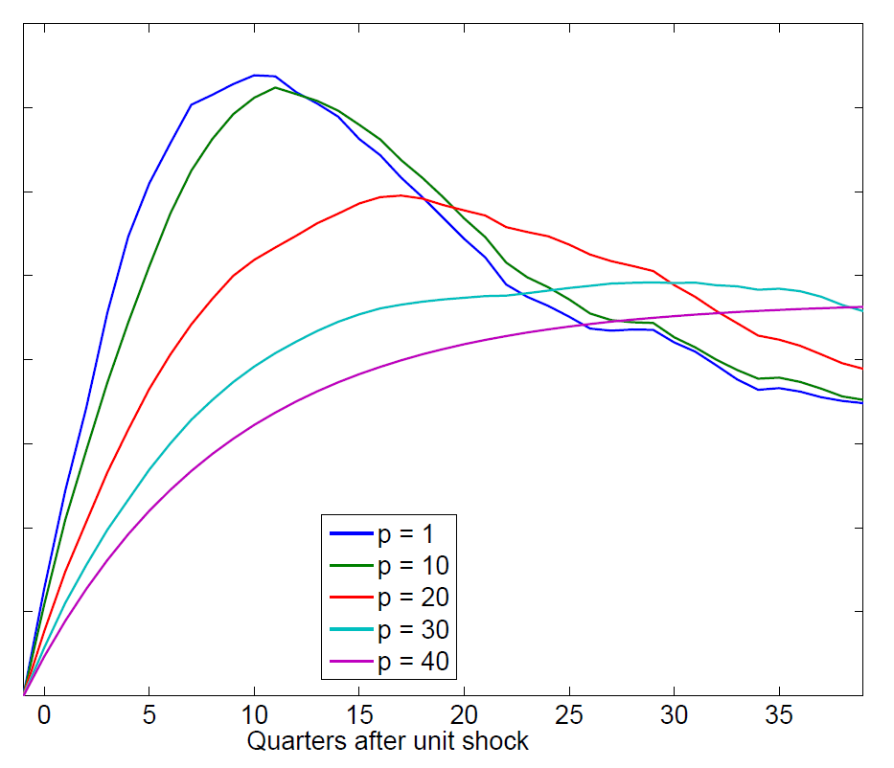
Actual dynamics for consumption, assuming agents use p-lag AR model when true AR model has 40 lags

Slide 192
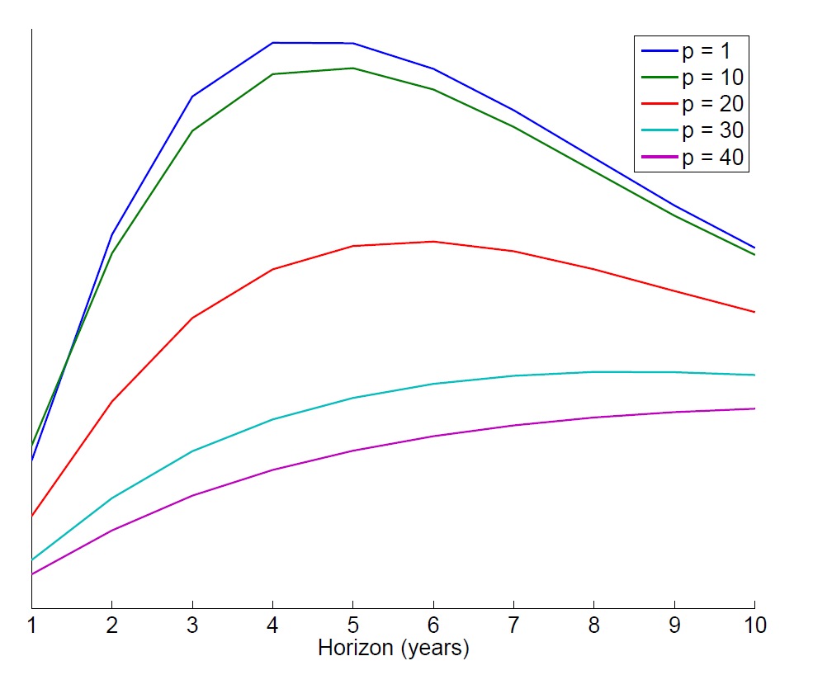
Covariance of consumption growth and cumulative return at different horizons

Slide 193
Empirical evaluation
Annual data (1929-2010)
Real per-capita consumption: US NIPA
Excess returns
P/E ratios
Simulations annualized for comparisons
Simulations generated for 82 years of data
Monte Carlo to generate confidence intervals

Slide 194
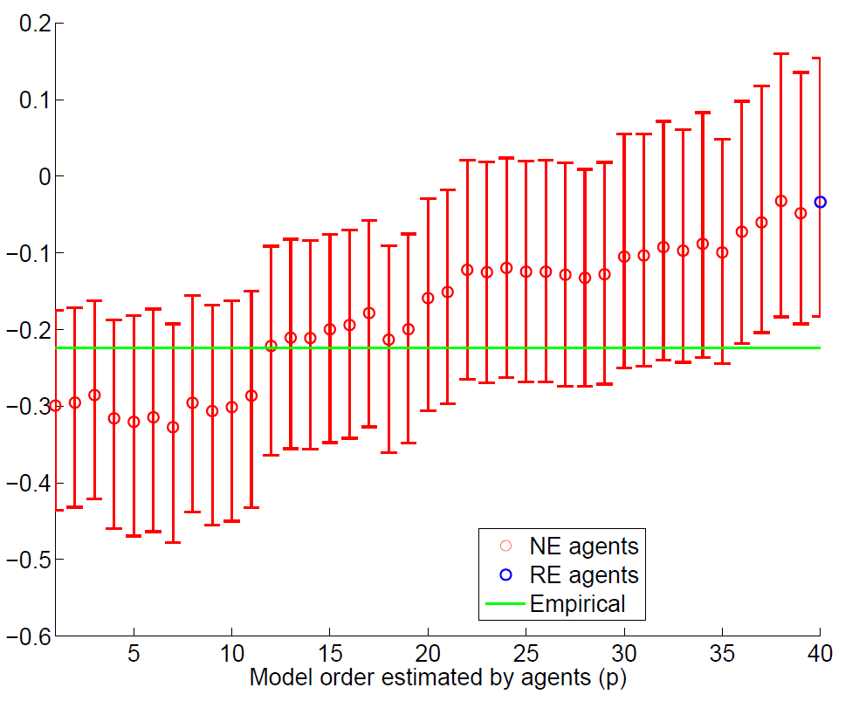
Correlation of Excess Returns in Year τ with Cumulative Excess Returns for Years τ + 2 to τ + 5, for Different AR(p) Models of Earnings

Slide 195
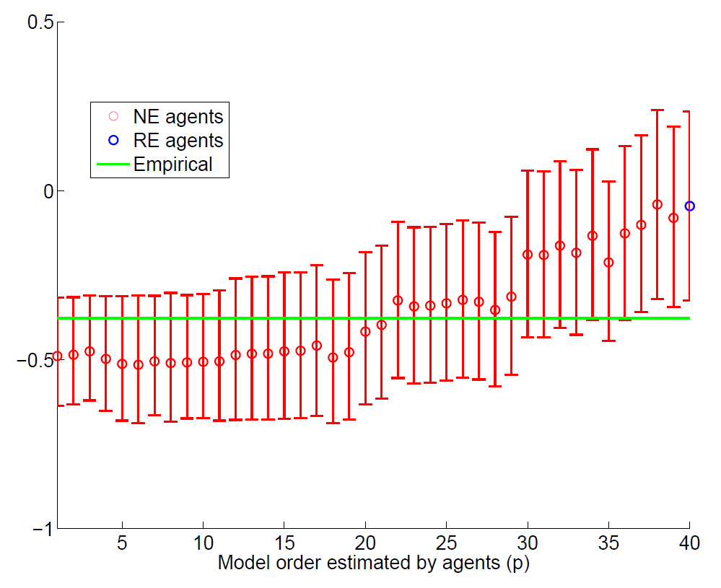
Correlation of P/E₄₀ in Year τ with Cumulative Excess Returns for
Years τ + 2 to τ + 5, for Different AR(p) Models of Earnings

Slide 196
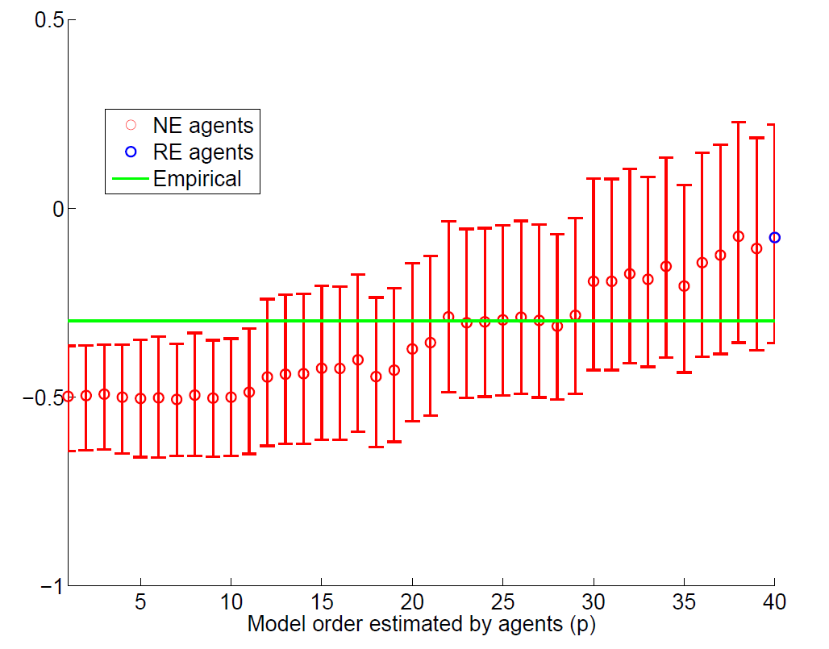
Correlation ΔlnC_{τ} with Cumulative Excess Returns for Years τ+2 to τ+5, for Different AR(p) Models of Earnings

Slide 197
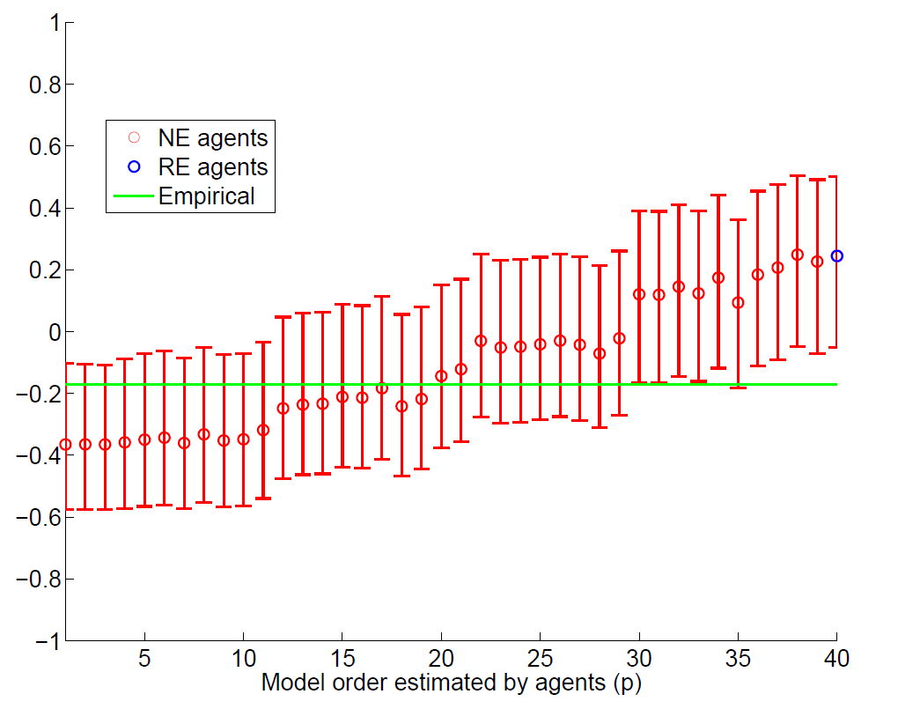
Correlation of P/E₄₀ in Year τ with (lnC_{τ+6} - lnC_{τ+2}), for Different AR(p) Models of Earnings

Slide 198
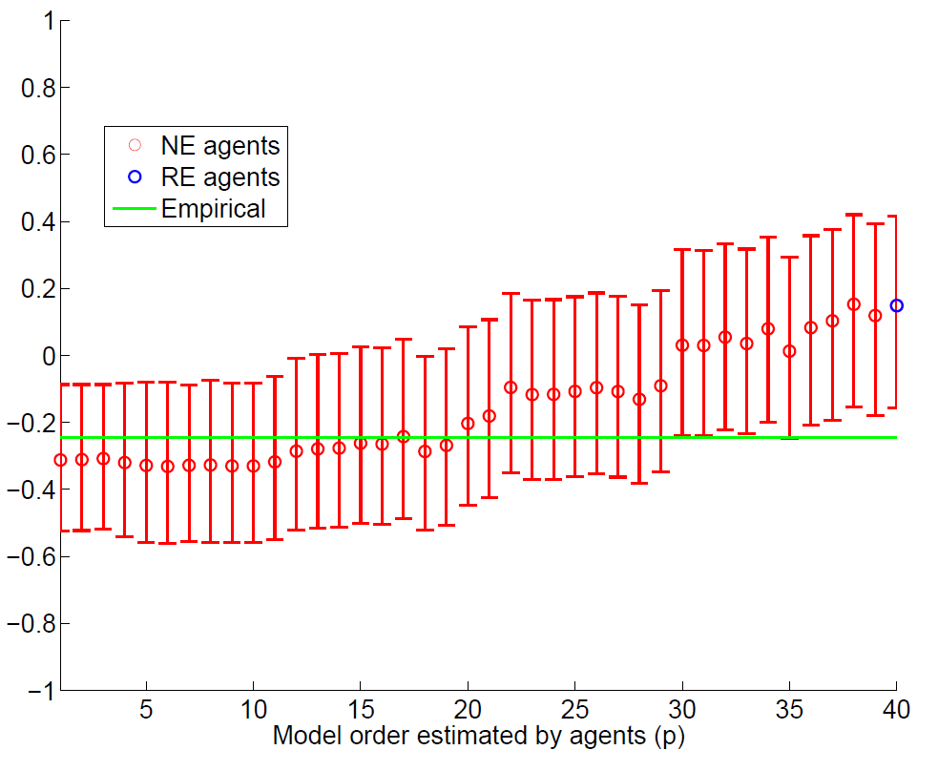
Correlation of ΔlnC_{τ} with (lnC_{τ+6} - lnC_{τ+2}), for Different AR(p) Models of Earnings

Slide 199
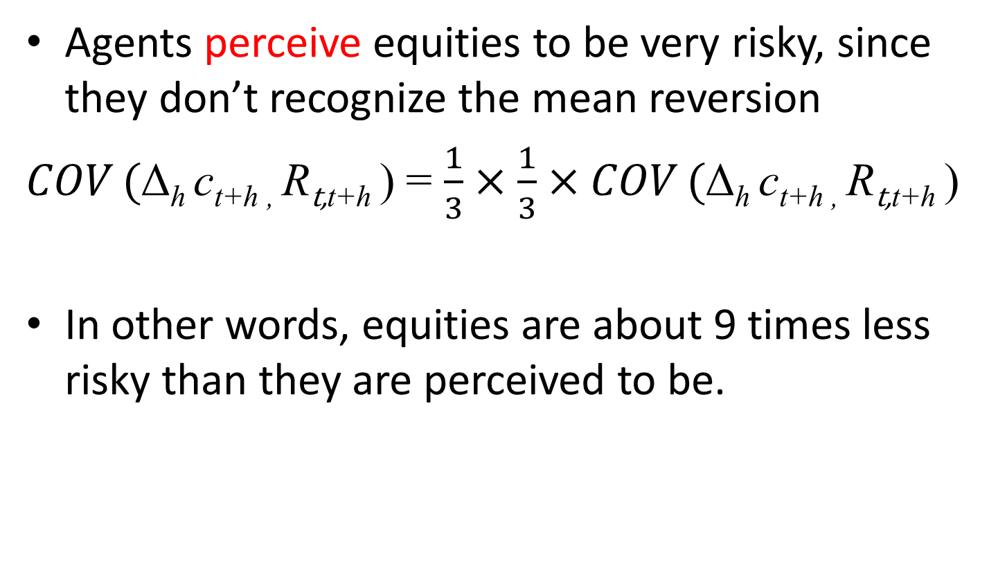
Application to equity premium puzzle
Agents perceive equities to be very risky, since they don’t recognize the mean reversion
$COV ($Δ$\text{h} \text{c}\text{t}\text{+}\text{h} \text{, }$R$\text{t}\text{,}\text{t}\text{+}\text{h}$) = $\frac{1}{3}×\frac{1}{3}×COV ($Δ$\text{h} \text{c}\text{t}\text{+}\text{h}\text{ , }$R$\text{t}\text{,}\text{t}\text{+}\text{h}$)
In other words, equities are about 9 times less risky than they are perceived to be.

Slide 200
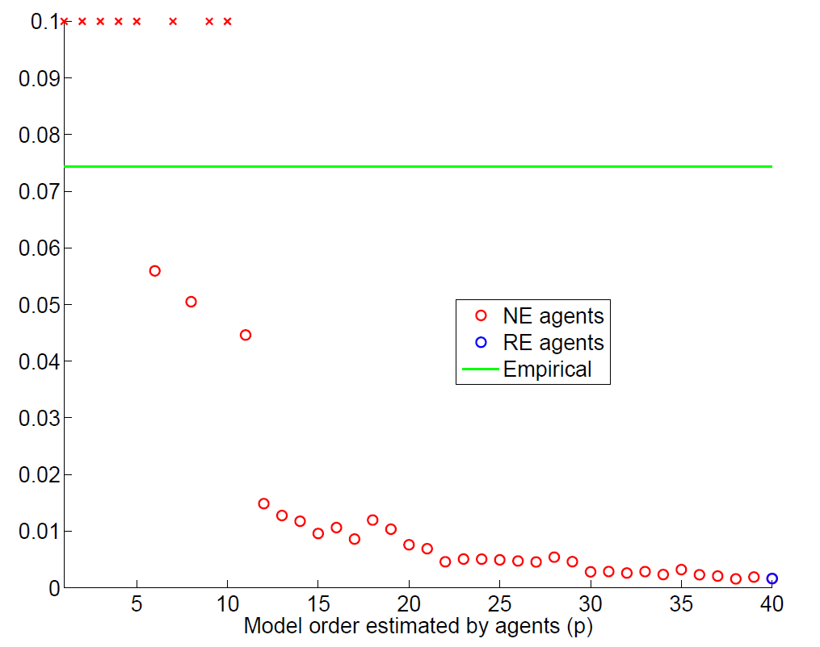
Equity Premium for Different AR(p) Models of Earnings

Slide 201
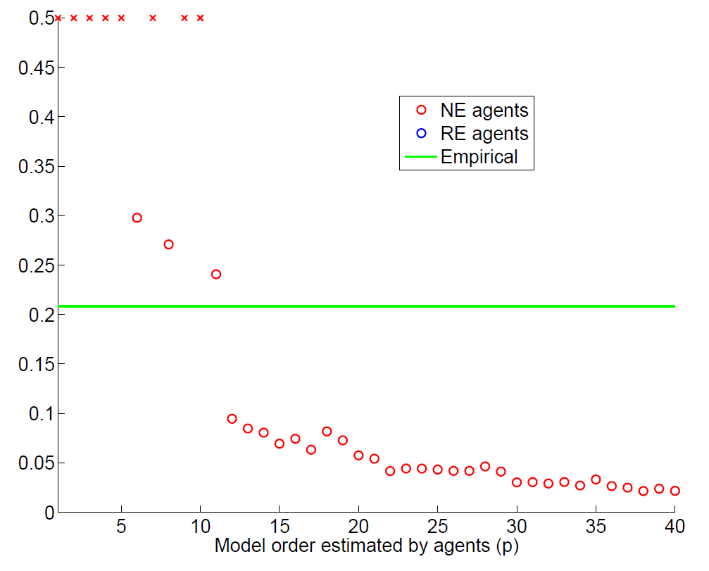
Standard deviation of equity returns for Different AR(p) Models of Earnings

Slide 202
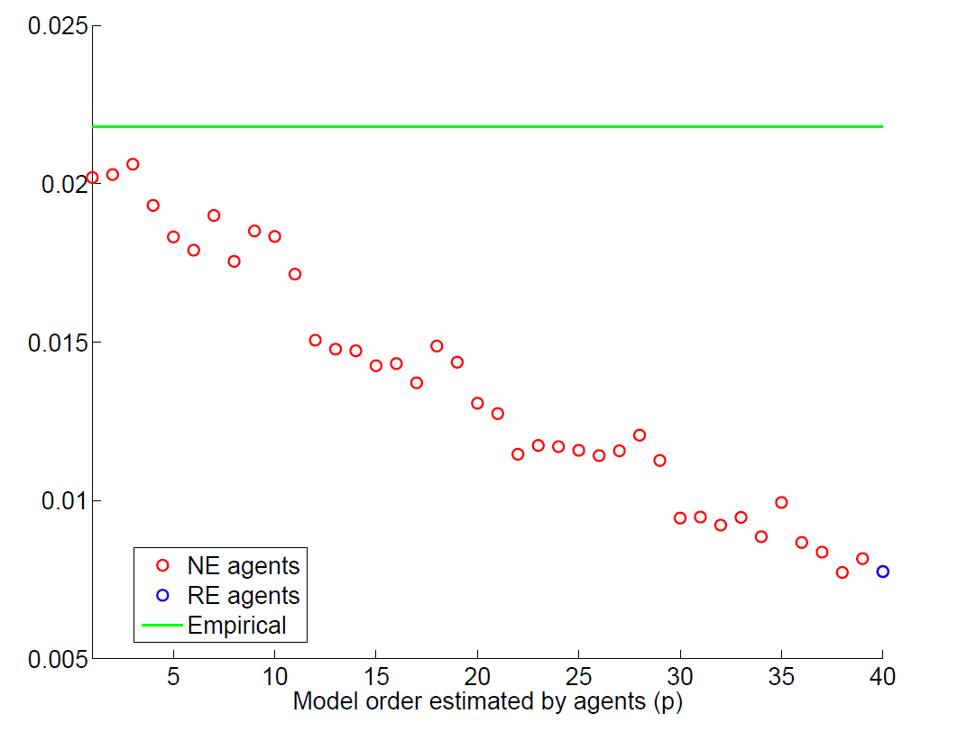
Standard Deviation of Consumption Growth for Different AR(p) Models of Earnings

Slide 203
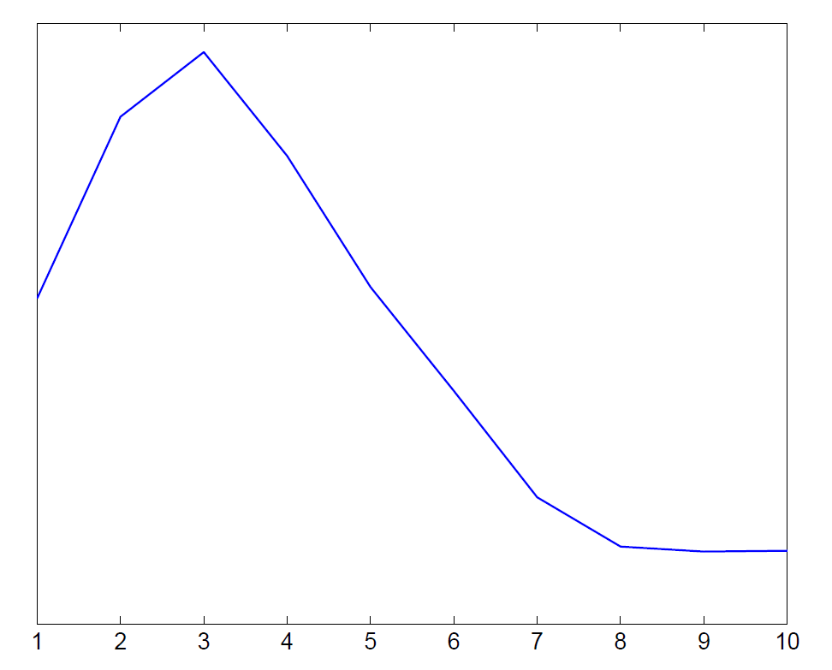
Covariance of consumption growth and cumulative return at different horizons
Simulated data
Empirical data

Slide 204
How would rational expectations (RE) agents behave in this economy?
Closed form solution for consumption function and asset allocation
RE agents hold 50% more equities than normal agents
RE agents adjust their equity allocation counter-cyclically

Slide 205
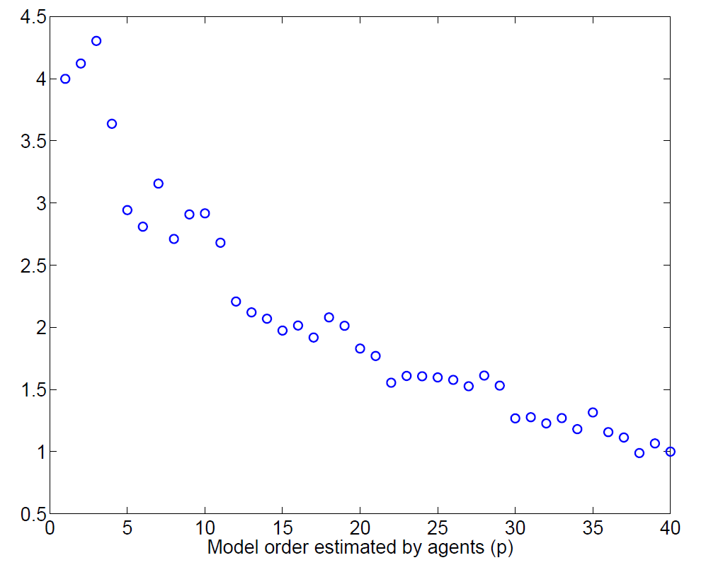
Relative leverage of RE agents as a function of the
AR(p) beliefs of non-RE agents

Slide 206
Summary
Fundamentals follow hump-shaped dynamics:
    Short-run momentum
    Long-run (partial) mean reversion
Agents use simple models that miss some of the mean reversion
Asset prices exhibit excess volatility and long-run mean reversion
Cycles in consumption (and investment)
The covariance of returns and consumption growth rises and then falls with horizon h
Equity is perceived as many times riskier than it actually is
Rational investors should hold more equity than typical investors
Rational investors should invest countercyclically

Slide 207
Looking ahead
To do dynamic economics we need models of forward looking beliefs
At the moment, rational expectations has an overwhelmingly dominant position
Need alternatives to the rational expectations benchmark

Slide 208
Psychological foundations of bubbles
Extrapolation – it’s a generally useful heuristic
LaPorta (2003)
Companies with high historical earnings growth have negative earnings surprises
Companies with low historical earnings growth have positive earnings surprises

Slide 209
Psychological foundations of bubbles
Return chasing
One standard deviation increase in an investor’s idiosyncratic 401(k) rate of return during the current year increases her 401(k) savings rate at year-end by 0.13 percentage points (Choi, Laibson, Madrian, and Metrick, 2009)
Depression babies avoid stocks in the 1960’s and “Oil shock babies” avoid stocks in the 1990’s (Malmendier and Nagel, 2009)
Brokerage investors repurchase individual stocks they previously sold for a gain while shunning individual stocks they previously sold for a loss (Barber, Odean, and Strahilevetz, 2004)
Finnish investors are more likely to subscribe to future IPOs if they experienced high returns in their prior IPO subscriptions (Kaustia and Knüpfer, 2008)

Slide 210
Psychological foundations of bubbles
Wishful thinking
e.g., Weinstein (1980)
Believe optimistic scenarios if they are plausible
70% of drivers believe they are in the top 30%
Good economic news is viewed uncritically and bad economic news is viewed skeptically

Slide 211
Social proof:
It must be right, if everyone else is doing it e.g., Asch (1954)
Psychological foundations of bubbles
Solomon Asch paradigm
7 male college students in the room
“task involving visual judgment”
One card contains a single line
Another card contains three lines

Slide 212
Social proof continued
a.
b.
c.
Which line on the left is the same as the line on the right?

Slide 213
Social proof continued
Task: pick out the matching line
Easy task: error rate for a lone subject is <1%
In actual experiment, 6 of the 7 subjects are fakes
In some trials the fakes respond erroneously
Error rate of real subject during such trials is 36.8%

Slide 214
Overconfidence
Psychological foundations of bubbles
Overconfidence (2nd moment)
Alpert and Raiffa (1982)
How many births occurred in these randomly chosen states in 2004?
  California, Illinois, Mississippi, North Carolina, Texas, Wyoming
Now provide a 99% confidence interval for each state.
In other words, for each state pick two numbers (low and high) so that there is a 99% chance that the true value of the number of births lies in that interval.

Slide 215
Number of births in 2004
CA | IL | MI | NC | TX | WY
545,071 | 180,934 | 42,810 | 119,851 | 384,389 | 6,807

Slide 217
Asset pricing
Agents perceive that the interest rate fell from 0.07 to 0.06 and the rate of housing appreciation rose from 0.03 to 0.04. (Prime variables are the new perceptions.)

Slide 218
Rational asset pricing
Agents should have recognized two things:
Lower steady state inflation would produce a lower steady state rate of house price appreciation.
Positive economic events in the 1990’s would not permanently raise the real rate of housing appreciation.

Slide 219
2. Short-run consequences
1995-2007
A simple model of consumption
Assume: no uncertainty & perfect capital markets

Slide 220
Manipulate expressions to yield consumption function

Slide 221
Special cases

Slide 222
Calibrate
Discount rate (-lnδ)? 1%-10%
Risk-free real interest rate (-lnR)? 2%-5%
Coefficient of relative risk aversion (γ)? 0.5-5
Let’s pick a benchmark case:
  δ = 0.95
  γ = 1
So λ = 0.05 (marginal propensity to consume)

Slide 223
Technical slide
Accumulated excess consumption: take 1998:1 as benchmark C/GDP ratio. Then take all future excesses (using the ratio as the predicted level) and accumulate. Then divide by GDP in 2008.
Trade deficits are just summed up.

Slide 224
The Basic Ingredients of the
Financial Crisis
Bubbles in housing and equities
Leverage in household and financial sectors
Consumption and Investment Cycle

Slide 225
2. Leverage
Household leverage
Leverage in financial sector

Slide 226
Down payments
(New construction from 2003-2007)
Half of down payments are less than 10% of purchase price
Size of down payment
Source: American Housing Survey 2007

Slide 227
Household leverage:
Fraction of home buyers with no downpayment
(New construction in last 4 years)
19%!
Source: American Housing Survey

Slide 228
Household mortgages divided by GDP
1952 Q1 – 2008 Q4

Slide 229
Financial sector leverage
Gross Leverage Ratios exceeded 30:1 at
Merrill Lynch
Lehman Brothers
Morgan Stanley
Bear Sterns
Only Goldman Sachs has stayed below this threshold with a maximum leverage ratio of 24.

Slide 230
Lehman at the start of the financial crisis
Assets (billions $) |  | Liabilities and stockholders' equity (billions $)
Cash | 20 | Short-term borrowing | 546
Securities and other assets | 671 | Long-term debt | 123
 |  | Total Liabilities | 669
 |  | Stockholders' equity | 22
Total assets | 691 | Total Liabilities + Stockholders' equity | 691
Lehman Brothers, November 30, 2007

Slide 231
Why so much leverage?
Why were households so leveraged?
  Belief that housing would appreciate
  Natural channel to fund consumption boom
Why were banks so leveraged?
  Belief that tranched asset-backed securities were really AAA (e.g., CDO’s)
  Implicit belief that national housing prices would appreciate (or at least stabilize)

Slide 232
Lehman’s forecasts in 2005
HPA = House Price Appreciation
Source: Gerardi et al (BPEA, 2008)

Slide 233
Alan Greenspan
“While local economies may experience significant speculative price imbalances, a national severe price distortion seems most unlikely in the United States, given its size and diversity.” (October, 2004)
If home prices do decline, that “likely would not have substantial macroeconomic implications.” (June, 2005)
Though housing prices are likely to be lower than the year before, “I think the worst of this may well be over.” (October, 2006)

Slide 234
Quarterly rates of foreclosure filings for different categories of mortgage, as well as the aggregate category, which is labeled “All loans”. The annualized rate of foreclose is the sum of the quarterly rates of foreclosure. So a 1.5% quarterly foreclosure rate for four consecutive quarters generates a 6% annual rate of foreclosure.

Slide 235
Consequences for banking sector
Bear Sterns sold in a fire sale to JP Morgan Chase (3/2008)
Lehman Brothers goes bankrupt (9/2008)
WaMu enters receivership and sold to JP Morgan Chase (9/2008)
Wachovia sold in a fire sale to Wells Fargo (9/2008)
Merrill Lynch sold in a fire sale to Bank of America (9/2008)
Citigroup, Bank of America, and Morgan Stanley on the brink of failure/bankruptcy (12/2008)
All together about 400 US banks fail (2007-2012)

Slide 236
Case studies
Four (quick) case studies:
Bear Sterns: Bear was sold (3/16/2008) to JPMorgan Chase.
Lehman Brothers: Lehman filed for Chapter 11 protection (9/15/2008) and was dissolved.
Washington Mutual: WaMu bank was seized by the Office of Thrift Supervision (9/25/2008) and the banking subsidiary was sold to JPMorgan Chase. Washington Mutual, Inc., the holding company, filed Chapter 11.
Citigroup: Citi was protected from failing by the Treasury and the Fed.

Slide 237
Bear
Bear was the first major investment bank to fail during the current crisis
3/16/2008: Under pressure, Bear signs a “merger” agreement with JP Morgan Chase
The final price ends up being $10 per share (95% fall in value for Bear's shareholders)
The Fed makes the deal possible by issuing a non-recourse loan of $29 billion to JP Morgan Chase. The loan is collateralized by toxic assets on Bear's balance sheet. (Maiden Lane portfolio)

Slide 238
Lehman
Fed received criticism for bailing out Bear. Critics argued that there was now a moral hazard problem, since Bear's creditors received no haircut (and even Bear'shareholders walked away with $10/share). In response, the Fed vowed to draw a tougher line next time.
9/15/2008: Lehman Brothers fails to receive support from the Fed and files for Chapter 11 protection.
This is the largest bankruptcy in U.S. history. Lehman's failure generates a "systemic" shock as creditors lose 90 cents on the dollar.

Slide 239
WaMu
WaMu was the largest savings and loan association.
9/2008: bank-run depletes 9% of deposits.
9/25/2008 (a Thursday): OTS seizes Washington Mutual Bank from Washington Mutual, Inc. and places it into FDIC receivership. That night, FDIC sells the bank (minus unsecured debt) to JPMorgan Chase for $1.9 billion. Bank re-opens the next day.
Stripped of its principal asset, the holding company, Washington Mutual, Inc. files Chapter 11 on 9/26/2008. WaMu equity investors are effectively wiped out.

Slide 240
Citi
Citi is often claimed to be “too big to fail”
October 2008: TARP investment of $25 billion
11/24/2008: Treasury provides another $20 billion in TARP funds; Treasury, Fed, and FDIC will cover 90% of the losses on a $335-billion portfolio after Citi absorbs the first $29 billion. Citi gives US $27 billion of preferred shares and warrants to acquire stock. The government dictates mortgage modifications, salary caps, and a dividend cap (1 cent a share).
2/27/2009: US takes a 36% equity stake by converting $25 billion into common shares.
Year-end 2009: Citi repays remaining $20 billion loan (with $3.1 bl interest), terminates its loss-sharing deal, and government starts to sell its common shares.

Slide 241
The Basic Ingredients
Bubbles in housing and equities
Leverage in household and financial sectors
Consumption and Investment Cycle

Slide 242
3. Consumption and Investment Cycle
A simple model of consumption.
Consumption equals annuity value of wealth.
C = 0.05 * wealth

Slide 243
Consequences for consumption
Bubble reaches a peak of at least $12 trillion
With an MPC of 0.05, consumption should rise by $600 billion
Another way of thinking about this is in units of GDP.
Consumption as a share of GDP should rise by

Slide 244
Consumption over GDP
1947:1 to 2010:4

Slide 245
US trade deficit supports the higher level of consumption
Trade balance over GDP 1947.1 – 2010.4

Slide 246
A match between the consumption boom and the trade deficit
Let’s use 1998:1 as the beginning of the boom
And 2008 as the end
Accumulated consumption boom is 42% of 2008 GDP
Accumulated trade deficits are 43% of 2008 GDP

Slide 247
Consequences for consumption
Wealth falls by $14 trillion
With a Marginal Propensity to Consume of 0.05, consumption should fall by $700 billion, which is about 7% of aggregate consumption
So ln(consumption) should fall by 0.07.

Slide 248
Log(Real Consumption)
1947:1 to 2010:4

Slide 250
Investment boom
Think about Tobin’s q
As housing prices go up – a rise in q -- a boom in residential housing construction begins
When housing prices fall – a fall in q – the boom in residential construction ends

Slide 251
Investment ratio
Investment divided by GDP 1947:1 to 2009:4
1998:1
0.17
Total Investment
Residential
Investment

Slide 252
Homes for Sale
(thousands of units)
2226

Slide 253
Selected topics in behavioral macro and behavioral finance
Money illusion
Downward nominal wage rigidity
Belief formation & learning
Asset pricing
Bubbles and the financial crisis

