Slide 1
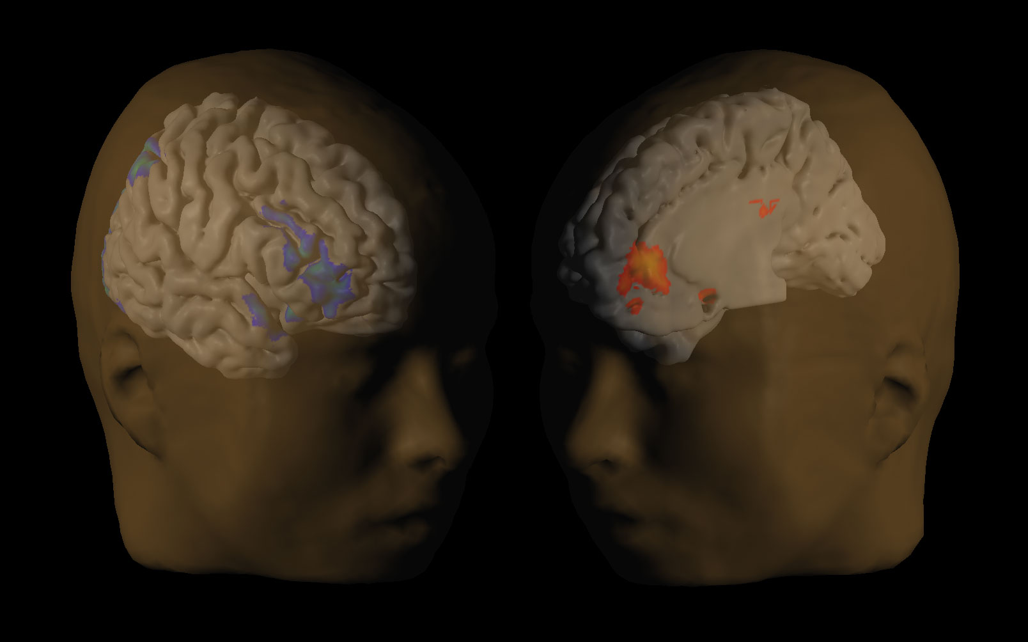
David Laibson
July 3, 2014
This deck contains “hidden slides” that were not presented.
View in “slideshow” mode to avoid these hidden slides.
Biosocial Science

Slide 2
Outline:
Biosocial science: definition and methods
Multiple Systems Hypothesis
Genoeconomics

Slide 3
Biosocial science: definition.
Definition: Biosocial science is the study of the biological microfoundations of economic cognition and economic behavior.
Biological microfoundations are neurochemical mechanisms and pathways, like brain systems, neurons, genes, and neurotransmitters.
Economic cognition is cognitive activity that is associated with economic perceptions, beliefs and decisions, including mental representations, emotions, expectations, learning, memory, preferences, and decision-making.

Slide 4
The “field” of neuroeconomics
(neuroscience piece of bio-social science)
About a decade old
About 200 neuroscientists and economists are active (equal representation of neuroscientists and economists)
This contrasts with behavioral economics, where it’s more one-sided (mostly economists and few psychologists).
In neuroeconomics, there is a mix of behavioral economists, classical economists, and some economists who are not in either camp.
You don’t need to believe people are “behavioral” to be a neuroeconomist
Annual neuroeconomics conference and a “society.”

Slide 5
Neuroeconomics: methods
Animal behavioral studies (e.g., addicting rats to cocaine, loss aversion in monkeys; Chen et al 2006)
Studies of children (e.g. Mischel et al 1975)
Studies of children with autism (e.g. Sally et al 2001).
External physiological measurement (e.g., pupil dilation, voice tone, facial expression, skin conductance, heart rate)
Cognitive load (remember this seven digit number and do a task; e.g. Shiv and Fedorhikin 1999)

Slide 6
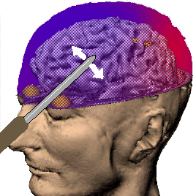
More methods...
Lesions, localized damage, gene knockout…
e.g., experimental destruction of both amygdalas in an animal tames the animal, making it sexually inactive and indifferent to danger like snakes or other aggressive members of its own species
e.g., humans with lesions of the amygdala lose affective (i.e. emotional) meaning
e.g., knocking out the gene that makes a key protein for amygdala function makes rats relatively fearless
e.g., hippocampus removal prevents experiences from being encoded in long-term memory

Slide 7
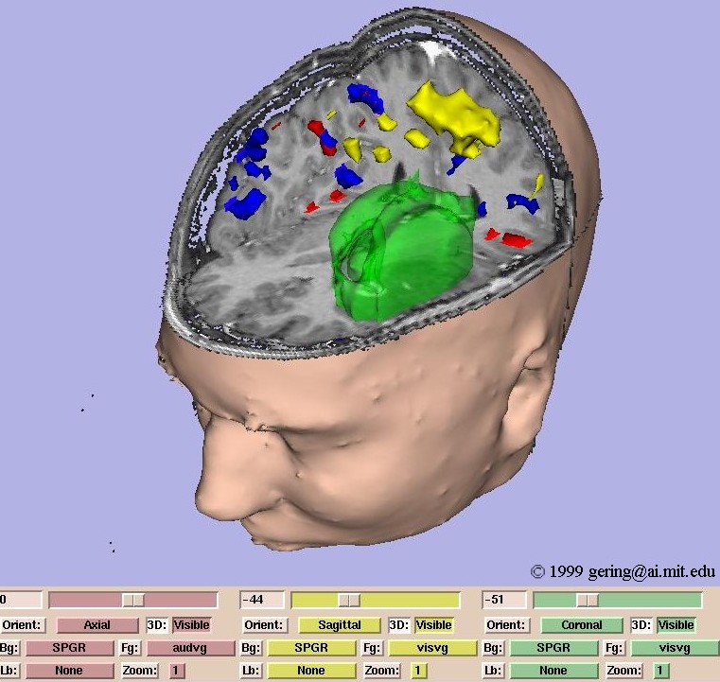
More methods
Brain stimulation (e.g., electrical stimulation of the amygdala elicits violence and aggressivity; at special loci, electrical brain stimulation is highly reinforcing)
Single neuron measurement (e.g., track high frequency dopamine release in animal models, Schultz et al, Glimcher)
Transcranial magnetic stimulation (TMS)
EEG, PET, fMRI… (taking pictures of the active brain; e.g., McCabe, Houser, Ryan, Smith, and Trouard 2001).

Slide 8
Schultz, Dayan, Montague (1997) Science 275:1593-1599
Positive prediction error
“better than expected”
Zero prediction error
“same as expected”
Negative prediction error
“worse than expected”

Slide 9
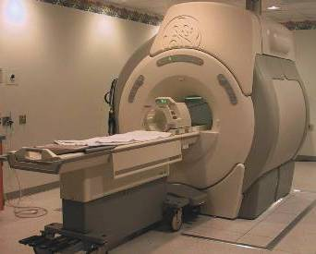
fMRI: functional magnetic resonance imaging
Source: Scott Huettel

Slide 10
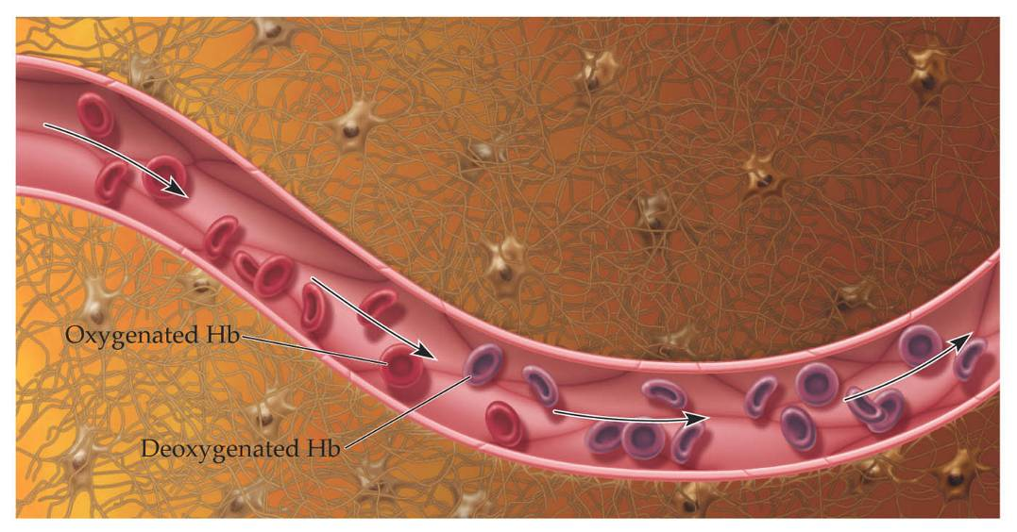
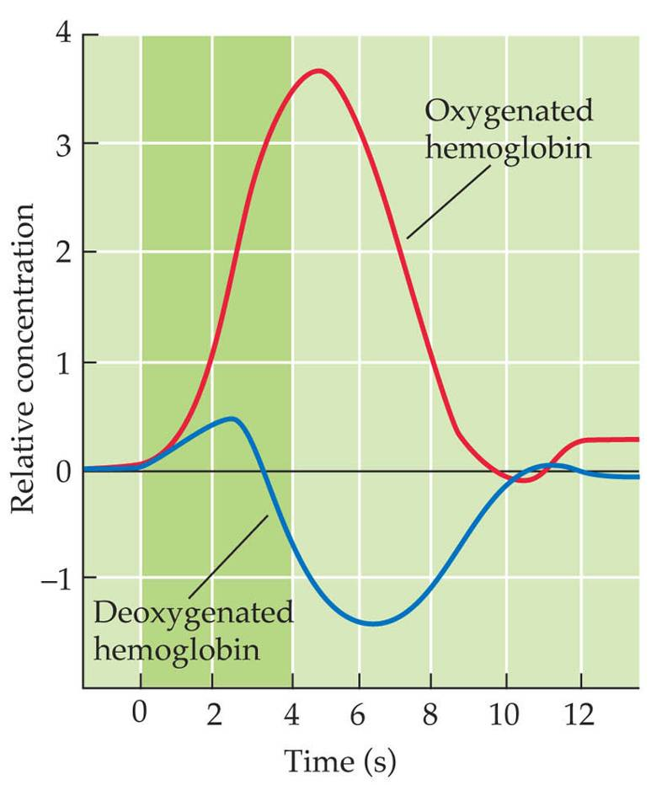
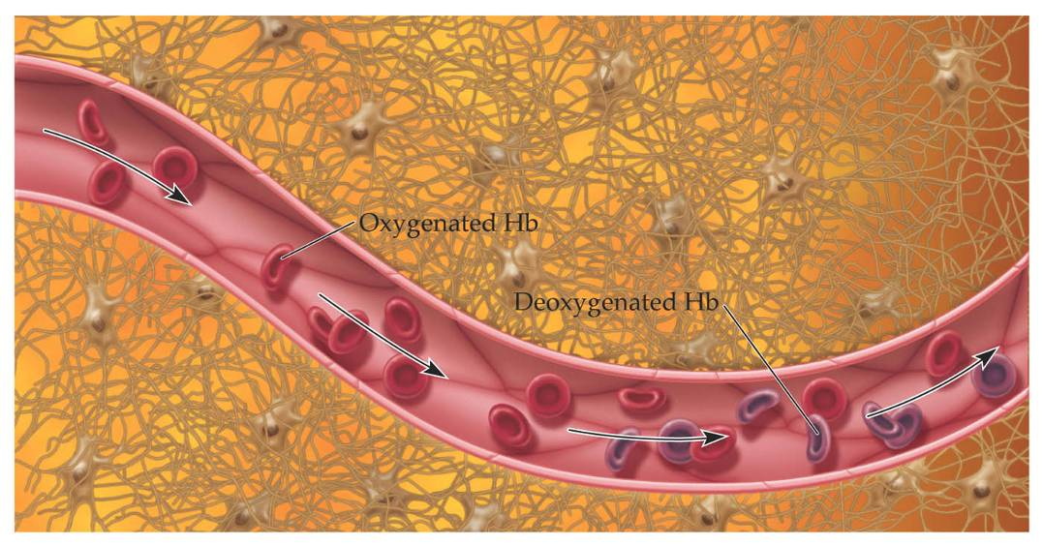
The fMRI Blood-Oxygenation-Level-Dependent (BOLD) Response
Increased neuronal activity results in increased MR (T₂*) signal
BASELINE
ACTIVE
Source: Scott Huettel

Slide 11
Basic experimental design
Task
A
Task
B
Task
C
Time
Rest
12 sec
Rest
12 sec
Rest
12 sec
Rest
12 sec

Slide 12
Basic econometric methodology
Divide brain into 30,000 voxels (cubes 2 mm on edge)
Measure blood flow at the voxel level (BOLD signal)
Run “regressions” (general linear model) relating BOLD signal to covariates:
BOLD_{v,i,t} = FE_{i} + controls_{t} + task dummy_{t}
Indexes for voxel (v), subject (i), and time (t)
Controls: time in scanner, lagged reward event, etc.
event dummy: decision, experience, event, etc.
Analogous method: “contrast”

Slide 13
Multiple-testing problem (cf Vul et al 2010)
Don’t worry:
Strict thresholds (α = 0.001 and 5-voxel contiguity)
Pre-specification of hypothesis (ROI)
Replication
Converging lines of evidence (fMRI, single neuron measurement, knock-outs, legions, rTMS)
This is the same multiple testing problem that hangs over all empirical research
Worry:
Are all significant voxels reported?
Were the specification searches reported?
Are all GLM’s (regressions) reported?
Is the neuroscientific explanation of the data post-hoc?
Shouldn’t the effect size be adjusted for multiple testing

Slide 14
Unusual features of neuroeconomic experiments
Extensive pre-scanner piloting (scanner time is $$$)
Only need about 40 scanned subjects (not that expensive after all – about $20,000 for scanner costs)
Claustrophobia and noise issues
Try to implement within-subject designs
Tasks can’t take too long (max about 45 minutes)

Slide 15
Continued…
Can do almost anything in the scanner
  Play games
  Play real-time games with other subjects (so-called hyperscans)
  Eat
  Experience pain
Most economists need neuroscience collaborators to implement neuroimaging experiments
Analysis is subject to methodological criticisms (lots of hypothesis tests) – use conservative thresholds, such as 5+ contiguous voxels and α = 0.001 or smaller

Slide 16
Why should economists study the brain?
Because we care about the brain for its own sake? (Not for most of us.)
Because we hope to improve our measurements of utility? (Maybe. Maybe not.)
Because the study of the brain will catalyze the development of new models, speeding up the rate of progress in model development. (Yes.)
Because neuroscience will provide new empirical empirical tests. (Yes.)
Because we will eventually be able to use neuroscience measurements to help people better understand and manage themselves. (Yes.)

Slide 17
Aside on Genoeconomics
Brand new field with some methodological challenges
Definitions and data:
Deoxyribonucleic acid (DNA): 3 billion base pairs (guanine-cytosine, adenine-thymine),
  32,000 genes (i.e., locus of DNA that expresses a protein)
  lots of base pairs that play some regulatory role but do not directly transcribe proteins
  DNA is divided into 23 chromosomes
Phenotypes: outcome variable, such as a trait (e.g., eye color, health, income, marital status, etc…)
Twin studies: e.g., contrast correlations between monozygotic (identical) twins and correlations between dizygotic twins. Differences in correlations are used to infer heritability: the fraction of variance that is ascribed to genes (as opposed to environment).

Slide 18
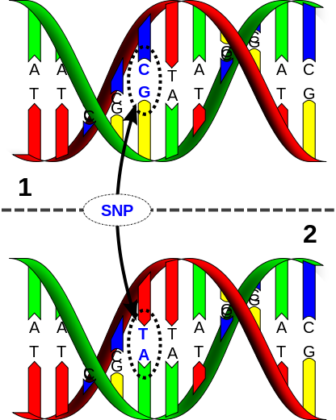
SNPs: single-nucleotide polymorphisms (a single DNA base pair differs with meaningful frequency across people)
  About 1-5 million loci
Genotyping: mapping some part of a person’s DNA (e.g., 1 million SNPs, using an Illumina chip)
Power is an enormous problem in gene finding
Most published results are probably false positives
Need 10,000 to 100,000 subjects for adequate power assuming typical plausible effect sizes (see Benjamin et al 2012).
Solution: Social Science Genetic Association Consortium

Slide 19
References:
Daniel J. Benjamin, David Cesarini, Matthijs J.H.M. van der Loos, Christopher T. Dawes, Philip D. Koellinger, Patrik K.E. Magnusson, Christopher F. Chabris, Dalton Conley, David Laibson, Magnus Johannesson, and Peter M. Visscher. (2012). "The Genetic Architecture of Economic and Political Preferences," Proceedings of the National Academy of Sciences 109(21): 8026-8031.
Daniel J. Benjamin, David Cesarini, Christopher F. Chabris, Edward L. Glaeser, David I. Laibson, Vilmundur Guðnason, Tamara B. Harris, Lenore J. Launer, Shaun Purcell, Albert Vernon Smith, Magnus Johannesson, Jonathan P. Beauchamp, Nicholas A. Christakis, Craig Atwood, Benjamin Hebert, Jeremy Freese, Robert M. Hauser, Taissa S. Hauser, Patrik Magnusson, Alexander Grankvist, Christina Hultman, Paul Lichtenstein (2012). "The Promises and Pitfalls of Genoeconomics," Annual Review of Economics 4: 627-662.
Chabris, Christopher F., Benjamin M. Hebert, Daniel J. Benjamin, Jonathan Beauchamp, David Cesarini, Matthijs J.H.M. van der Loos, Magnus Johannesson, Patrik K.E. Magnusson, Paul Lichtenstein, Craig S. Atwood, Jeremy Freese, Taissa S. Hauser, Robert M. Hauser, Nicholas A. Christakis, David Laibson (2012), “Most Reported Genetic Associations with General Intelligence Are Probably False Positives” Psychological Science.

Slide 20
Part I: A neuroeconomics example:
The Multiple Systems Hypothesis
Statement of Hypothesis
Variations on a theme
Caveats
Illustrative predictions
  Cognitive load manipulations
  Willpower manipulations
  Affect vs. analytic manipulations
  Cognitive Function
  Development
  Neuroimaging/TMS
Directions for future research

Slide 21
Statement of
Multiple Systems Hypothesis (MSH)
The brain makes decisions (e.g. constructs value) by integrating signals from multiple systems
These multiple systems process information in qualitatively different ways and in some cases differentially weight attributes of rewards (e.g., time delay)

Slide 22
An (oversimplified) multiple systems model
System 1
Integration
System 2
Behavior

Slide 23
An uninteresting example
What is 6 divided by 3?
Addition
Integration
Division
Behavior

Slide 24
A more interesting example
Would you like a piece of chocolate?
Abstract
goal:
diet
Integration
Visceral
reward:
pleasure
Behavior

Slide 25
A more interesting example
Would you like a piece of chocolate?
Abstract
goal:
diet
Integration
Visceral
reward:
pleasure
Behavior

Slide 26
Variations on a theme
Charioteer’s two horses (Socrates/Plato, The Phaedrus, 370 BC):
“First the charioteer of the human soul drives a pair, and secondly one of the horses is noble and of noble breed, but the other quite the opposite in breed and character. Therefore in our case the driving is necessarily difficult and troublesome.”
Interests vs passions (Smith)
Superego vs Ego vs Id (Freud)
Controlled vs Automatic (Schneider & Shiffrin, 1977; Benhabib & Bisin, 2004)
Cold vs Hot (Metcalfe and Mischel, 1979)
System 2 vs System 1 (Frederick and Kahneman, 2002)
Deliberative vs Impulsive (Frederick, 2002)
Conscious vs Unconscious (Damasio, Bem)
Effortful vs Effortless (Baumeister)
Planner vs Doer (Shefrin and Thaler, 1981)
Patient vs Myopic (Fudenburg and Levine, 2006)
Abstract vs Visceral (Loewenstein & O’Donoghue 2006; Bernheim & Rangel, 2003)
PFC & parietal cortex vs dopamine reward system (McClure et al, 2004)

Slide 27
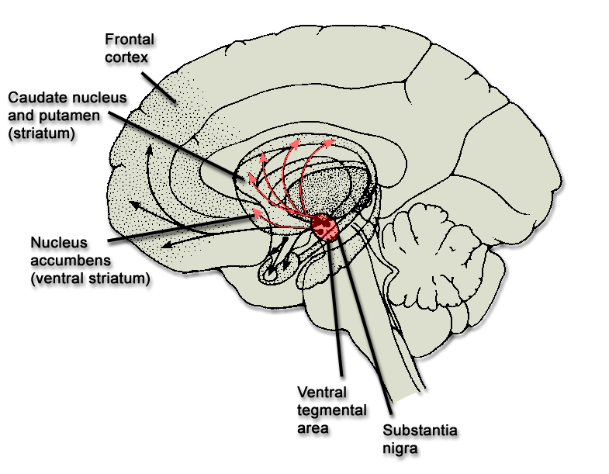
Affective vs. Analytic Cognition
Frontal
cortex
Parietal
cortex
mPFC
mOFC
vmPFC
Dopamine
reward system

Slide 28
Relationship to quasi-hyperbolic model
Hypothesize that the fronto-parietal system (PFC) is patient
Hypothesize that dopamine reward system (DRS) is impatient.
Then integrated preferences are quasi-hyperbolic
 |  | now | t+1 | t+2 | t+3
PFC |  | 1 | 1 | 1 | 1 | …
DRS |  | 1 | 0 | 0 | 0 | …
Total |  | 2 | 1 | 1 | 1 | …
Total normed |  | 1 | 1/2 | 1/2 | 1/2 | …

Slide 29
Relationship to quasi-hyperbolic model
Hypothesize that dopamine reward system is impatient.
Hypothesize that the fronto-parietal system is patient
Here’s one implementation of this idea:
U_{t} = u_{t} + β [δu_{t+1} + δ²u_{t+2} + δ³u_{t+3} + ...]
(1/β)U_{t} = (1/β)u_{t} + δu_{t+1} + δ²u_{t+2} + δ³u_{t+3} + ...
(1/β)U_{t} =(1/β−1)u_{t} + [δ⁰u_{t} + δ¹u_{t+1} + δ²u_{t+2} + δ³u_{t+3} + ...]
DRS fronto-parietal cortex

Slide 30
Commonalities between classification schemes
Affective system
fast
unconscious
reflexive
myopic
Analytic system
Effortful
slow
conscious
reflective
forward-looking
(but still prone to error: heuristics may be analytic)

Slide 31
Caveats
N ≥ 2
The systems do not have well-defined boundaries (they are densely interconnected)
Maybe we should not say “system,” but should instead say “multiple processes”
Some systems may not have a value/utility representation
  Making my diet salient is not the same as assigning utils/value to a Devil Dog
If you look downstream enough, you’ll find what looks like an integrated system (see many papers by Antonio Rangel)

Slide 32
Related Predictions
Cognitive Load Manipulations
  Shiv and Fedorikhin (1999), Hinson, Jameson, and Whitney (2003)
Willpower manipulations
  Baumeister and Vohs (2003)
Affect vs. analytic manipulations
  Rodriguez, Mischel and Shoda (1989)
Cognitive Function
  Benjamin, Brown, and Shapiro (2006), Shamosh and Gray (2008)
Developmental Dynamics
  Green, Fry, and Myerson (1994),
Neuroimaging/TMS Studies
  Tanaka et al (2004), McClure et al (2004), Hariri et al (2006), McClure et al (2007), Kabel and Glimcher (2007), Hare, Camerer, and Rangel (2009), Figner et al (2010), Albrecht et al (2010)

Slide 33
Cognitive Load Should
Decrease Self-regulation
Shiv and Fedorikhin (1999)
Load manipulated by having people keep either a 2-digit or 7-digit number in mind during experiment
Subjects choose between cake or fruit-salad
Processing burden | % choosing cake
Low (remember only 2 digits) | 41%
High (remember 7 digits) | 63%

Slide 34
Cognitive Load
Increases Discounting
Hinson, Jameson, and Whitney (2003)
Task: Subjects choose one reward from a set of two or more time-dated rewards.
Some subjects are under cognitive load: hold 5-digit string in memory
One month discount rate*
Control (2 items): 26.3%
Treatment (2 items + load): 49.8%
Treatment (3 items): 48.4%
*Discount rate for 1 month is ln(1+k), where discount function is 1/(1+kt).

Slide 35
Willpower is a domain general and exhaustable resource
Muraven, Tice and Baumeister (1998)
All subjects watch upsetting video clip
  Treatment subjects are asked to control emotions and moods
  Control subjects are not asked to regulate emotions
All subjects then try to squeeze a handgrip as long as possible
Treatment group gives up sooner on the grip task
Interpretation: executive control is a scarce resource that is depleted by use
Many confounds and many variations on this theme

Slide 36
Affect Augmentation/Reduction Predictably Changes Patience
Rodriguez, Mischel and Shoda (1989)
Task: Children attempt to wait 15 minutes, to exchange a smaller immediate reward for a larger delayed reward.
Manipulations:
  Control
  Affect Augmentation: exposure to rewards
  Affect Reduction: think of delayed reward abstractly (pretzels are logs, marshmallows are clouds)
Results:
  Ability to wait goes down after affect augmentation
  Ability to wait goes up after affect reduction
  (Delay task also predicts later life success: e.g., SAT scores)

Slide 37
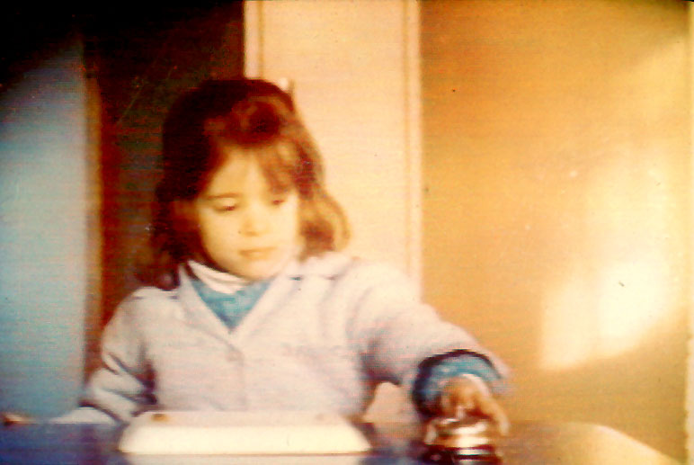
Delay of Gratification Paradigm

Slide 38
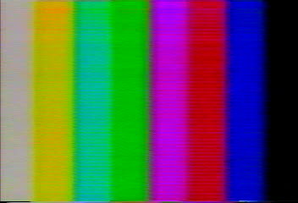
Delay of Gratification Paradigm

Slide 39
Individuals with greater analytic intelligence should be more patient
Shamosh and Gray (2008)
Meta-analysis of the relationship between delay discounting and analytic intelligence
  e.g. g, IQ, math ability
In 24 studies, nearly all found a negative relationship
Quantitative synthesis across 26 effect sizes produce a correlation of -0.23
See also work by Burks et al. (2009) which finds this pattern in a sample of truck drivers.

Slide 40
Shamosh and Gray (2008)
“Delay discounting paradigms appear to require some of the specific abilities related to both working memory and intelligence, namely the active maintenance of goal-relevant information in the face of potentially distracting information, as well as the integration of complex or abstract information.”
Manage affect: “controlling one’s excitement over the prospect of receiving an immediate reward”
  Shift attention away from affective properties of rewards
  Transform reward representation to make them more abstract
Deploy strategies
Recall past rewards and speculate about future rewards

Slide 41
Individuals with greater analytic intelligence should be more patient
Benjamin, Brown, and Shapiro (2006)
Choice task: “500 pesos today vs. 550 pesos in a week”
One standard deviation increase in a subject’s math test score is associated with a 9.3% increase in the subject’s likelihood of choosing patiently

Slide 42
Patience should track PFC development
PFC develops more slowly than other brain regions
The willingness to delay gratification is compromised during adolesence as a consequence of the interplay between mature affective/emotional systems and immature top-down control systems (e.g., PFC).
  Neuroimaging evidence shows that among adolescents, mature neural systems below the cerebral cortex (e.g. the accumbens) become disproportionately activated during decision tasks relative to later-maturing top-down control systems, thereby biasing the adolescent's action toward immediate over long-term rewards (Galvin et al 2006; Casey, Getz, and Galvan 2008; Casey, Galvan, and Hare 2005).
Green, Fry, and Myerson (1994) show that patience is correlated with age.

Slide 43
Cross-species evidence
Non-human species have a disproportionately smaller PFC
Sated monkeys have a 50% discount for juice rewards delayed 10 seconds (Livingstone 2009)
Patience increases as the subject population switches from pigeons, to rats, to human children, to human adults (Tobin and Logue, 1994).
Some researchers have argued that high rates of impatience in non-human species are usually observed in food deprived animals, potentially invalidating comparisons to sated human subjects (e.g., Rosati et al 2007; see McClure et al 2007 for evidence of high rates of impatience among non-sated human subjects).

Slide 44
Neural activity in fronto-parietal regions differentiated from neural activity in dopamine reward system regions
Not clear.
At least seven relevant studies:
  McClure et al (2004) – supportive
  McClure et al (2007) – supportive
  Kable and Glimcher (2007) – critical
  Hariri et al (2007) – supportive
  Hare, Camerer, and Rangel (2009) – integration
  Fehr et al (2009) – supportive
  Albrecht et al (2010) – supportive
And one other study that is related (and supportive):
  Tanaka et al (2004): different behavioral task

Slide 45
Tanaka et al (2004)
LONG condition: optimal to take a small payoff hit now to get a delayed payoff benefit later in time.
SHORT condition: optimal to take a small payoff now.
They contrast activation in the SHORT condition to activation in a control 'NO' condition in which there was no reward: They get activation in the OFC, insula, occipitotemporal area, the striatum, the globus pallidus and the medial cerebellum.
Next, they contrast activation in the LONG and SHORT conditions. In this contrast an increased activity was observed in VLPFC and the DLPFC, and the premotor cortex (like us) , the Inferior parietal cortex (IPC), the striatum, the dorsal raphe nucleus, the lateral cerebellum , the PCC, and the subthalamic nucleus.
In sum, there is a reasonably good overlap of our Beta areas and their SHORT system activation and our Delta areas and their LONG system activation.

Slide 46
McClure, Laibson, Loewenstein, Cohen (2004)
Intertemporal choice with time-dated Amazon gift certificates.
Subjects make binary choices:
$20 now or $30 in two weeks
$20 in two weeks or $30 in four weeks
$20 in four weeks or $30 in six weeks

Slide 47
Dopamine reward system
Fronto-parietal cortex
$20
$30
Fronto-parietal cortex
$20
$30
Fronto-parietal cortex
$20
$30

Slide 48




areas respond “only” to immediate rewards
7
T₁
0
x = -4mm
y = 8mm
z = -4mm
VStr
MOFC
MPFC
PCC
BOLD Signal
Time
Delay to earliest reward = Today
0.2%
Delay to earliest reward = 2 weeks
Delay to earliest reward = 1 month
2 sec

Slide 49
β Analysis
Summary of Significant Voxels
 | X | Y | Z | Max T | n
Medial OFC | -8 | 48 | -4 | 5.034 | 16
Ventral striatum | 6 | 8 | -4 | 4.369 | 5
L Posterior hippocampus | -26 | -38 | -8 | 4.582 | 7
Medial PFC | 0 | 44 | 12 | 6.793 | 74
Posterior cingulate cortex | -8 | -28 | 32 | 5.354 | 21
All voxels significant at p < 0.001

Slide 50


δ Areas respond equally to all rewards
VCtx
PMA
RPar
x = 44mm
DLPFC
VLPFC
LOFC
0.4%
x = 0mm
2s
0
T₁
15
Delay to earliest reward = Today
Delay to earliest reward = 2 weeks
Delay to earliest reward = 1 month

Slide 51
δ Analysis:
Summary of Significant Voxels
 | X | Y | Z | Max T | n
Visual cortex | -4 | -80 | 4 | 14.787 | 1093
PMA | 0 | 12 | 56 | 5.277 | 15
SMA | 4 | 30 | 40 | 4.987 | 10
R Posterior parietal cortex | 40 | -60 | 44 | 7.364 | 191
L Posterior parietal cortex | -32 | -60 | 52 | 9.568 | 73
R DLPFC | 44 | 44 | 16 | 7.422 | 59
R VLPFC | 40 | 20 | -8 | 7.596 | 39
R Lateral OFC | 24 | 50 | -12 | 5.509 | 5
All voxels significant at p < 0.001

Slide 52
Effect of Difficulty
VCtx
PMA
RPar
100%
75%
P(choose early)
BOLD Signal
50%
25%
0%
1-3%
5-25%
35-50%
Sec
(R’-R)/R
DLPFC
VLPFC
LOFC
4.5
4.0
BOLD Signal
Response Time (sec)
3.5
3.0
Sec
2.5
Difficult
0.4%
Easy
Difficult
1-3%
35-50%
5-25%
Easy
2s

Slide 53
Brain activity in the frontoparietal system and dopamine reward system predict behavior
(Data for choices with an immediate option.)
0.05
Fronto-parietal cortex
Brain Activity
0.0
DRS
-0.05
Choose
Immediate
Reward
Choose
Delayed
Reward

Slide 54

McClure, Ericson, Laibson, Loewenstein, Cohen
(2007)
Subjects water deprived for 3hr prior to experiment
(a subject scheduled for 6:00)

Slide 55
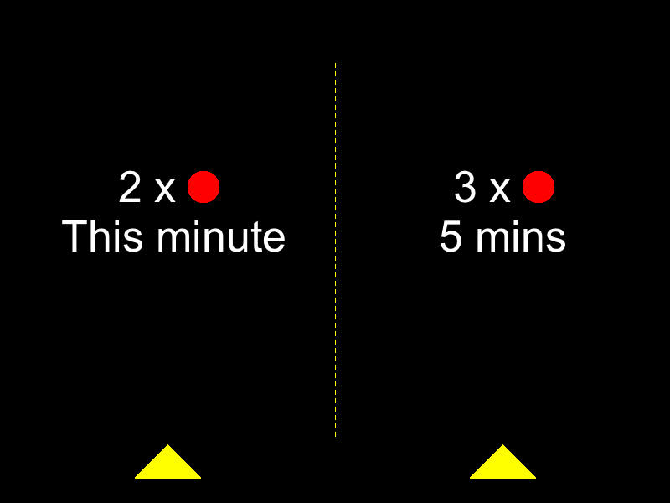
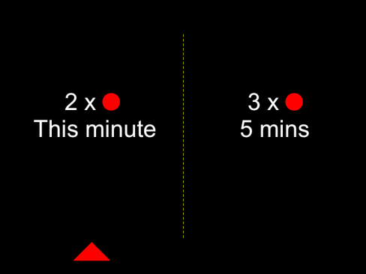


A
15s
10s
5s
Time
i
ii
iii
…
iv. Juice/Water squirt (1s )
B
(i) Decision Period
(ii) Choice Made
(iii) Pause
(iv) Reward Delivery
Free (10s max.)
2s
Variable Duration
Free (1.5s Max)
15s
Figure 1

Slide 56
Experiment Design
d
d'-d
(R, R')
∈ { This minute, 10 minutes, 20 minutes }
∈ { 1 minute, 5 minutes }
∈ {(1,2), (1,3), (2,3)}
d = This minute
d'-d = 5 minutes
(R, R') = (2,3)

Slide 57
Behavioral evidence
0.8
0.6
P(choose early)
0.4
0.2
0
This Minute
10 Minutes
20 Minutes
d = delay to early reward

Slide 58
Behavioral evidence
0.8
0.8
d’-d = 1 min
d’-d = 5 min
0.6
0.6
P(choose early)
0.4
0.4
0.2
0.2
0
0
This Minute
10 Minutes
20 Minutes
This Minute
10 Minutes
20 Minutes
d = delay to early reward
d = delay to early reward

Slide 59
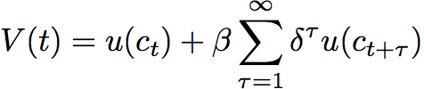
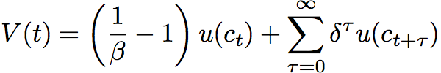
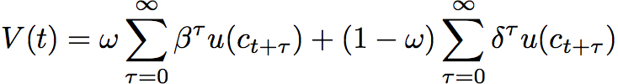
Discount functions fit to behavioral data
β = 0.53 (se = 0.041)
δ = 0.98 (se = 0.014)
DRS
PFC
= 0.47 (se = 0.101)
δ = 1.02 (se = 0.018)
Evidence for two-system model
Can reject exponential restriction with t-stat > 5
Double exponential generalization fits data best

Slide 60


Juice and Water treated equally
(both behavioral and neurally)
SMA
Ins
11
0.2%
2s
T
VStr
0
y = 12mm
Juice
Water
Time (2 second increments)

Slide 61







Neuroimaging data estimated with general linear model.
A
β areas: respond only to immediate rewards
PCu
ACC
PCu
ACC
NAcc
PCC
NAcc
SGC
MOFC/SGC
x = -12mm
x = -2mm
x = -8mm
z = -10mm
B
δ areas: respond to all rewards
BA9/44
11
PCC
SMA/PMA
BA10
BA46
T
PPar
Vis Ctx
Ant Ins
0
x = 0mm
x = 40mm
x = -48mm
Figure 4

Slide 62




Relationship to Amazon experiment:
δ areas (p<0.001): respond to all rewards
x = 0mm
x = -48mm
β areas (p<0.001): respond to immediate rewards
x = 0mm
y = 8mm
Juice
only
Amazon
only
Both
Figure 5

Slide 63




Relationship to Amazon experiment:
δ areas (p<0.01)
x = 0mm
x = -48mm
β areas (p<0.01)
x = -4mm
y = 12mm
Primary
only
Money
only
Both
Figure 5

Slide 64
Fitting discount functions using neuroimaging data.
 | Discount factor | StdErr
ACC | 0.1099 | (0.132)
MPFC | 0.0000 | NA
NAc | 0.9592 | (0.014)
PCC | 0.9437 | (0.014)
PCu | 0.9547 | (0.011)
β systems
N(t) = β^{d}R + β^{d'}R' + X(t)·θ + ε(t)
β = 0.963 (0.004)
0.963²⁵ = 0.39
δ systems
AntInsL | 0.9908 | (0.007)
AntInsR | 0.9871 | (0.006)
BA10L | 1.0047 | (0.011)
BA10R | 0.9953 | (0.010)
BA46 | 0.9870 | (0.008)
BA944 | 0.9913 | (0.006)
PCC | 0.9926 | (0.006)
PParL | 0.9970 | (0.005)
PParR | 0.9959 | (0.005)
SMAPMA | 0.9870 | (0.006)
VisCtx | 0.9939 | (0.005)
N(t) = δ^{d}R + δ^{d'}R' + X(t)·θ + ε(t)
δ=0.990 (0.003)
0.990²⁵ = 0.78

Slide 67
What determines immediacy?
Is DRS activation associated with relatively “early” (or earliest) options?
or
Do juice and money have different discount functions?
or
Does thirst invoke more intense discounting?

Slide 68
Our working hypotheses.
One system associated with midbrain dopamine neurons (DRS) shows high sensitivity to time delay.
Second system associated with lateral prefrontal and posterior parietal cortex shows less sensitivity to time delay.
Combined function of these two systems explains decision making across choice domains.

Slide 69


Hare, Camerer, and Rangel (2009)
Health Session
Taste Session
Decision Session
4s
food item
presentation
Rate Health
Rate Taste
Decide
fixation
+
+
+
Rate Health
Rate Taste
Decide
Notes:
Subjects fast for 3 hours
Come and first rate health and taste for each food (counterballanced)
One reference item that is neutral on both scales is identified
Subjects shown the reference food
Then shown each food item again and must decide whether or not to eat what is currently on the screen or the reference item
One trial randomly selected and the choice implemented

Slide 70
Details
Taste and health ratings made on five point scale:
  -2,-1,0,1,2
Decisions also reported on a five point scale: SN,N,0,Y,SY
“strong no” to “strong yes”
Subject choices sometimes reflect self control
  Rejection of an unhealthy, good tasting food, OR
  Consumption of a healthy, bad tasting food
Notes:
On slide

Slide 71
Subjects
SC (self-control) group = 19 dieting subjects who showed self-control during the decision phase
NSC (no self-control) group = 18 comparison subjects who did not exhibit self-control during the decision phase
Notes:
Sc group 19 (14 female) mean age 26 ± 4 yrs
NSC group 18 (6 female) mean age 24 ± 5 yrs

Slide 72
Who is classified as a self-controller: SC?
(must meet all criteria below)
Use self-control on > %50 of trials in which self-control is required (decline Liked-Unhealthy items or choose Disliked-Healthy ones)
Decision = β₁HR + β₂LR + ε
  β₁> β₂
R² for HR > R² for LR
Notes:
Walk through criteria

Slide 73
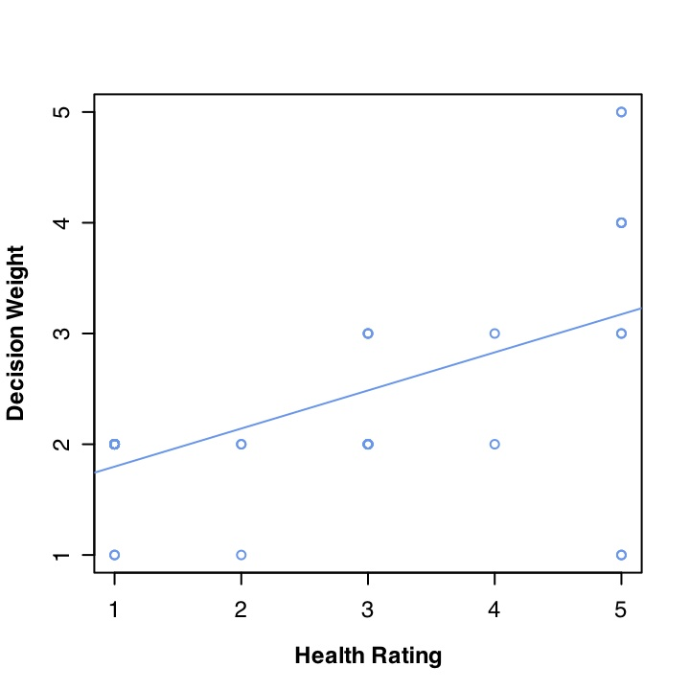
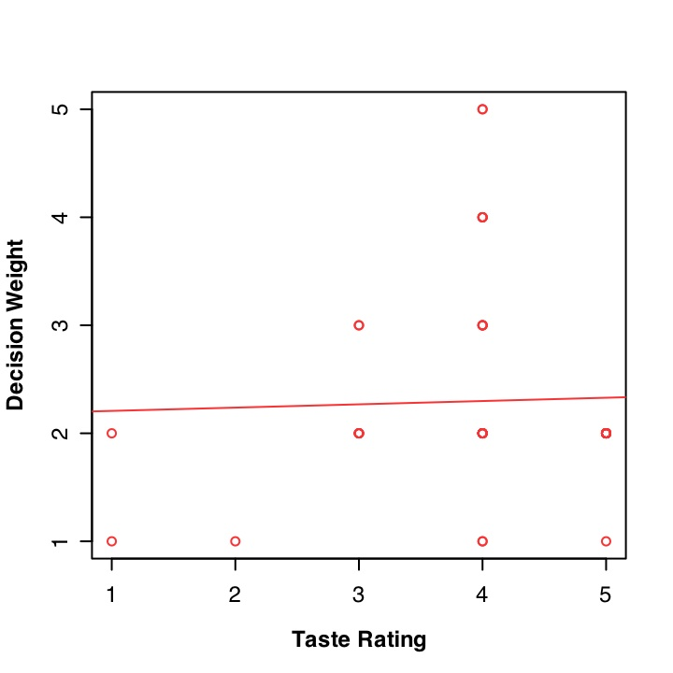
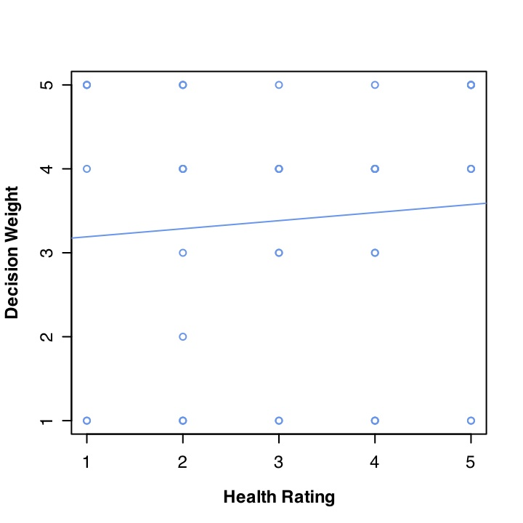
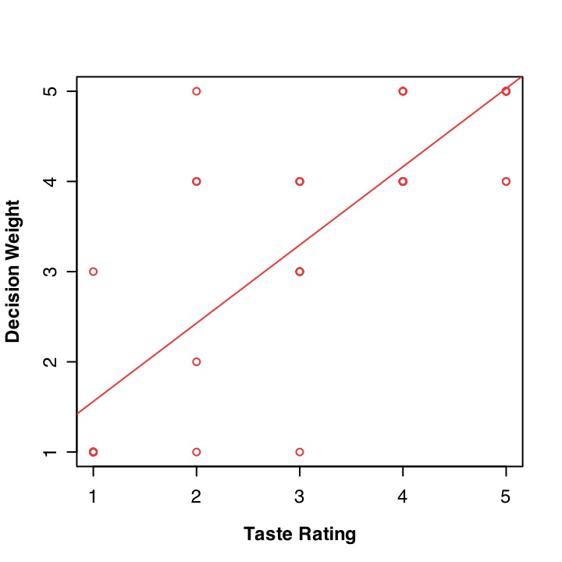
Examples of individual behavioral fits
Self-controller
Non-
self-controller
Notes:
Walk through graphs

Slide 74
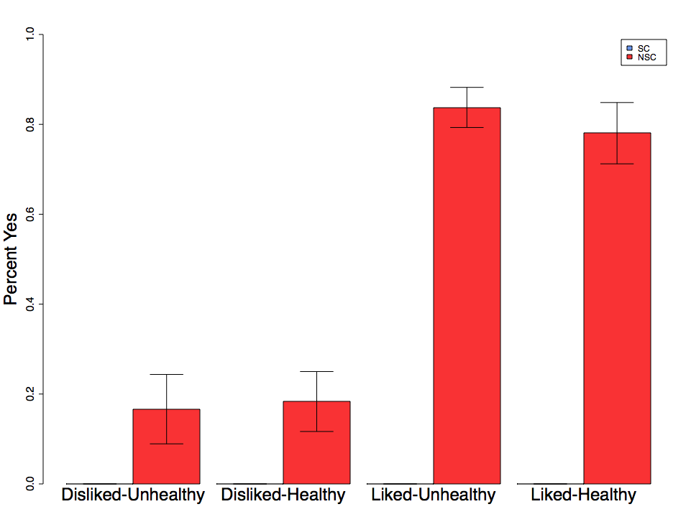
Result: NSC group chose based on taste
Percent Yes
Disliked
Unhealthy
Disliked
Healthy
Liked
Unhealthy
Liked
Healthy
Notes:
Non-control subjects choose based on taste only

Slide 75
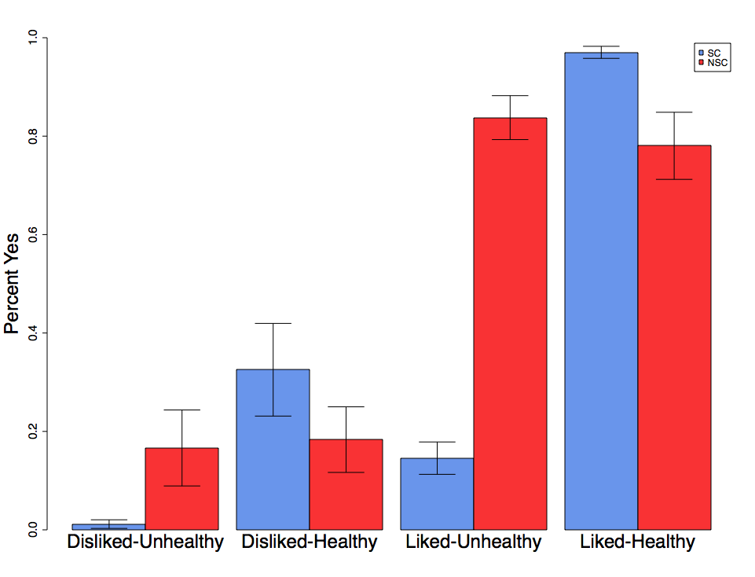

Result: SC group chose based on taste and health
*
*
Percent Yes
Disliked
Unhealthy
Disliked
Healthy
Liked
Unhealthy
Liked
Healthy
Notes:
In contrast SC group chooses based on both health and taste
No significant difference for either disliked pair ( Liked-Unhealthy t=12.5, p=1e-13 ) (Liked-Healthy t=2.7, p=.013)

Slide 76
SC group versus NSC group
*
*
Percent Yes
Disliked
Unhealthy
Disliked
Healthy
Liked
Unhealthy
Liked
Healthy
Notes:
Stark difference for liked but unhealthy items

Slide 77
Question: Is there evidence for a single valuation system?
Neuroimaging Results
Notes:
On slide

Slide 78
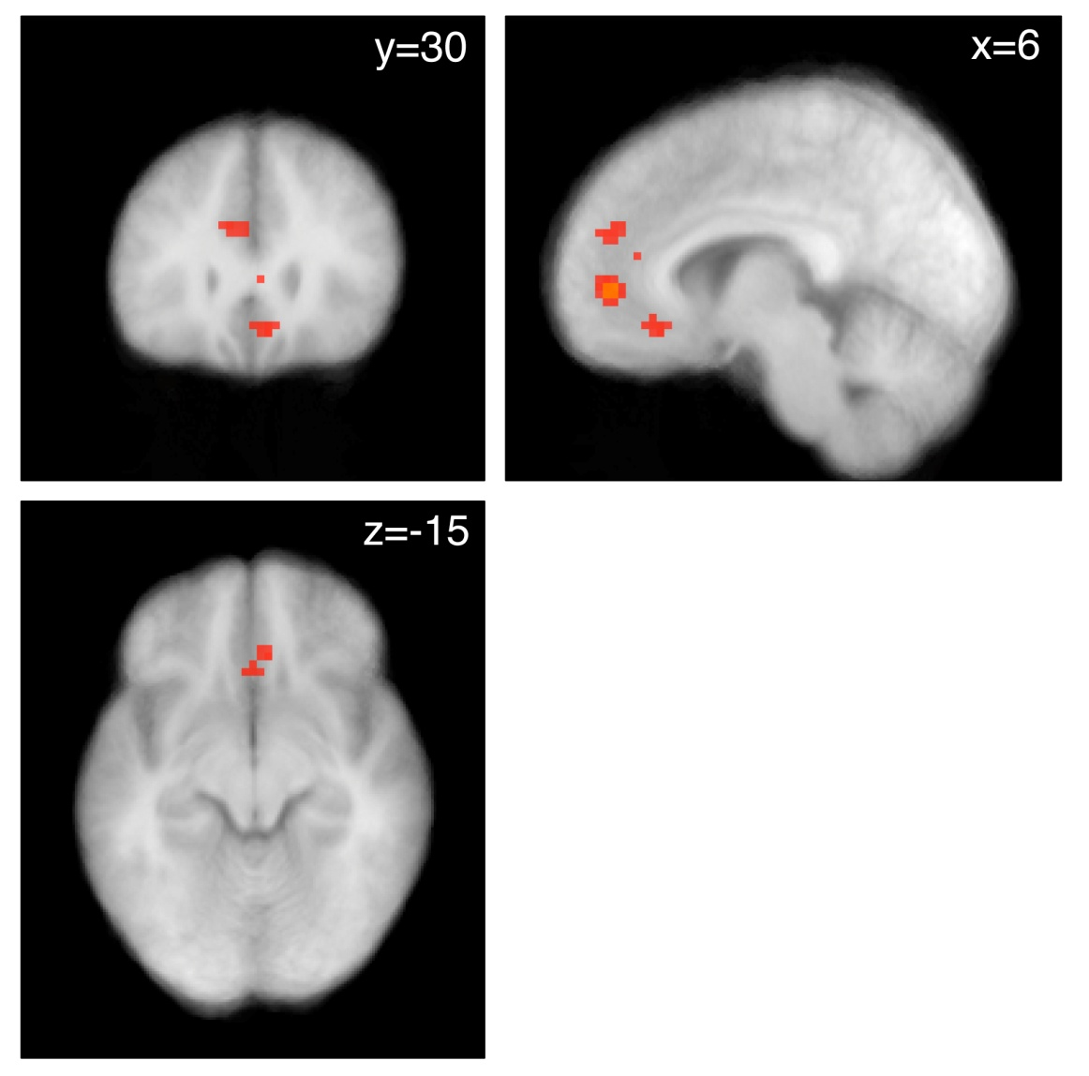
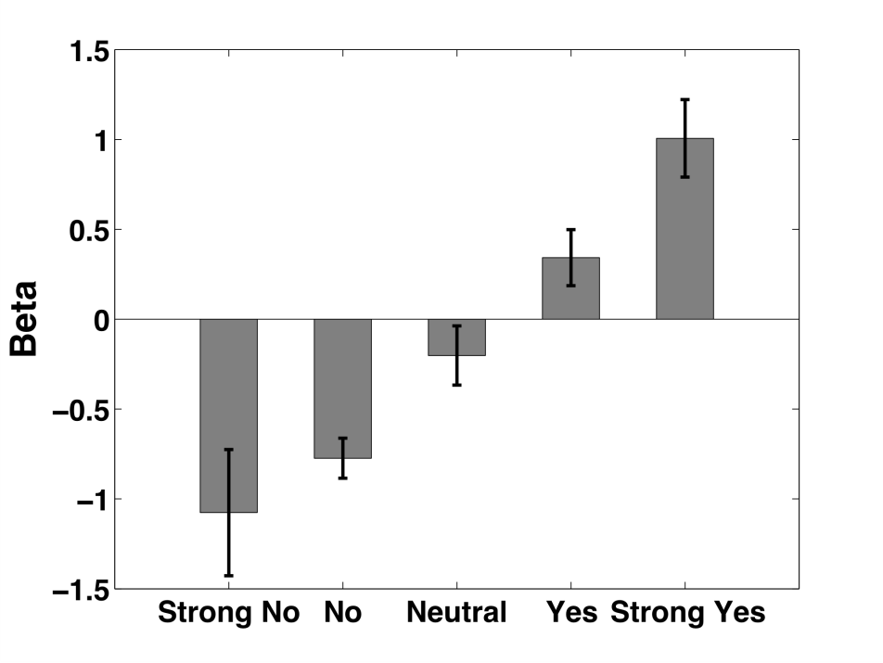
Activity in vmPFC is correlated with a behavioral measure of decision value (regardless of SC)
L
p < .001
p < .005
Notes:
vmPFC regions are correlated with decision value or weight using the strong no, no, neut, yes, strong yes scale
Model: R1= image onset, M1 = decision strength;
Contrast of M1 in Decision session - LR session
Red = .005
Yellow = .001
No MC correction applied to current image, but survives SVC based on Plassmann07 and Hare08

Slide 79
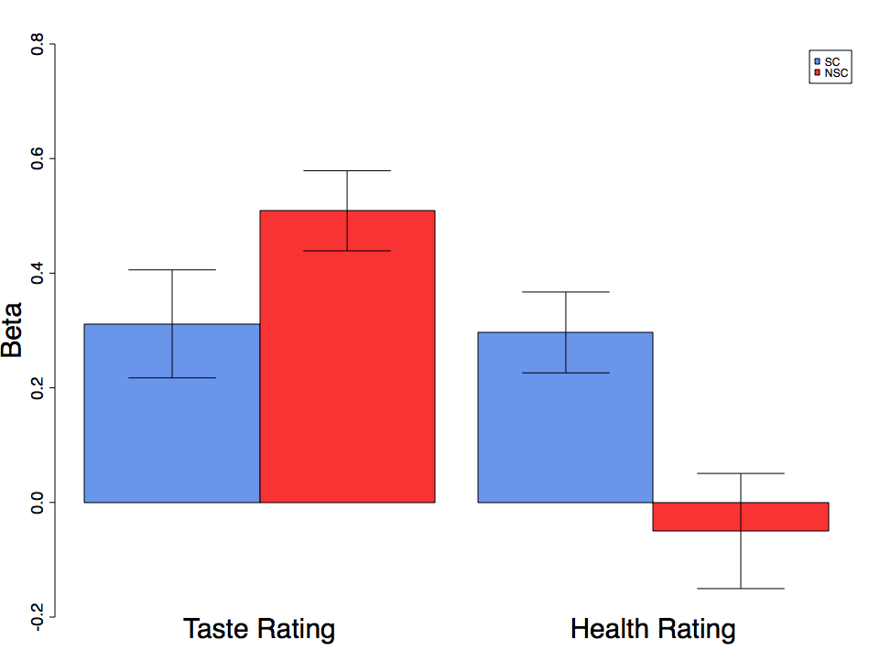
vmPFC BOLD signal reflects both taste and health ratings
*
*
*
Beta
Taste Rating
Health Rating
Notes:
At peak decision voxel, NSC group activity is correlated with taste only
SC group activity is correlated with both health and taste and those two combine to make up the decision value
Parametric regressors for taste (liking) and health ratings at the peak decision voxel for each subject.
Betas from model where R1= image onset, M1 = HR, M2=LR
Peaks selected from model where R1= image onset, M1 = decision strength; Contrast of M1 in Decision session - LR session
Peaks drawn from the combination of ROIs for SCgroup, NSC group, and all subs for M1 in decision session - liking session.
NSC taste = p=1.2819e-06
NSC health = p=.626
SC taste = p<.004
SC health = p <.0006

Slide 80
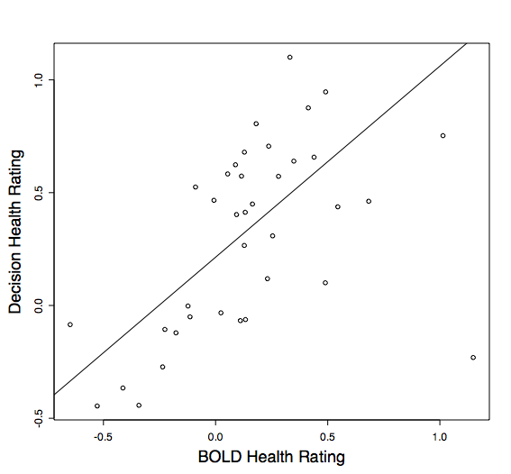
The effect of HR in the vmPFC is correlated with its effect on behavior
Robust reg
Coef = .847
Decision Health Rating Beta
BOLD Health Rating Beta
Notes:
Strong correspondence between the weight for health ratings on neural activity and the variance in decisions explained by health ratings.
When BOLD beta is used to explain the Decision beta robust regression coefficient = .847.
Robust regression done in R using rlm function with MM estimation
Pearson correlation is .512
BOLD beta from health rating taken from model where R1 = image onset, M1 = HR, M2 =LR (ie HR beta with full variance)

Slide 81
Neuroimaging Results
Question: Does self-control involve DLPFC modulation of the vmPFC valuation network?

Slide 82
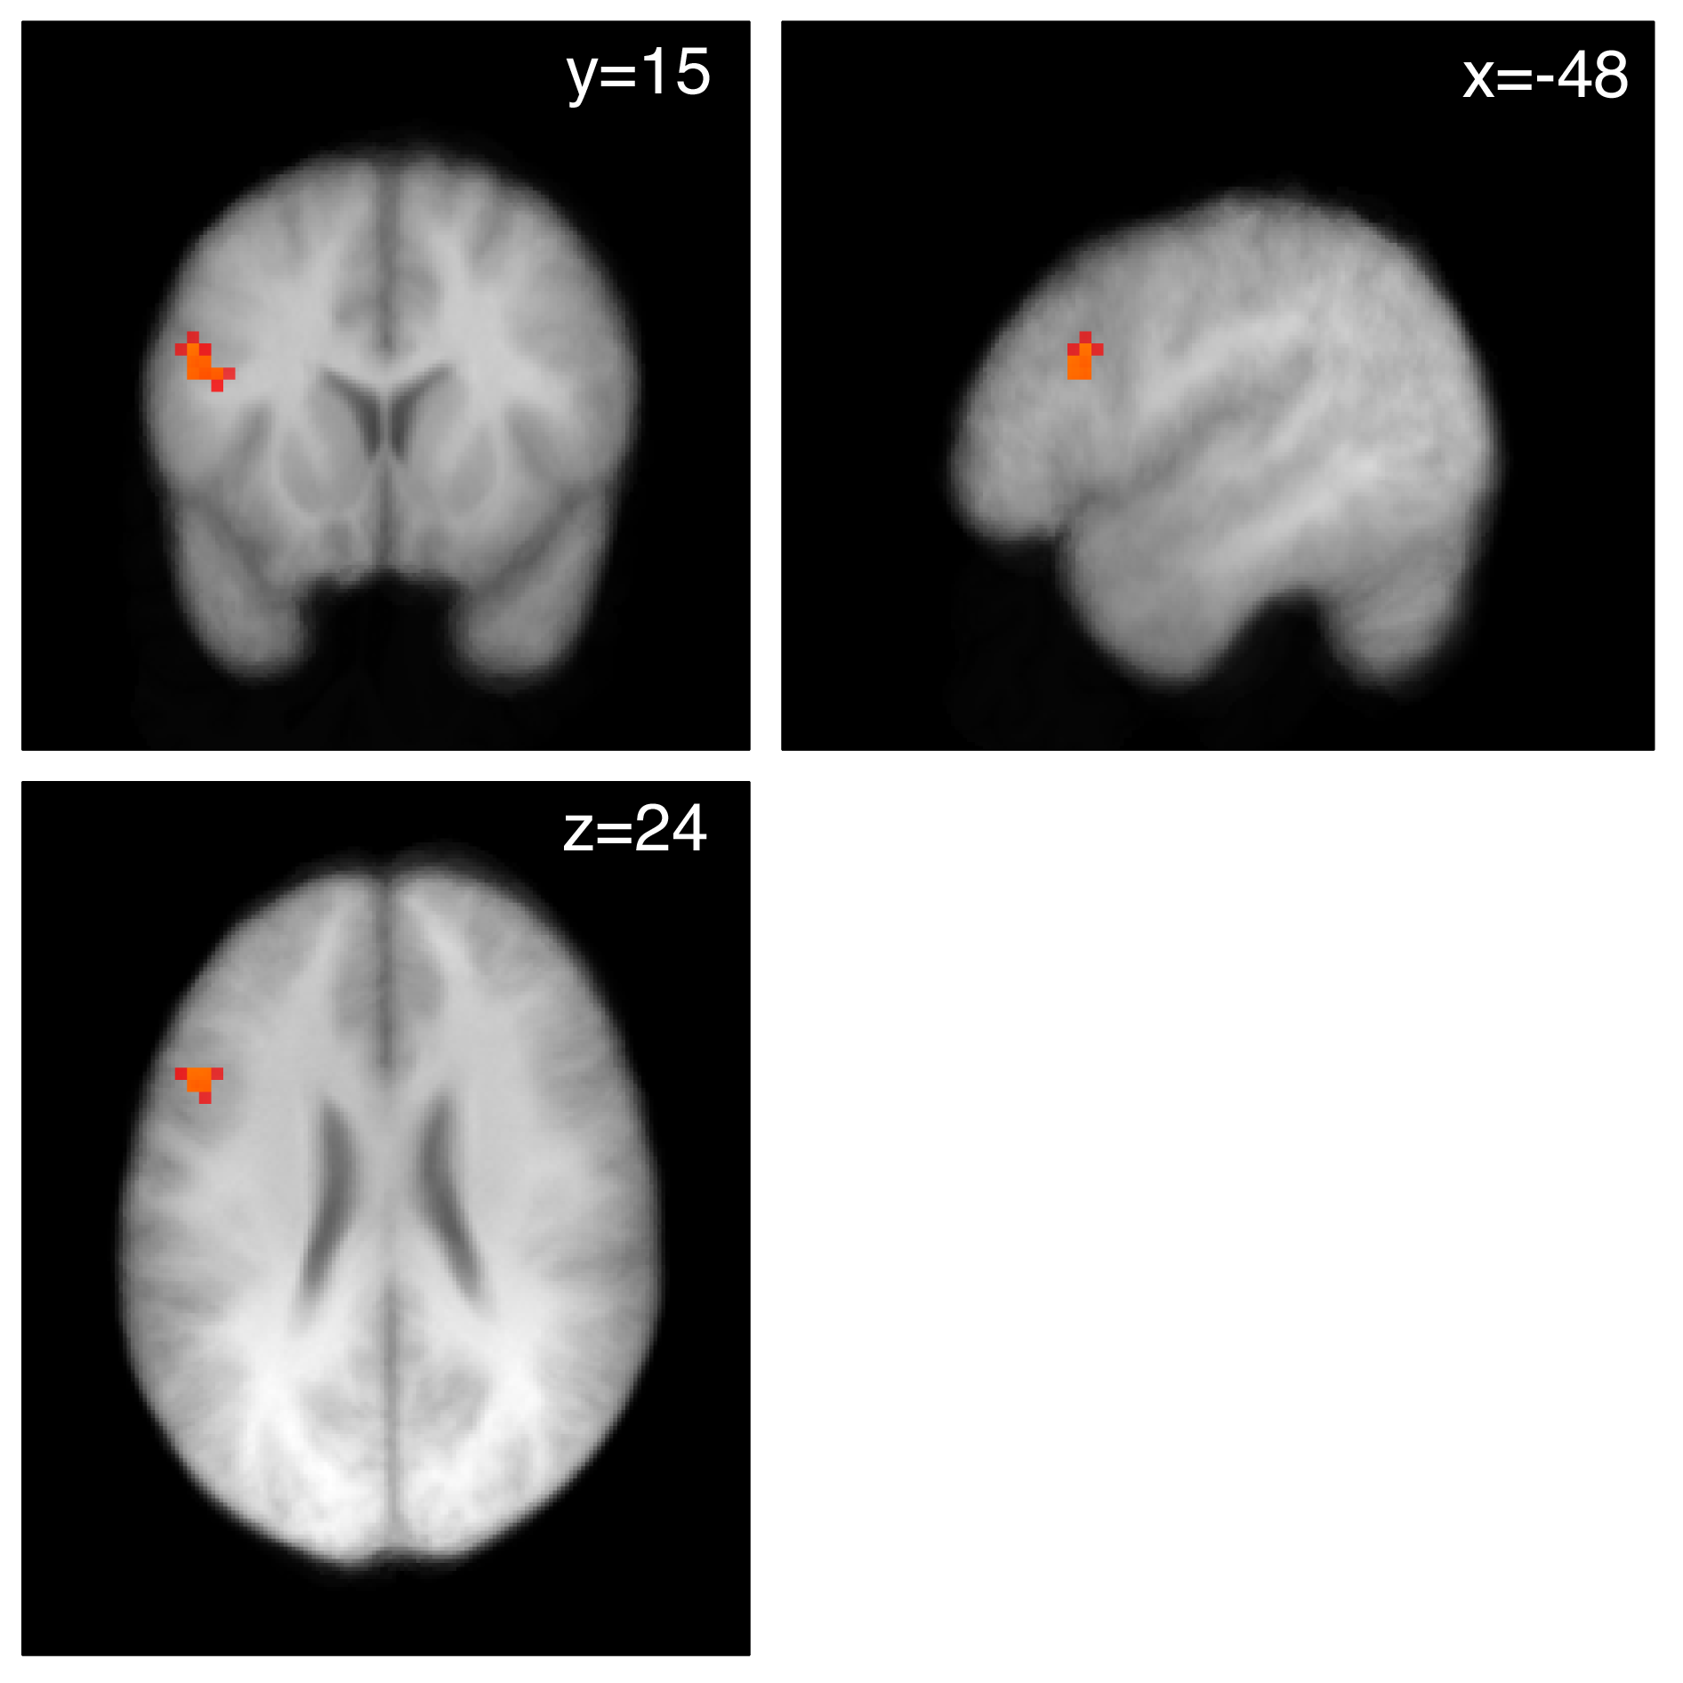
More activity in DLPFC in successful self control trials than in failed self control trials
L
p < .001
p < .005
Notes:
Model: R1 = SC trials, R2 = Non SC trials, R3 = Failed SC trials
Contrast: SC group R1 - NSC group R1
Masked by Contrast of SC group R1+ FWE corrected to .05 -could also think of it as a conjunction (dlpfc only)
Current image MC corrected to P< .05 at cluster level using CorrClus from Tom Nichols (21 voxels at p=.005)
Red = .005
Yellow = .001

Slide 83
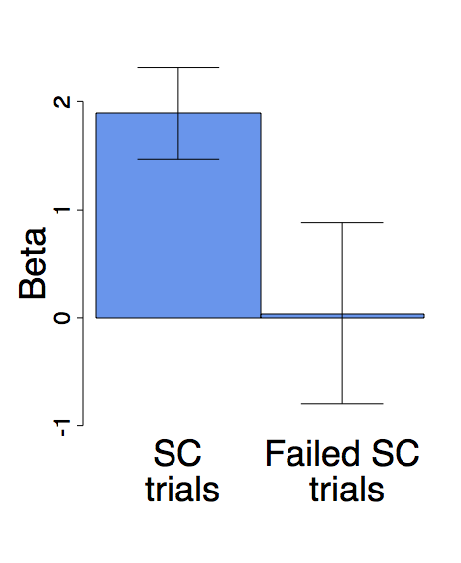
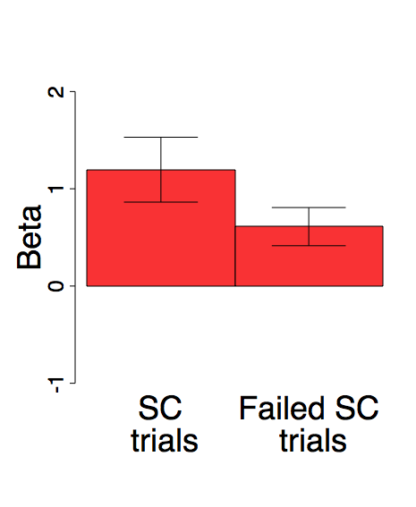
SC group has greater DLPFC than NSC when implementing self-control
SC group
NSC group
*
*
Notes:
Both groups show increased activity in L DLPFC for SC vs FSC trials
Model: R1=SC trials, R2 = No SC trials, R3 = Failed SC Trials
Peaks for R1-R3
ROI based on SC group R1 - NSC group R1 at .005
Both SC trial - FSC trial contrasts are sig at p<.05
Between groups SC trials t=1.7, p<.09

Slide 84
This result establishes that DLPFC activity increases during self-control.
Question: Is there more direct evidence that DLPFC modulates the vmPFC value networks
Neuroimaging results

Slide 85
Functional Connectivity
Initial psychophysiological interaction (PPI) results revealed no task related connectivity between left DLPFC and vmPFC value computation region
Notes:
On slide

Slide 86
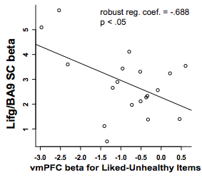
Some evidence for connectivity

Slide 87
An indirect route?
Left DLPFC (IFG9)
Area X
vmPFC
Notes:
L DLPFC did display significant connectivity with several regions.
Therefore, we explored the possibility that it might influence value computation indirectly

Slide 88
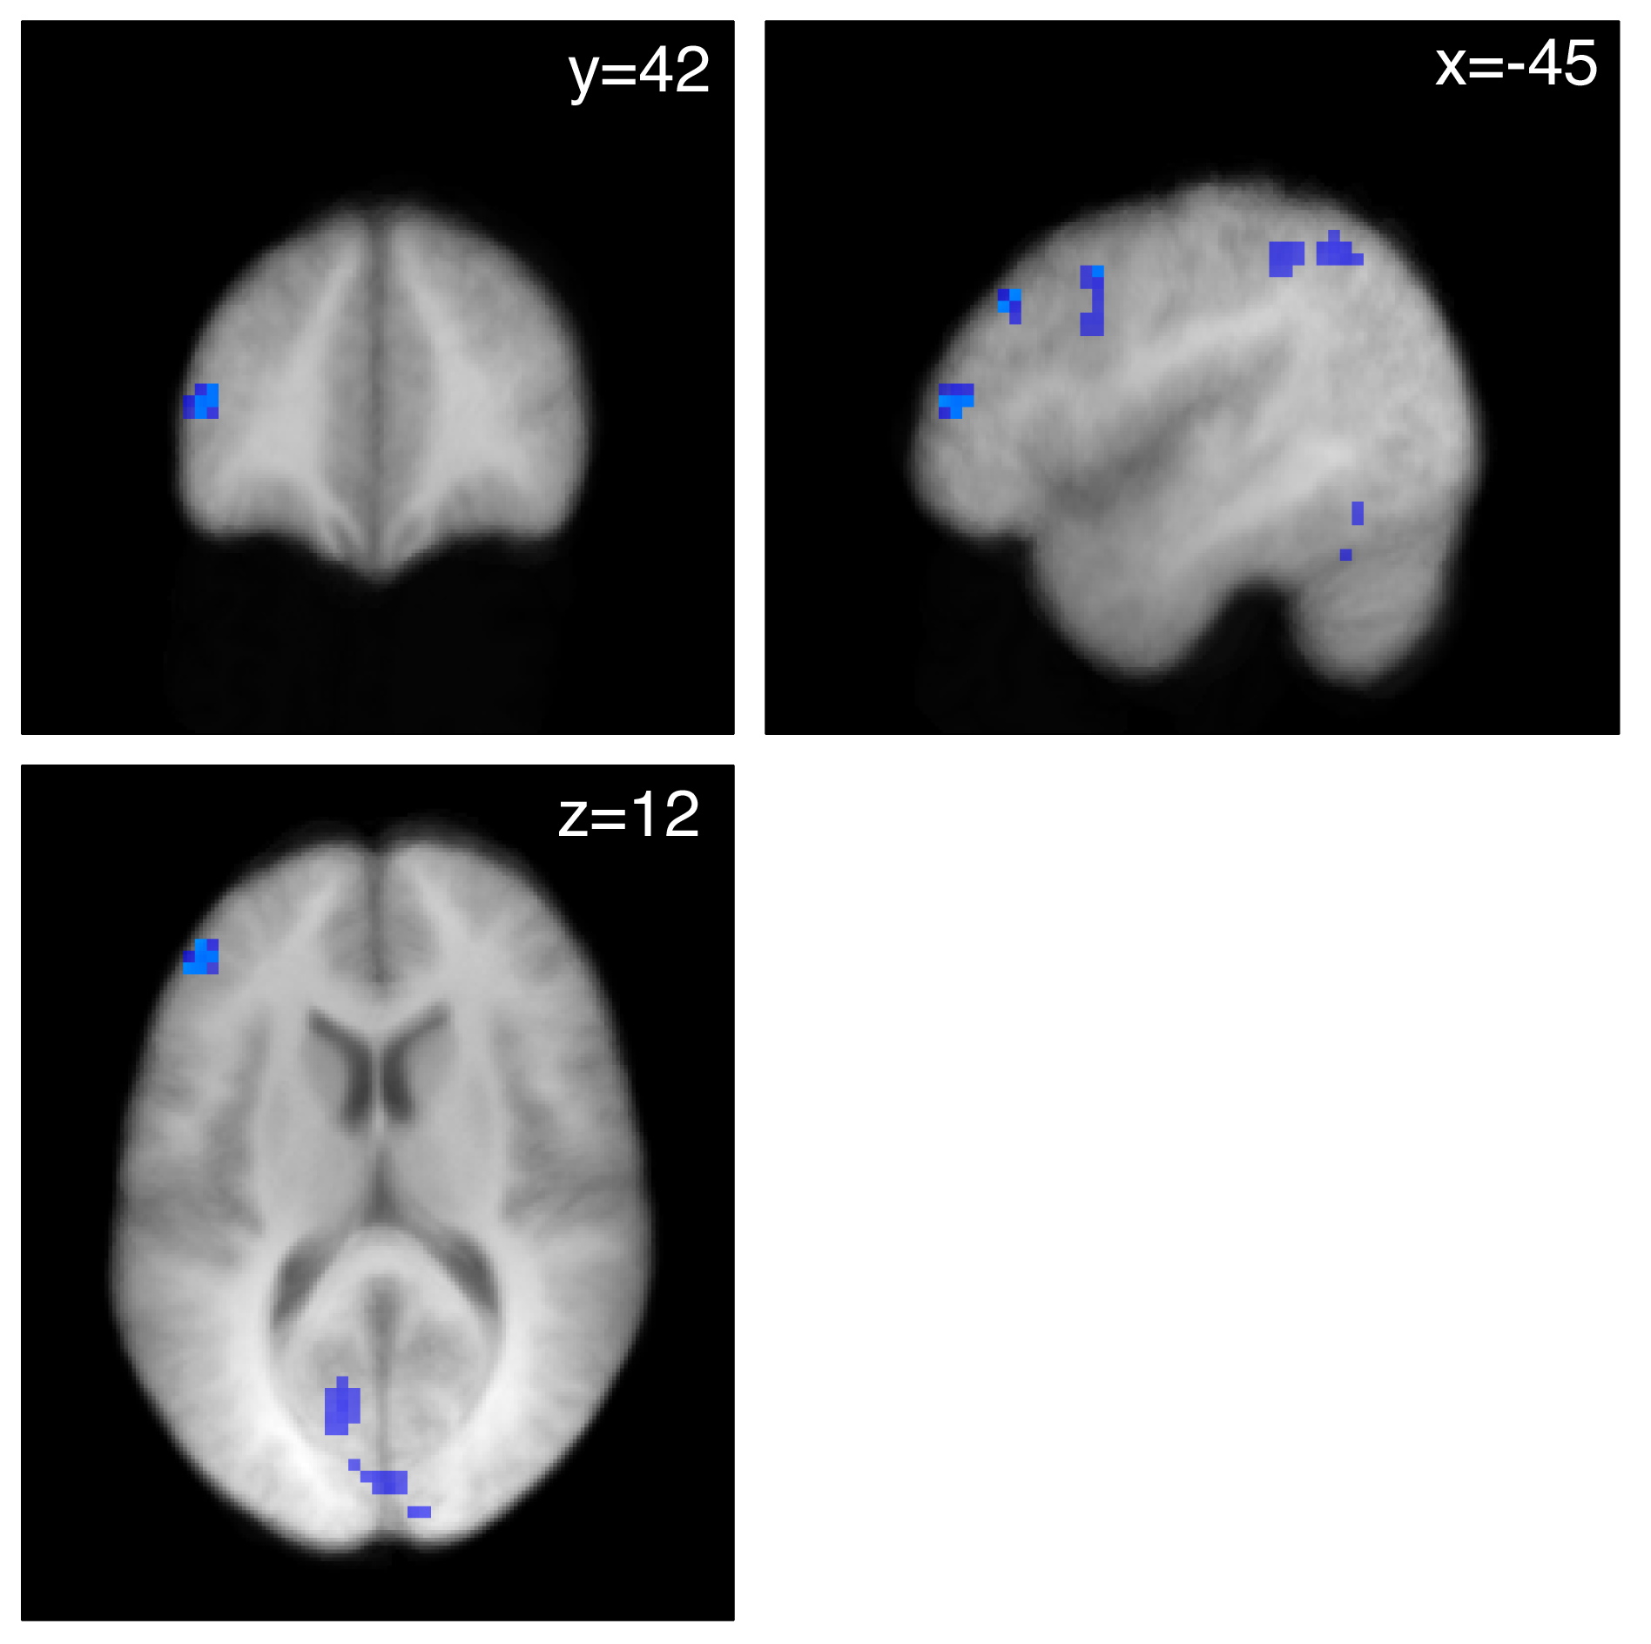
Node 1: Functional Connectivity with adjacent area of left DLPFC (negative correlation)
Left DLPFC (IFG9)
L
Area X
p < .001
p < .005
vmPFC
Notes:
We selected on region that showed functional connectivity rather than exploring them all.
Region selected based on … next slide
Regions showing negative PPI with the Lifg/BA9 region in SC group.
Dark blue =.005
Light blue =.001

Slide 89
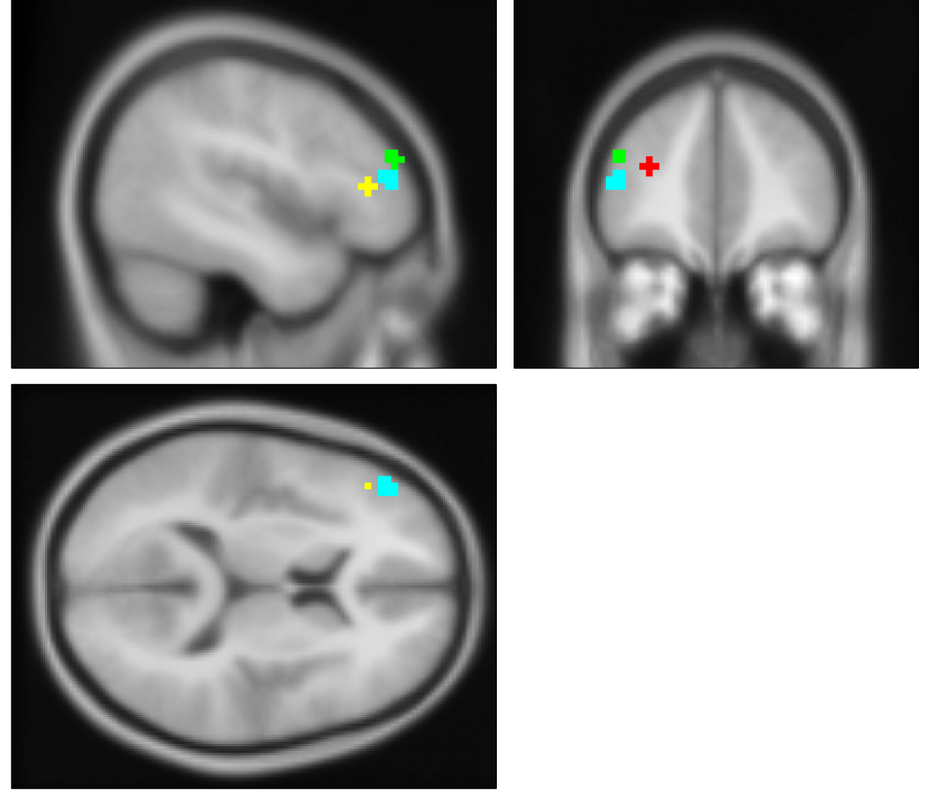
Justification for selection
Notes:
We selected a region of left ifg/BA 46 based on previous studies showing that this region was also correlated with measures of value.
However, in those studies activity was on the right side, not the left
Red = peak (4mm sphere) of Ldlpfc region reflecting decision strength in model where R1 = image onset, M1 = decision strength. Contrast is M1 in decision session - liking session
Green = peak (4mm sphere) for region dlpfc region reflecting WTP in Plassmann07 NOTE x-coordinates are FLIPPED!!!
Yellow = peak (4mm sphere) for region dlpfc region reflecting WTP/GV in Hare08 NOTE x-coordinates are FLIPPED!!!
Blue = negative ppi ROI at .005 for SC group

Slide 90
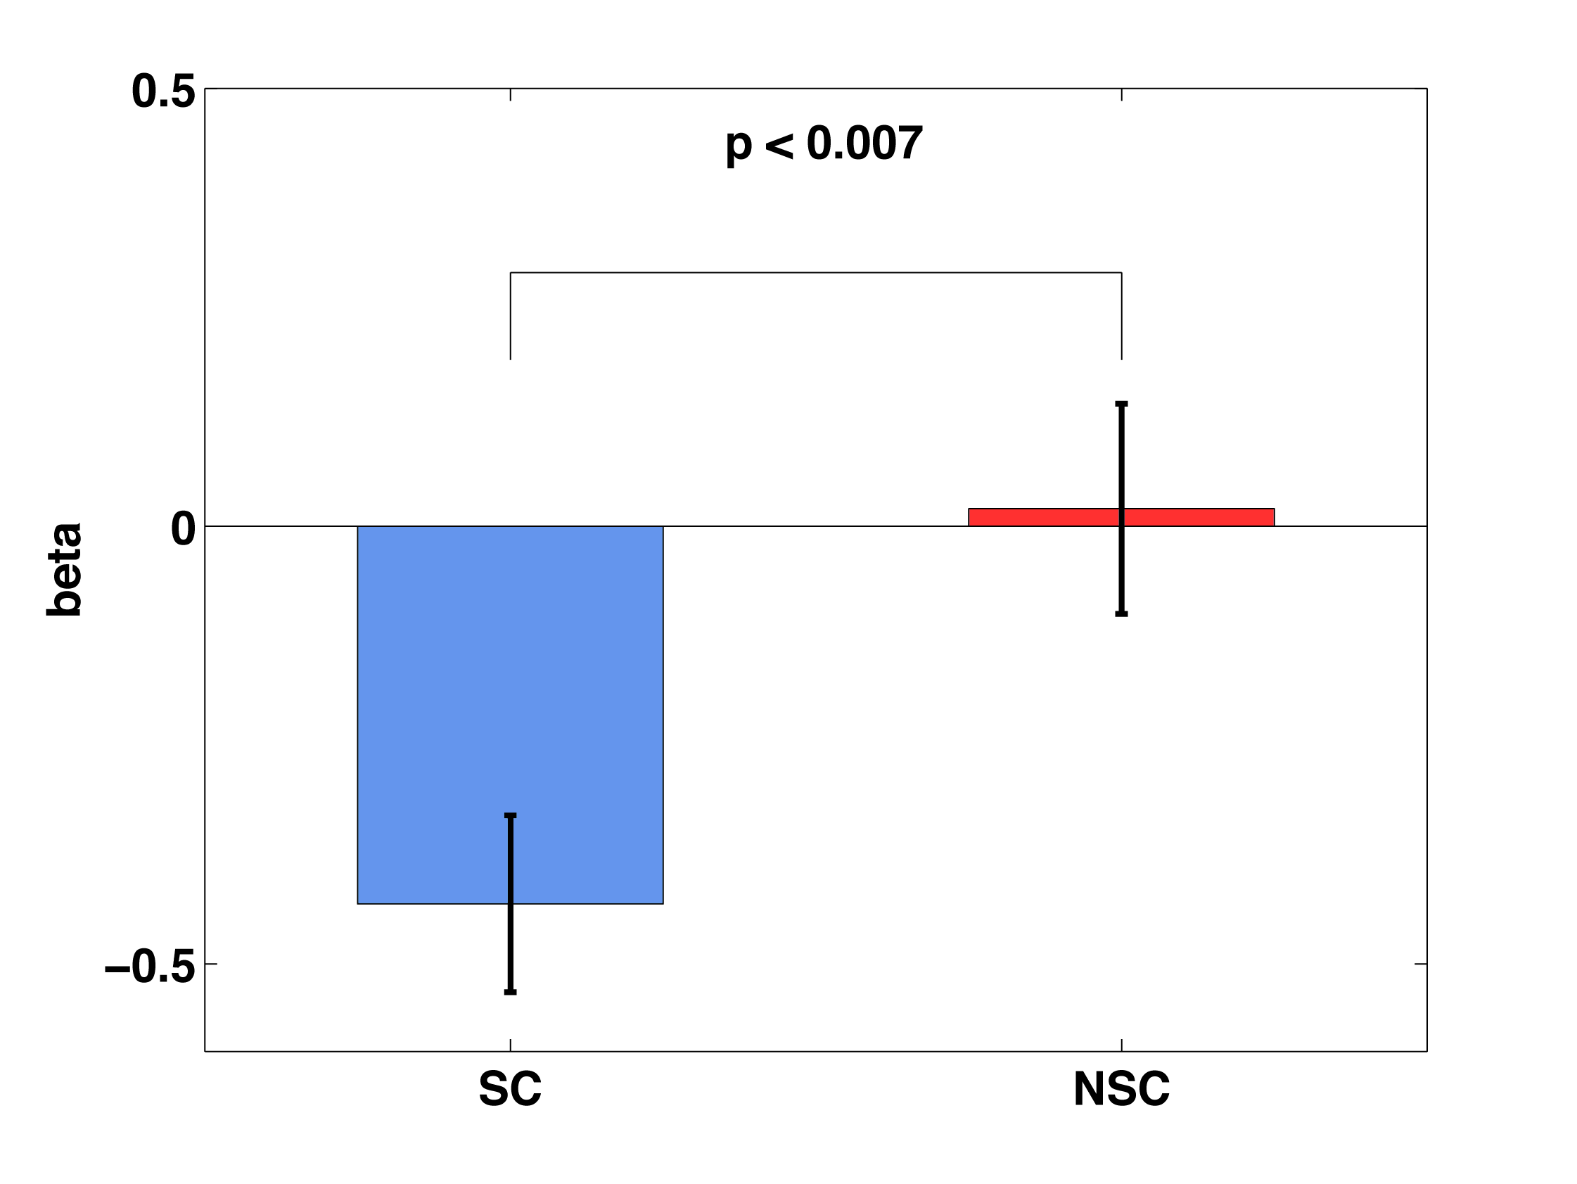
Group difference in PPI
PPI Beta
SC group
NSC group
Notes:
The NSC group did not show significant PPI between IFG9 and IFG46. Graph shows a significant difference between the groups.
Because no connectivity, we focus on SC group only from here on.
Beta plot for the average of voxels in the Lifg46 ROI showing neg PPI with the Lifg9 SC region

Slide 91
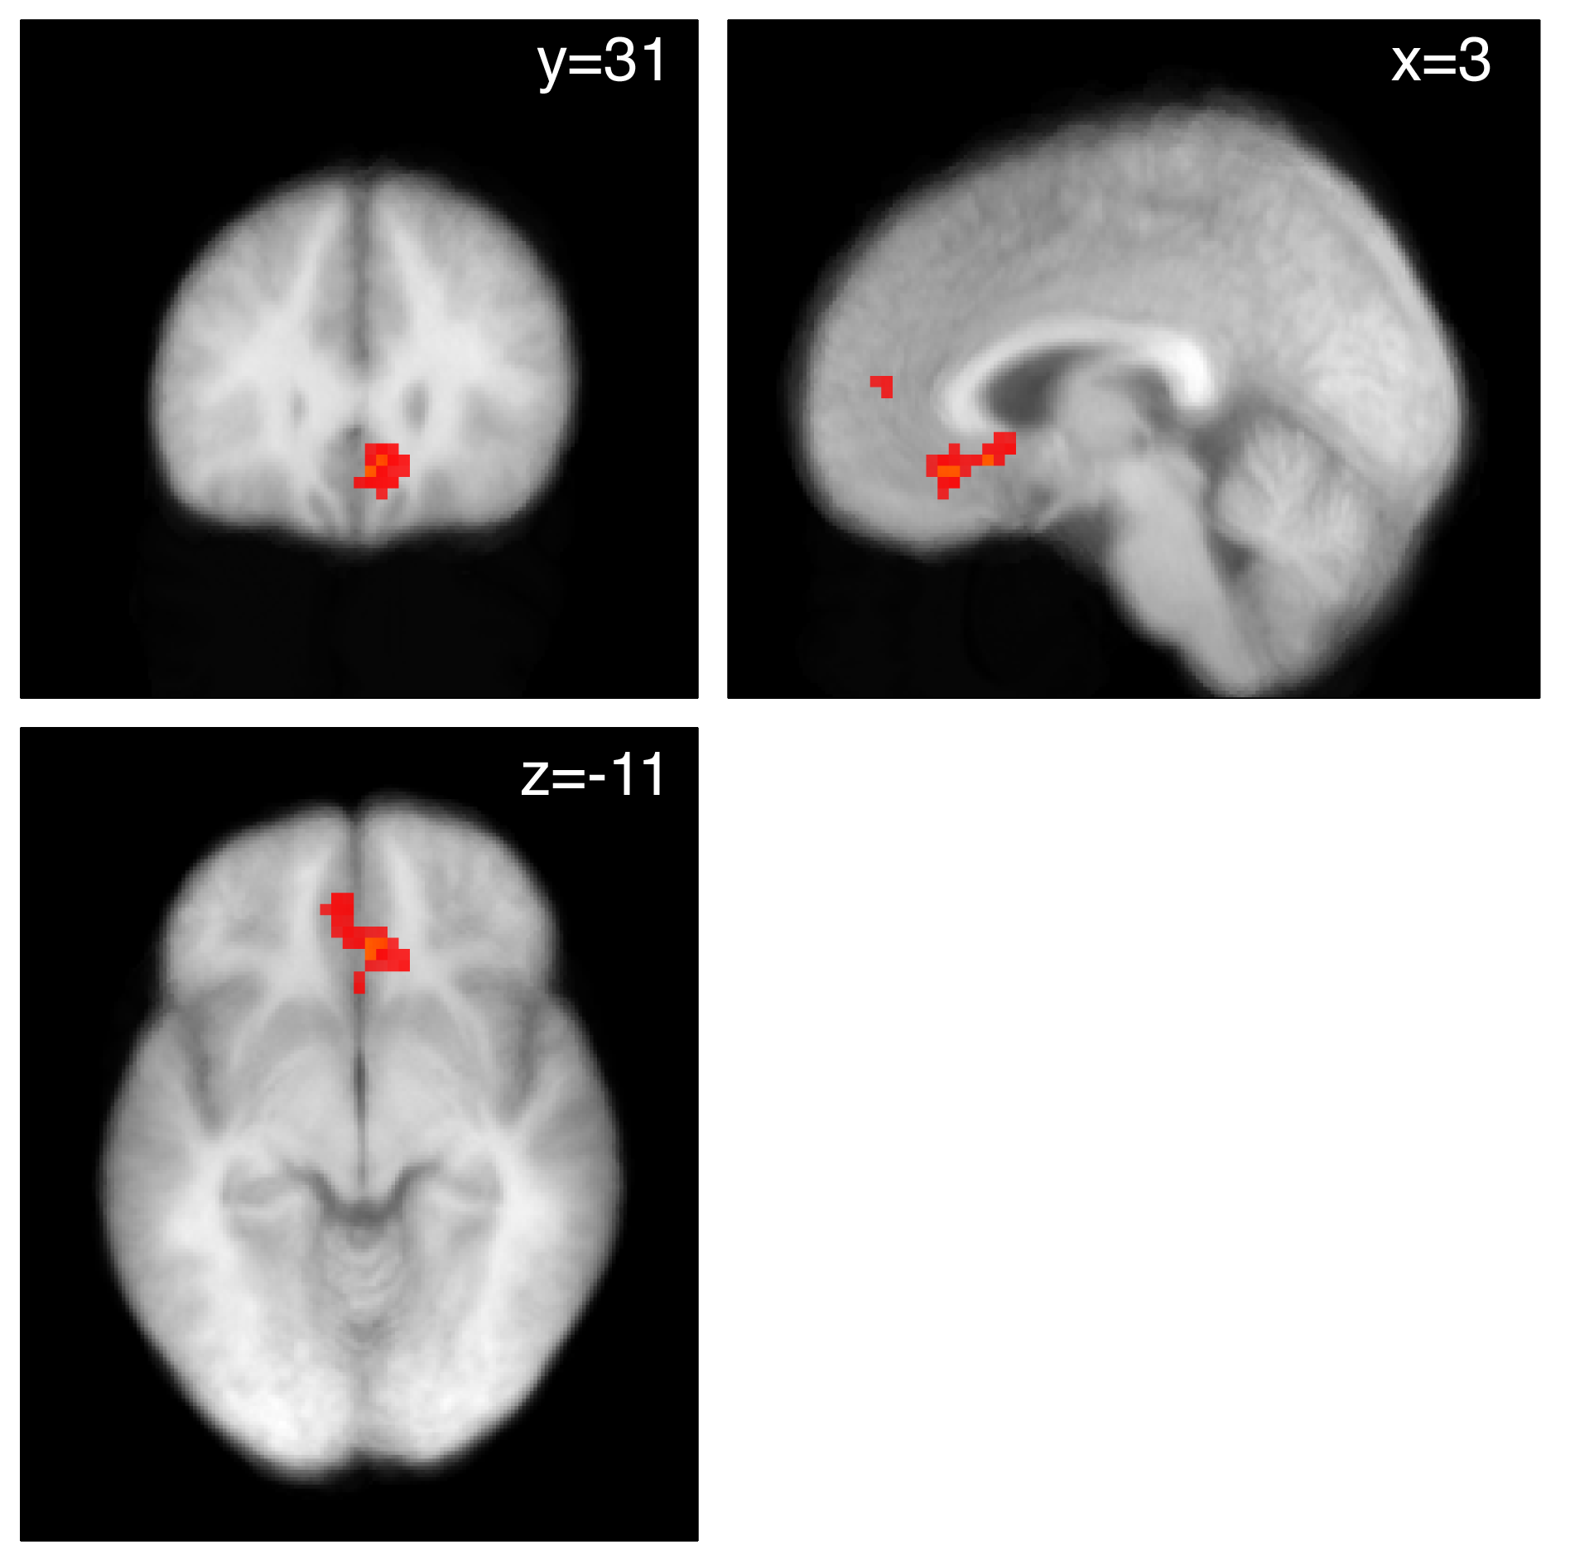
Node 2: Functional connectivity with anterior left DLPFC
Left DLPFC (IFG9)
L
p < .001
p < .005
Area X
vmPFC
Notes:
IFG46 is positively connected with the vmPFC
vmPFC regions showing positive PPI with Lifg46
PPI model included unhealthy trials
Red = .005
Yellow = .001

Slide 92
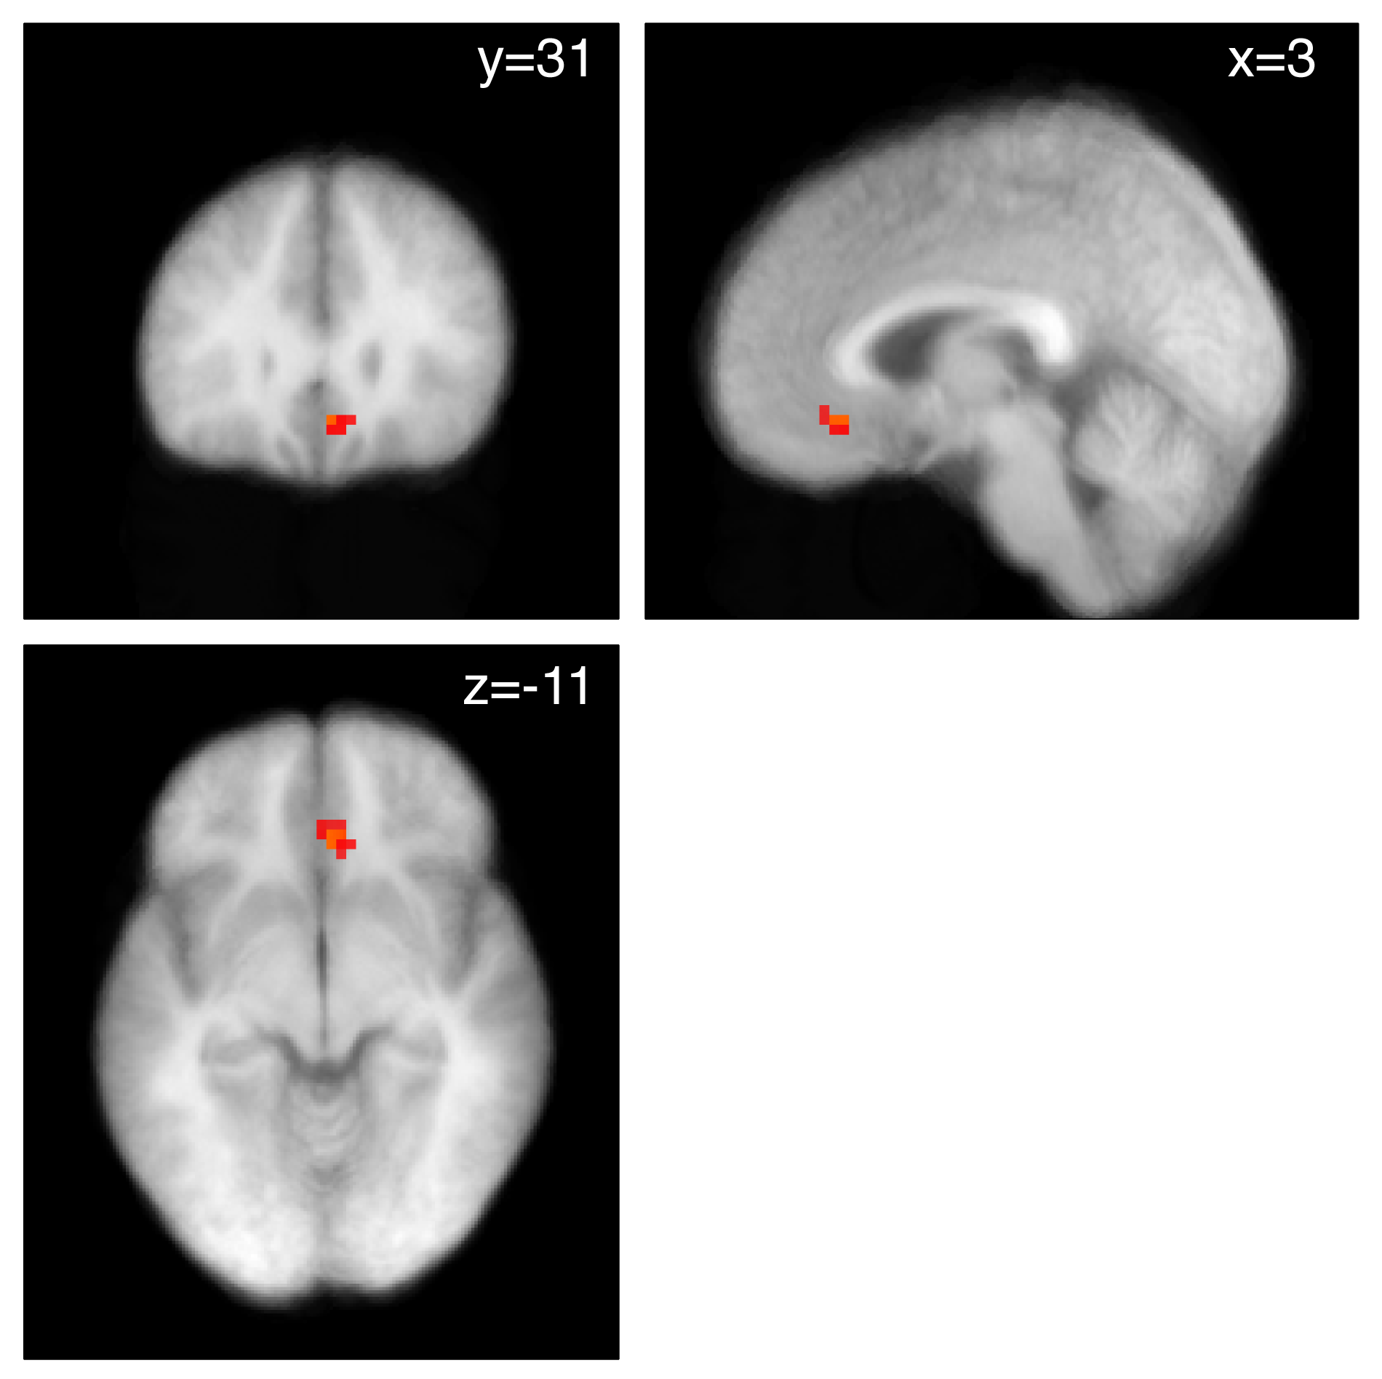
Result: Conjunction of regions showing connectivity and correlation with values
L
p < .001
p < .005
Notes:
Conjunction of PPI and decision regions
Red = .005
Yellow = .001

Slide 93
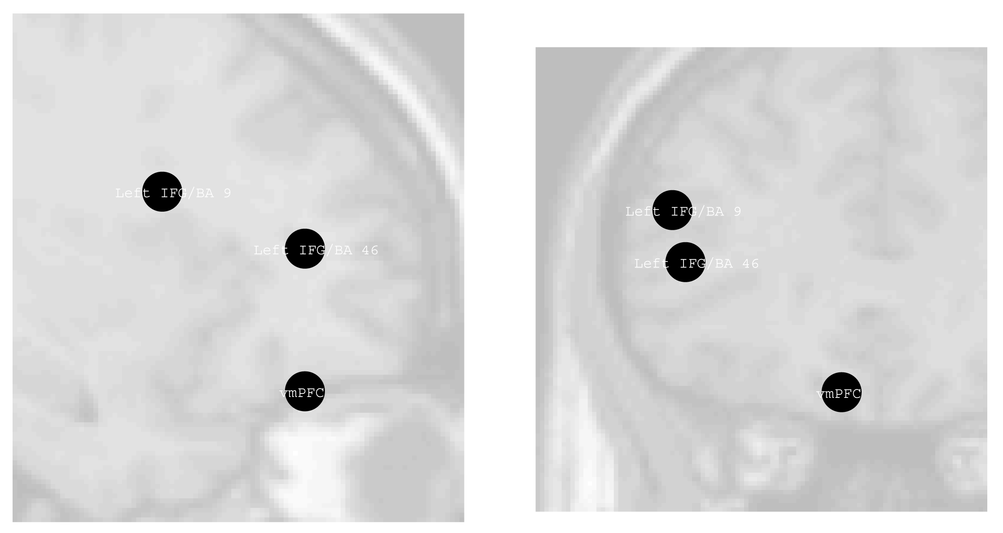
Self-control network
Sagittal
Coronal
Notes:
Example of the network identified by the PPI analysis for one subject.
Note that peaks choosen in subject dependent manner so exact locations vary slightly.

Slide 94
Dynamic Causal Modeling
PPI shows that activity in two brain regions is correlated in task dependent manner.
Does not provide information about causation or directionality
Dynamic Causal Modeling (DCM) can provide evidence for directionality
Friston et al (2003) NeuroImage; Marreiros et al (2008) NeuroImage
Notes:
On slide

Slide 95
Regions modeled
IFG/BA9
IFG/BA9
IFG/BA46
IFG/BA46
vmPFC
vmPFC
Notes:
This slide is just to pair the names with the approximate locations

Slide 96
Multiple models tested
Model 1
Model 2
Model 3
IFG9
IFG9
IFG9
All decisions
Unhealthy
SC
Healthy
Non control
Failed SC
IFG46
IFG46
IFG46
All decisions
Unhealthy
SC
Healthy
Non control
Failed SC
vmPFC
vmPFC
vmPFC
Notes:
We compared several possible models using Bayesian Model Selection techniques
These represent models with intrinsic connectivity in the predicted directions
Talk more about the task related modulation in a minute.

Slide 97
Multiple models tested
Model 1`
Model 2`
Model 3`
IFG9
IFG9
IFG9
All decisions
Unhealthy
SC
Healthy
Non control
Failed SC
IFG46
IFG46
IFG46
All decisions
Unhealthy
SC
Healthy
Non control
Failed SC
vmPFC
vmPFC
vmPFC
Notes:
These represent models with intrinsic connectivity in the opposite direction of that predicted

Slide 98
Multiple models tested
Group Bayes Factor
5.8e+61
Group Bayes Factor
6.5e+88
Group Bayes Factor
8.8e+86
Model 1
Model 2
Model 3
IFG9
IFG9
IFG9
All decisions
Unhealthy
SC
Healthy
Non control
Failed SC
IFG46
IFG46
IFG46
All decisions
Unhealthy
SC
Healthy
Non control
Failed SC
vmPFC
vmPFC
vmPFC
Notes:
Predicted direction is better in all cases
Now what types of decisions modulate the connectivity?
Compare between these three models

Slide 99
Best Model
Group Bayes Factor
>9e+100 for both comparisons
Rate
coefficient
IFG9
Intrinsic
0.50
0.99
All decisions
0.21
0.99
Bayesian
posterior
IFG46
Intrinsic
0.10
0.99
All decisions
0.09
0.92
vmPFC
Notes:
Best model fit for the data is the one where all decisions modulate the connectivity between each pair of regions.
Compared to H&UH 12 subjects strongly in favor or all decision model (three inconsistents show very strong evidence for H&UH model)
Compared to SC split 12 subjects strongly in favor of all decision model (of the three inconsistents there are 2 ties and one with weak evidence for SC model)

Slide 100
Summary of DCM results
Additional evidence for the hypothesis that that self-control involves DLPFC modulation of value computations in the vmPFC

Slide 101
What is Self-Control for the brain?
I: Goal directed decisions are guided by a common valuation system
II: Self-control involves DLPFC modulation of this valuation network
Notes:
On slide

Slide 102
Evidence for Hypothesis I:
Common value system
Correlation between behavioral measures of value and neural activity in vmPFC across several studies
vmPFC regions correlated with decision values reflect both taste and health ratings during self-control
  Consistent with value computed based on two separate factors in the same region
Notes:
On slide

Slide 103
Evidence for Hypothesis II:
DLPFC modulation of value computation
DLPFC is more active in the self-control group than the non-self-control group
PPI & DCM results showing that activity in DLPFC influences activity in vmPFC value computation regions through a two node network
Notes:
On slide

Slide 104
Making sense of previous fMRI literature on the neural basis of intertemporal discounting
There seems to be a single value system
  consistent with findings of Kable & Glimcher
This value signal is modulated by DLPFC when self-control is required
  consistent with McClure and colleagues showing increased DLPFC when choosing later larger reward
Notes:
On slide

Slide 105
Bottom Line
There seems to be a single system that computes a common value across multiple factors during goal directed decision-making.
Self-control is exercised by DLPFC which modulates the input weights these factors have on the value signal computed in vmPFC networks.
Notes:
On slide

Slide 106
Potential implications
At their core, self-control deficits may be deficits of DLPFC function or connectivity between DLPFC and valuation areas
This has implications for:
- early detection of self-control deficits
- co-morbidities between emotion regulation, cognitive control, and self-control failures
Notes:
On slide

Slide 107
Kable and Glimcher (2007)
Task: subjects make intertemporal monetary choices.
Fit hyperbolic discount functions to subjects’ behavior.
Identifying assumption: behavioral preferences should match neural activation up to a linear transformation.
Find brain regions that match the hyperbolic discount function estimated on behavioral data.
This analysis identifies mPFC, PCC, VStr.
Are these integration regions? (Especially PCC?).

Slide 108
Kable and Glimcher (2007)
Why don’t Kable and Glimcher also identify PFC and Parietal Cortex?
These ROIs are not involved in the decision?
These ROIs are involved in the decision but they don’t show sensitivity to time delay for this money task? (cf McClure et al 2004)
These ROIs are involved in the decision and they do show sensitivity to time delay but that sensitivity is a small part of total variance (at the subject level), so these regions are not accepted by the filter?

Slide 109
Hariri et al (2007)
Measure individual differences in VStr responsivity using a task involving positive and negative feedback with monetary reward.
Measure individual differences in impatience using choices among time-dated rewards.
VStr responsivity correlates with impatience.
“Increased preference for smaller immediate over larger delayed rewards reflects both a relatively indiscriminate and hyper-reactive VStr circuitry.”

Slide 110
Figner, Knoch, Johnson, Krosch, Lisanby, Fehr and Weber (2010)
Disruption of function of left, but not right, lateral prefrontal cortex (LPFC) with low-frequency repetitive transcranial magnetic stimulation (rTMS) increased choices of immediate rewards over larger delayed rewards.
rTMS did not change choices involving only delayed rewards or valuation judgments of immediate and delayed rewards.
Causal evidence for a neural lateral-prefrontal cortex–based self-control mechanism in intertemporal choice.

Slide 111
Albrecht, Volz, Sutter, Laibson, and von Cramon (2011)
An immediate reward in a choice set elevates activation of the ventral striatum, pregenual anterior cingulate cortex and anterior medial prefrontal cortex.
These dopaminergic reward areas are also responsive to the identity of the recipient of the reward.
Even an immediate reward does not activate these dopaminergic regions when the decision is being made for another person.
Results imply that participants show less affective engagement (i) when they are making choices for themselves that only involve options in the future or (ii) when they are making choices for someone else.
Also find that behavioral choices reflect more patience when choosing for someone else.

Slide 112
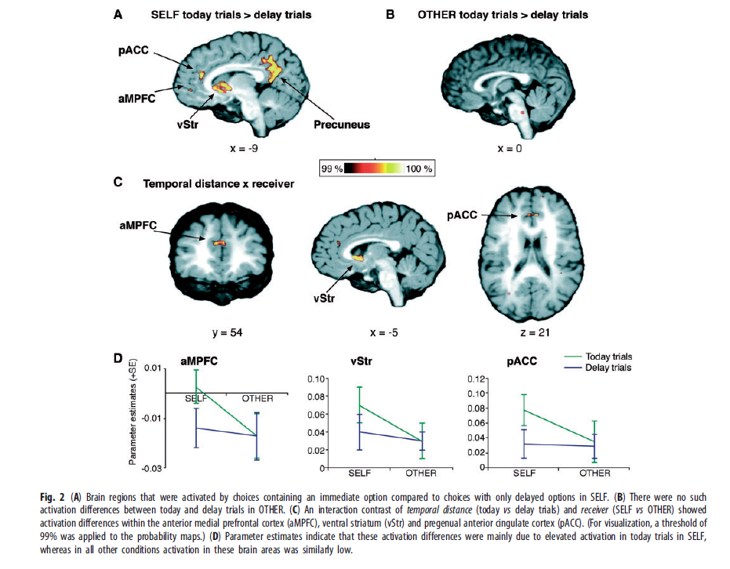

Slide 113
Future work:
New hypotheses and new models of multiple systems?
New empirical tests?
Localization? Pathways?
How do the systems communicate?
How are the inputs integrated?
When are the systems cooperative and when conflictual?
When they are in conflict, are they strategic?
What manipulations enhance or weaken the signals coming from these systems?
Can we influence individual systems in the lab?
Can we influence individual systems in the field?
Can we produce useful formalizations of their operation?

Slide 114
The Sweet Taste of Revenge de Quervain et al
Science (2004)
Two subjects, A and B, have the opportunity for a social exchange that benefits both parties.
However, to complete the exchange, A has to move first while B moves second, i.e., A has to trust B, and B can cheat A.
A is informed about B’s action and A has an opportunity to punish B.
A‘s brain is scanned when he is informed about B’s action (i.e, whether B cheated him or not) and when A deliberates whether, and how much, he wants to punish B.

Slide 115
Stage 1:
  Both A and B receive an endowment of 10 MUs (1 MU = CHF 0.1 = 1 dime).
  A decides whether to keep or to transfer his endowment to B. In case of a transfer B receives 4 times A‘s endowment (40 MUs), in addition to his own endowment of 10 MUs.
Stage 2:
  B has the option to keep all the points he possesses or to give half of his MUs to A
    If A trusts and B is trustworthy both earn 25.
    If A trusts and B cheats, A has nothing and B has 50.
    Both have 10 if A does not trust and B keeps everything.
Stage 3:
  Both players receive an additional endowment of 20 Mus
  A has the opportunity to use this money to punish B or to keep the money.
  Every MU invested into the punishment of B decreases B‘s payoff by 2 MUs.

Slide 116
Treatments
Player A sequentially faced 7 different B players.
  In 3 cases B cooperated (transferred half of his MUs back).
  In 3 cases B cheated (transferred no MUs back).
  In 1 case a random device forced B to ‘cheat’. Player A knew that in this case B‘s play was determined by rolling a die.

Slide 117
Details about treatments in which B cheats
Treatment where B decides himself and punishment is costly for both A and B (Intentional & Costly, IC). A is hypothesized to experience a desire to punish cheating and he can in fact punish.
Treatment where B decides himself and punishment is free for A but costly for B (Intentional & Free, IF). A is hypothesized to experience a desire to punish cheating and he can in fact punish – even without a cost.
Treatment where B decides himself and punishment is only symbolic, i.e., A and B have no costs of punishing (Intentional & Symbolic; IS). A is also hypothesized to experience a desire to punish cheating but he cannot punish.
Treatment where B‘s decision is randomly imposed on B; punishment is costly for both A and B (Non-intentional & Costly, NC). A is to have no or a much less of a desire to punish B for „non-cooperation“ because B is not responsible for his „action“.

Slide 118
Hypotheses:
The following contrasts are hypothesized to show activation of reward related (N Accumbens, N caudate) neural circuits:
  (IC – IS) because no punishment possible in IS.
  (IF – IS) because no punishment possible in IS.
  (IC – NC) because no desire to punish in NC.
  (IF – NC) because no desire to punish in NC.
  (IC + IF) – (IS + NC) because in IS & NC there is either no possibility or no desire to punish so that there cannot be any satisfaction from punishing.
The following contrast is hypothesized to show activation of cognition related (PFC, OFC) neural circuits.
  (IC – IF) because in IC subjects must weigh the costs and benefits of punishing while in IF there are no costs.
  Related to the Sanfey et al. (2003) hypothesis.

Slide 119
intentional & costly IC
Behavioral and Questionnaire Results
intentional & free IF
intentional & symbolic IS
non
-
intentional & costly NC
Perceived unfairness
3
2
1
0
Actual payoff reduction imposed on B
-1
40
-2
35
-3
30
Desire to punish
25
3
20
2
15
1
10
0
5
-1
0
-2
-3

Slide 120
(IC + IF) - (IS + NC) activates the nucleus caudate

Slide 121
Differential activation of Nucleus Caudate relative to mean brain activation
(IC + IF) - (IS + NC)

Slide 122
Differential activations across contrasts

Slide 123
If caudate activity reflects satisfaction from punishment subjects with stronger caudate activation should punish more
Question: Does caudate activation cause
punishment or does punishment cause
caudate activation?
p < 0.001

Slide 124
Are subjects with higher caudate activation in the IF condition willing to pay more for punishing in the IC condition?
If caudate activation reflects
satisfaction from punishment
subjects with stronger caudate
activation in IF should be
willing to pay more for
punishment.

Slide 125
Does (IC – IF) activate the PFC/OFC?

Slide 126
Summary of revenge study
Experimental evidence and social preference theories suggest that many people prefer to punish unfair acts.
This study supports the view that satisfaction is associated with the punishment of unfair acts.
Correlation between caudate activity and punishment in IC, and between caudate activity in IF and punishment in IC supports this interpretation.

Slide 127
Part II:
Genoeconomics
David Laibson
Economics Department, Harvard University
October 20, 2013

Slide 128
Main Collaborators
  Dan Benjamin (Cornell University)*
  David Cesarini (New York University)*
  Christopher F. Chabris (Union College)
  Jaime Derringer (University of Colorado-Boulder)
  Magnus Johanesson (Stockholm School of Economics)
  Philipp Koellinger (Rotterdam University)*
  Sarah Medland (Queensland Inst. of Medical Research)
  Niels Rietveld (Rotterdam University)
  Olga Rostapshova (Harvard University)
  Patrick Turley (Harvard University)
  Peter Visscher (University of Queensland)
  *co-leaders of the Social Science Genetic Association Consortium
  We gratefully acknowledge NIH’s NIA and OBSSR, NSF, and the Ragnar Söderberg Foundation for financial support.

Slide 129
Background
In the last 20 years, there have been rapid, advances in measuring genetic variation across individuals.
The cost of genotyping continues to decline precipitously (now about $100 per person)
Many large-scale social surveys now collect genetic data on respondents
We are at the beginning of an explosion in social-science genetics research

Slide 130
Genoeconomics Outline
Some promises for social science
Conceptual framework
Discovering genetic effects
The power problem
Some ways forward
Public policy questions

Slide 131
Genetic data in Social Science
Biological mechanisms for behavior
Direct measures of structural parameters
  E.g., preferences, abilities
Instrumental variables (Turley et al 2013)
Control variables
Prediction
Targeting interventions
  E.g., children susceptible to dyslexia.

Slide 132
Outline
Some promises for social science
Conceptual framework
Discovering genetic effects
The power problem
Some ways forward
Public policy questions

Slide 133
Genetics Primer
Human DNA is a sequence of ~3 billion nucleotide molecules (spread across 23 chromosomes).
This human genome has 20,000-25,000 subsequences called genes.
Genes provide instructions for building proteins.
At the vast majority of locations on the genome, there is no “common” variation in nucleotides across individuals.

Slide 134
SNPs: single-nucleotide polymorphisms (a single DNA base pair that differs with meaningful frequency across people)
  About 1-5 million loci
Genotyping: mapping some part of a person’s DNA (e.g., 2 million SNPs, using an Illumina chip)

Slide 135
Single-nucleotide polymorphisms (SNPs): Nucleotides where individuals differ (a small % of all nucleotides).
(There are also other types of variation.)
At the vast majority of SNP locations, there are only 2 possible nucleotides:
  major allele (more common)
  minor allele (less common).
From each parent, may inherit either allele; SNP unaffected by which received from whom.
Genotype for each SNP: #minor alleles (0,1,2).

Slide 136
Genetic Effects
Let i index individuals; j index SNPs.
Let y_{i} denote some outcome of interest.
Simplest model: Population regression is
μ : population mean of the outcome.
x_{ij} : genotype ∈ {0,1,2} of person i for SNP j.
β_{j} : effect of SNP j.
ε_{i} : effect of residual factors.

Slide 137
Interpreting Genetic Effects
β_{j} is the treatment effect from changing an individual’s SNP at conception.
  Can be done in animal models
  Not necessarily a structural parameter; e.g., could be environmentally mediated.
  E.g., now established that there is an effect of at least one SNP in the gene FTO on body weight.
    In a sample of 40,000, Frayling et al. (2007) found that people with 2 major alleles weigh 3 kg more than people with 2 minor alleles.
    One mechanism may be preference for energy-rich foods (Cecil et al., 2008).

Slide 138
Outline
Some promises for social science
Conceptual framework
Discovering genetic effects
The power problem
Some ways forward
Public policy questions

Slide 139
Discovering Genetic Effects
A naïve approach would be to run the regression
Even if one could measure all J SNPs in the genome, would fail the rank condition.
It is standard to instead run K << J separate regressions,
for each of K SNPs.
  If SNPs uncorrelated, get unbiased estimates.
  In fact, issue of identifying causal SNP.

Slide 140
Two Approaches
Candidate gene study (K small)
  Specify ex ante hypotheses about a small set of SNPs based on known or believed biological function.
  Set significance threshold α = .05 / K.
  Good approach when hypotheses have strong priors.
    Some major early successes: e.g., APOE, ALDH.
  Most work in social-science genetics (pre-2013). (Reviews: Ebstein, Israel, Chew, Zhong, and Knafo, 2010; Beauchamp et al., 2011; Benjamin et al., 2012)
Genome-wide association study (K large)
  Atheoretical testing of all SNPs measured on the chip (typically 1-2.5 million).
  Set significance threshold α = 5 × 10⁻⁸ (since approximately 1 million independent SNPs in genome).
  Now the norm in medical-genetics research.

Slide 141
Why GWAS?
Candidate gene approach is eminently reasonable, but social-science results often fail to replicate.
  Low power (in the small samples typically used; discussed next), population stratification, uncorrected-for multiple hypothesis testing / publication bias.
Other advantages of GWAS:
  Discipline from hypotheses is illusory because the pool of seemingly-plausible potential hypotheses is huge.
    Estimated that 70% of genes affect gene expression in the brain. (Ramsköld et al. 2009)
  Hypothesis-free design makes the need to correct for multiple hypothesis testing transparent.
  To address population stratification, it is possible and standard practice to control for principal components of the GWAS data.

Slide 142
Outline
Some promises for social science
Conceptual framework
Discovering genetic effects
The power problem
Some ways forward
Public policy questions

Slide 143
The Power Problem
Existing studies reporting signi ficant gene-behavior associations have usually relied on samples in the range 50 to 3000. (Ebstein et al., 2010; Beauchamp et al., 2011; Benjamin et al., 2012)
Such small samples only make sense under the assumption that some SNPs have explanatory power of at least R² ≈ 2%.
What effect sizes are reasonable to expect? Credible evidence from physical and medical traits:
  Smoking and CHRNA3: R² ≈ 0.5%.
  BMI and FTO: R² ≈ 0.3%.
  Largest identi fied SNP for height: R² ≈ 0.4%.
Therefore, most existing studies in social-science genetics are underpowered, implying a high false discovery rate. (Beauchamp et al., 2011; Benjamin et al., 2012)

Slide 144
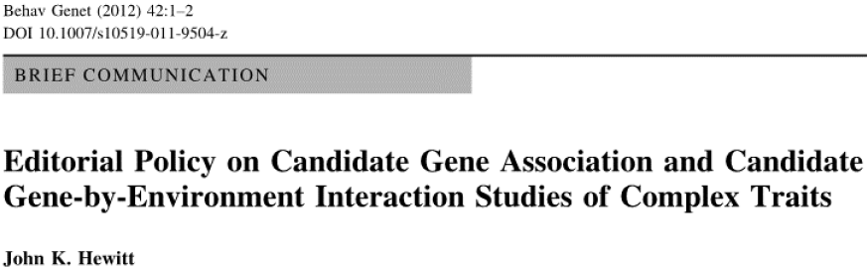
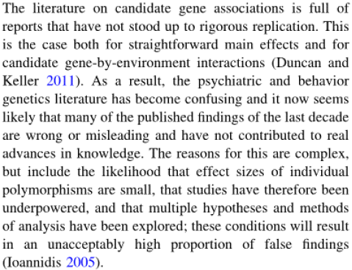
A Problem in Social-Science Genetics

Slide 145
Calibration: Power Analysis
Two alleles: High and Low.
Outcome distributed normally.
Either there is a true association or not.
If associated, R² = 0.1%.
  Probably large for behavior; upper bound of effect size of COMT on cognitive function. (Barnett et al., 2008)
Sample size for 80% power:
Now suppose significant association at α = .05.
7,845.

Slide 146

Bayesian Analysis of a Candidate-Gene Study
Given significant at α = .05, posterior probability of true association with effect size R² = 0.1%.
 |  | Sample size
 |  | N = 100 (power = .06) |  | N = 5,000 (power = .61) |  | N = 30,000 (power = .99)
Prior prob-ability | .01% | .01% |  | .12% |  | .20%
 | 1% | 1% |  | 11% |  | 17%
 | 10% | 12% |  | 58% |  | 69%
Calculated by Bayes’ Rule:

Slide 147
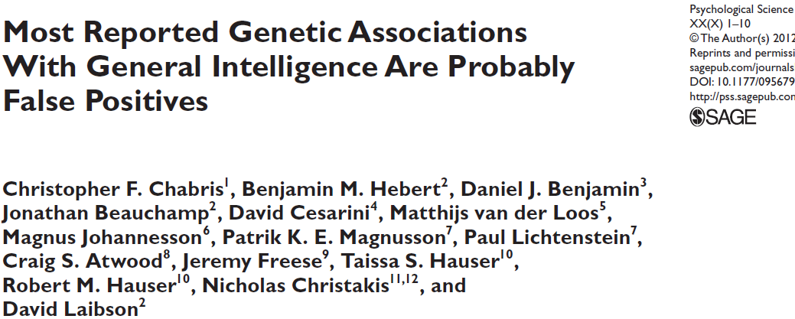
Notes:
Want to begin with a concrete example of the statistical power problem in action. Work led by Chris Chabris at Union College and in this paper, we try to replicate existing published associations with IQ test scores.

Slide 148
Selected the candidate SNPs from an authoritative review (Payton, 2008).
Use three different datasets, the WLS, the Framingham Heart Study and a Swedish sample of twins, to try to replicate the associations between 12 SNPs with published g associations.
Total sample was just shy of 10,000 individuals (so power is excellent, given reported effect sizes).
In none of the samples were we able to replicate any of the associations reported in the literature.
Even worse, we cannot reject the null hypothesis that the SNPs jointly have no explanatory power for g.
Notes:
Chris and collaborators selected SNPs from a review article on genetics of cognition and genotyped WLS respondents for these SNPs. Subsequently added data from FHS and Sweden. Often sample 100 times larger than original study.

Slide 149
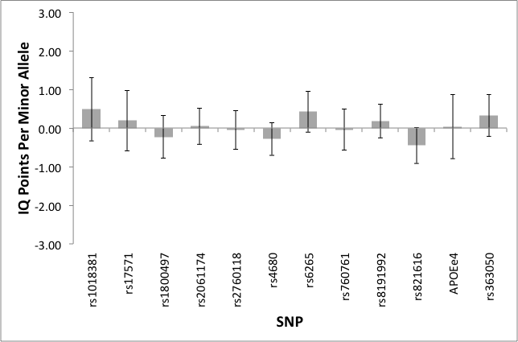
Pooled estimates (11 SNPs + APOE)
Notes:
This figure shows the pooled estimated regression coefficients from the three studies, weighted by the inverse by the variance of the estimate. We have followed the convention of standardizing the dependent variable so that its standard deviation is sixteen, and as you can see we can usually rule out effects larger than 1/16 SD. This graph illustrates a pattern of results that are all too common in the candidate gene literature. It used to be the case that the talk ended with pessimistic news, leaving our audiences disappointed and frustrated and wanting more, but fortunately… we think we have recently turned a corner.

Slide 150
Outline
Some promises for social science
Conceptual framework
Discovering genetic effects
The power problem
Some ways forward
  GWAS with large samples
  Exploiting cumulative effect of many SNPs
Public policy questions

Slide 151
The SSGAC
For novel gene discovery, medical genetics literature now requires very large samples (> 30,000) for top journals and genome-wide significance.
  “consortia” meta-analyze results from GWASs using p < 5 × 10⁻⁸.
Notes:
One can imagine a number of constructive responses to the power problem, and here I want to focus on one. In the medical world, researchers have responded to the reality that most genetic effects on medical traits are small by encouraging data pooling to increase sample size and statistical power. With Dan and David, and Philipp Koellinger at Erasmus University, I have tried to create a similar research infrastructure for social science outcomes. We call this infrastructure the SSGAC and it is run under the auspices of the CHARGE consortium. Our first ongoing project is on educational attainment, not because we think it is the ideal phenotype, but because it is available in a large sample.

Slide 152
Bayesian Analysis of a GWAS
Given significant at α = 5 × 10⁻⁸, posterior probability of true association with effect size R² = 0.1%.
 |  | Sample size
 |  | N = 100 (power = .00) |  | N = 5,000 (power = .00) |  | N = 30,000 (power = .51)
Prior prob-ability | .01% | .03% |  | 57% |  | 100%
 | 1% | 3% |  | 99% |  | 100%
 | 10% | 25% |  | 100% |  | 100%
Calculated by Bayes’ Rule:

Slide 153
The SSGAC
For novel gene discovery, medical genetics literature now requires very large samples (> 30,000) for top journals and genome-wide significance.
  “consortia” meta-analyze results from GWASs using p < 5 × 10⁻⁸.
SSGAC: Social Science Genetic Association Consortium studies social science traits, pooling GWAS data from 60 large samples.
In tradeoff between larger sample and higher-quality measure, larger sample often trumps. (Chabris et al., AJPH)
Notes:
One can imagine a number of constructive responses to the power problem, and here I want to focus on one. In the medical world, researchers have responded to the reality that most genetic effects on medical traits are small by encouraging data pooling to increase sample size and statistical power. With Dan and David, and Philipp Koellinger at Erasmus University, I have tried to create a similar research infrastructure for social science outcomes. We call this infrastructure the SSGAC and it is run under the auspices of the CHARGE consortium. Our first ongoing project is on educational attainment, not because we think it is the ideal phenotype, but because it is available in a large sample.

Slide 155
The SSGAC
For novel gene discovery, medical genetics literature now requires very large samples (> 30,000) for top journals and genome-wide significance.
  “consortia” meta-analyze results from GWASs using p < 5 × 10⁻⁸.
SSGAC: Social Science Genetic Association Consortium studies social science traits, pooling GWAS data from 60large samples.
In tradeoff between larger sample and higher-quality measure, larger sample often trumps. (Chabris et al., AJPH)
Initial project on education attainment.
  42 datasets with joint sample size of N = 104,328 in discovery phase, and 12 datasets with N ≈ 25,000 in replication phase.
  Years of educational attainment harmonized using the International Standard Classification of Education (ISCED).
    U.S.-equivalent years of education.
    Binary variable for college attainment.
  Apply all the usual, stringent, quality control fi lters and principal-component controls for population strati fication.
Notes:
One can imagine a number of constructive responses to the power problem, and here I want to focus on one. In the medical world, researchers have responded to the reality that most genetic effects on medical traits are small by encouraging data pooling to increase sample size and statistical power. With Dan and David, and Philipp Koellinger at Erasmus University, I have tried to create a similar research infrastructure for social science outcomes. We call this infrastructure the SSGAC and it is run under the auspices of the CHARGE consortium. Our first ongoing project is on educational attainment, not because we think it is the ideal phenotype, but because it is available in a large sample.

Slide 156
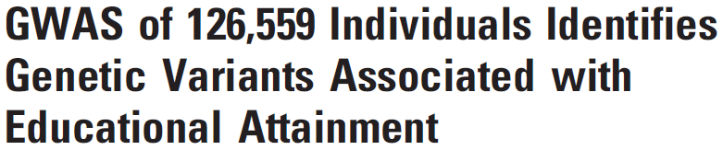


Slide 157
Three SNPs Genome-Wide Significant and Replicate
 |  | Discovery |  |  | Replication |  |  | Combined
EduYears | Gene | β | p-value |  | β | p-value |  | β | p-value | Effect size
rs9320913 | POU3F | 0.11 | 4×10⁻⁹ |  | 0.08 | 0.01 |  | 0.10 | 4×10⁻¹⁰ | 0.02%
College | Gene | OR | p-value |  | OR | p-value |  | OR | p-value
rs11584700 | LRRN2 | 0.92 | 2×10⁻⁹ |  | 0.91 | 5×10⁻⁴ |  | 0.92 | 8×10⁻¹²
rs4851266 | LOC150577* | 1.05 | 2×10⁻⁹ |  | 1.05 | 0.003 |  | 1.05 | 5×10⁻¹¹
Years: difference between those with 0 and 2 minor alleles is ≈ 2 months of educational attainment.
College: difference in probability of college completion ≈ 3.6%.
Effect size R² ≈ 0.02% an order of magnitude smaller than for complex physical / medical traits → even greater power challenges!
Notes:
What did we find? In our discovery stage, we identified 3 SNPs , one for eduyears and two college. All three replicate.
Top row shows the results for the eduyears SNP. Estimated coefficient. S.E. in discovery, the replication attempt and the estimate we get when we combine discovery and replication. EduYears is measued in years, so a coefficient of 0.1 corresponds to roughly 1 month of educational attainment.
Bottom row shows analogous estimates for college, but the coefficients are odds-ratios, so the usual interpretational issues arise. But our estimates imply the two homozygotes differ by around 3.6 percentage points.
I want to emphasize the small R2. It has important implications for our understanding of architecture of social science traits. If EA is representative of other SS traits, then 1/20 of height. Important for how we design and conduct studies and evaluate existing claims of positive associations based on studies relying on small samples.

Slide 158
Outline
Some promises for social science
Conceptual framework
Discovering genetic effects
The power problem
Some ways forward
  GWAS with large samples
  Exploiting cumulative effect of many SNPs
Public policy questions

Slide 159
Polygenic Scores
Some uses of genetic data, such as genes-as-controls and targeting interventions, only require predicting the outcome (not identifying individual SNPs).
Even though effects of individual SNPs are tiny, their cumulative predictive power could be substantial.
Given estimates of SNP effects from a GWAS, can construct a “polygenic predictive score”:
The closer ’s are to β_{j}’s, the better the prediction of y_{i} from ; hence R² greater in larger sample.
  For height: R² ≈ 10% for N = 180,000 (Lango Allen et al., 2010).
  In educational attainment GWAS with N ≈ 120,000, R² ≈ 2%.

Slide 160
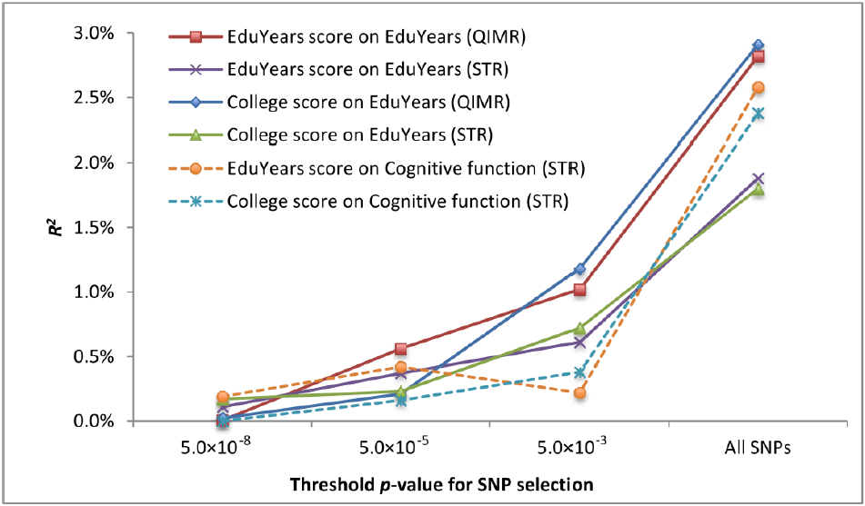
Linear Polygenic Score Predicts Education and Cog. Function
Notes:
For many of the applications that Dan listed, it is important how predictive the genetic data are. This figure tries to summarize much of what we presently know about this question. To make matters concrete, let me describe how we constructed the red line. This line shows how good a job we can do predicting educational attainment in an Australian sample. To construct this line, we reran the meta-analysis omitting the Australian sample and then used estimated SNP effects to construct a prediction equation in the Australian sample. This prediction equation is constructed by taking a linear combination of genotypes in the Australian data, weighting each by the estimated coefficient in the discovery sample. We constructed the scores using SNPs whose nominal p-values fall below a certain threshold, taking linkage disequilibrium into account. We also performed this exercise in our Swedish sample, and with a different outcome variable. The score is actually more predictive of cognitive skills than it is of educational attainment. If you are skeptical that 3% is actually enough to achieve a substantial reduction in sample size in a randomized controlled trial, you are right. However, we also report projections of how the R2 will change as larger samples become available. With 500,000 subjects, we project that the R2 will exceed 10%. Notice also the evidence of polygenicity.

Slide 161
Polygenic Scores
Some uses of genetic data, such as genes-as-controls and targeting interventions, only require predicting the outcome (not identifying individual SNPs).
Even though effects of individual SNPs are tiny, their cumulative predictive power could be substantial.
Given estimates of SNP effects from a GWAS, can construct a “polygenic predictive score”:
The closer ’s are to β_{j}’s, the better the prediction of y_{i} from ; hence R² greater in larger sample.
  For height: R² ≈ 10% for N = 180,000 (Lango Allen et al., 2010).
  In educational attainment GWAS with N ≈ 120,000, R² ≈ 2%.
  Project that for EA with N ≈ 1,000,000, will reach R² ≈ 20%.

Slide 162
Outline
Some Promises for Social Science
Conceptual Framework
Discovering Genetic Effects
The Power Problem
Some Ways Forward
  GWAS with large samples
  Exploiting cumulative effect of many SNPs
  Focus on well-established genetic effects
Notes:
Now I want to talk about one of several constructive responses to the power problem that one could imagine.

Slide 163
Way #3: Well-Established, Proximal Genetic Effects
I have emphasized highly polygenic architecture and small effects for behavioral traits.
  I believe true of most traits of interest to social scientists.
Exceptions: traits with fairly direct biological precursors.
  Examples: Preferences for consumption of nicotine, alcohol, caffeine, salty foods.
  Some of these are clearly relevant for health.
  Some recent genoeconomics work on smoking. (e.g., Fletcher, 2011)
Starting work on structural modeling of smoking initiation and quitting that incorporates genetic data using HRS.
  The biological pathways are well understood, but the behavioral responses are not → role for economic modeling.

Slide 164
Outline
Some promises for social science
Conceptual framework
Discovering genetic effects
The power problem
Some ways forward
  GWAS with large samples
  Exploiting cumulative effect of many SNPs
Public policy questions

Slide 165
Public policy
Within a few decades we’ll be able to use polygenic risk scores to partially predict the lifetime trajectory of a newborn (10% to 30% of the variation)
  Health phenotypes
  Social science phenotypes
    e.g., educational attainment
We need a regulatory framework
  Should individuals be allowed to know their own genotypes? (Probably)
  Who can this information be given to?

Slide 166
Potential benefits
In principle, the genome could be used to identify risk factors for things like:
  Dyslexia
  Smoking/Substance abuse
  Compulsive gambling
  Schizophrenia
  Diabetes
  Obesity
  Dropping out of high school

Slide 167
The ‘Coasian’ benchmark
“Everyone owns the property rights to their own information”
But externalities abound
  My DNA reveals my identical twin’s DNA, etc….
  My decision not to publicly reveal my DNA reveals information nonetheless
    In equilibrium, everyone reveals, since “not revealing” reveals that you have something to hide
    Another application of Akerlof’s lemons model

Slide 168
There is a public interest in blocking information sharing
Health insurance companies can’t use DNA for pricing
But what about colleges, employers, romantic partners, and everyone else who’d like to know my genetic endowment?

Slide 169
If a college is allowed to measure my cognitive function with an SAT, why can’t they measure my cognitive function with a DNA test?
Both the SAT and DNA are noisy measures.
Why is the SAT appropriate but DNA is not?

Slide 170
The cases for information bans
Insurance markets
  Genetic endowment is a pre-existing condition
Externalities
  My genetic information is not just my own, since it is shared by everyone with whom I am related
  Unraveling in adverse selection markets
Misunderstanding of genetic information (e.g., “genetics is destiny”)
  External harms: e.g., hiring
  Internal harms: e.g., fatalism and incentives

Slide 171
Fairness?
Does genetic information bother us because it is unambiguously beyond our “control”?
Does the use of genetic information violate our fairness norms more grossly than other kinds of information?

Slide 172
Concluding Thoughts
Many social-science traits are influenced by many SNPs of tiny effect (R² = 0.02%)
Nevertheless, polygenic risk scores can be used to predict behavior and this predictive power will increase as sample sizes increase (e.g., N = 1,000,000)
We need to decide what to do with genetic data, which raises both philosophical and empirical questions
  What happens when people use genetic data?

Slide 173
Outline:
Neuroeconomics: definition
Multiple Systems Hypothesis
Genoeconomics

