Slide 1
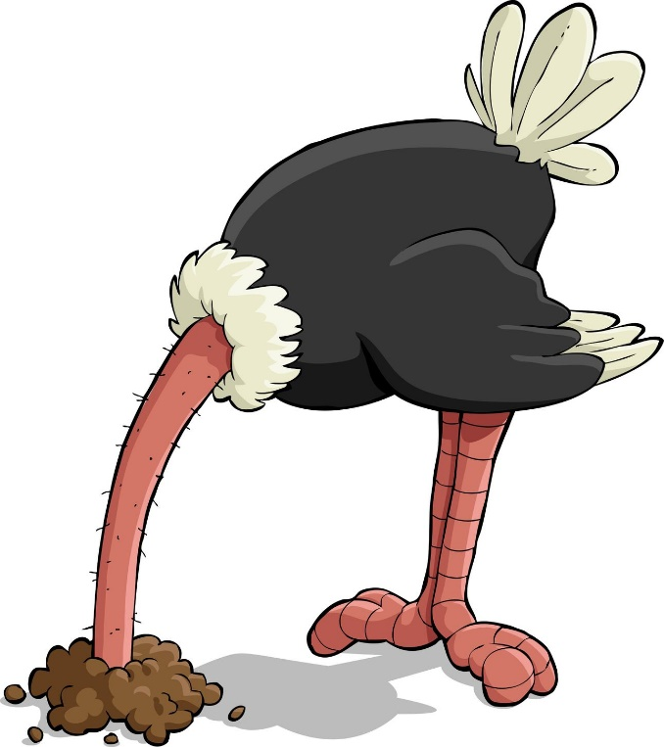
Information Avoidance

Slide 2

Economics of Information
Stigler, 1961; The Economics of Information. JPE 69 (3), 213-225.
  Information is a scarce commodity, like any other, that can be bought and sold
  Information valued to the extent that it aids in decision making, and only to that extent
  (valid) information will never be actively avoided; at worst it will be
  ignored
1970s: “new economics of information”
(asymmetric information)
  adverse selection (George Akerlof)
  signaling (Michael Spence)
  screening (Joseph Stiglitz)
Often said that we are in the “age of
information”
Is it time for a new new economics
of information?

Slide 3
Belief-based utility (“new new economics of information”)
Schelling (1987): “the mind as a consuming organ”
Abelson (1986) “Beliefs are like possessions”
Loewenstein, George. 1987. “Anticipation and the Valuation of Delayed Consumption.” Economic Journal, 97(387): 666–684.
Geanakoplos, John, David Pearce, and Ennio Stacchetti. 1989. “Psychological games and sequential rationality.” Games and Economic Behavior, 1(1): 60–79.
Caplin, Andrew, and John Leahy. 2001. “Psychological Expected Utility Theory and Anticipatory Feelings.” QJE, 116(1): 55–79.
Kőszegi (2010). “Utility from anticipation and personal equilibrium” Economic Theory. 44(3):415-444
Benabou & Tirole (e.g., 2010) “Identity, Morals and Taboos: Beliefs as Assets.” QJE 126(2): 805–55.
Some of this work summarized in:
Loewenstein, G. (2006). The pleasures and pains of information. Science, 312, 704-706.

Slide 4
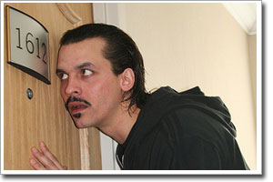

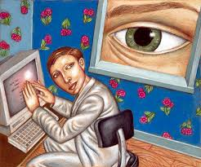


Lots of information-related phenomena don’t fit with economic models
Many of these are key to recent developments in, e.g., social networking, e-commerce, etc.
 | Desire to | Desire not to
Obtain information | Curiosity | Information avoidance
Share information | Desire to reveal | Privacy

Slide 5

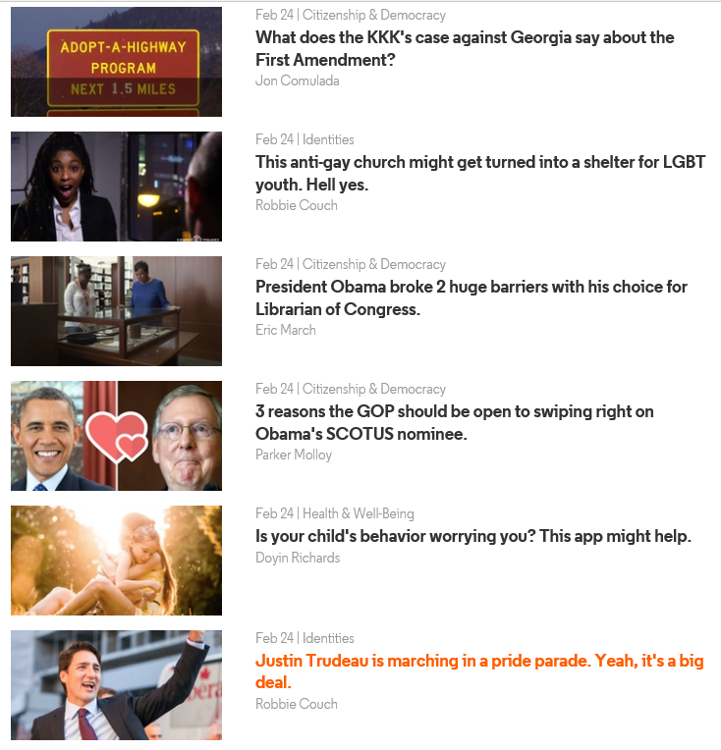
Curiosity
Loewenstein (1994). The psychology of curiosity: A review and reinterpretation. Psychological Bulletin, 116, 75-98.
Account of curiosity based on concept of an information gap
Enumeration of some of curiosity’s most salient features..
    Intensity
    Stimulus-dependence/transience
    Disappointment when satisfied
Golman & Loewenstein (2012), Curiosity, Information Gaps, and the Utility of Knowledge. SSRN
  Formal model of information gaps
Chater & Loewenstein, G. (2016). The Under-appreciated Drive for Sense-making. Journal of Economic Behavior and Organization.
Kruger & Evans (2009). “The paradox of Alypius and the pursuit of unwanted information.” JESP, 45(6), 1173-1179.
Hsee & Ruan (2015). Curiosity Kills the Cat. in Advances in Consumer Research. 43, 62-67.

Slide 6
 | Desire to | Desire not to
Obtain information | Curiosity | Information avoidance
Share information | Desire to reveal | Privacy

Slide 7

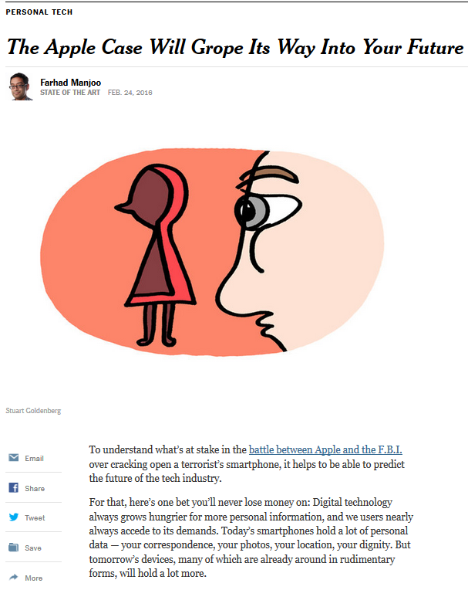
Privacy
    Acquisti, John & Loewenstein. 2012. "The Impact of Relative Standards on the Propensity to Disclose," JMR.
      Showing that people take their cues about what to reveal from others and from their past experiences
    Brandimarte, Acquisti & Loewenstein. 2013. Misplaced confidences: Privacy and the control paradox. SPPS.
      Showing that giving people more control over privacy may be giving them more rope to hang themselves with
    Acquisti, John & Loewenstein. 2013. What is Privacy Worth? Journal of Legal Studies.
      Showing that people exhibit default effects and loss aversion with respect to privacy
    Acquisti, Brandimarte & Loewenstein (2015). Privacy and human behavior in the age of information. Science.
    John, Acquisti & Loewenstein. 2011. Strangers on a Plane: Context-Dependent Willingness to Divulge Sensitive Information. Journal of Consumer Research.

Slide 8
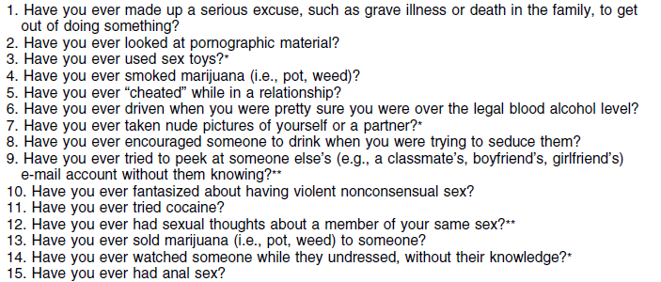
representative study from the BE & privacy line of research..
CMU students (n=200) asked if they have engaged in a series of sensitive and/or illegal behaviors
Most provided CMU email addresses from which it would have been trivial to determine their identity
John, L., Acquisti, A., & Loewenstein, G. (2011). "Strangers on a Plane: Context-Dependent Willingness to Divulge Sensitive Information." Journal of Consumer Research, 37(5), 858-873.

Slide 9
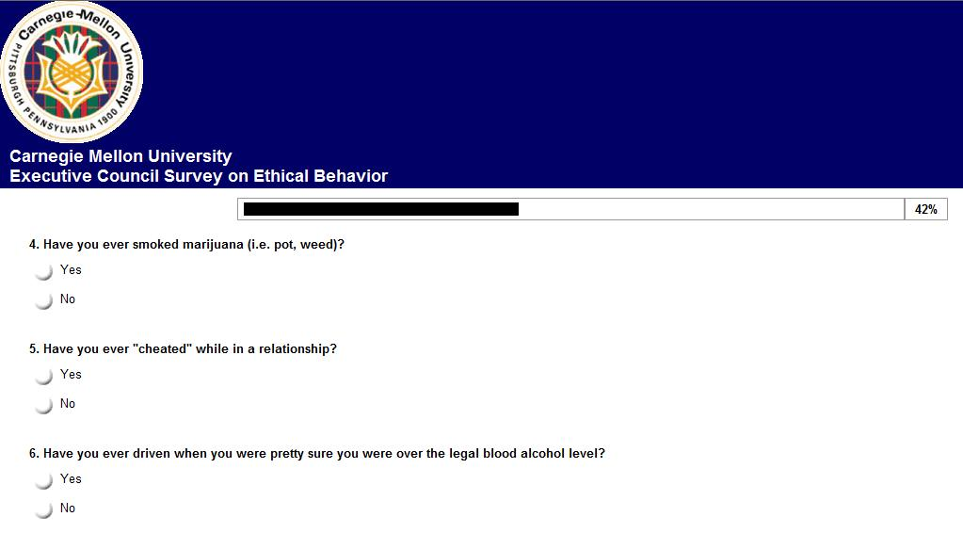
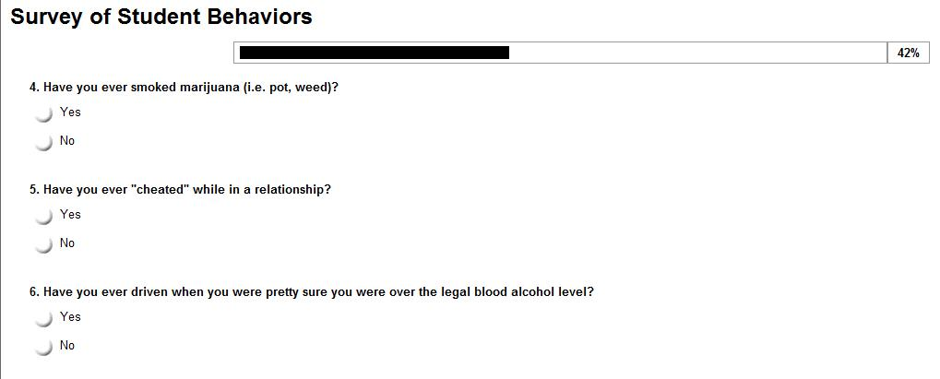
Professional Interface
(accompanied by elaborate assurances of confidentiality and anonymity)

Slide 10
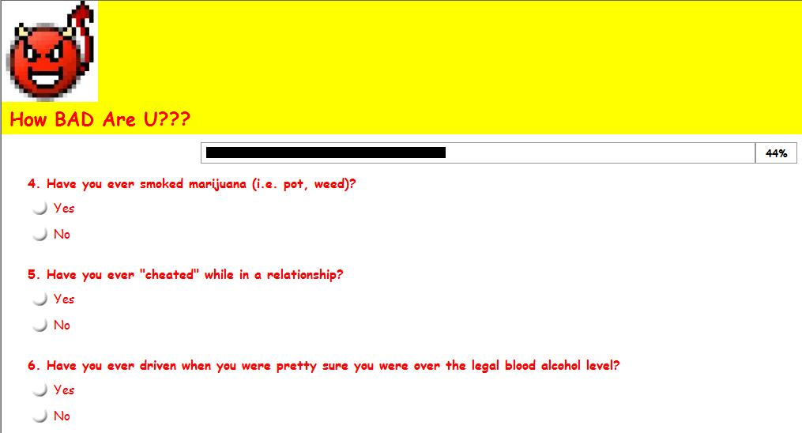
Unprofessional Interface

Slide 11
and neutral interface..
Unprofessional
Baseline
Professional

Slide 12
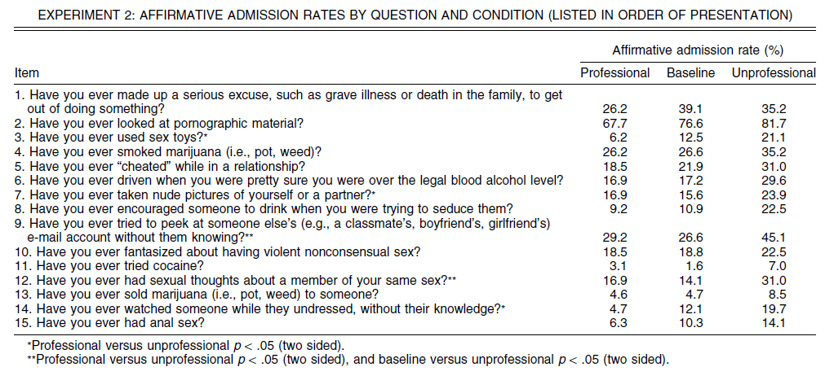
Hypothesis: Professional website, and privacy assurances backfire..
  remind people that privacy is an issue
  implicitly signal disapproval of the behaviors

Slide 13
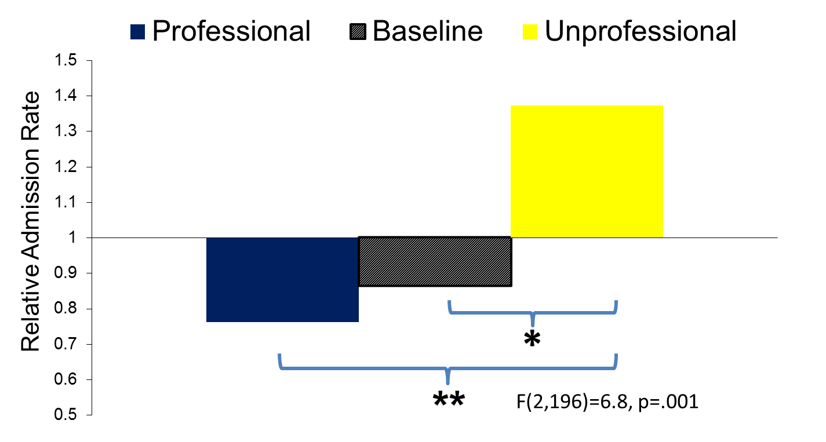
Overall results..
Follow-up study found that, when viewed side-by-side, people overwhelmingly viewed the professional website as more secure, and safer to share information on.

Slide 14
Main conclusions from privacy research:
  Concern about privacy is extremely context-dependent
  People’s willingness to share information varies in response to cues that have little connection to the true costs and benefits of sharing and withholding
  Overall, people don’t care much about privacy (except when one ‘rings alarm bells’
→ insight: Desire to reveal information is a far more powerful motive than the desire to conceal it

Slide 15
 | Desire to | Desire not to
Obtain information | Curiosity | Information avoidance
Share information | Desire to reveal | Privacy

Slide 16
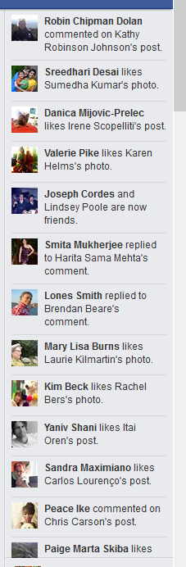
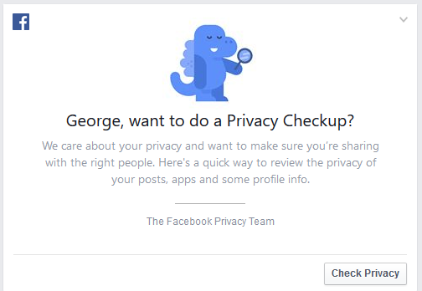
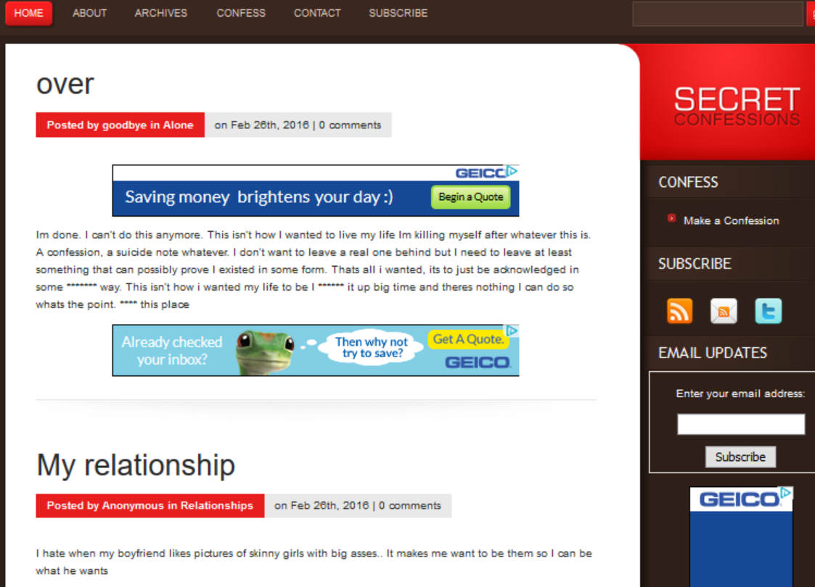
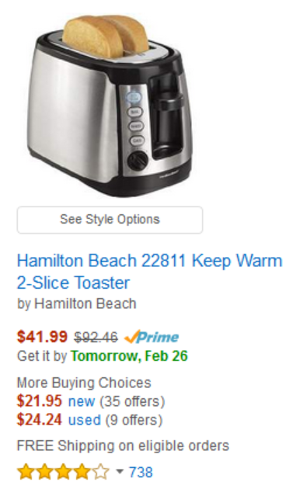
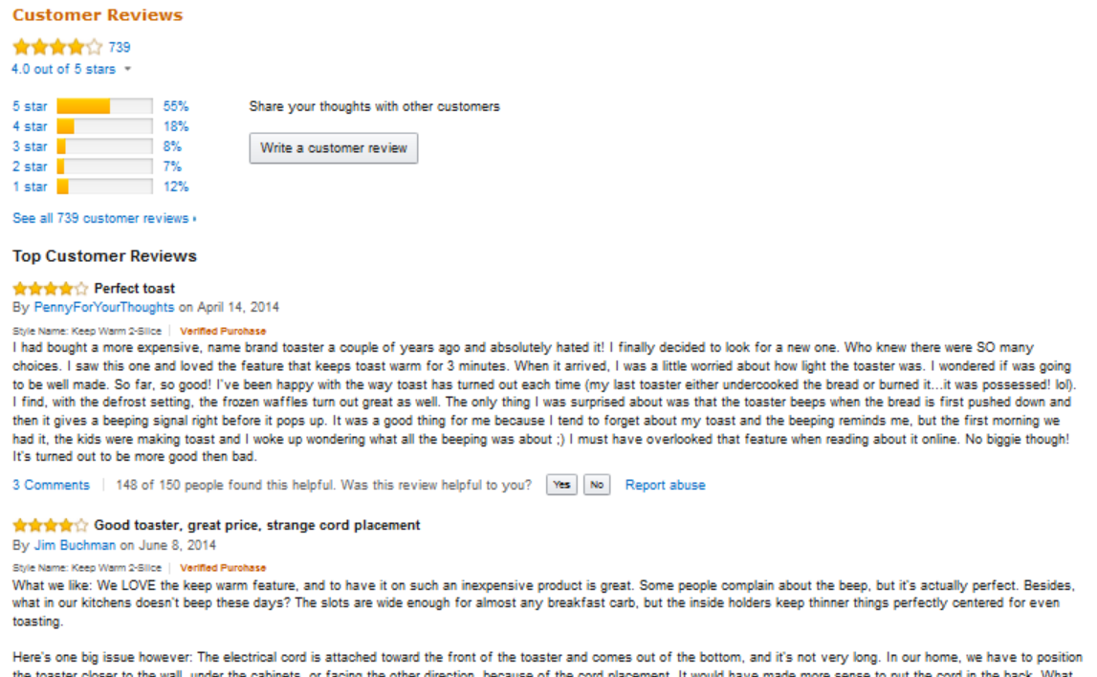
Desire to reveal

Slide 17
 | Desire to | Desire not to
Obtain information | Curiosity | Information avoidance
Share information | Desire to reveal | Privacy

Slide 18
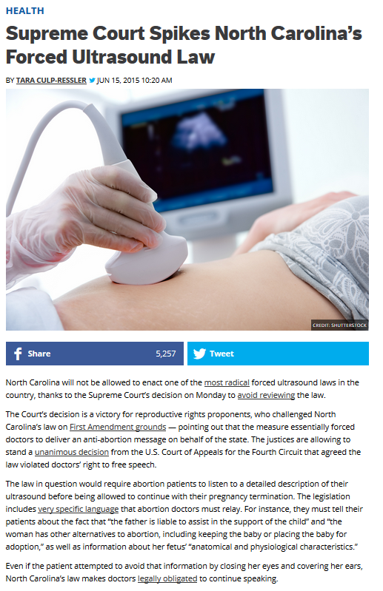
Information Avoidance
Definition of information avoidance:
  Individual must know that information exists
  Must be costless to acquire (or costly to avoid)
Methods of information avoidance
  Physical avoidance
  Inattention
  Biased interpretation of information
  Forgetting
Golman, Hagmann & Loewenstein (2016). Information Avoidance. Journal of Economic Literature.

Slide 19
Reasons for information avoidance
Strategic
  Intrapersonal
    As commitment device (e.g., with compound lotteries)
    Motivation maintenance
    Preventing choking
    Avoiding projection bias (e.g., curse of knowledge)
    Abdicating responsibility (also interpersonal)
    Saving it for later (e.g., mystery novel)
  Interpersonal
    Plausible deniability
    Strategic benefits (from public avoidance)
Hedonic…
Dana, Weber and Kuang (2007)
 | State
Choice | I | II
A | 6,1 | 6,5
B | 5,5 | 5,1
The dictator knows his own payoffs and can choose to costlessly reveal his partner’s payoffs, which depend on the state

Slide 20
First hedonic reason for information avoidance: Optimism maintenance (e.g., Brunnermeier & Parker, 2005)
  Lots of evidence with respect to medical tests – e.g., Oster et al. (2013) study of Huntington’s testing
    low rates of testing and high rates of optimism among those at risk for but untested
    At-risk people who don’t get tested make similar life decisions as those who get tested and learn they don’t have the condition, but very different from those who learn they do have the condition
  Laboratory study: Eil and Rao (2011)
    Had people either take an intelligence test or have their attractiveness rated by other subjects
    Gave them preliminary partial information
      Those who got initial feedback that was below their expectations didn’t want more information (and some were willing to pay not to get it)
      Those who got favorable feedback updated their beliefs positively
      Those who got negative feedback did not update their beliefs (negatively)

Slide 21
Second hedonic reason for information avoidance: Belief investments
Consequences: People..
  sort geographically on basis of beliefs; avoid interacting with people holding different beliefs
  avoid ‘conversational mine-fields’
  expose themselves to media consistent with their existing beliefs
  proselytize to try to bring others’ beliefs into conformity with their own
  seek to silence (in some cases by killing) those they disagree with
Basic intuition:
  People make investments based on their beliefs
  Discarding their beliefs would mean writing off those (sunk) investments
  Confronted with other people who have different beliefs, forced to recognize that they might be the one who is wrong
  Avoid encounters with other people or stimuli that might challenge their beliefs
Golman, Loewenstein, Moene & Zarri (forthcoming). The Preference for Belief Consonance. Journal of Economic Perspectives.

Slide 22
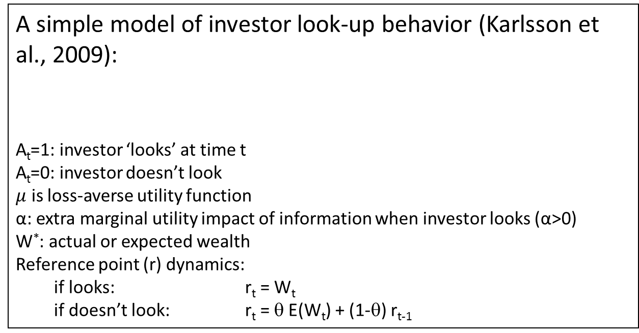
  Third hedonic reason for information avoidance: Attention Effect (knowing is, at least in the short-run, more painful than suspecting)
A simple model of investor look-up behavior (Karlsson et al., 2009):
A_{t}=1: investor ‘looks’ at time t
A_{t}=0: investor doesn’t look
$μ$ is loss-averse utility function
α: extra marginal utility impact of information when investor looks (α>0)
W*: actual or expected wealth
Reference point (r) dynamics:
  if looks: r_{t} = W_{t}
  if doesn’t look: r_{t} = θ E(W_{t}) + (1-θ) r_{t-1}
  Given plausible parameter values, the model predicts selective looking when the market is up – an ostrich effect

Slide 23
A study of the ostrich effect..
Panel of 1.1 million defined contribution accounts over 2007-2008 at Vanguard
Logins and trading observed daily over 2 years. N = 853 million day/investor obs.
Focus on 100k subsample of “paperless” accounts
Sicherman, Loewenstein, Seppi & Utkus (2016). “Financial Attention.” Review of Financial Studies

Slide 24
Distribution of logons (lookups)
Lookup frequency
0 2.7%
1 2.4%
> half of trading days 4.2%

Slide 25
Day-of-week effect

Slide 26
Trading v. logins as a measure of investor attention

Slide 27
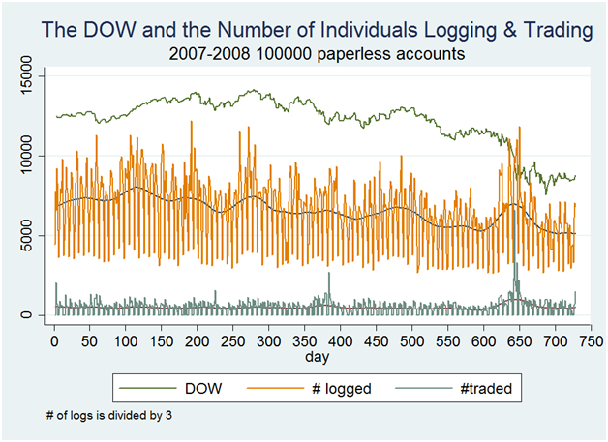
Lookups, trades and market changes

Slide 28
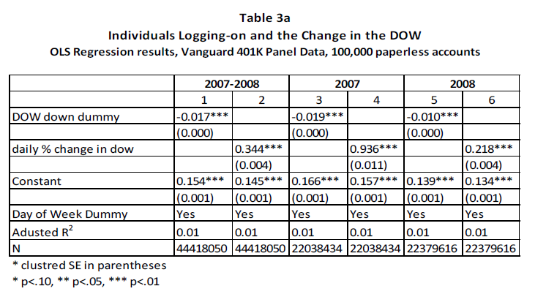
Simple test of ostrichness

Slide 29
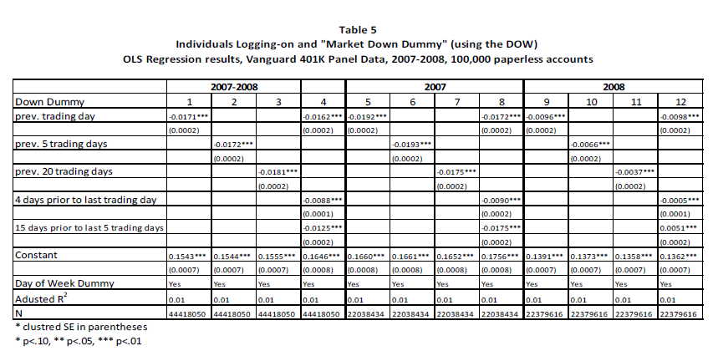
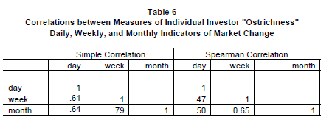
Different change intervals..

Slide 30
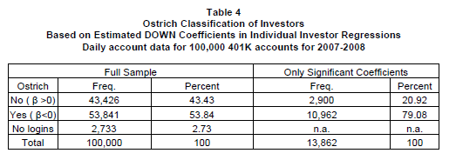
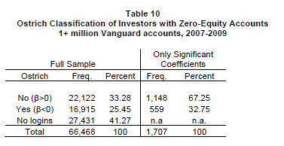
How many ostriches?
What about bond holders?

Slide 31
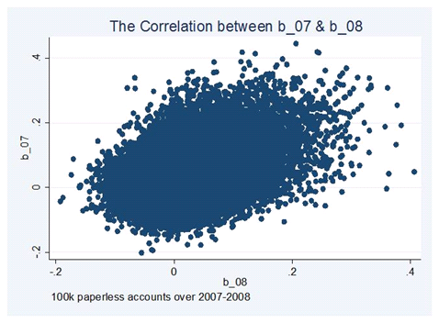
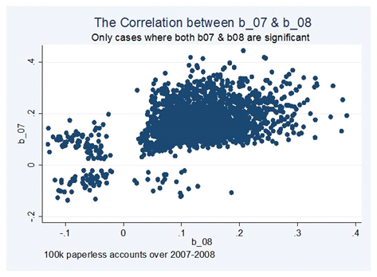
Once an ostrich, always an ostrich?
Simple correlation = 0.393
Spearman rank correlation = 0.173
Simple correlation = 0.459
Spearman rank correlation = 0.367

Slide 32
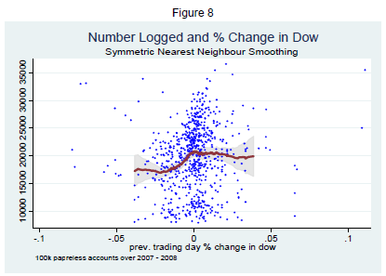
Do people login more in up markets or less in down markets?

Slide 33
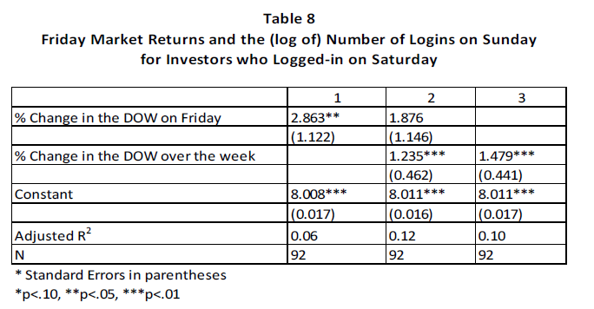
A strong test that it’s really psychology: double-weekend logins

Slide 34
Individual differences in logins and in ostricity..

Slide 35
Fixed Effects

Slide 36
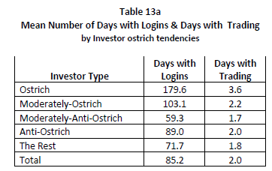
Do ostriches log in or trade more?

Slide 37
Distribution of Investors by their Level of “Ostrichness” and their Tendency to Trade Conditional on Market Trend (Up or Down)
 | Significant (t>2) |  | Moderate (1<t<2)
 | Trade Down | Trade Up | Trade Down | Trade Up
Ostrich | 172 | 178 | 3,096 | 2,610
Anti-ostrich | 177 | 25 | 2,908 | 117

Slide 38
Why information avoidance matters:
  Deprives people of potentially useful information – e.g.,
    Medical tests
    Teaching ratings (other type of feedback such as videos)

Slide 39
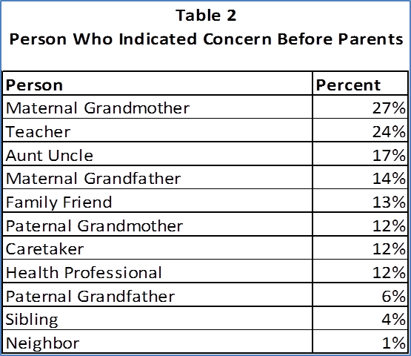
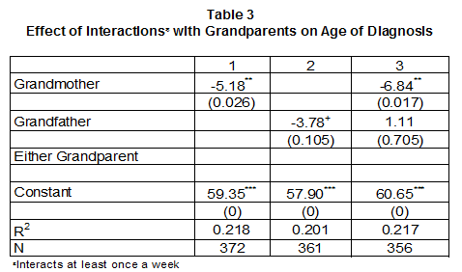
Sicherman, N. Loewenstein, G., Tvassoli, T. & Buxbaum, J. (under review). Grandma Knows Best: Family Structure and Age of Diagnosis of Children with Autism Spectrum Disorder.
Survey with 477 parents of children diagnosed with ASD.
Additional short survey with 196 “friends and family” referred by parents. 58% saw child at least once a week around time of diagnosis
Collected information about family structure, interactions with family and friends, and age of diagnosis, etc.
Results:
25% of parents reported that other people indicated concern that the child “might have a serious condition” before they started suspecting
48% of friends and family respondents report they suspected child had a serious condition before, they believe, either parent was concerned.
  Among these..
  51% claim to have expressed their concern to parents.
  27% “hinted concern”
  22% report did not express their concerns
Frequent interaction with a grandmother reduces the age of diagnosis by 5.18 months (p=0.026).

Slide 40
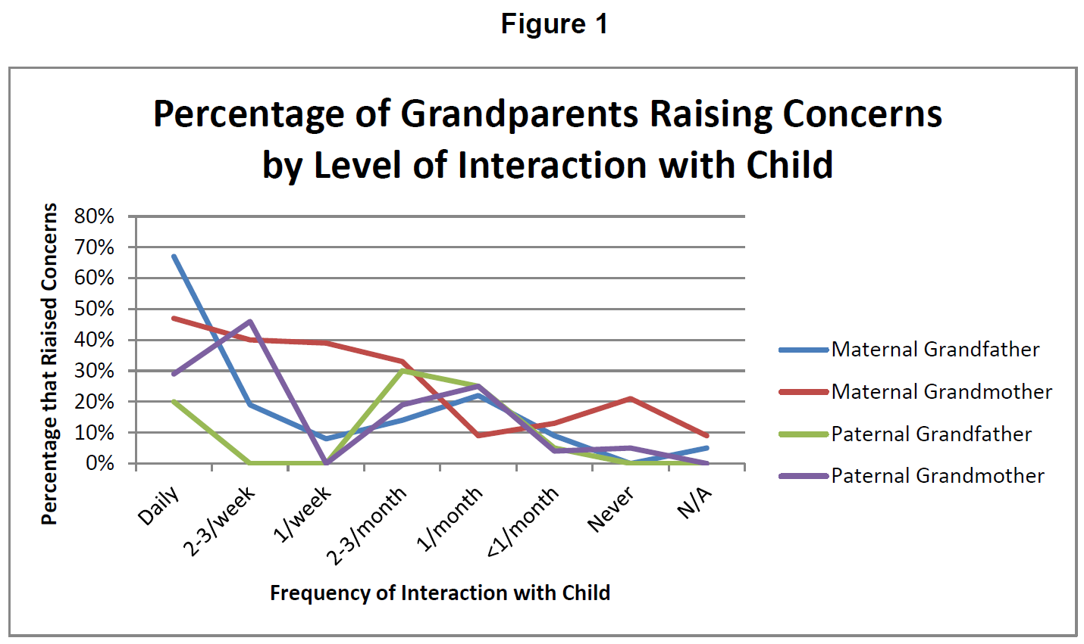

Slide 41
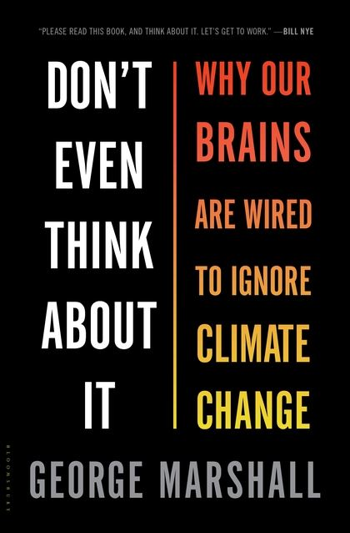
Why information avoidance matters:
  Deprives people of potentially useful information – e.g.,
    Medical tests
    Teaching ratings (other type of feedback such as videos)
  Reinforces confirmation bias, groupthink
  Contributes to media bias, polarization
“The bottom line is that we do not accept climate change because we wish to avoid the anxiety it generates and the deep changes it requires. In this regard, it is not unlike any other major threat. However, because it carries none of the clear markers that would normally lead our brains to overrule our short-term interests, we actively conspire with each other, and mobilize our own biases to keep it perpetually in the background” (page 228).

Slide 42
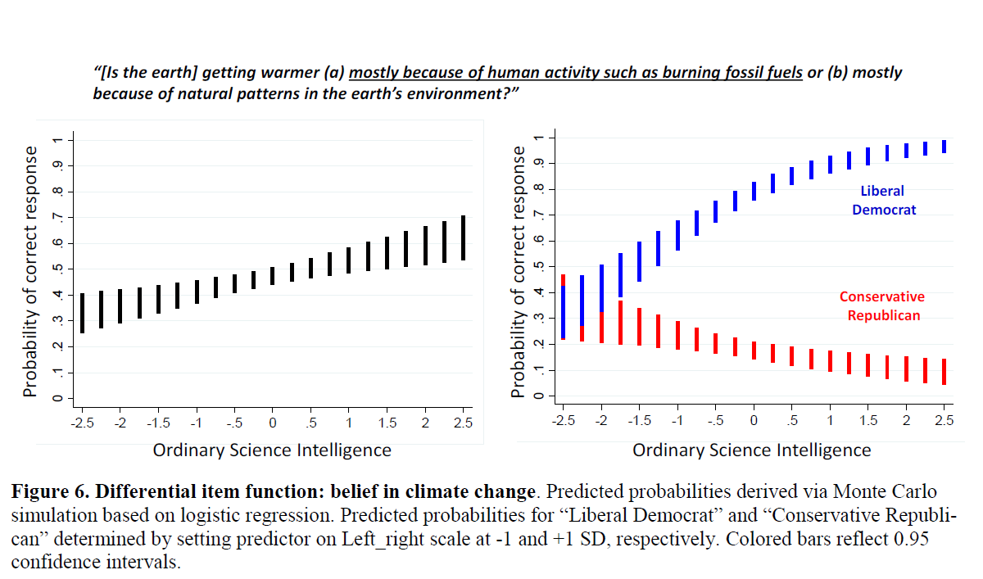
It isn’t an issue of ignorance
Dan M. Kahan (forthcoming). Climate Science Communication and the Measurement Problem. Advances in Political Psychology.

Slide 43


Mattress Girl Study (with Nik Gurney)

Slide 44
N=471 paid subject pool participants (8 excluded due to failing attention check)
Choose which of two essays, one short and one long, to read and answer questions about. One essay written by a friend of Amy Sulkowicz, the other by a friend of Paul Nungesser.
Two conditions:
Asked questions about their position on the issue, need for closure scale, preference for coherence scale, demographics
Secondary: module on investments in religion and attitudes toward religious people and atheists
Condition 1 | Condition 2
Sulkowicz friend essay short | Nungesser friend essay short
Nungesser friend essay long | Sulkowicz friend essay long

Slide 45
Choice of long essay
 | Nungesser long | Sulkowicz long
Support Sulkowicz | 35% | 56%
Support Nungesser | 41% | 34%
Logistic regression analysis: Choice Long = constant + B1 support mattress girl + B2 mattress girl long + B3 support mattress girl * mattress girl long (interaction is the key term)
Value and significance of interaction term for different sub-populations
Overall | Need for closure |  | Preference for consistency |  | education |  | politics |  |  | gender
 | Low | high | Low | high | No college | college | Demo-crat | Republi-can | Independent | Female | male
1.17 P=.004 | .16 P=.79 | 2.2 P<.0001 | .48 P=.40 | 2.0 P=.001 | .34 p=.11 | 1.8 P=.001 | .75 P=.29 | 2.3 P=.10 | 3.2 P<.0001 | .59 P=.28 | 1.8 P=.006

Slide 46
Why information avoidance matters:
  Deprives people of potentially useful information – e.g.,
    Medical tests
    Teaching ratings (other type of feedback such as videos)
  Reinforces confirmation bias, groupthink
  Contributes to media bias, polarization
  Contributes to misbehavior – e.g., moral wiggle room, plausible deniability
  But not always bad..
    Happens for (often sensible) reasons
    Can sometimes improve behavior – e.g., investing, teaching, etc.

Slide 47
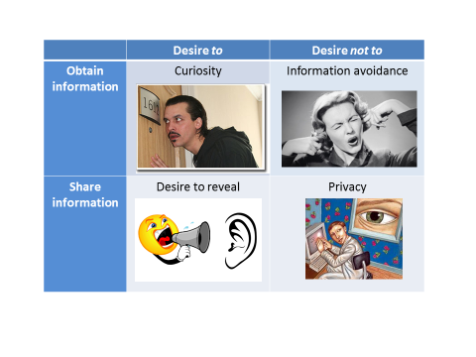
Overall conclusions
Our (economists’) understanding of the desire for (and desire to avoid) information still at an early stage
There are a multiplicity of motives, over and above the desire to improve decision making, driving the demand for information
Sometimes the ‘demand’ for information is actually a desire to avoid information

