Slide 1
Why Is Insurance Choice So Difficult For Consumers?
Eric J. Johnson
Center for Decision Sciences
Supported by the Sloan Foundation,
Behaviorally Informed Insurance,
Notes:
This presentation represents research unrelated to my employment. The views expressed are those of the author[s] and do not necessarily represent
those of the Director of the Consumer Financial Protection Bureau or other Bureau staff.

Slide 2
My (other) Interests
Time Preferences
  Measurement, particularly Adaptive methods ¹
  Processes of time preference choices.
Decision Neuroscience ²
  Information Acquisition. ³
    Behavioral Game Theory
Consumer Finance
  Mortgages, particularly management
    Mortgage choice and walking away ⁴
    Decisions about refinancing.
  Behavioral Insurance ⁵ ⁶ ⁷
  Aging ^{8,9}
Choice Architecture and Policy
  Defaults^{10,11}
  Overview of CA decisions (in preparation)
  Environmental Decisions & Local Warming ^{12,13}

Slide 3
Some references
1. Toubia, O., Johnson, E., Evgeniou, T. & Delquié, P. Dynamic Experiments for Estimating Preferences: An Adaptive Method of Eliciting Time and Risk Parameters. Management Science 59, 613–640 (2013).
2. Figner, B. et al. Lateral prefrontal cortex and self-control in intertemporal choice. 13, 538–539 (2010).
3. Reeck, C., Wall, D. & Johnson, E. J. Search predicts and changes patience in intertemporal choice. Proc Natl Acad Sci USA 114, 11890–11895 (2017).
4. Atlas, S. A., Johnson, E. J. & Payne, J. W. Time preferences and mortgage choice. Journal of Marketing Research 54, 415–429 (2017).
5. Johnson, E. J., Hershey, J., Meszaros, J. & Kunreuther, H. Framing, Probability Distortions, and Insurance Decisions. J Risk Uncertain 7, 35–51 (1993).
6. Ubel, P. A., Comerford, D. A. & Johnson, E. Healthcare.gov 3.0--behavioral economics and insurance exchanges. N. Engl. J. Med. 372, 695–698 (2015).
7. Johnson, E. J., Hassin, R., Baker, T., Bajger, A. T. & Treuer, G. Can Consumers Make Affordable Care Affordable? The Value of Choice Architecture. PLoS ONE 8, e81521–6 (2013).
8. Li, Y., Baldassi, M., Johnson, E. J. & Weber, E. U. Complementary cognitive capabilities, economic decision making, and aging. Psychol Aging 28, 595–613 (2013).
9. Li, Y. et al. Sound credit scores and financial decisions despite cognitive aging. Proc Natl Acad Sci USA 112, 65–69 (2015).
10. Johnson, E. J. & Goldstein, D. Medicine - Do defaults save lives? Science (New York, NY) 302, 1338–1339 (2003).
11. Dinner, I., Johnson, E. J., Goldstein, D. G. & Liu, K. Partitioning default effects: Why people choose not to choose. 17, 332–341 (2011).
12. Zaval, L., Keenan, E. A., Johnson, E. J. & Weber, E. U. How warm days increase belief in global warming. Nature Climate Change 4, 1–5 (2014).
13. Li, Y., Johnson, E. J. & Zaval, L. Local Warming. Psychological Science 22, 454–459 (2011).

Slide 4
Smart Choice Sets as Choice Architecture
Helping Consumers Cope with Information Overload by Sorting and Partitioning Large Sets
Benedict Dellart, Tom Baker and Eric Johnson
(r&r, JMR)

Slide 5
Some Facts
Insurance is one of the oldest financial, “most misunderstood” institutions
Huge market in the US and worldwide.
  $5.2 trillion, total cash and invested assets for Property/Casual and Life/Health (2015), 2.5 million employees in the US (2015)
  Insurance carriers and related activities contributed $450bn or 2.6% of US GDP in (2014)
  Worldwide is $4.8 trillion dollars in premiums (2017, OECD)
Primary Role is risk-management by households
  India: 4.4% have life policies, 22% growth in 2015.
  US: 21% have life policies, Korea, 94.4%
Notes:
DONE -- @kunal: possible to update US numbers in 2nd bullet and find source?
Source: http://www.iii.org/fact-statistic/industry-overview
Started by Phoenicians who insured against piracy 1750BC recorded in the Code of Hammurabi.

Slide 6
Insurance is a useful institution
Question:
  Could bad beliefs about consumers’ abilities cause markets not to work?
    Beliefs about Risk?
    Inability to calculate costs?
  Result:
    Firms do not provide information in a way that would result in more efficient markets
    Is there not adverse, but rather advantageous selection?

Slide 7
The Economics of Insurance
Basic theory of risk sharing
  Law of large numbers allows diversification of individual-specific risks
  Benefits those that are risk averse, or may suffer ruinous losses
Three economic barriers:
  Moral hazard: Hidden Actions
  Adverse selection: Hidden Information
  Transaction costs
Notes:
Hidden from the insurer, known to the buyer….

Slide 8
To make wise insurance choices
Ability to assess the probability and size of a risk.
Ability to assess the costs and benefits of the insurance offer.
A psychological view:
  These are assembled and do not (fully) exist until people need to make a decision.
    Assembled Beliefs
    Assembled Preferences.

Slide 9
What are the effects of behavioral consumers on insurance markets?
What if (some) firms are uninformed about consumers?
  What is the effect on
    competition,
    profits?
What if (more) firms are sophisticated about consumers?
  Could provide aids to help consumers. When will that work?
  Could exploit consumers bad beliefs and choices….

Slide 10
What are the behavioral reasons insurance markets may fail?
Perhaps people have the inaccurate beliefs about risks?
Perhaps they unable to calculate the costs and benefits of insuring?
If so, can we help insurance markets work?

Slide 11
Beliefs about risk

Slide 12
Risk.

Slide 13
Perceptions of Risk
The logic
Imagine two kinds of coverage that are:
  Mutually exclusive
  Exhaustive
What can we say about pricing?
Notes:
Our approach is to ask respondents to price incrementally two individual insurance policies that provide coverage against two mutually exclusive risks. We also elicit prices for coverage against a third risk that is a superset of the first two risks. While any price could be justified for the two components, the inclusion principle states that it is an error for the sum of the prices of the components to exceed the price of the larger, inclusive risk. 1 This simply reflects the probabilistic principle that two disjoint subsets cannot be more probable than a larger set that includes both.
Imagine that she first gives a reservation price for coverage of her right hand, and then gives the reservation price for incremental coverage of her left hand. We do not make any statement about how reasonable either price might be. However, we know that the sum of these two prices should exactly equal the price that she would be willing to pay for a policy covering both hands.

Slide 14
Johnson, Hershey, Meszaros and Kunreuther (JRU,1993)
³⁴
³⁴
³⁴
³⁴

Slide 15
More…
Notes:
Relationship to partitioning and support theory

Slide 16
More
.

Slide 17
Assembled Beliefs

Slide 18
Estimating longevity risk…

Slide 19
Life expectancy is essential knowledge
Fundamental Assumption of Economics Models.
  Life cycle models
  Essential knowledge in buying annuities, including when to claim Social Security benefits.
Can be asked two ways:
  What is the probability that you will live to be age 85 or older?
  What is the probability that you will die by age 85 or younger? (used by HRS)
These should be the related p(alive at 85) = 1 – p(die by 85)
Are they influenced by how we ask?
Notes:
Do you think differently in each frame?
How should I ask if I am selling life insurance?
How should I ask if I am selling annuities?

Slide 20
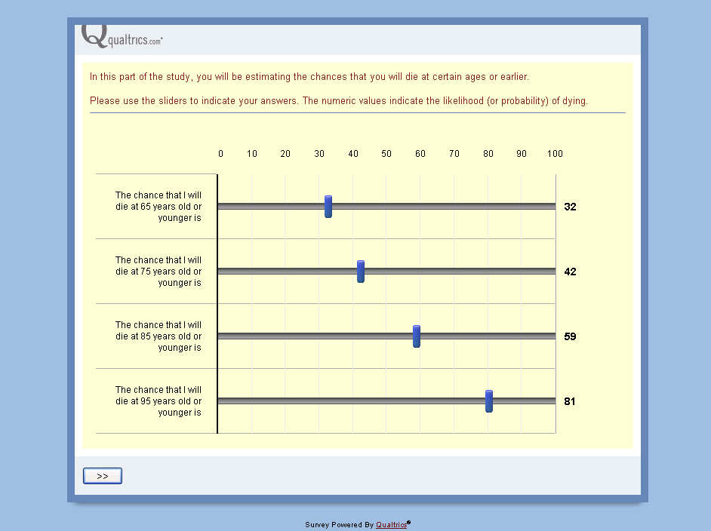
Example of Subjective Probability Task: Die-by or Live-to
Variations in starting points, ages covered, and response modes.

Slide 21
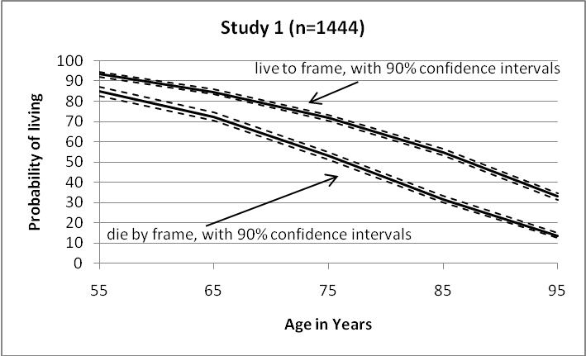
Payne, Sagara, Shu, Appelt and Johnson
Live to 84.9
Die by 75.1
Notes:
A convenience sample of U.S. residents (N=1,444) were recruited and run online through the internet panel company Survey Sampling International. Participants (54.6% female, Mage = 50.9, aged 18 to 83) were paid a fixed amount for participation. Note that the use of an internet survey differs from surveys like the Health and Retirement Study which has used in-person or telephone interview methods.

Slide 22
Study 5: Are these beliefs assembled? A Query Theory Analysis
What is the comes to mind when you consider whether or not you will [Live to/Die by] 85?
  Coded by participants as about living or dying, and favorability.
  Ex: ”Because of modern medicine I’ll live longer than my parents.
For each positive thought, the probability of being alive at 85 increased 9.1%
Aspect order and content partially mediated the effect of frame.
Notes:
Explain QT
Cox Oxaca test
Naïve firm random choice
Soph firm
Help consumers
Sell annuities with the live to frame, life insurance using the die by frame.
.

Slide 23

Can Consumers Make Affordable Care Affordable? The Value of Choice Architecture.
We thank the Russell Sage and Alfred P Sloan Foundation’s Working Group on Consumer Finance for support.
Eric J. Johnson, Center for Decision Sciences and Columbia Business School, Columbia University
Ran Hassin, Center for Rationality and Dept. of Psychology, Hebrew University
Tom Baker, Deputy Dean, Law School, University of Pennsylvania
Allison Bajger, Galen Treuer
Columbia University

Slide 24
Assembled Preferences

Slide 25
Why Beyond Nudges
Too often Choice Architecture has been taken to mean nudges
Nudges seem to equal defaults or even mandates.
Focuses on questions of intent and degree
  When does a nudge become a shove?
  Confuses ‘Libertatian Paternalism’ with the idea that choice architecture matters and is unavoidable.
Clearly acknowledged in Nudge: “Cafeteria”
But:

Slide 26
Will Exchanges Produce Good Choices, Lower Costs?
Two goals: Consumers will pick the best plan for them and provide price competition
Hope of both sides of the aisle.
  Kathleen Sibelius, Secretary of HHS:
    “Insurance companies will compete for business on a transparent, level playing field, driving down costs; and Exchanges will give individuals and small businesses the same purchasing power as big businesses and a choice of plans to fit their needs.”
  Bill Frist, Physician and former Senate Majority Leader:
    "State exchanges are good from a conservative standpoint because they involve consumer choice and markets.”

Slide 27
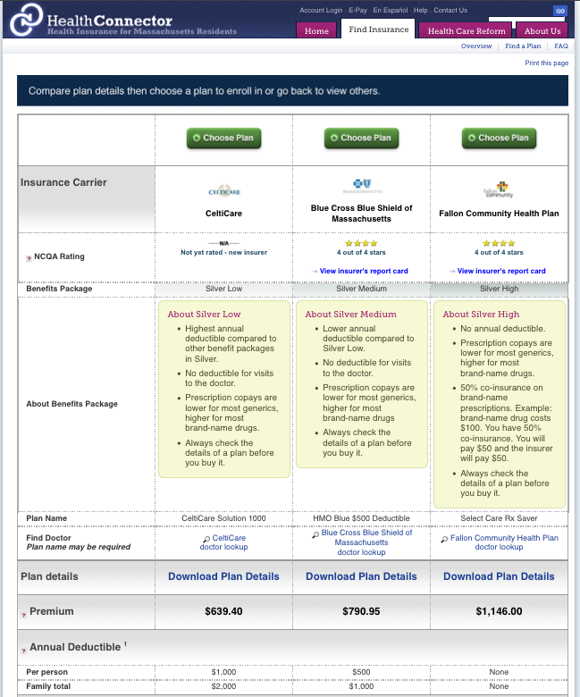
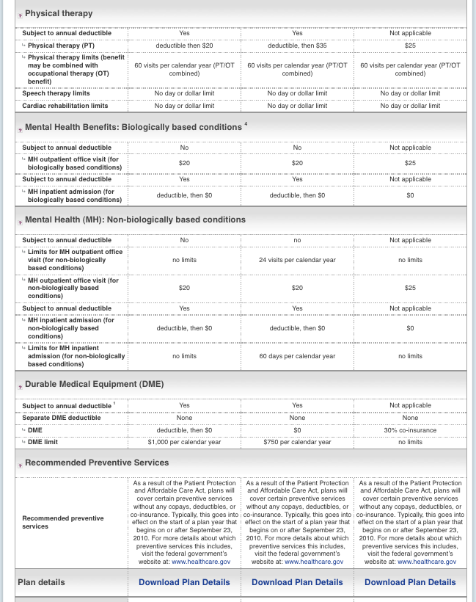
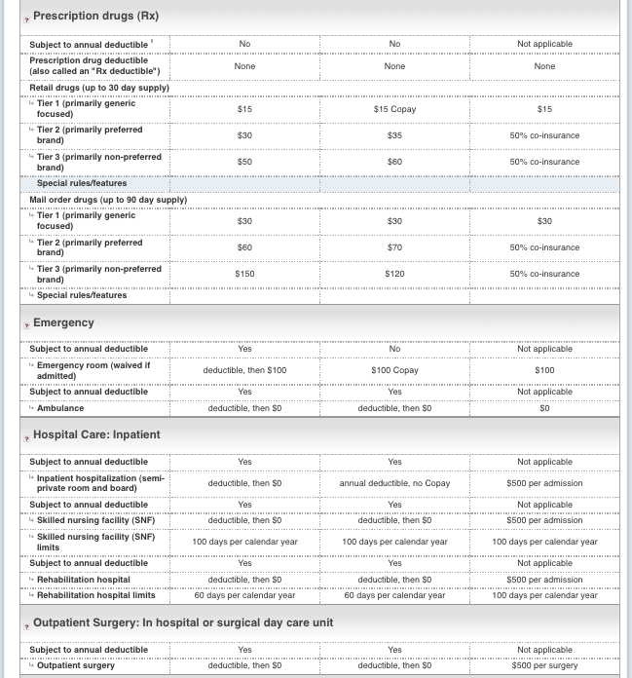

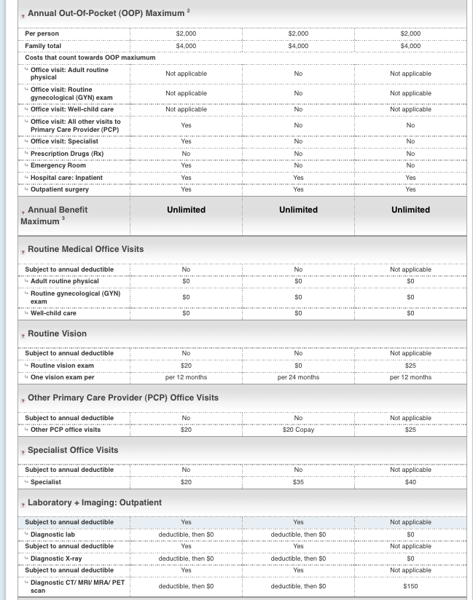

Slide 28
Experience with Exchanges
Medical Exchanges: Ericsson and Starc (2011) report extensive use of ‘choose the cheapest premium’ heuristic.
Medicare Part D
  Hess, McFaden and Winter (2007): People enroll rationally, but plan choice: “consumers are likely to have difficulty choosing among plans to fine-tune their prescription drug coverage”
  Kling, Mullainathan, Shafir, Vermeulen, and Wrobel (2008): Welfare through switching increased by clear summary of costs.
  Abaluck and Gruber(2009):“restricting the choice set to the three lowest average cost options would have likely raised welfare for elders”
Notes:
Quoted in Abaluck:
McFadden:
They find that 71% of potential enrollees were making the appropriate decision (under various assumptions about discount rates, etc.), while 10% of enrollees did not intend to enroll when it would be in their interests to do so, and 19% intended enroll when it would be in their interest to delay.
Also
Their findings are less sanguine, however, for choice of Part D plan. This survey offered individuals a choice of the standard plan described above versus alternatives that provide different levels of insurance coverage (e.g. catastrophic only, complete coverage, etc.), with corresponding actuarially fair premiums. They find that only about 36% of enrollees choose the cost-minimizing plan, and they do not place much value on the insurance aspects of more comprehensive plans. They conclude that “consumers are likely to have difficulty choosing among plans to fine-tune their prescription drug coverage, and do not seem to be informed about or attuned to the insurance feature of Part D plans.”
Need to check Ericsson and Starc. Is it only the premium

Slide 29
Maybe they do not like understand and do not like choosing?
Loewenstein et al. (2013) showed that only 14% of people understand standard terms like deductibles (4 4-answer multiple choice tests)
Aetna survey found “Consumers who found health care benefits decisions difficult cited the following reasons: the available information is confusing and complicated (88 percent), there is conflicting information (84 percent) and it is difficult to know which plan is right for them (83 percent).”

Slide 30
Who will be the exchange customers?
Subsidizes those with incomes up to 400% of the federal poverty level
PriceWaterhouseCoopers: 97% will be buying insurance for the first time.
Kaiser Family Foundation: 13% of adults will be in fair or poor health (twice the norm)
Some scenarios suggest many more participants because small firms will stop offering insurance.
77% HS diploma or less
58% White, 11% Black, 25% Hispanic
Median income:
  $23,994 individual
  $48,528 family of four in 2007
65% will have been uninsured
80% of adults employed
Average age 35
Half married, 2.6 individuals per family/household
Will spend from 4% to 9.5% of household income on health insurance premiums

Slide 31
Choosing Health Coverage
Several Steps:
  Estimate your usage.
  What are your risk preferences and capabilities?
  Locate the most cost-effective policy.
    This typically requires calculation of
      (12*Monthly Premium) + (N of visits * Copay) + min(Out of Pocket Costs, Deductible)
Can people locate the most cost-effective policy?
  We specify usage, eliminate risk (specify visits, out of pocket expenses), present minimal additional information, no brand names.
  Present either 4 or 8 options.

Slide 32
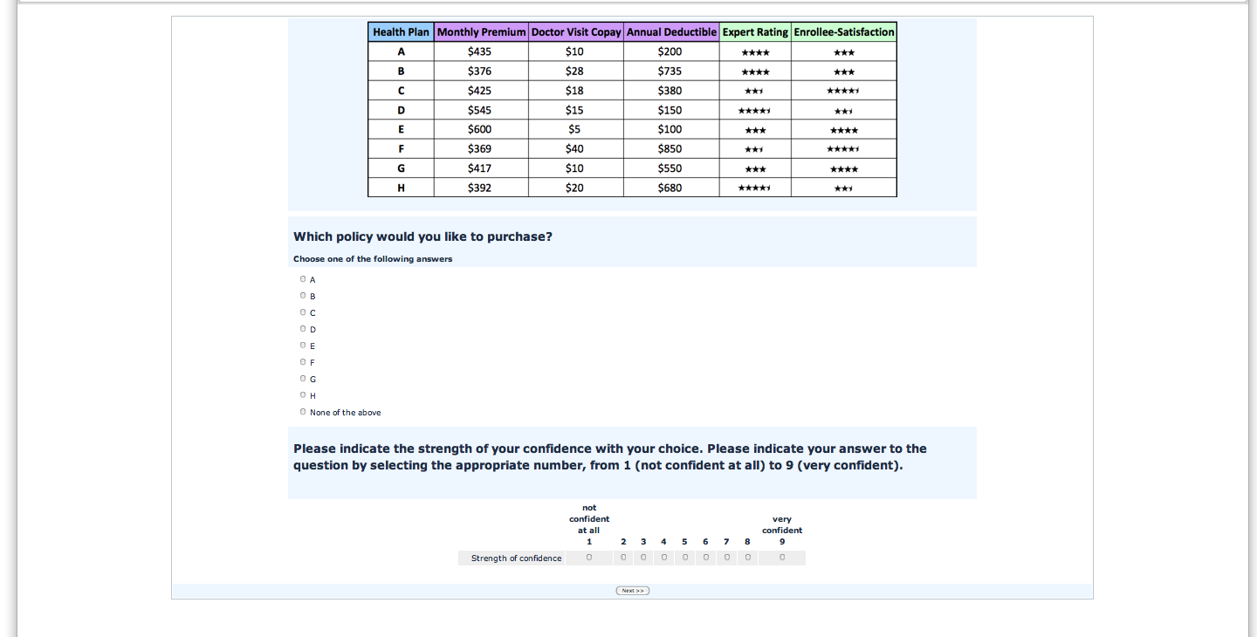
Select the most cost-effective plan for the next year, ignoring quality.
You go to the doctor 5 times, $800 in Expense
Notes:
High Level UNCON

Slide 33
Overview of Studies
Experiment 1: Can people do this?
  4 vs. 8 options, high or low number of visits (usage)
  Population that matches the target.
Experiment 2: Incentives.
Experiment 3: Can a calculator help?
Experiment 4: Calculator and No quality measures. Better Respondents.
Experiment 5: The “Best” Respondents.
Experiment 6: Real People, Placing a Value on Choice Architecture.
Realistic Attribute Correlations
Orthogonal Attributes

Slide 34
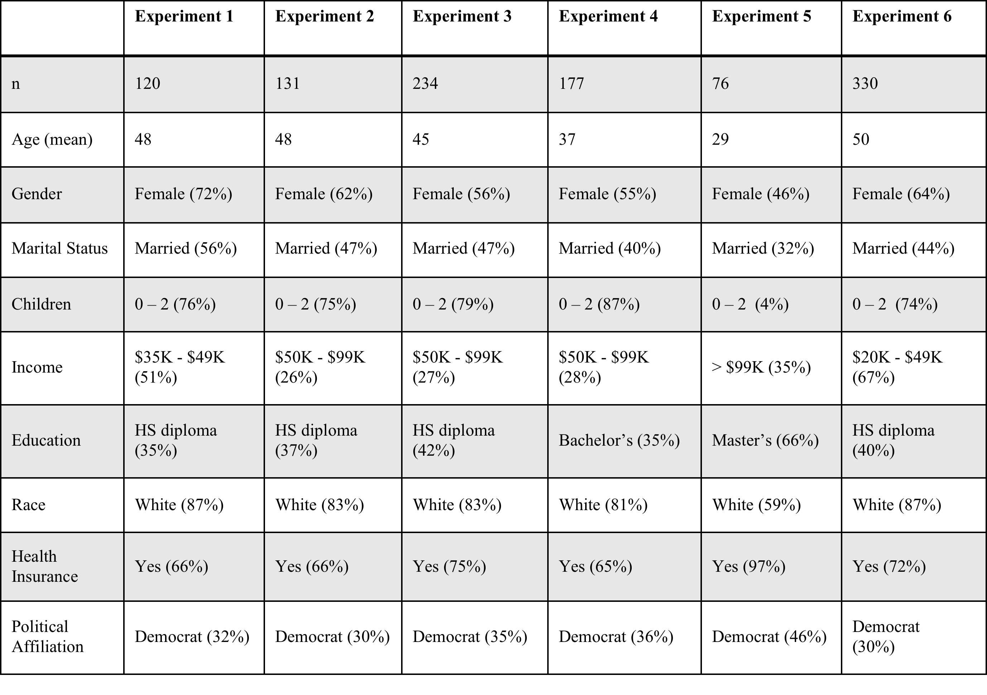
Demographics
 | Experiment 1 | Experiment 2 | Experiment 3 | Experiment 4
n | 120 | 131 | 234 | 177
Age (mean) | 48 | 48 | 45 | 37
Gender | Female (72%) | Female (62%) | Female (56%) | Female (55%)
Marital Status | Married (56%) | Married (47%) | Married (47%) | Married (40%)
Children | 0 – 2 (76%) | 0 – 2 (75%) | 0 – 2 (79%) | 0 – 2 (87%)
Income | $35K - $49K (51%) | $50K - $99K (26%) | $50K - $99K (27%) | $50K - $99K (28%)
Education | HS diploma (35%) | HS diploma (37%) | HS diploma (42%) | Bachelor’s (35%)
Race | White (87%) | White (83%) | White (83%) | White (81%)
Health Insurance | Yes (66%) | Yes (66%) | Yes (75%) | Yes (65%)
Political Affiliation | Democrat (32%) | Democrat (30%) | Democrat (35%) | Democrat (36%)

Slide 35
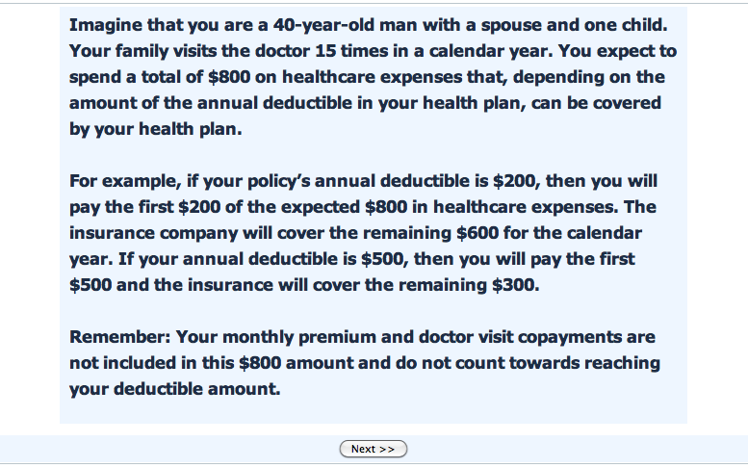
Scenario
Notes:
This was matched the scenario to the gender of the participant. This is the HIGH USAGE condition-15 doctor visits. (LOW USAGE has 5 doctor visits)
We later tested their recall of this information.

Slide 36

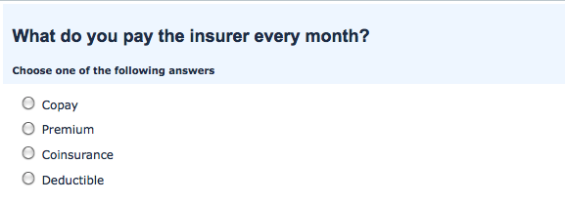
Background Information / Quiz
A few pages later…..
Notes:
We presented participants with background information regarding the 5 features of each health plan (3 cost-premium, copay, deductible , 2 quality- enrollee-satisfaction and expert rating)
..015 change of getting right by chance.
Then, we tested them on this information. If they failed any of the 3 quiz questions, they were bounced back to the information page and took the test again. This occurred up to 3 times.
We have a reader as well.

Slide 37
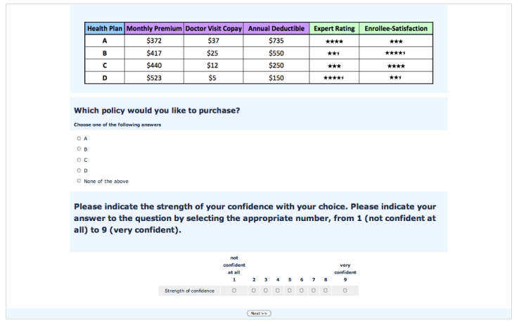
Experiment 1: Choice from 4 plans
Notes:
High Level UNCON

Slide 38
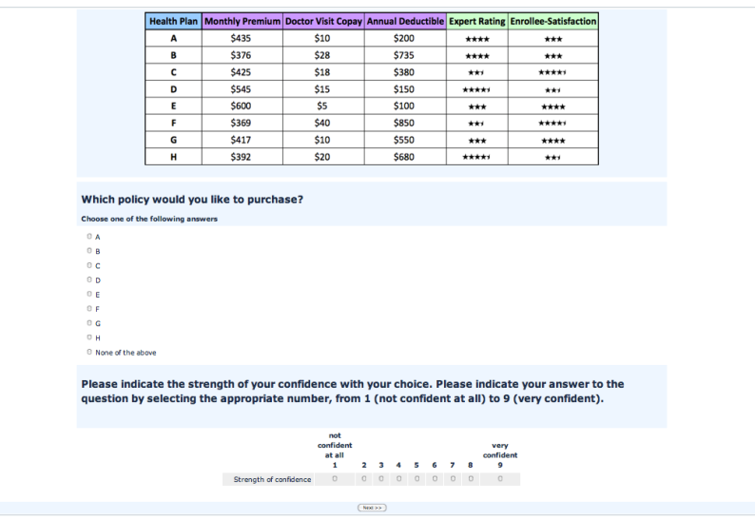
Experiment 1: Choice from 8 plans
Notes:
High Level UNCON

Slide 39
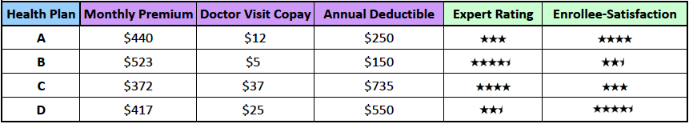
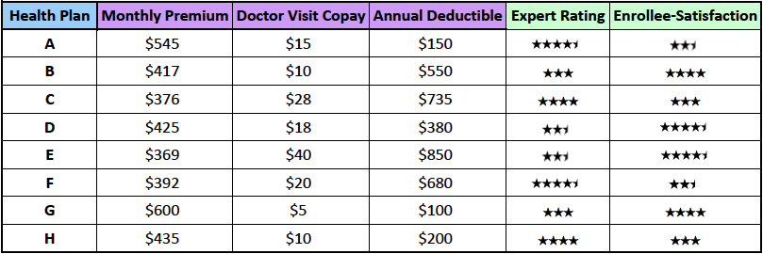
Cost Effective option
What is the most cost effective policy?
Total Annual Cost
$5,384
$5,387
$7325: a $1900 mistake
Notes:
There are different dominating options for the high and low usage conditions.
Quality measures are all equal
There is quite a bit of spread
For low usage minimizing the out of pocket option (g) in 8, costs 7325 a 1900 dollar mistake.

Slide 40
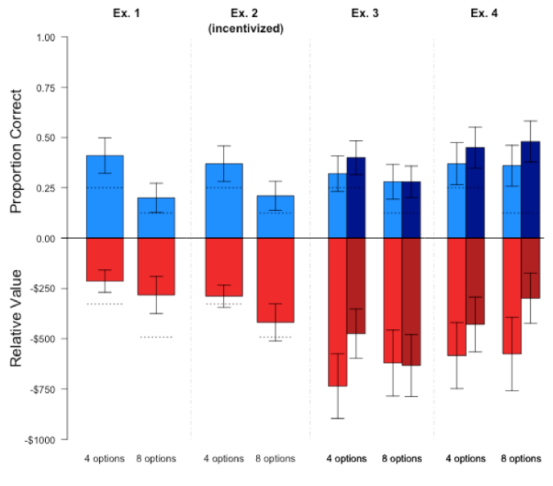

Slide 42
Exp. 2: Increasing motivation
They get $1 extra for each one they get correct
They get an entry into a $200 lottery for each of the two choices they get right.
Notes:
High Level UNCON

Slide 44
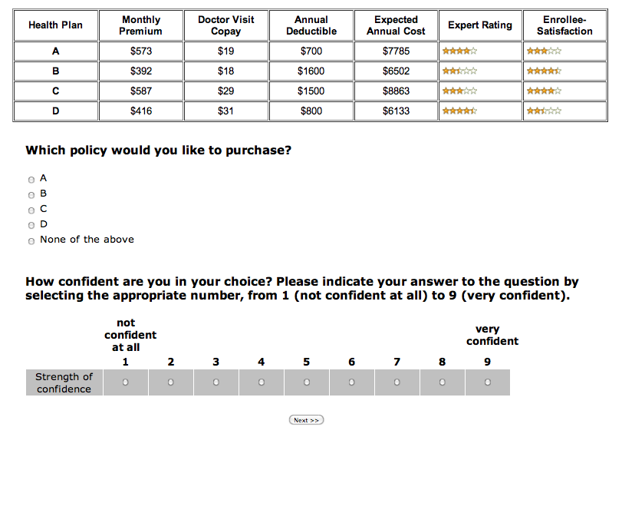
Exp. 3: Orthogonal Attributes & Calculators
  Also change the usage attribute to out of pocket costs.
Notes:
High Level UNCON

Slide 46
Experiment 4
Perhaps they are getting confused by quality?
  Half the respondents see only price information.
  No significant difference.
Perhaps if they were smarter? More used to online experimentation?
  Amazon Mechanical Turks.
  Only U. S.
  Only > 99% approval ratings.

Slide 47
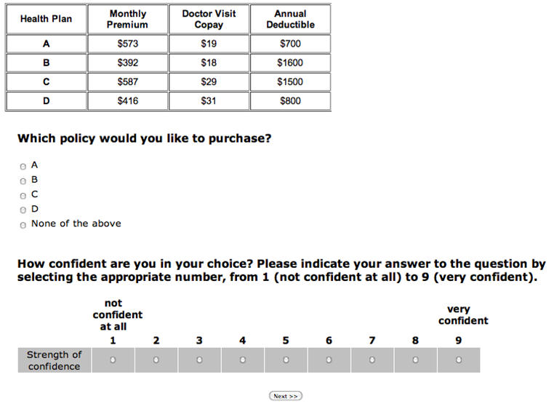
Exp. 4: Materials (cont.)
NO “Calculator” and NO quality
Notes:
High Level UNCON

Slide 48
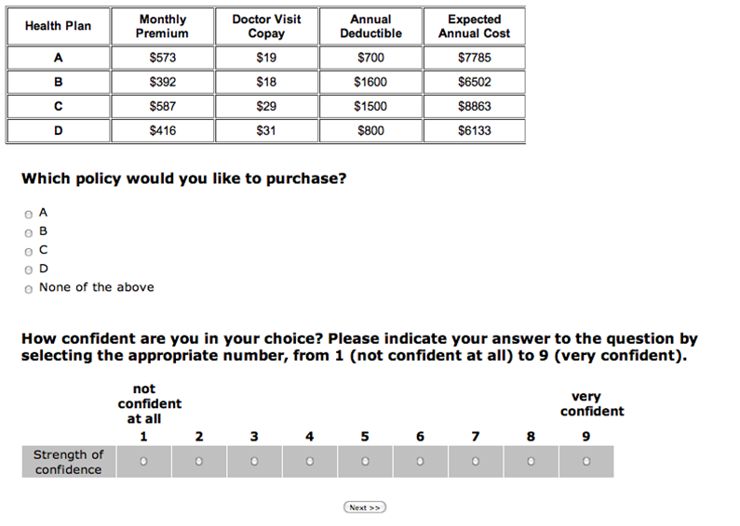
Exp. 4: Materials (cont.)
With “Calculator” and NO quality
Notes:
High Level UNCON

Slide 50
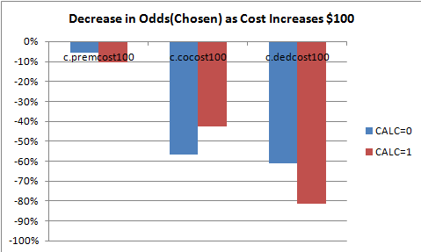
Why? They are overweighting copays and deductibles

Slide 51
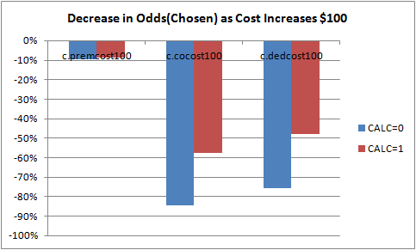
Why? They are overweighting copays and deductibles
Calculator Helps.

Slide 52
Is This Performance Abnormal?
Study | % Most Cost Effective | Method | Manipulated/Observed
Hanoch et al. (2011) | 46% | Mouselabweb: Hypothetical Choices | Options: 3 vs. 9
Heiss, McFadden & Winter (2006) | 36% | Administrative Data: Medicare Part (D)
Abaluck and Gruber (2011) | 12.2% | Field + administrative data: Medicare Part (D) | Naturally occurring variation.
See also Schram and Sonnemans (2011), Wood et al. (2011) for increased options leading to less effective choice.
Notes:
But they have measures that are not easily comparted.

Slide 53
From Johnson et al. 1993 (based upon Thaler and Johnson, 1990)
See also Jarnebrant, Toubia & Johnson, MS, 2009

Slide 54

Reframing of Premiums
Suppose that you have just started a new job.
  This insurance provides you with an income if you have an injury or sickness that restricts your ability to do your normal work for more than 10 days. You are considering purchasing one of two policies. Both pay 2/3rds of your salary for as long as you are disabled.
    Policy A will refund $1200 to you if you do not file a claim within five years. The monthly cost of Policy A is $90.
    Policy B has no refund. The monthly cost of Policy B is S70
  57% preferred A, and would pay an average of $91.65
Mutual of Omaha offers this policy, as do others
Notes:
Mutual of Omaha offered a popular disability insurance policy that refunded the entire premium if the insured did not make a claim on the policy from inception to reaching age 65. Maccabees Life Insuranee Com- pany offers a disability policy that refunds as much as 80% of premiums paid every 10 years if the insured docs not become disabled.
The rebate policy, which was preferred by 57% of the respondents, had an average premium that was S21.65 higher than the average premium for the no-rebate policy. The standard deviation was 1 I.I. Even if consumers were sure they would not beeome dis- abled, this implies a negative discount rate. At the .05 level, the average premium differ- ence is significantly higher than a premium difference of $19.82 (one-tailed), which implies a return of less than 1%. far less than the rate consumers should demand. Since we found that the average estimated probability of colleeting disability payments on the policy, and hence not receiving some or all of the rebate, was 3.6%, this result becomes even more striking.

Slide 55
Reframe Deductibles as Rebates.
Imagine that you have just bought a new $12,000 car and are buying insurance for your car…..
  This policy has a deductible of $600 which will be subtracted from the total claims against the policy…. Would you pay a premium of $1000 for one year of this coverage? [44.3%yes]
  With this policy, a rebate of $600 minus any claims paid will be given to you at the end of the year….Would you pay a premium of $1600 for one year of this coverage? [67.8%yes]
  n = 187

Slide 56
Bhargava et al. (QJE, in press) studied choices at a Fortune 50 company.

Slide 57
61% chose a dominated plan, costing them and average of $351 a year.

Slide 58
What would a firm that is maximizing profit do?
Notes:
What is the incentive for the company to debias consumers?

Slide 59

The Psychology of Insurance
Narrow Framing and Mental Accounting.
Example: People dislike deductibles, but reframing can make them accept them.

Slide 60
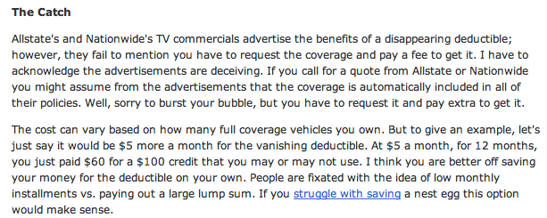
But…. From a insurance comparison site:
Notes:
From a insurance comparison site.

Slide 61
The Costs and Benefits of Insuring
Do firms use mental accounting and reframing to make policies more ‘attractive?’
Why are there deductibles?
  Answer: Limit moral hazard.
  But people hate high deductable policies
  Syndor found 83% of consumers choose lower deductibles than they should.
    Of those additional premiums, 75% are retained by the insurance company.
    A common problem: People don’t file small claims because they are afraid it will increase their premium.

Slide 62
How Can we Help?
Introducing Choice Architecture….

Slide 63
Can Anyone Do This?
Columbia MBA Students in a Consumer Finance course. GMAT: Mean 716, 5 years work experience, 16% of 6669 applicants accepted.
Over half from Financial Services or Consulting.

Slide 64
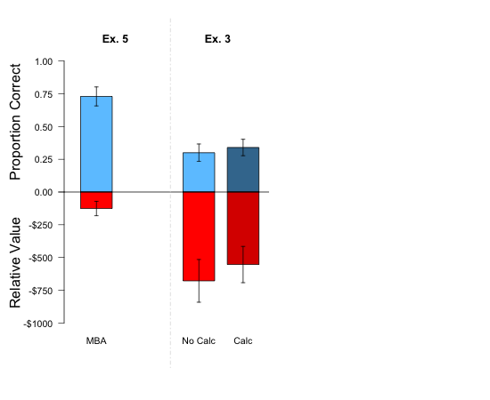

Slide 65


Slide 66
Can Anyone Do This?
How do they do it?
  Excel (40%)
  Calculators (41%)
  73% said they calculated the annual cost.

Slide 67
Can Choice Architecture Improve Performance?
Explain terms and test.
Everyone gets the formula and is tested.
Different interventions
  Control: Is quick education enough?
  Incentives: People are paid by a sharp scheme, $2-$8 depending on their performance
  Calculators: More effective if understood?
  Smart Defaults: Pre-checked selection depending upon usage.
  Calculators and Smart Defaults.

Slide 73
Other Experimental Concerns
Selection: Drop outs rates are low, not in choice.
Effort: There is no return to working harder on this task.
Heterogeneity?
Others?

Slide 74
The Value of Choice Architecture
$456
$323
$306
$30

Slide 75
What is the Value of Choice Architecture?
Difference in Performance:
  A $533 loss with no aid.
  A $77 loss with calculators and smart defaults.
  A $456 savings.
For individuals, this error is 1% of household income.
In aggregate 2017 saw 9 million people enrolled, the aggregate difference is $4.1 billion dollars a year.
Since almost all are subsidized, there will be a large benefit to taxpayers.
Cheap to implement.
Notes:
A sidelight:
Do people know how well/badly they are doing?
In this study…..
they report about 7 on the 9 point scale.
the correlation between confidence and performance is .19
The most confident, incentives without any choice architecture.
No other difference Except when the calculator AND default are present.

Slide 76
Tools of a Choice Architecture
Use Choice Architecture
  Smart Defaults: Pick ‘best’ option given answers to simple questions such as age, family size, health, tolerance for out-of-pocket expenses.
  Tell, Don’t Ask: Present actuarially generated numbers for expected usage as an anchor.
  Smart Sets or Standardize Options
    Limit choice options.
    Eliminate dominated options.
  Sorting and Calculators
  Frame out-of-pocket costs.
But that is paternalistic: “EZPath” choices.
Social Support, Friends, Brokers?
Notes:
Rationale:
Program is heavily subsidized by your tax dollars. Should it not be cost effective?
Employers typically limit choice: Do you want the government to be like an employer or a phone directory
Dominated options exist.
Placement for pricing power
Form of soft regulation.
Suggestions differ
Smart sets are data driven
Second category is to be tested (Phase 1 and 2)
EZPath is like 1040EZ

Slide 77
Experiment 2: Results (cont)
“Please indicate which resources you used or would like to have had access to:”
Resource | Calculator | Peer Chat | Expert Chat | Talk to Family | Talk to friend
Proportion Agreeing | 0.63 | 0.053 | 0.32 | 0.33 | 0.21
Notes:
High Level UNCON

Slide 78
Summary
People do not select the most cost-effective option.
People place higher weight on co-pays and deductible.
You can do it if you have a Columbia MBA, or if you have the right choice architecture
Bad News: Without improved design, there may not be effective price competition.
Good News: There are effective solutions, ignoring them is expensive.
Notes:
----- Meeting Notes (12/13/11 11:59) -----
Calculator---total annual cost defined twice…
given an example….
goverment exampls 1040a…
avoid calculator as a term
No company selects as menu of many plans. The government should be like that.

Slide 79
More problems
  People are not switching, shopping.
  Solutions?
Notes:
As of Dec. 5, only about 720,000 customers had returned to the federal exchange serving 37 states to re-enroll or switch plans, according to the Department of Health and Human Services.

Slide 80
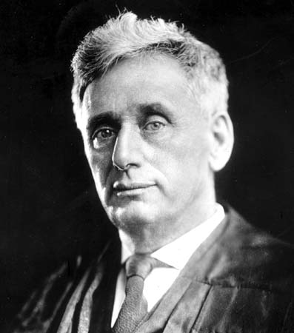
Outcomes
Parts of our recommendations have, and will be implemented.
The states are the laboratories of democracy:
“ a state may, if its citizens approve, serve as a laboratory; and try novel social and economic experiments without risk to the rest of the country
            Judge Louis Brandeis, New State Ice Co. vs. Lieberman, 285 U.S. 262

Slide 81
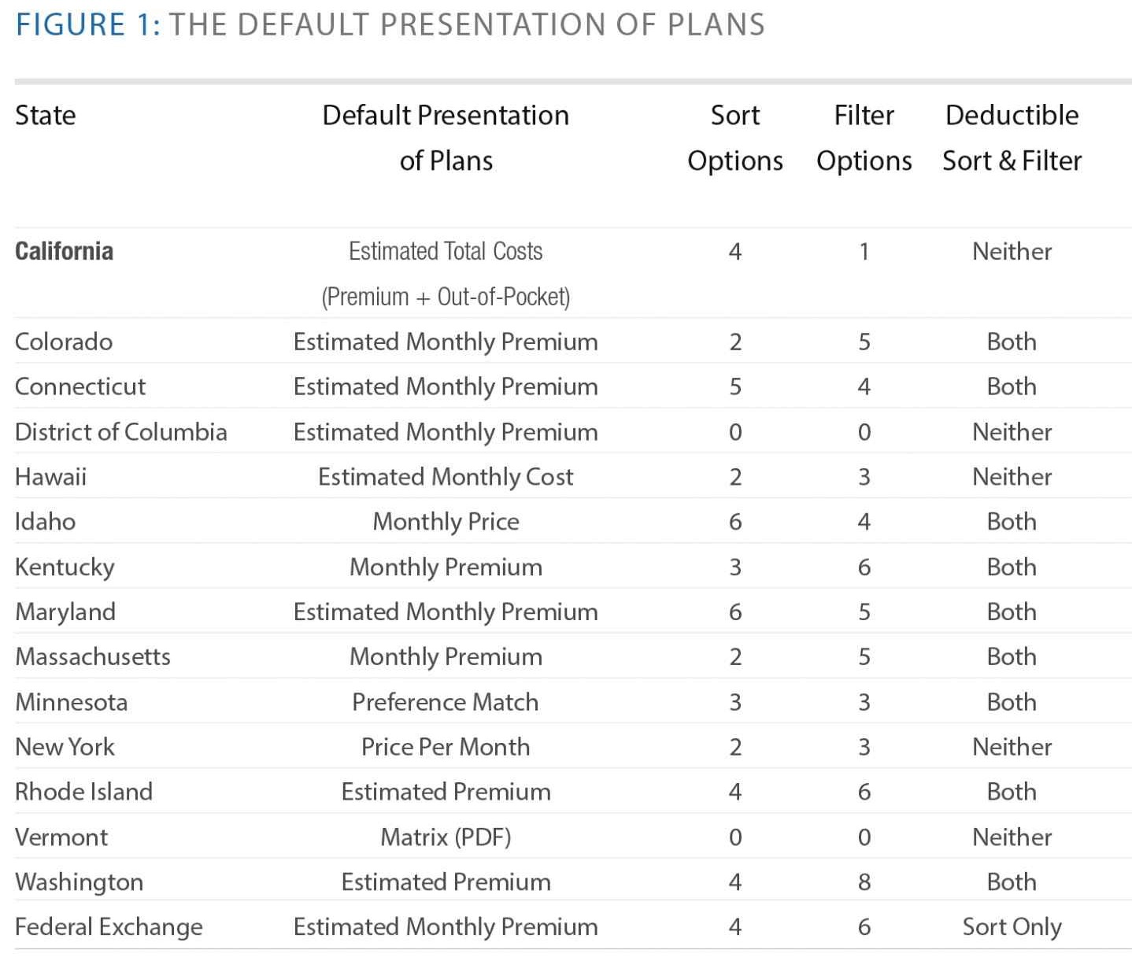

Slide 82

Thanks

Slide 83
How Can we Help?
What not to do..

Slide 84
Examples from Ubel, Camerford and Johnson: What not to do.

Slide 85
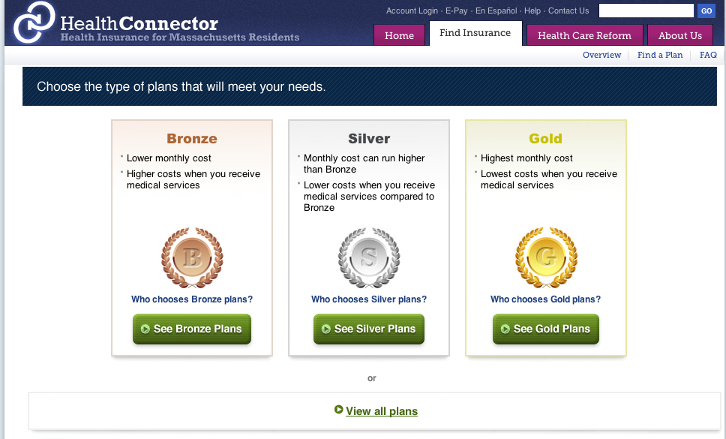

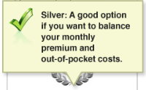
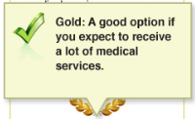
Medals: good vs. bad,
Note: Only reflect risk
Notes:
I put in animation to you can make the point that the explanations for the categorization have nothing to with quality, but rather the amount of the monthly premium and amount of medical services expected.

Slide 86
What do you think of when you hear bronze, silver and gold?
(and you’re an ordinary person?)

Slide 87
Most non-mathematically inclined people say the would look at Gold no matter what it describes

Slide 88
Sorting
Federal and other exchanges sorted by premium in Year 2.
Evidence is that sorting increases the importance of an attribute.
Result: Less utilization because of higher deductibles.
Other Effect: Weekly vs. Monthly premiums.

Slide 89
How Can we Help? (Part 2)
How to offer more options?

Slide 90

The Curse of Choice
Consumers are faced with a massive increase in available options (e.g., financial services, travel, apparel) and they may select worse options because of the very many choices that they are presented with.
  Chernev, Böckenholt, and Goodman 2015
  Botti and Iyengar 2006
  Schwartz 2004
On exchanges, choices differ from 8 (NY, Upstate County) to 154 (Utah)
Notes:
Eric is sending me

Slide 91
We propose Partitioned Sorted Sets
Partition Sorted Sets combine three generic choice architecture tools as an ensemble:
  User Model: An algorithm that (probabilistically) infers which alternatives are better for the consumer.
  Sorting: Sort alternatives by best predicted fit.
  Partitioning: Divide the choice set to highlight the top ranked group of alternatives. A soft limit, because consumer can click through.

Slide 92





Sorting on predicted attractiveness
Big data and analytics increasingly facilitate sorting based on comprehensive user models, compared to e.g., price-based sorting only.
Aggregators, online exchanges and recommendation websites can help consumers.
Notes:
Eric is sending me

Slide 93
Searching too much
Sorting can increase the weight given to the attribute
Paradoxically, sorting and low cost searching may cause consumers to search too much. They overestimate the benefits of further inspection.
Consumers are more likely to erroneously select a product further down the list
    Diehl 2005

Slide 94
Partitioning and Sorting
We propose partitioning as a solution:
  Introducing a single small additional cost in a search sequence will strongly prevent further search.
        Gilbert and Wilson 2007; Kahneman and Miller 1986; Schwarz 1990; Wilson and Gilbert 2005.
  Search amongst a small set of alternatives promotes a higher quality choice process.
        Hauser and Wernerfelt 1990; Johnson and Payne 1985; Johnson and Meyer 1984; Payne 1976

Slide 95
Study 1:
Do Smart Choice Sets Help?
Controlled 2x2 online experiment with representative paid panel.
  Price-based vs. price-quality based sorting
  Partitioned vs non-partitioned
Data: N=858
  Average age 48.3 years old; 50.9% females; 36.9% bachelor degree or higher

Slide 96
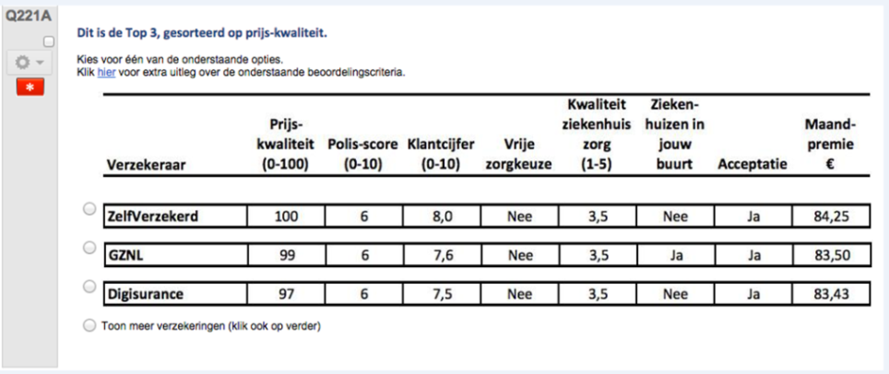
Decision task
Consumer hypothetical health insurance decision task in a simplified controlled setting. Same set of products shown to all respondents.

Slide 97
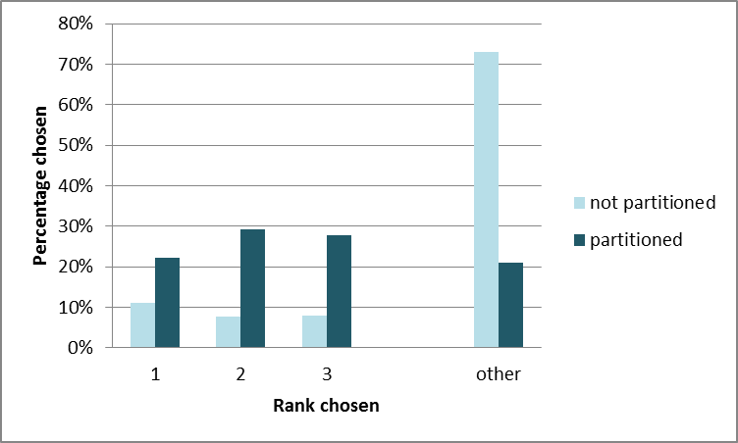
Partitioning: Rank chosen

Slide 98
Study 2:
How Much Does it Help?
Controlled 3x2 online experiment with representative paid panel.
  High, medium and low quality sorting
  Partitioned vs non-partitioned
Data: N=1577
  Average age 45.5 years old; 51.1% females; 42.2% bachelor degree or higher

Slide 99
A Principle Agent Task
Consumers follow well-defined decision rule on behalf of someone else.
This person desires a minimum set level of coverage, and otherwise the best ratio of the monthly premium paid per review ratings that customers gave for the insurance provider.
Allows to determine normatively best outcome. Otherwise, decision task same as in Study 1.

Slide 100
Sorting: Rank chosen
Order probit of conditions on rank chosen:
  Significant effect of price-quality (p<0.001)
  Significant effect of partitioning (p<.001)
  No interaction

Slide 101
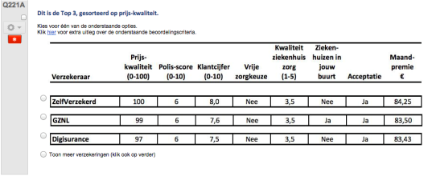
What is the process? Study 4

Slide 102
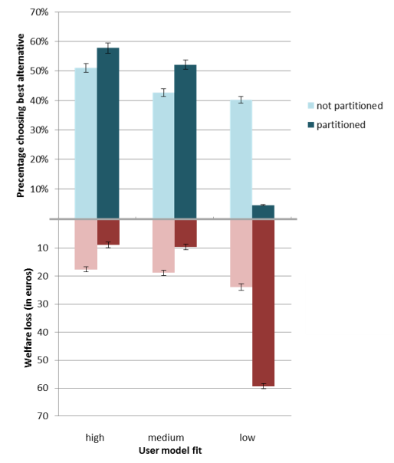
Impact of Smart Choice Sets

Slide 103


The nature of fixations.
What the eye sees, what the brain tell us.
  Foveal vision is narrow (See Marisa’s runners) ~ 2 degrees. Has about half of all the visual cortex.
  Saccadic Masking: Can you see your eye move in a mirror?

Slide 105
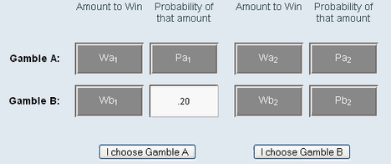
Respondent 1297
Johnson, Schulte-Mecklenbeck, Willemsen, Psychological Review. (2008)

Slide 106
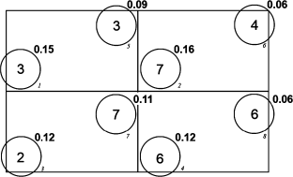
Two major sets of applications
Individual Choices
  Risk
  Time preferences
Games
Up
Row Player
Down
Polonio, Di Guida & Coricelli, GEB 2015

Slide 107
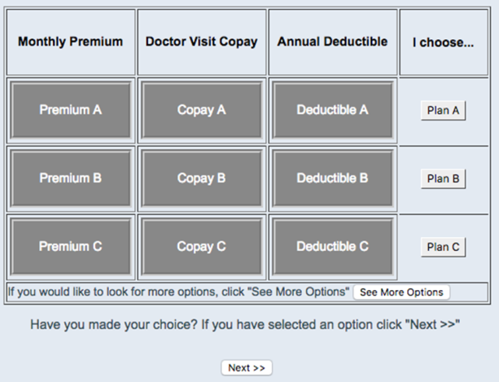
Partitioned task

Slide 108
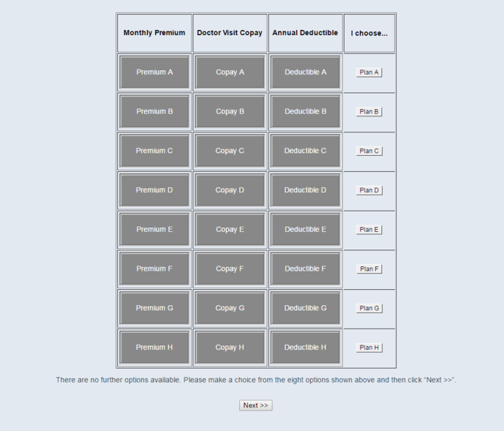
Non-partitioned task

Slide 109
What is the process? Study 4

Slide 112
Comparing Non-partitioned vs. Partitioned Search

Slide 113
Field data:
Health Insurance Choices
Largest online health insurance broker in the Netherlands. Approx. 2M visits annually for health plans. Website sorts health plans by attractiveness.
Data: N₁=8,519 (year 1); N₂ = 35,113 (year 2)

Slide 114
Choice architecture change
Website implemented a major choice architecture change between two yearly enrollment periods.
Shifted sorting from price-based ranking only to ranking by balanced price-quality score
Partitioned the recommendation list (top 3), while showed the full list before.

Slide 115
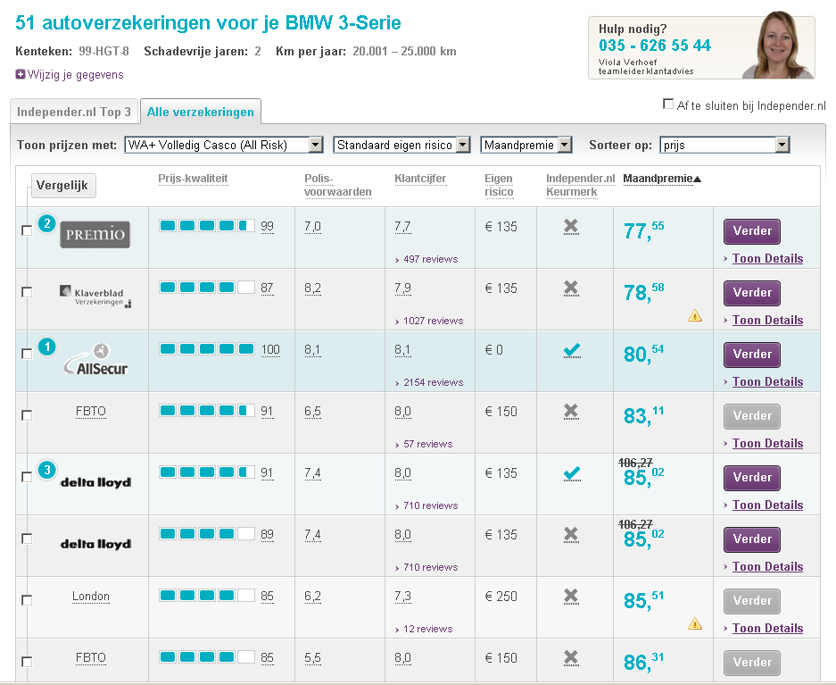
Before Choice Architecture:
Price-based ranking

Slide 116
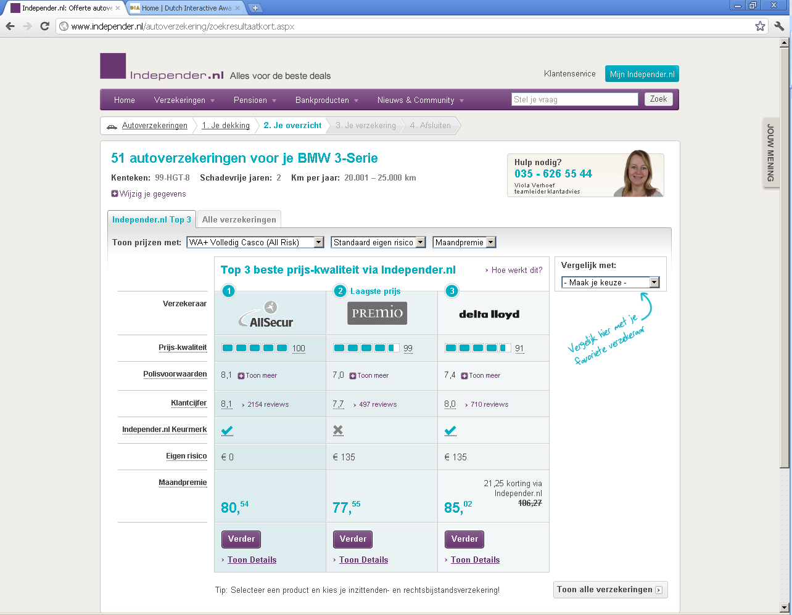
Top 3 zoekresultaat
After: Partitioning + Better Ranking
Top 3 + Price/Quality Ranking
After: Introduced Top 3 - Price-Quality
Details

Slide 117
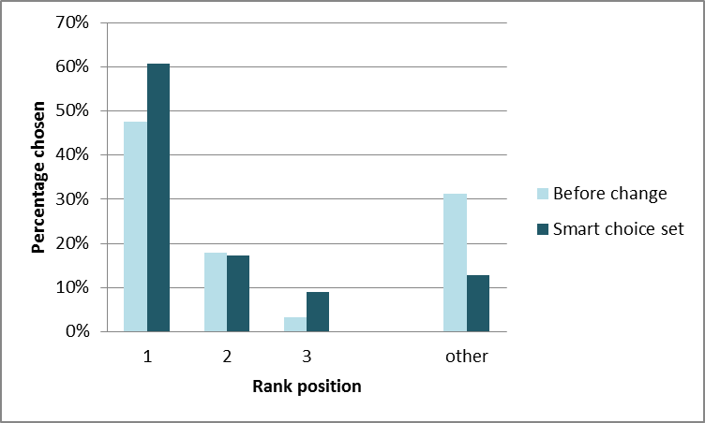
Percentage rank chosen

Slide 118
PROPOSED MODERATED MEDIATION STRUCTURE FOR PROCESS DATA

Slide 119
Conclusions
As proposed, sorting on attractiveness facilitates individual choices.
  Häubl and Thrifts 2000; Diehl, Kornish and Lynch 2003;
  Dellaert and Häubl 2012
Narrowing the number of choices produces better choices.
  Johnson et al 2013; Abaluck and Gruber 2009;
  Chernov, Bockenholt and Goodman 2015.
Narrowing choice hurts decision quality if sorting quality is (very) poor.

Slide 120
Thank you for your attention!

Slide 121
Similarity
As you know from news reports, both terrorism and mechanical failures are sources of danger to travellers. Suppose that you are planning to fly to London next week. You are offered a flight insurance policy that will provide $100,000 worth of life insurance in case of your death due to
  Any act of terrorism $14.12
  Any non-terrorism related mechanical failure $10.31
  Any reason $12.03
This insurance covers you from the moment you step on the plane until the moment you exit the plane at your desired location. How much would you pay for this coverage?
Notes:
Generals often get accused of fighting the last war, consumers often insure against the last (or most similar) disaster

Slide 122
Innovators
Punchline: If people overweight some probabilities and underweight others this will affect their insurance behavior.
Source of profitability for low probabilities
Notes:
Oscar, funded by ABC i.e. google ventures emphasizes easy to understand policies, and narrow networks, but has had problems serving the individual care market.
Rally is trying to change risk profiles has had amazing penetration…partnered with United Health Care. Talk about meeting.

Slide 123
Summary
Insurance is a major tool for household risk management and a huge, misunderstood and innovative industry.
Traditionally driven by economic analysis which emphasized risk aversion as a source of profits, moral hazard, adverse selection, and transaction costs.
Increasingly insurance behaviors are driven by behavioral analysis, especially reframing of costs and benefits and understanding risk perception.
Behaviorally informed analysis (Framed Field Experiments and RCT’s) could improve insurance markets.

Slide 125
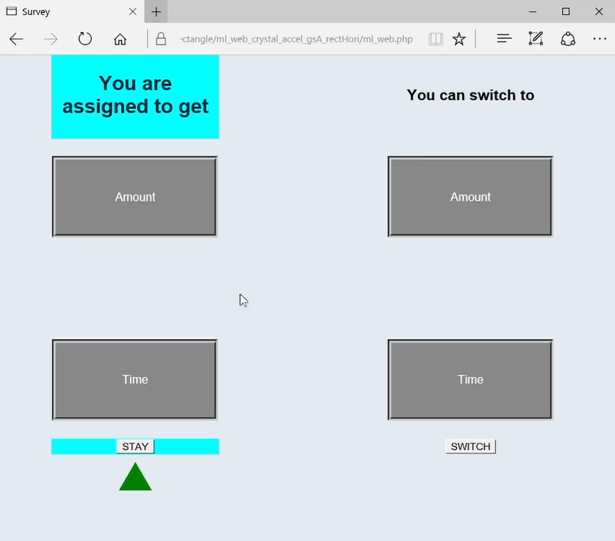


Slide 126


Slide 127
Implications
For Intertemporal Choice
For models
Systematic heterogeneity in choice processes.
These differences in choice have causal effects on revealed preferences.
Interventions which increase comparative search increase patience.
Studies (particularly fMRI) studies of intertemporal choice may be aggregating over two very different processes.
While, in the aggregate, search may look like a random walk, it is not.

Slide 128
Thanks to collaborators
Preference as Memories Lab
Partitioned Sorted Choice Sets:
Benedict Dellart, Tom Baker
Can Consumers Make Affordable
Care Affordable:
Ran Hassin, Tom Baker, Allison
Bajger, Galen Treuer

Slide 129
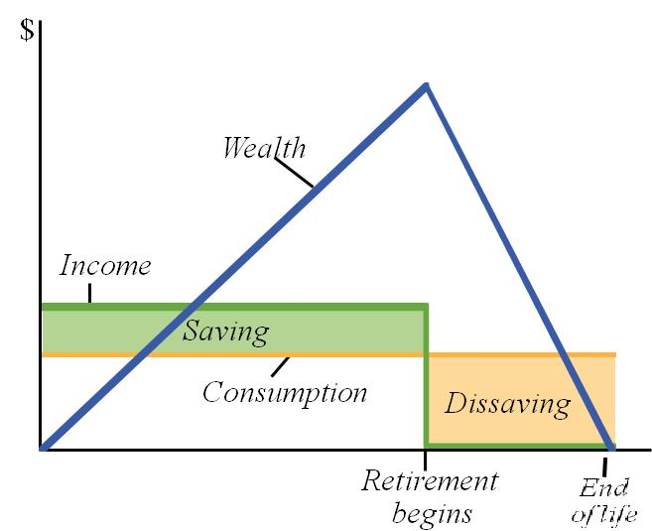
Insurance help manage risk in this model
Cognition over the Life Span
When to retire
Measuring
Risk and Time Preferences
Consumption:
Mortgages
Health
Insurance
Life Expectancy

Slide 130
Cognition over the Life Span
^{the}

Slide 131
Time Preferences

Slide 132
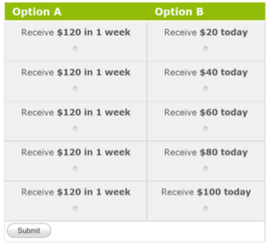
Dynamic Experiments for Eliciting Preferences (DEEP)
Do adaptive testing for time and risk preferences.
Use Hierarchical Bayes Estimation to shrink individual estimates.
Goal automated, efficient individual estimation.
Many related projects, ours assumes a functional form, incorporates error.
Alternative are price lists and titrators.

Slide 133
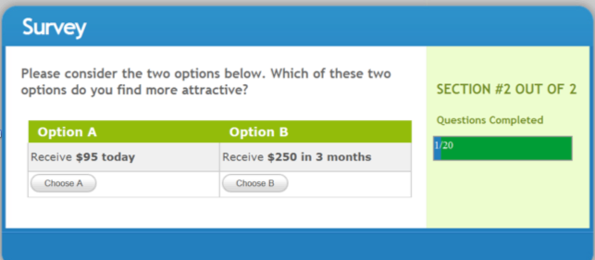
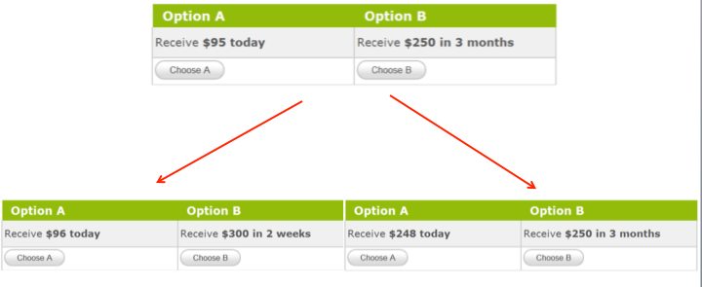
DEEPtime

Slide 134
Summary

Slide 135
Summary
Neurometric vs. Constructive Perspectives.
Time:
  We know this is predictive of a broad range of long term outcomes.
  Evidence of neural substrates.
  At the same time, we know the parameters are quite sensitive to how the questions are framed: Accelerate vs. Delay, Hidden Zero
Understanding the process that generates parameter estimates:
  Produces better measures and understanding
  Produces better interventions.
Notes:
Use Goldstyn et al. example.

Slide 136
Consumers’ decisions to spend and save.
Every day we make decisions that will affect our future financial well beings.
  In economics, the workhorse model for consumer financial decisions is the permanent income/life cycle savings hypothesis.
  What can consumer research and psychology add to this?

Slide 137
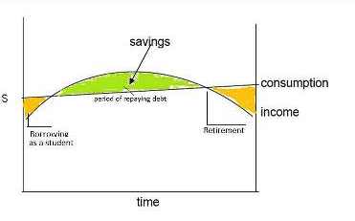
The Permanent Income/Life Cycle Savings Hypothesis
How do consumers decide to save and spend?
Economics has a workhorse model.
People save and spend based on estimated future income.
Goal is to ‘bounce the last check you write’
Involves:
  Exponential Discounting.
  Expectation of future income and spending
  Usually Solved by Backward Induction

Slide 138
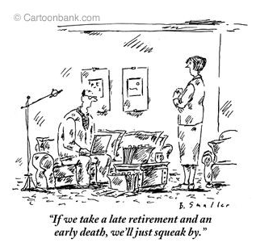
In contrast…..

Slide 139
Used to study:
Investments in human capital
  Education
  Health
Mortgage Choice
When to retire
Longevity Expectations.
Influential in public policy
What can psychology offer?
  The quality of cognition over the lifespan
  People discount differently than implied by exponential discounting
  Beliefs (and preferences) are constructed
These suggest opportunities for choice architecture.
Notes:
How many psychologists are there at the OFPB Office of Research? One.

Slide 140
Implications
The effect of age will depend on:
  Relative G_{f} and G_{c} demands of the task
  Different aids for old and young, educated and less educated
Technological change will limit the ability of G_{c} to compensate.
G_{c} eventually stops increasing with age.
Age is just a label:
  Deteriorating neural substrates? Are there G_{f} interventions? (results so far are mixed).
  Increasing G_{c} through just in time education?

Slide 141
Big Picture
Can Psychology/Marketing/Behavioral Decision Research Matter in Policy?
Choice Architecture is useful when we know the causes of errors.
  For Aging, separate routes for helping younger and older decision-makers.
  For Retirement, helping people think about later benefits helps them become more patient
  For Life Expectancy: Give them the statistics, let them adjust.

Slide 142
Backup

Slide 143
Sample Issues
Tradeoff between representativeness and data quality. ($2 a minute vs. 4 hours for $35).
‘Representative’ sample may contain lots of non-sampling error
  They are really matched on certain variables.
  By design exclude hard to recruit populations (homeless, ill, etc.)
We statistically control for many variables.

Slide 144
Method
1292 participants via Survey Sampling Int’l
  Ages: 45-70
  Benefits: eligible or expecting to become eligible
68% female
60% at least 2-year degree
Median income $35,000-$49,999

Slide 145
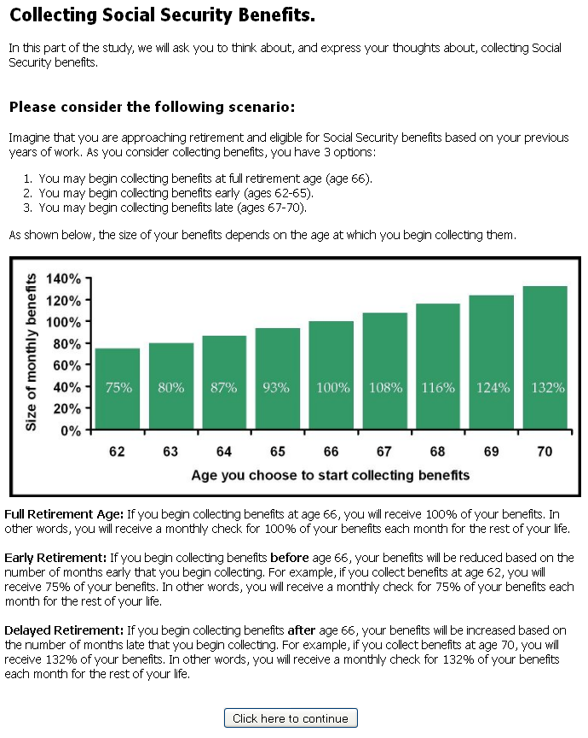
Notes:
----- Meeting Notes (12/1/11 11:04) -----
are life expectations wrong
life expectations

Slide 146
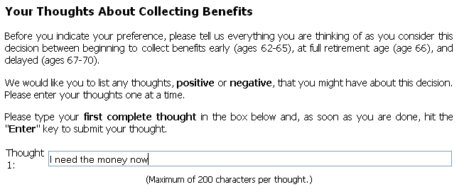

Slide 147
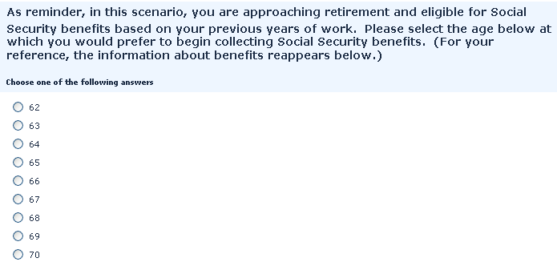

Slide 148
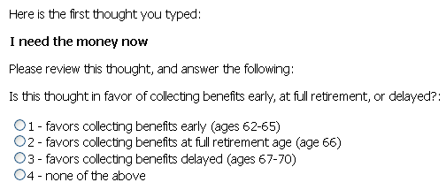

Slide 149
Many Ps prefer to claim early
Notes:
----- Meeting Notes (12/1/11 11:04) -----
aspect content on

Slide 150
Early claiming is a focal option for many Ps

Slide 151
Prominence of thoughts in favor of early claiming predicts preferences for early claiming
† p < .10, * p < .05, ** p < .01, *** p < .001
Notes:
----- Meeting Notes (12/1/11 11:04) -----
range on income

Slide 152
Prominence of thoughts in favor of early claiming predicts preferences for early claiming
Prominence of Early-Claiming Thoughts
β = -.68, p < .001
Preferred Claiming Age

Slide 153
Eligible vs. Not-yet-eligible
† p < .10, * p < .05, ** p < .01, *** p < .001

Slide 154
What is the process?
Many Ps adopt early claiming as focal option.
Prominence of early-claiming thoughts predicts preference for early claiming

Slide 155
Study 2: Display Intervention (Mild)

Slide 156
Display Intervention
Many people use early claiming as focal option.
Prominence of thoughts in favor of early claiming leads to preference for early claiming
In study 2, we alter the information display to shift people’s focal option and encourage later claiming

Slide 157
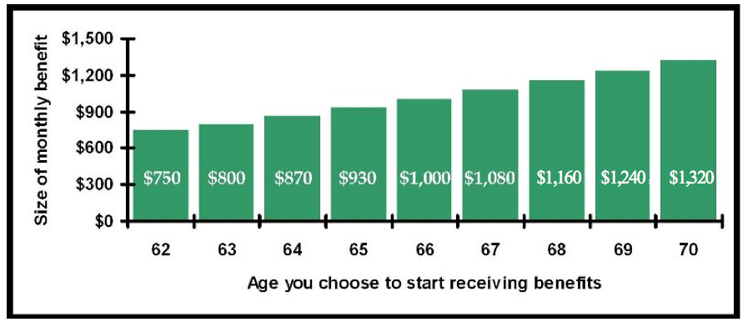

Shifting the x-axis

Slide 158
Study 2: Display Intervention
Alter choice description to emphasize full claiming
Participants seeing shifted-axis graph will…
  adopt later claiming as a focal option
  will prefer to claim later
Effect of display manipulation on claiming will be mediated by prominence of early-claiming thoughts

Slide 159
Method
408 participants via Survey Sampling Int’l
  Ages: 45-70
  Benefits: eligible or expecting to become eligible
67% female
53% at least 2-year degree
Median income $35,000-$49,999

Slide 160
Ps in the shifted axis condition do not adopt later claiming as a focal option
p > .5

Slide 161
Ps in the shifted axis condition do not prefer to claim later
p > .2

Slide 162
Display Intervention (1)
Shifted axis delayed preferred claiming age on average 2.5 months
Very similar to Brown et al (2011)
Altering both graph and text might yield bigger delay

Slide 163
Study 3: Display Intervention (Extreme)

Slide 164


Standard
Manipulation

Slide 165

Preferred Claiming Age

Slide 166
Study 4: Process Intervention (1)

Slide 167
Process Intervention
Many people use early claiming as a focal option
Prominence of thoughts in favor of early claiming leads to preference for early claiming
In study 4, we alter how people approach the decision to shift people’s focal option and encourage later claiming

Slide 168
Query Theory
Johnson et al., 2007; Weber et al., 2007
Queries executed first carry more weight and influence decision
Natural order: Participants list early-claiming thoughts first and later-claiming thoughts second
Unnatural order: Participants list later-claiming thoughts first and early-claiming thoughts second

Slide 169
Study 4: Process Intervention
Use standard choice description but ask participants to “frame the future first”
Participants in unnatural order will…
  adopt later claiming as reference point
  will have less prominent thoughts about early claiming
  will prefer to claim later
Effect of thought order on claiming will be mediated by prominence of early-claiming thoughts

Slide 170
Method
322 participants via Survey Sampling Int’l
  Ages: 45-70
  Benefits: eligible or expecting to become eligible
65% female
54% at least 2-year degree
Median income $35,000-$49,999

Slide 171


Slide 172


Slide 173

An Illustration….

Slide 174


Two approaches
Reframe (pioneered by Brown and colleagues)
Changing Cognition: Manipulating the Queries.
What are the reasons you would want to retire early?
What are the reasons you would want to retire later?

Slide 175
Query Theory 101
Decisions often have natural reference point or focal option
Initial thoughts are biased in favor of the focal point: Output interference
Subsequent thoughts are influenced by this bias
The focal option predicts the order and balance of thoughts, which predict choice

Slide 176
Query Theory
To answer “How Much…”, people:
  Decompose question into component queries.
  These are conducted serially
  Different valuation questions suggest different query orders.
Should I retire NOW?
How much will you pay for a mug?
Why retire early?
Why retire later?

Slide 177
Query Theory(2)
  Path dependence: Because of inhibition of potentially relevant information, the first query produces a richer representation.
    Retrieval Induced Forgetting
    Part-List Cueing
    Attentional shifts
Should I retire Now?
Why retire early?
Why retire late?

Slide 178
Common Predictions
  Thoughts will predict decisions.
  Changes in task will produce:
    Changes in what people retrieve:
      Content.
      Order.
  Changing the order of queries will cause:
    Changes in claiming age
    Debias some common valuation puzzles
  These changes will mediate claiming age.

Slide 179
Query Theory & Claiming
Early claiming is focal option for many Americans
The prominence of thoughts about early claiming will predict a preference for early claiming
Design interventions to shift focal point and thereby preferred claiming age

Slide 180
Overview of Studies
Study 1: Investigate claiming decision
Study 2: Display intervention: Mild Framing
Study 3: Display intervention: Extreme Framing
Study 4: Process intervention (1) QT
Study 5: Process intervention (2) A QT checklist.

Slide 181
Study 1: What is the process?

Slide 182
Study 1
Many participants will prefer to claim early
Early claiming will be a focal option for many participants
Prominence of thoughts in favor of early claiming will predict preference for early claiming
We will see a reversal: Eligables will claim earlier because it is NOW

Slide 183
Study 1
Impatience will predict early claiming for eligible participants only: Preference Reversal.
Greater longevity risk and better perceived health will predict preferences for later claiming for both eligible and not-yet-eligible participants

Slide 184

Ps in the unnatural order adopt later claiming as a reference point
t(214) = -3.32, p = .001, Cohen’s d = .45

Slide 185
Ps in the unnatural order have less prominent thoughts in favor of early claiming
t(283.1) = 25.01, p < .001, Cohen’s d = 2.77

Slide 186
Ps in the unnatural order prefer to claim later
t(319.9) = -2.47, p = .01, Cohen’s d = .28

Slide 187
Effect of thought order mediated by reduced prominence of early-claiming thoughts
Prominence of Early-Claiming Thoughts
β = -.81, p < .001
β = -.54, p < .001
Unnatural Thought Order
(β = .14, p = .01)
Preferred Claiming Age
β = -.30, p = .001
Mediation, p < .001

Slide 188
Process Intervention
Unnatural order delayed preferred claiming age on average 9 months
Prominence of thoughts strong predictor, even compared to traditional economic predictors

Slide 189
Study 5
Understanding the process helps design interventions.
  Changing displays: Not yet
  Changing the order of consideration: Yes.
In the real world…. What choice architecture?
  Checklists, better displays, and even defaults.

Slide 190







A QT Checklist

Slide 191
Produces Significant Change
Checklist order significantly affected claiming age:
  Natural: 65.28
  Unnatural: 65.91
Different Orders took different times to complete:
  Natural order: later reasons took 1.1 seconds longer
  Unnatural order: later reasons were 1.28 seconds faster.
This difference predicted claiming age.
Story: Output interference make the second catergory harder/slower to process.

Slide 192
Effectiveness of Interventions
Months relative
To Control
Brown, Kapetyn and Mitchell

Slide 193




vs.
vs.
Notes:
As they approach their 60s, people are faced with 2 decisions – when to retire and when to collect SSA benefits.

Slide 194
vs.
Notes:
However, people tend to treat this as one decision and retire and collect benefits at the same age

Slide 195
Retirement Benefits: Social Security.
Benefits can be claimed at any age 62-70
The longer claiming is delayed, the larger the monthly benefit
Benefits freeze in size at claiming

Slide 196
When to Claim SSA Benefits?
Benefits can be claimed at any age 62-70
The longer claiming is delayed, the larger the monthly benefit (same with annuities).
Benefits freeze in size at claiming.
62 = EEA
Earliest
Eligibility
Age
66 or 67 = FRA
Full Retirement
Age
70
Last Age of Benefit Increase

Slide 197
The later you begin collecting benefits,
the larger the benefits become
70
Last Age of Benefit Increase
62 = EEA
Earliest
Eligibility
Age
67 = FRA
Full Retirement
Age
Notes:
In this example, FRA = 67. Range from 75% at 62 to 132% at 70.

Slide 198
Plausible Paths | MouselabWeb | Choice Architecture
Time | Deep
Risk | Deep, Field Data
Assembling Preferences | Query Theory | SS,

