Slide 1


Reducing Inequality Using
the Tools of Behavioral Economics
Raj Chetty
Harvard University

Slide 2
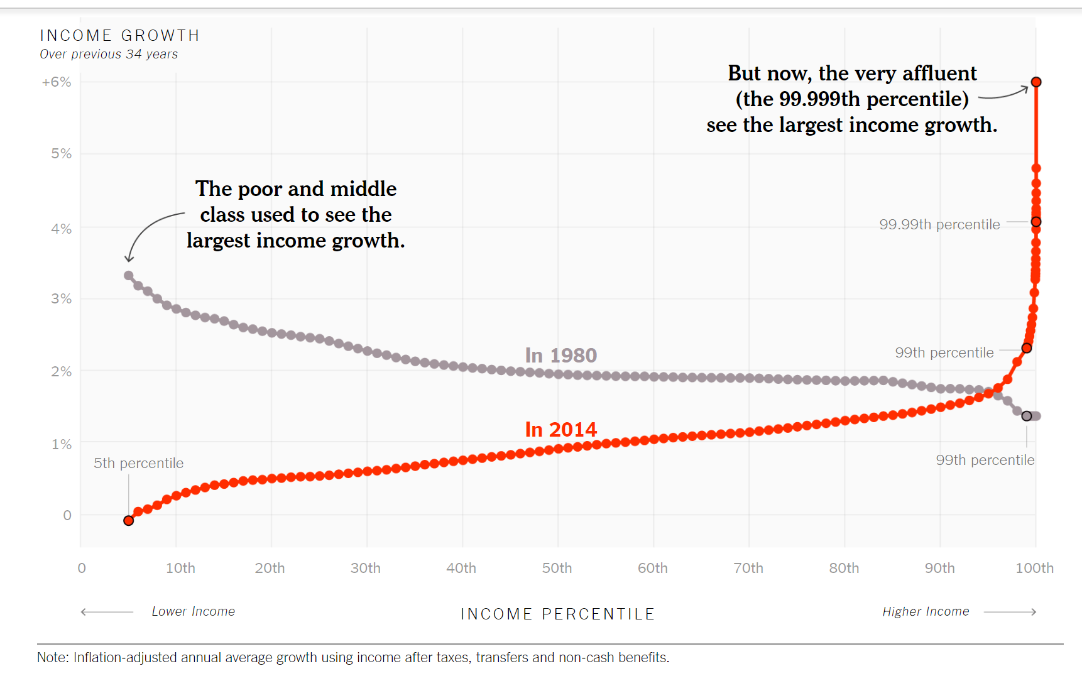
Income Growth by Household Income Level in 1980 vs. 2014
Source: Piketty, Saez, and Zucman (2017)
Notes:
Note: after this, load this link for interactive version of this chart:
https://www.nytimes.com/interactive/2017/08/07/opinion/leonhardt-income-inequality.html

Slide 3
Share of Income Going to Households in the Top 1%, by Year
24
22
20
18
16
Top 1% Share of Total Income
14
12
10
8
1920
1930
1940
1950
1960
1970
1980
1990
2000
2010
Source: Piketty and Saez (2003, updated series)
Year
Notes:
In 2018, to be among the top 1 percent of U.S. earners, a family needs an income of $421,926

Slide 4
Inequality and Economic Mobility
Stagnating wages in the middle class have led to reductions in absolute mobility across generations
Notes:
Economists have focused primarily on inequality of outcomes within generations, but public is often concerned about inequality of opportunity
[S
One key aspect

Slide 5
The Fading American Dream
Percent of Children Earning More than Their Parents, by Year of Birth
100
90
80
Pct. of Children Earning more than their Parents
70
60
50
1940
1950
1960
1970
1980
Child's Year of Birth
Source: Chetty, Grusky, Hell, Hendren, Manduca, Narang (Science 2017)

Slide 6
Inequality and Economic Mobility
Stagnating wages in the middle class have led to reductions in absolute mobility across generations
Children from low-income families have particularly poor outcomes because of high degree of persistence of income across generations

Slide 7
Mean Child Household Income Rank vs. Parent Household Income Rank
100
80
60
Children’s Mean Hhold. Inc. Rank (Ages 31-37)
40
20
0
0
20
40
60
80
100
($22K)
($43K)
($69K)
($105K)
($1.5M)
Parent Household Income Rank

Slide 8
Inequality and Economic Mobility
Stagnating wages in middle class have led to reductions in absolute mobility across generations
Children from low-income families have particularly poor outcomes because of persistence of income across generations
→ Central question of public interest: how can we increase upward mobility
out of poverty?

Slide 9
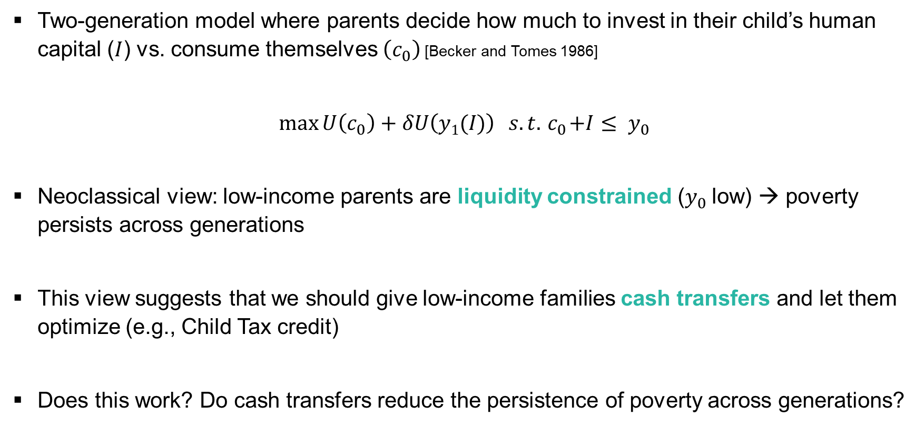
Intergenerational Income Dynamics: A Simple Framework
Two-generation model where parents decide how much to invest in their child’s human capital ($I$) vs. consume themselves $\left(c_{0}\right)$ [Becker and Tomes 1986]
$$\max{U\left(c_{0}\right)+δU\left(y1(I)\right)} s.t. { c}_{0}+I≤ y_{0}$$
Neoclassical view: low-income parents are liquidity constrained ($y_{0}$low) → poverty persists across generations
This view suggests that we should give low-income families cash transfers and let them optimize (e.g., Child Tax credit)
Does this work? Do cash transfers reduce the persistence of poverty across generations?

Slide 10
Effects of Cash Transfers on Children’s Outcomes
Cesarini et al. (QJE 2016): study impacts of lottery wins on children’s outcomes using Swedish registry data
  How much of the cross-sectional correlation between parents’ incomes and kids’ outcomes can be explained by the causal effect of income?

Slide 11
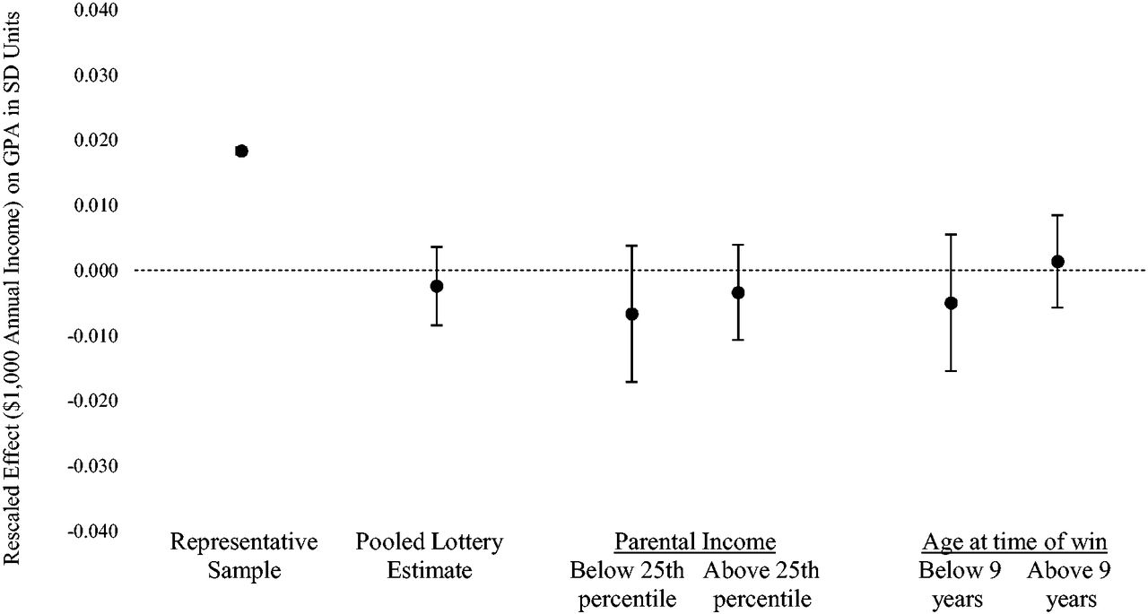
Causal Effects of Income via Lottery Wins on Children’s GPA
Source: Cesarini, Lindqvist, Ostling, Wallace 2016
Notes:
Figure III Household Income and Child Grade Point Average
This figure compares our lottery-based estimates, rescaled for comparability, of the causal impact of wealth on child GPA in different subsamples to the household-income gradient estimated in a large representative sample of children. All coefficients are in standardized GPA units. Gradients include controls for birth demographics and the lottery estimates additionally include demographic controls for the winning parent. Standard errors are clustered using an iterative algorithm that assigns siblings and half-siblings to the same cluster.

Slide 12
Effects of Cash Transfers on Children’s Outcomes
Cesarini et al. (QJE 2016): study impacts of lottery wins on children’s outcomes using Swedish registry data
  How much of the cross-sectional correlation between parents’ incomes and kids’ outcomes can be explained by the causal effect of income?
Concern: people may spend lottery winnings differently from “regular” income
Jacob et al. (QJE 2015): study impacts of housing voucher lottery in Chicago
  Effectively gave some households $12,000 of assistance (relative to median annual income of $19,000)

Slide 13
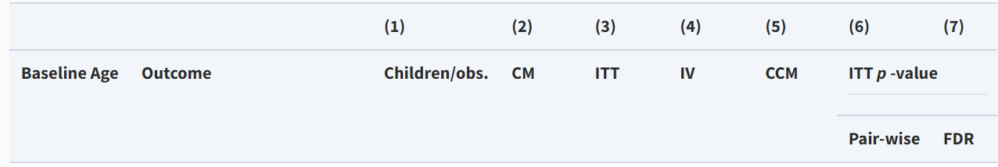
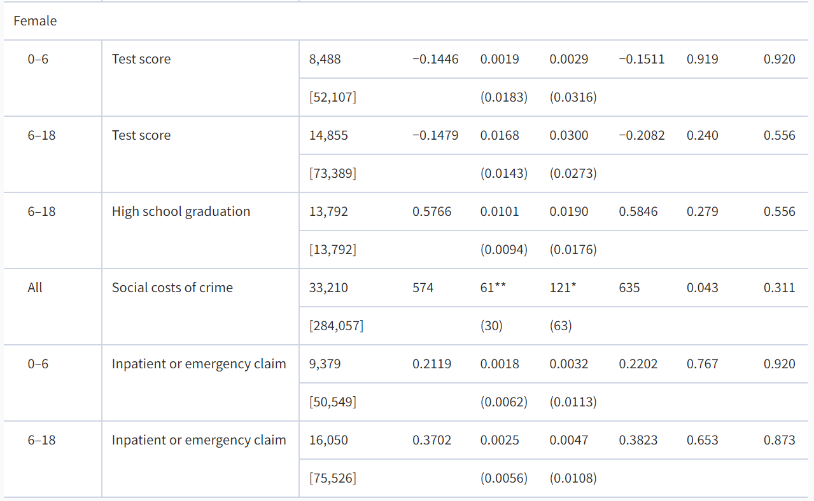
Effects of Housing Voucher Receipt on Education, Criminal Behavior, and Health
Source: Jacob, Kapustin, Ludwig 2015

Slide 14
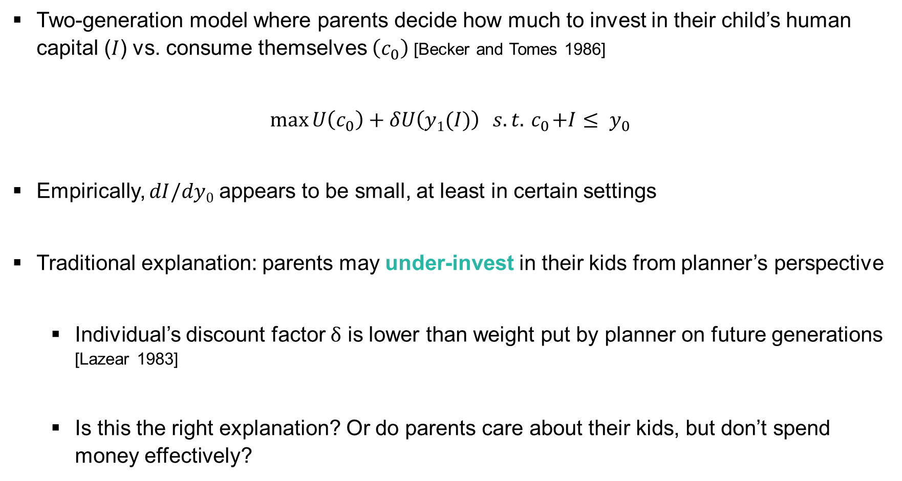
Intergenerational Income Dynamics: A Simple Framework
Two-generation model where parents decide how much to invest in their child’s human capital ($I$) vs. consume themselves $\left(c_{0}\right)$ [Becker and Tomes 1986]
$$\max{U\left(c_{0}\right)+δU\left(y1(I)\right)} s.t. { c}_{0}+I≤ y_{0}$$
Empirically, $dI/dy0$ appears to be small, at least in certain settings
Traditional explanation: parents may under-invest in their kids from planner’s perspective
  Individual’s discount factor $δ$ is lower than weight put by planner on future generations
  [Lazear 1983]
  Is this the right explanation? Or do parents care about their kids, but don’t spend money effectively?

Slide 15
Effects of Labeled Cash Transfers on Children’s Outcomes
Benhassine et al. (AEJ-PP 2015): study impacts of “labelled” cash transfers in Morocco using a randomized trial
  Small cash transfer made to fathers of school-aged kids, not conditional on school attendance but explicitly labeled as an “education support” program
Notes:
small cash transfer made to fathers of school-aged children in poor rural communities, not conditional on school attendance but explicitly labeled as an education support program

Slide 16
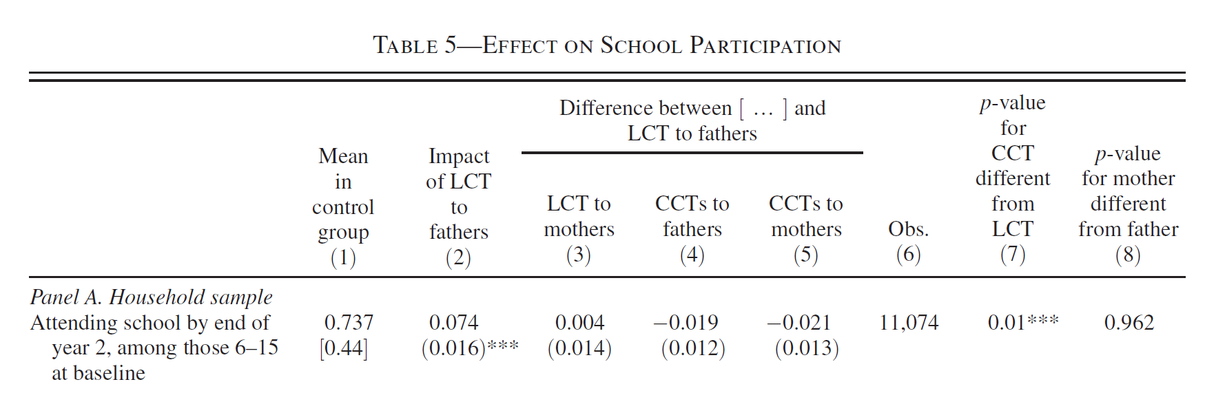
Impacts of Labeled Cash Transfers on School Attendance
Source: Benhassine, Devoto, Duflo, Dupas, and Pouliquen 2015

Slide 17
Effects of Labeled Cash Transfers on Children’s Outcomes
Benhassine et al. (AEJ-PP 2015): study impacts of “labelled” cash transfers in Morocco using a randomized trial
  Small cash transfer made to fathers of school-aged kids, not conditional on school attendance but explicitly labeled as an “education support” program
Hastings and Shapiro (AER 2018) provide further evidence for the view that labels matter and that low-income households do not treat money as fungible
  Event-study design analyzing impacts of SNAP eligibility (about $200 per month of food stamps) on spending patterns
Notes:
small cash transfer made to fathers of school-aged children in poor rural communities, not conditional on school attendance but explicitly labeled as an education support program

Slide 18
Causal Effect of SNAP Receipt on SNAP Eligible Products
Source: Hastings and Shapiro 2018

Slide 19
Causal Effect of SNAP Receipt on SNAP Ineligible Products
Source: Hastings and Shapiro 2018

Slide 20
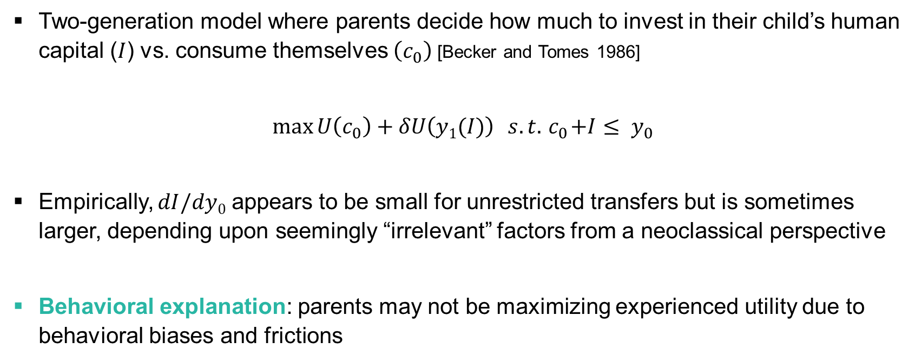
Intergenerational Income Dynamics: A Simple Framework
Two-generation model where parents decide how much to invest in their child’s human capital ($I$) vs. consume themselves $\left(c_{0}\right)$ [Becker and Tomes 1986]
$$\max{U\left(c_{0}\right)+δU\left(y1(I)\right)} s.t. { c}_{0}+I≤ y_{0}$$
Empirically, $dI/dy0$ appears to be small for unrestricted transfers but is sometimes larger, depending upon seemingly “irrelevant” factors from a neoclassical perspective
Behavioral explanation: parents may not be maximizing experienced utility due to behavioral biases and frictions

Slide 21
Potential Behavioral Biases that Amplify Intergenerational Poverty
Potential behavioral biases/frictions that may affect investment in children:
  Status-quo/present bias: gains for children realized 10-20 years later, but costs paid up front [Laibson 1997]
  Poverty amplifies focus on immediate needs
  [Mullainathan and Shafir 2013, Haushofer and Fehr 2014]
  Lack of information [Hastings and Weinstein 2007]

Slide 22
Addressing Inequality Using the Tools of Behavioral Economics
Data indicate that we need to go beyond providing cash assistance to reduce intergenerational persistence of inequality
Motivates focus on interventions such as support for education or nutritional programs that impact children’s outcomes
Insights from behavioral economics can be very valuable in designing such interventions
Illustrate work being done in this field by focusing on one example: neighborhood choice and the design of affordable housing policies [Bergman, Chetty, DeLuca, Hendren, Katz, Palmer 2020]

Slide 23
Three Facts on Neighborhoods and Economic Opportunity
Children’s prospects for upward income mobility vary substantially across neighborhoods

Slide 24
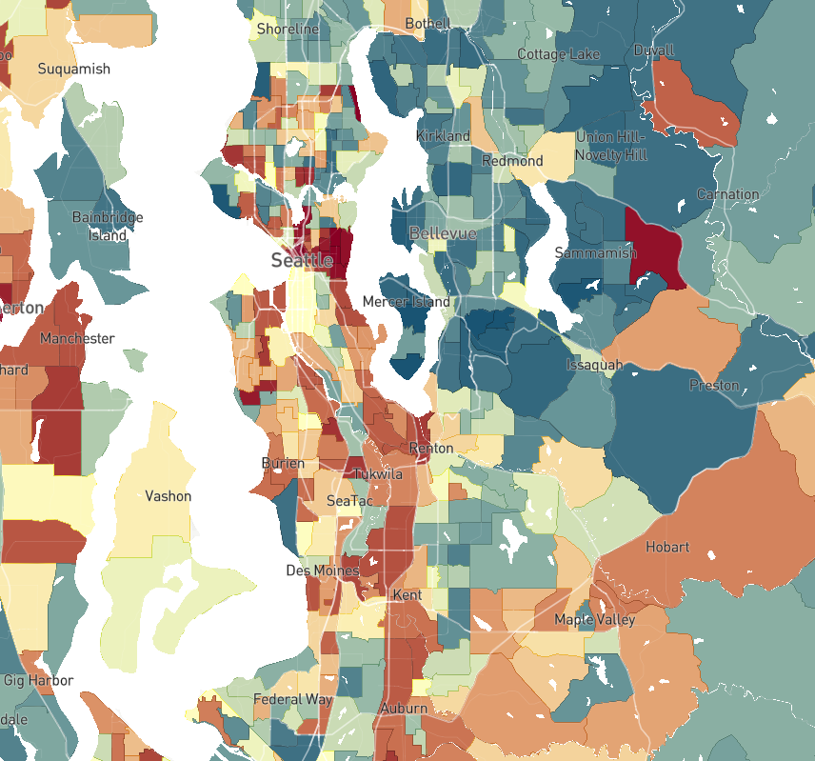

The Geography of Upward Mobility in Seattle
Average Income at Age 35 for Children with Parents Earning $27,000 (25th percentile)
Percentile Rank in Adulthood
> 60 ($55k)
48 ($39k)
< 30 ($20k)
Chetty Friedman Hendren Jones Porter (2018); visit www.opportunityatlas.org for data on other cities

Slide 25
Three Facts on Neighborhoods and Economic Opportunity
Children’s prospects for upward income mobility vary substantially across neighborhoods
Moving to better neighborhoods earlier in childhood improves children’s outcomes in adulthood significantly

Slide 26
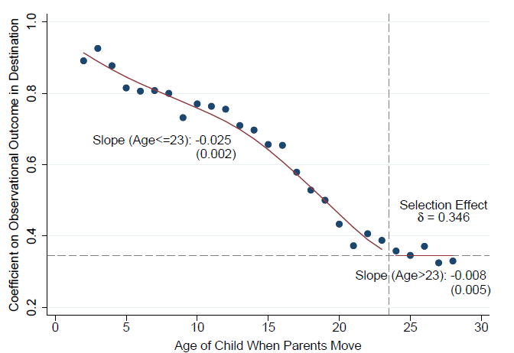
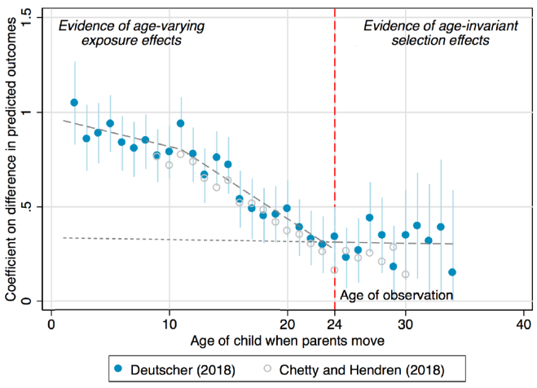
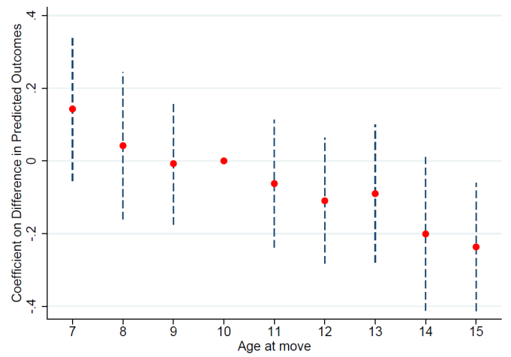
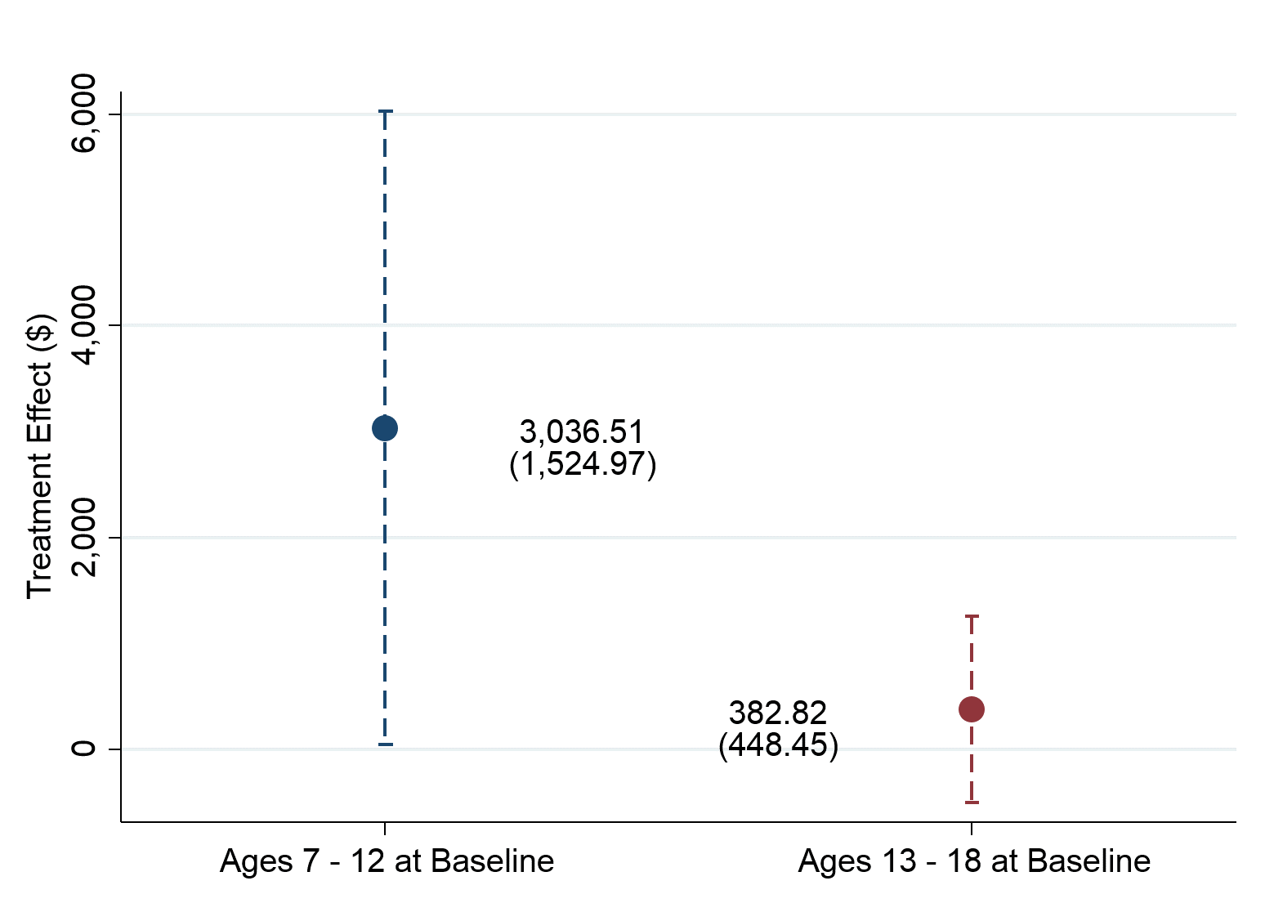
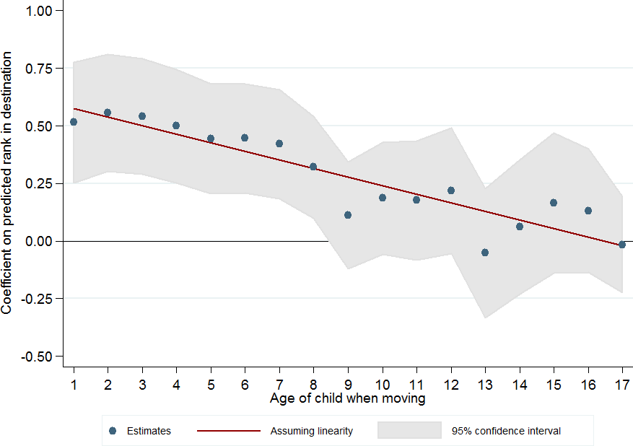
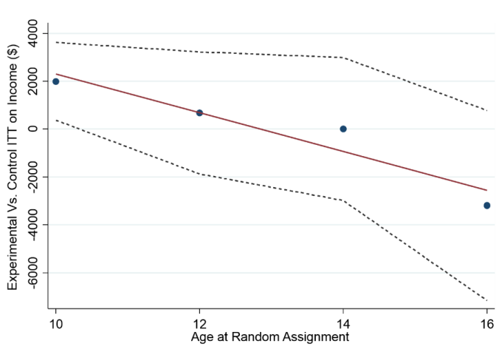
Estimates of Childhood Exposure Effects
United States
Australia
Montreal, Canada
Source: Chetty, Friedman, Hendren, Jones, Porter (2018)
Source: Deutscher (2018)
Source: Laliberté (2018)
Chicago Public Housing Demolitions
Denmark
MTO: Baltimore, Boston, Chicago, LA, NYC
Source: Faurschou (2018)
Source: Chetty, Hendren, Katz (AER 2016)
Source: Chyn (AER 2018)

Slide 27
Three Facts on Neighborhoods and Economic Opportunity
Children’s prospects for upward income mobility vary substantially across neighborhoods
Moving to better neighborhoods earlier in childhood improves children’s outcomes in adulthood significantly
Low-income families who receive housing vouchers predominantly live in low-opportunity neighborhoods

Slide 28
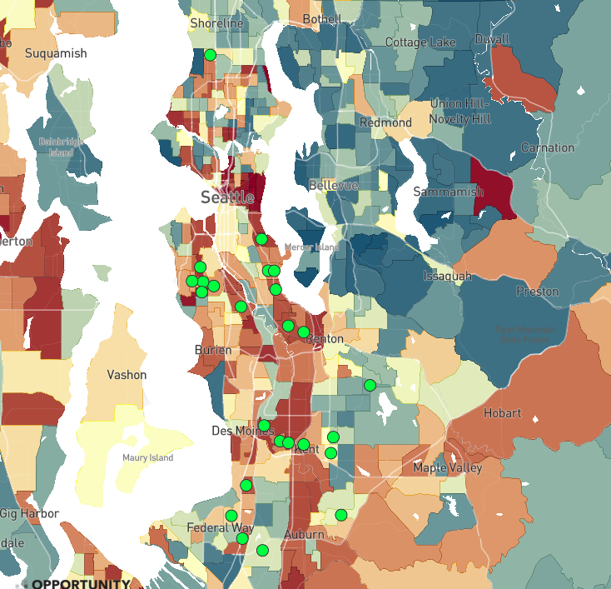

Is Affordable Housing in Seattle Maximizing Opportunities for Upward Mobility?
Most Common Current Locations of Families Receiving Housing Vouchers in Seattle
25 most common tracts where voucher holders lived in 2015-17
Percentile Rank in Adulthood
> 60 ($55k)
48 ($39k)
< 30 ($20k)

Slide 29
Why Don’t Low-Income Families Move to Opportunity?
Two classes of explanations:
  Preferences: families may prefer to stay in current neighborhoods because of other amenities (e.g., commute time, proximity to family)
  Behavioral Frictions: families may be unable to find housing in high-opportunity areas because of lack of information, challenges in search, etc.
If behavioral frictions or constraints are driving segregation, can we reduce them through changes in affordable housing policy?

Slide 30



Creating Moves
to Opportunity
Randomized trial to develop and test strategies to reduce barriers that housing choice voucher recipients may face in moving to high-opportunity areas
Source: Bergman, Chetty, DeLuca, Hendren, Katz, Palmer (2020)

Slide 31
Treatment Interventions
CUSTOMIZED
SEARCH
ASSISTANCE
DIRECT
LANDLORD
ENGAGEMENT
SHORT-TERM FINANCIAL ASSISTANCE
On average, non-profit staff spend 6 hours with each household
47% of rentals in high-opportunity areas made through links via non-profit staff
Average financial assistance of $1,000 for security deposits, application fees, etc.
Program Cost: $2,660 per family issued a voucher
(2.2% of average voucher payments over 7 years)

Slide 32
Experimental Results: Fraction of Families that Leased Units in High Opportunity Areas
60
53.0%
50
40
30
to High Opportunity Areas
Share of Households Who Moved
20
15.1%
10
0
Control
Treatment
Difference:
37.9 pp
SE: (4.2)

Slide 33
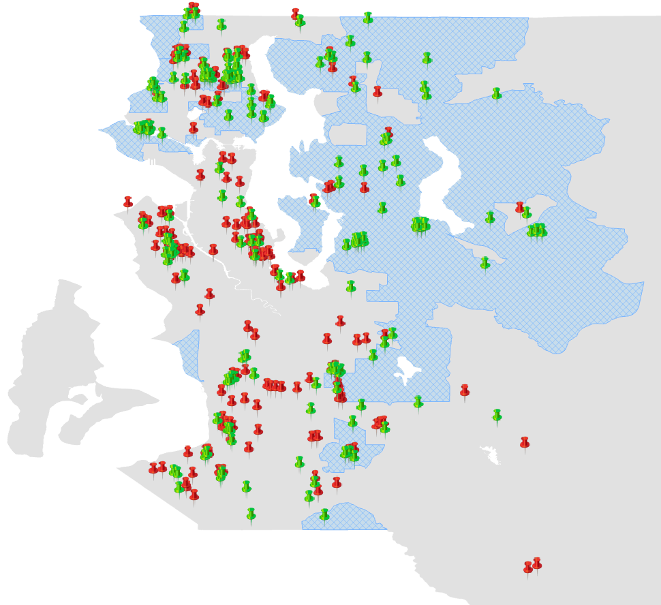


Destination Locations for Families that Leased Units Using Housing Vouchers
Lake City
Inglewood
High-Opportunity
Area
Ballard
Northeast Seattle
Magnolia
Capitol
Hill
Control
Bellevue
CMTO
Treatment
West Seattle
Cougar
Mountain
Issaquah
Rainier
Valley
Newport
Burien
Tukwila
East Hill
Des Moines
Kent
Lea Hill, Auburn

Slide 34
Tradeoffs in Unit Characteristics
Are families making sacrifices on other dimensions to move to high-opportunity areas?

Slide 35
Tradeoffs in Neighborhood and Unit Quality
Treatment Effects on Distance Moved and Unit Size
Distance Moved
Unit Size
15
1500
1419.9
1278.8
10.6
10.6
10
1000
Mean Distance Between
Square Footage of Unit
Origin and Destination (miles)
5
500
0
0
Control
Treatment
Control
Treatment
Difference:
-0.0 miles
Difference:
141.1 sq. ft.
SE: (1.4)
SE: (110.1)
Notes:
Second, we don’t see families trading of aspects of unit quality or distance in their move for neighborhood quality.

Slide 36
Satisfaction with New Neighborhoods
Based on Surveys Six Months Post-Move
“Very Satisfied” with New Neighborhood?
“Very Sure” Will Stay?
62.2%
60
60
49.5%
40
40
Pct. Very Satisfied
Pct. Very Sure They Will
with New Neighborhood
28.6%
Stay in New Neighborhood
20
20
20.0%
0
0
Control
Treatment
Control
Treatment
Difference:
33.6 pp
Difference:
29.5 pp
SE: (11.6)
SE: (10.7)
Notes:
Third, we’ve surveyed after their moves, the CMTO group are significantly more satisfied with their new neighborhood, 34pp, and they are much more certain they would like to stay in their new neighborhood, 30pp more than the control group.
-So we view this as encouraging evidence that these families are likely to persist in opportunity nbhds, though ultimately we’ll measure their persistence directly as time goes on.
Note: This is Among All Households In Survey Sample (N = 90)

Slide 37

Unpacking Behavioral Mechanisms
Evidently, many families prefer high-opportunity areas but are unable to move to such neighborhoods without additional assistance
What are the barriers families face in moving to higher-opportunity areas?
Two approaches:
  Second phase of experiment with unbundled treatments
  Qualitative evidence from surveys of families

Slide 38
Fraction Who Leased Units in High Opportunity Areas in Phase 2 of CMTO
60
58%
40
Percent of Households Who Have Moved
32%
to High Opportunity Areas
21%
20
16%
0
Control
Financial+Info.
Partial Services
Full Services
Notes:
Note: this one is conditional on Lease-Up for the time being b/c control group lease-up rate is lower; in final version can switch to uncond

Slide 39
Qualitative Evidence on Mechanisms
We also conducted a qualitative study of 161 families interviewed for two hours each during search process and post-move
Key lessons from these interviews (based on systematic coding of 8,000 pages of transcripts):
  [Scarcity] Most families have extremely limited time and resources to search
  [Mullainathan and Shafir 2013]
  [Customization] Case workers’ ability to respond to each family’s specific needs is crucial above and beyond standardized resources

Slide 40
Illustrative Quotes
Emotional/Psychological Support
“It was this whole flood of relief. It was this whole flood of, “I don’t know how I’m going to do this” and “I don’t know what I’m going to do” and “This isn’t working,” and yeah…I think it was just the supportive nature of having lots of conversations with Megan.” –Jackie
Brokering with Landlords
“When you find a place, I will come with you and we will help you to fill out the application. I will talk with the landlord, I will help you to do a lot of stuff, that maybe sometimes will be complicated.” –Leah

Slide 41
Implications of CMTO Seattle Experiment
Residential segregation of low-income families in the U.S. is driven more heavily by behavioral frictions rather than deep-rooted preferences
Affordable housing policies are now being redesigned to reduce such frictions in light of this evidence
Notes:
--This qualitative work suggests there are first-order frictions, some of which are not explicitly modeled in residential choice.
--But importantly, CMTO suggests these barriers can be addressed by affordable housing policy, with substantial effects on the segregation of low-income families and upward mobility.
--Scale up CMTO, place based policies

Slide 42
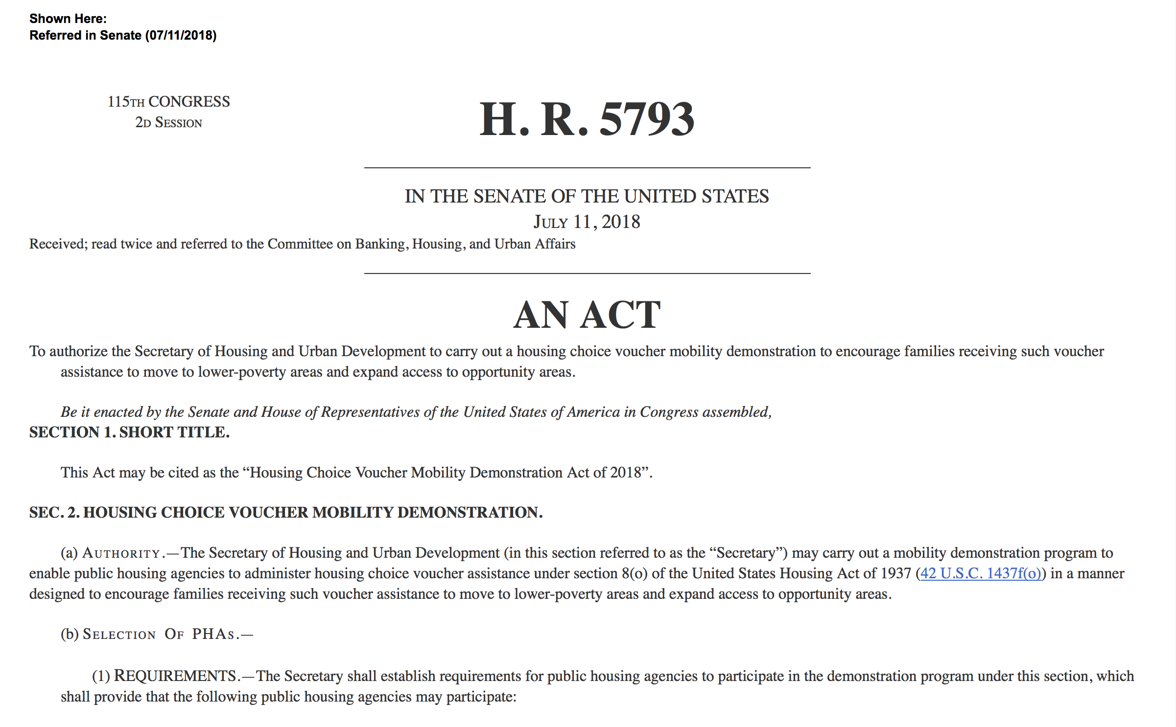
Housing Choice Voucher Mobility Demonstration Act
Notes:
Now law. Has $60 mil of funding to do CMTO-type stuff, partly inspired by our work. We are working with various groups to try to shape what happens with the money. what we say is that we are planning to scale CMTO by working with 18 PHA's across the country and with HUD, as part of the new mobility demonstration

Slide 43
Family Stability and Opportunity Vouchers Act
The Family Stability and Opportunity Vouchers Act puts a significant down payment on evidence-based housing mobility vouchers for the nation’s most vulnerable families with young children. The bill couples mobility vouchers with customized support services to help families escape the cycle of poverty and move to high opportunity areas.
Specifically the bill:
Creates an additional 500,000 housing vouchers over five years for low-income, high-need families with young children. Pregnant women and families with a child under age 6 would qualify for these new vouchers if they have a history of homelessness or housing instability, live in an area of concentrated poverty, or are at risk of being pushed out of an opportunity area.
Provides voucher recipients with access to counseling and case management services that have a proven track record of helping families move out of poverty.
The bills resources would enable housing agencies to engage new landlords in the voucher program and connect families with information about housing in high-opportunity neighborhoods, and community-based supports for families as they move.

Slide 44
Implications of CMTO Seattle Experiment
Residential segregation of low-income families in the U.S. is driven more heavily by behavioral frictions rather than deep-rooted preferences
Affordable housing policies are now being redesigned to reduce such frictions in light of this evidence
More broadly, sociological determinants of choice appear to be important in many other domains
Notes:
--This qualitative work suggests there are first-order frictions, some of which are not explicitly modeled in residential choice.
--But importantly, CMTO suggests these barriers can be addressed by affordable housing policy, with substantial effects on the segregation of low-income families and upward mobility.
--Scale up CMTO, place based policies

Slide 45
Impact of Year-Up Sectoral Job Training Program on Earnings
Experimental Treatment
40,000
Experimental Control
30,000
Average Annual Earnings ($)
20,000
10,000
0
-5
-4
-3
-2
-1
0
1
2
3
4
5
Year Relative to Graduation from Year-Up Program
Source: Chetty et al. (in progress)

Slide 46
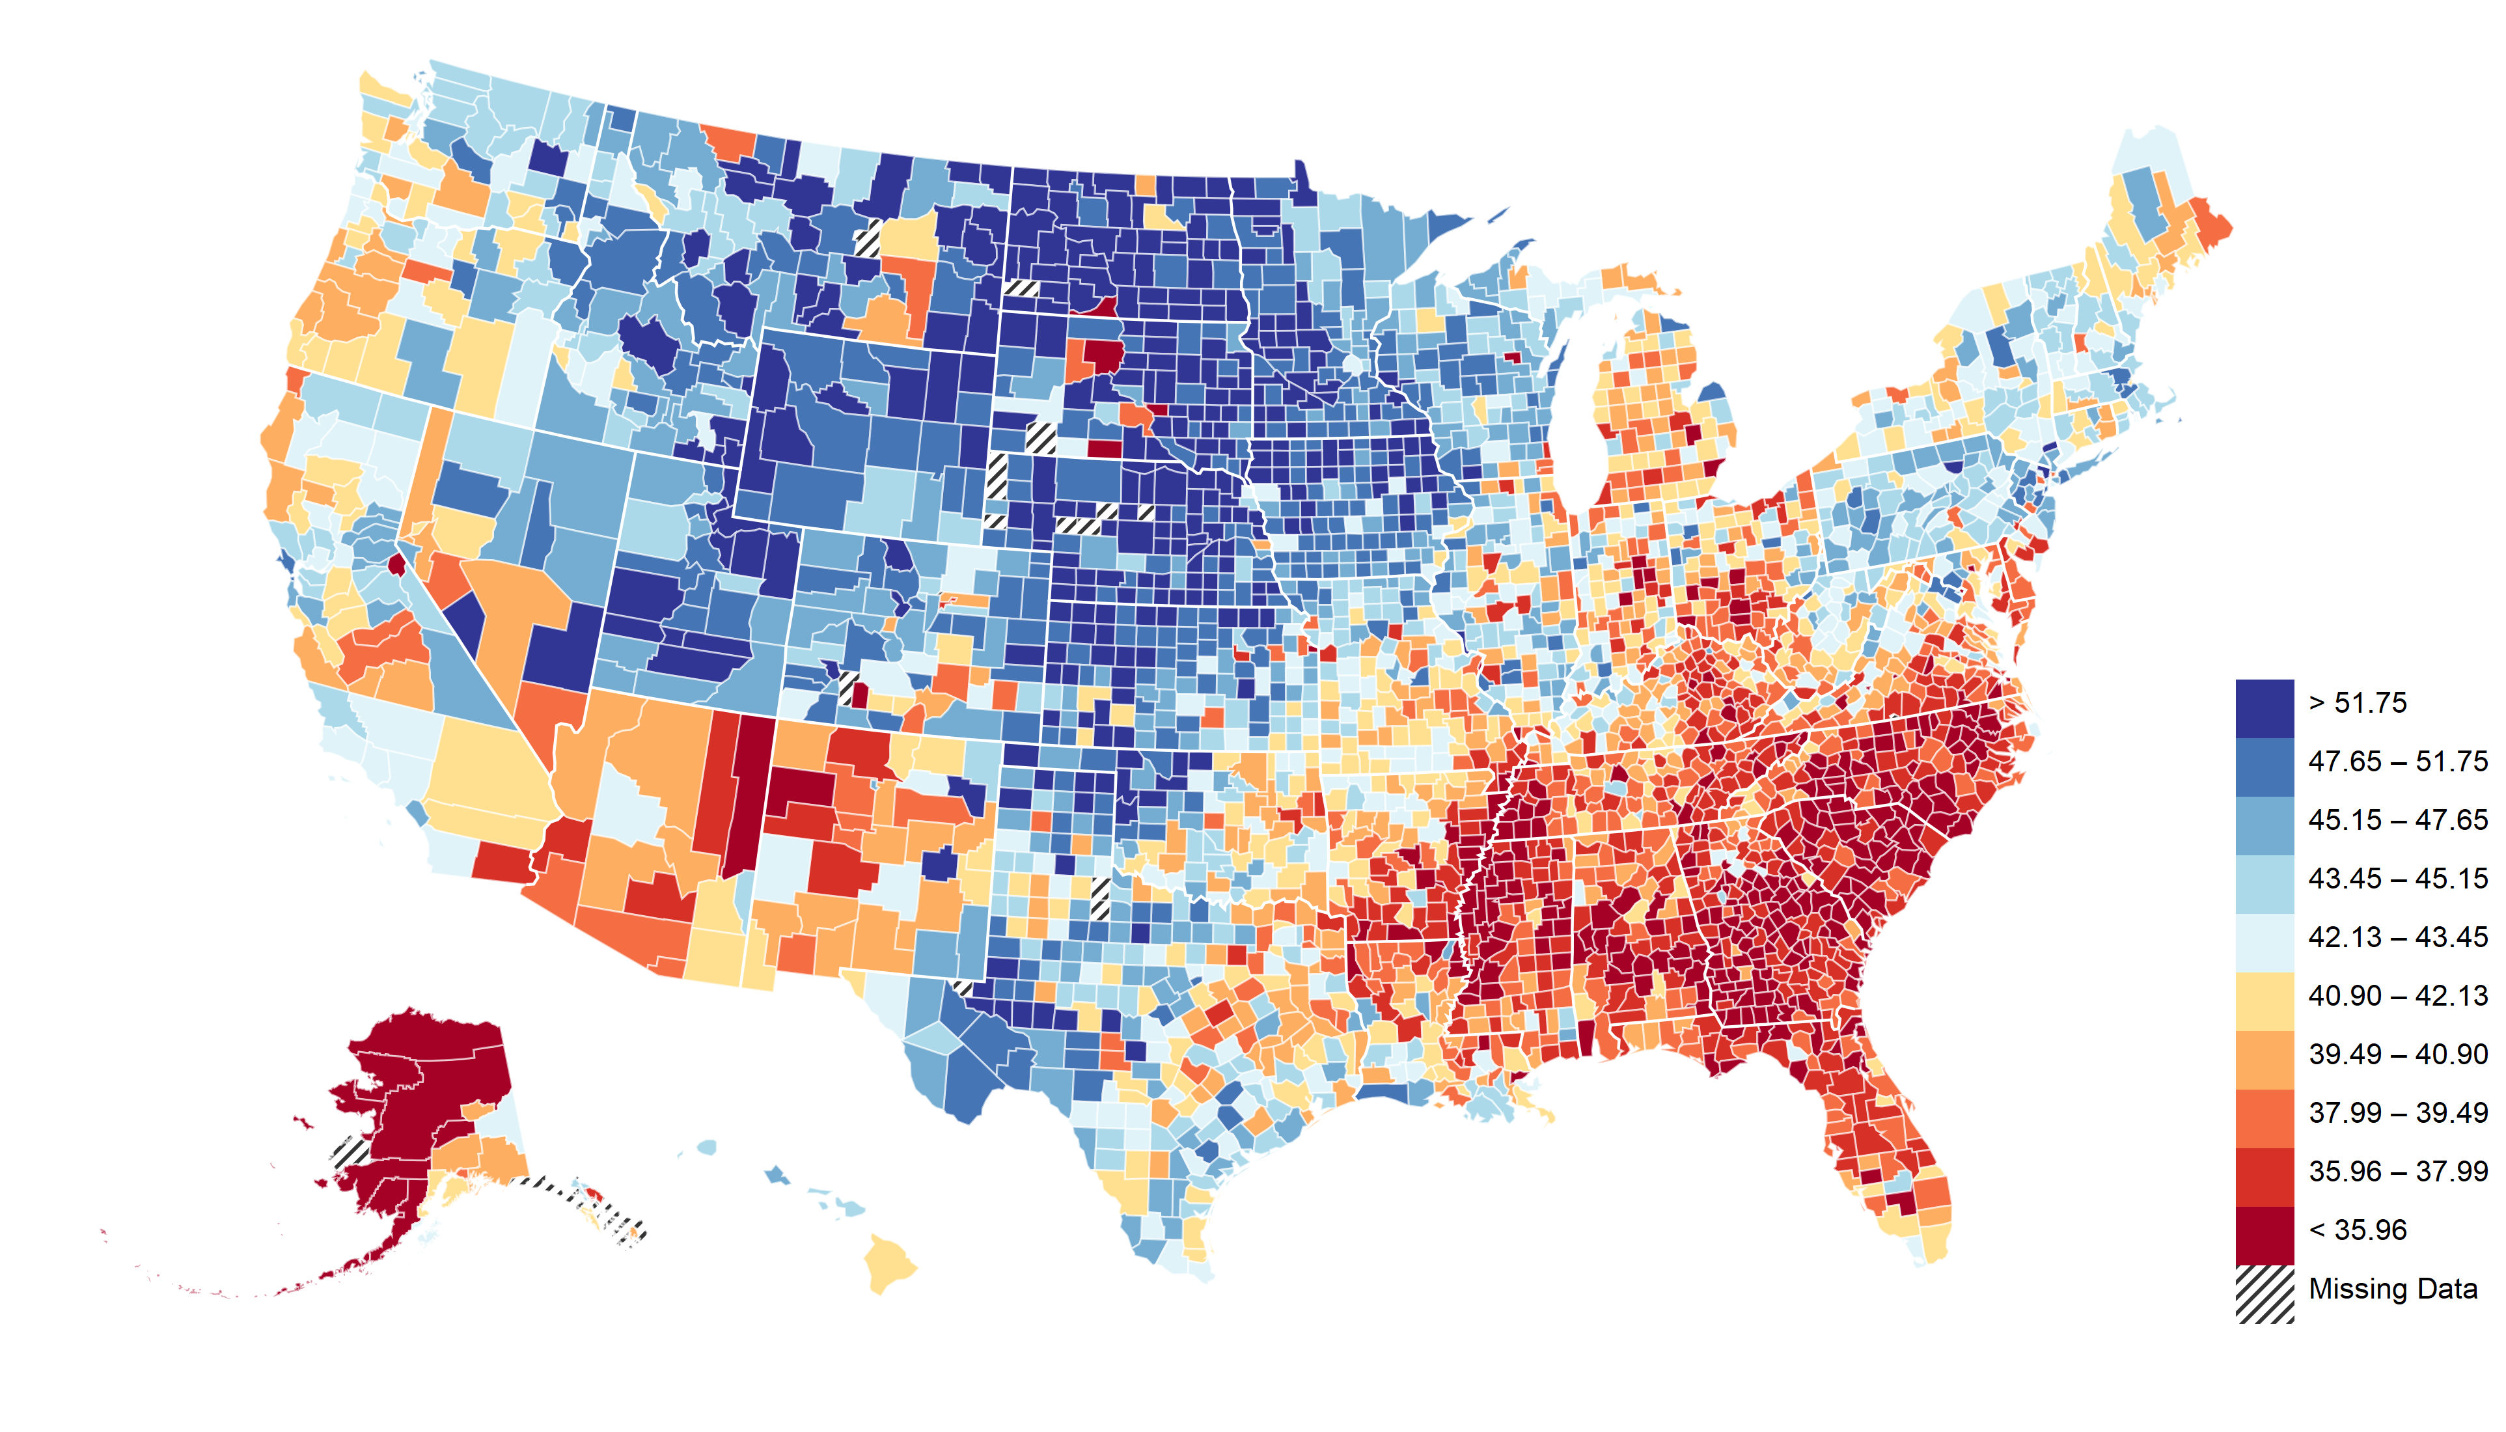
The Geography of Upward Mobility in the United States
Average Income at Age 35 for Children whose Parents Earned $25,000 (25th percentile)
Minneapolis
UM: $34.3k
Salt Lake City
UM: $36.5k
Indianapolis
UM: $31.0k
Boston
UM: $32.1k
New York
UM: $33.2k
>$43k
San Francisco
UM: $42.3k
Los Angeles
UM: $34.3k
$32k
Charlotte
UM: $25.8k
<$26k
Reliability = 0.99

Slide 47
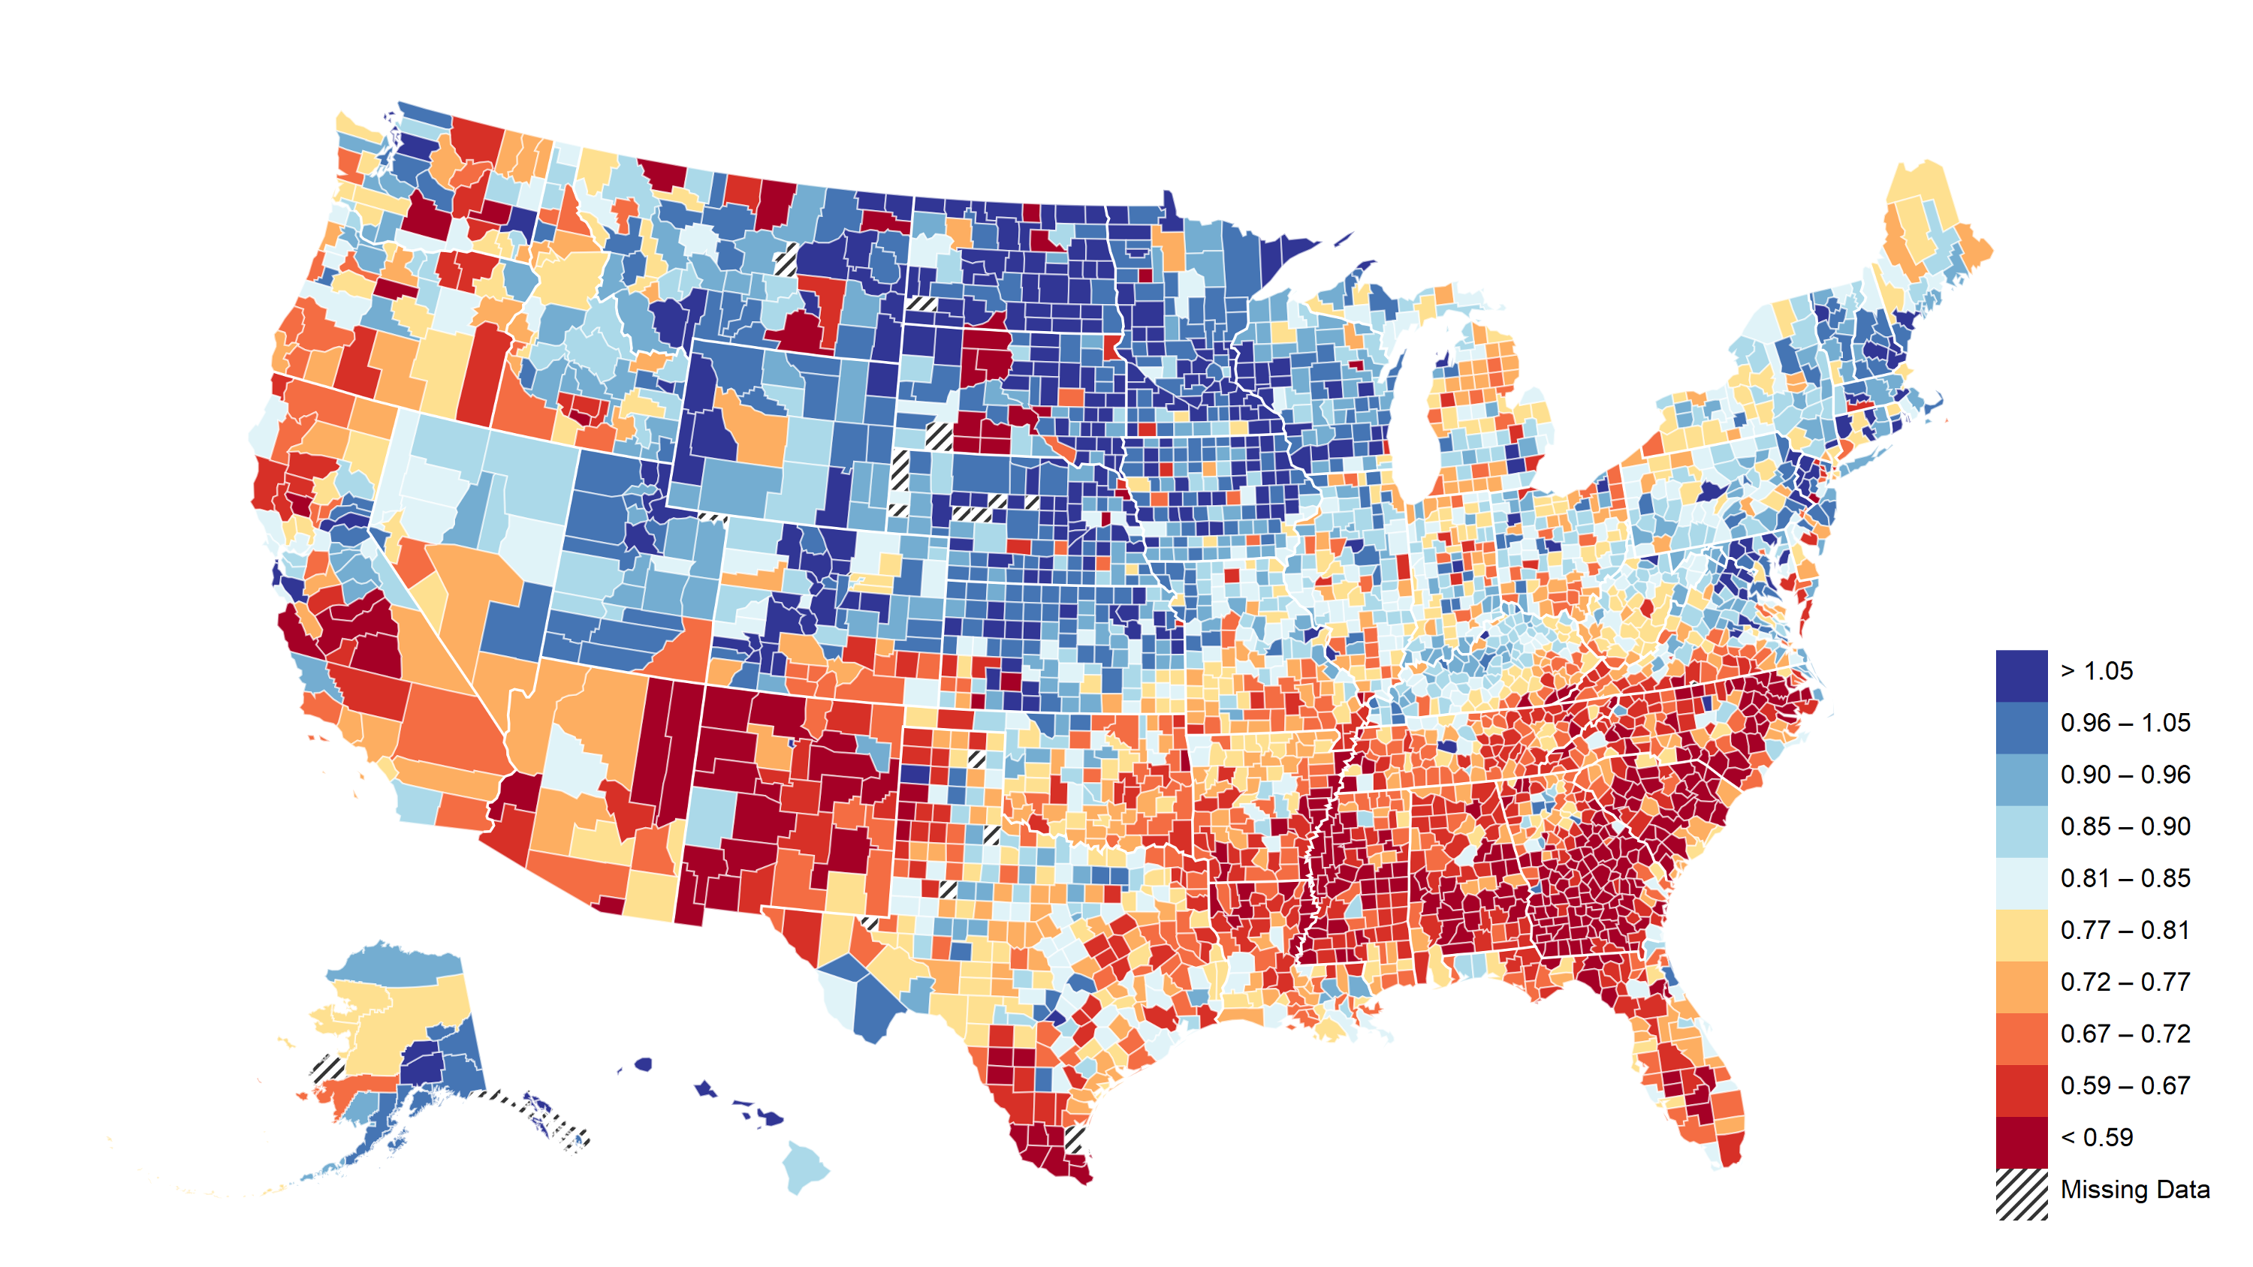
Economic Connectedness of Low-SES Individuals by County
Fraction of Above-Median-SES Friends Among Below-Median People on Facebook
Minneapolis
EC: 49%
Salt Lake City
EC: 47%
Indianapolis
EC: 33%
Boston
EC: 40%
New York
EC: 38%
>53%
San Francisco
EC: 59%
Los Angeles
EC: 36%
40%
Charlotte
EC: 36%
<30%
Source: Chetty, Jackson, Kuchler, Stroebel, et al. (Nature, in press)

Slide 48
Upward Mobility vs. Economic Connectedness Across Counties
Upward Mobility
Measured in Tax Data
Economic Connectedness
Measured in Facebook Data
>$43k
>53%
$32k
40%
<$26k
<30%
Correlation = 0.63

Slide 49
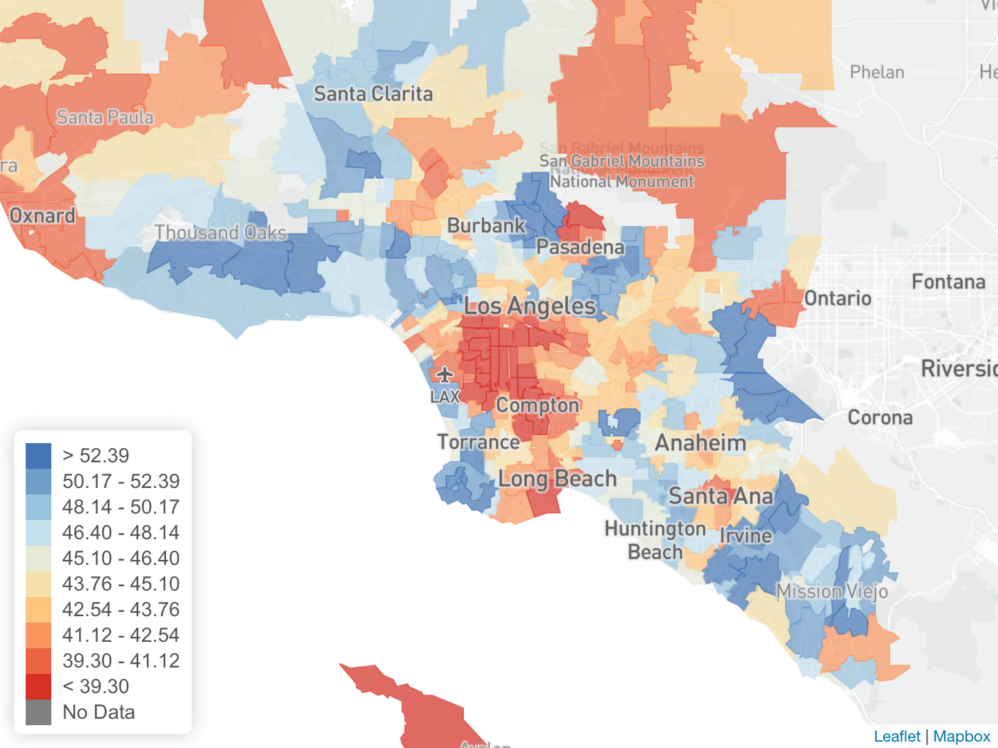
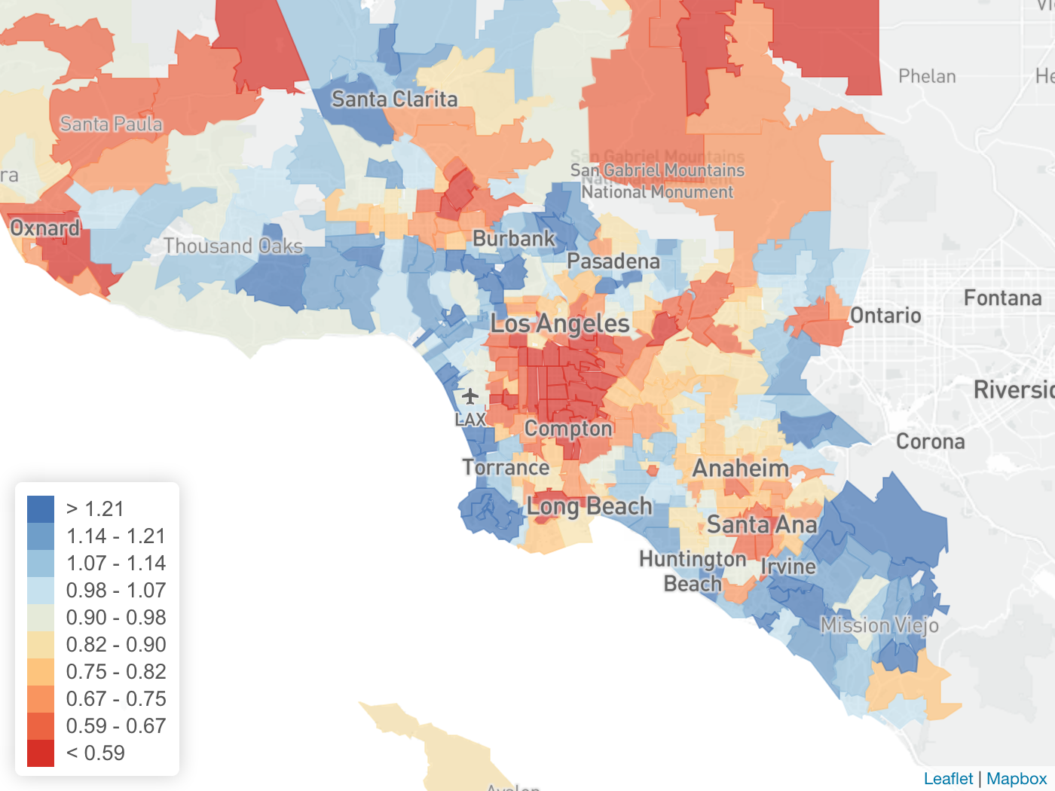
Upward Mobility vs. Economic Connectedness Across ZIP Codes
Los Angeles Metro Area
Upward Mobility
Economic Connectedness
>$45k
>60%
$35k
43%
<$30k
<30%
Correlation = 0.68

Slide 50
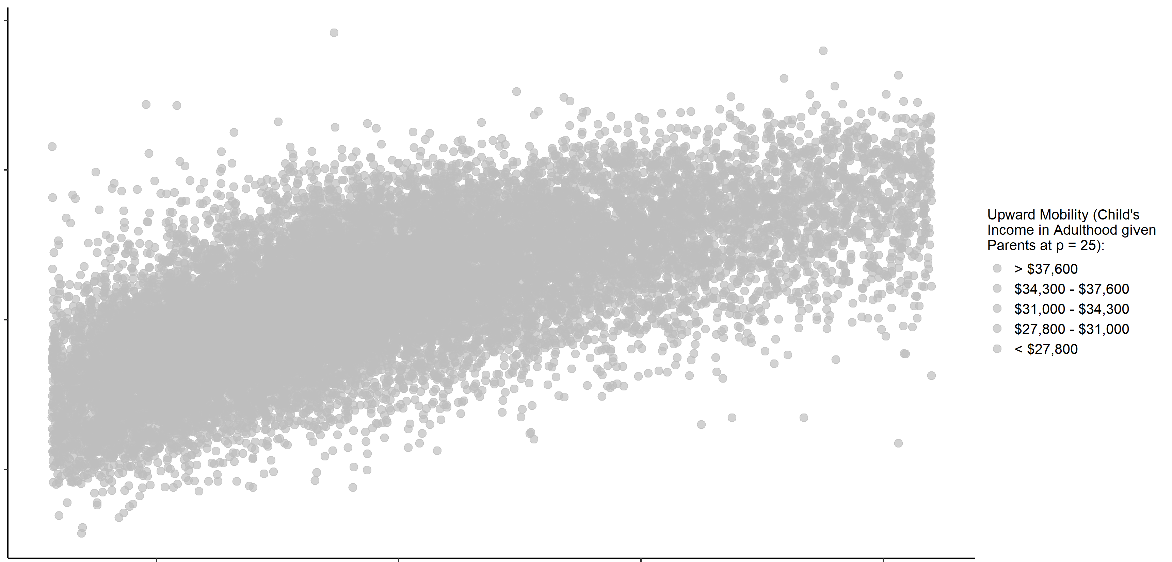
Economic Connectedness vs Household Median Income, by ZIP Code
80%
60%
Economic Connectedness:
% High-SES Friends Among Low-SES People
40%
20%
$40k
$60k
$80k
$100k
Household Median Income ($)

Slide 51
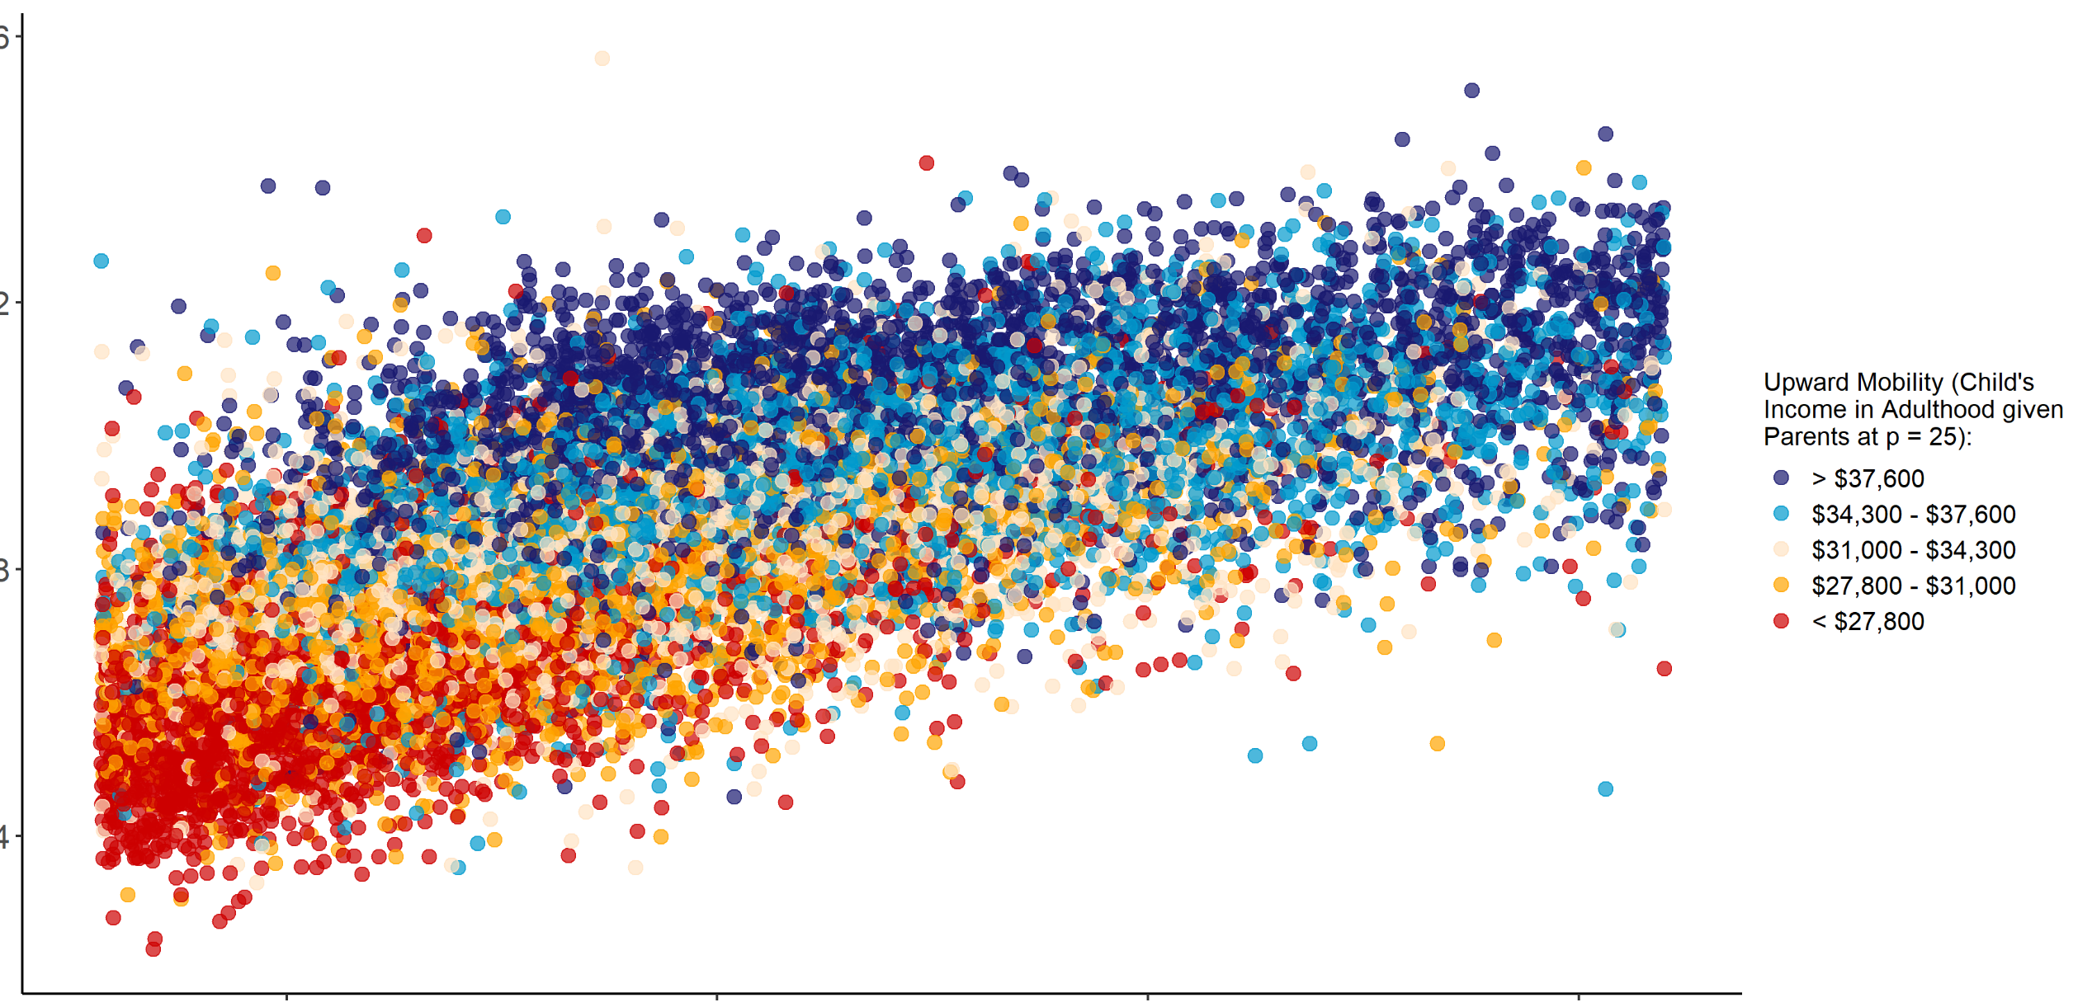
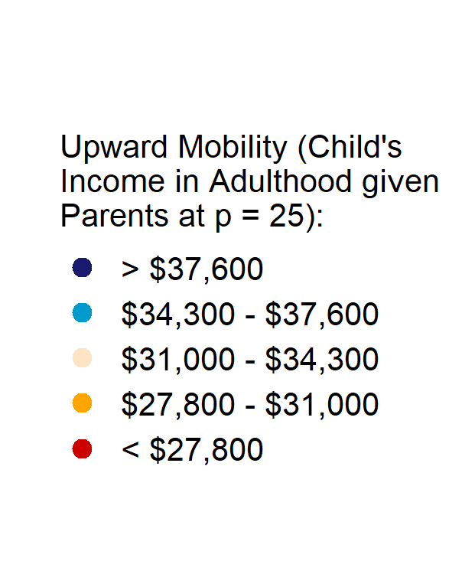
Economic Connectedness vs Household Median Income, by ZIP Code
Colored by Rate of Upward Mobility
80%
60%
Economic Connectedness:
% High-SES Friends Among Low-SES People
40%
20%
$40k
$60k
$80k
$100k
Household Median Income ($)

Slide 52
Economic Connectedness vs Household Median Income, by ZIP Code
Colored by Rate of Upward Mobility
80%
60%
Economic Connectedness:
% High-SES Friends Among Low-SES People
40%
20%
$40k
$60k
$80k
$100k
Household Median Income ($)

Slide 53



Broader Implications for Behavioral Economics and Inequality
Understanding the decision-making process of low-income households is critical to tackle poverty
For complex decisions, need to go beyond light-touch interventions (e.g., nudges) and provide deeper support
Big data can help us target interventions and monitor their impacts
Notes:
Key challenge going forward: scaling while retaining fidelity

Slide 54


Some Directions for Future Research
Empirical Evidence: Gathering more evidence on choice problems where behavioral frictions do or do not amplify inequality
Behavioral Theory: Understanding and modelling the role of social factors and support, going beyond individual biases
General Equilibrium: Studying the role of markets in mediating inequality: do firms help or hurt behavioral agents? What happens when some agents are more sophisticated than others?

