Slide 1
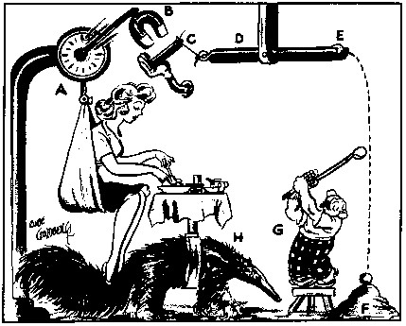
Behavioral Mechanism Design and Paternalism
David Laibson
April 27, 2022

Slide 2
It is a standing topic of complaint that a man knows too little of himself. Be it so: but is it so certain that the legislator must know more? It is plain, that of individuals the legislator can know nothing: concerning those points of conduct which depend upon the particular circumstances of each individual, it is plain, therefore, that he can determine nothing to advantage.
Jeremy Bentham
Jeremy Bentham, An Introduction to The Principles of Morals and Legislation (Introduction by Laurence J. Lafleur) 319 (1948 [1781]). See also Mario J. Rizzo and Douglas Glen Whitman, The Knowledge Problem of New Paternalism, 2009 BYU L. Rev. 905 (2009).

Slide 3
It may be admitted that, so far as scientific knowledge is concerned, a body of suitably chosen experts may be in the best position to command all the best knowledge available…[Yet] scientific knowledge is not the sum of all knowledge.…[A] little reflection will show that there is…the knowledge of the particular circumstances of time and place. It is with respect to this that practically every individual has some advantage over all others in that he possesses unique information of which beneficial use might be made, but of which use can be made only if the decisions depending on it are left to him or are made with his active cooperation.
Friedrich A. Hayek
F.A. Hayek, “The Use of Knowledge” in Society, 35 American Economic Review 519-530, 521-522 (1945). See also Mario J. Rizzo and Douglas Glen Whitman, The Knowledge Problem of New Paternalism, 2009 BYU L. Rev. 905 (2009).

Slide 4
How Are Preferences Revealed?
Beshears, Choi, Laibson, Madrian (2008)
Revealed preferences (decision utility)
Normative preferences
Why might revealed ≠ normative preferences?
  Cognitive errors
  Passive choice
  Complexity
  Shrouding
  Limited personal experience
  Intertemporal choice (e.g., present bias)
  Third party marketing

Slide 5
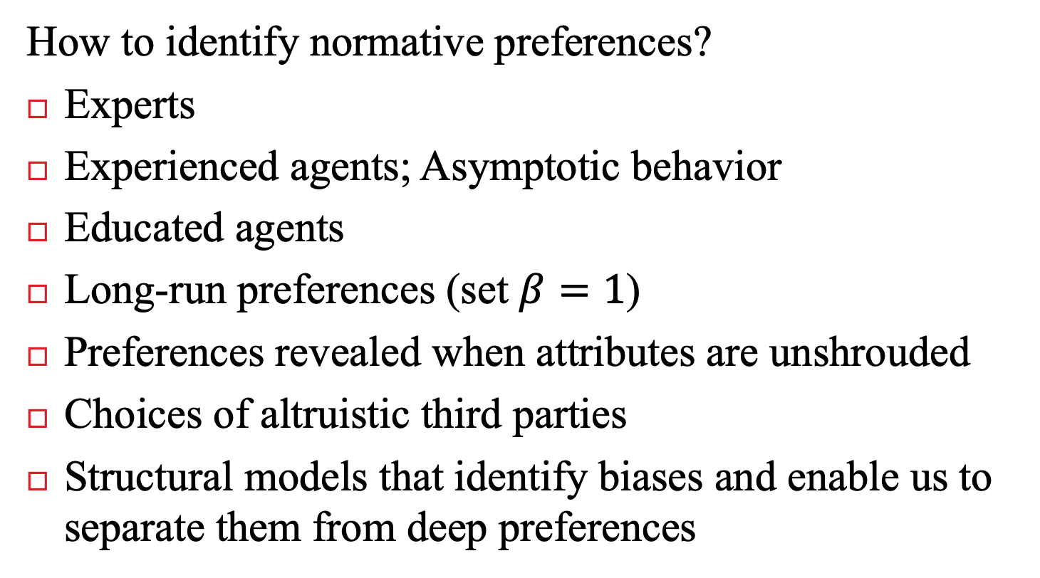
How Are Preferences Revealed?
Beshears, Choi, Laibson, Madrian (2008)
How to identify normative preferences?
Experts
Experienced agents; Asymptotic behavior
Educated agents
Long-run preferences (set $β=1$)
Preferences revealed when attributes are unshrouded
Choices of altruistic third parties
Structural models that identify biases and enable us to separate them from deep preferences

Slide 6
Behavioral mechanism design
Specify a positive theory of consumer/firm behavior (consumers and/or firms may not behave optimally). Consumers might have pertinent private information.
Specify a social welfare function, i.e. normative preferences (not necessarily based on revealed preference)
Solve for the institutional regime that maximizes the social welfare function, conditional on the theory of consumer/firm behavior (and info asymmetries).

Slide 7
  Laibson, Repetto, Tobacman (1998)
  Laibson (1998)
  O’Donoghue and Rabin (1999)
  Camerer, Issacharoff, Loewenstein, O‘Donoghue, & Rabin (2003)
  Choi, Laibson, Madrian, Metrick (2003)
  O’Donoghue and Rabin (2005)
  Amador, Werning, and Angeletos (2006)
  Beshears, Choi, Laibson, Madrian (2008)
  Choi, Laibson, Madrian, and Metrick (2009)
  Allcott and Taubinksy (2015)
  Farhi and Gabaix (2018)
  Allcott, Lockwood, and Taubinsky (2019)
  Beshears, Choi, Harris, Laibson, Madrian, Sakong (2020)
  Bernheim and Gastell (2020)
  Moser and Olea de Souza e Silva (2019)
  Lockwood (2020)
  Beshears, Choi, Clayton, Harris, Laibson, Madrian (2022)

Slide 8
Today:
Three examples of behavioral mechanism design
  A. Optimal defaults: what default should an enlightened planner set?
  B. Optimal illiquidity: how illiquid should retirement savings be?
  C. How should we tax/subsidize wage earners?

Slide 9
A. Optimal Defaults – public policy
Mechanism design problem in which policy makers set a default for agents with present bias
Carroll, Choi, Laibson, Madrian and Metrick (2009)

Slide 10
Basic set-up of problem
Specify behavioral, positive model of households
  Flow cost of staying at the default
  Effort cost of opting-out of the default
  Effort cost varies over time → option value of waiting to leave the default
  Present-biased preferences → procrastination
Specify (dynamically consistent) social welfare function of planner (e.g., set β=1)
Planner picks default to optimize social welfare function

Slide 11
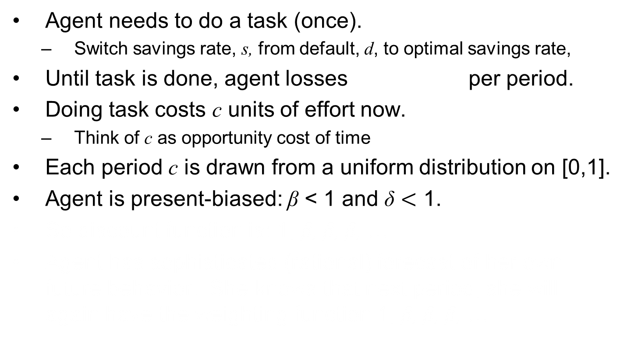
Specific Details
Agent needs to do a task (once).
  Switch savings rate, s, from default, d, to optimal savings rate,
Until task is done, agent losses per period.
Doing task costs c units of effort now.
  Think of c as opportunity cost of time
Each period c is drawn from a uniform distribution on [0,1].
Agent is present-biased: β < 1 and δ $<$ 1.
So discount function is: 1, β, β, β, …
Agent has sophisticated (rational) forecast of her own future behavior. She knows that next period, she will again have the weighting function 1, β, β, β, …

Slide 12
Timing of game
Period begins (assume task not yet done)
Pay cost θ (since task not yet done)
Observe current value of opportunity cost c (drawn from uniform distribution)
Do task this period or choose to delay again?
It task is done, game ends.
If task remains undone, next period starts.
Pay cost θ
Observe current value of c
Do task or delay again
Period t-1
Period t
Period t+1

Slide 13
Sophisticated procrastination
There are many equilibria of this game.
Let’s study the stationary equilibrium in which sophisticates act whenever c < c*. We need to solve for c*.
Let V represent the expected continuation payoff function if the agent decides not to do the task at the end of the current period t:
Likelihood of doing it in t+1
Likelihood of not doing it in t+1
Cost you’ll pay for certain in t+1, since job not yet done
Expected cost conditional on drawing a low enough c* so that you do it in t+1
Expected cost starting in t+2 if project was not done in t+1

Slide 14
In equilibrium, the sophisticate needs to be exactly indifferent between acting now and waiting.
Solve for c*.
Expected delay is:

Slide 16
How does introducing β < 1 change the expected delay time?
If β=2/3, then the delay time is scaled up by a factor of
In other words, it takes times longer than it “should” to finish the project

Slide 17
V vs. V hat

Slide 18
A model of procrastination: naifs
Same assumptions as before, but…
Agent has naive forecasts of her own future behavior.
She thinks that future selves will act as if β = 1.
So she (mistakenly) thinks that future selves will pick an action threshold of

Slide 19
In equilibrium, the naif needs to be exactly indifferent between acting now and waiting.
To solve for V, recall that:

Slide 20
Substituting in for V:
So the naif uses an action threshold (today) of
But anticipates that in the future, she will use a higher threshold of

Slide 21
So her (naïve) forecast of delay is:
And her actual delay will be:
Being naïve, scales up her delay time by an additional factor of 1/β.

Slide 22
Summary
If β = 1, expected delay is
If β < 1 and sophisticated, expected delay is
If β < 1 and naïve, anticipated delay is
If β < 1 and naïve, true delay is

Slide 23
Behavioral mechanism design
Specify a positive theory of consumer/firm behavior (consumers and/or firms may not behave optimally).
Specify a social welfare function, i.e. normative preferences (not necessarily based on revealed preference)
Solve for the institutional regime that maximizes the social welfare function, conditional on the theory of consumer/firm behavior.

Slide 24
We’ve provided a theory of consumer behavior.
Now solve for government’s optimal policy.
We need to solve for the optimal default, d.
The government’s objective is exponentially weighted, since it uses V as the welfare criterion.
The government doesn’t know the optimal level of savings, s* , for each individual (info asymmetry).

Slide 25
Two reasons for the planner to use a social welfare function with β=1.
This is the preference of all past selves for today.
  Including self zero.
  Including the planner at date zero.
  This is the long-run perspective.
This is the restriction that eliminates “present bias.”
However, this is a normative assumption.
This is an ‘if, then’ analysis.
If the planner has a social welfare function with β=1, then the following policies are socially optimal.

Slide 26

Total expected costs as a function of s* - d
Case of β = 1
Always act immediately
Always act immediately
Wait to act until a low cost period
$$\overline{c}$$
0
0
s* - d

Slide 27
Total expected costs as a function of s* - d
Case of β = 1
Always act immediately
Always act immediately
Wait to act until a low cost period
$$\overline{c}$$
0
0
s* - d

Slide 28
Total expected costs as a function of s* - d
Case of β < 1
Always act immediately
Always act immediately
$$\overline{c}$$
0
0
0
s* - d

Slide 29
Total expected costs as a function of s* - d
Case of β < 1
$$\overline{c}$$
0
0
-10
+10
s* - d
Automatic enrollment with a center default

Slide 30
Total expected costs as a function of s* - d
Case of β < 1
$$\overline{c}$$
0
0
-3
s* - d
+17
Automatic enrollment with an offset default

Slide 31
Optimal ‘Defaults’
Two classes of optimal defaults emerge from this calculation
  Automatic enrollment
    Optimal when employees have relatively homogeneous savings preferences (e.g. match threshold) and relatively little propensity to procrastinate
  Active Choice — require individuals to make a choice (eliminate the option to passively accept a default)
    Optimal when employees have relatively heterogeneous savings preferences and relatively strong tendency to procrastinate
Key point: sometimes the best default is no default.

Slide 32
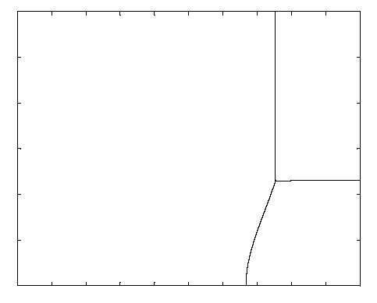
Preference Heterogeneity
30%
Low Heterogeneity High Heterogeneity
Offset
Default
Active Choice
Center
Default
0%
0
Beta
1

Slide 33
Lessons from theoretical analysis of defaults
  Defaults should be set to maximize average well-being, which is not the same as saying that the default should be equal to the average preference.
  Endogenous opting out should be taken into account when calculating the optimal default.
  The default has two roles:
    causing some people to opt out of the default (which generates costs and benefits)
    implicitly setting savings policies for everyone who sticks with the default

Slide 34
When might active choice be socially optimal?
Defaults sticky (e.g., present-bias)
Preference heterogeneity
Individuals are in a position to assess what is in their best interests with analysis or introspection
  Savings plan participation vs. asset allocation
The act of making a decision matters for the legitimacy of a decision
  Advance directives or organ donation
Deciding is not very costly

Slide 35
Empirical evidence on active choice
Carroll, Choi, Laibson, Madrian, Metrick (2009)
Active choice mechanisms require employees to make an active choice about 401(k) participation.
Welcome to the company
You are required to submit this form within 30 days of hire, regardless of your 401(k) participation choice
If you don’t want to participate, indicate that decision
If you want to participate, indicate your contribution rate and asset allocation
Being passive is not an option

Slide 37
Active choice in 401(k) plans
Active decision raises 401(k) participation.
Active decision raises average savings rate by 50 percent.
Active decision doesn’t induce choice clustering.
Under active decision, employees choose savings rates that they otherwise would have taken three years to achieve. (Average level as well as the multivariate covariance structure.)

Slide 38
Other active choice interventions
Active choice in asset allocation (Choi, Laibson, and Madrian 2009)
Active choice in home delivery of chronic medications (Beshears, Choi, Laibson, Madrian 2013)

Slide 39
The Flypaper Effect in Individual Investor Asset Allocation (Choi, Laibson, Madrian 2009)
Studied a firm that used several different match systems in their 401(k) plan.
I’ll discuss two of those regimes today:
Match allocated to employer stock and workers can reallocate
  Call this “default” case (default is employer stock)
Match allocated to an asset actively chosen by workers; workers required to make an active designation.
  Call this “active choice” case (workers must choose)
Economically, these two systems are identical.
They both allow workers to do whatever the worker wants.

Slide 40
Consequences of the two regimes
Balances in employer stock
 |  | Match Defaults into Employer Stock | Active choice
 | Own Balance in Employer Stock | 24% | 20%
 | Matching Balance in Employer Stock | 94% | 27%
 | Total Balance in Employer Stock | 56% | 22%

Slide 41
Prescription Drug Home Delivery
Beshears, Choi, Laibson, Madrian (2013)
  90 day fills (vs. 30 day for retail)
  Time saving (no trip to pharmacy)
  Convenient refill system
    Internet or phone
    More timing leeway than for retail fill
  Lower error rate (although error rates low for both channels)
  Lower cost to individuals, PBM, and employer health plan

Slide 42
Prescription Drug Coverage
 | Copay
Type of Prescription Drug | Retail (30 day max) | Home Delivery (90 day max) | Savings (90 day)
Generic | $8 | $20 | $4
Preferred brand, no generic available | $25 | $55 | $20
Preferred brand, generic available | 35% $35 min/$70 max | 35% $70 min/$140 max | $35 min/ $70 max
Non-preferred brand, excl. lifestyle drugs | 35% $70 min/$140 max | 35% $140 min/$280 max | $70 min/ $140 max
Non-preferred brand, lifestyle drugs | 85% | 80% | 5%
Notes:
Table 1. Prescription Drug Copayment Structure
This table summarizes the basic copayment structure in the firm’s prescription drug plan during the time period studied (the years 2007, 2008, and 2009). Some special categories of treatments (e.g., infertility) are omitted. A small number of drugs moved from one category to another during the sample period. Beginning in April 2008, some employees with certain chronic diseases were invited to enroll in a special program that offered reduced copayment amounts and rates, which are not shown. Note that costs in the home delivery column are for 90 day refills, whereas costs for retail are for 30 day costs.

Slide 43
Disadvantages of Prescription Drug Home Delivery (vs. Retail Pharmacy)
  Risk of theft
  Risk of privacy loss
  Reduces personal interaction with pharmacist

Slide 44
What would you choose?

Slide 45
Select Home Delivery: Active Choice for Home Delivery of Prescription Medication
Program designed to increase uptake of prescription drug home delivery
Examine adoption at a large U.S. company
Employees targeted for inclusion:
  Taking a medication on list of targeted long-term maintenance medications
  Not already using home delivery for targeted medication
Targeted employees contacted by e-mail, mail, and telephone starting November 2008
Notes:
Examine how an active choice approach works in the context of enrollment in home delivery for prescription drugs. Large U.S. employers adopts program to encourage employees enrolled in its health plans to make an active choice about whether they want home delivery or pharmacy pick-up for long-term maintenance medications. Program is called “Select Home Delivery” (SHD).

Slide 46
Select Home Delivery: Active Choice and Home Delivery of Prescription Drugs
Active decision approach: those targeted “required” to make active choice about home delivery or retail
  PBM will contact Dr. to get prescription if desired
  Different decisions for individual drugs allowed
Mechanisms to enforce active choice
  Each retail fill ➔ reminder from PBM until active choice is made
  After three retail fills w/o an active choice, payment denied (individual must pay full prescription cost out of pocket)
  Choice could be home delivery or retail pharmacy, but making a choice required for payment
Notes:
Employees do not have to choose home delivery, but they are given a deadline (three retail pharmacy refills) by which time they have to make a yes/no choice about whether they want home delivery. There is no penalty for choosing “NO”. Motivation behind program is a belief that many individuals would prefer home delivery but they simply don’t get around to signing up (procrastination).

Slide 47
Empirical Approach
Two observationally similar cohorts
  2007 cohort (pre-Select Home Delivery)
  2008 cohort (post-Select Home Delivery)
Outcomes of interest
  Participation in home delivery
  Adherence
Sample selection criteria for both cohorts
  Regular, full-time employee as of December 1st
  Employee filled a retail, long-term prescription for a targeted drug between October 12th and November 26th
  Employee did not fill a home delivery prescription for the same drug between May 1st and November 1st
Notes:
Empirical approach: Compare outcomes for targeted employees after SHD implemented with behavior of employees before SHD implemented. Use same targeting criteria to define pre-cohort.

Slide 48
Home Delivery Utilization for All Employees: 2006 to 2010
Notes:
This graph displays the fraction of prescriptions that are filled through Home Delivery in a given month. The universe is all prescription refills in a given month. Note that Home Delivery prescriptions need to be refilled less often, since the supply of medicine goes up to 90 days. The supply limit for a retail prescription fill is 30 days. The Select Home Delivery program was in effect during the time period marked by the red vertical lines (November 2008-October 2009). In November 2009, a more aggressive approach to increasing take-up of home delivery was adopted by the company which accounts for the increase in home delivery utilization in this period. We do not analyze this second program in this paper.

Slide 49
Home Delivery Adoption: Logit Regression (Marginal Effects)
 | No Controls |  | Add Controls
2008 Cohort | 0.338** | (0.004) | 0.348** | (0.004)
Female |  |  | -0.003 | (0.005)
Age |  |  | 0.003** | (0.0002)
Tenure (<2 yrs. Omitted)
2 to <5 yrs. |  |  | -0.022** | (0.006)
5 to <10 yrs. |  |  | -0.025** | (0.006)
10+ yrs. |  |  | -0.041** | (0.007)
Salary (1st quart. Omitted)
Salary 2nd quartile |  |  | 0.009 | (0.006)
Salary 3rd quartile |  |  | 0.026** | (0.006)
Salary 4th quartile |  |  | 0.059** | (0.006)
Number of targeted drugs |  |  | 0.0000 | (0.002)
Past PDC |  |  | 0.001** | (0.0001)
Past PDC missing |  |  | 0.048** | (0.007)
Rough savings ($100) |  |  | 0.008** | (0.003)
Disease class effects | No |  | Yes
Pseudo R² | 0.155 |  | 0.174
Sample size | 49,913 / 94,450 |  | 48,433 / 91,083
Notes:
The observations in this regression are uniquely identified by a combination of individual ID and medication GPI-4 code. In the second regression, standard errors are clustered by individual.

Slide 50
Prescription Drug Home Delivery: Requiring an Active Choice
Active choice ➔ big increase in home delivery: 6% to 40%
Among those who choose, we see a slight preference for home delivery
About 22% don’t make an active choice

Slide 51
Home Delivery, Retail, or No Choice: Multinomial Logit (Marginal Effects):
 | HD | Retail | No Choice
Female | -0.005 | 0.022** | -0.017**
Age | 0.004** | -0.0002 | -0.004**
Tenure (<2 yrs. Omitted)
2 to <5 yrs. | -0.036** | 0.036** | 0.0001
5 to <10 yrs. | -0.034** | 0.051** | -0.018*
10+ yrs. | -0.057** | 0.094** | -0.037**
Salary (1st quart. Omitted)
Salary 2nd quartile | 0.011 | -0.003 | -0.083
Salary 3rd quartile | 0.029** | -0.004 | -0.025**
Salary 4th quartile | 0.076** | -0.033** | -0.043**
Number of targeted drugs | 0.007** | 0.025** | -0.032**
Past PDC | 0.001** | 0.001** | -0.002**
Past PDC missing | 0.036** | 0.026* | -0.062**
Potential savings ($100) | 0.010* | 0.002 | -0.012*
Disease class effects | Yes
Pseudo R² | 0.052
Sample size | N=49,036

Slide 52
Characteristics by Choice Outcome
Home Delivery | Retail | No Choice
 | Female | Male
Older |  | Younger
Lower tenure | Higher tenure | Lower tenure
High paid | Lower paid | Lower paid
 | More drugs | Fewer drugs
High past PDC | High past PDC | Low past PDC
Missing PDC (newer script) | Missing PDC (newer script) | Have PDC (older script)
High savings |  | Low savings

Slide 53
Financial Benefits of Select Home Delivery Program
Annualized Cost Savings
 | Average
Individual | $444,683
Company | $377,981
Total | $822,664
Rough estimate: total annualized savings of
~$822,664 per year
  Does not include savings to PBM
  Not a steady state estimate

Slide 54
B. Optimal illiquidity
  Amador, Werning, and Angeletos. "Commitment vs flexibility." (2006)
  Beshears, Choi, Harris, Laibson, Madrian, Sakong “Which early withdrawal penalty attracts the most deposits to a commitment savings account?” (2020)
  Moser and Olea de Souza e Silva “Optimal Paternalistic Savings Policies” (2019)
  Beshears, Choi, Clayton, Harris, Laibson, Madrian, “Optimal Illiquidity” (2022)

Slide 55
Is liquidity in the US retirement system socially optimal?
For every $1 that flows into the U.S. defined contribution system (for households 55 and under), $0.40 simultaneously flows out.
  Argento, Bryant, and Sabelhaus (2014)
Is this a good thing or a bad thing?

Slide 56
International comparison of employer-based DC retirement accounts
Beshears, Choi, Hurwitz, Laibson, Madrian (2015)
United States:
  liquidity (10% penalty or no penalty)
Canada, Australia:
  no liquidity, unless long-term unemployed
Germany, Singapore, UK:
  no liquidity (from retirement accounts)
  Who has it right?

Slide 57
Questions
Is this too much leakage?
Is 10% the right penalty?
  1970s Senate wanted 30% penalty
  1970s House wanted 10% penalty

Slide 58
To answer these questions, we’re going to employ behavioral welfare economics.
Three ingredients:
A positive theory of human behavior
A normative criterion: planner’s objective
Derivation of the policies/institutions that maximize “2” subject to the constraints imposed by “1.”
Our analysis builds on that of Amador, Werning, Angeletos (2006).

Slide 59
Behavioral mechanism design
(cf. Angeletos, Werning, and Amador 2006)
A positive theory of consumer behavior:
  Quasi-hyperbolic (present-biased) consumers
A normative social welfare function
Solve for the institutions that maximize the social welfare function, conditional on the theory of consumer behavior.

Slide 60
1. A positive theory of consumer behavior
Present-biased preferences
Taste shifters (e.g., medical bills)
N savings accounts

Slide 61
Fundamental tradeoff
Limited self-control
  Motivates illiquidity
But unpredictable, uninsurable legitimate spending needs exist
  Motivates flexibility

Slide 62
Model setup
Households live for 2 periods
  Period 1 = working life
  Period 2 = retirement
Consumption in period 1, produces utils $θu\left(c1\right)$
$θ$ is random variable representing how valuable pre-retirement spending is
Consumption in period 2, produces utils$u\left(c2\right)$

Slide 63
Benevolent social planner
Social planner’s preference over household’s consumption given by
$$θu{{(c}_{1})}+δu(c_{2})$$
$δ$ is classical discount factor
$θ$ can’t be observed by planner, but planner knows population-wide distribution of $θ$

Slide 64
Household preferences
Household’s preference over consumption given by
$$θu(c_{1})+βδu{(c_{2})}$$
Present bias term $β$ is between 0 and 1
  Represents excessive impatience
  Lower value = more excessive impatience

Slide 65
Savings accounts
At time 0, planner sets up N savings accounts with linear early withdrawal penalties.
For each account, planner chooses
  $x_{n}$: allocation to the n’th account
  $π_{n}$: penalty for early withdrawal

Slide 66
Planner’s optimization problem
M$ax \iint{\left[θu\left(c_{1}\left(θ,β\right)\right)+δu\left(c_{2}\left(θ,β\right)\right)\right]dF\left(θ\right)dG(β)}$
By creating and populating savings accounts:
  $\{{(x}_{1}$, $x_{2}$, $…, x_{N})$, ${(π}_{1}$, $π_{2}$, $…, π_{N}$) }
Subject to an aggregate budget constraint:
$$\sum_{n}{x_{n}=Y+\sum_{n}{{π_{n}\left(\int{\int{w_{n}\left(θ,β\right)}dF\left(θ\right)dG(β)}\right)}_{}}}$$
  where $w_{n}(θ,β)$ is the equilibrium quantity of early withdrawals from illiquid account n of a household with taste-shifter $θ$ and present-bias discount factor $β$.
Households choose $c_{1}\left(θ,β\right)$ and $c_{2}\left(θ,β\right)$ subject to their present-biased preferences, naïve beliefs, and piecewise linear budget set.

Slide 67
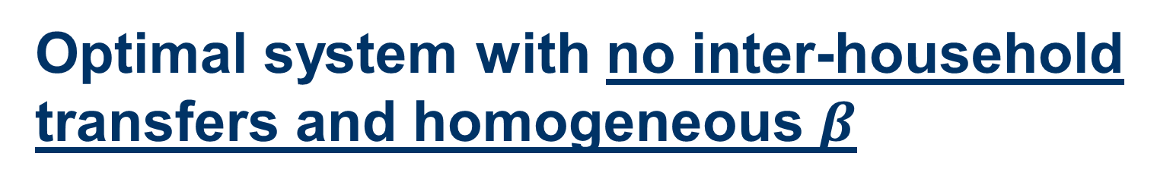
Optimal system with no inter-household transfers and homogeneous $β$
Planner can’t redistribute early-withdrawal penalties collected
  Penalties are “burned”
Everybody has same degree of self-control
Theorem: Optimal system has only 2 accounts: one completely liquid account and one completely illiquid account (Angeletos, Werning, and Amador, 2006)
Illiquid account like Social Security or DB pension

Slide 68
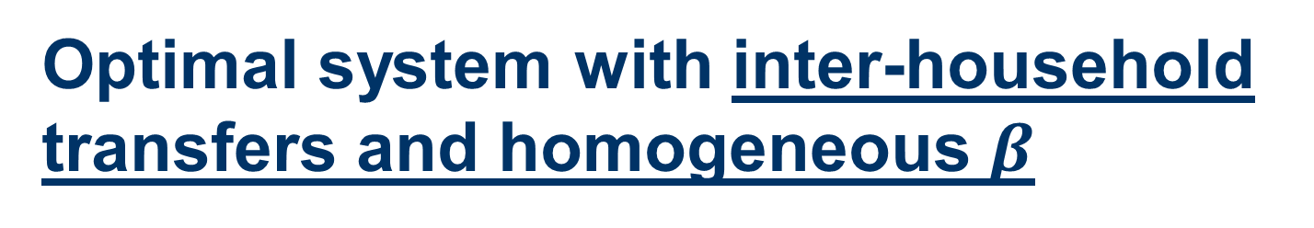
Optimal system with inter-household transfers and homogeneous $β$
Planner can redistribute early-withdrawal penalties collected
Everybody has same degree of self-control
Theorem: A system with one completely liquid account and one completely illiquid account is not optimal

Slide 69
N=1 account is approximately optimal
Social welfare gain (relative to laissez faire) expressed as a percentage of the endowment for an economy with $β=0.6.$
One account: 2.794%
Two accounts: 2.860%
General mechanism: 2.881%

Slide 70
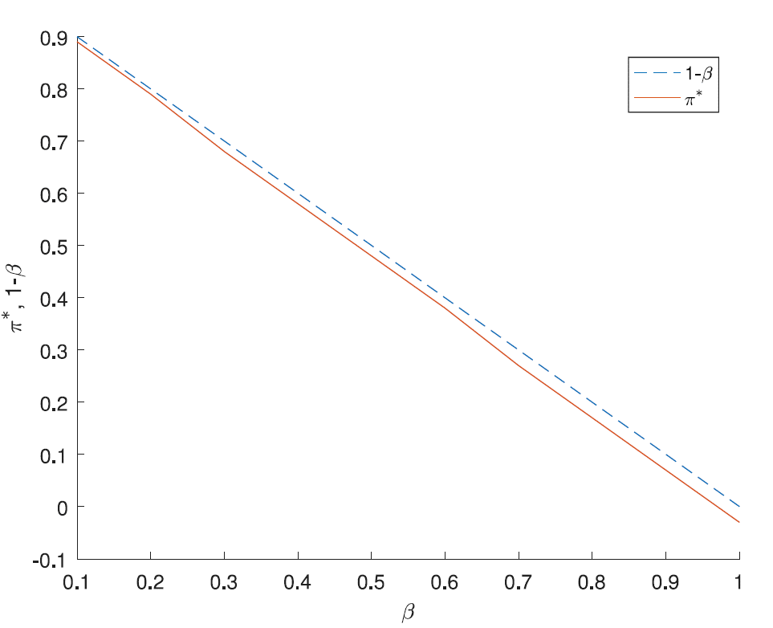
Optimal penalty

Slide 71


Optimal system with inter-household transfers and heterogeneous $β$
Planner knows distribution of $β$ values but doesn’t know who is who.

Slide 72
N=2 accounts is approximately optimal
Social welfare gain (relative to laissez faire) expressed as a percentage of the endowment
Two flexible accounts: 6.136%
Liquid + illiquid: 6.105%
Liquid + flexible + illiquid: 6.137%
General mechanism: 6.144%

Slide 73
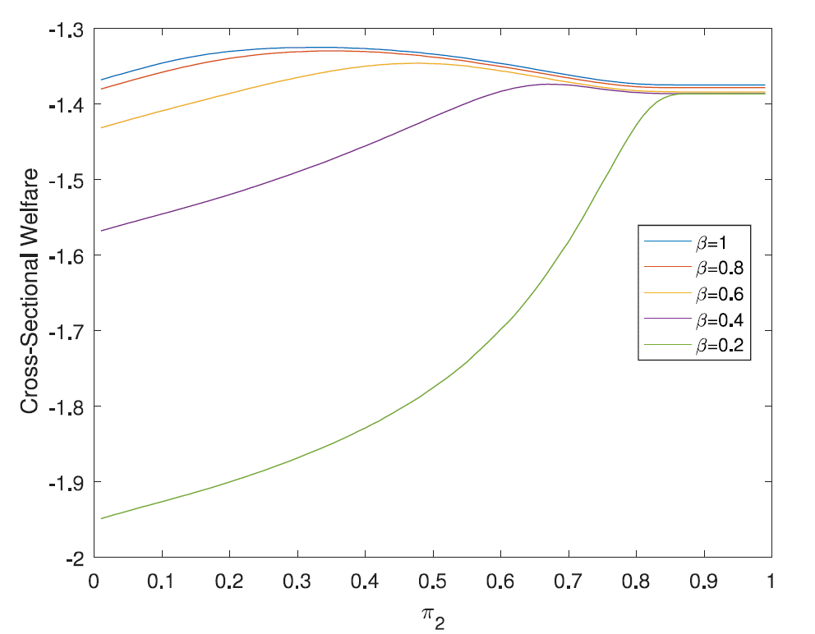
Two-account system: $π_{1}=0,π_{2}>0$

Slide 74
US-style system
liquid account
illiquid account
account with 13% early withdrawal penalty
Welfare gain from third account is 0.032%
Leakage rate from the third account is 90%

Slide 75
Structure of accounts in U.S. retirement savings system might be close to optimal, but…
Within highly simplified model:
Two accounts, one fully liquid and one fully illiquid, achieves almost all possible welfare gains
401(k)/IRA system adds only a little to welfare
  10% withdrawal penalty is approximately optimal
  High leakage is optimal
However, the model implies that the fully illiquid account should be populated with far more (forced) savings than we see in the U.S.
  Some of that leakage is for legitimate purposes
  Penalties generated by leakage benefit the rest of us

Slide 79
Caveat
Our planner optimizes the amount deposited in each account
Planner chooses allocations that generate approximate consumption smoothing even for agents who consume everything they can in the first period
This is not consistent with the status-quo U.S. system

Slide 80
$θ$ distribution
Normal distribution with mean 1, standard deviation 0.25, truncated at 1/3 and 5/3

Slide 81
Third Example: EITC
(Earned Income Tax Credit)
Lockwood (2020)
What is the optimal income tax system?
Can we explain negative marginal income taxes?
Note that standard redistribution motives (without present bias) lead the planner to give low income workers a lump sum transfer, not a negative marginal income tax.

Slide 82
Basic ingredients of the model.
Labor supply is endogenous and ability is unobservable by the government.
Planner is not present-biased.
Households are present biased.
Low income households have the most present bias.

Slide 83
Notation for planner’s problem:
Ability: output/hour
(unobservable)
Fixed cost of working
Consumption
Income
Planner’s
objective
Welfare
weight
Tax
function
CDF
of ability

Slide 84
Household’s optimization problem
(with present bias).
Present bias at the household level

Slide 85
Heterogeneous present bias

Slide 87
Summary of behavioral mechanism design
Specify a positive theory of consumer/firm behavior (consumers and/or firms may not behave optimally).
Specify a social welfare function (not necessarily based on revealed preference)
Solve for the institutional structure that maximizes the social welfare function, conditional on the theory of consumer/firm behavior.

Slide 88
Today:
Three examples of behavioral mechanism design:
  A. Optimal defaults: what default should an enlightened planner set?
  B. Optimal illiquidity: how illiquid should retirement savings be?
  C. How should we tax/subsidize wage earners?

