Slide 1

Choice Architecture and Nudges
David Laibson
July 15, 2022

Slide 2
Nine claims about household finance
Households:
Have low levels of financial literacy
Have very few liquid assets (live hand to mouth)
Have substantial illiquid wealth
Have a high MPC out of liquid wealth and liquidity
Have a low MPC out of illiquid wealth
Don’t choose optimal financial service products
Barely change their behavior after financial education interventions
Have misaligned financial intentions and financial actions
Make financial choices that are seemingly easy to manipulate (today)

Slide 3
Nudges
Nudges appear to work in the financial domain
Nudges in the long-run (modest effects)
The health domain
A framework for thinking about nudges

Slide 4

Opt-in enrollment
Opt-out enrollment (auto-enrollment)
PROCRASTINATION
UNDESIRED BEHAVIOR:
Non-participation
DESIRED BEHAVIOR:
participation
START HERE
Madrian and Shea (2001); Choi, Laibson, Madrian, and Metrick (2002)

Slide 5
Active Choice
PROCRASTINATION
UNDESIRED BEHAVIOR:
Non-participation
DESIRED BEHAVIOR:
participation
Must choose for oneself
START HERE
Carroll, Choi, Laibson, Madrian, Metrick (2009)

Slide 6
Quick enrollment
PROCRASTINATION
UNDESIRED BEHAVIOR:
Non-participation
DESIRED BEHAVIOR:
participation
START HERE
Beshears, Choi, Laibson, Madrian (2013)

Slide 7

Quick enrollment
PROCRASTINATION
UNDESIRED BEHAVIOR:
Non-participation
DESIRED BEHAVIOR:
participation
START HERE
Beshears, Choi, Laibson, Madrian (2013)

Slide 8
Participation in 401K plans
(for a typical firm)
Default non-enrollment (opt in)
40%
Quick Enrollment
(“check a box”)
50%
Active choice (perceived req’t to choose)
70%
Default enrollment (opt out)
90%
Participation Rate (1 year of tenure)

Slide 9

Automatic Enrollment is Dramatically Increasing Savings Plan Participation in the UK
Mandatory automatic enrollment phased in from 2012-2017 by firm size
Opt-out rate of 9-10%
~39 percentage point increase in workplace savings plan participation from 2012-2017

Slide 10
Savings Experiment in Afghanistan
Blumenstock, Callen, and Ghani (2018)

Slide 11
Gauging employee attitudes to automatic enrollment
In surveys, 97% of employees in auto-enrollment firms report that they approve of auto-enrollment.
Even among employees who opt out of automatic enrollment, 79% report that they approve of auto-enrollment

Slide 12
Save More Tomorrow (SMarT)
Benartzi and Thaler (2004)
People pre-commit to saving more in the future.
Saving increases are synchronized with salary increases.
People remain in the plan unless they drop out.

Slide 13
Save More Tomorrow (SMarT)
Benartzi and Thaler (2004)
  Manufacturing firm hired a financial consultant to advise employees on how much to save
  Financial consultant typically advised 5% increases
  If participants did not accept the advice, they were offered the SMarT program

Slide 14
The First SMarT Program (cont.)
  Participants precommit to increase their saving rate by 3% per year
  Saving increases synchronized with pay raises
  The increases continue unless the participant opts out or hits the plan max

Slide 15
Participation Data

Slide 16
Saving Rates

Slide 17
Evidence on Asset Allocation
Private account component of Swedish Social Security system (Cronqvist and Thaler, 2004)
  At inception, one-third of assets are invested in the default fund
  Subsequent enrollees invest 90% of assets in the default fund
Company match in employer stock (Choi, Laibson and Madrian 2009)

Slide 18
Active Choice
PROCRASTINATION
UNDESIRED BEHAVIOR:
Non-participation
DESIRED BEHAVIOR:
participation
Must choose for oneself
START HERE

Slide 19
The Flypaper Effect in Individual Investor Asset Allocation (Choi, Laibson, Madrian 2009)
Studied a firm that used several different match systems in their 401(k) plan.
I’ll discuss two of those regimes today:
Match allocated to employer stock and workers can reallocate
  Call this “default” case (default is employer stock)
Match allocated to an asset actively chosen by workers; workers required to make an active designation.
  Call this “active choice” case (workers must choose)
Economically, these two systems are identical.
They both allow workers to do whatever the worker wants.

Slide 20
Consequences of the two regimes
Balances in employer stock
 |  | Match Defaults into Employer Stock | Active choice
 | Own Balance in Employer Stock | 24% | 20%
 | Matching Balance in Employer Stock | 94% | 27%
 | Total Balance in Employer Stock | 56% | 22%

Slide 21
Regulatory use of defaults: Card Act
Agarwal, Chomsisengphet, Mahoney, Stroebel (2014)
CARD Act: signed into law on May 22, 2009.
Primarily amended the Truth in Lending Act and instituted a number of new protection and disclosure requirements for credit cards.
The regulation excluded small business credits cards.
The provisions of the CARD Act were scheduled to take effect in three phases between August 20, 2009, and August 22, 2010.

Slide 22
Card Act: Phase 1 – August 20, 2009:
Required banks to provide consumers with 45-day advance notice of rate increases or any other significant changes to terms and conditions.
Required lenders to (i) inform consumers in the same notice of their right to cancel the credit card account before the increase or change goes into effect and (ii) mail or deliver periodic statements for credit cards at least 21 days before payment is due.

Slide 23
Card Act: Phase 2 – February 22, 2010:
No fees could be imposed for making a transaction that would put the account over its credit limit unless the cardholder explicitly “opts in” for the credit card company to process rather than decline over-limit transactions.
Furthermore, an over limit fee may be imposed only once during the billing cycle in which the limit is exceeded.
Required statements to display:
  Number of months and total cost to the consumer (principal and interest) that it would take to pay the outstanding balance, if the consumer pays only the required minimum payments;
  The monthly payment amount that would eliminate the outstanding balance in 36 months and the total cost to the consumer, including interest and principal.

Slide 24
Card Act: Phase 3 – August 22, 2010:
Regulated the fees banks can charge by requiring them to be “reasonable and proportional.”
Cannot charge a late fee of more than $25 unless one of the last six payments was late (in which case the fee may be $35).
Late fee cannot be larger than the minimum payment.
Over limit fees capped at the actual over limit amount.
Prevented issuers from charging more than one penalty fee per violation in a single billing period.
Prohibited the charging of inactivity fees for not using the credit card for a period of time.
Required lenders to re-evaluate any new rate increases every six months.

Slide 25
Regulatory use of defaults: Card Act
Agarwal, Chomsisengphet, Mahoney, Stroebel (2014)

Slide 26
Agarwal, Chomsisengphet, Mahoney, Stroebel (2014)

Slide 27
However, there is a new wave of evidence on leakage and crowd-out
Argento, Bryant, Sabelhaus (2014): for households under age 55, retirement savings account inflows are offset by substantial outflows (40% of the inflows).
Beshears et al (2017): four years after hire, leakage offsets about 1/4 of the positive effect of auto-enrollment.
Beshears et al (2019): four years after hire, automatic enrollment may increase auto loan balances and first mortgage balances. The net savings effect of auto-enrollment is ambiguous.
Choukhmane (2019): There are dynamic crowd-out effects, which substantially limit the long-term net worth effects of auto-enrollment.

Slide 28
Jachimowicz, Duncan, Weber, Johnson (2019)
Meta-study of 58 default studies (N=73,675)
Average effect size is 0.68 standard deviations
This paper codes auto-enrollment (Madrian and Shea 2001) as having an effect size of approximately one standard deviation.
This effect represents that effect on participation at one-year of tenure.
However, the medium-run effect on average saving at this firm is zero (Choi, Laibson, Madrian, and Metrick 2004)

Slide 29
Nudges
Nudges appear to work in the financial domain
Nudges in the long-run
The health domain
A general framework for thinking about nudges

Slide 30
A history of auto-enrollment
3. Auto-enrollment in 401(k) plans
Thaler (1994): auto-enrollment (AE) policy proposal
Madrian and Shea (2001): first empirical study of AE, including documentation of off-set savings effects
Choi, Laibson, Madrian, and Metrick (2004): empirical evidence of small medium-run savings and wealth formation effects from AE with low default savings rate
Benartzi and Thaler (2004): auto-escalation policy proposal and implementation (with opt-in)
Choukmane (2019): replication of Choi et al (2004), documentation of cross-firm AE crowd-out, and structural model implying a $250 transaction cost for opt-out
Dubner (2019): AE is “the most successful nudge, and the greatest triumph to date of behavioral economics.”
Beshears et al (2022a,2022b): modest long-run effects

Slide 31
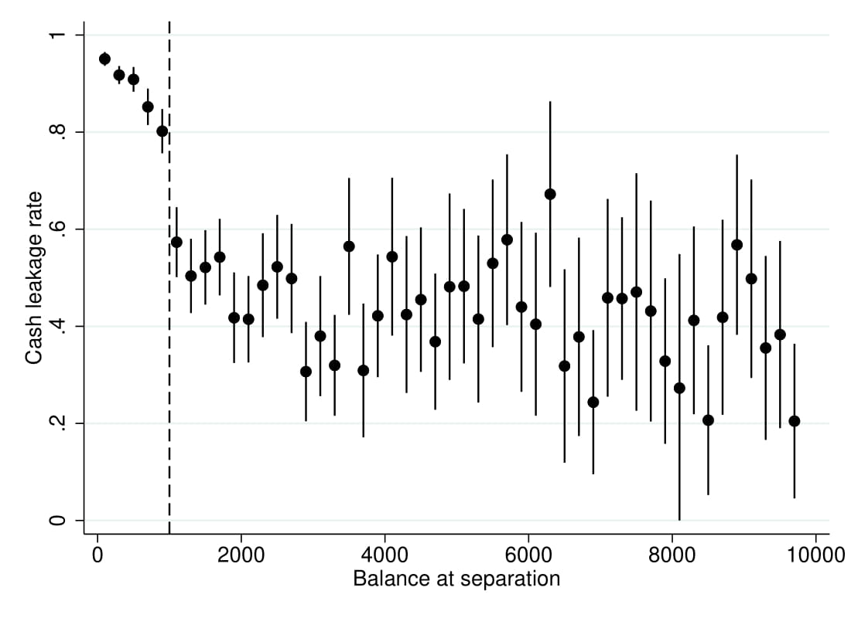
Cash leakage rate at tenure year 5
Beshears et al (2022)

Slide 32
Beshears et al (2022)
US auto-savings only modestly increases long-run wealth formation
Culprits:
  Employees frequently adjust contribution rate
    Diminishes difference between auto-enrolled and non-auto-enrolled employees
  Most employees leave company within a few years
    Auto escalation can’t push savings rate to high level for early leavers
  Job transition frequently triggers withdrawals in the US
    Particularly among low-income workers, who are most powerfully affected by auto-policies in the first place (while still employed by firm)

Slide 33
“The semblance of success in nudging consumers to pay down credit card debt”
Paul Adams, Ben Guttman-Kenney, Lucy Hayes, Stefan Hunt, David Laibson, Neil Stewart (2018)
Research led by the Financial Conduct Authority.

Slide 34
“Semblance of success”
40,708 UK credit cards newly issued in 2017
  Cardholders who attempt to set up an automatic payment are randomized into control and treatment

Slide 35
Control arm

Slide 36
Control arm

Slide 37
Treatment arm

Slide 38
Selection of automatic payment at the 2nd statement cycle for Control arm (left) and Treatment arm (right)
Automatic
full
Automatic
fixed
36.9%
9.6%
Automatic
Minimum
No Automatic
Control
Treatment

Slide 39
“Semblance of success”
However, the intervention has no effect on more important outcomes: total debt repayments, credit card spending, borrowing costs or debt net of payments.
Consumers in the treatment arm pick small automatic fixed payments (though they are larger than the minimum payment) and also offset these increased automatic payments by reducing the value of their ad hoc manual payments.

Slide 40
Some evidence on long-run behavior
Long-run ‘true’ effects smaller than short-run (proximate) effects.
Auto-feature nudge in retirement savings domain:
  Long-run true effect: small increase in retirement savings
  Short-run (proximate) effects: large increase in participation rate during 1st year of tenure
(Anti-) minimum payment nudge in credit card domain:
  Long-run true effects: no change in credit card debt
  Short-run (proximate) effects: large reduction in the use of automatic minimum payment

Slide 41
Defined Benefit Pension Annuitization
Effect of joint-and-survivor default on annuitization
  Pre-1974: Less than half of married men have joint-and-survivor annuity
  Post-ERISA (I + II): joint-and-survivor annuitization increases 25 percentage points (Holden and Nicholson 1998)
  Post-1984 amendments: joint-and-survivor annuitization increases 5 to 10 percentage points (Saku 2001)

Slide 42
Other weak default effects in the savings domain
Many/most households opt out of Defined Benefit annuitization (see Previterro 2010; Banerjee 2013)
  73% take cash-out
Most households generally opt out of aggressive defaults (Beshears, Choi, Laibson, and Madrian 2010)
Low income households are stickier than high income households (Beshears, Choi, Laibson, Madrian, and Wang 2016).

Slide 43
Social marketing and peer effects
Beshears, Choi, Laibson, Madrian, Milkman (2011)
How does information about your peers affect savings behavior?

Slide 44
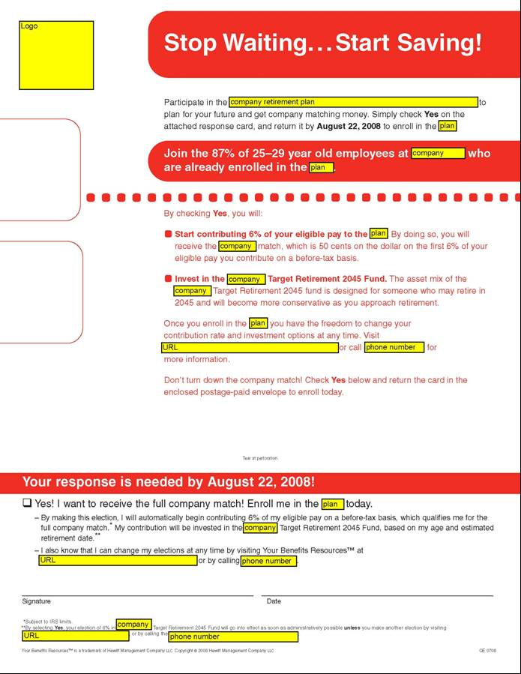
Notes:
44

Slide 45
Variation in peer information has no net impact on savings behavior
Small perverse effects for unionized workers
Small positive effect for non-unionized workers
Sources of variation of peer information:
  Exclusion vs. inclusion of peer information
  Variation in peer success (due to variation in comparison group)
All sources of variation generate consistent findings.

Slide 46
4. Behavioral mechanism design
Specify a social welfare function (not necessarily based on revealed preference)
Specify a theory of consumer/firm behavior (consumers and/or firms may not behave optimally).
Solve for the institutional structure that maximizes the social welfare function, conditional on the theory of consumer/firm behavior.

Slide 47
Specific example of behavioral mechanism design: optimal defaults
Empirical evidence on active choice

Slide 48
Nudges
Nudges appear to work in the financial domain
Nudges in the long run
The health domain
A framework for thinking about nudges

Slide 49
Translation to the health domain
Similarities with saving behavior:
Individuals and society have aligned goals
  Improve health and control costs
Individuals want behavior change (just not right now)
  Improve diet
  Increase physical activity
  Stop smoking
  Adhere to therapeutic recommendations
  Utilize wellness programs

Slide 50
Information and disclosure generally don’t do much on their own
Example
New York City calorie disclosure
(Elbel et al 2009)
Calories from
fast food purchases
 | Before | After
NYC (intervention city) | 825 | 846
Newark (control city) | 823 | 826

Slide 51

Flu shot study: Control Condition
Employees informed of the dates/times of
workplace flu clinics

Slide 52

Flu Shot Study: Date Plan Condition
Employees invited
to choose a concrete
DATE for getting
a flu vaccine
Employees informed
of the dates/times of
workplace flu clinics

Slide 53

Date/Time Plan Condition
Employees invited
to choose a concrete
DATE AND TIME for
getting a flu vaccine
Employees informed
of the dates/times of
workplace flu clinics

Slide 54
Flu shot adherence
Milkman, Beshears, Choi, Laibson, and Madrian 2011
Flu shot letter
33.0%
Flu shot letter
+ date plan
34.6%
Flu shot letter
+ date plan
+ time plan
37.2%

Slide 55
Use Active Choice to encourage adoption of Home Delivery of chronic medication
Beshears, Choi, Laibson, and Madrian (2021)
Voluntary
No plan design change
Lower employee co-pay
Time saving for employee
Lower employer cost
Better medication adherence
Improved safety
Past Member of Express Scripts Scientific Advisory Board
(Payments donated to charity by Express Scripts.)

Slide 56
Home Delivery Utilization for All Drug Classes
%
Beshears, Choi, Laibson, Madrian (2012)
Notes:
This graph displays the fraction of prescriptions that are filled through Home Delivery in a given month. The universe is all prescription refills in a given month. Note that Home Delivery prescriptions need to be refilled less often, since the supply of medicine goes up to 90 days. The supply limit for a retail prescription fill is 30 days. The Select Home Delivery program was in effect during the time period marked by the red vertical lines (November 2008-October 2009). In November 2009, a more aggressive approach to increasing take-up of home delivery was adopted by the company which accounts for the increase in home delivery utilization in this period. We do not analyze this second program in this paper.

Slide 57
Results from pilot study on 54,863 employees without home delivery taking chronic medication
Among those making an active choice:
Fraction choosing home delivery: 52.2%
Fraction choosing standard pharmacy pick-up: 47.8%

Slide 58
Results from pilot study at one company
Rxs by Mail*
After
Annual Savings at pilot company
Plan | $350,000+
Members | $820,000+
Total Savings | $1,170,000+
Before
* Annualized

Slide 59
Nudges
Nudges appear to work in the financial domain
Nudges in the long run
The health domain
A framework for thinking about nudges

Slide 60
Outline
Seemingly minor nudges affect behavior
At least four psychological factors jointly contribute to these effects
  Financial illiteracy
  Endorsement
  Complexity and transaction costs
  Present-bias
  (Status quo bias/Loss Aversion)
The surprising weakness of incentive- and information-based interventions
Extensions to health domain

Slide 61
Effect size in Madrian and Shea (2001)
4. Three nudge meta-studies
37% enrollment vs. 86% enrollment
[(0.37)(0.63)+(0.14)(0.86)]/2 = 0.18
So pooled s.d. is 0.42
So Cohen’s d for this example is 0.49/0.42

Slide 62
Dellavigna and Linos (2020)
All data from two Nudge Units:
  SBST/OES, 2015-present
  BIT North America 2015-present
Each unit shared its complete record of results
  All have a pre-analysis plan
  90% of trials unpublished in academic journals
Average treatment effect: 1.3 percentage points (using “participation” rates as the domain).
N = 24 million

Slide 63
Behavior Change for Good (2019)
52 RCT’s (N~63,000)
Field experiments conducted with gym members: 24-Hour Fitness
Replication of previously successful effects of reminders, implementation intentions, financial incentives
0/52 new interventions have significant effects
When researchers who designed these interventions were surveyed in advance they reported a 40% likelihood that their own experiment would work.

Slide 64
A framework for thinking about nudge effects
4. A general framework for thinking about nudges
 | Large Welfare | Small Welfare | No Welfare | Adverse Welfare
Large Proxy
Small Proxy
No Proxy
Adverse Proxy

Slide 65
A framework for thinking about nudge effects
4. A general framework for thinking about nudges
 | Large Welfare | Small Welfare | No Welfare | Adverse Welfare
Large Proxy
Small Proxy
No Proxy
Adverse Proxy

Slide 66
A framework for thinking about nudge effects
4. A general framework for thinking about nudges
 | Large Welfare | Small Welfare | No Welfare
Large Proxy
Small Proxy
No Proxy

Slide 67
A framework for thinking about nudge effects
4. A general framework for thinking about nudges
 | Large Welfare | Small Welfare | No Welfare
Large Proxy
Small Proxy
No Proxy

Slide 68
A framework for thinking about nudge effects
4. A general framework for thinking about nudges
 | Large Welfare | Small Welfare | No Welfare
Large Proxy
Small Proxy
No Proxy

Slide 69
A framework for thinking about nudge effects
4. A general framework for thinking about nudges
 | Large Welfare | Small Welfare | No Welfare
Large Proxy
Small Proxy
No Proxy

Slide 70
Illustrative cases
4. A general framework for thinking about nudges
 | Large Welfare | Small Welfare | No Welfare
Large Proxyx | Bettinger et al (2012) FAFSA assistance | Madrian & Shea (2001) AE in 401(k) plans | Adams et al (2019) Shroud option for automatic minimum credit card payment
Small Proxyx |  | Milkman et al (2011) Implementation intention for vaccination | Choi et al (2011) Education targeting 401(k) savings
No Proxyx |  |  | Beshears et al (2015) Peer norming for retirement saving

Slide 71
Why do most welfare effects tend to be small?
4. A general framework for thinking about nudges
In most cases, welfare effects involve cumulated behavior (that’s why we use short-run proxies –waiting for the cumulative effects to play out is methodologically hard)
Welfare effects are driven by persistent mechanisms that tend to substantially undo the proxy effects of transitory nudge interventions.
These persistent mechanisms include deep preferences, biases, and institutions
(But we should still “nudge”, because the benefits, however small on average, vastly exceed the costs)

Slide 72
Nine claims about household finance
Households:
Have low levels of financial literacy
Have very few liquid assets (live hand to mouth)
Have substantial illiquid wealth
Have a high MPC out of liquid wealth and liquidity
Have a low MPC out of illiquid wealth
Don’t choose optimal financial service products
Barely change their behavior after financial education interventions
Have misaligned financial intentions and financial actions
Make financial choices that are seemingly easy to manipulate

