Slide 1
Misunderstanding and Mispredicting Preferences
George Loewenstein

Slide 2
Narratives and Valuations (joint with Dor Morag (a fellow ‘summer-camper’))
Initial experiments
Participants: 483 Prolific workers (study 1); 1010 Mturk workers (Study 2)
Subjects identified and provided a picture of an item they owned without knowing why.
  Exp1: mug of special significance to them;
  Exp2: randomized to hat of special significance or miscellaneous hat.
Randomized to either list (in bullet form) the characteristics of the item (list condition), or tell its story – e.g., how they came to posses it (narrative condition).
WTA elicited using a Multiple Price List (MPL) mechanisms (Three questions verified their understanding of the transaction).
  Exp 1: 40 selling decisions between $1 and $100
  Exp 2: 48 selling decisions between $1 and $300
For a subset of participants (1 of 25 in Exp 1, unspecified in Exp 2), one decision was randomly selected to be binding.
Morag, Dor and Loewenstein, George Narratives and Valuations (September 8, 2021). Available at SSRN: https://ssrn.com/abstract=3919471

Slide 3
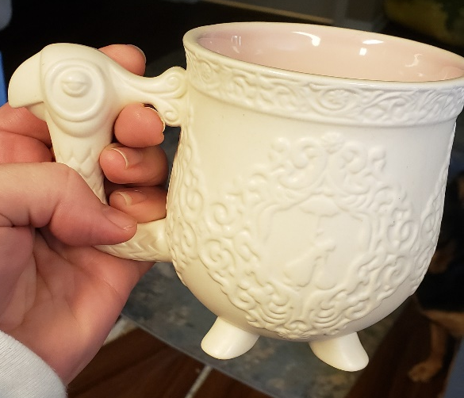
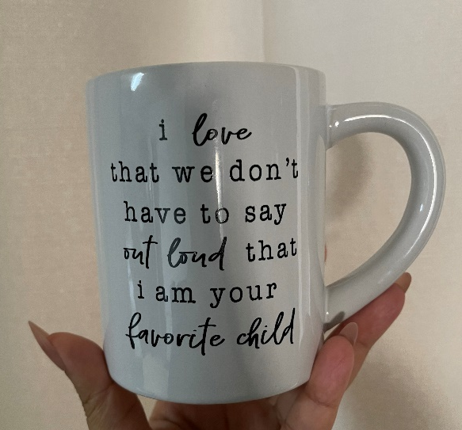
Example observations
Narrative condition: “I grew up loving Mary Poppins. I would watch it over and over again until our VHS tape wore out and we had to get a new one. I saw this mug many times while visiting Disney World, but never let myself buy it. Then it went on clearance and became mine!“
  WTA=$20, and $100 randomly selected.
List condition:
    “white
    black writing
    side handle
    easy to carry
    microwave safe"
  WTA=$15, and $40 randomly selected.

Slide 4
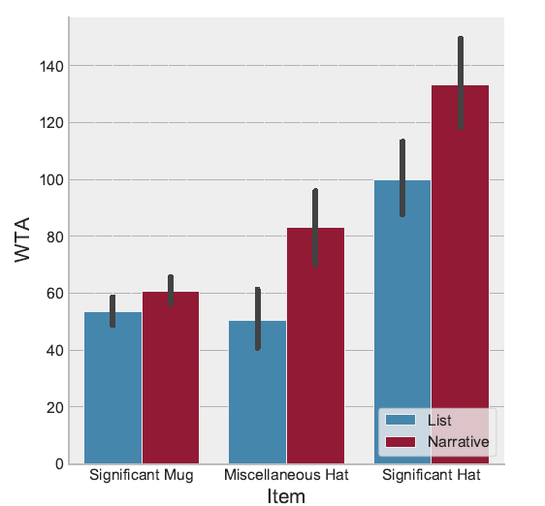
Results: Mean WTA by Experimental Condition (both experiments)
Unwilling to sell (UWS):
Item | List condition | Narrative condition
Significant mug (WTA>$100) | 21% | 33%
Miscellaneous hat (WTA>$300) | 6% | 14%
Significant hat (WTA>$300) | 12% | 25%
Analysis of WTP/WTA to trade item for equivalent new version showed similar effects
UWS were top-coded as if they were willing to sell at the highest price in the MPL

Slide 5
Is this economics?

Slide 6
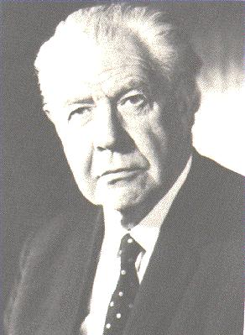
Neoclassical economic theory “is capable of being set out and defended in absolutely non-hedonistic terms” and has no “essential connection with psychological hedonism, or for that matter with any other brand of Fach-Psychologie…
Why the human animal attaches particular values in this sense to particular things, is a question which we do not discuss. That is quite properly a question for psychologists or perhaps even physiologists.”
Lionel Robbins (1932)
Robbins, L. R. B. (1932). The nature and significance of economic science (Vol. 2). London: Macmillan.

Slide 7
Two notions of utility
Traditional economics (Hicks/Allen/Samuelson): ordinal index of preference (revealed by choices)
  little content other than consistency (e.g., Sen, 1977) (and consistency makes little sense)
Kahneman: Decision Utility versus Experience Utility
  Decision utility: close to economic conception
  Experience utility: close to Benthamite conception of utility as happiness
Kahneman, D., Wakker, P. P., & Sarin, R. (1997). Back to Bentham? Explorations of experienced utility. The quarterly journal of economics, 112(2), 375-406.

Slide 8
Distinction between decision and experience utility opens door to many interesting questions
Can people predict their own decision utility (what they will choose in the future)?
Can people predict their own experience utility (happiness, what will make them happy)?
Do two types of utilities correspond; do decisions maximize happiness?
My focus today: predictions of decision utility
  Do people know what they will want/choose (not what will make them happy) in the future?

Slide 9
Predicting preferences
Many important decisions require predicting future preferences – e.g.,
  Choosing a job
  Deciding where to live
  Committing to having a baby
  Buying a durable good
One major cause of misprediction: projection¹
Cognitive projection:
  Hindsight bias (exaggerating degree to which whatever happened could have been foreseen)
  Curse of knowledge (overestimating the degree to which other people know whatever you know)
Preference projection:
  Preferences are state-dependent: u(x,s) (states include all factors that exert a transitory influence on preferences)
  People ‘project’ their current state-dependent preferences on themselves in the future – they assume that these preferences will be more similar to their current preferences than will be the case
¹Projection: concept proposed by Freud in which humans defend themselves against thoughts or feelings they find unacceptable by attributing them to others
Loewenstein, O'Donoghue & Rabin (2003). Projection bias in predicting future utility. Quarterly Journal of Economics, 118, 1209-1248.
Van Boven & Loewenstein (2003). Social projection of transient drive states. Personality and Social Psychology Bulletin, 29(9), 1159-1168.
Loewenstein (2005). Projection bias in medical decision-making. Medical Decision Making, 25, 96-105.

Slide 10
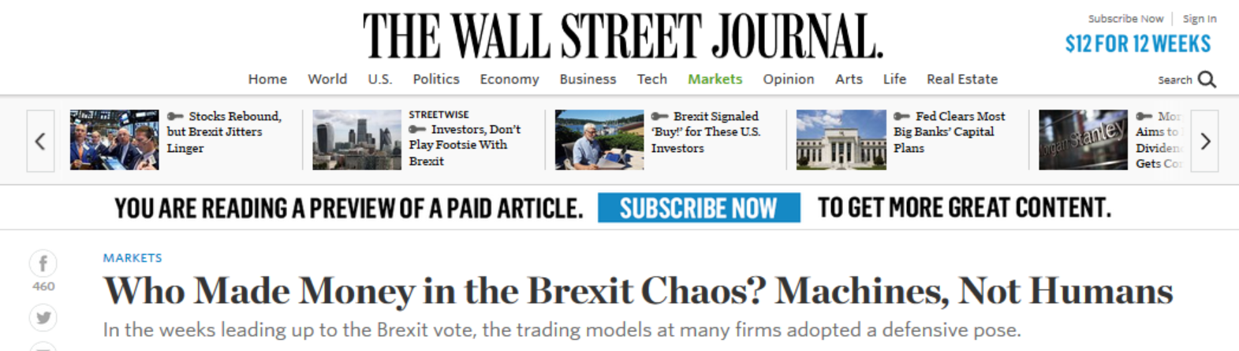
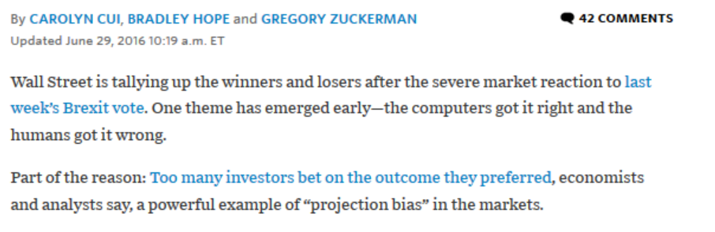
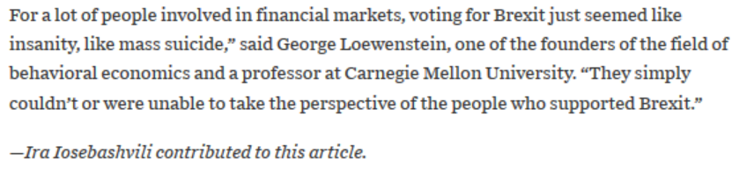

Slide 11
One important state: ownership
Let u(c,s), where c=1 if the individual owns the object in the current period (and 0 otherwise); s=1 if individual owns object in the previous period (and 0 otherwise):
    u(1,1)-u(0,1) > u(1,0)-u(0,0) (due to loss-aversion)
Can people anticipate how object ownership will affect their preferences?

Slide 12
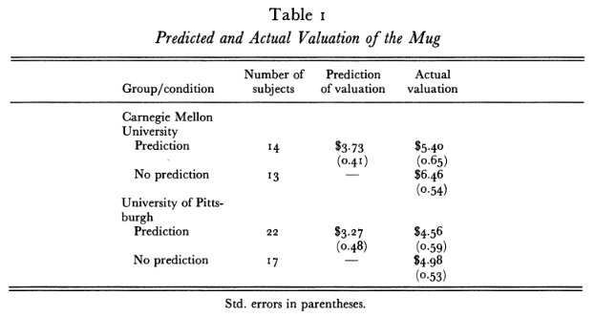
Are people aware of the endowment effect?
Subjects 27 CMU undergraduates & 39 Pitt MBAs
Procedure: 1. All shown mug
        2. Half predict how much they would sell it for
3. All given a mug and opportunity to sell
Loewenstein, G. & Adler, D. (1995). A bias in the prediction of tastes. Economic Journal, 105, 929-937.
Notes:
stopped

Slide 13
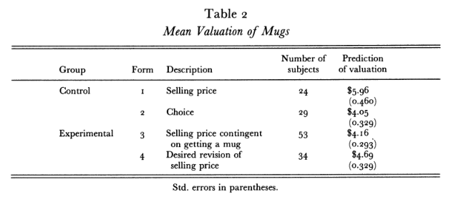
Study 2 (n=106 Northwestern executive students)
Randomly assigned to 2 conditions isolated in 2 rooms:
  Control: half of subjects get mugs; give selling price; others give choice prices
  Experimental: told there is a 50% chance of getting a mug; elicited prices they were told would apply if they got the mug
  Those who got a mug give (hypothetical) revised prices
All prices elicited with BDM

Slide 14
“Buyer’s agent study” (31 pairs of Cornell undergrads)
Procedure:
  Owners given mugs and asked for minimum selling prices
  Buyer’s agents given $10 with which to purchase mug. If their offer is accepted they can keep the difference, but not the mug. If rejected, they get nothing.
Results:
  mean minimum selling price: $6.98 (EV-maximizing offer= $7.00
  mean offer: $5.54 (p<.01). Only 29% of offers accepted.
  average earnings of agents: E.V.=$.85
  At offer of $7.00: E.V. of agent earnings=$2.00
  66% of offers would be accepted.
VanBoven, L., Dunning, D. & Loewenstein, G. (2000) Egocentric empathy gaps between owners and buyers: Misperceptions of the endowment effect. Journal of Personality and Social Psychology, 79(1), 66-76.

Slide 15
Debiasing study (study 5 from paper)
n=53 Cornell undergrads
Same as other buyers’ agents studies, except that half of buyers' agents owned a mug, and all introspected about what price they would sell those mugs at.

Slide 16
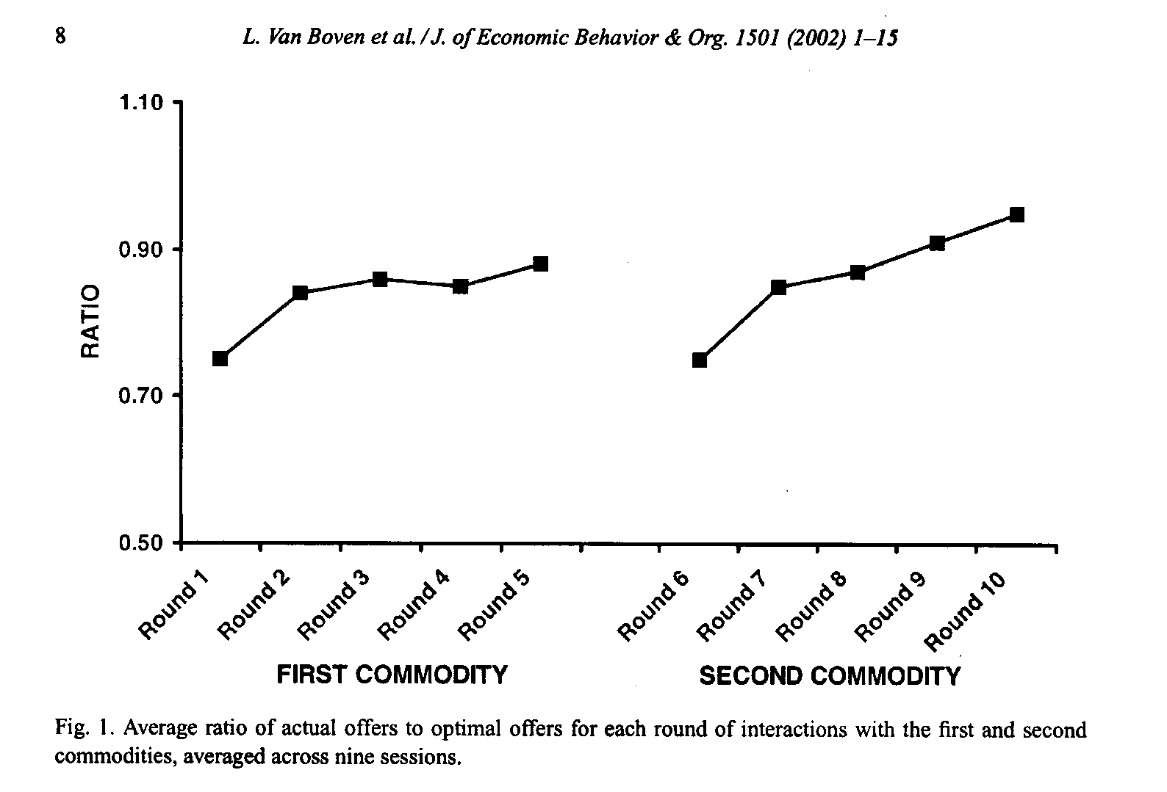
Repeated markets study; learning from experience?
Owners given Cornell object
Five rounds of buyer’s agent procedure, one of which counted
- After 5th round, repeated with new object
Van Boven, L., Loewenstein, G., & Dunning, D. (2003). Mispredicting the endowment effect: underestimation of owners’ selling prices by buyer’s agents. Journal of Economic Behavior and Organization, 51, 351-365.

Slide 17
Three field studies documenting projection bias..
Catalog orders and cold
Convertibles and heat
Health insurance and air pollution

Slide 18
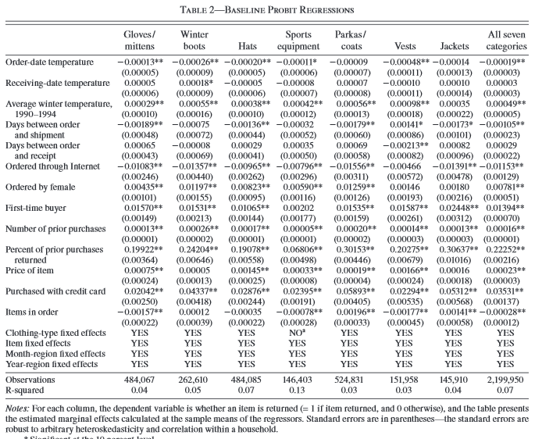
Catalog orders (temperature)
Data: 12 million orders of weather-related items, including zip code of buyer, date of order, and whether item was returned; merged with weather data
Dependent variable: returns (indicative of order having been a mistake)
Decline in order-date temperature of 30ºF leads to 3.95% increase in return rate
Conlin, M., O’Donoghue, T. & Vogelsang, T.J. (2007). Projection Bias in Catalog Orders AER, 97(4): 1217-1249

Slide 19
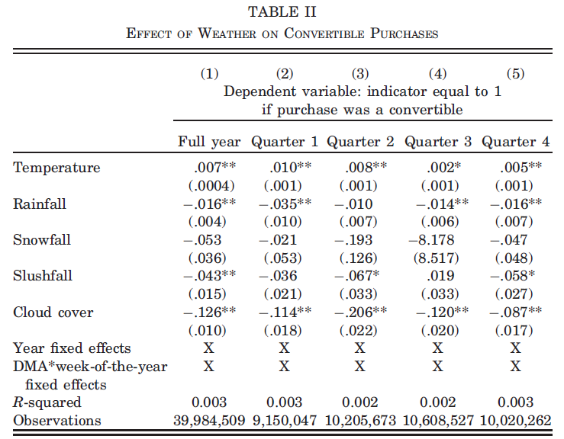
Convertible purchases
Automobile transactions from a sample of 20% of all dealerships in the U.S. between 2001 and 2008 (~40M transactions).
Cars are both new and used (~50/50).
Data contain detailed information about each car type and the MSA where the dealership is located.
data merged with MSA-level weather data
10 degree higher than average temperature → .07 percentage point increase in the percentage of cars sold that are convertibles (2.7% difference)(in all seasons)
Similar effects for cold weather and 4-wheel drive vehicles
Busse, M. R., Pope, D. G., Pope, J. C., & Silva-Risso, J. (2015). The psychological effect of weather on car purchases. The Quarterly Journal of Economics, 130(1), 371-414.

Slide 20
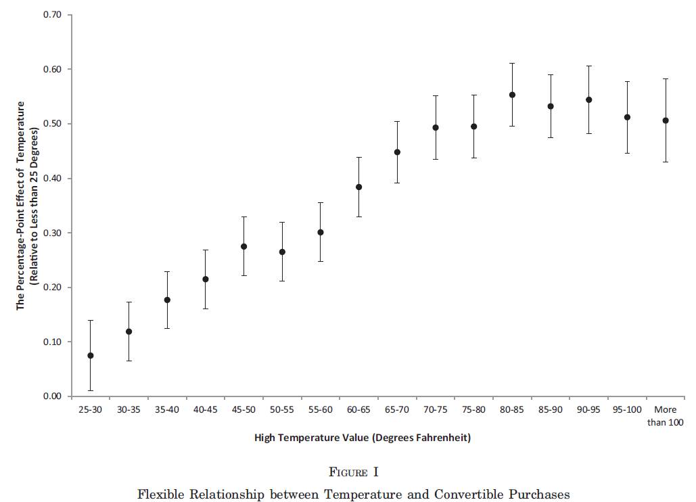
Convertible purchases
Busse, M. R., Pope, D. G., Pope, J. C., & Silva-Risso, J. (2015). The psychological effect of weather on car purchases. The Quarterly Journal of Economics, 130(1), 371-414.

Slide 21
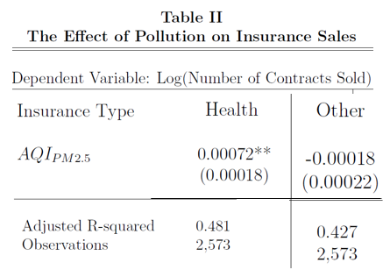
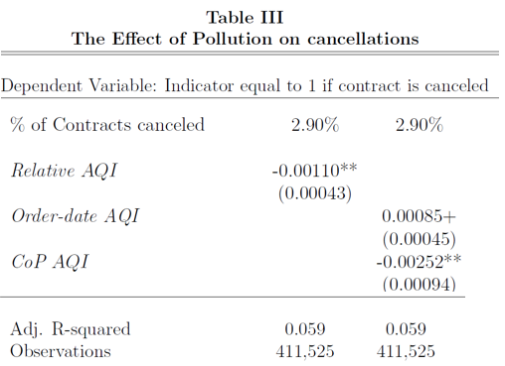
Health insurance purchases
Chang, Huang & Wang (working paper; 2016). “Projection Bias and the Demand for Insurance.”
Detailed information on purchases of over one million health insurance contracts from Chinese insurer (and cancelations during mandatory 10 day ‘regret period’ during which policies can be costlessly canceled)
Merged with data set of hourly measures of air quality in major cities
A 1 s.d. increase in air pollution on a day leads to a 9% increase in contracts sold that day.
Contracts purchased during high pollution days more likely to be canceled, and cancelations more likely on low pollution days (1 s.d. decrease in air pollution during cooling off period increases cancelation probability by 4.1%)
Chang, T. Y., Huang, W., & Wang, Y. (2018). Something in the air: Pollution and the demand for health insurance. The Review of Economic Studies, 85(3), 1609-1634.

Slide 22
In sum.. lots of lab and field evidence of projection bias

Slide 23
Arguably the most important determinant of preferences: Affect
Includes emotions (e.g., anger, fear), drives (e.g., hunger, thirst, sex, sense-making(?)), motivational feeling states (e.g., pain)
  “Emotions constitute 'superordinate programs' that orchestrate a concerted psycho-physiological response to recurrent situations of adaptive significance in our evolutionary past, such as fighting, falling in love, escaping predators and experiencing a loss in status.”
  Arguably the most important determinant of preferences: Affect
  Includes emotions (e.g., anger, fear), drives (e.g., hunger, thirst, sex, sense-making(?)), motivational feeling states (e.g., pain)
  Emotions, according to this perspective, .. can and typically do involve a wide array of physiological and psychological changes, including effects on perception, attention, inference, learning, motivation, and physiology.
→ Emotions reprogram us fundamentally
Cosmides, L. & Tooby, J. (2004). "Evolutionary Psychology and the Emotions" In M. Lewis & J. M. Haviland-Jones, Eds. Handbook of Emotions. NY: Guilford.

Slide 24
Hot-cold empathy gap (one specific form of projection bias)
The evolutionary account of emotion, and its implication that emotions reprogram us, has an important implication:
When in one emotional state it is almost impossible to imagine how one will feel or behave in a different emotional state
Loewenstein, G. (1996). Out of control: Visceral influences on behavior. Organizational Behavior and Human Decision Processes, 65, 272-92.

Slide 25
Varieties of hot-cold empathy gaps...
Cold predicting hot and hot predicting cold
Prospective, retrospective and interpersonal
Examples:
Prospective cold predicting hot
  plans (made right after lunch) to eschew dessert after dinner
Prospective hot predicting cold
  shopping on an empty stomach
Interpersonal
  “Ran’s foot was much worse. Ever since the graft had broken down it had been getting worse and a deep ulcer was now eroding his forefoot. In the mornings it gave him hell, particularly when we had just started, and although he would generally steel himself and say nothing, occasionally even he would have to say something about the pain -- try to share a part of it.. I could do nothing but reassure him that I understood, though I didn’t really. Pain is a problem that cannot be shared.” Stroud, 1993
Notes:
Ranulph Fienes, Mike Stroud

Slide 26
Thirst (prospective & interpersonal)
Subjects: n=47 visitors to a private gym
Upon entering, asked if they would complete short survey
To qualify, must be planning a vigorous cardiovascular workout lasting at least 20 minutes.
Randomly assigned to two conditions after agreeing to participate:
Not thirsty: complete survey before exercising
Thirsty: complete survey immediately after exercising
(Van Boven, L. & Loewenstein, G. (2003). Social Projection of transient drive states. Personality and Social Psychology Bulletin, 29(9), 1159-1168.)

Slide 27
Main measures
Imagine that three vacationers in Colorado this past August embarked on a short, 6 mile hike…As the day wore on, they realized that they were hopelessly lost… Worse, because they had packed lightly for a short hike, they had not carried much in the way of food or water…
In the space below, please take the perspective of one of the three hikers and describe your situation—how you got into it, how you feel now, both physically and mentally, and what you are hoping will happen. ____________________________________________
Which do you think is most unpleasant for the lost hikers, their hunger or thirst?
Which do you think the hikers regretted not packing more, water or food?
If you were in the hikers’ shoes, which would be most unpleasant to you?
If you were in the hikers’ shoes, which do you think you would regret not packing?
How hungry are you right now? (1-10 scale)
How thirsty are you right now? (1-10 scale)
How warm are you right now? (1-10 scale)

Slide 28
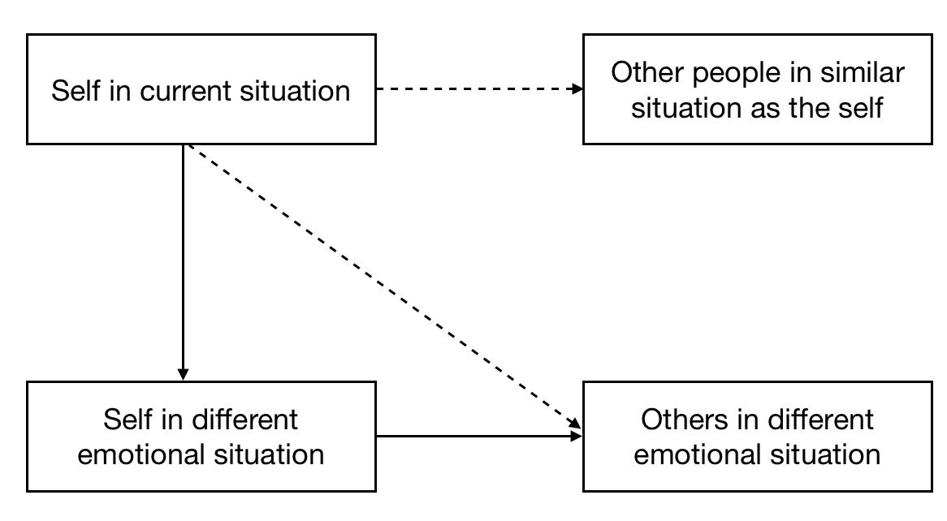

Slide 29
Results
 | before (cold) | after (hot) | significance of difference
Mentioned thirst before hunger in essay | 19% | 50% | p<.05
thirst more unpleasant | 61% | 92% | p<.02
would regret more not packing water | 61% | 88% | p<.05
thirst more unpleasant for hikers | 57% | 88% | p<.02
hikers would regret more no packing water | 52% | 92% | p<.01
Replicated with preschool children by researchers at the University of Oregon:
Atance, C.M. and Meltzoff, A.N. (2006). Preschoolers' Current Desires Warp Their Choices for the Future. Psychological Science, 17(7), 583-587.

Slide 30
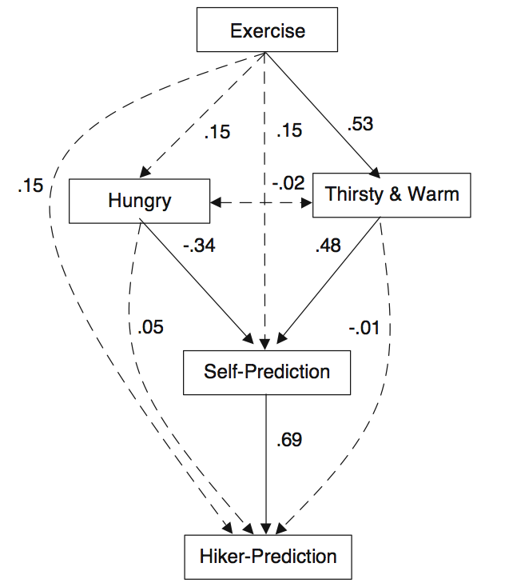

Slide 31
Hot-cold empathy gaps: Fear
Students given opportunity to tell joke in front of the class one week later for $2.00.
Half decided immediately after watching scary film-clip
One week later allowed to change their minds (in either direction)
No film Film sig.
(unafraid) (afraid) of diff.
Agree to tell joke one week
beforehand 32%
Agree to tell a joke just
before joke would be told 13%
(n=30)
Van Boven, L., Loewenstein, G., Welch, E. & Dunning, D. (2012). The Illusion of Courage in Self-Predictions: Mispredicting One’s Own Behavior in Embarrassing Situations. Journal of Behavioral Decision Making, 25, 1-12.

Slide 32
Hot-cold empathy gaps: Fear
Students given opportunity to tell joke in front of the class one week later for $2.00.
Half decided immediately after watching scary film-clip
One week later allowed to change their minds (in either direction)
No film Film sig.
(unafraid) (afraid) of diff.
Agree to tell joke one week
beforehand 32% 10% p<.03
Agree to tell a joke just
before joke would be told 13% 0% n.s.
(n=30) (n=30)
Van Boven, L., Loewenstein, G., Welch, E. & Dunning, D. (2012). The Illusion of Courage in Self-Predictions: Mispredicting One’s Own Behavior in Embarrassing Situations. Journal of Behavioral Decision Making, 25, 1-12.

Slide 33
Applications

Slide 34
Addiction
Procedure (simplified):
n=13 addicts receiving Buprenorphine (BUP) (methadone-like maintenance drug)
made repeated choices (8 times over a period of weeks) between extra dose of BUP or different money amounts, either to be received immediately or 5 days later
Made some choice right before receiving BUP (i.e., when deprived) and others right after (when satiated)
Prediction: Addicts will value delayed BUP more highly if choosing when they are currently craving than when they are not currently craving
Badger, G.J, Bickel, W.K., Giordano, L.A., Jacobs, E.A. Loewenstein, G. (2007). Altered States: The Impact Of Immediate Craving On The Valuation Of Current And Future Opioids. Journal of Health Economics. 26(5), 865-876.

Slide 35
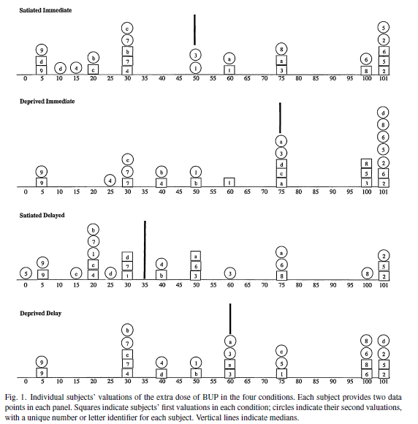
No evidence of learning over time; difference between first and second valuations in specific conditions (e.g., deprived, delayed choice):
(F1,84=.1, p=0.85).

Slide 36
Results
Similar results for smokers… Sayette, M. A., Loewenstein, G. Griffin, K. M. & Black, J. J. (2008). Exploring the cold-to-hot empathy gap in smokers. Psychological Science, 19, 926-932.

Slide 37
Helps to explain..
over-optimism about quitting among smokers
  University of Michigan’s Monitoring the Future longitudinal study (Johnston, O’Malley, & Bachman, 1993) found that among respondents who were occasional smokers (less than one cigarette per day), only 15% predicted that they might be smoking in 5 years, but 5 years later 43% were, in fact, smoking
why people begin taking addictive drugs in the first place
Intolerance and lack of empathy toward addicts

Slide 38
  “I sat with an older woman watching a program in which a woman who directed a prominent treatment program described how, as an alcoholic in denial, she drank alcoholically throughout her years as a parent, thus raising six children who all either became substance abusers or required therapy as children of an alcoholic. The woman's argument was that she had inadvertently inherited her alcoholism from her two alcoholic grandfathers (a model of genetic transmission of alcoholism, incidentally, which no one has actually proposed). The woman I was sitting with clucked about how insidious the disease was that it could make a mother treat her children this way. I turned to her and asked: "Do you really think you could ever have gotten drunk and ignored your children, no matter how delightful you found drinking or how it relieved your tension or however you reacted to alcohol genetically?" Neither she nor I could imagine it, given her values as a parent. “
Stanton Peele(1987). A Moral Vision of Addiction: How People's Values Determine Whether They Become and Remain Addicts.

Slide 39
Suicide
Considerable fraction of suicide is impulsive, especially among the young
Lots of (albeit mixed) research examining link between suicide and impulsivity
However, hopelessness is a consistent predictor of suicide
Hot-cold empathy gaps helps to explain why hopelessness → suicide – because it feels like one will never recover
  "When you are depressed, the past and the future are absorbed entirely by the present. You can neither remember feeling better nor imagine that you will feel better" Solomon, 1998

Slide 40
Studies of Golden Gate Bridge attempted suicides..
Friend (2003) reports that “survivors [of Golden Gate Bridge jumps] often regret their decision in midair” -- e.g.
    Ken Baldwin “hurdled over the railing, afraid that if [he] stood on the chord [he] might lose courage” On the bridge, Baldwin counted to ten and stayed frozen. He counted to ten again, then vaulted over. As he crossed the chord in flight, Baldwin recalls, “I instantly realized that everything in my life that I’d thought was unfixable was totally fixable—except for having just jumped.
Seiden (1978) found that of 515 people who were prevented from jumping between 1937 and 1971and followed up an average of 26 years, 94% still alive or had died of natural causes:
    “the findings confirm previous observations that suicidal behavior is crisis-oriented and acute in nature.”

Slide 41
End of life decision making
Lots of evidence that people don’t experience the kind of death they want
But, do people know what they want?
  Underprediction of desire for "heroic measures“ (Slevin et al., 1990):
    % who say they'd accept a grueling course of chemotherapy for 3 extra months of life
      radiotherapists 0%
      oncologists 6%
      healthy persons 10%
      current cancer patients 42%
  Chochinov (1999; Lancet):
  168 cancer patients receiving end-of-life care rated themselves twice a day on pain, nausea, appetite, activity, drowsiness, sense of well-being, depression, anxiety, and will to live.
    Over 12 hour periods, patients' will to live often fluctuated by 30 percent or more.
  → "These large fluctuations suggest that will to live is highly unstable."

Slide 42
How much life are people willing to give up to experience a high quality death?
Tested whether people would trade healthy life expectancy for better EOL
Computerized survey instrument describing hypothetical patient experiences in the ICU
General population sample (n=104) recruited in Pittsburgh, Pennsylvania.
Life expectancy traded (from a baseline of 80 healthy years followed by a one-month fatal ICU stay) for improving ICU care in 4 domains: pain and discomfort, daily environment, treatment decisions, family support, and all of these together.
Bryce, Loewenstein, Arnold, Schooler , Wax & Angus (2004). Quality of death: Assessing the importance placed on end-of-life treatment in the intensive-care unit. Medical Care, 42, 423-431

Slide 45
Torture
Torture is banned by numerous international treaties signed by most countries of the world. But what is torture?
4 experiments show that people who experience even a mild version of the specific pain produced by an interrogation tactic are more likely to classify that tactic as torture, and view it as unethical, than are those who are not experiencing pain.
  social pain manipulation → opposition to use of prolonged solitary confinement
  sleep deprivation (based on when survey collected during exam time) → sleep deprivation viewed as less acceptable method of interrogation
  submersion of hand in ice water → view of “cold cell” interrogation tactics being defined as ‘torture’ rather than ‘interrogation’
  addressed question of whether those who are experiencing pain overestimate it, or those who are not experiencing pain underestimate it (as we conjecture)
Nordgren, L.F., Morris, M., & Loewenstein, G. (2011). Psychological Impediments to an Objective Evaluation of Modern Interrogation Tactics. Psychological Science, 22(5) 689–694.
Morris McDonnell, M., Nordgren, L.F. and Loewenstein, G. (2011). Torture in the Eyes of the Beholder: The Psychological Difficulty of Defining Torture in Law and Policy. Vanderbilt Journal of Transnational Law, 44

Slide 46
Open questions..
Is there anything special about mispredicting preferences (or is it just one manifestation of cognitive projection)?
Is there anything special about affect?
Do people mispredict how they will feel, or the impact of how they will feel on their preferences (on how they will behave)?
Why do we make this systematic mistake?

Slide 47
Slide 3 revisited
Some related well-researched issues..
Can people predict their own experience utility (happiness, what will make them happy)?
Do two types of utilities correspond; do decisions maximize well-being?
Should decisions maximize well-being? Do people want to maximize well-being?

Slide 48
In sum..
Preferences are extremely state-dependent
We make decisions (often long-term) based on predictions of future preferences
We mispredict future preferences due to projection bias – because we project our current states on our future (and also past, and also other people’s) states
Transformative nature of states (most importantly affects) + Loss of perspective→ Long-term decision-making is powerfully influenced in a non-normative fashion by transient factors
  “It is always thus, impelled by a state of mind which is destined not to last, that we make our irrevocable decisions.”
Marcel Proust, Remembrance of Things Past

