Slide 1
Fragile Self-Esteem
RSF 2022 Summer Institute
George Loewenstein
Based on completed and in-process work with..
Botond Koszegi
Takeshi Murooka
and others

Slide 2
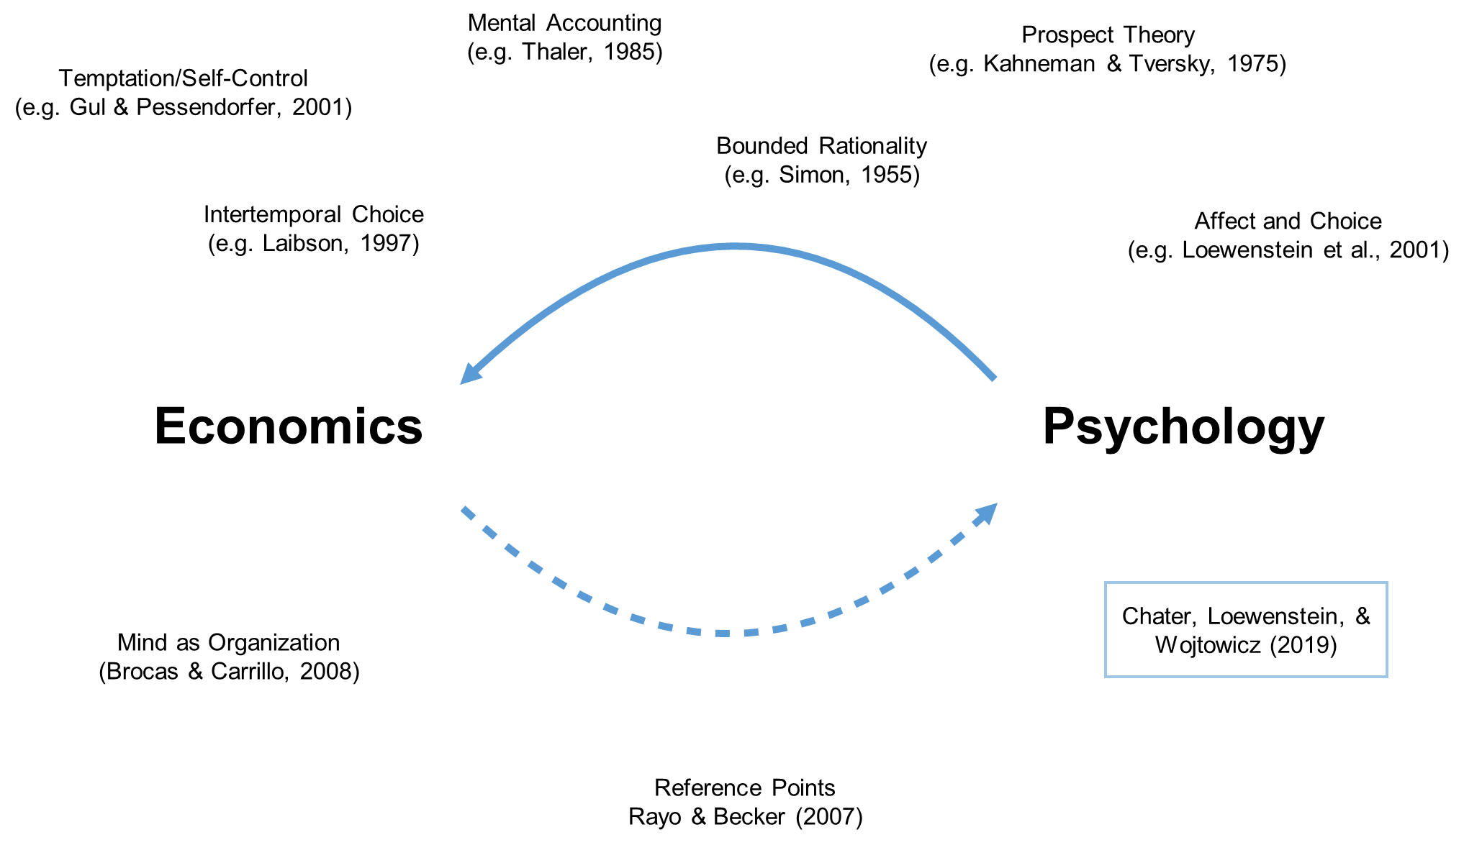
Connections between economics and psychology

Slide 3
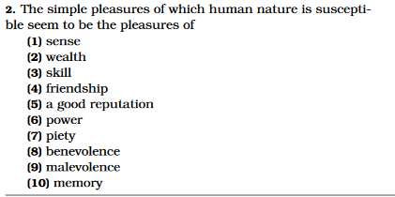

Large body of research and theorizing in psychology and economics assumes that people care about their social, and self-image
For what purpose is all the toil and bustle of this world? what is the end of avarice and ambition, of the pursuit of wealth, of power, and preeminence? Is it to supply the necessities of nature? .. To be observed, to be attended to, to be taken notice of with sympathy, complacency, and approbation, are all the advantages which we can propose to derive from it. It is the vanity, not the ease, or the pleasure, which interests us.
Adam Smith, Theory of Moral Sentiments
Jeremy Bentham, Introduction to Principles of Morals and Legislation
Leary, M. R., & Baumeister, R. F. (2000). The nature and function of self-esteem: Sociometer theory. In Advances in experimental social psychology (Vol. 32, pp. 1-62). Academic Press.
Brennan, G., & Pettit, P. (2004). The economy of esteem: An essay on civil and political society. Oxford University Press, USA.

Slide 4

Focus of paper: fragile self-esteem – ‘insecurity’
Emotional insecurity or simply insecurity is a feeling of general unease or nervousness that may be triggered by perceiving of oneself to be vulnerable or inferior in some way, or a sense of vulnerability or instability which threatens one's self-image or ego.
Closely related to distinction between explicit and implicit self-esteem
Pervasive across people (though differences in extremity)
Most interesting and important situation: High-but-fragile self-esteem
Takes extreme form in, and is an identifying feature of, narcissistic personality disorder
Koszegi, Loewenstein, Murooka, T. (2021). Fragile self-esteem. Review of Economic Studies.
Loewenstein, , Koszegi & Murooka (in process). Insecurity. (paper aimed at psychology journal)

Slide 5
Research by psychologists has identified diverse consequences of high-but-fragile self-esteem
Kernis (2001) reports that “among high self-esteem individuals, the more unstable their self-esteem..”
  the greater their anger and hostility proneness;
  the more severe their depressive symptoms, and the lower they score on various dimensions of psychological well-being;
  the more defensively they react to perceived transgressions;
  the more they engage in self-handicapping (i.e., introducing obstacles to their own success)
  The more boastful they are

Slide 6

Some personal observations (including from biographies)..
Many of the most successful academics seem to embody a combination of hubris and insecurity – they have to have something to prove
Many biographies of prominent individuals reveal a similar pattern – e.g.,
Insecurity (e.g., jealousy) has a nasty tendency to be self-fulfilling
His relentless drive, his wretched feelings of shame and degradation, and his precocious self-sufficiency combined to produce a young man with an insatiable craving for success. (Ron Chernow, Alexander Hamilton)
The blow to his self esteem [from being rejected at the academy of art] had been profound. And the bitterness showed.. He would fly off the handle at the slightest thing. His loss of self confidence could flare up in an instant into boundless anger and violent denunciation of all who he thought were persecuting him. (Ian Kershaw, Hitler)
Henry Kissinger grew up with that odd mix of ego and insecurity that comes from being the smartest kid in the class. From really knowing you're more awesomely intelligent than anybody else, but also being the guy who got beaten up for being Jewish” (Walter Isaacson, Kissinger).
For all his accomplishments, the 37th president (Nixon) was a man of deep contradictions: a law-and-order candidate who flouted the law, an insecure man with a deep reservoir of hubris. (Brinkley, review of Graff, Watergate: A new History)

Slide 7
What does it mean for self-esteem to be fragile/insecure?
A wrong answer: that it is variable
In fact, in people with high but fragile self-esteem, there is a big downside risk, but little upside potential
E.g., according to Baumeister (1997), violence and cruelty arise from people who..
    “think well of themselves most of the time but who are vulnerable to frequent
    or large fluctuations in their self-esteem. For these people, that miserable sinking feeling that goes with a drop in self-esteem is all too familiar, and they are on guard to avoid it. Even a slight hint or mild implication that questions their personal worth may elicit a strong response."

Slide 8
Why would self-esteem be subject to asymmetric shifts?
A clue:
    “People with Rejection Sensitivity have such a strong emotional reaction to negative judgments, exclusion, or criticism from others that it sends them into a mental tailspin“ (Bonior, 2019).
Airplanes go into tailspins as a result of self-reinforcing feedback; our argument is that self-esteem can also go into tailspins as a result of self-reinforcing feedback.
We argue that self-esteem generates feedback that establishes the possibility of multiple self-esteem personal equilibria (SEPs).
An individual at a high SEP will be afraid of the possibility of dropping to a low SEP, entailing a potentially catastrophic drop in self-esteem
Kőszegi, B., & Rabin, M. (2006). A model of reference-dependent preferences. The Quarterly Journal of Economics, 121(4), 1133-1165.
Kőszegi, B. (2010). Utility from anticipation and personal equilibrium. Economic Theory, 44(3), 415-444.

Slide 9
Crux of the (economic) model: mood-contingent memory
Individual has a store of ego-relevant memories
Recall of these memories depends on mood, which depends on self-esteem as a result of mood-contingent memory
self-esteem → mood → memories recalled
But, what memories one recalls also affects self-esteem
  memories recalled → self-esteem
Possibility of multiple self-esteem personal equilibria (SEPs) at which a level of self-esteem evokes memories that support it – e.g.,
  Feeling good about oneself and recalling memories of events that make one feel good about oneself
  Feeling bad about oneself and recalling memories that make one feel bad
In the version of the paper aimed at psychology, we discuss a wider range of feedback processes that can have similar effects – e.g.,
  Effects of self-esteem/confidence on performance (and vice-versa)
  Effects of self-esteem/confidence on other people’s reactions to one (and vice-versa)

Slide 10
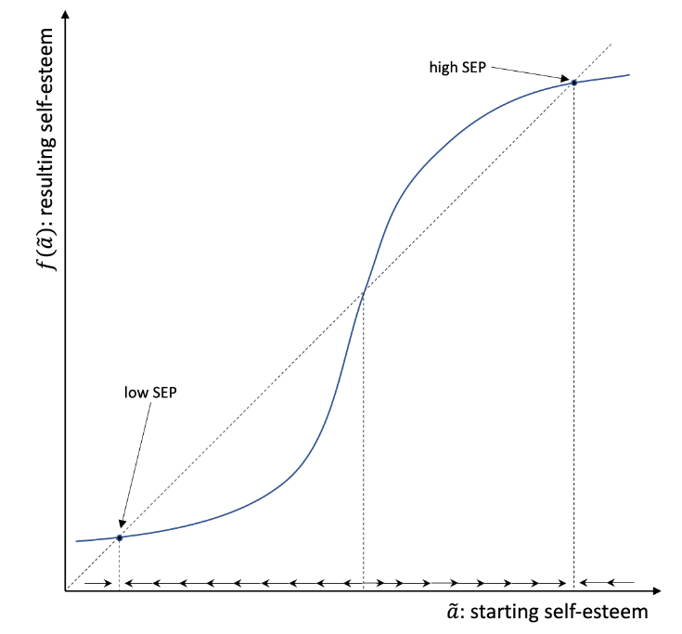
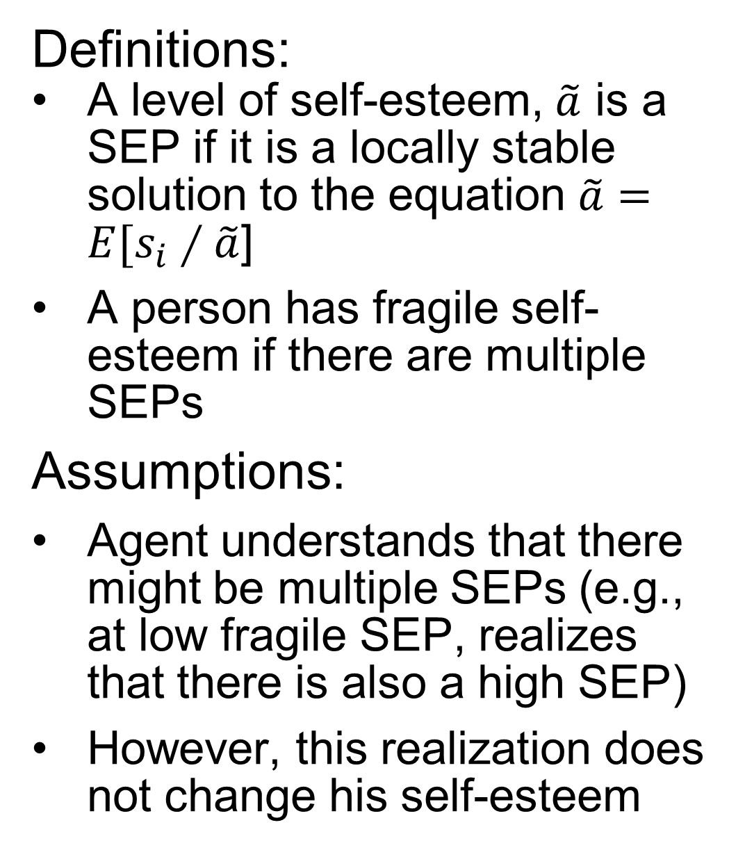
SEP (self-esteem personal equilibrium): Example with simple recall function
Definitions:
A level of self-esteem, $\tilde{a}$ is a SEP if it is a locally stable solution to the equation $\tilde{a}=E[s_{i}∕\tilde{a}$]
A person has fragile self-esteem if there are multiple SEPs
Assumptions:
Agent understands that there might be multiple SEPs (e.g., at low fragile SEP, realizes that there is also a high SEP)
However, this realization does not change his self-esteem

Slide 11
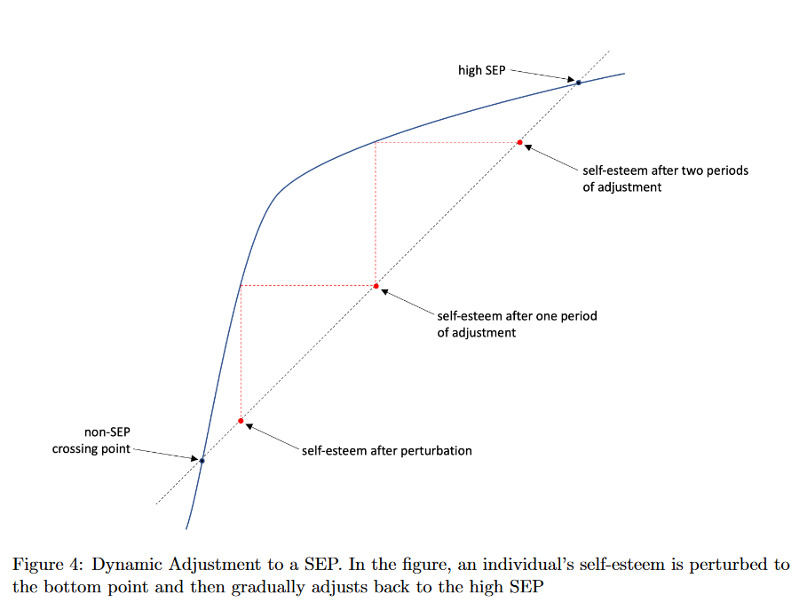
Dynamics

Slide 12
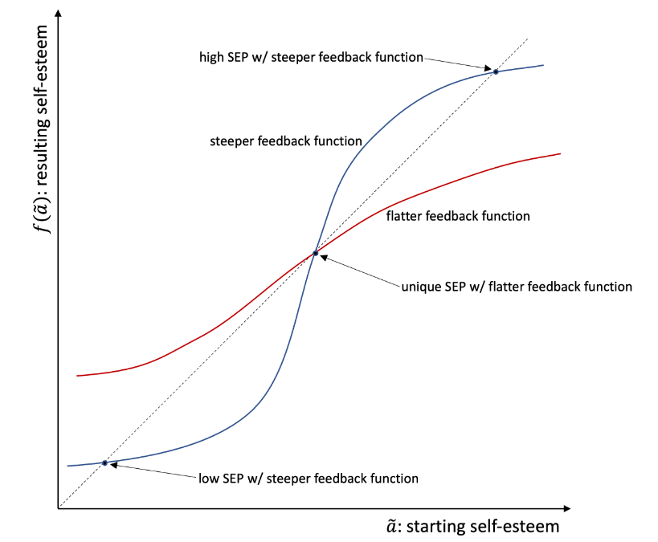
The impact of the strength of the feedback function
When feedback effects are weak, there will be only one equilibrium, and the agent will assess his own ability accurately
When feedback effects are strong there will be multiple equilibria
When there are multiple equilibria, the agent will either be over-confident (if at high SEP) or under-confident (if at low SEP), but not accurately calibrated (connection to over-confidence and the ‘impostor syndrome’).
People will either work too hard (because they are overconfident and anxious not to perturb a high SEP) or insufficiently hard (because they are under-confident)

Slide 13
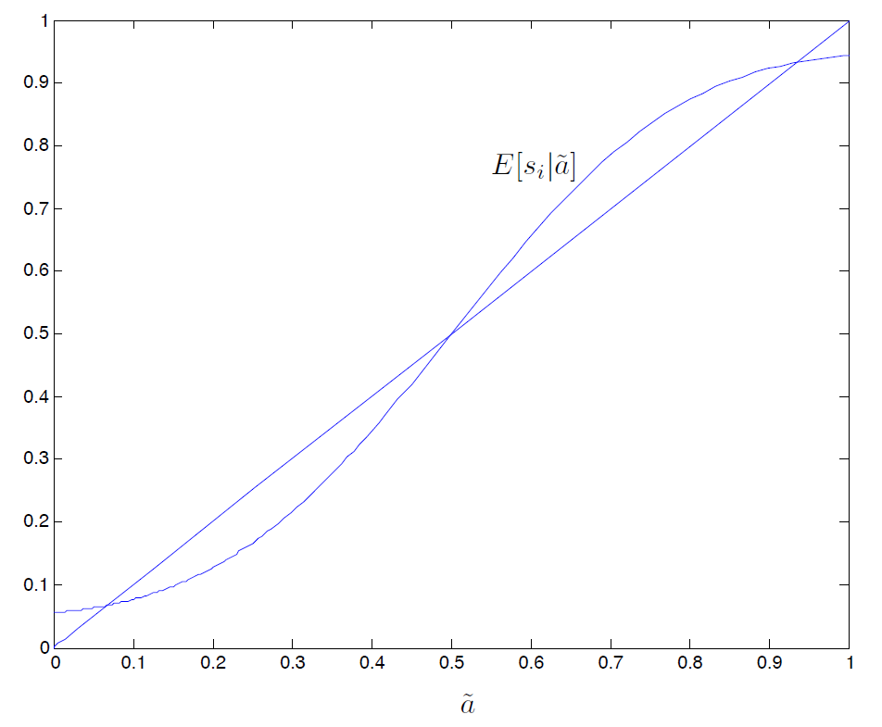
Implications..
Which SEP the individual ends up at, will depend on where he begins – which side of the unstable equilibrium-point
Perturbations that drive him over the unstable equilibrium will lead to a massive change in self-esteem (and mood)
“I have observed in myself, so often that it no longer surprises me, that if I give a performance before some audience I am jollier at dinner, and eat more, if I am pleased with my performance. Disagreeable feedback spoils the evening. At my age the statistical record of my performance ought to reflect so many observations of good, poor, and mediocre performance that one more experience at either tail of the distribution could hardly affect a rational self-assessment. I try to remind myself that on those occasions when feedback depresses me; but my welfare function is apparently not constructed that way.”
Thomas Schelling, The Mind as a Consuming Organ, 1988
An interesting prediction from this framework is that an individual at a high SEP can slough off a certain amount of bad news, but too much bad news at once will drive him to a low SEP
Surprisingly, we were unable to locate a test of this intuitive prediction in the psychology literature.

Slide 14
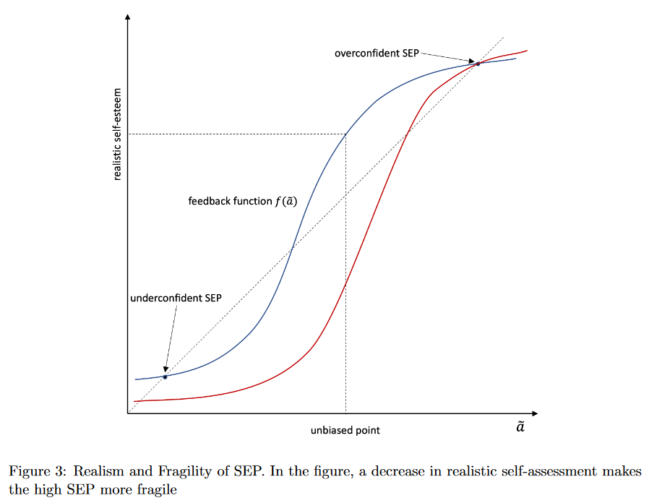
Implications..
Differences in ability tend to affect the unstable cross-over point more than they affect the location of SEPs
→ People with low abilities will have unstable high SEPs and very stable low SEPs
→ The fragility of an individual’s SEP can be diagnostic of their ability, even when the level of their SEP (self-esteem is not)

Slide 15
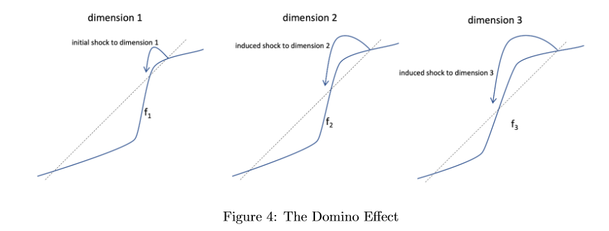
Multiple domains of self-esteem
  Diversification can provide protection against ego-drops
  But hits to ego in one domain can spill over into other domains

Slide 16
Applications

Slide 17
Information avoidance
Traditional economic models don’t predict information-avoidance
Belief-based utility models can (by assuming concave utility of beliefs)
  But, such models predict that people will only be weakly information-avoidant, and avoidant across-the board
Current model can make sense of very strong information avoidance: fear of dropping to a low SEP
Predicts domains in which it will occur – those in which the individual has fragile self-esteem, in which ego is very important, and in which self-esteem is highly reference-dependent

Slide 18
Self-handicapping (putting obstacles in the way of success to muddy signals from failure)
Self-handicapping is a special form of information avoidance
Most economic models have trouble explaining self-handicapping because individuals have a huge store of ego-relevant information
Current model can explain why an individual would be highly averse to getting one piece of negative ego-related information and might avoid situations in which such information could arrive – because one piece of negative information can have a huge impact if it perturbs a high SEP
Helps to explain the structure of most self-handicapping experiments:
  Individuals are given feedback on task performance that is better than they anticipate – creating insecurity about whether a good performance is likely to be repeated
  Given the opportunity to undermine themselves to avoid getting more feedback
  One example of how insecurity is self-fulfilling

Slide 19
Education..
Dominant theories of under-investment in education attribute it to lack of information or present-bias
But informational interventions and immediate rewards (which should be effective given present-bias) have been found to be largely ineffective
Our framework implicates under-confidence as a likely cause
Can also help make sense of:
  the documented consequences of a “fixed” versus “growth” mindset
  Why students who are afraid of failure might identify their ego with non-academic activities
Students who perform poorly but who manage to cling to a high SEP are those most likely to self-handicap – e.g., choose classes/topics that are extremely easy or extremely difficult, or introduce barriers to their own success – e.g., drugs, alcohol, not studying

Slide 20
Workaholism/professional success..
Term “workaholism” coined in a 1968 confessional essay by Wayne Oates (who authored 57 books)
Oats and other psychologists see workaholism see it as a disorder with components that overlap with addiction – e.g.,
  “working beyond what is reasonably expected of the worker, despite the potential for negative consequences (e.g., marital issues)” (Clark, 2016)
Our model interprets workaholism as a manifestation of a high but fragile SEP.
  Predicts that workaholics will be especially likely to be low in ability
  Explains why workaholics tend to score high on narcissism (which is currently the best measure of high but fragile self-esteem)

Slide 21
Job search
Lots of research shows that unemployment is a highly aversive state (e.g., Lucas, Clark, Georgellis & Diener, 2004).
Surprisingly, however, studies of job search (e.g., Krueger & Mueller, 2010) find that people spend remarkably little time on job search (the U.S. is the highest in an international comparison, at half an hour a day)
Most unemployed are probably at low SEP, in which case they will under-invest in job-search due to under-confidence
Those at high SEPs might be expected to search a lot, but they might be anxious to preserve a fragile high SEP, and search could result in rejection..
  →Implications for the kinds of search activities that job-seekers engage in -- i.e., those that don’t expose them to the risk of explicit rejection)

Slide 22
Aggression
People at high but fragile SEPs are, in-effect, walking on the top of a wall; they have high self-esteem, but minor challenges to self-esteem can potentially topple them
Aggression, in this view, represents an attempt to silence those who threaten one’s self-esteem
The more unrealistic is the agent's high self-esteem, the more fragile it is, and hence the smaller is the slight that triggers a response, and the stronger is the reaction
The plethora of adages such as “They who Threaten are afraid" (Diary of Benjamin Franklin) and “All Cruelty Springs from Weakness" (Seneca) point to the ubiquity of the phenomenon.
Lots of supportive evidence – e.g.,
  Berkowitz’s (1978) study of violent criminals failed to find support for the prediction it tested, but instead concluded that the men were ``quick to see themselves as challenged and frequently interpreted someone else's remarks as belittling them,'' which ``often infuriated'' them and ``stimulated them to lash out impulsively.'‘
  Narcissism (an indicator for high fragile self-esteem) is commonly associated with anger and aggression

Slide 23
Trauma
Theory can help to explain why one, often quite brief, experience can have such a major impact on well-being and functioning
  Conventional economic model simply views trauma as a very bad but short-lived experience
  Conventional psychological model adds that trauma is stored as a memory that can be recalled intrusively
  Current model adds idea that trauma is likely to both lower low SEP and also make it more likely to get triggered

Slide 24
Many other psychological phenomena – e.g.,
Rejection sensitivity..
    “Individuals who have this condition respond extremely negatively to the perception of being rejected: It goes far beyond the run-of-the-mill discomfort that most of us experience.. They feel like failures, disproportionate to what has actually occurred. They may feel rage and want to lash out. They often exaggerate how people are against them, or how much people dislike them, or they carry long-term shame“ (Bonior, 2019).
  Leary and Baumeister’s (2000) ‘sociometer theory’ of self-esteem posits that “self-esteem.. Performs the essential job of monitoring and reacting to social acceptance and rejection”
  We posit that rejection-sensitive individuals are just at the extreme of this form of sensitivity
Failures to apologize
  Apologizing is so simple, yet enormously consequential; yet people often fail to do so (Chaudhry & Loewenstein, 2020)
    “Why can some people never admit they’ve misstepped, .. Even when they’re obviously in the wrong?” “For these people, admitting wrongdoing and offering an apology is too psychologically threatening. Offering an apology implies that they’ve harmed another person in some way, which can elicit feelings of shame. People who cannot apologize often have such deep feelings of low self-worth that their fragile egos cannot absorb the blow of admitting they were wrong” (Winch, 2021).

Slide 25
Gender differences
Diverse research in psychology and economics document robust differences between males and females in aggression, risk-taking, health behaviors, educational aspirations and attainments, and political attitudes.
New vein research connects all of these differences to the notion of ”precarious masculinity,” in which ’manhood’ (unlike womanhood) is seen as ”a social state that requires continual proof and validation”(Bosson and Vandello, 2011).
E.g., “proverbs” expressing themes about the precariousness of either manhood or womanhood –e.g., “Manhood is hard won and easily lost”– are more endorsed, liked, and understood than comparable womanhood proverbs (“Womanhood is hard won and easily lost”) (Vandello et al., 2008).
Other research links fragile manhood (with obvious links to fragile self-esteem)to each of the gender differences enumerated above.
  E.g., Bosson et al. (2009) threatened some men’s manhood by having them perform a conventionally feminine hair-braiding task, while other men braided rope.
    Men whose manhood had been threatened by braiding hair were more likely to choose to hit a bunching bag relative to solving a puzzle, and punched more aggressively
    More likely to gamble and opt for an immediate payoff
    Fragile self-esteem has also been linked to health behaviors, gender differences in educational aspirations and attainments, and support for extremist politicians

Slide 26
Conclusions: Research on attention
In addition to its focus on ego, paper is also example of new research on attention.
  Sims (2003), Caplin et al. (2020): Models of “rational inattention”
  Camerer & Johnson (2004), Johnson, Camerer, Sen & Rymon, 2002; Crawford (2008); Crawford, Cost-Gomes & Iriberri (2006): Process-tracing studies of attention in economic games
  Gabaix, Laibson (2006), Gabaix (2014): Model of how firms use "shrouded attributes" to profit from limited consumer attention
  Chetty, Looney, Kroft (2009): Demonstrate that not all taxes are equally salient, and model this in terms of limited attention.
  Lacetera, Pope, Sydnor (2011): Demonstrate limited attention using car price data.
  Schwartzstein (2014): Connects selective attention to a variety of behavioral biases.
My own focus on attention:
  Paper (with Edika Quspe-Torreblana, John Gathergood and Neil Stewart) documenting “attention avoidance,” and arguing that many phenomena that have been classified as “information avoidance” are actually attention-avoidance
  JEL review of attention in economics (with Zach Wojtowicz) – arguing that attention should be treated as a key scarce resource in economics, on a par with land, labor, capital
  Set of projects (also with Zach) examining the role of motivational feeling states associated with thinking – e.g., boredom and mental effort – in allocating attention efficiently

Slide 27
Conclusions…
We all know that ego is hugely important – very likely more important than consumption, for most people
We (behavioral researchers) have only scratched the surface when it comes to modeling the implications of this insight
More generally, we have only started to exploit the possible gains from trade between economics and psychology
Behavioral researchers should expand the range of psychological phenomena we incorporate into our models
Tools/perspective of economics can help to formalize ideas from psychology to generate new insights and predictions

