Slide 1
2022 Behavioral Summer Camp:
Research Transparency in Behavioral Economics
Stefano DellaVigna, UC Berkeley and NBER
July 8, 2022

Slide 2
Research Transparency
What are obvious principle of research transparency?
  (No fake data) Data is real!
  (No publication Bias) Published research presents a reliable summary of research findings
  (Reproducibility) It is possible to replicate published research results
What do we know about these basic principles in
  Economics,
  Behavioral economics, and
  Other social sciences?

Slide 3
1. No Fake Data
Worst case scenario is if researchers make up their data. Does that happen in the social sciences?
Unfortunately, yes.
Social Psychology:
  Dietrich Stapel (Tilburg University) – 58 (!) papers (JPSP, Science) retracted for manufacturing results of experiments
  “His general method towards the end of his career was to develop a complete experiment […] – and then pretend that he would run the experiments at schools to which only he had access. Instead of doing so, he would make up the data and send these to colleagues for further analysis.” (Wikipedia)
  Jens Forster (Bochum University), 5m euro Humboldt grant, retracted multiple papers on JPSP
  Karen Ruggiero (Harvard University) (https://www.science.org/content/article/psychologist-made-sex-bias-results)

Slide 4
1. No Fake Data
Social Psychology:
  Dirk Smeesters (Erasmus University), detected by our own Uri Simonsohn
    Suspicion of very strange results
    Asked for data
    Found suspicious patterns (e.g., treatment = control + X)
  Brian Wansink (Cornell University), research on food choices, plate size, 15 studies retracted. Official Cornell statement: “The practices identified included data falsification, a failure to assure data accuracy and integrity, inappropriate attribution of authorship of research publications, inappropriate research methods, failure to obtain necessary research approvals, and dual publication or submission of research findings”
Economics? I am not aware, yet

Slide 5
2. No Publication Bias
Fake data is the worst
But: problem if working paper series and journals publish only a selective, misleading subset of research results
Multiple biases:
  Conflict of interest
    drugs in medicine
    bias in finance: “Rewriting History” and I/B/E/S (Ljungqvist, Malloy, and Marston, JF 2009)
  Publication Bias: Not publishing results that are not statistically significant relative to null
  Specification Searching: Running multiple models (e.g., with and without controls, in logs or levels) and select the specification most likely to publish

Slide 6
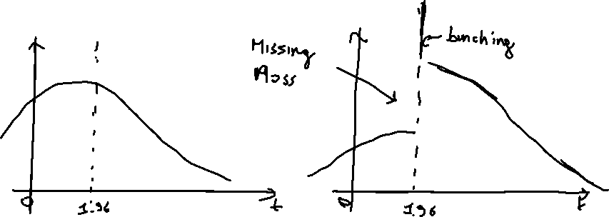
2. No Publication Bias
Focus on (2) and (3) combined
Keep the exposition non-technical, for publication bias and p-hacking start from Andrews and Kasy (AER 2019, AK)
  Assume that results which are not statistically significant are only published with a fraction of the probability of significant results, e.g., 20%
  Can infer from published papers evidence on publication bias
  Test 1. Distribution of t stats across papers (e.g., a meta-analysis)

Slide 7
2. No Publication Bias
Test 2. Plot of results with t-stat and standard error
Illustrative example from AK
  No publication bias at left
  Publication bias at right

Slide 8
2. No Publication Bias
Use these tests for evidence
Economics:
  Brodeur et al., (AEJ Applied 2016): screen all articles in AER/JPE/QJE in 2005-11
  Brodeur, Cook, Hayes (AER 2020): screen all articles in 25 econ journals from 2015 to 2018 → 684 articles, 21,740 tests

Slide 9
2. No Publication Bias
  Brodeur, Cook, Hayes (AER 2020): screen all articles in 25 econ journals from 2015 to 2018 → 684 articles, 21,740 tests
  Test can be used to compare across types of evidence
  How does that compare to other social sciences?

Slide 10
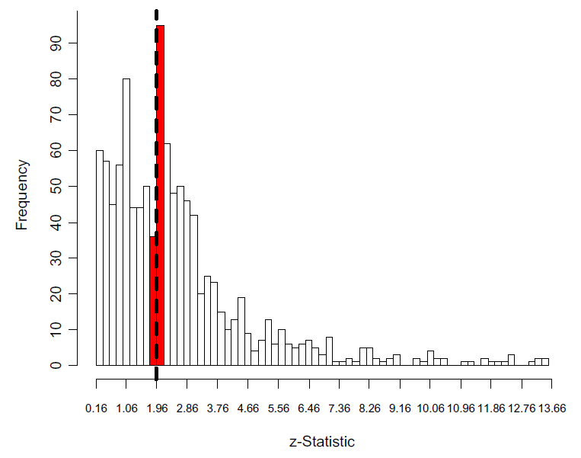
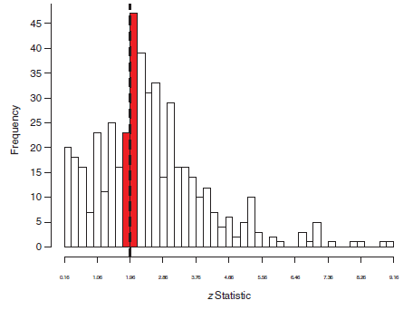
2. No Publication Bias
  Political Science. Gerber and Malhotra (QJPS 2008): articles in APSR and AJPS (2 top polisci journals) [left]
  Sociology. Gerber and Malhotra (Soc Methods 2008): articles in ASR, AJS and SQ [right]
  Brodeur et al (AER): “the ratio of tests just above and below 1.96 is only 1.10 in economics in comparison to over 2 for political science and sociology.”

Slide 11
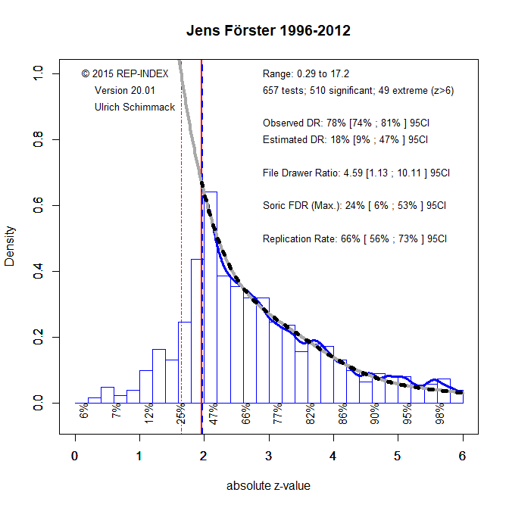
2. No Publication Bias
  Test can be used to confirm suspicion of publication bias or data faking for select authors
  Return to Jens Forster (faked data). Shockingly biased (https://replicationindex.com/2021/01/23/jens-forster-and-the-credibility-crisis-in-social-psychology/)

Slide 12
3. Reproducibility
  Third feature is ability to reproduce studies: Code, data, and experimental instructions posted, with enough detail
  Economics:
    American Economic Review started in 2004 under editor Robert Moffitt to require posting of data for all papers with data
    Policy adopted over time by most other economics journals
    In 2018 the American Economic Association created the data editor position (Lars Vilhuber)
      Replicate all articles before they get published
  Psychology:
    Before 2015, rarely posting data, code, or even instructions
    Drastic change after work of Uri Simonsohn, Leif Nelson, Joe Simmons
    Still no data editor position

Slide 13
3. Reproducibility
Very important development since 2015: Replication papers
  Open Science Collaboration (Science 2015, OSC): Replicate 100 prominent laboratory experiment in psychology, work with authors to get instructions, do design. Set power at 80% for original finding
  Camerer et al. (Science 2016). Replicate 18 economics lab experiments in AER/QJE in 2011-14
  How does the evidence for publication bias look like for original experiments in OSC [left] and Camerer et al [right]? V. clear
  OSC (psych) Camerer et al (econ)
Not surprisingly, replication is very partial:
  Psychology: 48% of original effect size
  Economics: 66% of original effect size

Slide 14
What Should We Do?
Where do this leave us in economics?
  1. No Fake Data. Assume real data, but eyes open
  3. Reproducibility.
    Keep emphasis on posting of data/code
    It does take time and effort, plan for it! Peer review of code, read best practices, etc
    Allow for exceptions for administrative/proprietary data, but aim to minimize those (e.g., data editor role at AEA)

Slide 15
What Should We Do?
  2. No Publication Bias. Two sets of to-dos
  Assume publication bias
    Always include corrections for it in meta-analyses
    Healthy suspicion of results with single t-stat at 2
  Counter publication bias
    Progress on publishing null results
    Keep more record of studies run (pre-registrations, grants…)
    Elicit predictions of research results to mitigate pub bias
    Power your experiments correctly!
    Find datasets with no selective publication

Slide 16

Assume Publication Bias
Example of the importance of correcting for pub. Bias
Mertens et al. (PNAS 2022)

Slide 17

Assume Publication Bias
Could this be affected by publication bias?
So many issues:
  Publication bias not included in reporting of main results
  Funnel plot executed incorrectly, centered in estimated effect, not at zero. Why? Default setting in R!!
  When discussed, publication bias dismissed.
  Effect size of 0.4 s.d. discussed as small to moderate!! (huge)

Slide 18
Counter Publication Bias
1. Progress on publishing null results
Within models, or in a policy-relevant setting, all magnitudes may be of interest → Less publication bias
  Clear plus for economics versus psychology (only sign matters)
Example: Meta-analysis of minimum-wage studies in AK from Wolfson and Bellman (2015)
Not much publication bias!

Slide 19
Counter Publication Bias
2. Keep better record of studies run
Pre-registration of a study (AEA registry) allows record of study before it is run
Studies supported by major grants should require some record of results
Create searchable (short) summary for all projects in these categories

Slide 20
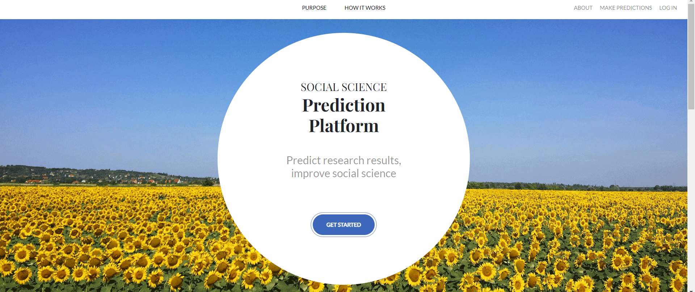
Counter Publication Bias
3. Prediction of research results
Common case of precise null results:
  Run study for which experts widely expected high effectiveness
  Find precise zero
  It should not be a null, you are rejecting the previous prior!
  But ex post, people find rationalizations. Now what?

Slide 21
Counter Publication Bias
Social Science Prediction Platform (SSPP) (co-PI with Eva Vivalt)
  Identify group of relevant researchers
  Post project on platform with 5-10 Qualtrics
  Collect predictions
  Ex post, compare results to average (median) forecast

Slide 22
Counter Publication Bias
4. Power studies correctly
So mis-leading to think that 0.2 s.d. effect is modest effect!
Assume effect size most times of 0.05 or 0.1 standard dev
Can your study be powered for that?
Do not take effect size for power from published studies, as those are likely biased by publication bias!
More on this soon

Slide 23
Counter Publication Bias
5. Find data sets with no selective publication
Example 1: Franco, Malhotra, and Simonovits (Science 2014)
  Time Sharing Experiments in Social Science, 221 studies
  Researchers have to ask permission and write proposal and undergo peer review to get approval
  Mostly political science, psychology, sociology
  Authors get back at all proposals approved: did you publish?

Slide 24
Counter Publication Bias
5. Find data sets with no selective publication
Example 2: DellaVigna and Linos (EMA 2022): Nudge Units!
Access to administrative record on all RCT nudge trials run by 2 major Nudge Units
Compare to meta-analysis of published nudge papers

Slide 25
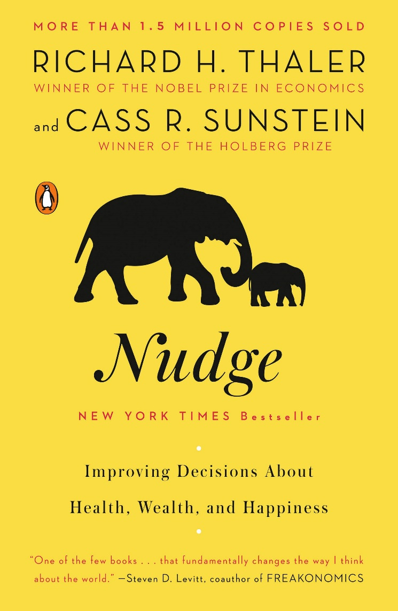
Introduction
Thaler and Sunstein (2009): “Nudge”
  Choice architecture that alters people's behavior in a predictable way without forbidding any options or significantly changing their economic incentives
Notes:
As of 2018 OECD count, there are 202 units dedicated to using behavioral science in government. This is already outdated (for example, India just announced a team).

Slide 26
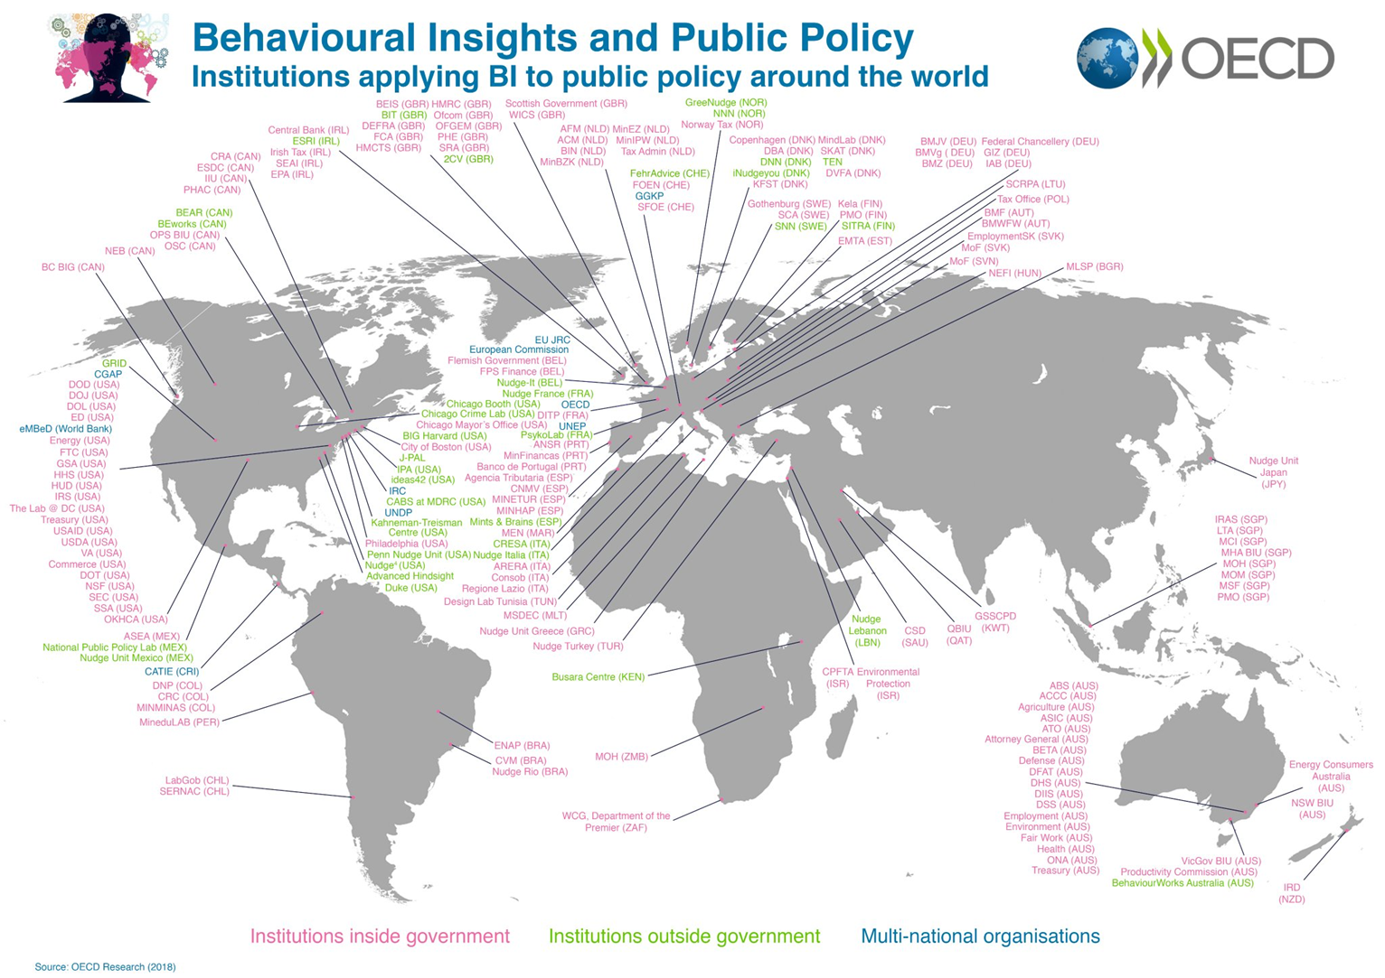
Introduction
Thaler and Sunstein (2009): “Nudge”
  Choice architecture that alters people's behavior in a predictable way without forbidding any options or significantly changing their economic incentives
Nudge RCTs adopted in government
Unique opportunity to study RCTs at scale
Notes:
As of 2018 OECD count, there are 202 units dedicated to using behavioral science in government. This is already outdated (for example, India just announced a team).

Slide 27
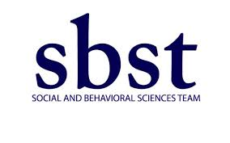


Overview
Collaboration with two Nudge Units:
  SBST/OES, 2015- present
  BIT North America 2015- present
Two key features:
  (Transparency) Each trial has a trial report, and many have pre-analysis plans
  (Novelty) 87% of trials unpublished in academic journals

Slide 28
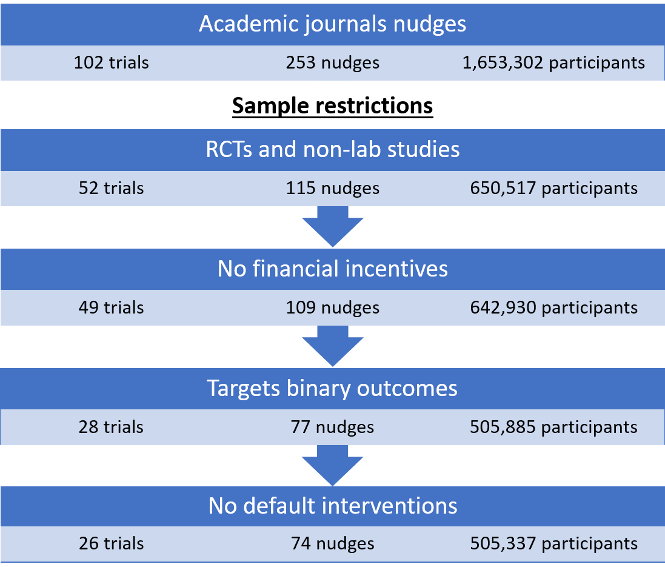
Academic Journals: Sample
Start from two recent nudge meta-analyses:
Hummel & Maedche (2019) and Benartzi et al. (2017)

Slide 29
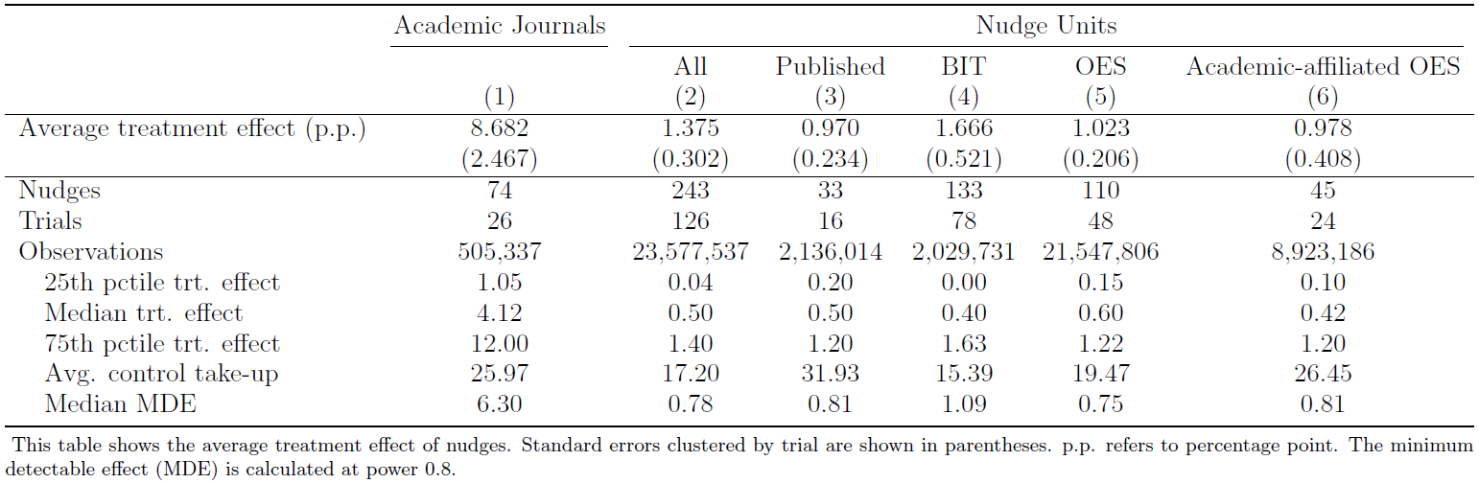
Academic Journals: Effect Size
Average nudge increases take up by:
  8.7 percentage points (33% over avg. control take-up)
Large effects!
Notes:
Woojin to update

Slide 30
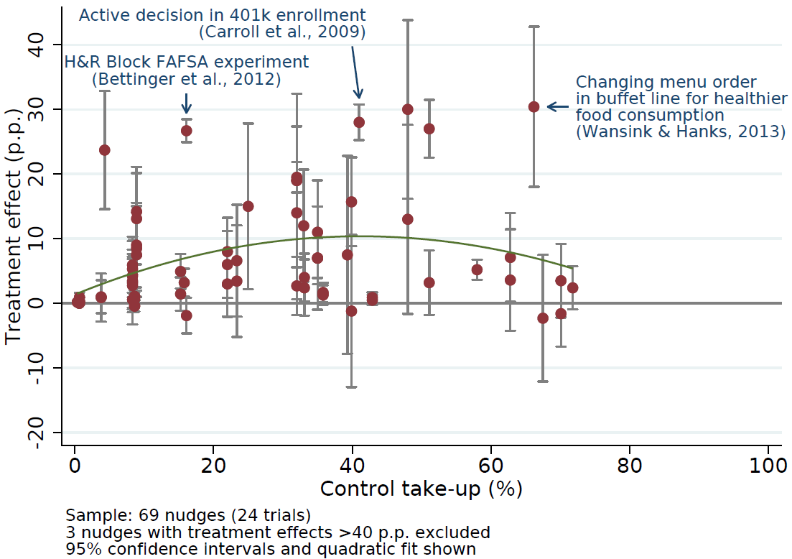
Academic Journals: Effect Size
Now compare to effect of nudges in Nudge Units

Slide 31
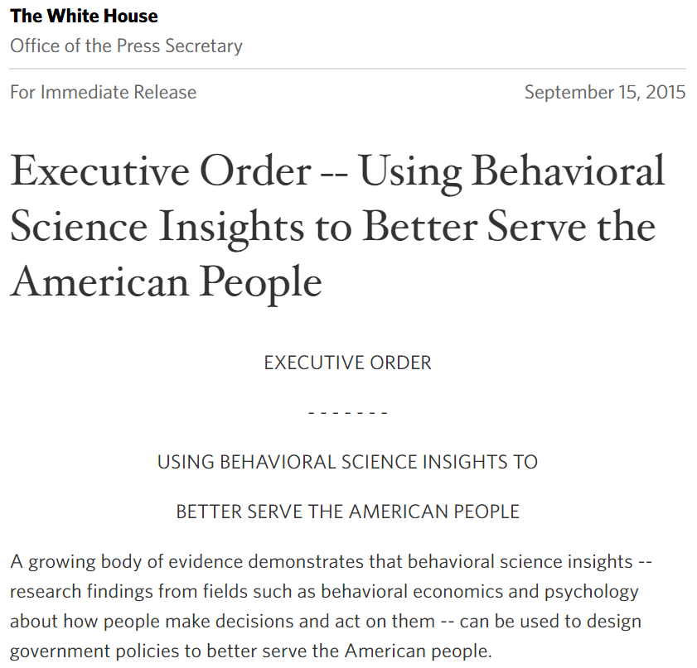

Nudge Units
Office of Evaluation Sciences
  Since 2015: 72 trials
  All trials have a trial report
  Commitment to publish all reports online
BIT North America
  Launched in 2015 in New York as expansion of UK team
  50+ cities
  90+ trials
  Pre-analysis plan for each trial
Notes:
To say: Remarkable case of transparency and willingness to be evidence-based

Slide 32
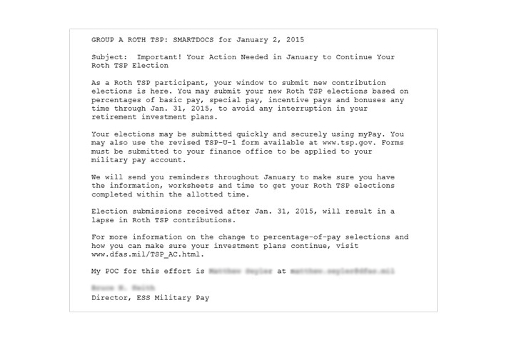
Nudge Units: OES
  Control communication for OES trial
  “Increasing Servicemember Roth TSP Re-Enrollment”
Notes:
Woojin – add from survey since those are pre-approved?

Slide 33
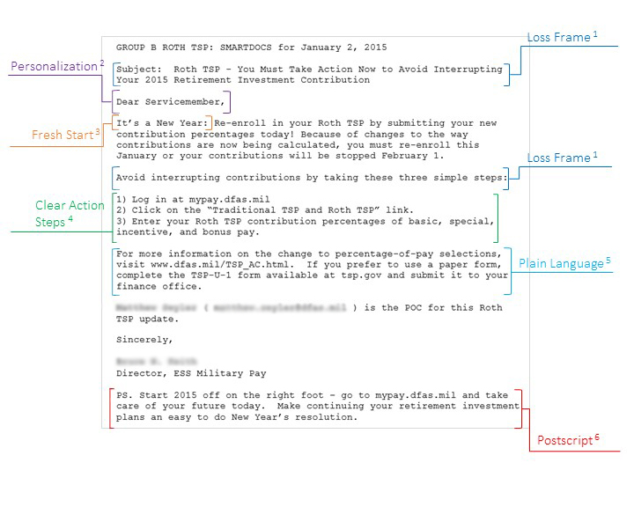
Nudge Units: OES
  Treatment communication for OES trial
  “Increasing Servicemember Roth TSP Re-Enrollment”

Slide 34
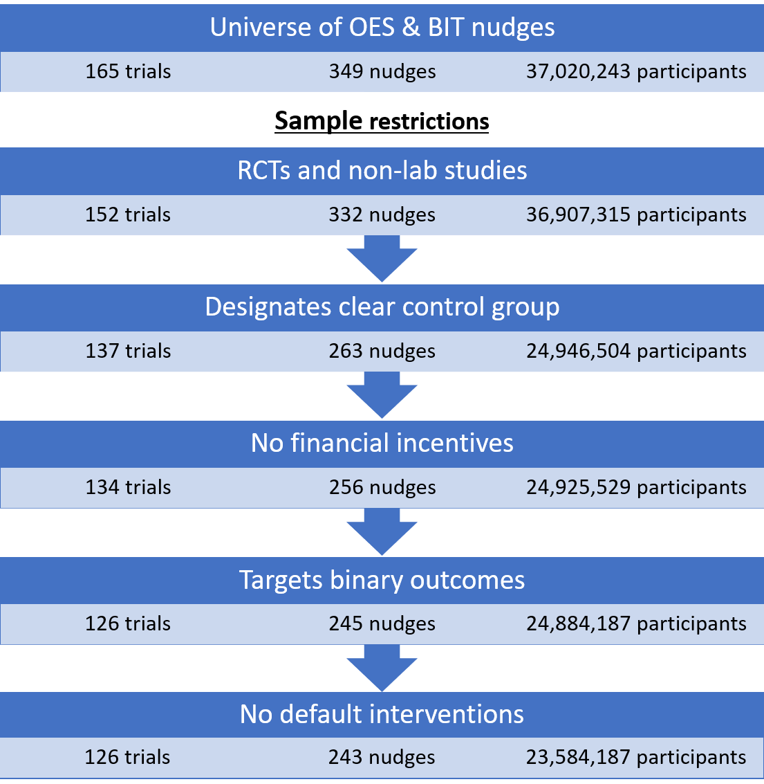
Nudge Units: Sample
Notice: Only 16 of 126 trials are published or working paper

Slide 35
Nudge Units: Effect Size
Average nudge increases take up by:
  1.4 percentage points (8% over avg. control take-up)
Statistically and economically significant impact
Six times smaller than Academic Journals nudges
Notes:
Woojin to update

Slide 36
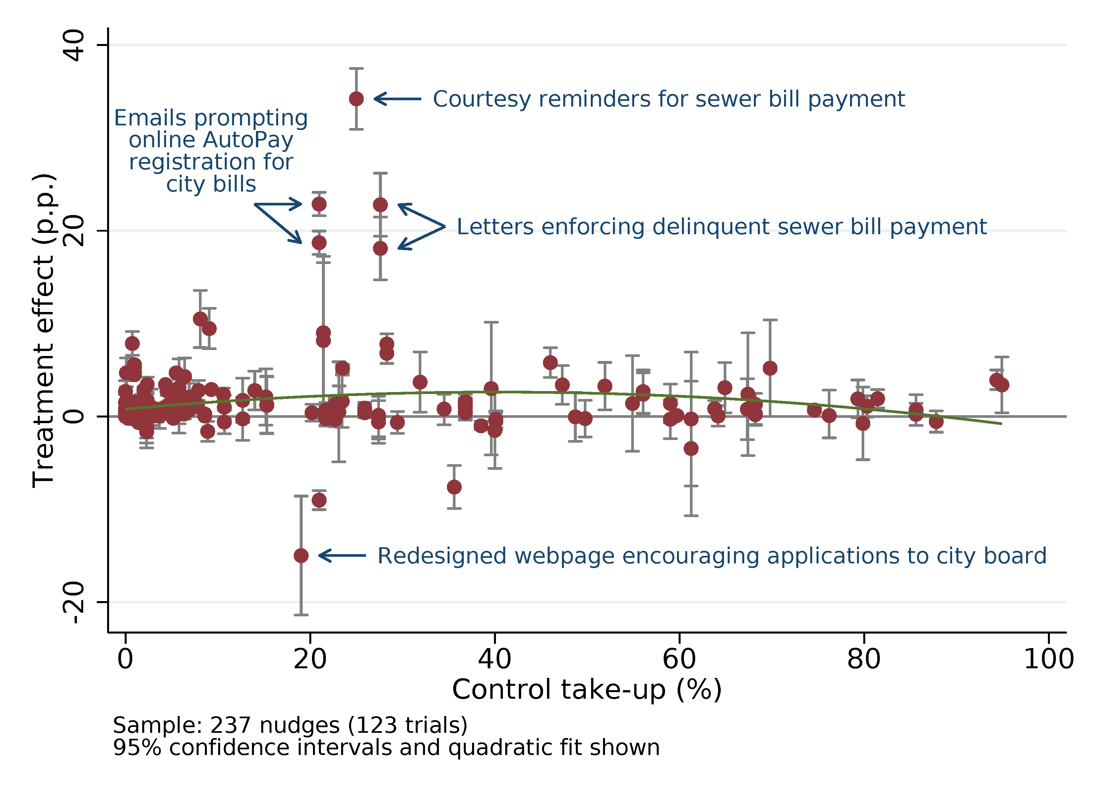
Nudge Unit Effect: Effect Size
Raw data on effect size
  All treatments

Slide 37
Simple Model of Rs and NUs
Can we weave together the findings in a simple model?
Model with 2 components
(Statistical Power) Rs and NUs both design nudge experiments aiming for 80% statistical power, given expected effect size – with different expected effect sizes.
(Publication Bias) NUs record all results, Rs write up non-significant results only with probability γ < 1
How far can we go with this simple model?
Start with component (1)

Slide 38
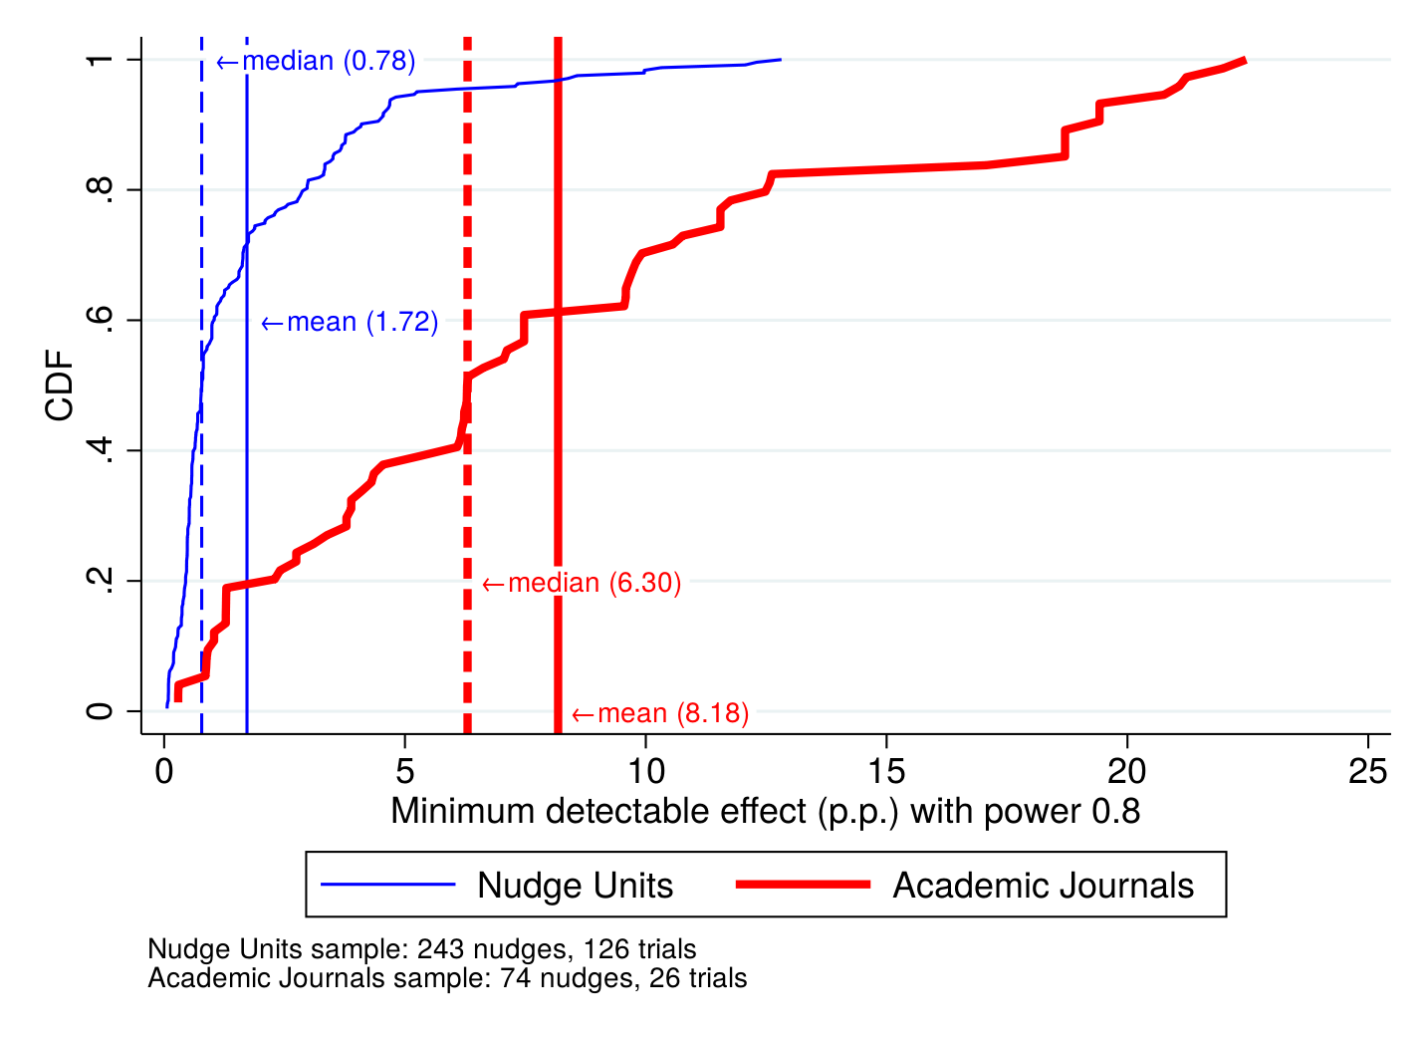
Statistical Power
How well powered are the trials? MDE at 80% in p.p.
Much higher power for Nudge Units vs. Acad. Jour.
→ NUs expect d_{NU} =2 pp., Rs expect d_{NU} =8 pp.
Does this “revealed” forecast capture actual pred.?

Slide 39
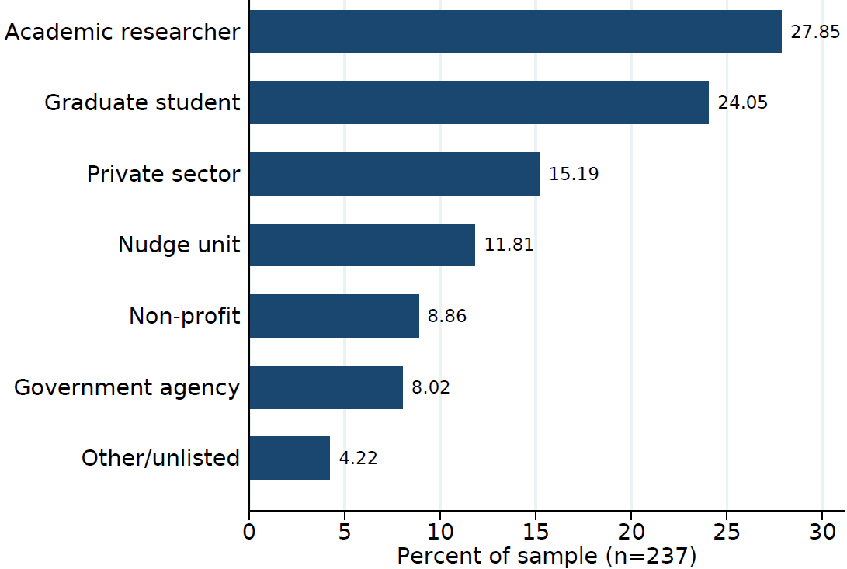
Forecasts of Effect Sizes
Direct evidence on expected effect sizes
(DellaVigna and Pope, 2018a,b; DellaVigna, Vivalt, and Pope, 2019)
Site: https://socialscienceprediction.org
  Present the setting, including 3 examples of nudges
  Ask to predict average p.p. effect of a nudge
    In NU sample & in published papers from meta-analyses
    Researchers and NU practitioners predict

Slide 40
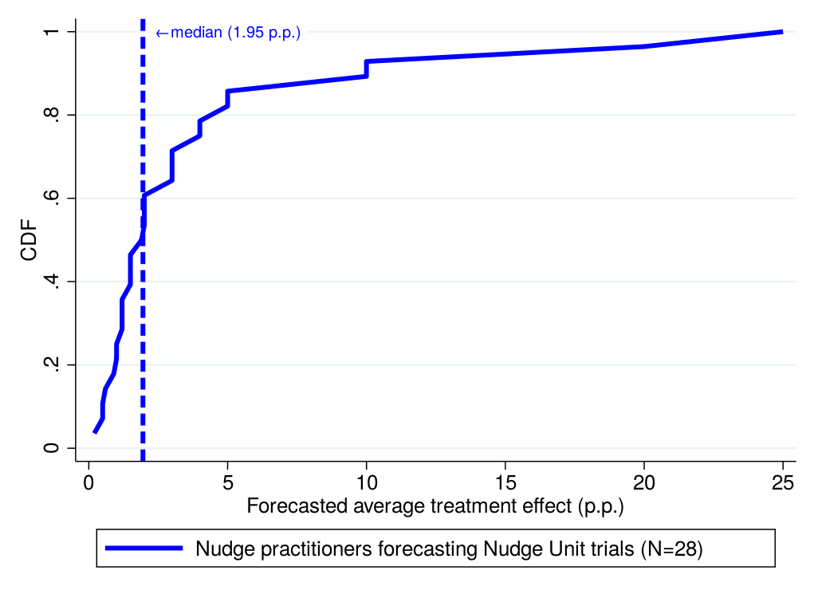
Forecasts of Effect Sizes (NUs)
Expectations of NU practitioners:
  Exactly in line with power calculation (2 pp.)
  In line with observed effect size (1.4 pp.)

Slide 41
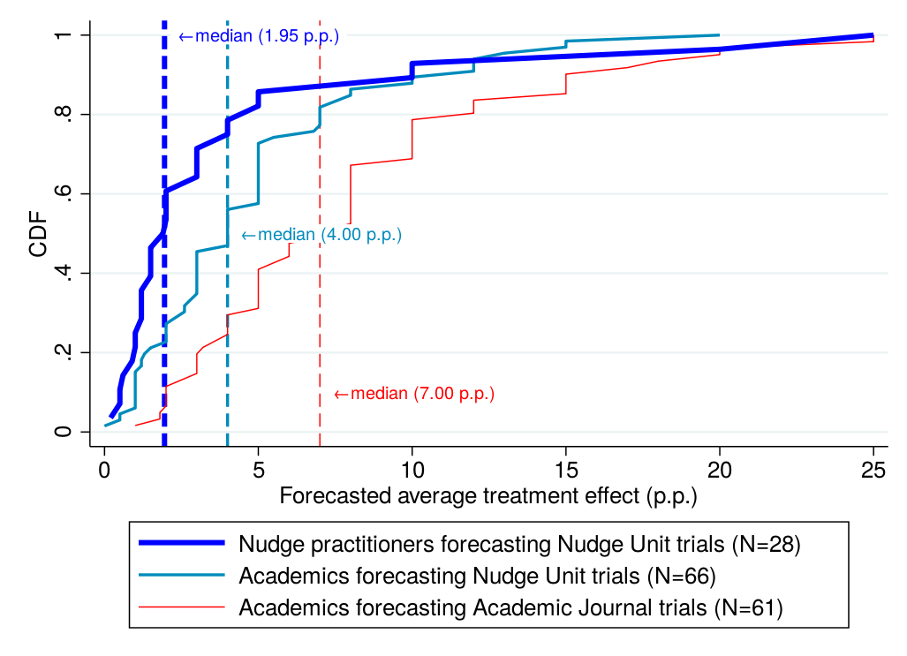
Forecasts of Effect Sizes (Rs)
Expectations of Researchers:
  Overestimate NU effect size (4 pp)
  Estimate about correctly Rs effect size (7 pp.)
Notes:
Implication: they may expect nudges that they run to also have 7pp effect

Slide 42
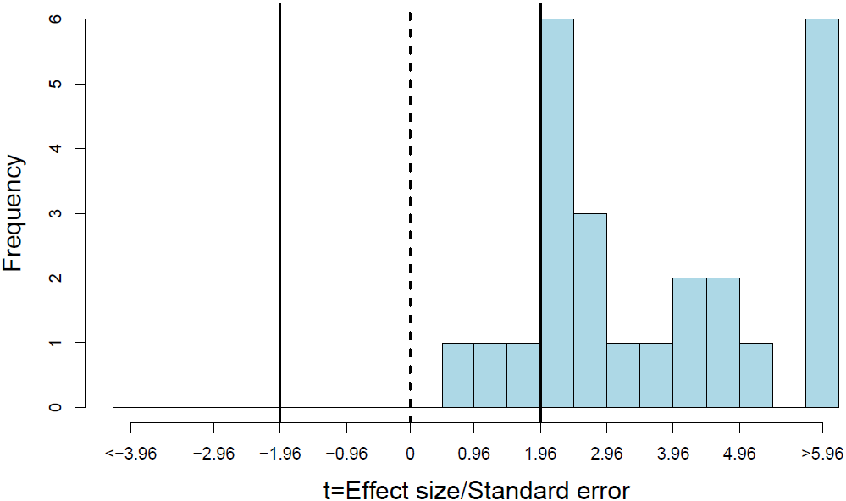
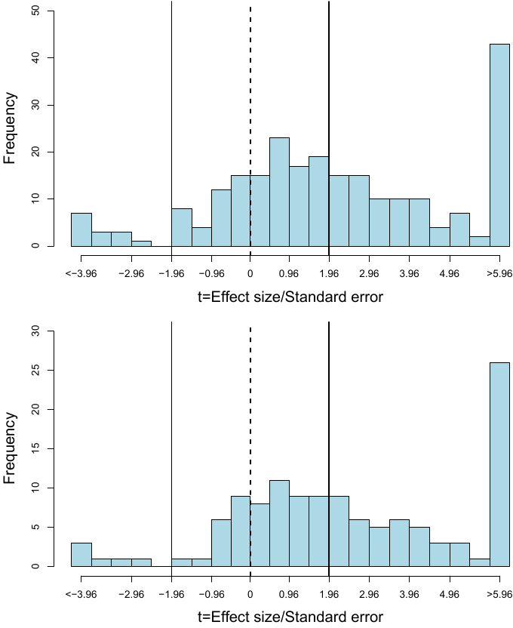
2. Publication Bias
Ac. Journals: t statistics for most significant treatm.
Nudge Units
Notes:
Excludes 1 trial in which the most significant treatment used incentives

Slide 43
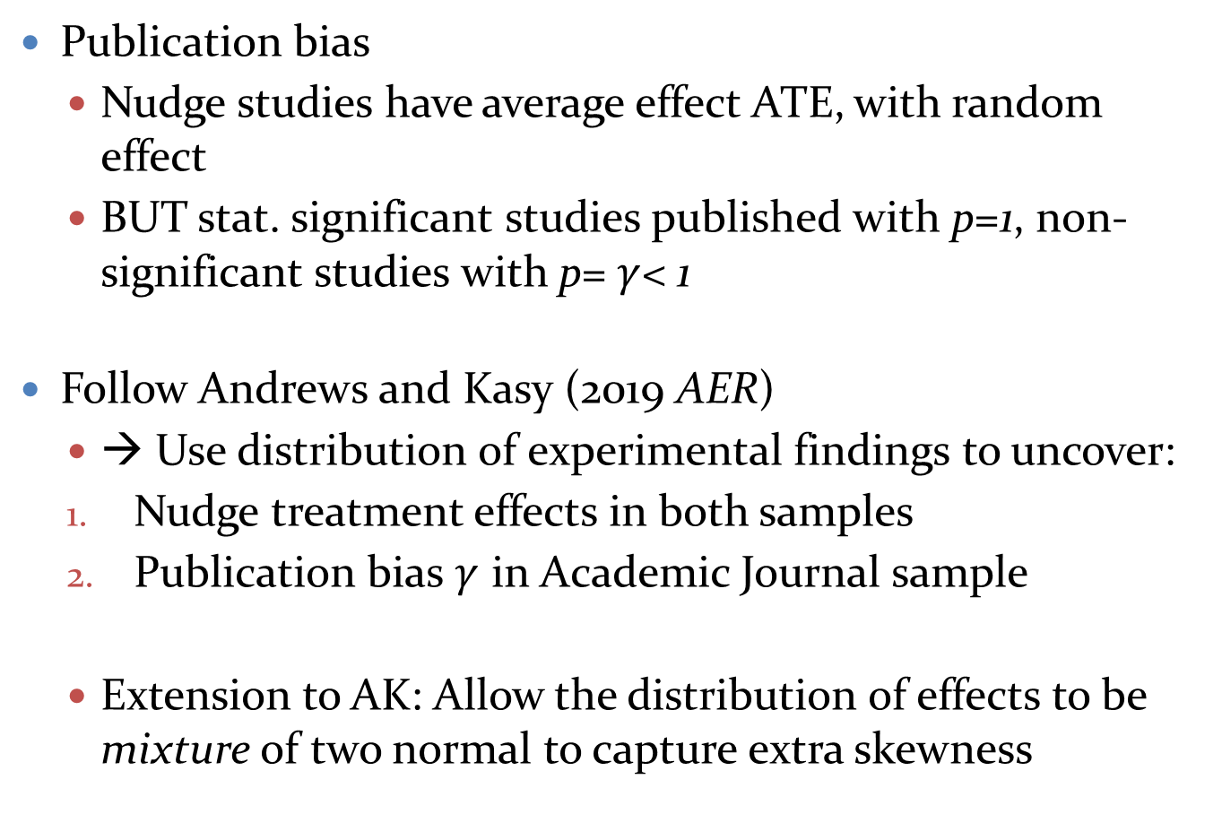
2. Publication Bias
Publication bias
  Nudge studies have average effect ATE, with random effect
  BUT stat. significant studies published with p=1, non-significant studies with p= $γ$< 1
Follow Andrews and Kasy (2019 AER)
  → Use distribution of experimental findings to uncover:
  Nudge treatment effects in both samples
  Publication bias $γ$ in Academic Journal sample
  Extension to AK: Allow the distribution of effects to be mixture of two normal to capture extra skewness

Slide 44
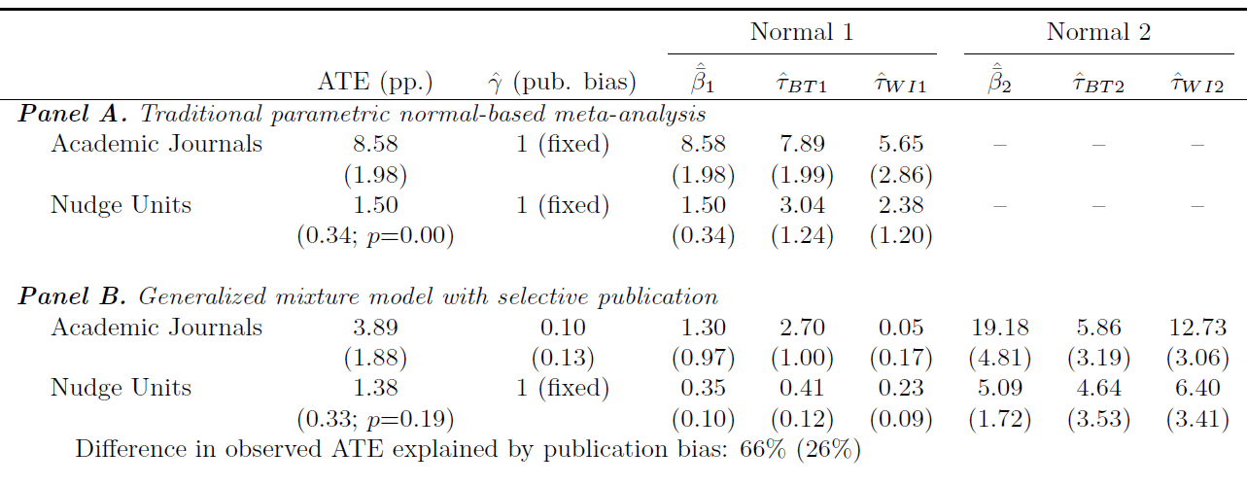

Meta-analysis methods – Pub. Bias
Estimates for Academic Journal sample
  Prob. of publishing trial w/o significant treatments $γ=0.10$
  Estimated ATE of 3.16 pp, much lower than uncorrected 8.58 pp effect
  → Publication bias can explain most of the effect

Slide 45
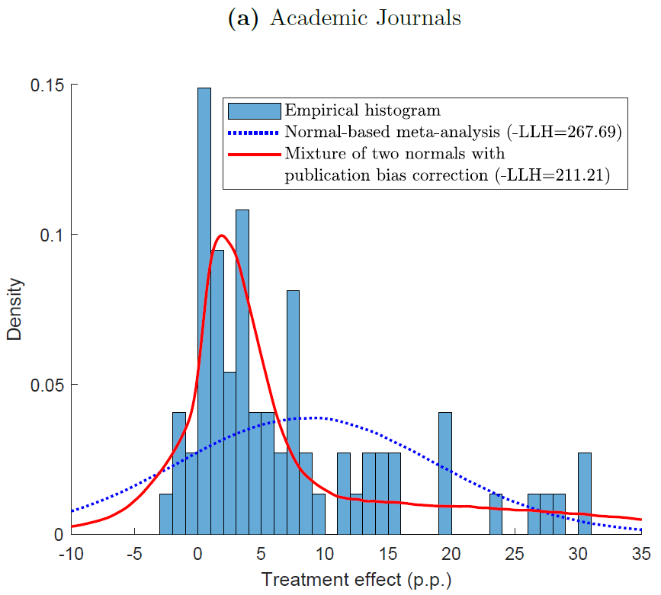
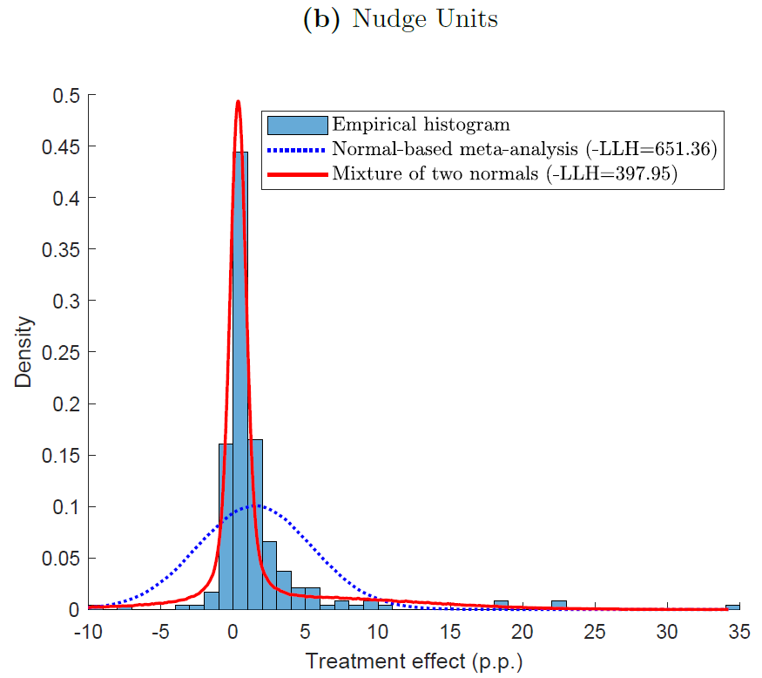
Meta-analysis methods – Pub. Bias
Good fit of effect size distribution

Slide 46
Power and Pub Bias
This example stress important point: worst is small effect size (likely for nudges) and low statistical power

Slide 47
THE END
Notes:
47

