Slide 1
2022 Behavioral Summer Camp:
Behavioral Labor Economics
Stefano DellaVigna, UC Berkeley and NBER
July 8, 2022

Slide 2
Behavioral Economics by Field
Fields of applications of Behavioral Economics
1980s and 1990s
  Behavioral Finance (Asset Pricing)
  Behavioral Household Finance
2000 on
  Behavioral Corporate Finance
  Behavioral Development Economics
  Behavioral Industrial Organization
2010 on
  Behavioral Public Finance
  Behavioral Health Economics
  Behavioral Political Economy
  Behavioral Firms
  Behavioral Macro (?)

Slide 3
Behavioral Labor Economics: History
What about Behavioral Labor Economics?
Work since early days of behavioral econ:
  Inter-industry wage differentials (Thaler, JEP 1989)
  Fairness constraints (Kahneman-Knetsch-Thaler, AER 1986)
  Gift Exchange (Akerlof, QJE 1982, AER 1984)
  Yet, did not quite pick up pace
Surprising because of deep psych roots in labor econ
  Institutionalists influenced by Veblen
  Richard Ely: “exploring the human problem by the psychological method”
  Albert Rees / John Dunlop: key role of fairness in labor negotiation

Slide 4
Five Main Areas
Five main areas of research:
  Worker Effort
    Present bias
    Horizontal / vertical social preferences
  Wage Setting
    Wage compression
    Nominal wage rigidity
  Job Search
    Present bias / overconfidence / ref dep in search effort
  Labor Supply
    Reference dependence and income targeting
    Gender norms
  Education
    College attendance
    Present bias / social norms / info / complexity of forms

Slide 5
Five Main Areas
Five main areas of research:
  Worker Effort
    Present bias
    Horizontal / vertical social preferences
  Wage Setting
    Wage compression
    Nominal wage rigidity
  Job Search
    Present bias / overconfidence / ref dep in search effort
  Labor Supply
    Reference dependence and income targeting
    Gender norms
  Education
    College attendance
    Present bias / social norms / info / complexity of forms

Slide 6
Worker Effort
What determines effort at the workplace?
  Explicit and implicit incentives (e.g., promotions)
  But also motivation
Factor 1 in motivation: Present bias
  Work entails immediate effort costs and delayed benefit
  Present bias →Not work hard enough
Key point, with remarkably little evidence
Kaur, Kremer, Mullainathan (JPE 2015) set up factory:
  Randomize timing of pay (relative to effort)
  Offer commitment device to work harder
Notes:
6

Slide 7
Worker Effort: Present Bias
Effort relative to pay identifies time preferences
Not quite beta-delta, but close
Notes:
7

Slide 8
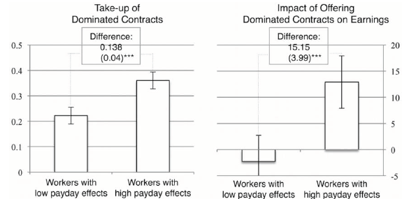
Worker Effort: Present Bias
Commitment device:
  High take-up and enhances production
Notes:
8

Slide 9
Worker Effort: Present Bias
Also on effort and present bias: Augenblick, Niederle, Sprenger (QJE 2015)
  Lab/Online experiment, allocate effort now versus later
  Methodological break-through to identify beta-delta, compared to money now- money later choices
  Experiment over multiple weeks
    Week 1: Allocation of how much effort between Weeks 2 and 3
    Week 2: Choose again allocation of effort between Weeks 2 and 3
    Is there a difference?
    Then same with money
Notes:
9

Slide 10
Worker Effort: Present Bias
Present bias over effort → Not over money
With same design, evidence on:
  Naivete’ vs. sophistication (Augenblick-Rabin RES 2019)
  Present-bias already within hours (Augenblick WP 2020)
  Naïve about self, not others (Fedyk WP 2020)
Notes:
10

Slide 11
Worker Effort: Social Preferences
Second key to motivation: social preferences
  If motivation important for effort, may justify paying higher wages to trigger reciprocity (Akerlof 1981)
Two main dimensions of social preferences:
  Horizontal Social Preferences (toward co-employees)
  Vertical Social Preferences (toward employer)
Two dimensions of effort:
  Extra effort that helps the employer (e.g., fix production defect)
  Boycott that hurts employer (e.g., stealing stationery)
Notes:
11

Slide 12
Worker Effort, Horizontal Preferences
Social Prefs: Effort depends on the type of contract
Bandiera, Barankay, Rasul (QJE 2005)
  Fruit pickers in the UK
  Farm switches from relative pay to individual piece rate
  Altruistic workers withhold effort under relative pay(negative externality), not under piece rate
  Dramatic 50 percent increase in production!
Notes:
12

Slide 13
Worker Effort, Horizontal Preferences
Bandiera, Barankay, Rasul (QJE 2005)
  But is it altruism?
  Alternative: repeated game collusion
  Test: Collusion hard to maintain w/ imperfect observability
  Strawberries (observe effort of all) vs raspberries (not so)
  It is all collusion! (Or reciprocity)
  → Importance to shut down repeated game incentives
Notes:
13

Slide 14
Worker Effort, Horizontal Preferences
  Pairs of workers switched quasi-randomly each day
  (So no repeated game confounds)
Notes:
14

Slide 15
Worker Effort, Horizontal Preferences
Notes:
15

Slide 16
Worker Effort, Horizontal Preferences
Extra evidence I: Social conflict
Extra evidence II: Switch to team pay
Notes:
16

Slide 17
Worker Effort, Horizontal Preferences
Comparison of pay to co-workers?
  Workers dislike wage inequality when they are lower paid: Card, Mas, Moretti, Saez (AER 2012); Cohn, Fehr, Herrmann, Schneider (JEEA, 2014); Breza, Kaur, Shamdasani (QJE, 2018)
Cohn et al: Workers hired in pairs to sell cards in weekend 1
On weekend 2, 25% cut for (randomly) 0, 1, or 2 workers
Effort decrease when pay cut to only 1 worker
Notes:
17

Slide 18
Worker Effort, Vertical Preferences
Gift Exchange hypothesis (Akerlof, QJE 1982, AER 1984): Generous employer triggers reciprocity among workers → Higher effort
Lab gift exchange (Fehr, Kirchsteiger, Riedl QJE 1993): Yes
But in the field? Issue: Reciprocity vs repeated game effects
Gneezy and List (EMA 2006) design idea:
  Create mini-job for 1 day (e.g., coding library cards)
  Advertise flat wage, no piece rate
  Randomly increase wage for “gift” workers after they showed up
  Compare effort to effort for control workers
Results? Mixed
  Large reciprocal response in e.g., Gneezy and List (2006, N=19), Kube et al. (AER 2011, N=48)
  No evidence in e.g., Esteves-Sorenson (MS, 2018, N=194)
Notes:
18

Slide 19
Worker Effort, Vertical Preferences
Let’s revisit the Gneezy-List design. Subjects maximize
Why does it matter? Effort could be inelastic, cannot pick up gift response
Notes:
19

Slide 20
Worker Effort, Vertical Preferences
DellaVigna, List, Malmendier, and Rao (AER 2022): Pay-rate design
  Add treatments with piece rate (pay rate) variation with no gift
  → Price out cost of effort function (typical “structural behavioral” trick)
  State/vary return to the employer v
  And… use large samples! (as much as possible)
Three experiments, all with features above, but
  Experiment 1: Effort is productivity in fixed amount of time (as in previous Gneezy-List designs), # folded envelopes in 20 mins, 10 times
  Experiments 2 and 3: Effort is doing extra work:
    After 2 hours of work, would you be able to help us for up to an extra hour?
Notes:
20

Slide 21
Worker Effort, Vertical Preferences
  Experiment 1: N= 446 (largest we know of). Yet, no gift effects…
  Well, is task sensitive to pay rate incentives? Just a bit!
  Productivity is inelastic (0.1) → Low powered test of gift exchange! (same in Araujo et al. JESA 2016 and DellaVigna and Pope RES 2018)
Notes:
21

Slide 22
Worker Effort, Vertical Preferences
  Experiment 2: N= 300 Sizable gift effects on extra work!
  Perhaps extra work is more sensitive to pay rate incentives? You bet!
  Replicates in Experiment 3 with online sample
Notes:
22

Slide 23
Worker Effort, Vertical Preferences
  On surface, Experiments 1 and 2/3 get very different gift exchange results as percent response
  Yet, results quite consistent re: underlying reciprocity parameter
  → Structural behavioral economics: Design experiments in light of model
Notes:
23

Slide 24
Worker Effort, Vertical Preferences
Now: negative reciprocity for unfair employer treatment
Notes:
24

Slide 25
Worker Effort, Vertical Preferences
Notes:
25

Slide 26
Worker Effort, Vertical Preferences
Lower quality replacement workers or boycott?
Notes:
26

Slide 27
Worker Effort, Other
Other behavioral determinants of effort:
Non-financial rewards as motivators (eg Akerlof and Kranton QJE 2000; Besley-Ghatak, AER 2005)
  Evidence mixed on importance (Ashraf, Bandiera and Jack, JPubE 2014)
Crowd-out of motivation from financial rewards (Deci, JPSP 1971; Gneezy and Rustichini QJE 2000)
  Several non-replications: Esteves-Sorenson and Broce (ReStat, 2022); Hossain and Li (MS 2014); DellaVigna and Pope (RES, 2018)
Overconfidence of workers, matters for eg, retention of truckers (Hoffman and Burks QE 2020) and gig economy choice (Pires, in progress)

Slide 28
Five Main Areas
Five main areas of research:
  Worker Effort
    Present bias
    Horizontal / vertical social preferences
  Wage Setting
    Wage compression
    Nominal wage rigidity
  Job Search
    Present bias / overconfidence / ref dep in search effort
  Labor Supply
    Reference dependence and income targeting
    Gender norms
  Education
    College attendance
    Present bias / social norms / info / complexity of forms

Slide 29
Wage Setting Implications
Implications of effort findings for wage setting
Present bias →
  Work in office, not at home
  Commit. devices, but why uncommon? (Laibson AEA)
Vertical social preferences →
  Gift exchange / efficiency wages maybe
  Constraints on Manager pay (Mas JPE 2017)
Horizontal social preferences →
  Pay compression / wage differentials across firms (Card, Heining, Kline QJE 2013)
  Drives outsourcing (Goldschmidt and Schmieder QJE 2017)
Overconfidence of workers → Stock options (Bergman and Jenter, 2007; Cowgill and Zitzewitz, 2015)

Slide 30
Wage Setting Implications, Outsourcing
Pay compression:
  Some firms pay more than others
  This applies also to low skill workers
  As competition strengthens → save $ by outsourcing low-skill workers (Goldschmidt and Schmieder QJE 2017)
Germany: Share of outsourced workers increased

Slide 31
Wage Setting Implications, Outsourcing
More outsourcing in firms with higher pay, controlling for all else
Preferences for equity have indirect effects

Slide 32
Wage Setting, Nominal Wage Rigidity
Kahneman, Knetsch and Thaler (1986) Telephone surveys in Canada in 1984 and 1985 --> Ask questions on fairness
A real and nominal wage cut is not fair (Question 4A)
A real (but not nominal) wage cut is fair (Question 4B)
Notes:
32

Slide 33
Wage Setting, Nominal Wage Rigidity
Early evidence: Bewley (1999), Card and Hyslop (1997)
Hipsman (2011): Admin data from several firms (Hewlett)
Base pay % increase among employees in 2007 and 2008
0.36% pay cuts, 54.58% pay freezes, 45.06% pay raises
Implications when low inflation: firings? Less hiring?
Notes:
33

Slide 34
Five Main Areas
Five main areas of research:
  Worker Effort
    Present bias
    Horizontal / vertical social preferences
  Wage Setting
    Wage compression
    Nominal wage rigidity
  Job Search
    Present bias / overconfidence / ref dep in search effort
  Labor Supply
    Reference dependence and income targeting
    Gender norms
  Education
    College attendance
    Present bias / social norms / info / complexity of forms

Slide 35
Job Search
Notes:
35

Slide 36
Job Search, Present Bias
Notes:
36

Slide 37
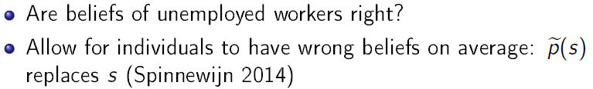
Job Search, Overconfidence
Notes:
37

Slide 38
Job Search, Overconfidence
Clear evidence for the first form of overconfidence
Very little known about the second (control overconfidence, Spinnewijn, JEEA 2015)
See also Mueller, Spinnewijn, and Topa (AER 2021)
Notes:
38

Slide 39
Job Search, Reference Dependence
The reference point is average of recent earnings (memory)
Notes:
39

Slide 40
Job Search, Reference Dependence
Search effort over time for a person
Krueger and Muller (BPEA 2011): web survey of UI recipients in NJ
DellaVigna, Heining, Schmieder, Trenkle (QJE 2022):
  Weekly SMS question on search effort for 6k unempl in Germany
Notes:
40

Slide 41
Job Search, Reference Dependence
  Response via SMS - How does search effort evolve over the spell and around UI expiration?
  Compare to path of hazard rate
  Decline in hazard AND search effort post expiration consistent with reference dependence
Notes:
41

Slide 42
1. Job Search, Reference Dependence
DellaVigna, Lindner, Reizer, Schmieder (QJE 2017)
UI reform in Hungary displays patterns in hazards after 270 days strongly suggestive of reference dependence
Notes:
42

Slide 43
Job Search, Reference Dependence
Standard model Reference-dependent model
Estimate of two models w/ same no. of parameters
  Standard model w/ unobserved heterog. (3 cost types)
  Model with reference dependence (2 cost types)
Notes:
43

Slide 44
Five Main Areas
Five main areas of research:
  Worker Effort
    Present bias
    Horizontal / vertical social preferences
  Wage Setting
    Wage compression
    Nominal wage rigidity
  Job Search
    Present bias / overconfidence / ref dep in search effort
  Labor Supply
    Reference dependence and income targeting
    Gender norms
  Education
    College attendance
    Present bias / social norms / info / complexity of forms

Slide 45
Labor Supply
(High-frequency) Labor Supply
Target earnings and Reference dependence
  When wages are higher, work less
  Observation data -- Cab drivers (Camerer et al., QJE 1997; Farber JPE 2005; Crawford and Meng, AER 2011; Farber, QJE 2015)
  Field exp -- Bike Messengers (Fehr and Goette, AER 2007)
  Literature was a mess
  Enter Thakral and To (AER 2021) that clarifies facts:
    Yes, drivers more likely to stop when earned more
    Effect size moderate overall
    ALSO: only recent earnings (last 2-3 hours) matter, not earnings very early on in day
Notes:
45

Slide 46
Labor Supply
  Thakral and To (AER 2021) key finding:
    Consistent with backward-looking reference points or form of KR reference points
Notes:
46

Slide 47
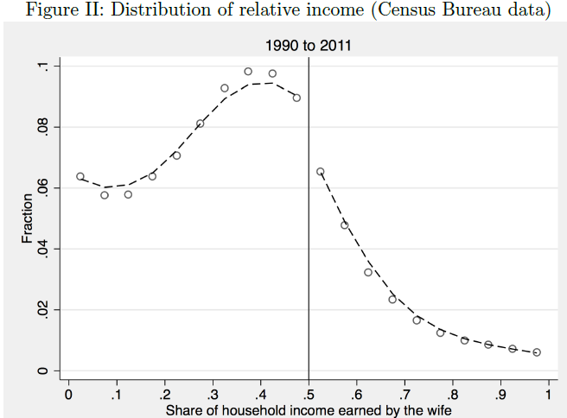
Labor Supply
Gender norms in Labor Supply (Bertrand, Kamenica, Pan QJE 2015)
  Husband dislikes if spouse earns more
  Marriages less likely to occur if wife earns more
Notes:
47

Slide 48
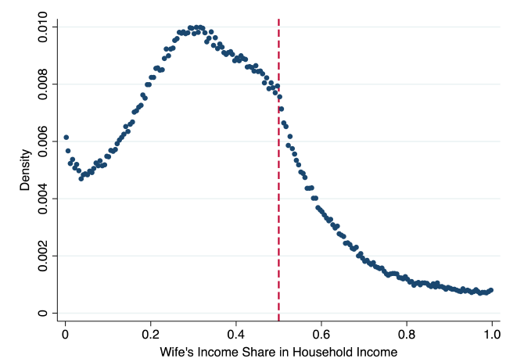
Labor Supply
  Hermle and Hildebrand (WP 2020): German admin data
  It is a kink, not a jump!
  → Social preferences with kink a’ la inequity aversion, not a notch in utility
Notes:
48

Slide 49
Five Main Areas
Five main areas of research:
  Worker Effort
    Present bias
    Horizontal / vertical social preferences
  Wage Setting
    Wage compression
    Nominal wage rigidity
  Job Search
    Present bias / overconfidence / ref dep in search effort
  Labor Supply
    Reference dependence and income targeting
    Gender norms
  Education
    College attendance
    Present bias / social norms / info / complexity of forms

Slide 50
Educational Choices
Benefits of attending school:
  Returns to school are high (10%-12%/yr of school)
  If anything, college premium has increased over time
Then why doesn’t (nearly) everyone go?
Active debate. Relevant behavioral factors:
  Excessive discounting (Oreopoulos, 2007)
  Poor information, misperceived returns to college (Jensen, 2010; Wiswall and Zafar, 2015)
  Complexity. FAFSA forms too hard (Bettinger, Long, Oreopoulos, Sanbonmatsu, 2012)
  Social norms. Acting white (Fryer and Austen-Smith; Bursztyn, Jensen)
Notes:
50

Slide 51
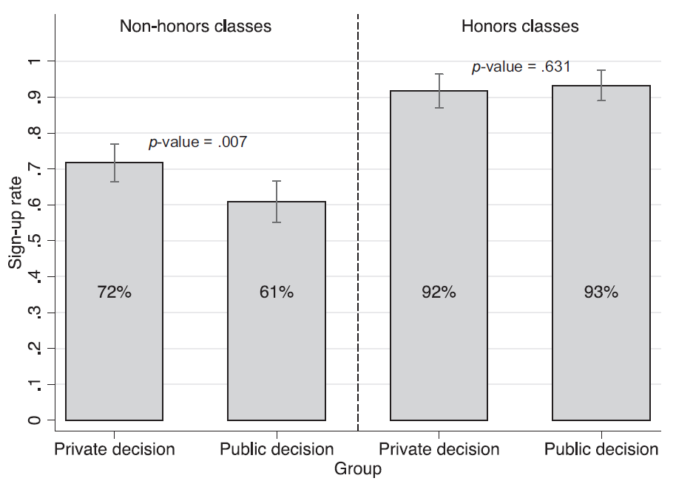
Educational Choices
  Do people skip educational investments to avoid counter-cultural signaling? (Bursztyn, Jensen, QJE 2015)
    Offer free SAT prep in minority LA public high schools
    “Bursztyn” design: (Public vs Private) X (Group signaled to)
    Public/Private: “Decision to sign up for the course will be kept completely private from everyone, except [including] the other students in the room”
Notes:
51

Slide 52
THE END
Notes:
52

Slide 53
Wage Setting, Nominal Wage Rigidity
Bewley (1999) interviews of managers and workers
  They hate nominal wage cuts
→ Expect employers to avoid nominal wage decreases
Card and Hyslop (1997): Early evidence on this
Notes:
53

