Slide 1
Field experiments in behavioral economics
RSF Summer CamP 2018
Gautam Rao
Harvard University

Slide 2
What is a field experiment?
Typical definition: Use of randomization or quasi-randomization in naturally-occurring settings to answer a causal question
Broader view: Controlled intervention in the world while measuring outcomes, even if not randomized

Slide 3
History in economics
Agricultural field experiments of the 1920-30s (Fisher; Neyman)
Large-scale social policy experiments in U.S. in 1960s-70s
  Negative income taxes, electricity housing allowances
Since the 2000s: modern economic field experiments
  Behavioral economics: John List etc.
  Development economics: Miguel and Kremer
In behavioral economics and psychology:
  Long tradition of lab and survey experiments
  Social psychology used to do lots of field experiments (e.g. Lewin, Milgram, Zimbardo, Sherif etc.)

Slide 4
Today
Methodological Points
Substantive Topics
  Gift exchange and reciprocity at work
  Charitable giving
  Norms, Self Image and Social Image
  Endowment effect
  Sleep deprivation
Practicalities and Q&A

Slide 5
Topics I won’t cover
Policy-evaluation field experiments (e.g. evaluations of nudges)
Field experiments with firms
Online experiments
Many many very cool field experiments, including but not limited to some of my favorites:
  Kaur-Kremer-Mullainathan: Self-control at work
  Breza-Kaur-Shamsadani: Morale effects of pay inequality
  Cullen and Perez-Truglia: Pay inequality
  Hanna-Mullainathan-Schwartzstein: Inattention
  Augenblick-Niederle-Sprenger and Augenblick-Rabin: Present Bias

Slide 6
Methodological Points
Lab vs field
Theory in field experiments
Design and Mechanism tests
Statistical Power
Measurement
Taking magnitudes seriously
Preregistration
Choice / Take-up experiments
Randomization bias / Site selection bias
Cutting-edge field setups

Slide 7
Quick word on lab vs. field experiments
Continuum
  Entirely artefactual and abstract lab experiments
  Entirely natural field experiments
  But lots of stuff is in between.
  Tradeoff control versus ecological validity
Famous List and Levitt critique of lab experiments
  Site-selection bias
  Demand effects
  Lack of market competition
  All true, but the real world also has many of these features!
Don't be dogmatic about this. Pick the right tool for the question. And be humble about interpretation. (Matthew’s comment about belief elicitation)
Lots of the best recent work blows up this distinction

Slide 8
Substantive Topics
Gift exchange and reciprocity at work
Charitable giving
Norms, Self Image and Social Image
Endowment effect
Sleep deprivation

Slide 9
What is the role of social preferences in employment contracts?
Standard View: Worker effort driven by incentives (including repeated game)
Social Preferences: Worker effort affected by social preferences towards employer (Akerlof 1982)
Observational Evidence suggestive of social preferences
  Krueger-Mas (2004): strike and sabotage
  Bandiera, Barankay, and Rasul (2005): relative pay
BUT: These papers are all consistent with repeated game incentives
  In fact: raspberries/strawberries in Bandiera et al. (2005)

Slide 10
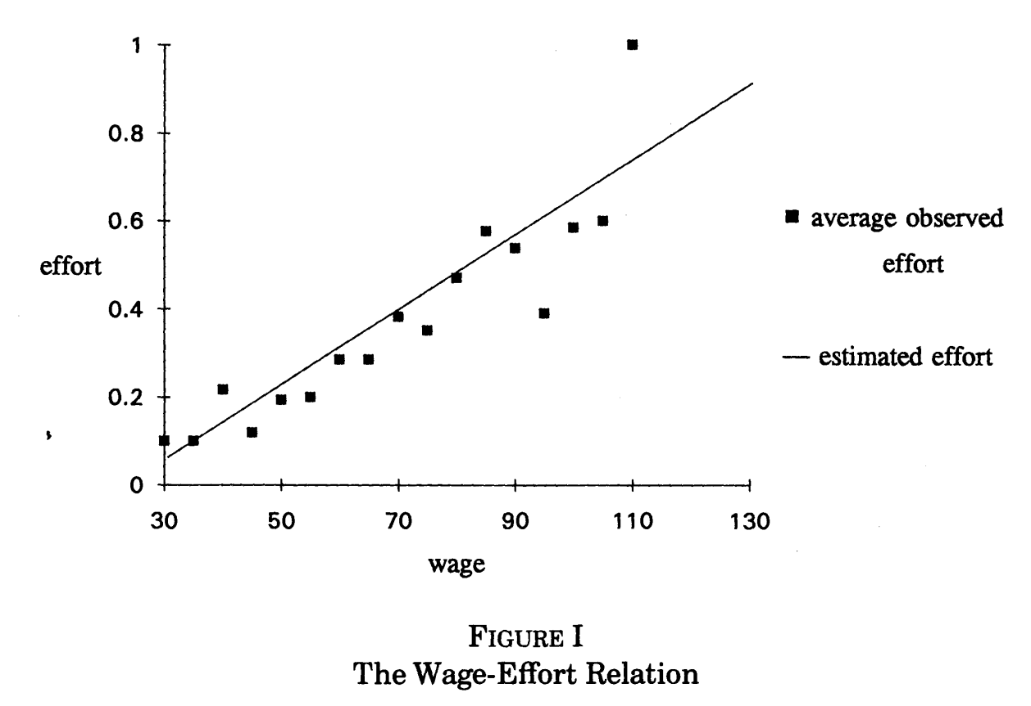
Influential lab experiment: Fehr, Kirschsteiger and Reidl (1993)
“Managers” paired anonymously with “workers” in one-shot interactions.
Managers select the wage, and workers then choose “effort”
Efficient outcome is high wage, high effort
Nash equilibrium is minimum wage, minimum effort
Find substantial gift exchange: workers choose higher effort in response to higher wage offers; managers anticipate this and offer higher wages than standard prediction

Slide 11
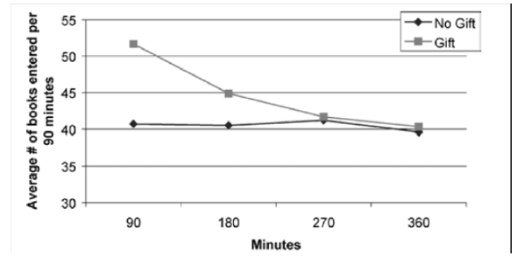
Moving to field: Gneezy and List (2006)
Design:
  Workers hired for one-time 6-hour task
  Advertised pay: Wage, no piece rate
  Control group receives announced pay
  Gift group receives surprise wage increase
Outcome = Productivity in fixed time
Gift exchange increases output, but short-lived
Follow-up literature finds stronger effects of pay cuts (Kube-Marechal-Puppe 2013)

Slide 12
DellaVigna, List, Malmendier and Rao (2016)
Goals
Nature of social preference at work (altruism vs. warm glow or norms)
Estimate model of worker effort with social preferences
Take magnitudes of gift / reciprocity effects seriously
One-time job preparing mailers for charitable fundraising.
Vary within and between:
  Return to the worker: 3 piece rates to benchmark effects + estimate elasticity
  Return to the employer: Introducing match to funds raised by the charity
  Gifts: Positive, negative, in-kind gifts

Slide 13
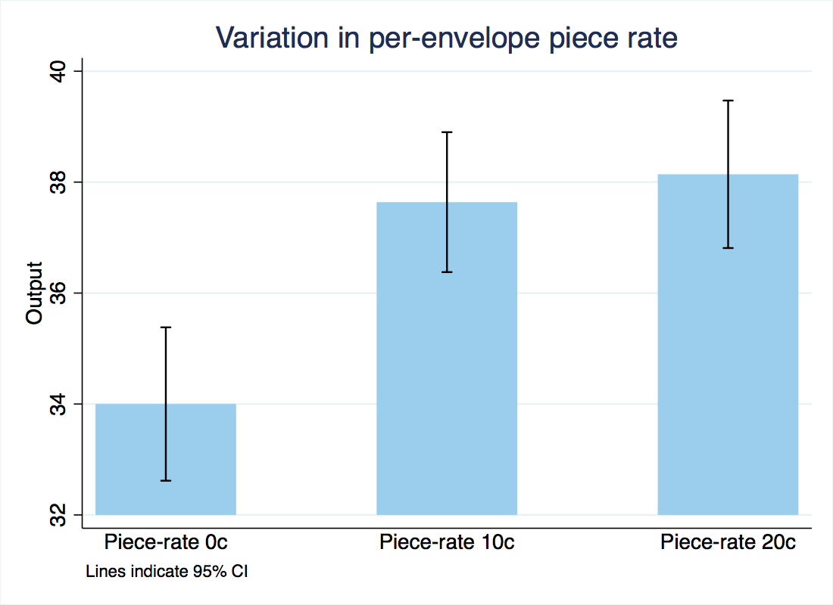
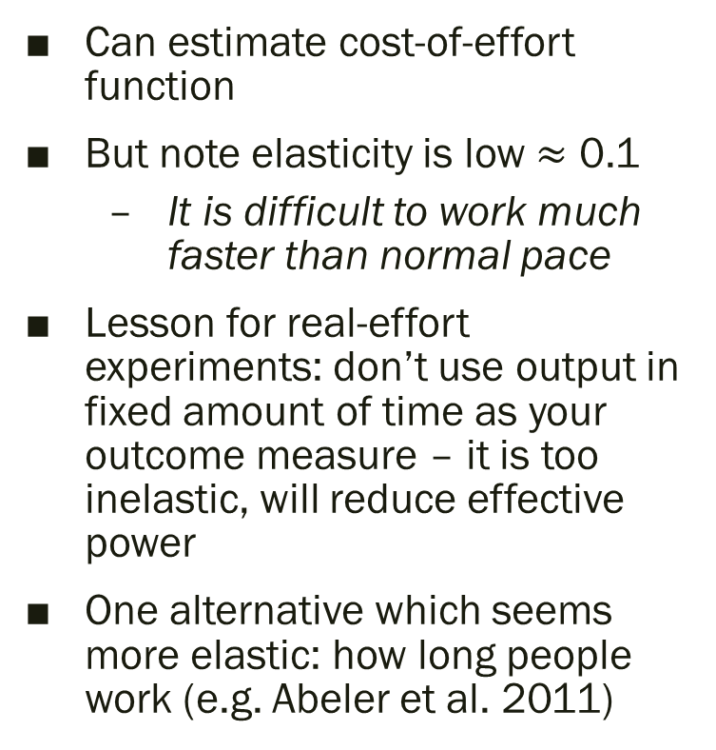
Finding 1: Response to piece rate
Can estimate cost-of-effort function
But note elasticity is low $≈$ 0.1
  It is difficult to work much faster than normal pace
Lesson for real-effort experiments: don’t use output in fixed amount of time as your outcome measure – it is too inelastic, will reduce effective power
One alternative which seems more elastic: how long people work (e.g. Abeler et al. 2011)

Slide 14
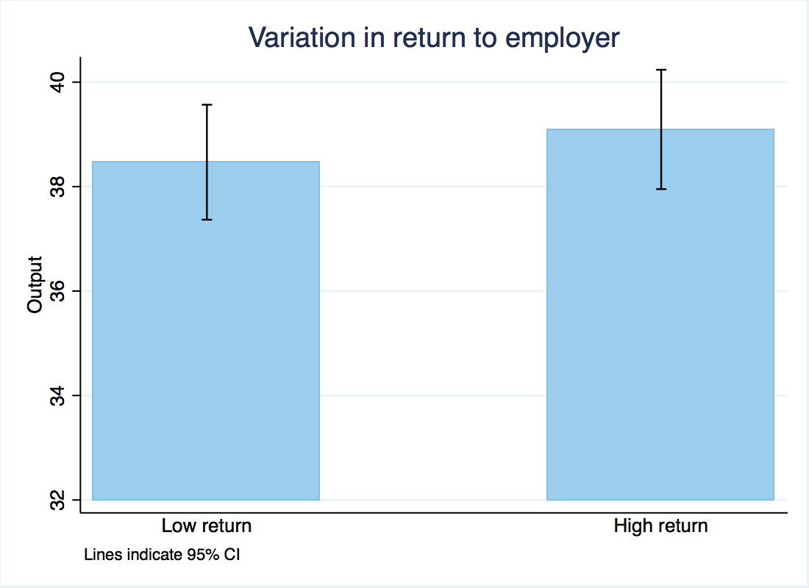
Finding 2: No response to return to employer
Doubling return to employer has no effect on output
Inconsistent with a simple altruism model
Another treatment shows that effort is reduced if the return to the employer is zero (paid training session) – consistent with caring about “meaning” of your work

Slide 15
Finding 3: No effect of gift or pay cut
No effect of doubling flat pay, cutting it in half, or providing an in-kind gift (thermos)
Suggests that, at least in one-shot interactions, gift exchange may be more limited than we thought

Slide 16
Methodological aside: Between-and Within-Subject Variation
Use both within and between-subjects variation in treatments
  Within person means observe same individual multiple times in different treatments
  Possibility of order effects → Randomize order of treatments
  Increases power by allowing us to control for individual ability
  Complexity for participants + Aesthetically unpleasing to many readers (ex-post)

Slide 17
Methodological aside: Pre-analysis plan
Pre-analysis plan posted on AEA website before getting data
Goal is to guard against p-hacking and specification fishing
Registered not just reduced form comparisons, but also theory+structural model
  Arguably particularly useful given the degrees of freedom in structural modeling
  Needed lots of pilot data to make functional form assumptions!
  Risk of tying one’s hands too much.

Slide 18
Substantive Topics
Gift exchange and reciprocity at work
Charitable giving
Norms, Self Image and Social Image
Endowment effect
Sleep, depression, hunger, alcohol, loneliness

Slide 19
Theories
Large literature on dictator games
Theories of distributional preferences (theories of dictator game giving?)
  Charness-Rabin, Fehr-Schmidt, Bolton-Ockenfels
  Main critique: Teaches us about fairness preferences, but hard to apply to behavior in field
Theories of altruism
  Pure altruism (e.g. Becker, 1981)
  Warm glow or impure altruism (Andreoni 1994; 2004)
Theories incorporating image / signaling motives
  Bodner and Prelec, 2002, Benabou and Tirole (2004, 2006)

Slide 20
Field experiments on charitable giving
Large literature working with charities to randomize some aspect of solicitations (e.g. work by John List, Dean Karlan etc.)
Many useful and interesting findings, e.g.:
  Gift exchange (Falk 2004): Including a gift (postcards) in mailer increases giving, does not crowd out future giving
  Karlan and List (2007): Matching donations increase giving, but no response from going beyond 1:1 match (what theory predicts this?)
  …many more

Slide 21
Altruism vs. Social Pressure: DellaVigna, List and Malmendier (2012)
Inspired by lab evidence on participants “opting out” of dictator games (e.g. Dana, Cain and Dawes 2006; Dana, Weber and Kuang 2007)
Possibilities:
  Giving because you like to give: (altruism, warm glow)
  Giving because you feel bad to say no (social pressure)
  What about signaling models?

Slide 22
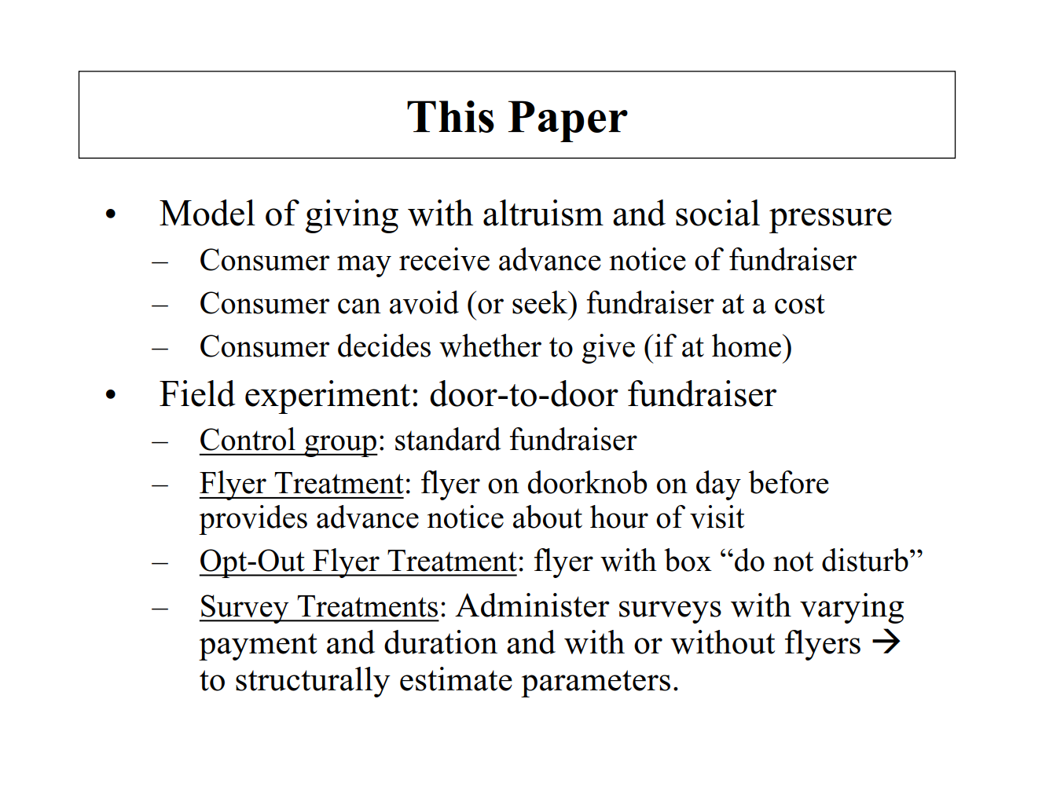

Slide 23
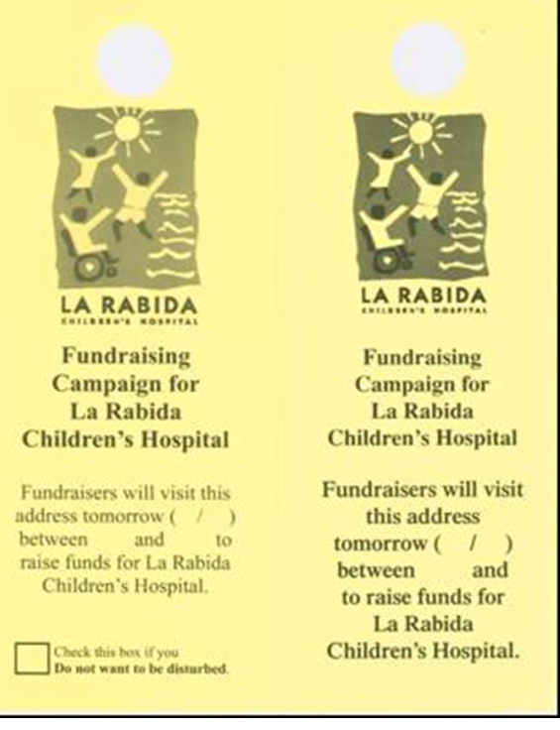


Slide 24
Flyer reduces door-answering

Slide 25
Opt out reduces overall giving

Slide 26
Substantive Topics
Gift exchange and reciprocity at work
Charitable giving
Norms, social and self image
Endowment effect
Sleep, depression

Slide 27
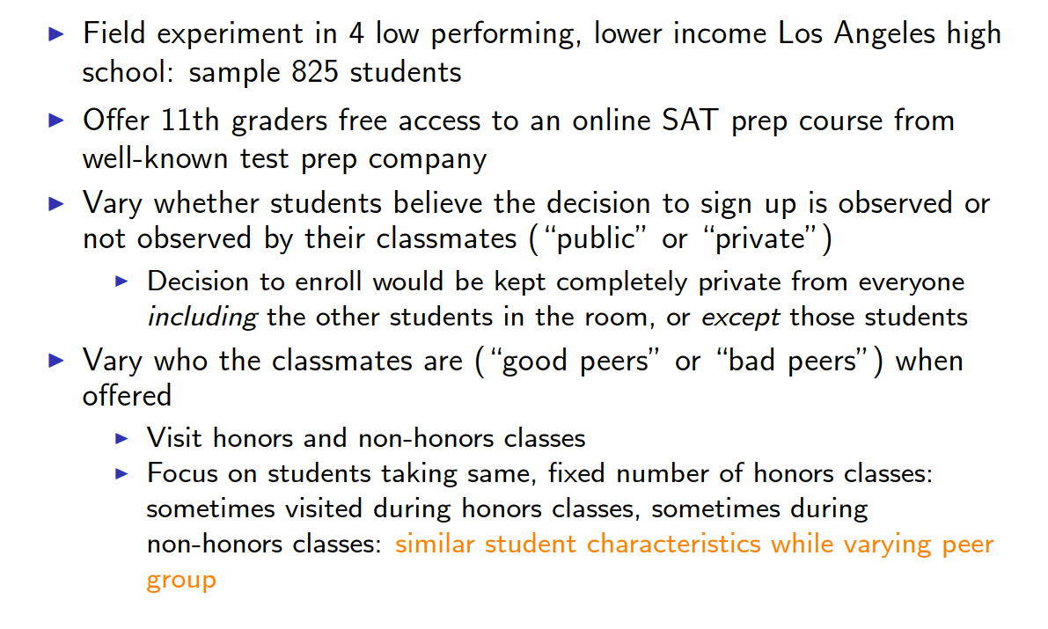
Bursztyn and Jensen (2015)

Slide 28
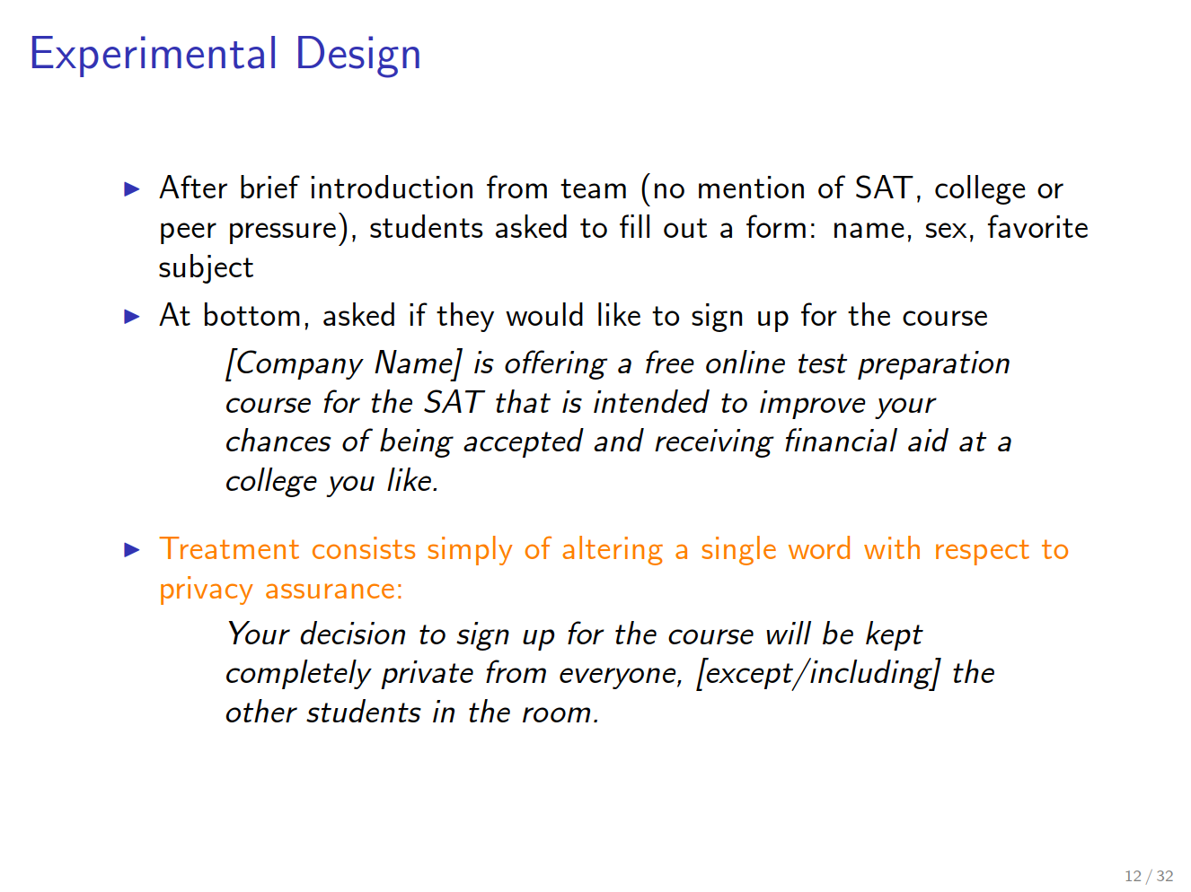

Slide 29
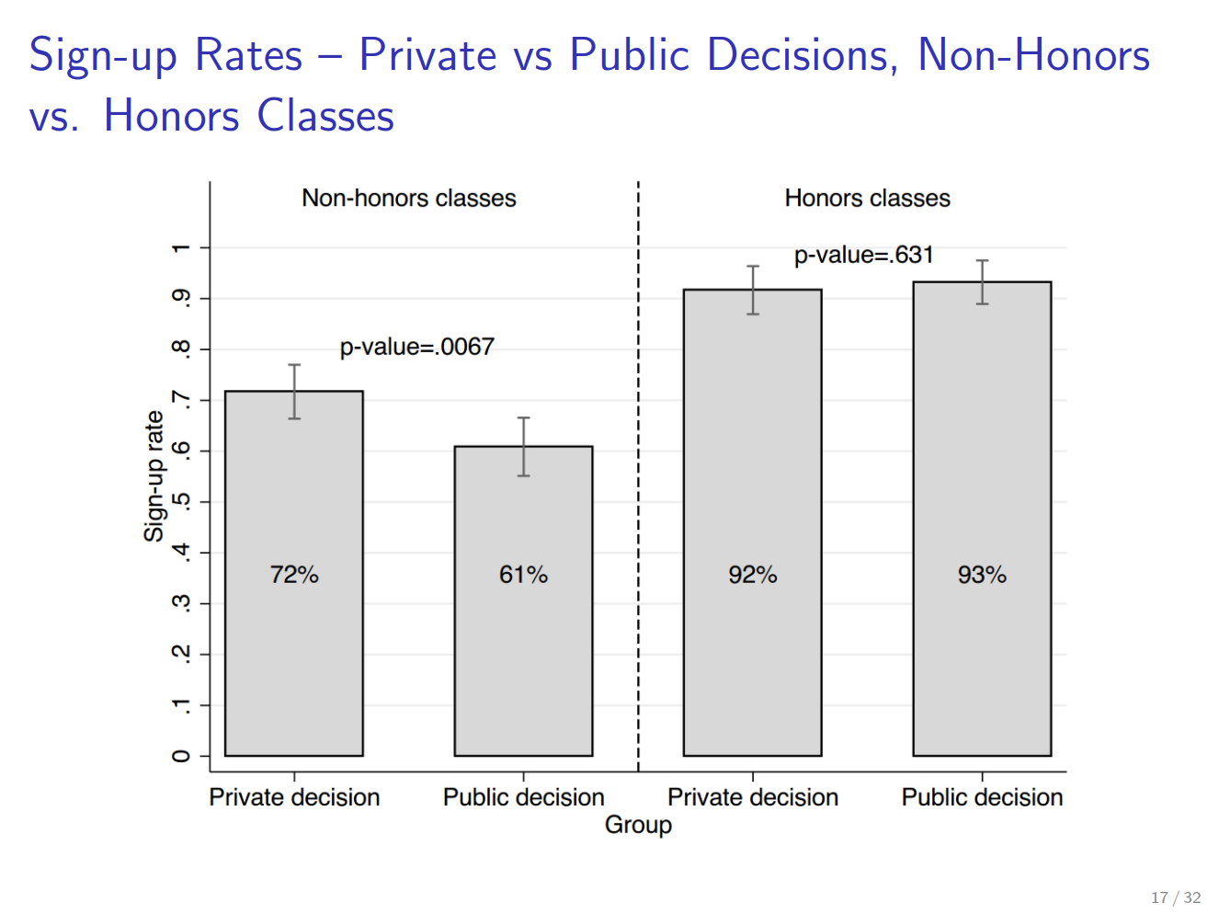

Slide 30
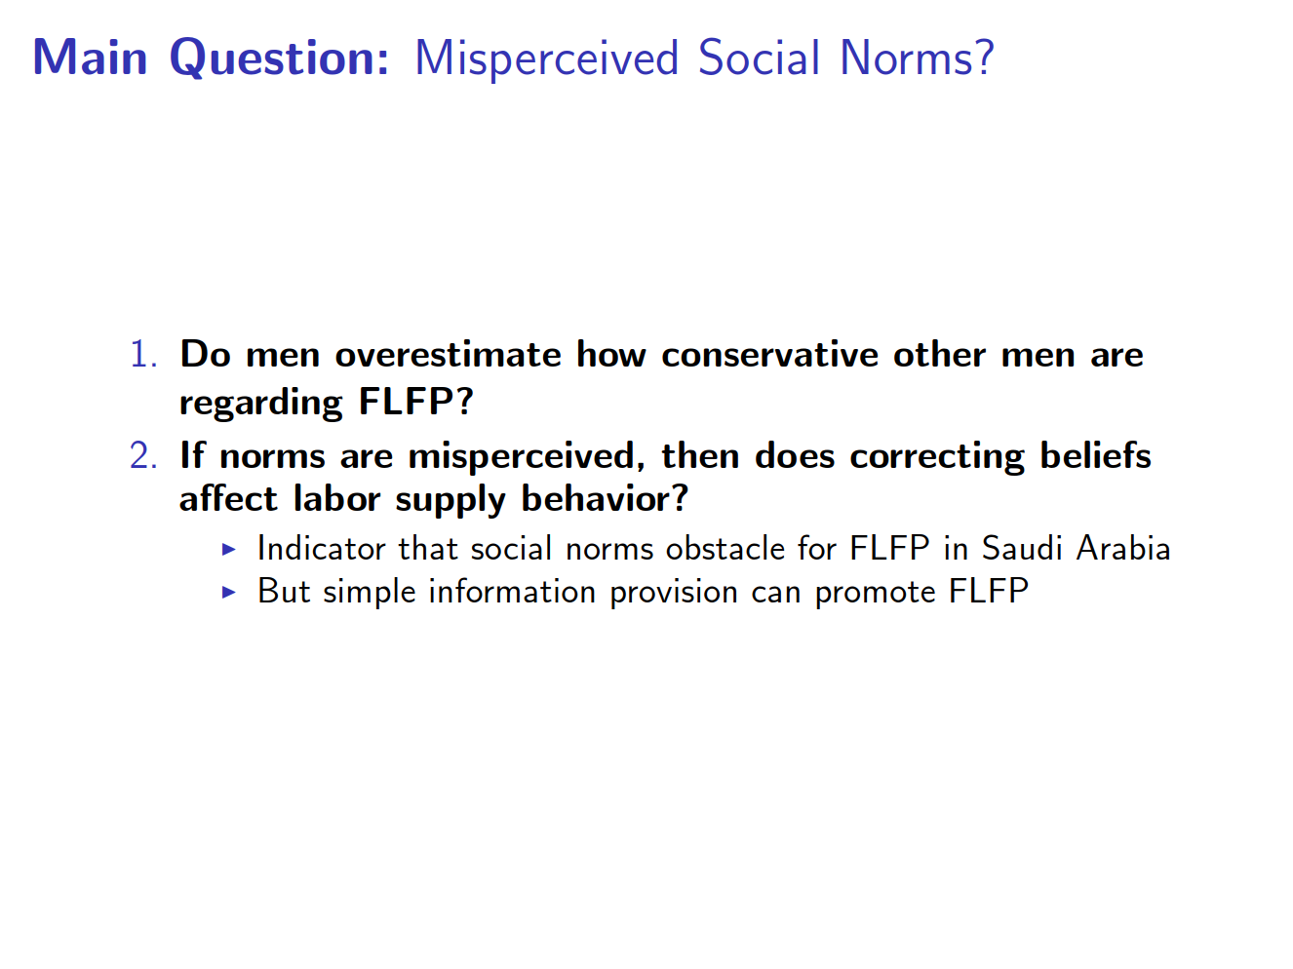
Misperceived Social Norms:
Bursztyn, Gonzalez and Yanagazawa-Drott (2018)

Slide 31
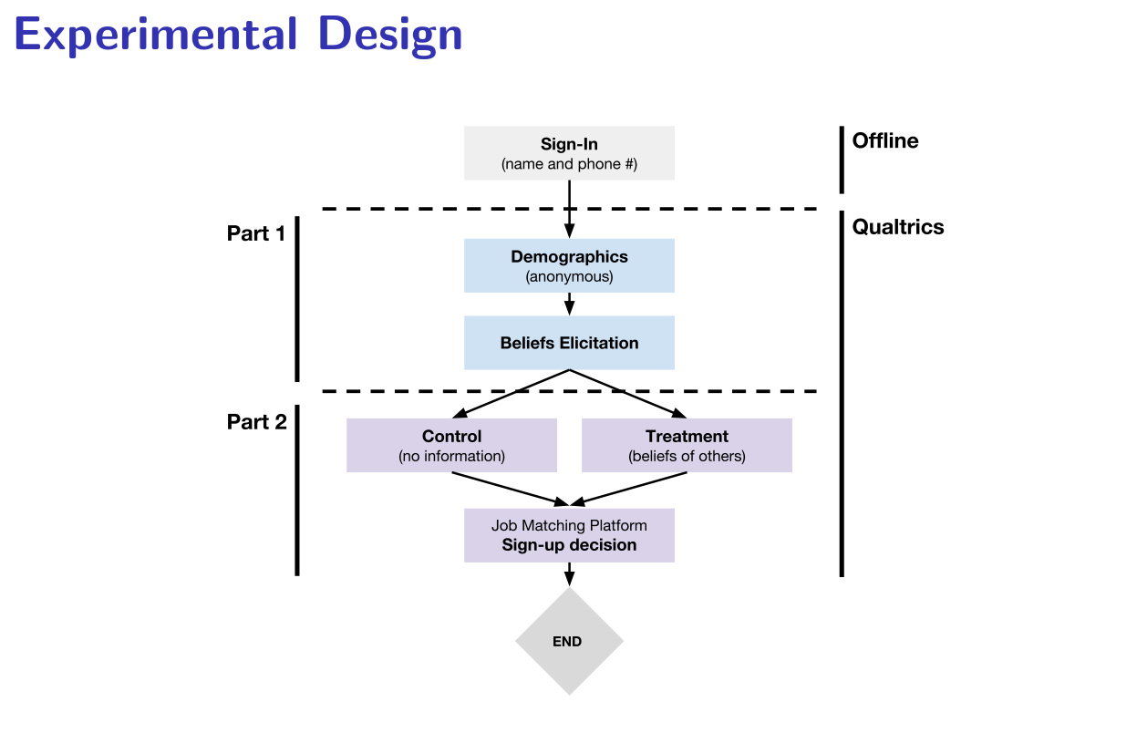

Slide 32
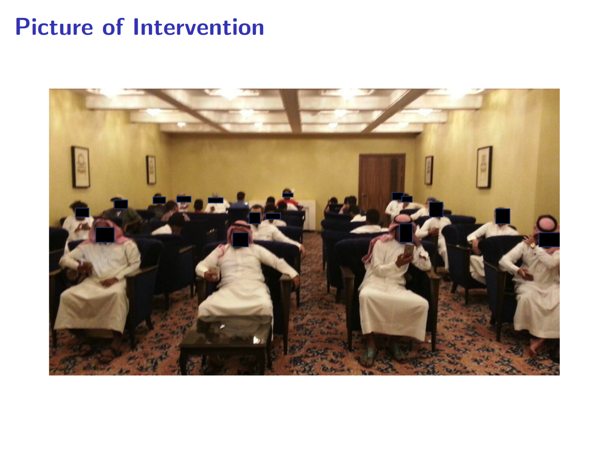

Slide 33
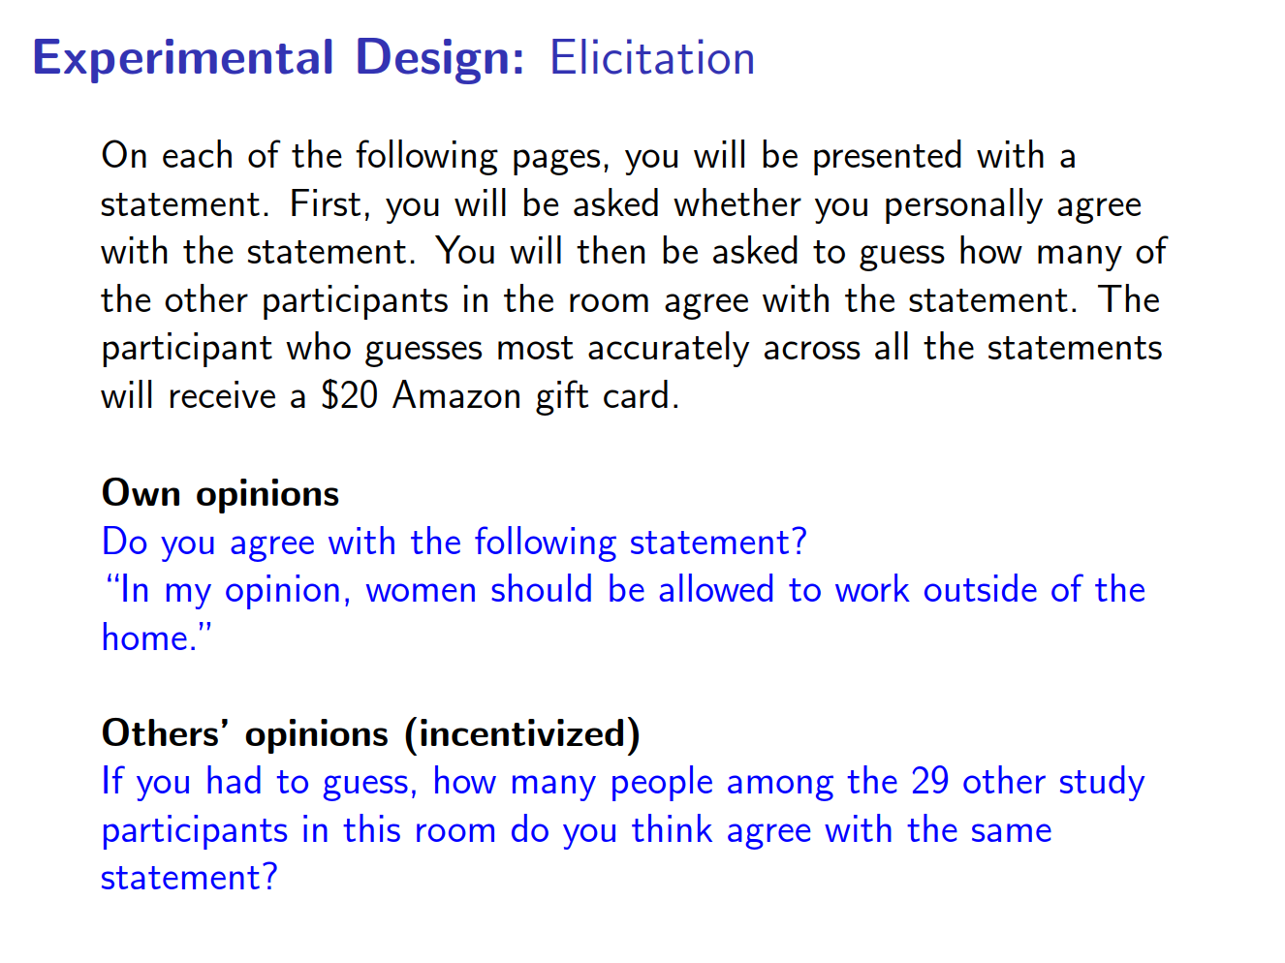

Slide 34
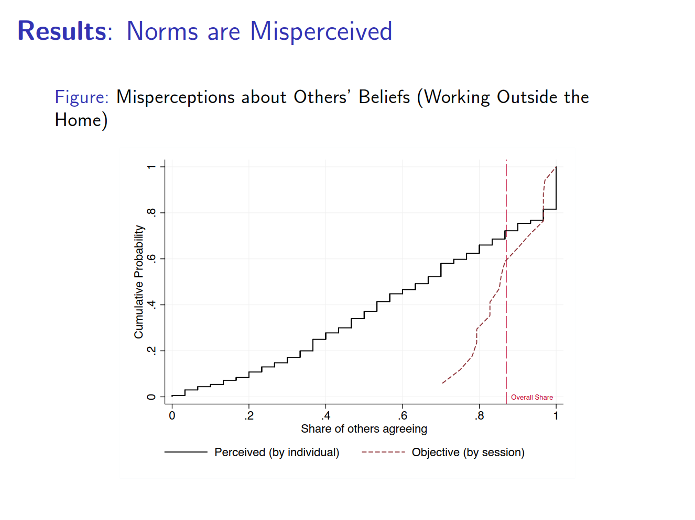

Slide 35
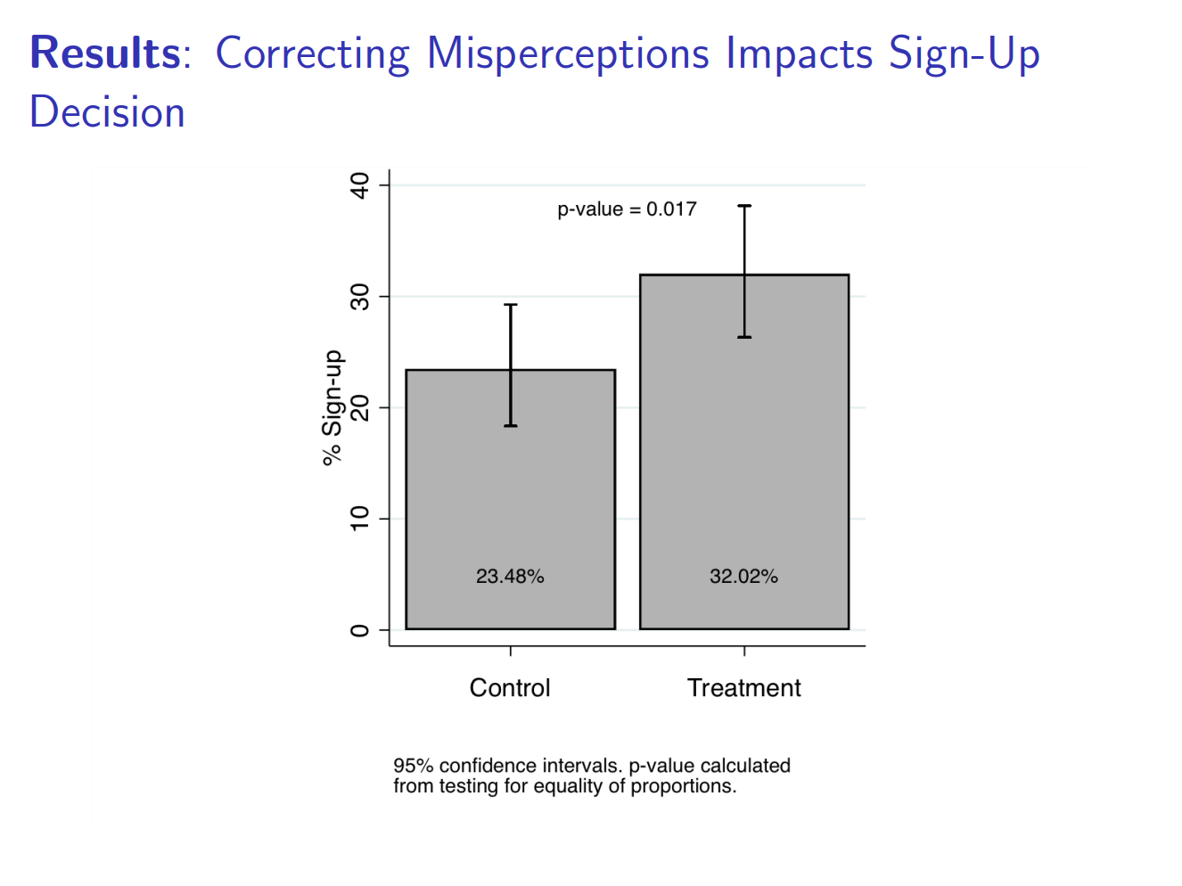

Slide 36
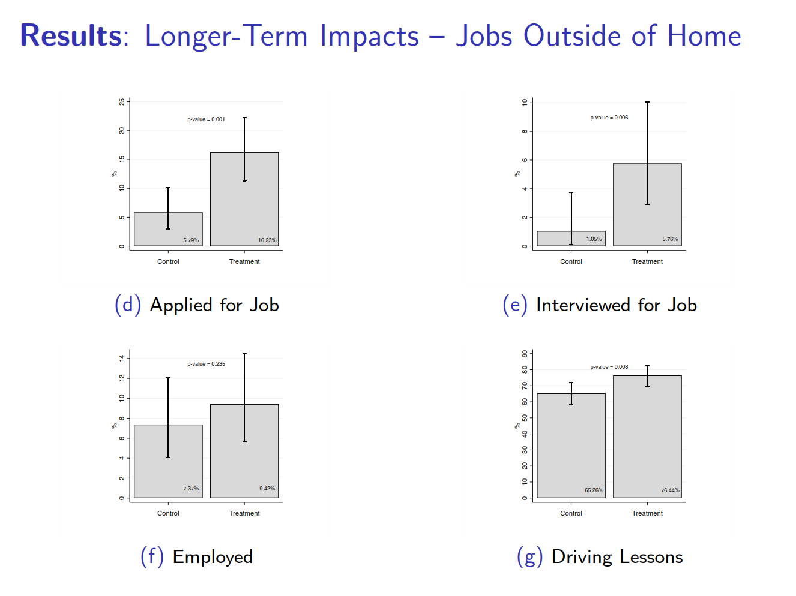

Slide 37
Substantive Topics
Gift exchange and reciprocity at work
Charitable giving
Norms, Self Image and Social Image
Endowment effect
Sleep, depression

Slide 38
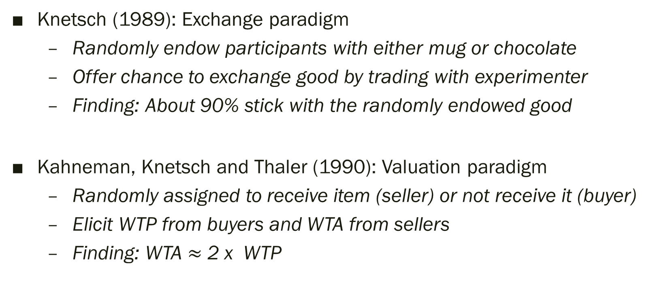
Classic lab experiments
Knetsch (1989): Exchange paradigm
  Randomly endow participants with either mug or chocolate
  Offer chance to exchange good by trading with experimenter
  Finding: About 90% stick with the randomly endowed good
Kahneman, Knetsch and Thaler (1990): Valuation paradigm
  Randomly assigned to receive item (seller) or not receive it (buyer)
  Elicit WTP from buyers and WTA from sellers
  Finding: WTA $≈$ 2 x WTP

Slide 39
Does the endowment effect survive in the market? List (2003; 2004; 2011)
List (2003; 2004): Exchange experiments outside the lab
  Using participants at sports card and pin shows
  Lab-in-the-field a.k.a. artefactual field experiment
  Goods used: Sports cards or pins (List 2003); mugs and chocolates (List 2004)
  Finding: Strong endowment effect among inexperienced traders, much less in experienced traders. Selection or treatment effect?
List (2011): Randomized incentives to get 6 months of trading experience in sport-card market. Then play exchange experiments.
  More experience trading causally reduces endowment effect

Slide 40
Interpretations?
Endowment effect is not really important in the field?
Expectations-based reference dependence: In the standard lab experiments, people do not expect to have the chance to sell. In the field, experienced / professional traders expect to sell the item.

Slide 41
Moving further afield: Carney, Kremer, Lin and Rao (2018)
Endowment effect and projection bias in the take-up of collateralized loans
Two types of loans:
  SACL: Collateralized using already-owned asset (e.g. home-equity loan)
  NACL: Collateralized using asset being financed by loan (e.g. car loan)
Idea:
  Collateralized loans involve some risk of losing collateral
  Loss aversion could make this less attractive
  Projection bias: may not fully anticipate attachment to the new asset
  “Don’t want to lose what I have” vs. “What do I have to lose?”

Slide 42
Identification Challenge
Want to compare demand for loans collateralized with:
  Already-owned (SACL)
  New assets (NACL)
And isolate the endowment eﬀect mechanism
Suppose we just randomized oﬀers for two types of loans to purchase a particular new asset
Problem:
  Maybe borrowers don’t have assets to provide as collateral
  We don’t know how much they value the assets they own
So we could not attribute diﬀerence to endowment eﬀect

Slide 43
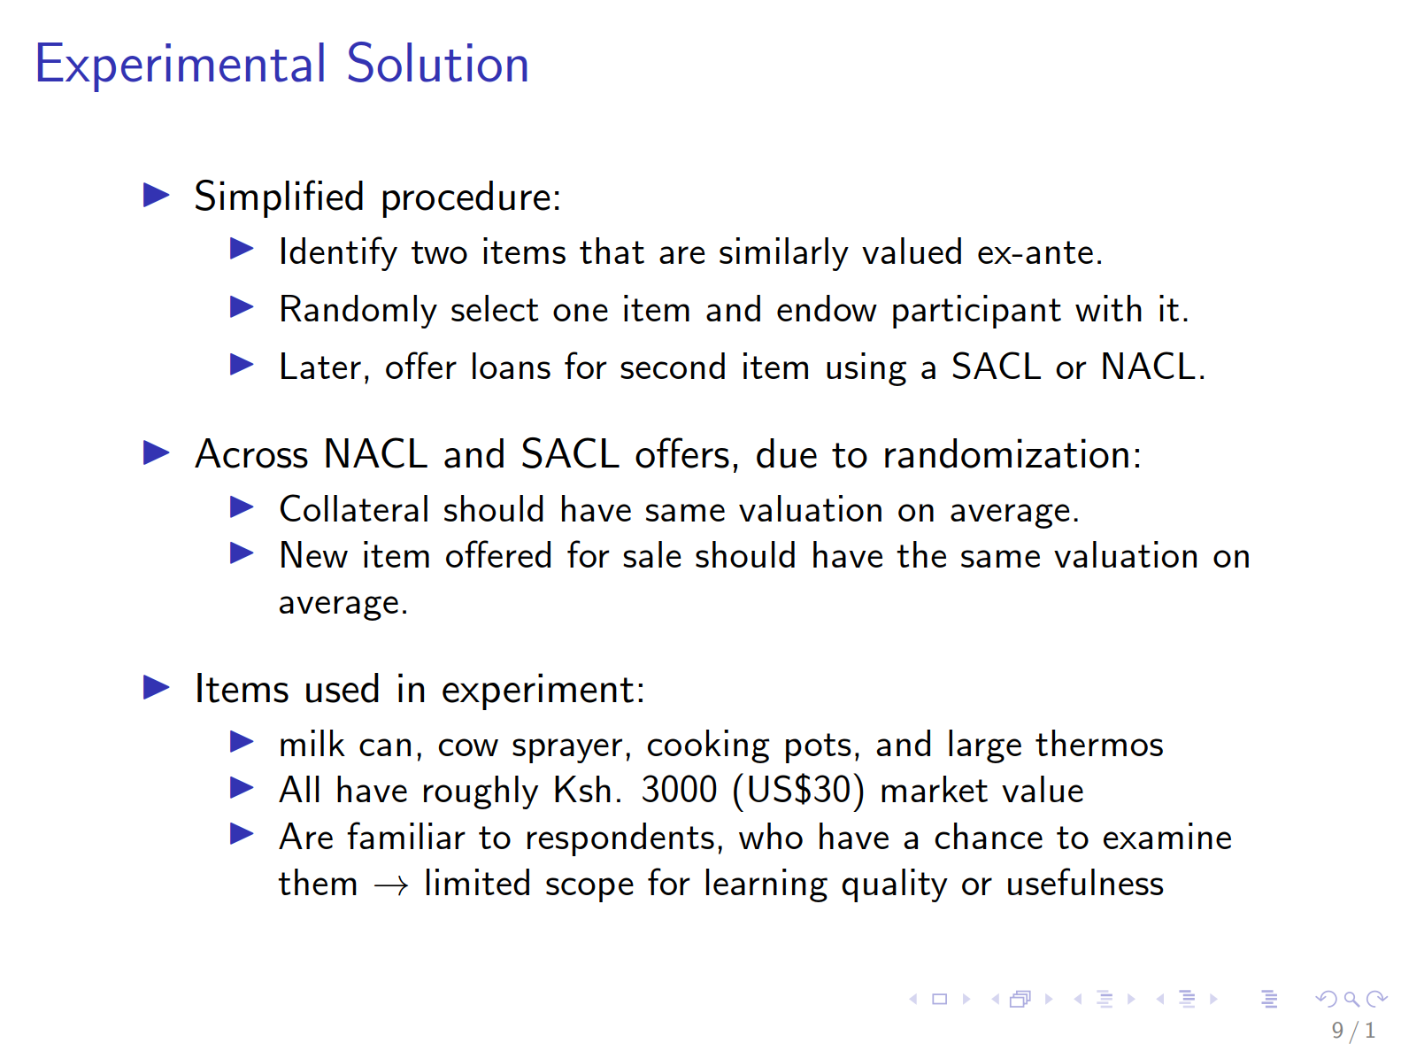

Slide 44
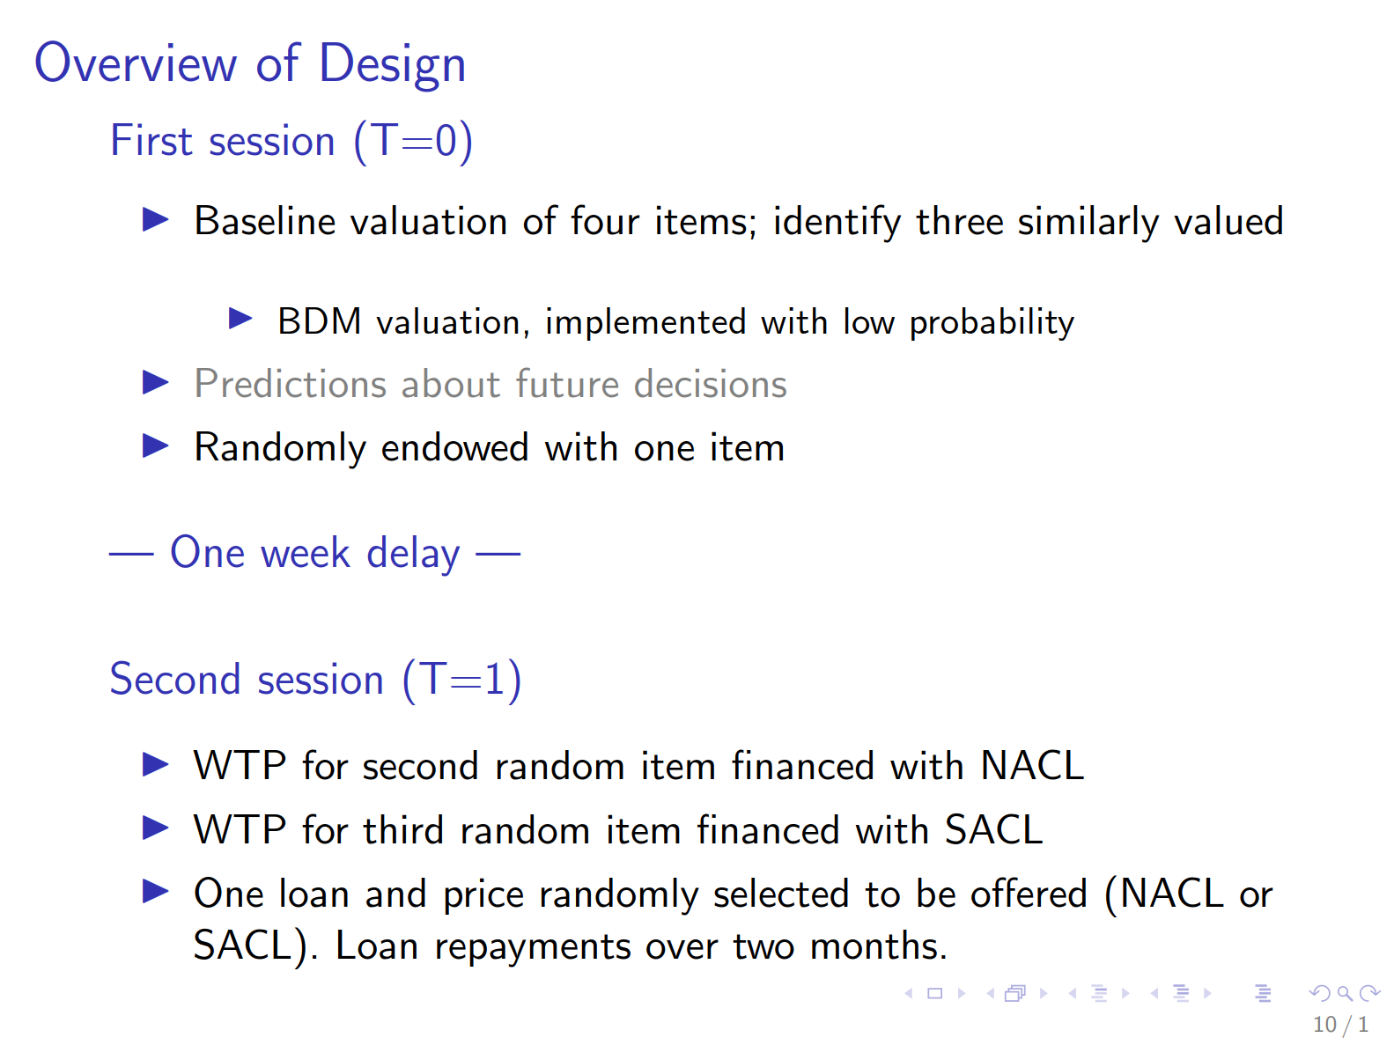

Slide 45
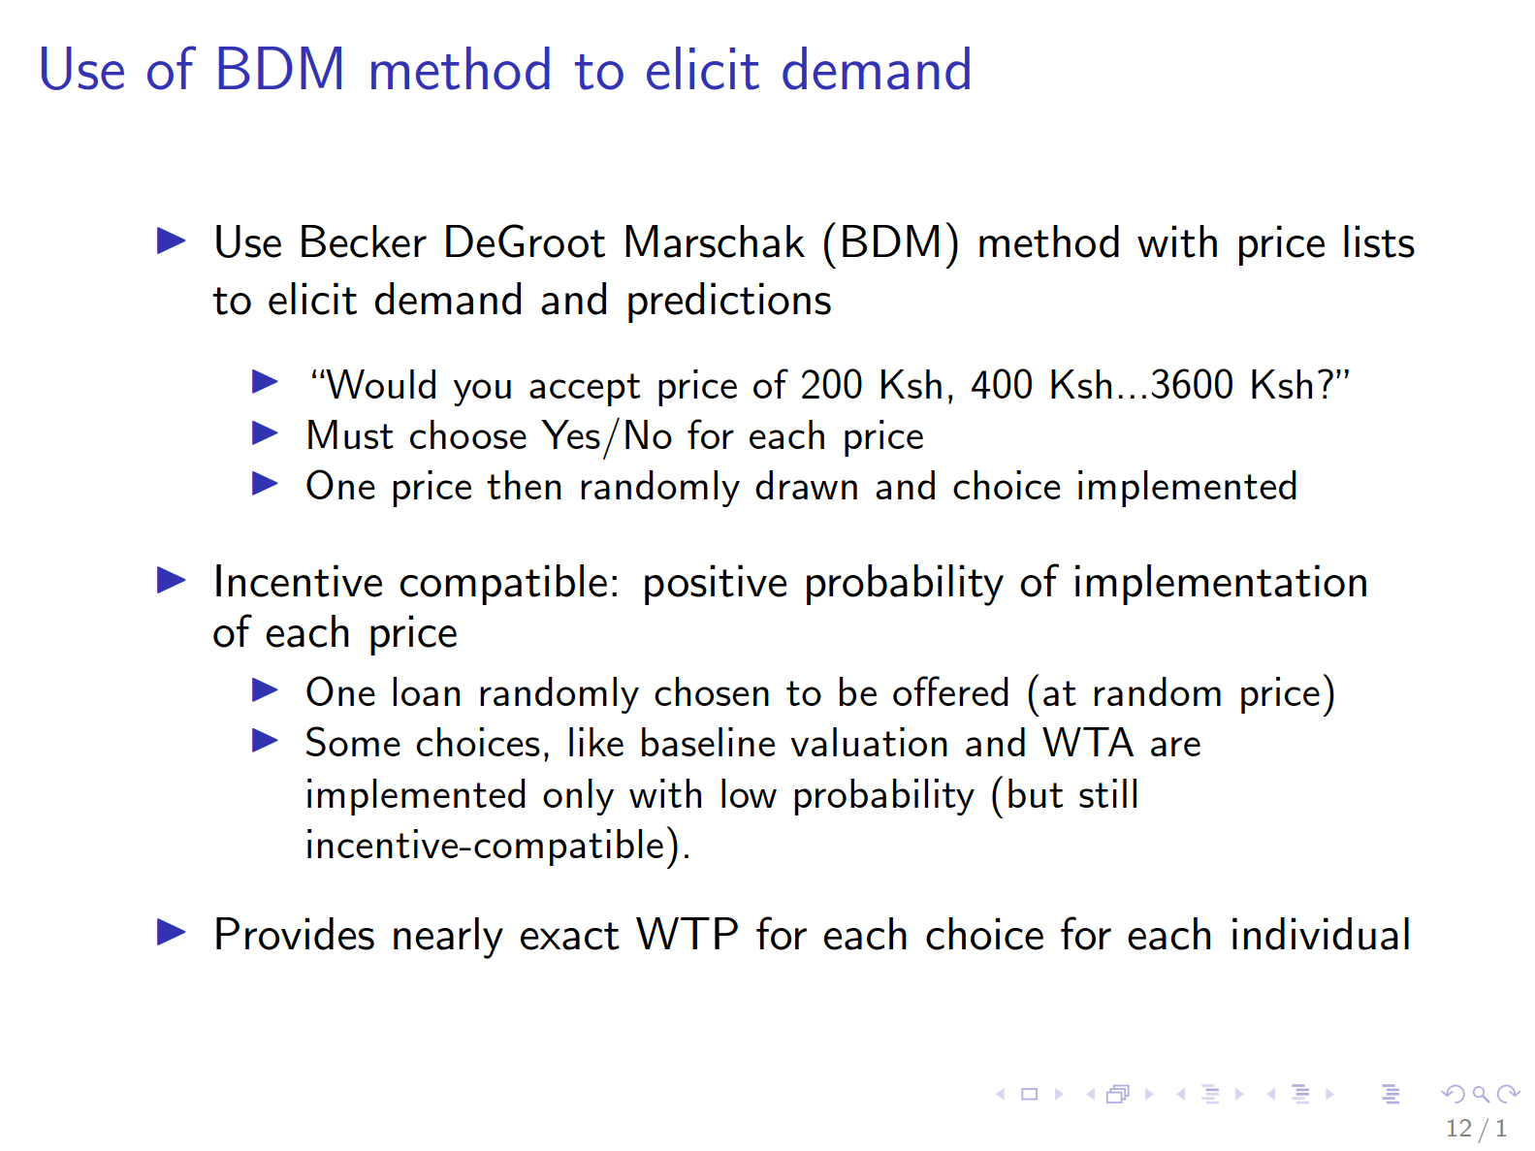

Slide 46
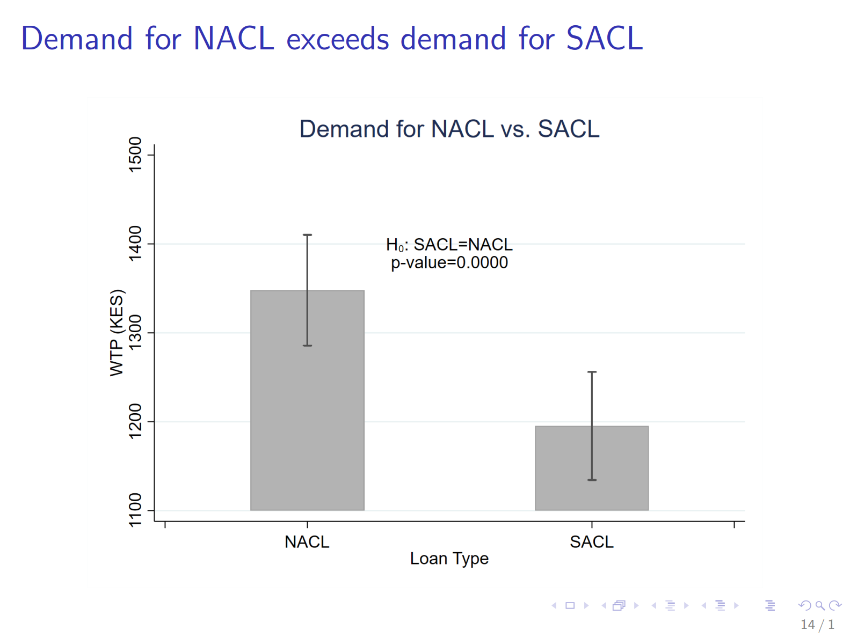

Slide 47
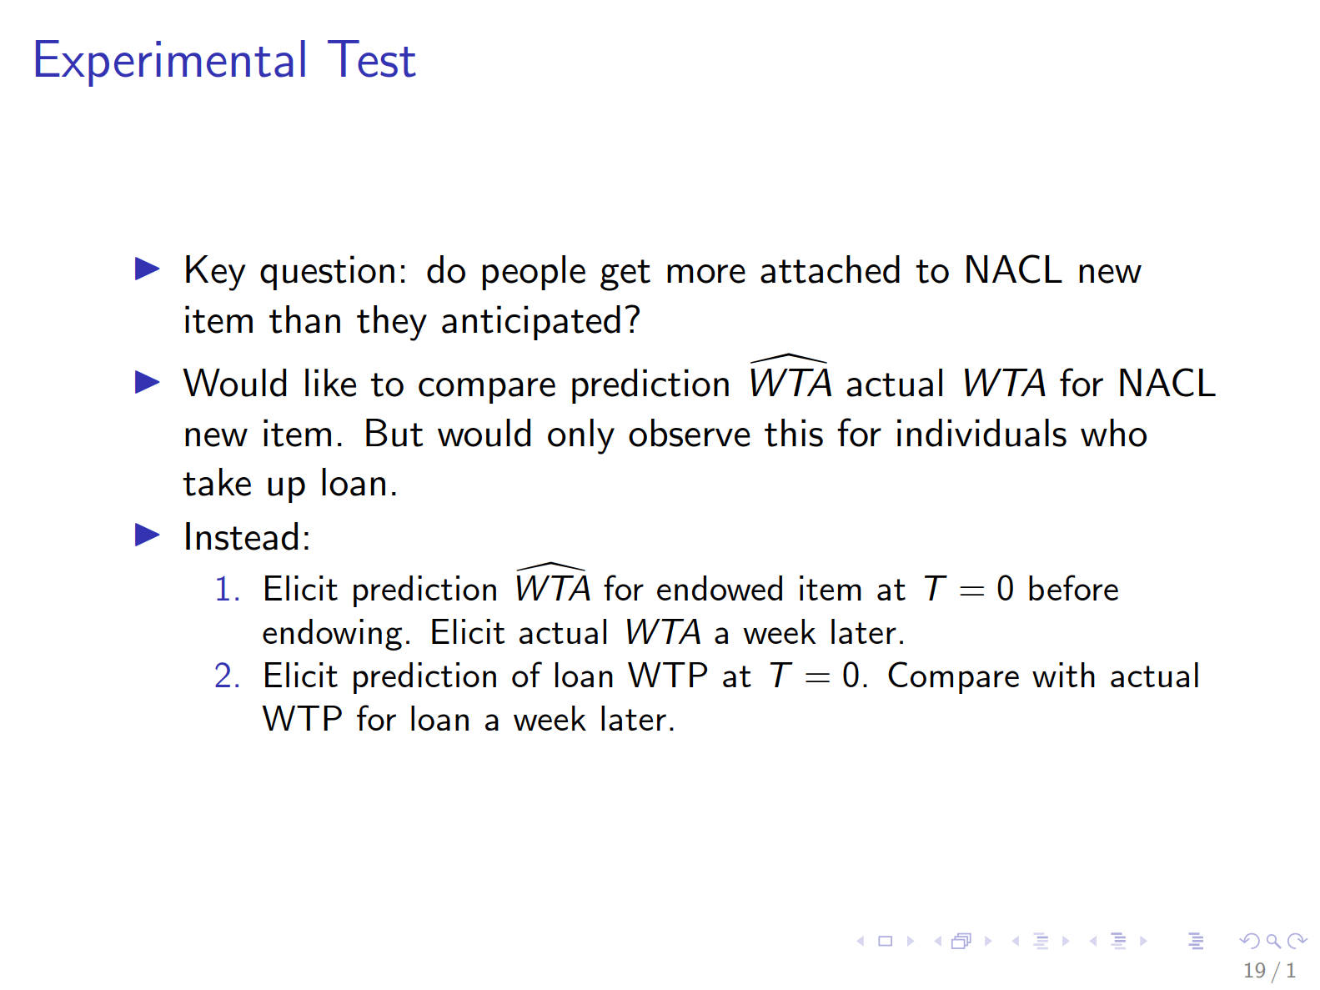
of misprediction / projection bias

Slide 48
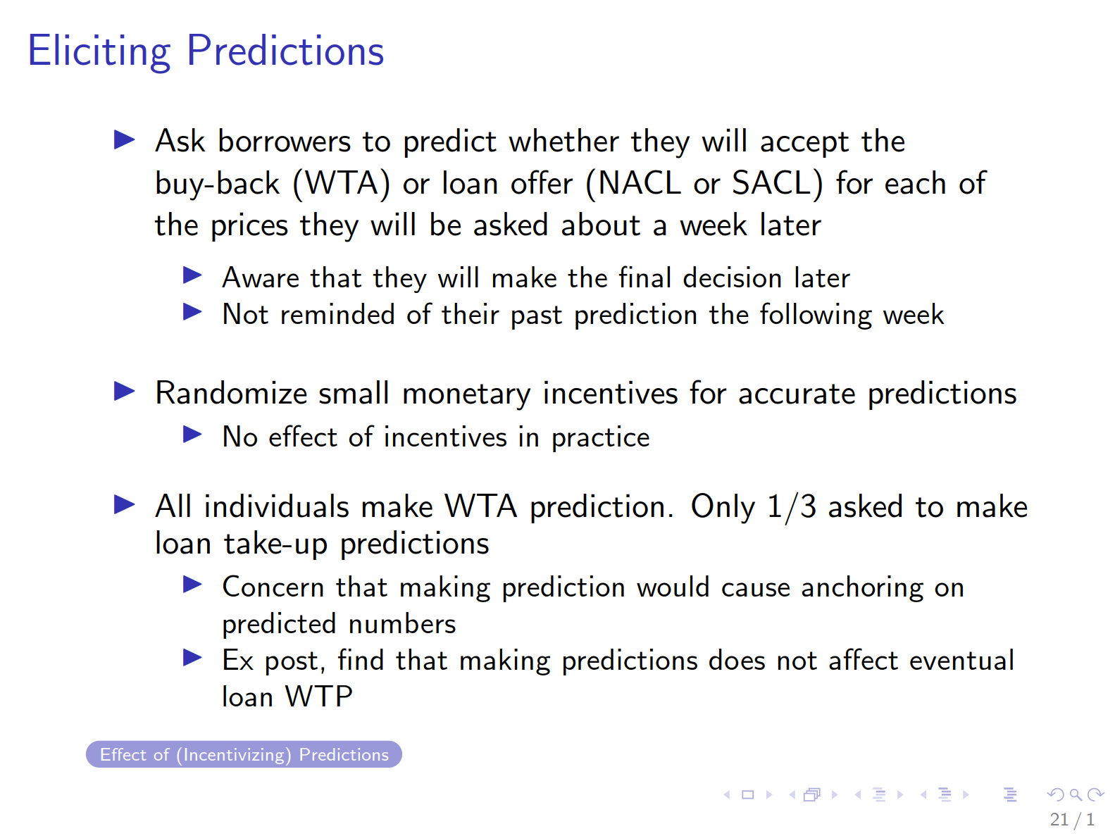

Slide 49
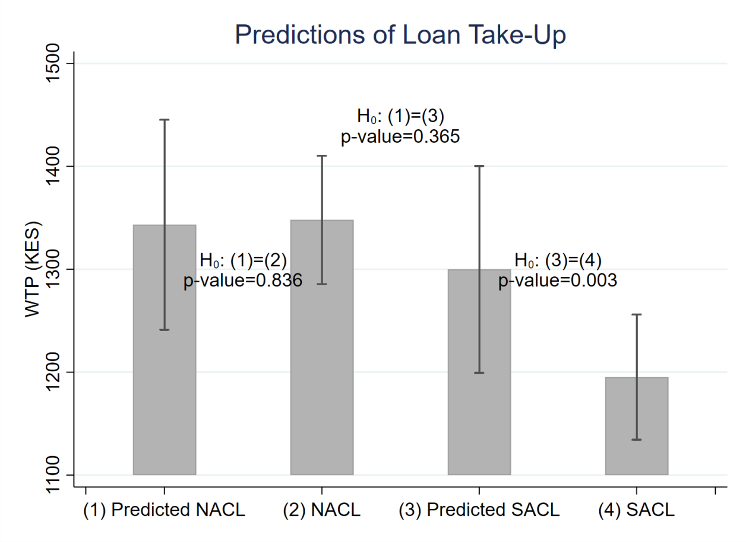
Over-predict SACL take-up but not NACL
(underpredict endowment effect)

Slide 50
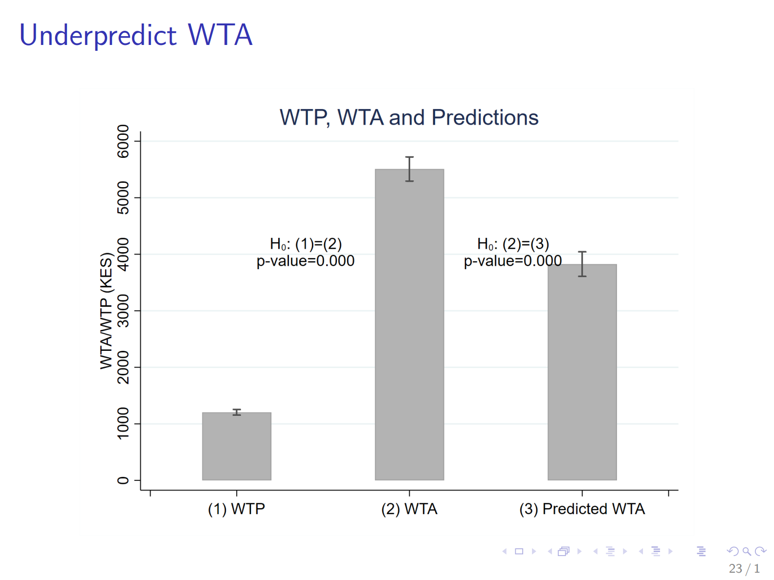
Under-predict WTA for endowed good

Slide 51
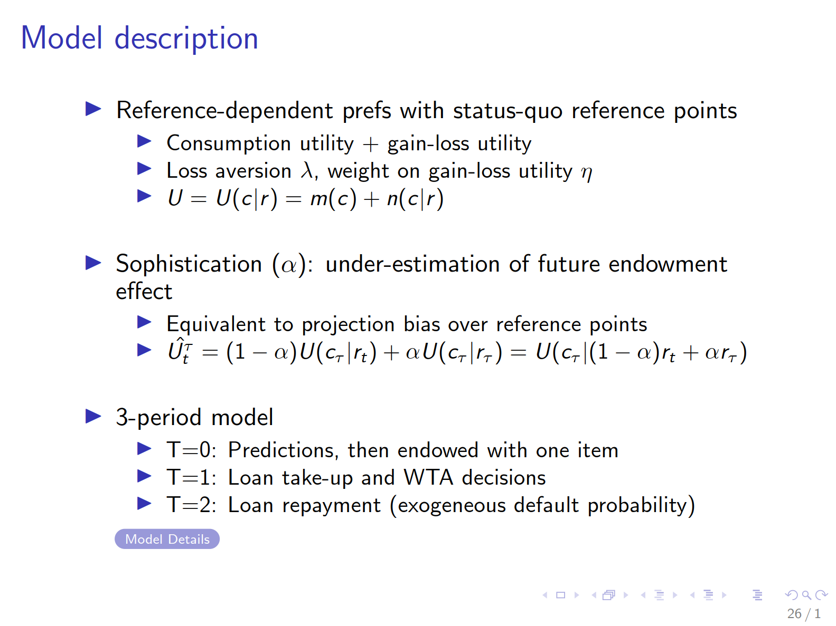

Slide 52
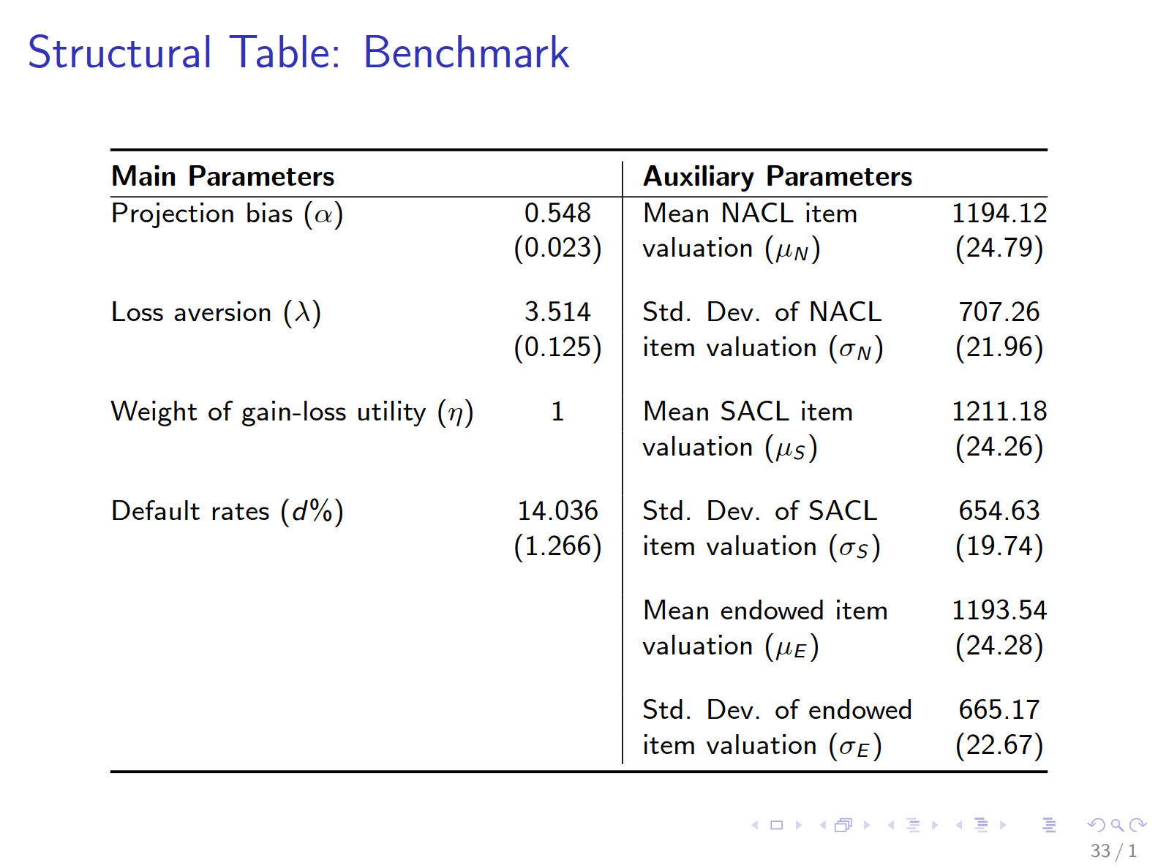

Slide 53
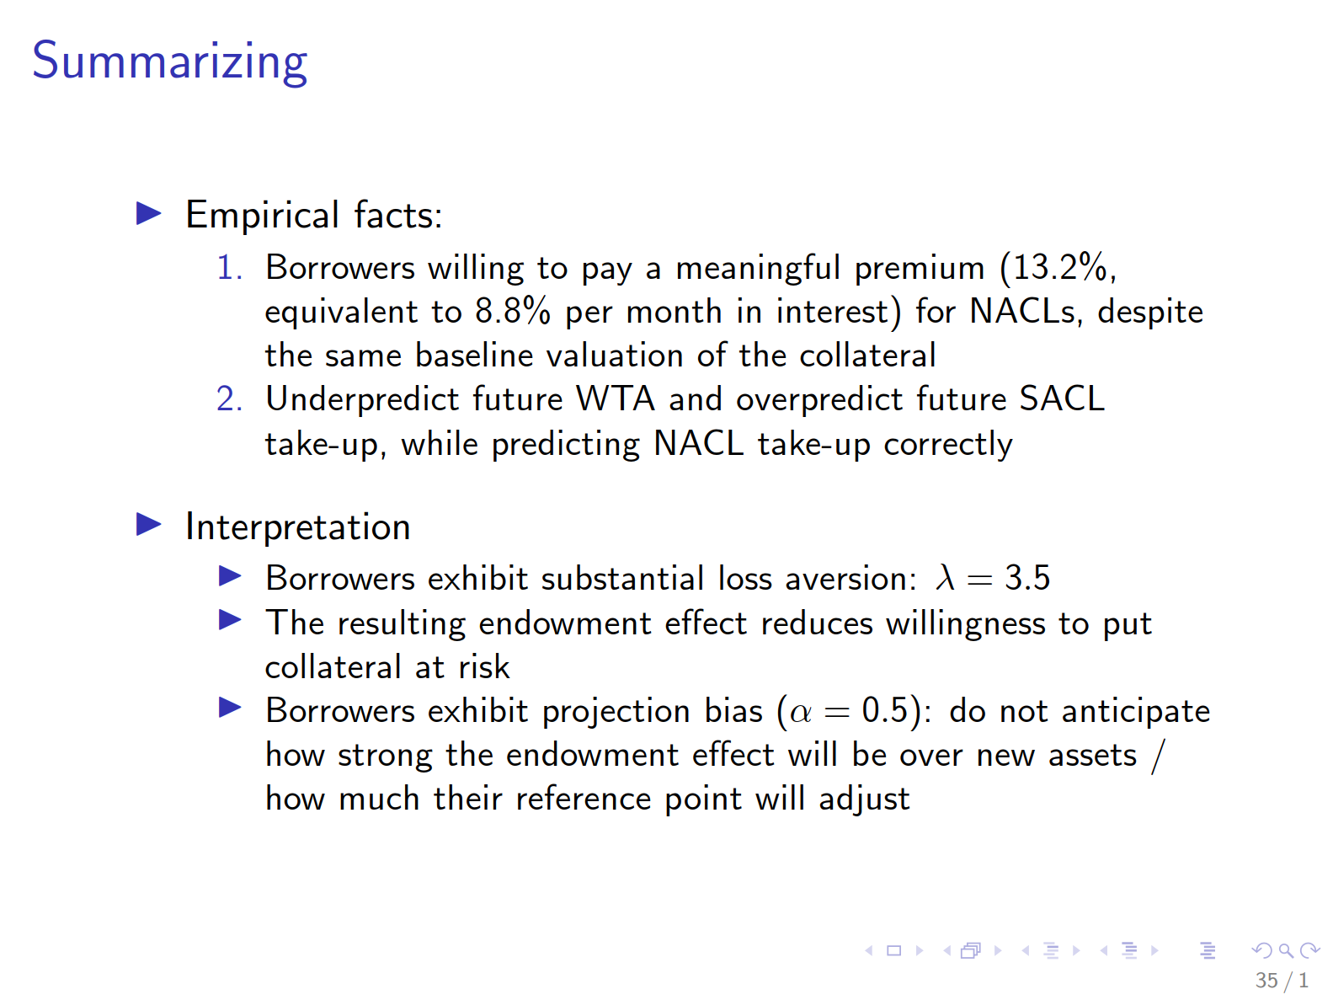

Slide 54
Methodological asides:
Takeup experiment; Use of BDM/MPL
Take-up experiment: quick to run
  Although multiple delays due to electoral violence!
Use of BDM / Multiple Price List methods to elicit WTP, WTA, predictions etc
  Increases power over take-it-or-leave-it offers
  Allows for individual-level parameter estimation
  Cost: Complexity, artificiality
  In our case, endowing participants with a good worth 15 days of per capita income already meant an entirely natural field experiment was out of the question

Slide 55
Substantive Topics
Gift exchange and reciprocity at work
Pay inequality
Charitable giving
Norms, Self Image and Social Image
Endowment effect
Sleep deprivation

Slide 56
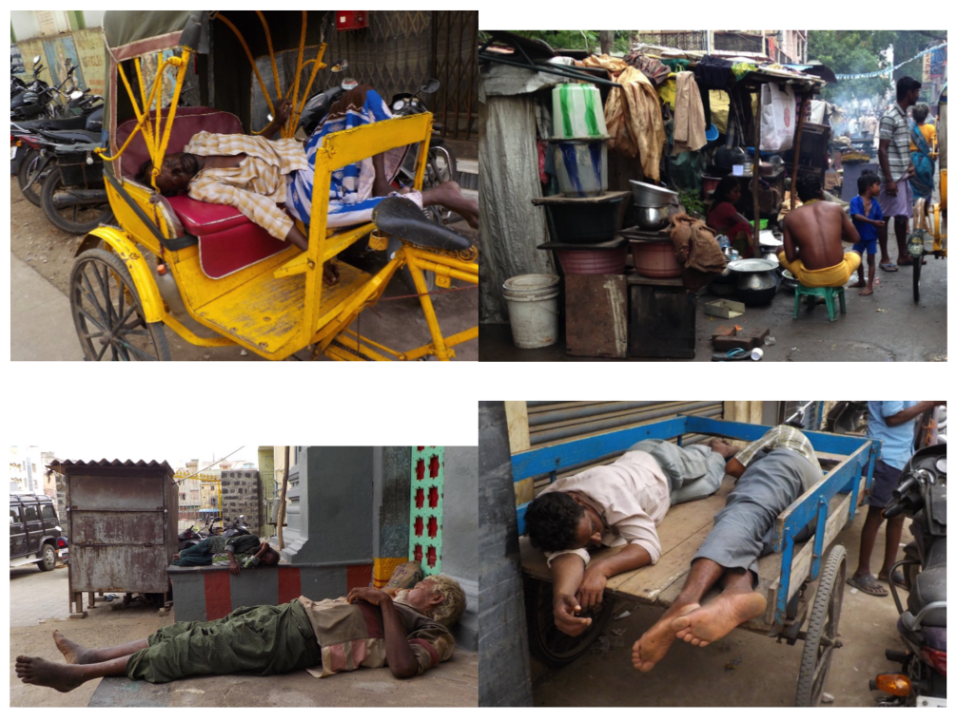
Sleep in Chennai

Slide 57
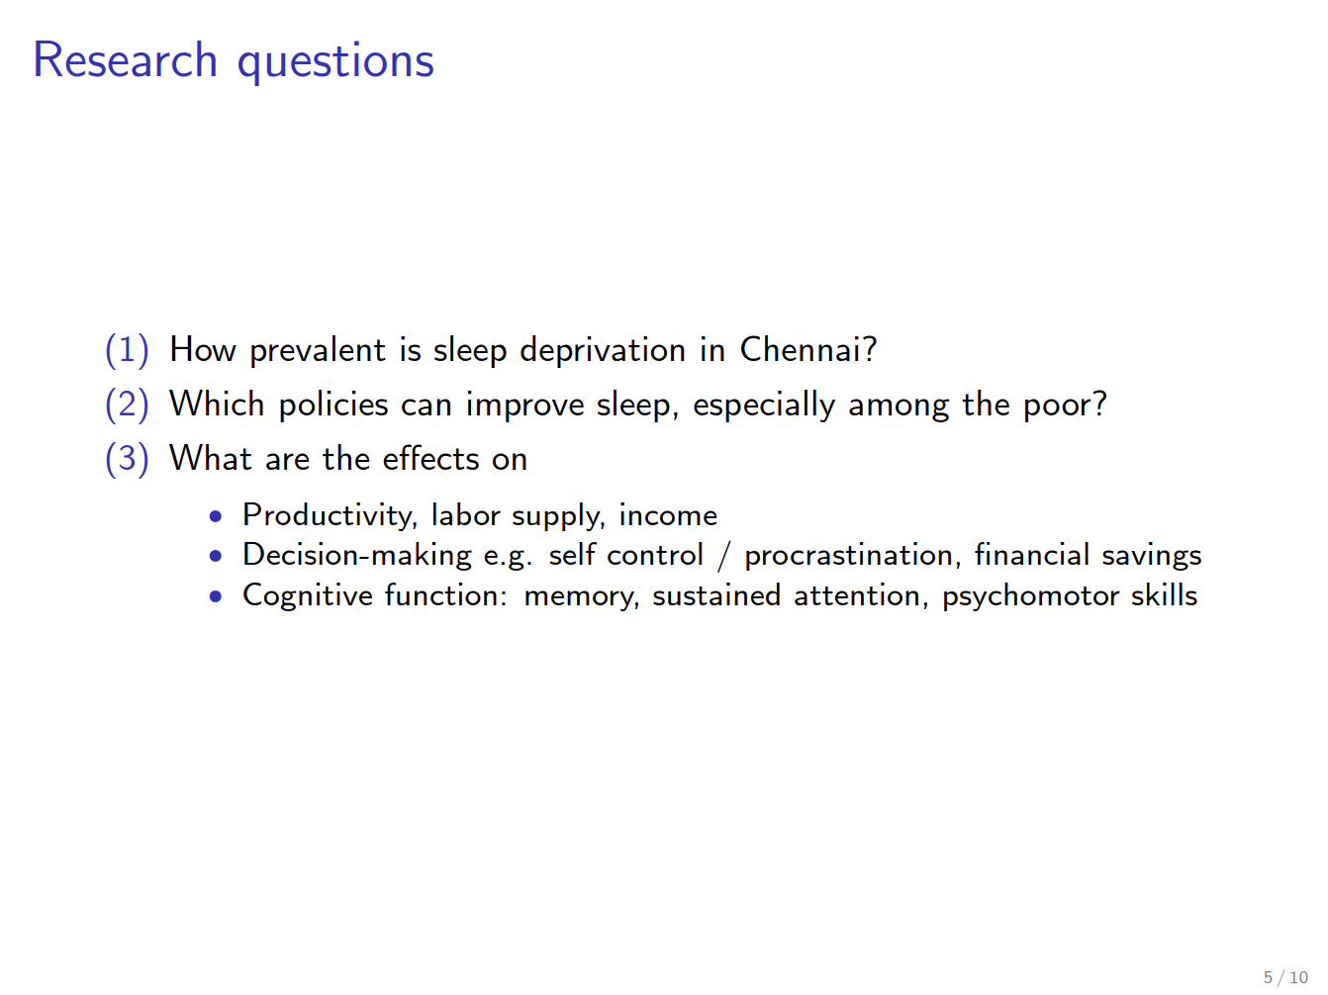

Slide 58
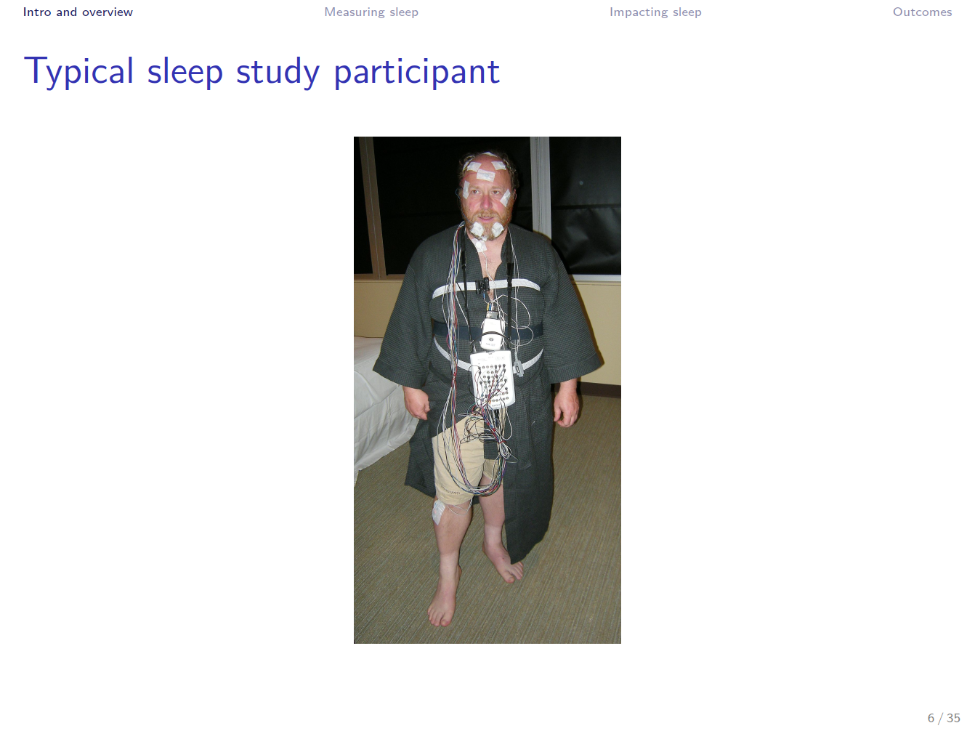

Slide 59
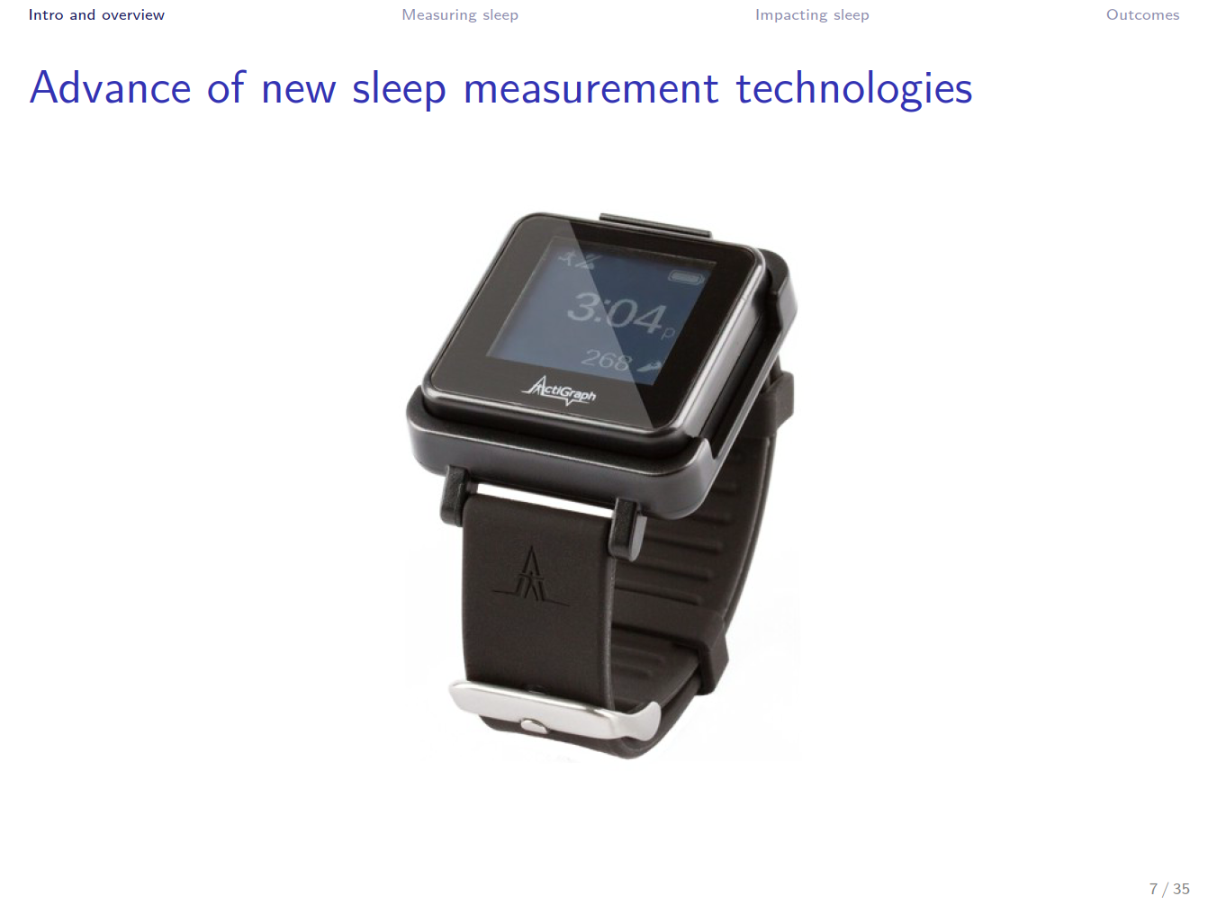
Measurement advances

Slide 60
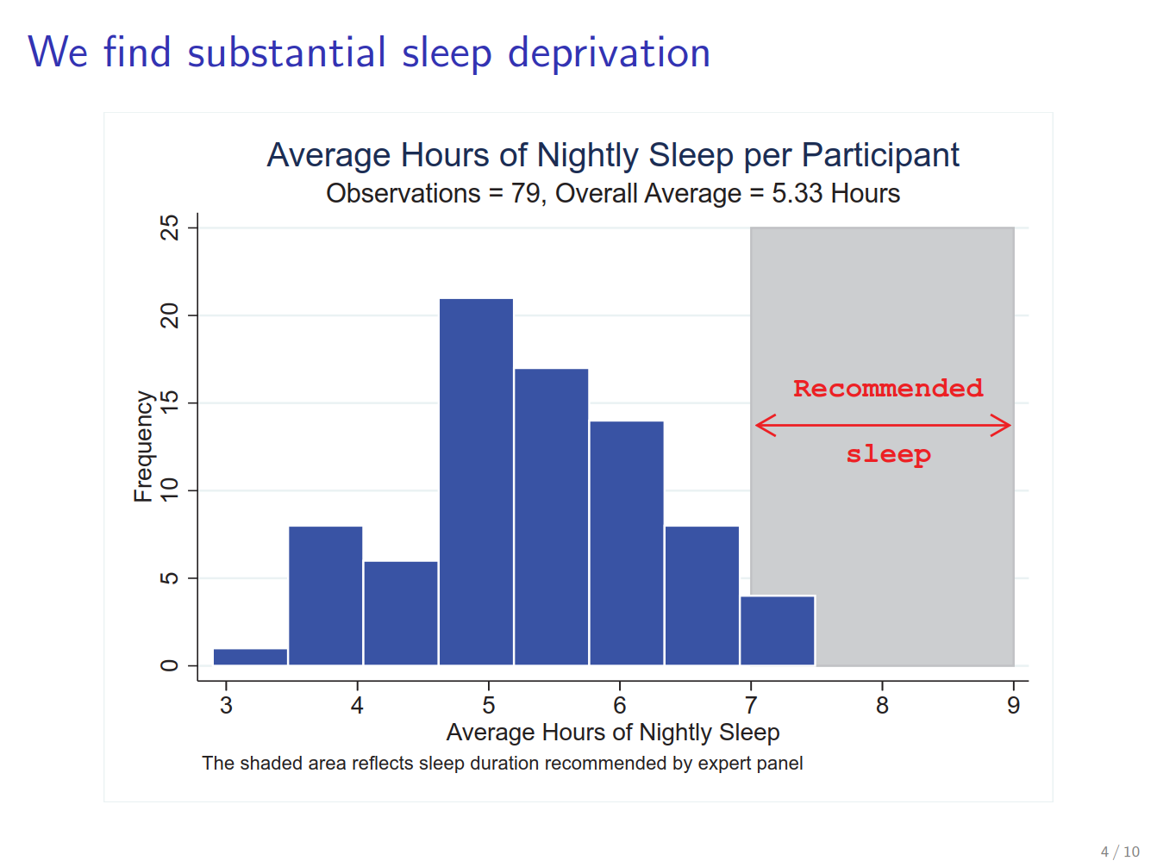

Slide 61
Randomized Controlled Trial
Sample:
  Recruit 450 low-income workers in Chennai
  Hire as data-entry workers for one month
Randomized treatments
  Devices to improve home sleep environment + daily feedback
  Devices + Feedback + Daily Financial Incentives
  (control receives same payments unconditionally)
  Cross-randomized with opportunity to nap at workplace
7 days of baseline work → randomization → 21 days of treatment
  Baseline observations add a lot of statistical power
  Longer treatment since effects of sleep likely to be cumulative

Slide 62
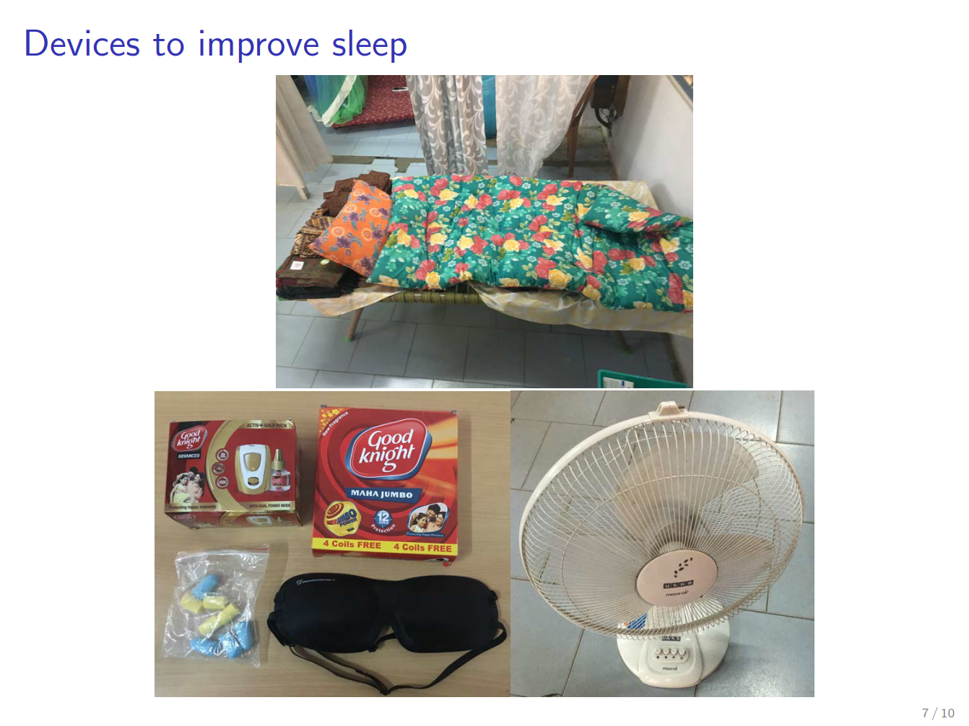

Slide 63
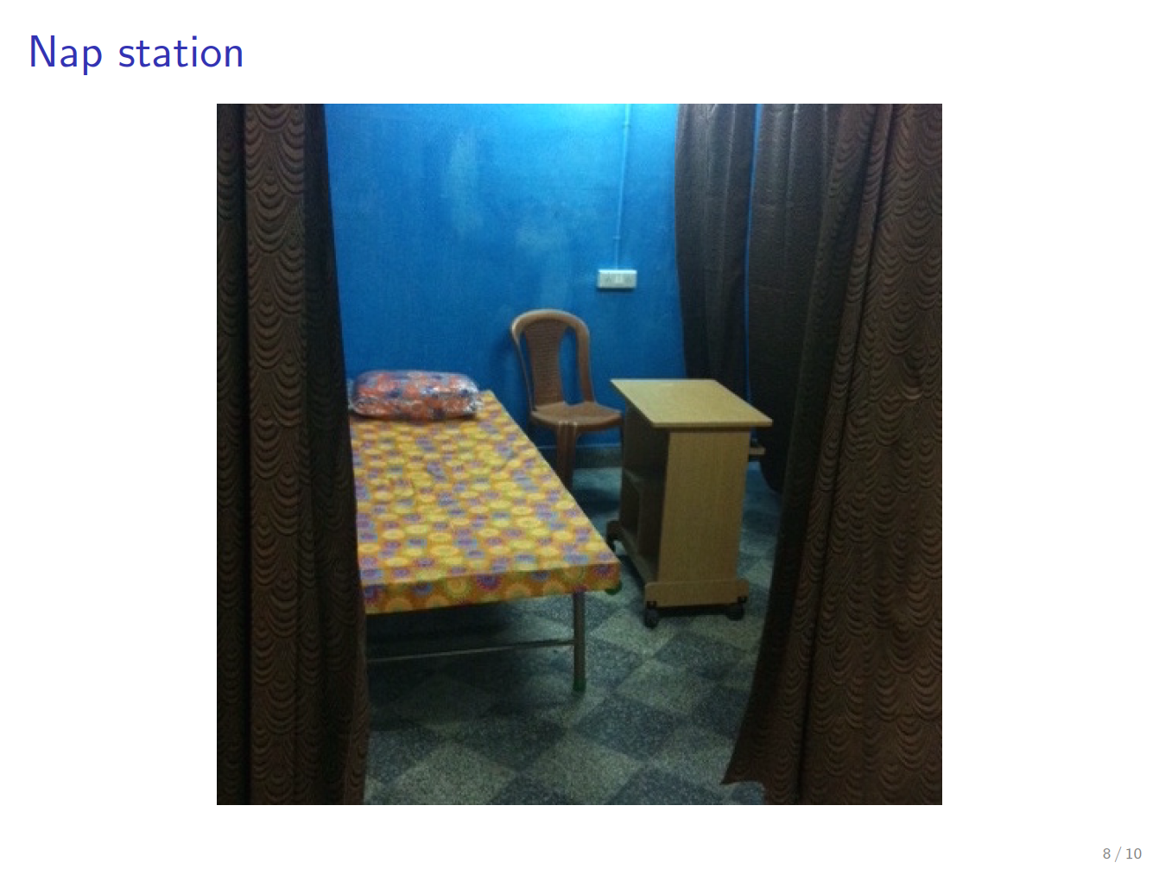

Slide 64
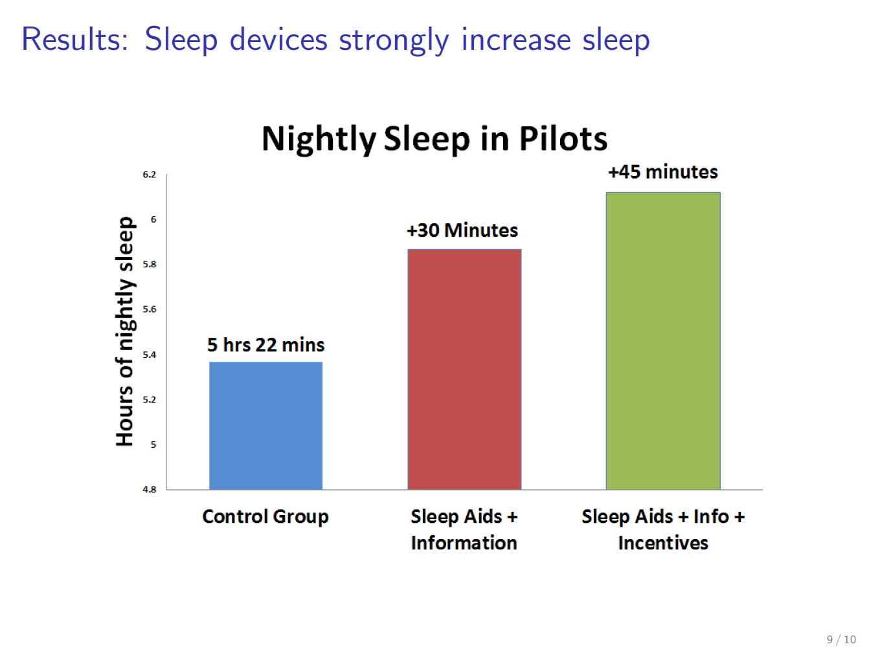

Slide 65
Outcomes
Sleep and sleep deprivation
Labor market outcomes
Decision-making
Cognitive function
Beliefs about the beneﬁts of sleep

Slide 66
Outcome measure: Labor market
Data entry task
  As in Kaur-Kremer-Mullainathan
  Vary piece-rate compensation within-individual over sessions
  Flexible labor supply
Useful properties
  Requires a variety of cognitive inputs impacted by sleep (e.g. attention, persistence)
  Precise measurement of labor supply, productivity and accuracy
  Allows for precise variation in incentives
Concern:
  Would sleep-deprived individuals be employed in a such a cognitively challenging task in a competitive firm?

Slide 67
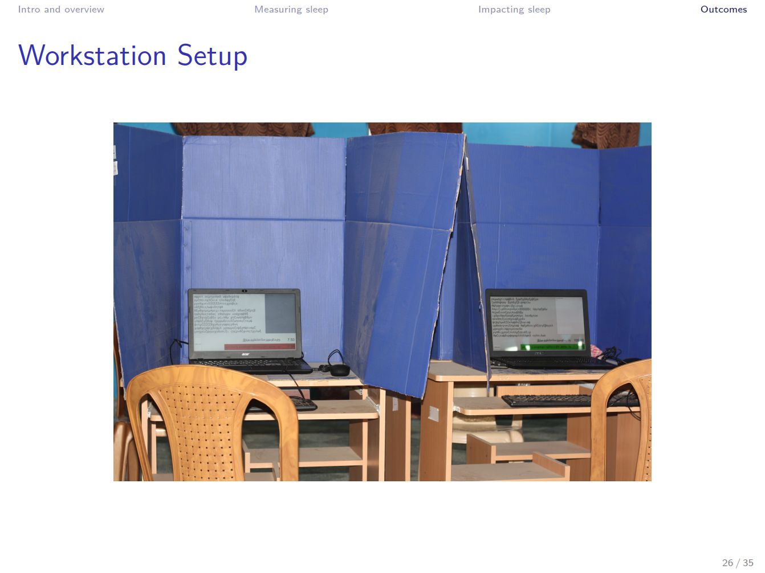

Slide 68
Outcomes: Labor supply and productivity
Main outcomes of interest
  Overall earnings: Rs. earned per day
  Labor supply: hours worked per day
  Productivity: Rs. earned/hour worked
How to disentangle labor supply vs. productivity?
  Some days are “short days” with bonus for sticking closely to work hours
  Hire Matthew to enforce start and end times
Do naps increase earnings?
  Compared to taking a break
  Compared to not taking a break

Slide 69
Outcomes: decision-making tasks
Time preferences
  Savings task: Individuals can save money at study oﬃce every day.
    Between-subjects variation in daily interest rates
    Potential income effects: estimate marginal propensity to save through piece-rate variation
  Intertemporal choice
    Work now vs. later a la Augenblick and Rabin
Susceptibility to default effects:
  Every day, participants have a chance to deposit or withdraw from savings
  Within-individual daily randomization of default contribution (0 or 40 Rupees)
  Variation of frequency of positive default across individuals
  Outcome: “Pass-through” of default onto daily savings

Slide 70
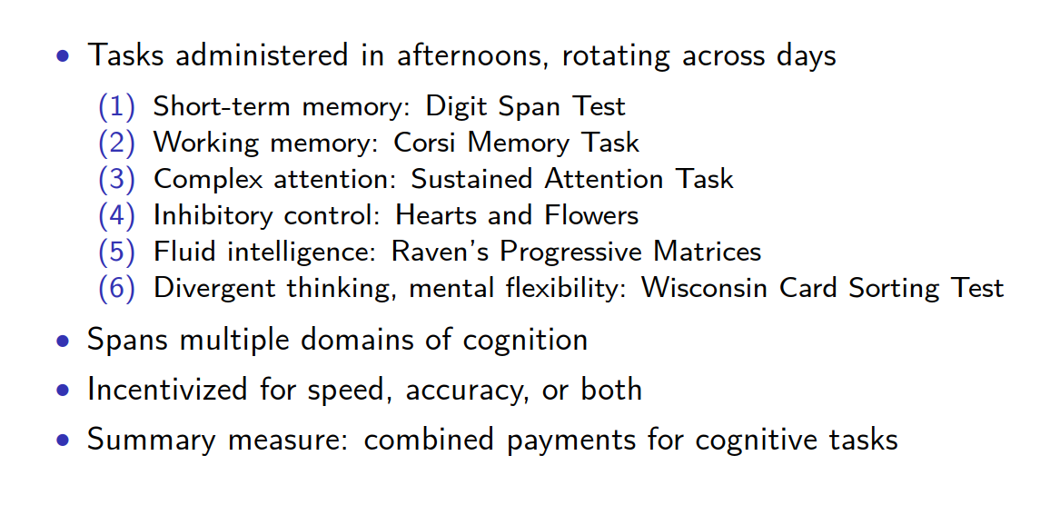
Outcomes: Cognitive Function

Slide 71
Methodological aside:
Controlled work environment
As in Kaur-Kremer-Mullainathan and Breza-Kaur-Shamsadani
Pros
  Better measurement: Can observe every keystroke entered, measure cognitive function, study procrastination etc.
  Any treatment we can dream of: randomized piece rates, nap cabins,
Cons
  Artificiality: Participants know they are in experiment (informed consent, etc). Potential demand effects.
  Not a firm surviving in competitive equilibrium; selection of workers may be odd

Slide 72
Methodological aside: statistical power
Use pilot data + Monte-Carlo simulation to consider different designs and pre-specified regressions
  e.g. how many days of pre-treatment vs. post-treatment days?
  Run ANCOVA regressions vs. Diff-in-Diff?
    Usually should use ANCOVA
  What outcomes are we hopelessly under-powered on? Drop these from design.
Strongly recommend taking power calculations seriously at design stage. Often need to go beyond canned Stata commands.
  Often won’t matter, but sometimes can get substantially more bang for the buck by choosing the right design / specification

Slide 73
Methodological aside:
Multiple-hypotheses testing
Increasingly important in experimental work: correcting for multiple tests when conducting hypothesis tests
Basic idea: the more hypotheses you test, the more likely you are to encounter Type-1 errors (“false discoveries)
Need to impose a penalty on your p-values for doing multiple tests
See Anderson (2008), List, Shaikh and Xu (2016) and Anderson and Magruder (2017) for approaches
What we do is organize outcomes by conceptually-related groups and correct p-values within group
And sometimes build indices / summary measures instead of testing each outcome by itself

Slide 74
Practicalities Q&A
Funding:
  Major challenge for field experiments
  Look for grants in other applied fields (e.g. development, education, etc.)
  Makes inexpensive take-up experiments, experiments with firms, more attractive
IRB: Start early, try to be as general as possible in application
  IRB will surprise and amaze you with the things they worry and don’t worry about
  Substantial heterogeneity across IRB officers (in my experience)
Timelines:
  Time spent up-front on design and thinking through analysis has a very high return

