Slide 1
Can the Market Multiply and Divide?
Non-Proportional Thinking in Financial Markets
July 2018
Kelly Shue (Yale and NBER)
Richard Townsend (UCSD)

Slide 2
Proportional thinking in financial markets
Market value of the firm:
Size = number of shares × share price
In financial markets, rational agents should react to news about firm value in terms of proportional price changes, i.e. returns
Holding firm size constant, nominal price of a financial security has no real meaning
  Price can easily be changed through splits or reverse splits
But changes in the value of stocks are frequently reported in dollar units rather than or in addition to return units…

Slide 3
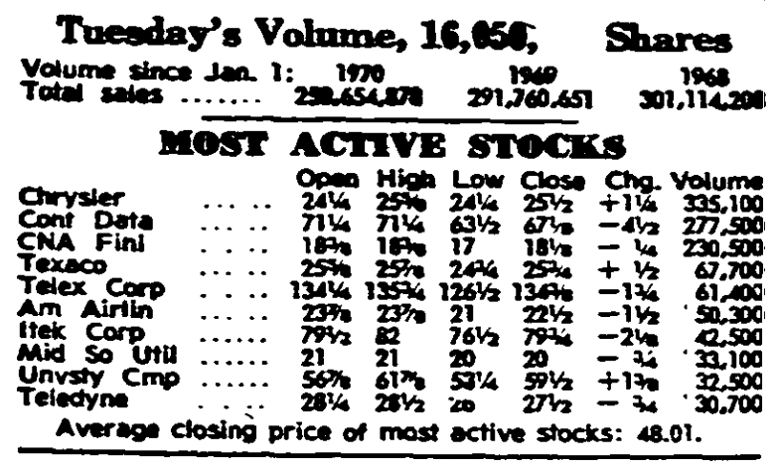
Wall Street Journal (1970s)

Slide 4
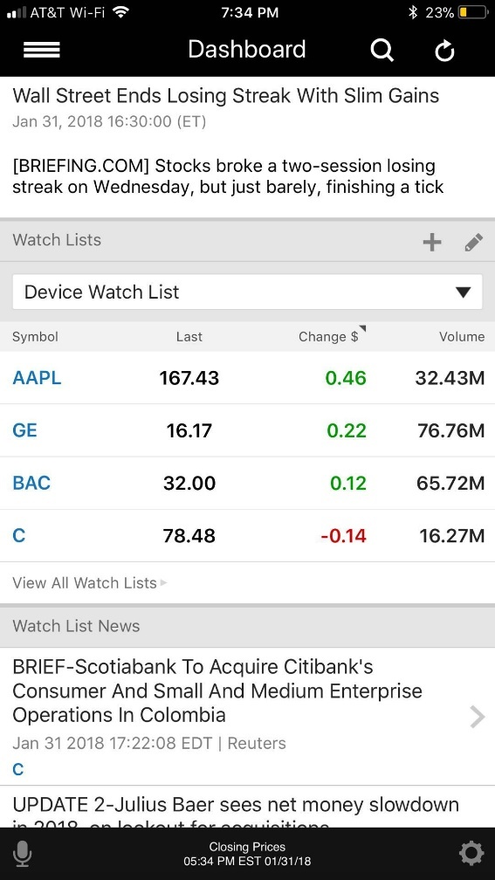
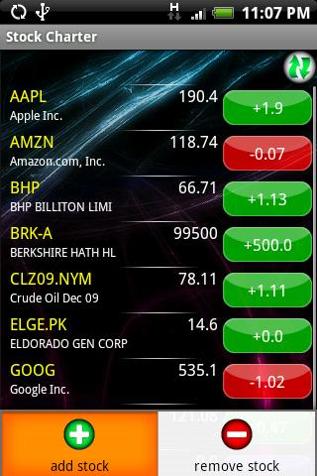
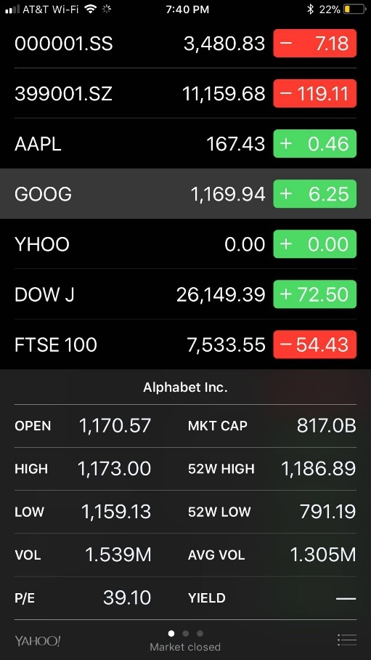
Android, Apple, and Etrade apps (2010s)
Notes:
Add in CNBC

Slide 5
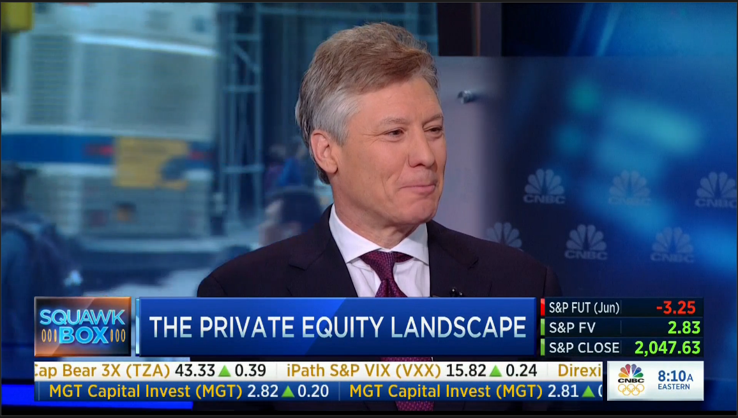
CNBC (2010s)

Slide 6
Our hypothesis
Non-proportional thinking: Investors think that news should correspond to a dollar change in price rather than a percentage change
  Motivated by experimental evidence (Svedsater et al. 2007)
Consider two otherwise identical stocks, one trading at $20/share, another at $30/share
  Investors may think the same piece of news should correspond to a $1 increase in price for both stocks
→ Overreaction to news for low-priced stocks: return reaction to news is (relatively) too big
→ Underreaction to news for high-priced stocks: return reaction to news is (relatively) too small

Slide 7
Volatility predictions
Measures of a stock’s volatility:
Total volatility: standard deviation of returns
Idiosyncratic volatility: standard deviation of returns in excess of market returns
Beta: scaled covariance between the stock’s return and the market return
Return overreaction for lower priced stocks → These stocks will have greater total volatility, idiosyncratic volatility, and absolute beta

Slide 8
Preview of results
A doubling in share price corresponds to 20-30% decline in volatility (total volatility, idiosyncratic volatility, and market beta)
Not driven by size—rather, the size-volatility relation flattens by 80% after controlling for price
To identify a causal effect of price, we show that volatility jumps immediately after stock splits and drops after reverse splits
Non-proportional thinking also distorts investors reactions to news that is reported in nominal rather than the appropriate proportional units: e.g. nominal earnings surprises
Not driven by tick-size limitations, volume, liquidity, or changes to a speculative investor base

Slide 9
Implications
A new explanation of under and overreaction to news
  Complements other behavioral explanations which focus on limited attention, biased beliefs about persistence
Offers insight into the determinants of volatility and drift
  Well-known asset pricing facts such as “small stocks have higher volatility and beta” are mostly driven by price
  Potential explanation for the “leverage effect” puzzle in which volatility is negatively related to past returns

Slide 10
Contrast with the proportional-thinking bias
E.g. Pratt et al. 1979, Thaler 1980, Tversky and Kahneman 1981, Azar 2011, Bushong et al. 2017
Consumers are often willing to drive to another store to save $10 off a $20 calculator but not to save $10 off a $100 jacket
Consumers should think in levels, but partially focus on the discount as a proportion of the purchase price
Investors in financial markets should think proportionally, but partially think in levels and fail to scale by price

Slide 11
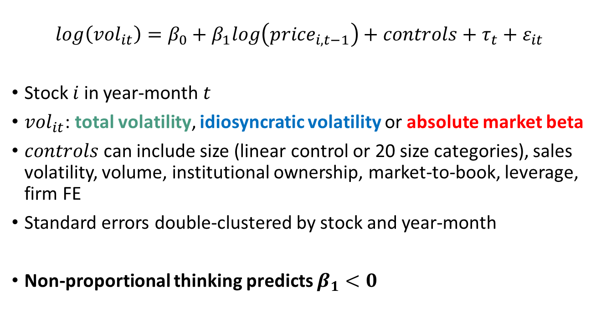
Baseline regression
$$log\left({vol}_{it}\right)=β_{0}+β_{1}log\left({price}_{i,t−1}\right)+controls+τ_{t}+ε_{it}$$
Stock $i$ in year-month $t$
${vol}_{it}$: total volatility, idiosyncratic volatility or absolute market beta
$controls$ can include size (linear control or 20 size categories), sales volatility, volume, institutional ownership, market-to-book, leverage, firm FE
Standard errors double-clustered by stock and year-month
Non-proportional thinking predicts $β_{1}<0$

Slide 12
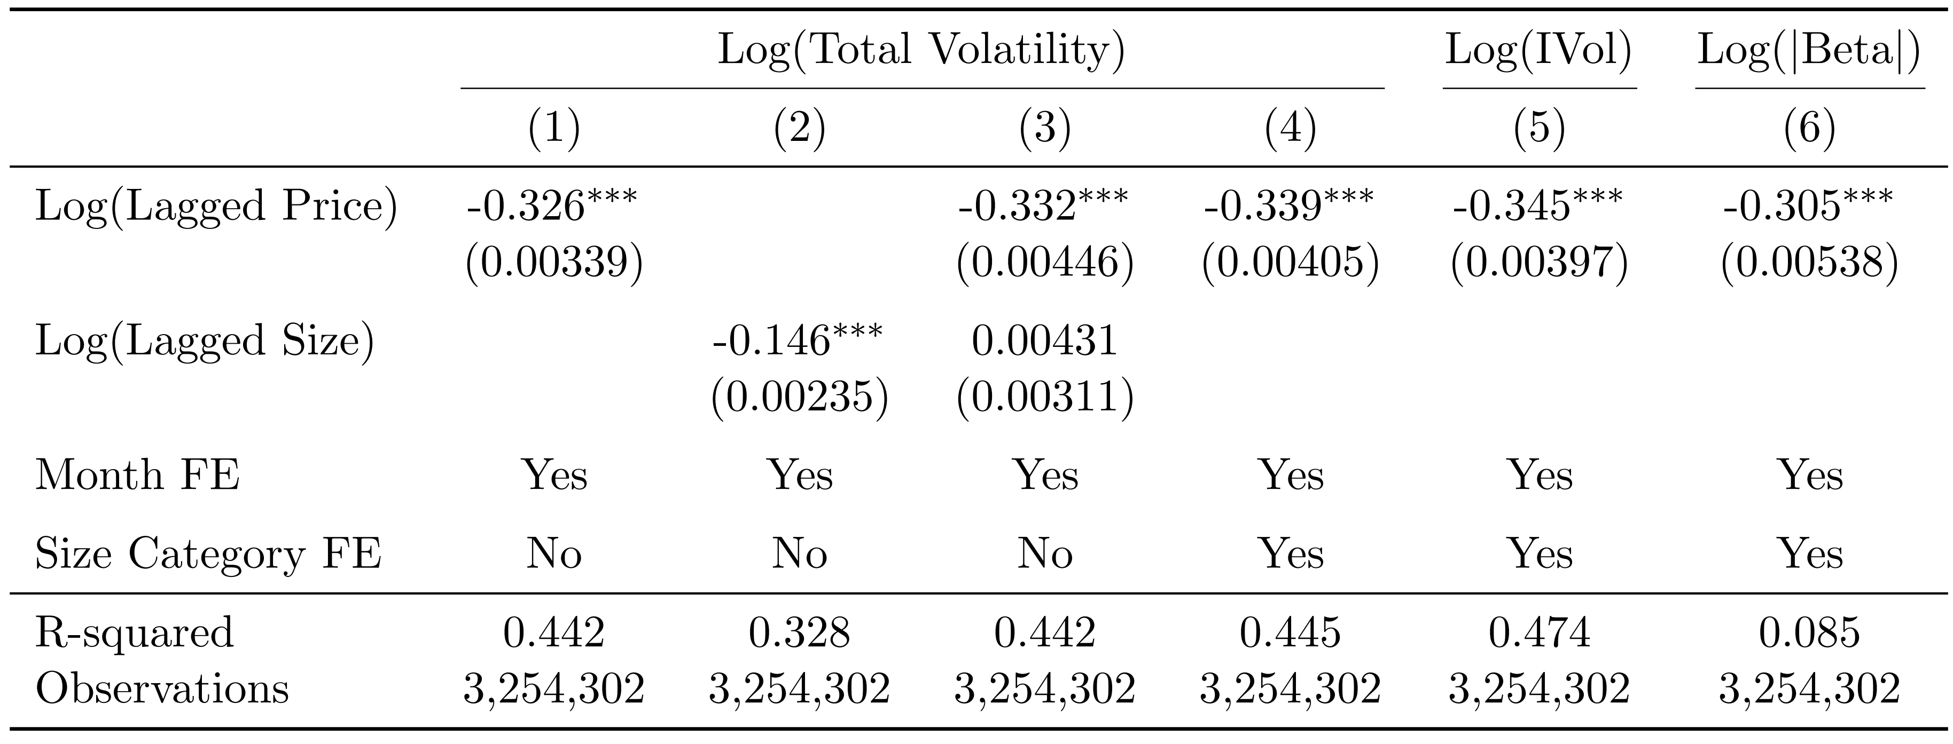

Baseline results
A doubling in price corresponds to a $>30\%$ decline in volatility
Holds after controlling flexibly for size, yet the size-volatility relation becomes insignificant once we control for price

Slide 13
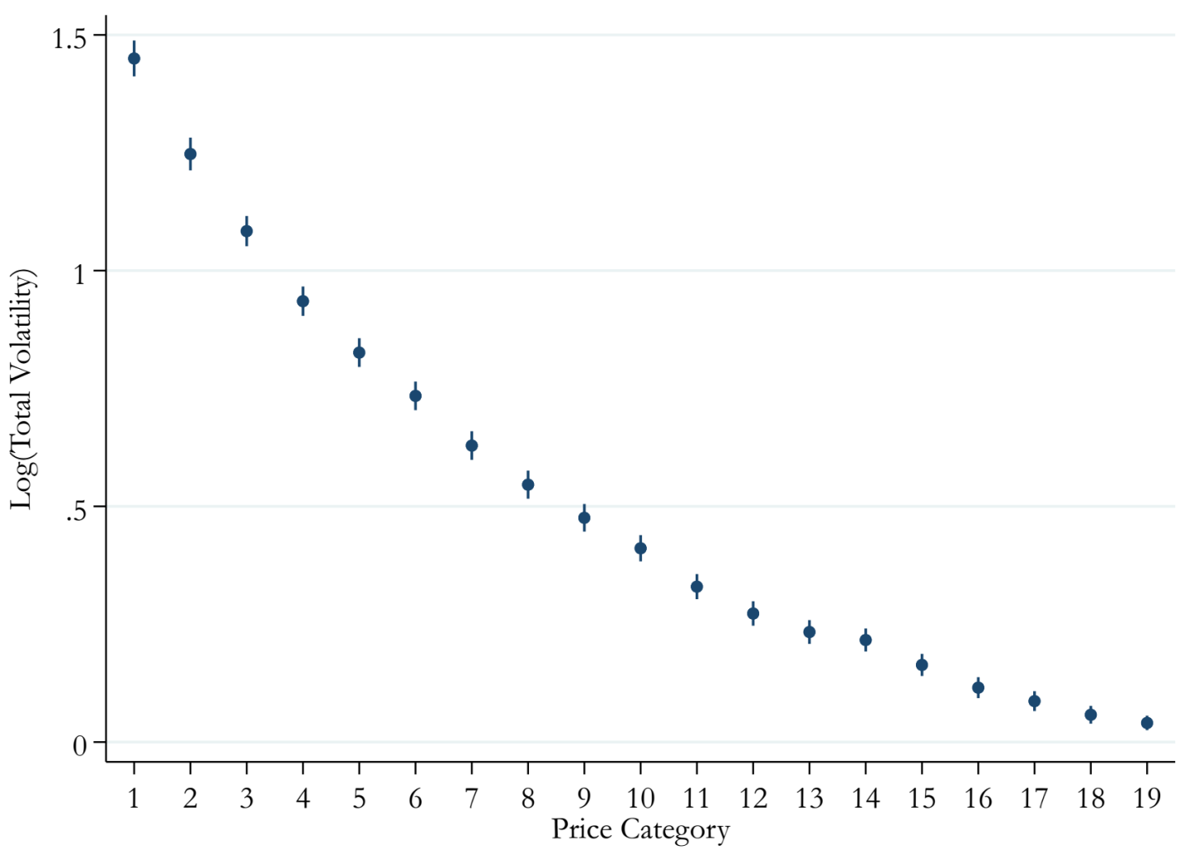
Non-parametric volatility-price relation
Plots coefficients for 20 price categories (omitted category 20), controlling for 20 size categories and time FE
Shows that negative relation is not driven only by low priced stocks that are subject to tick-size distortions

Slide 14
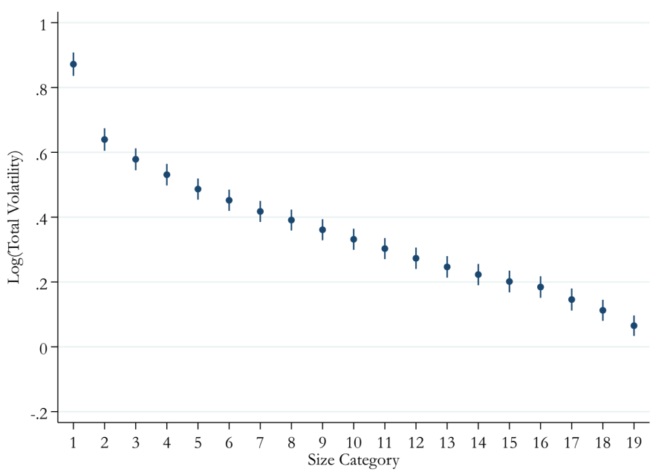
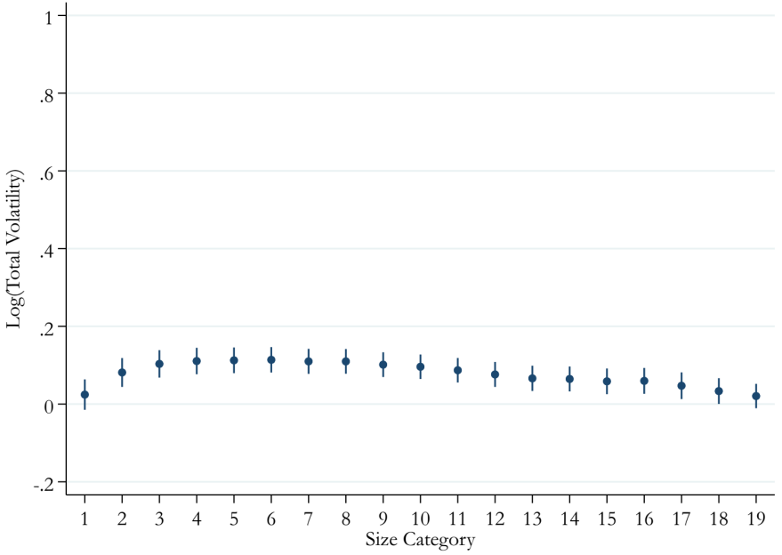
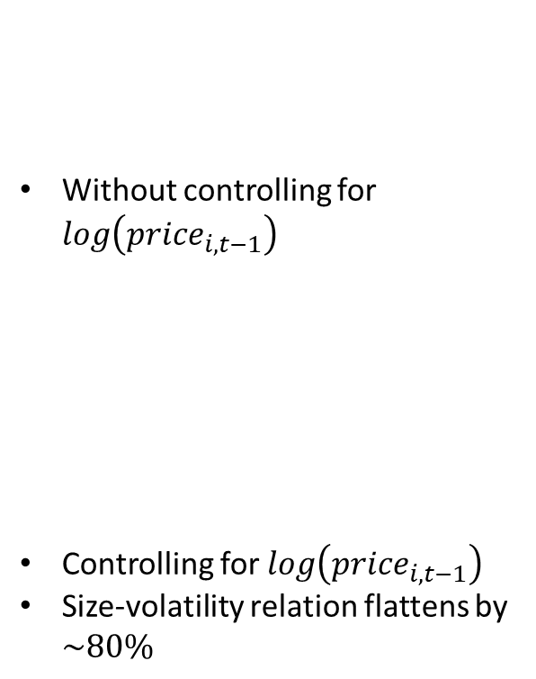
Price can explain the size-volatility relation
Without controlling for $log\left({price}_{i,t−1}\right)$
Controlling for $log\left({price}_{i,t−1}\right)$
Size-volatility relation flattens by $\sim 80\%$

Slide 15
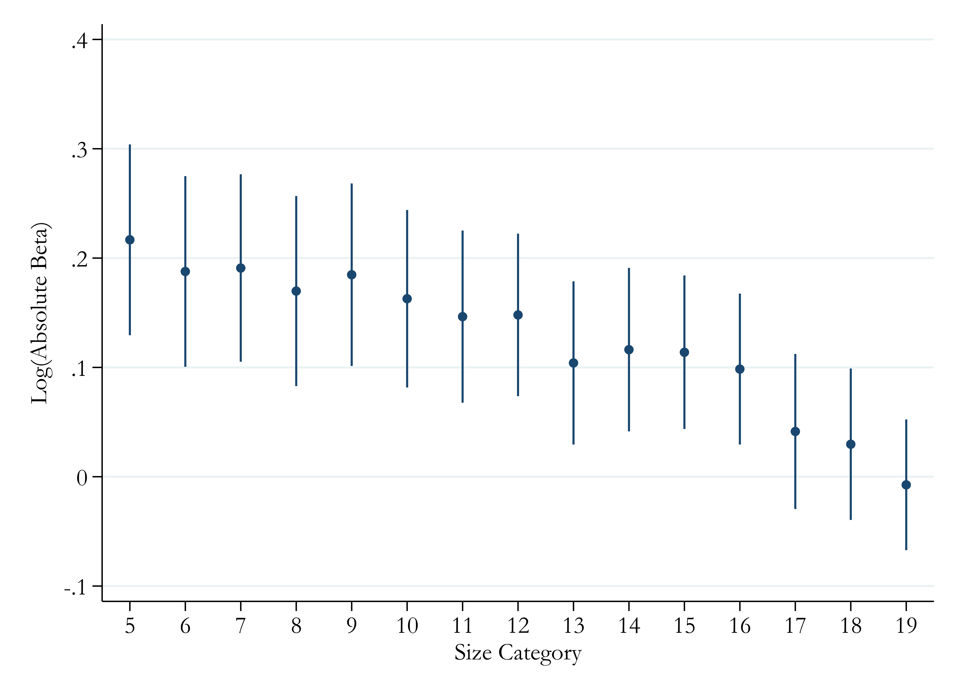
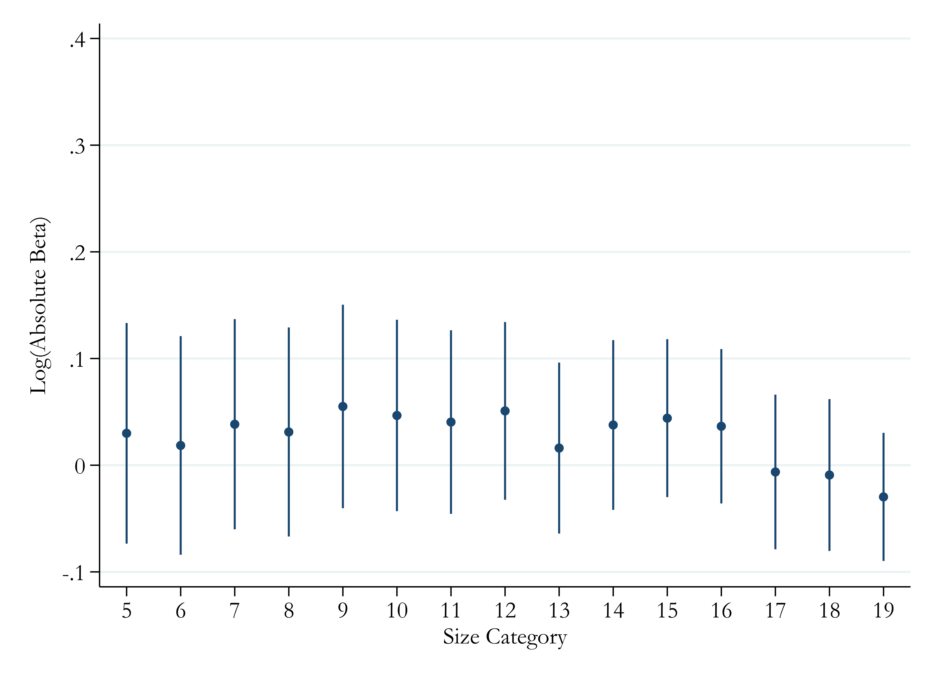

Price can explain the size-beta relation
Without controlling for $log\left({price}_{i,t−1}\right)$
Controlling for $log\left({price}_{i,t−1}\right)$
Size-beta relation flattens by $\sim 80\%$

Slide 16
Heterogeneity and robustness
The volatility-price relation isn’t driven by a correlation between price and institutional ownership/size
  But, magnitude of volatility-price relation declines with size and institutional ownership, consistent with limits to arbitrage
Lower priced stocks have higher upside and downside volatility and beta, so results not driven by one tail of returns
Similar magnitudes controlling for lagged sales volatility, market-to-book, volume turnover, and leverage
Similar results after adjusting conservatively for tick-size or restricted to a subsample with zero leverage

Slide 17
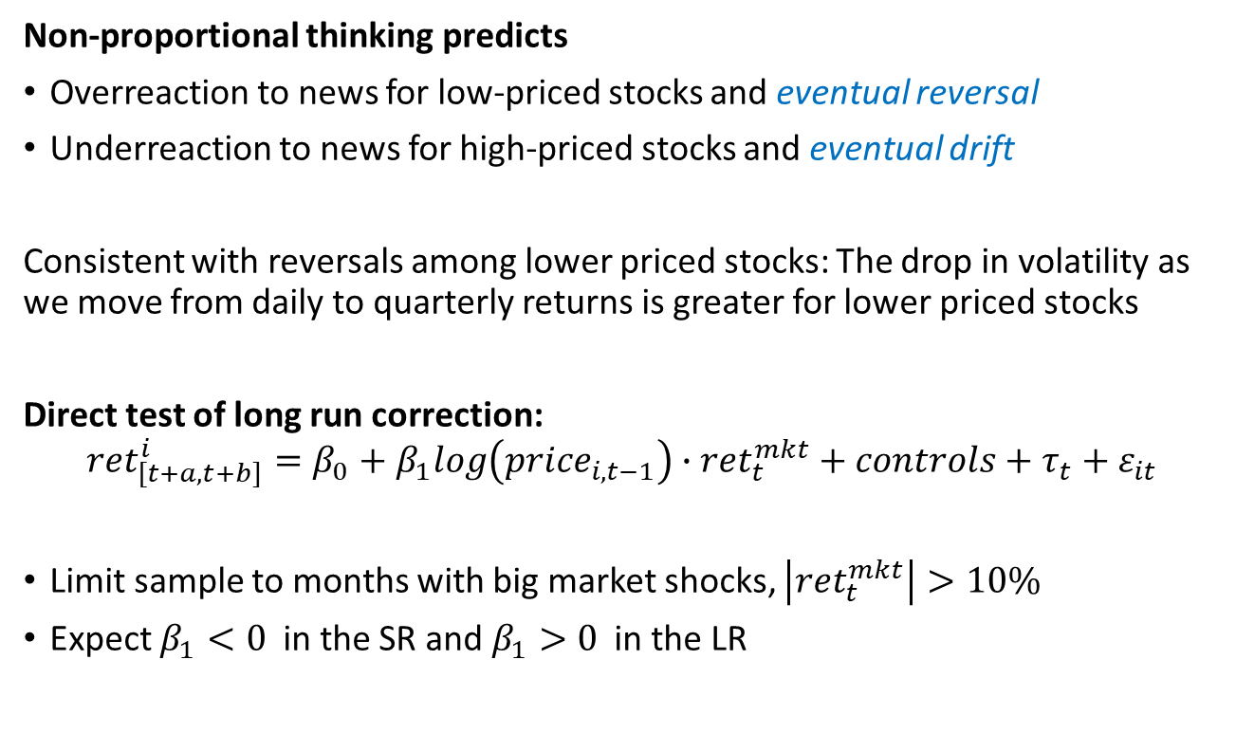
Long run correction of initial over- and under-reaction
Non-proportional thinking predicts
Overreaction to news for low-priced stocks and eventual reversal
Underreaction to news for high-priced stocks and eventual drift
Consistent with reversals among lower priced stocks: The drop in volatility as we move from daily to quarterly returns is greater for lower priced stocks
Direct test of long run correction:
$${ret}_{[t+a,t+b]}^{i}=β_{0}+β_{1}log\left({price}_{i,t−1}\right)∙{ret}_{t}^{mkt}+controls+τ_{t}+ε_{it}$$
Limit sample to months with big market shocks, $\left|{ret}_{t}^{mkt}\right|>10\%$
Expect $β_{1}<0$ in the SR and $β_{1}>0$ in the LR

Slide 18
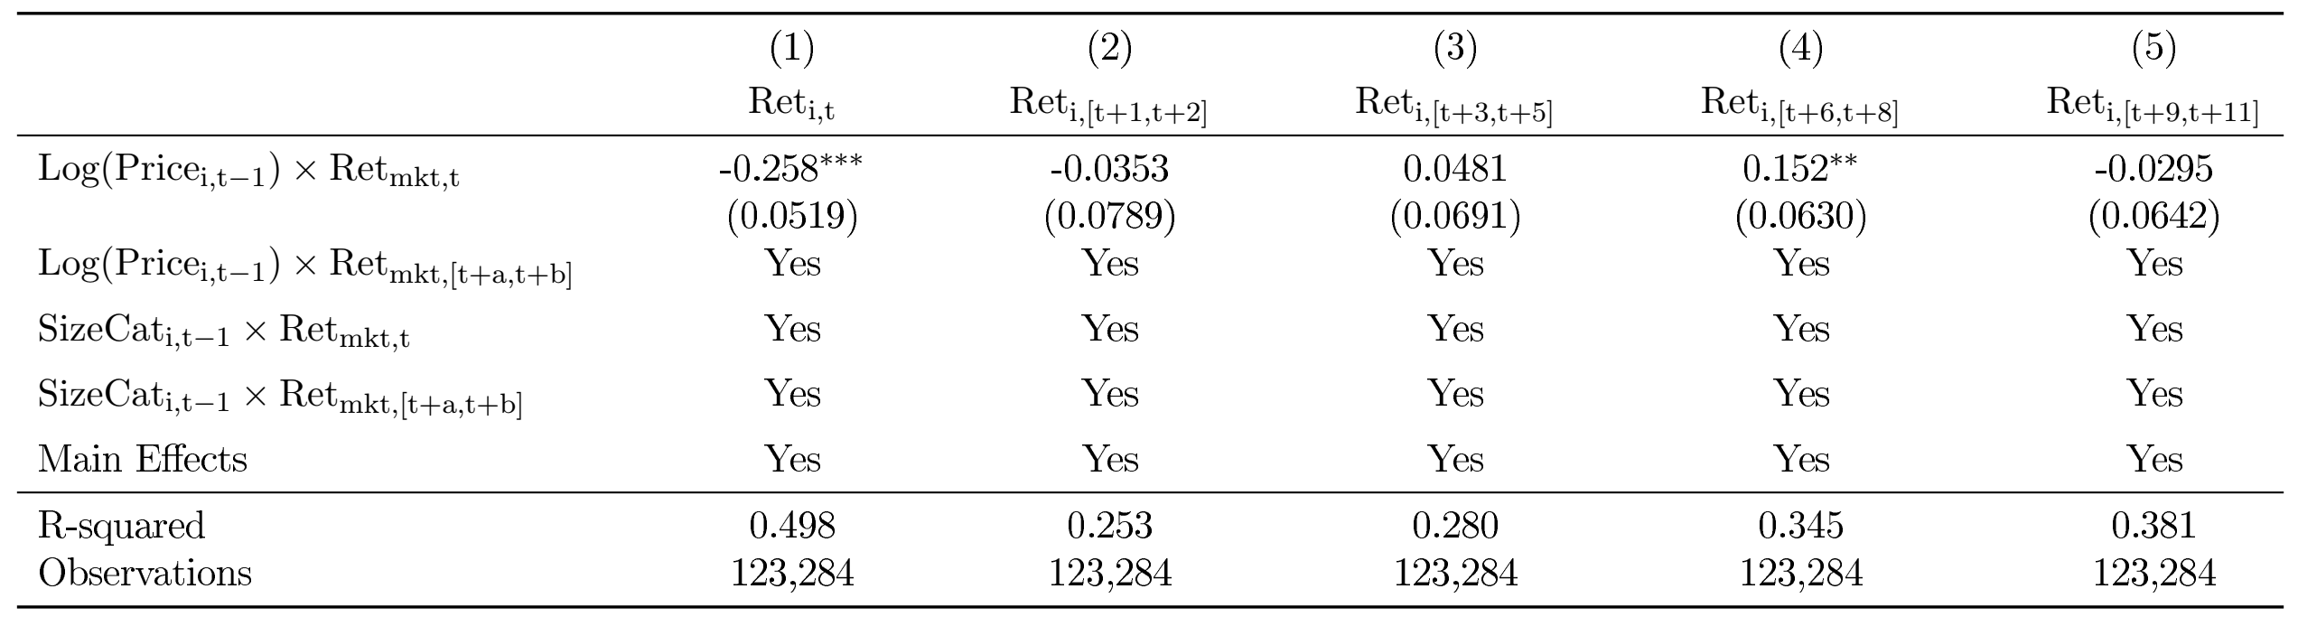
Long run correction of initial over- and under-reaction
Overreaction to news for low-priced stocks and eventual reversal
Underreaction to news for high-priced stocks and eventual drift

Slide 19
Splits as an event study
Potential concern: poor performance leads to low price and high vol
  More generally, omitted variables drive price-volatility relation
To identify a causal effect of price, we conduct a regression discontinuity around stock splits
  Following a standard 2-for-1 stock split, the price falls by half
Splits are not random (they tend to follow good performance), but splits are pre-scheduled and fundamentals are unlikely to change exactly on the split date
  We verify this in the data
Expect the opposite patterns for reverse splits

Slide 20
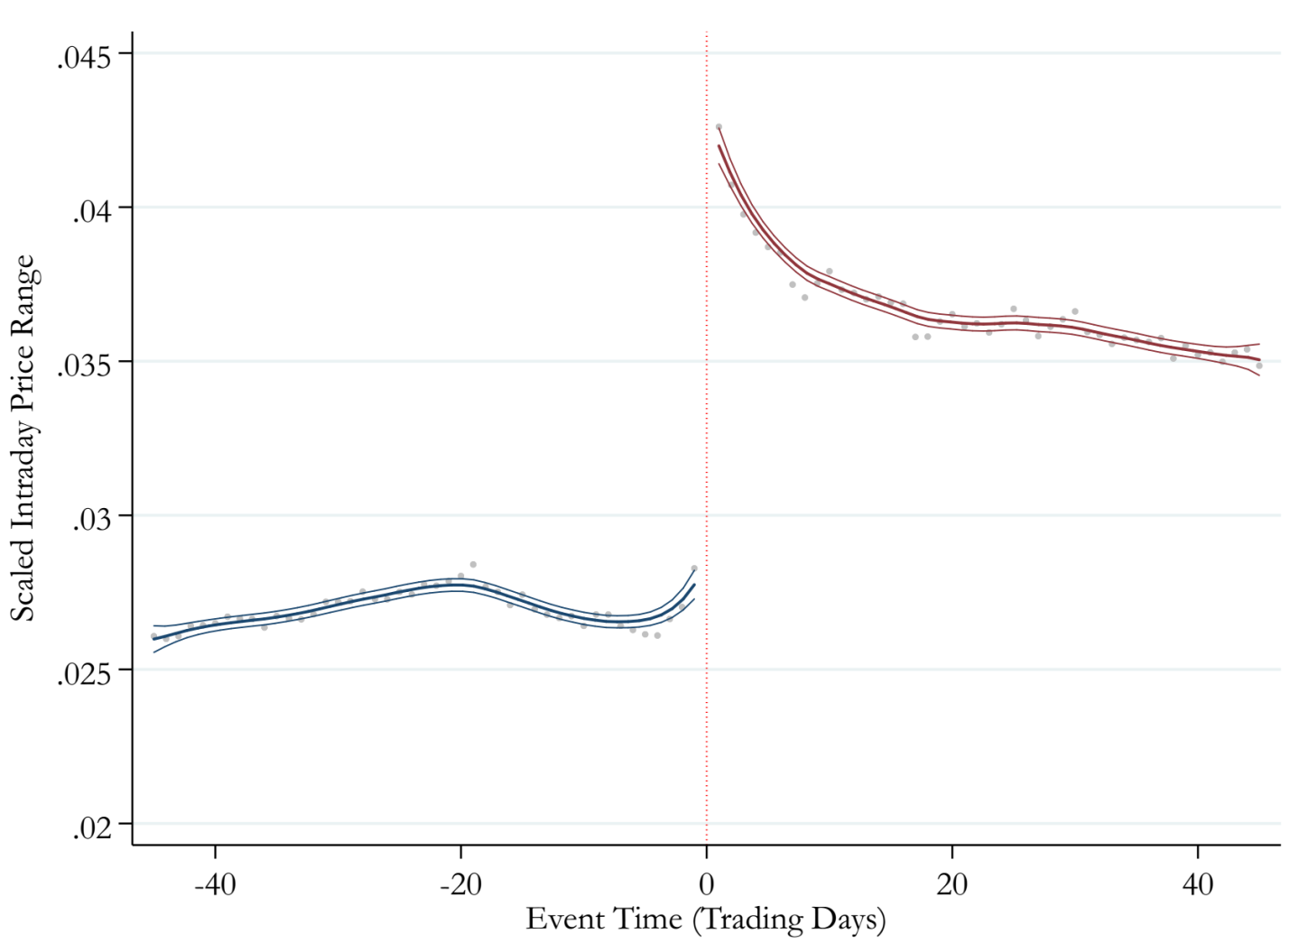

Regression discontinuity around stock splits
Proxy for daily volatility using scaled intraday price range
$>35\%$ persistent increase in intraday price range after splits

Slide 21
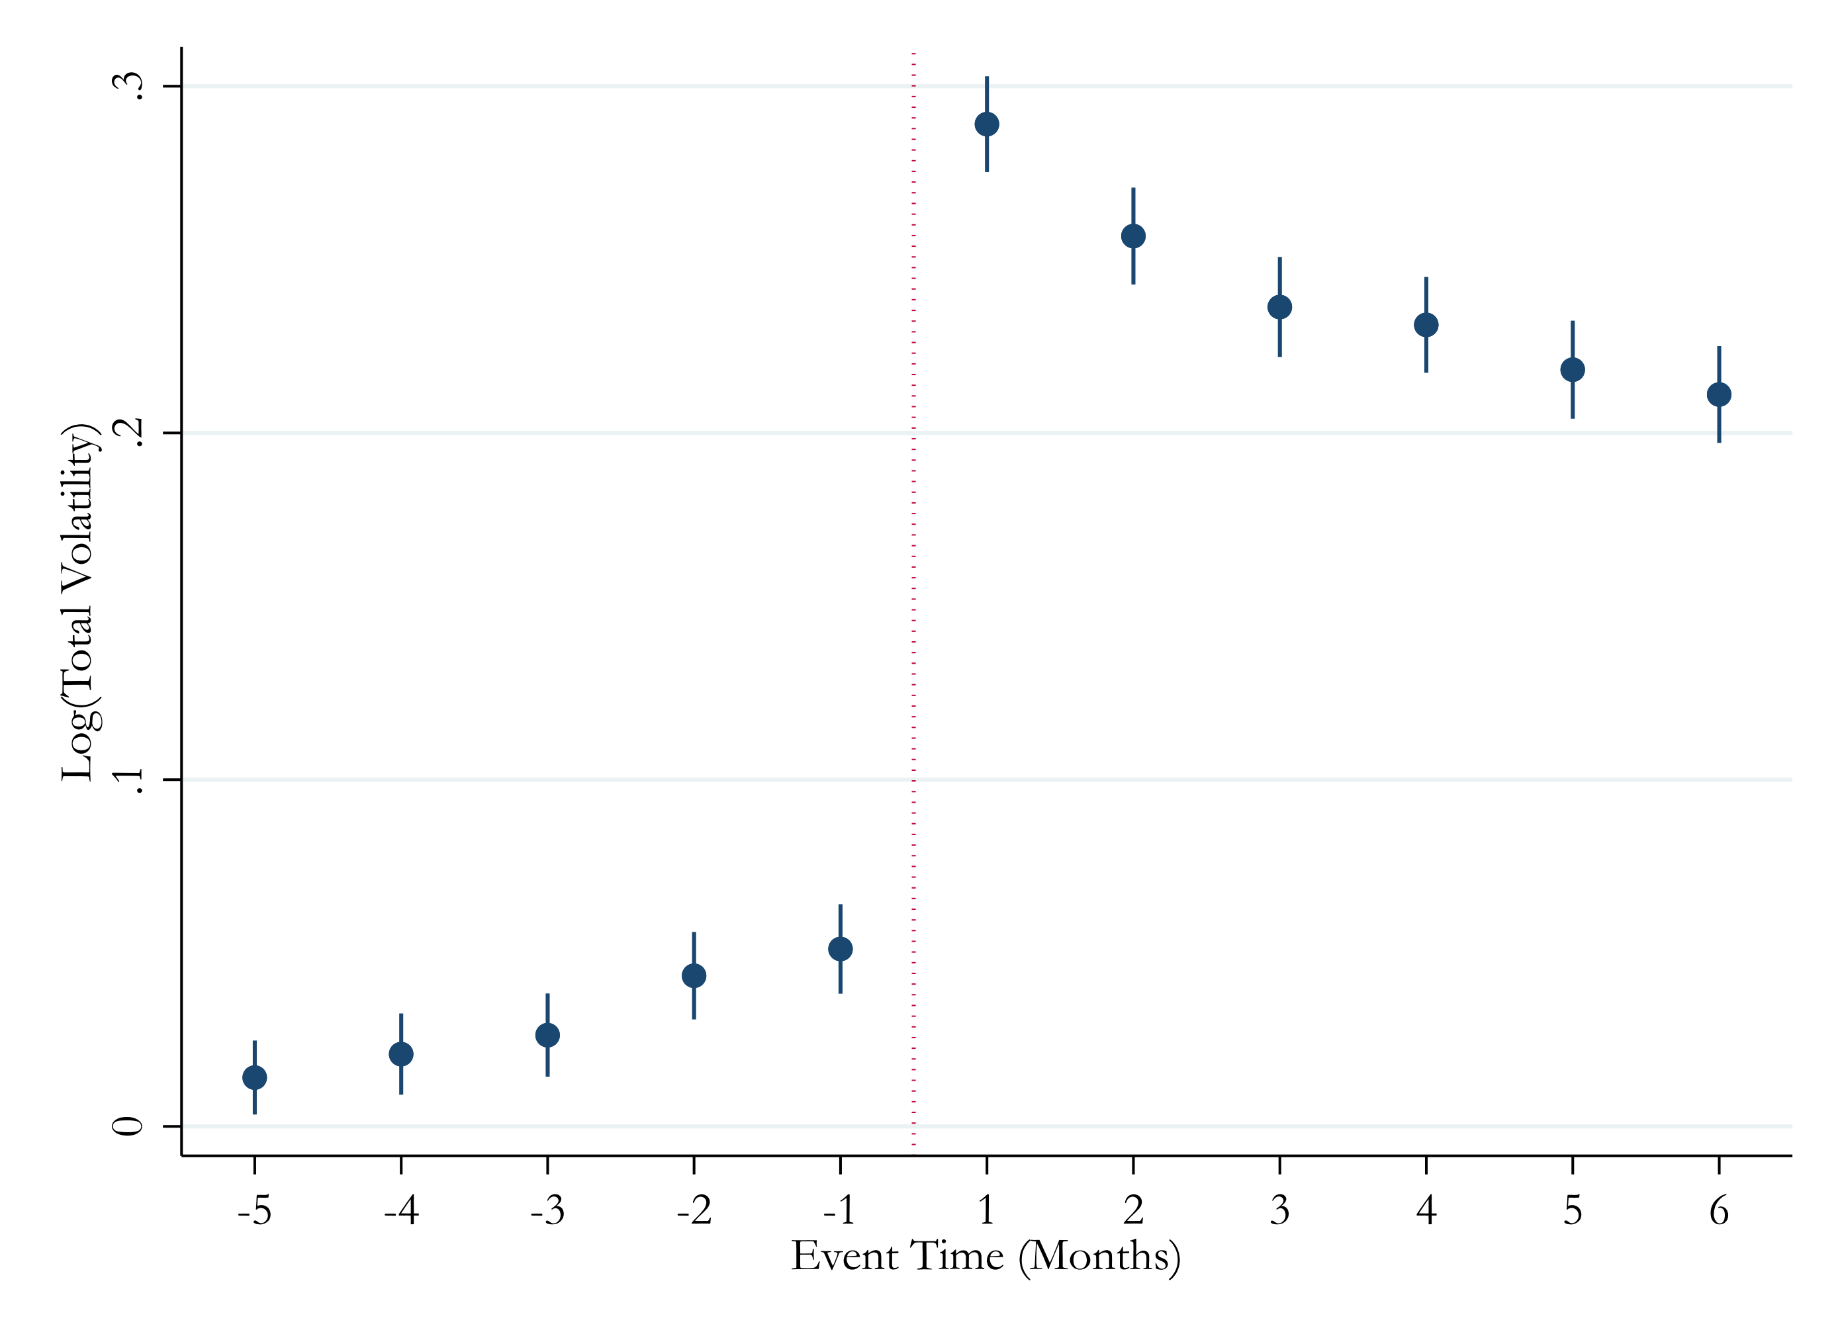

Splits (total volatility)
Regression coefficients on event months ($t=−6$ is omitted), controlling for stock and calendar year-month FE

Slide 22
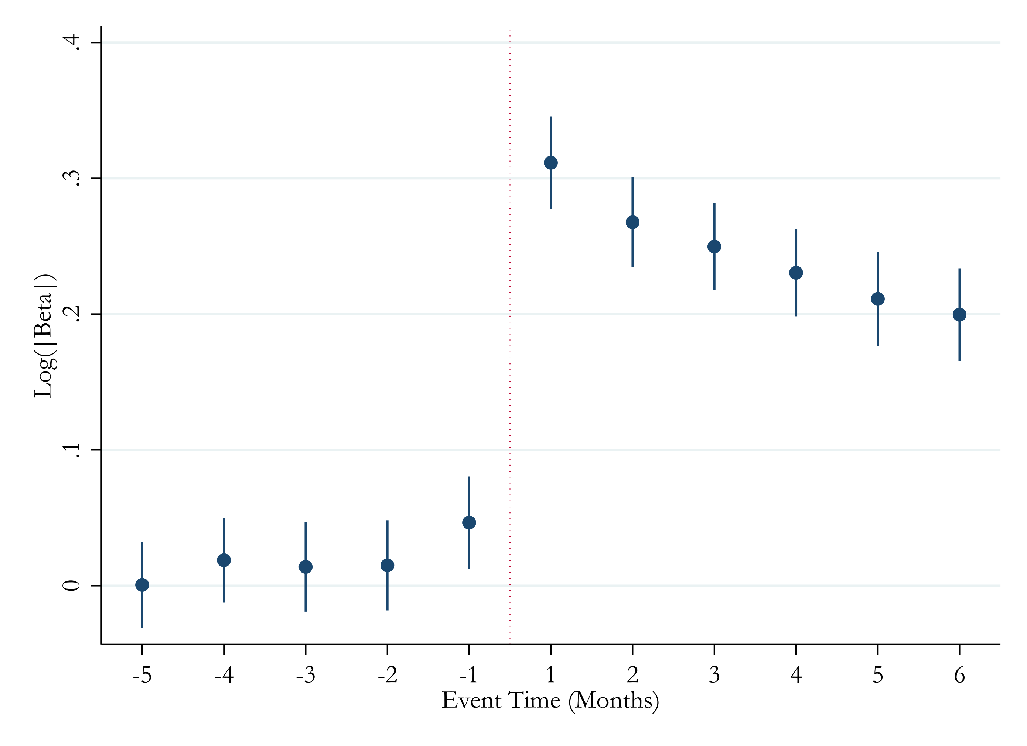
Splits (absolute beta)

Slide 23
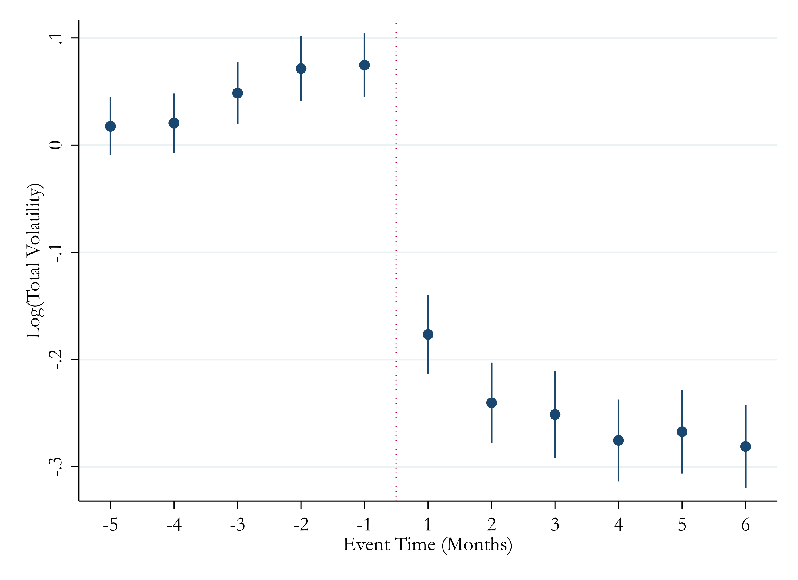
Reverse splits
Following reverse splits when price jumps, volatility drops

Slide 24
Remaining alternative explanations
Low prices may attract speculative investors who push up volatility
(Brandt et al. 2009; Dhar et al. 2004)
  Unlikely that investor base changes in a single day after split
  Not obvious that speculative investors would overreact to news, leading to higher betas and subsequent reversals
Firms may announce splits when they expect changes in firm strategy/performance, which could affect volatility
  However, splits are usually announced one month ahead
We can also examine these stories in more detail…

Slide 25
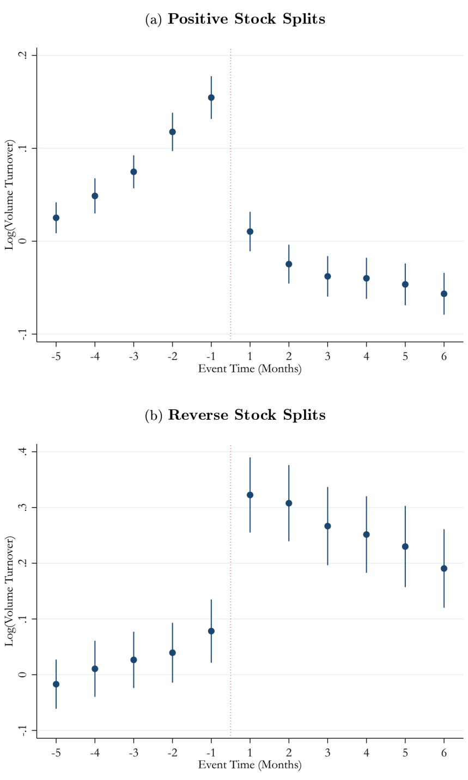
Volume after splits
Holding a stock’s market cap constant, increased speculation should lead to higher volume
Instead, volume drops after splits, consistent with some investors trading fixed numbers of shares
Volume increases following reverse splits, consistent with some investors trading fixed numbers of shares

Slide 26
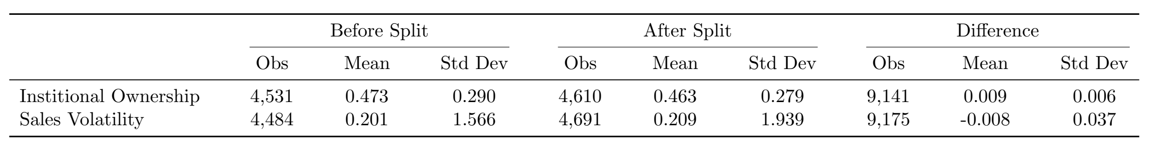
Institutional ownership and sales volatility
Changes in institutional ownership and sales volatility after splits are economically small and insignificant
Also, splits are not associated with discontinuous changes in retail investor characteristics e.g. income and net worth
(data from Barber and Odean, 2000)

Slide 27
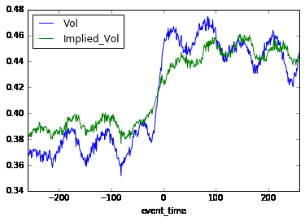
Option implied vol and actual vol
Usually, we expect Implied Vol > Vol in option markets
Results are consistent with option traders under-estimating the increase in volatility after splits

Slide 28
Extension: reactions to earnings surprises
Non-proportional thinking may distort reactions to news if the news itself is reported in nominal rather than the appropriate scaled units
Suppose a firm’s EPS beats expectations by 5 cents per share
  This is a bigger positive surprise if the firm’s price is $20/share than if the firm’s price is $30/share
  Therefore, most academic papers measure earnings news as 5 cents scaled by lagged share price
However, the media usually reports the nominal EPS surprise…

Slide 29
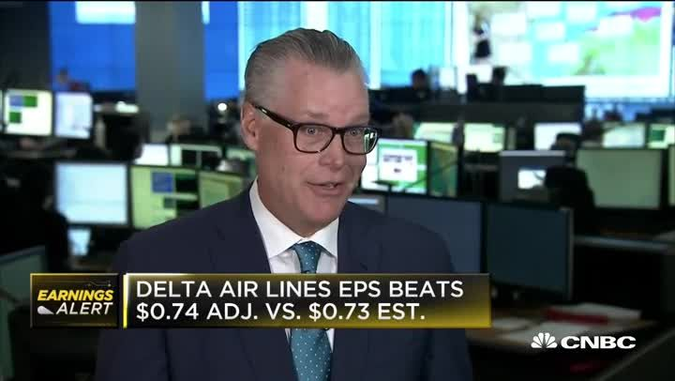
CNBC earnings announcement news

Slide 30
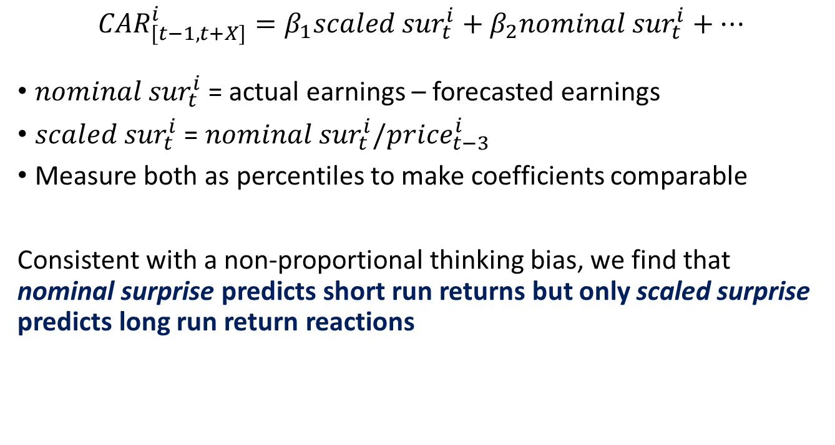
Nominal vs. scaled earnings surprise
${CAR}_{[t−1,t+X]}^{i}=β_{1}{scaled sur}_{t}^{i}+β_{2}{nominal sur}_{t}^{i}+…$
${nominal sur}_{t}^{i}$ = actual earnings – forecasted earnings
${scaled sur}_{t}^{i}$ = ${nominal sur}_{t}^{i}/{price}_{t−3}^{i}$
Measure both as percentiles to make coefficients comparable
Consistent with a non-proportional thinking bias, we find that nominal surprise predicts short run returns but only scaled surprise predicts long run return reactions

Slide 31
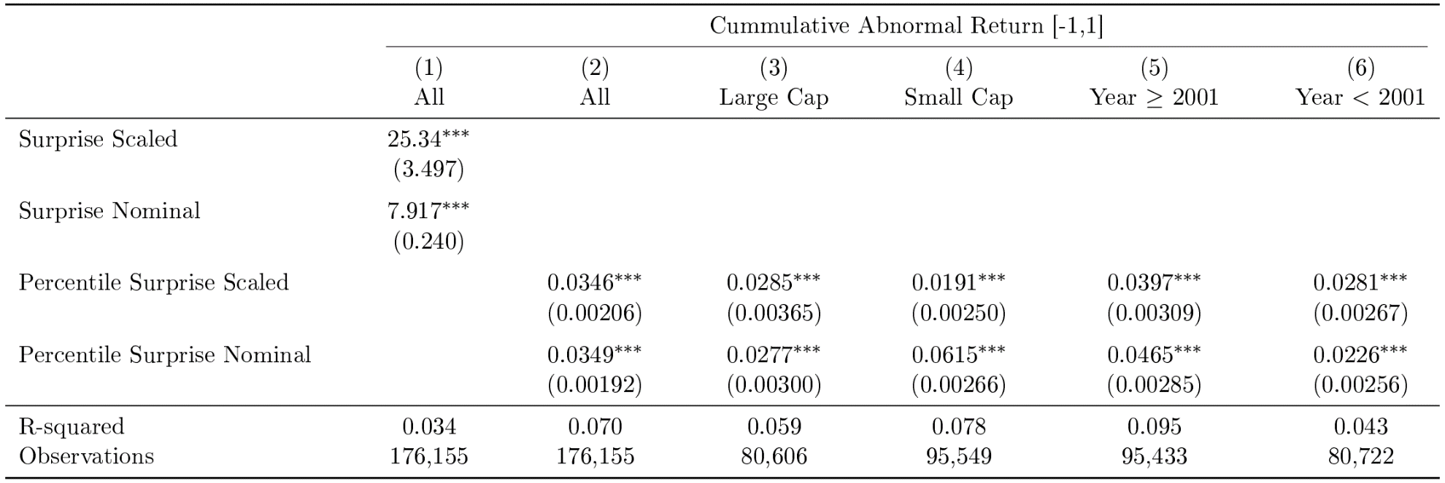
Short run reactions to earnings surprises
In the short run, investors react as much or more to the nominal earnings surprise

Slide 32
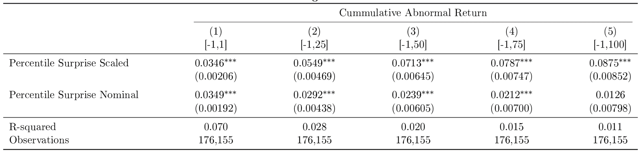
Long run reactions to earnings surprises
In the long run, only the scaled earnings surprise affects prices
Implies overreaction to the scaled earnings surprise for high priced firms
  Opposite of the baseline prediction of underreaction to news for high priced firms, because the news itself is reported in the wrong units!

Slide 33
Conclusion
Non-proportional thinking: Investors think that news should correspond to a dollar change in price rather than a percentage change in price
  Return overreaction for low-priced stocks and underreaction for high priced stocks
Economic magnitudes are large
  Non-proportional thinking can explain a significant portion of the “leverage effect” puzzle as well as the volatility-size and beta-size relations in the data
Non-proportional thinking also distorts reactions to news that is itself reported in nominal rather than real units
Offers insight into the determinants of volatility, drift, and reversals

Slide 34
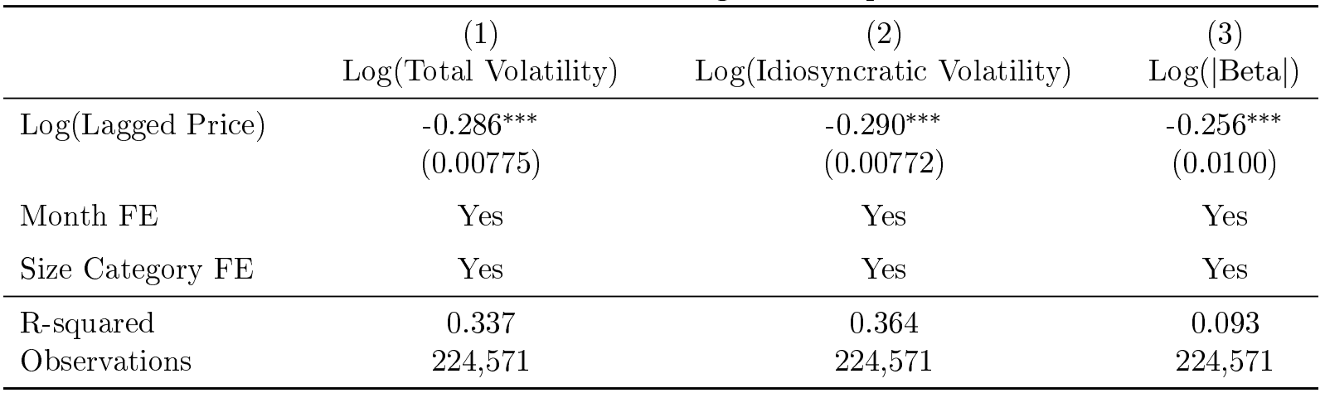
Leverage does not explain the “leverage effect”
Leverage effect: firms with low price or negative returns have high vol
  Potential explanation: As asset value declines, equity becomes more levered, so equity volatility and beta increases
But, we find similar patterns for firms with zero leverage

Slide 35
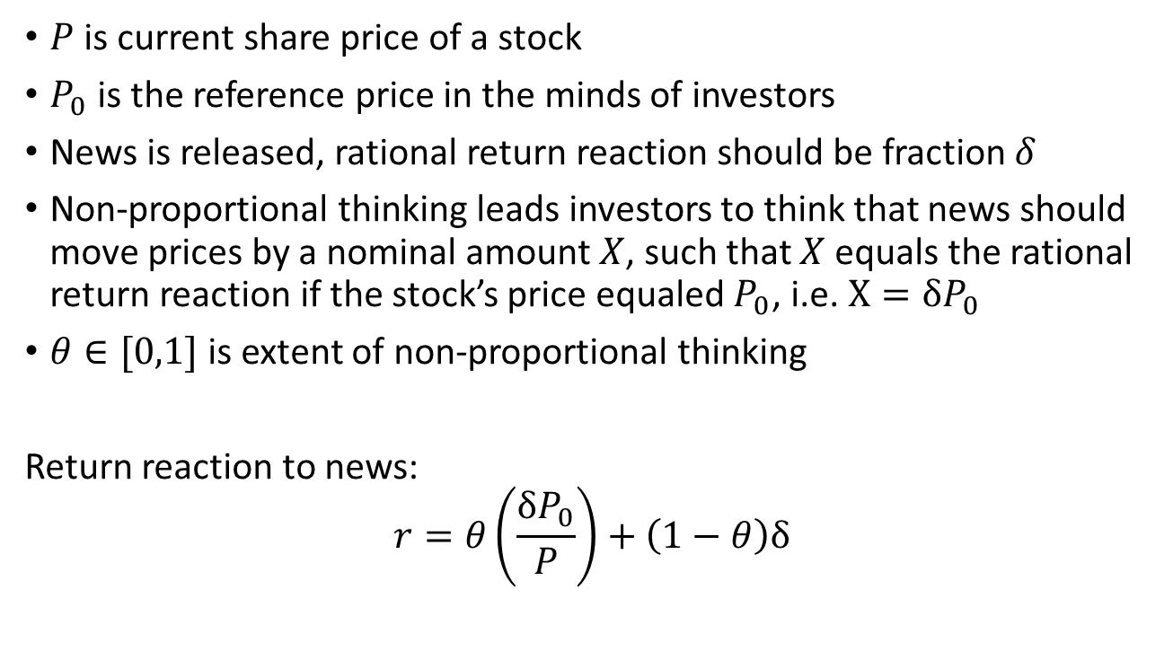
A simple model of non-proportional thinking
$P$ is current share price of a stock
$P_{0}$ is the reference price in the minds of investors
News is released, rational return reaction should be fraction $δ$
Non-proportional thinking leads investors to think that news should move prices by a nominal amount $X$, such that $X$ equals the rational return reaction if the stock’s price equaled $P_{0}$, i.e. $X=δP_{0}$
$θ∈[0,1]$ is extent of non-proportional thinking
Return reaction to news:
$$r=θ\left(\frac{δP_{0}}{P}\right)+\left(1−θ\right)δ$$

Slide 36
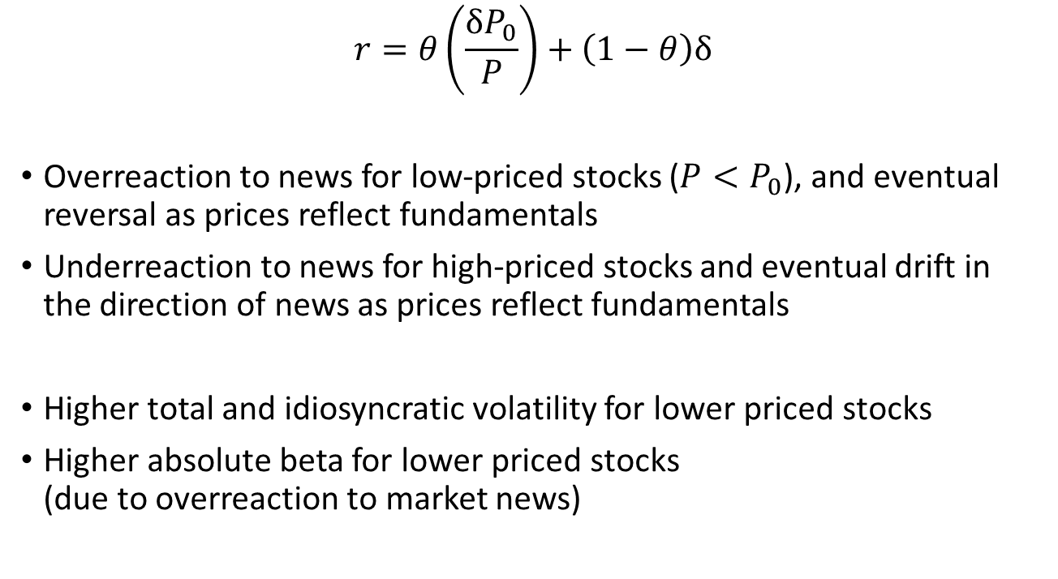
Model predictions
$$r=θ\left(\frac{δP_{0}}{P}\right)+\left(1−θ\right)δ$$
Overreaction to news for low-priced stocks ($P<P_{0}$), and eventual reversal as prices reflect fundamentals
Underreaction to news for high-priced stocks and eventual drift in the direction of news as prices reflect fundamentals
Higher total and idiosyncratic volatility for lower priced stocks
Higher absolute beta for lower priced stocks
(due to overreaction to market news)
Notes:
Log r = theta*delta*log(p0)-theta*delta*P+(1-theta)*log(delta)
OVB formula
Coefficient on log P if we don’t control for P0= -theta*delta + theta*delta*cov(P,P0)/var(P), so positively biased if cov(P,P0)>0

Slide 37
Data
CRSP
CompuStat
I/B/E/S: Quarterly earnings surprises relative to analyst forecasts
Optionmetrics
Thomson One: Institutional ownership data
Ken French Data Library: size cutoffs, market variables
Barber and Odean (2000)

Slide 38
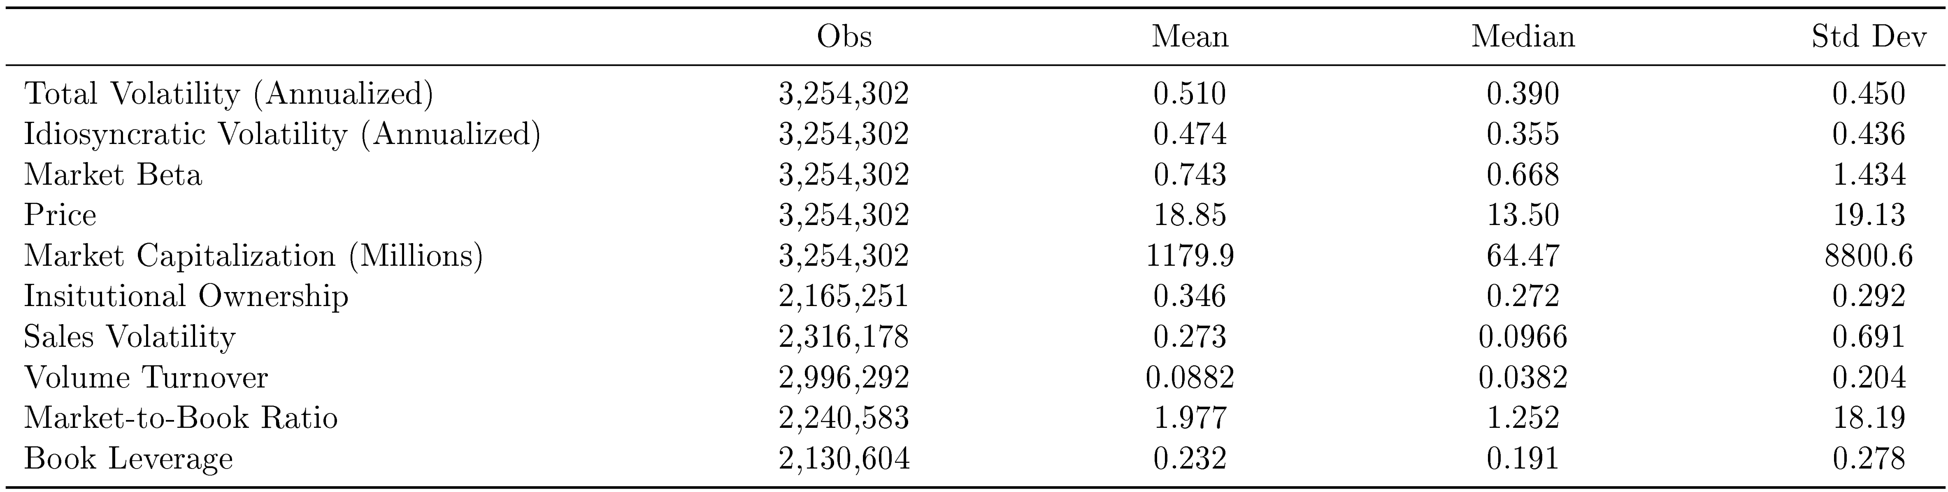
Summary statistics

Slide 39
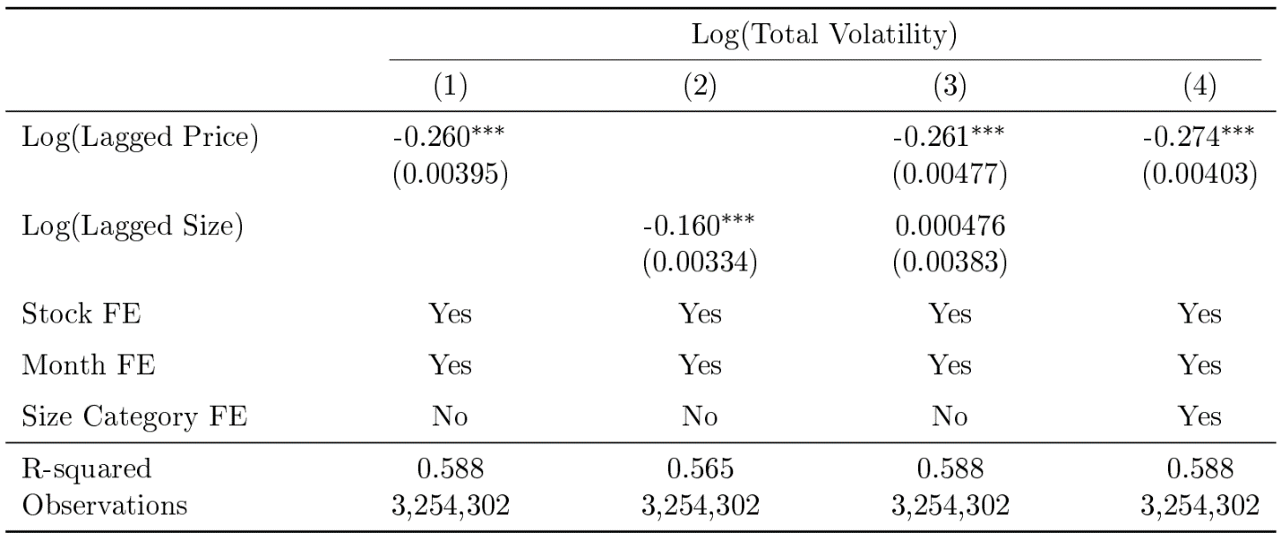
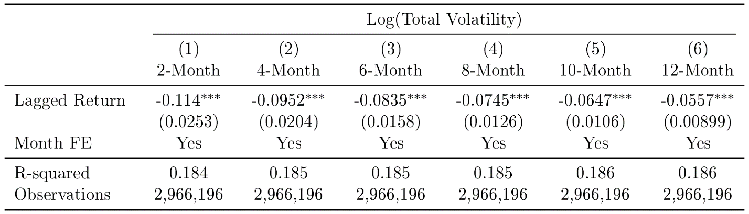
Within-firm changes in price
Controlling for firm FE (identifying off of within-firm changes in price)
Recent returns have a stronger negative relation with volatility

Slide 40
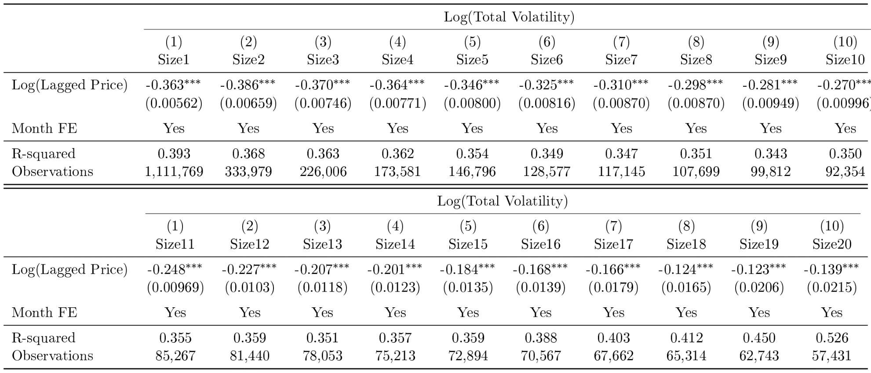
Heterogeneity by size
Volatility-price relation isn’t driven by a correlation between price and size
  But the magnitude of volatility-price relation declines with size, consistent with limits to arbitrage

Slide 41
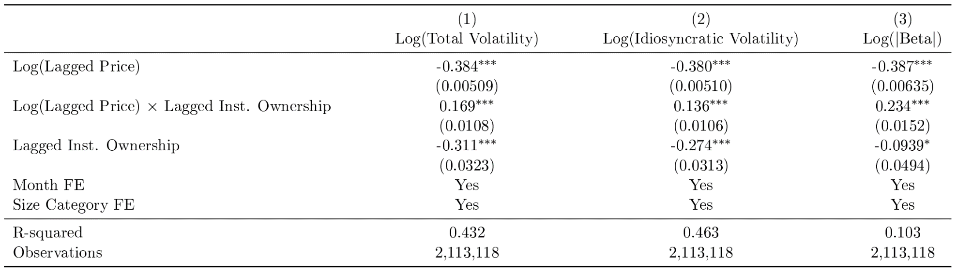
Heterogeneity by institutional ownership
Volatility-price relation isn’t driven by a correlation between price and institutional ownership
  But the magnitude of volatility-price relation declines with institutional ownership, consistent with limits to arbitrage

Slide 42
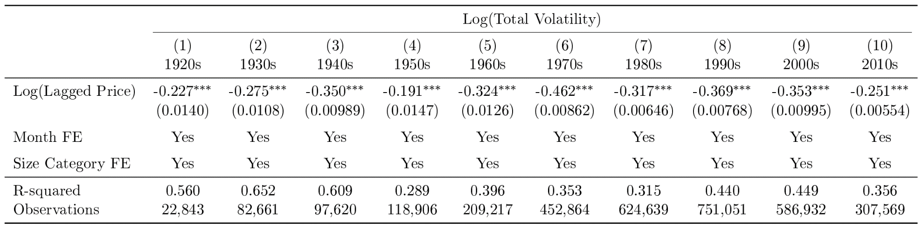
Heterogeneity by decade
Some variation over time, but the relation is not only driven by the early sample period

Slide 43
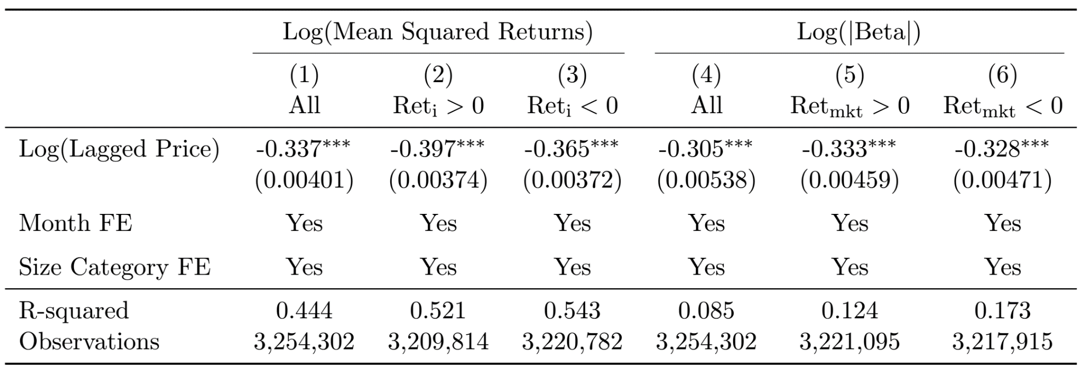
Upside and downside volatility
Non-proportional thinking predicts that investors will overreact to both positive and negative news for lower priced stocks
Lower share price is associated with greater upside and downside volatility, as well as greater upside and downside beta

Slide 44
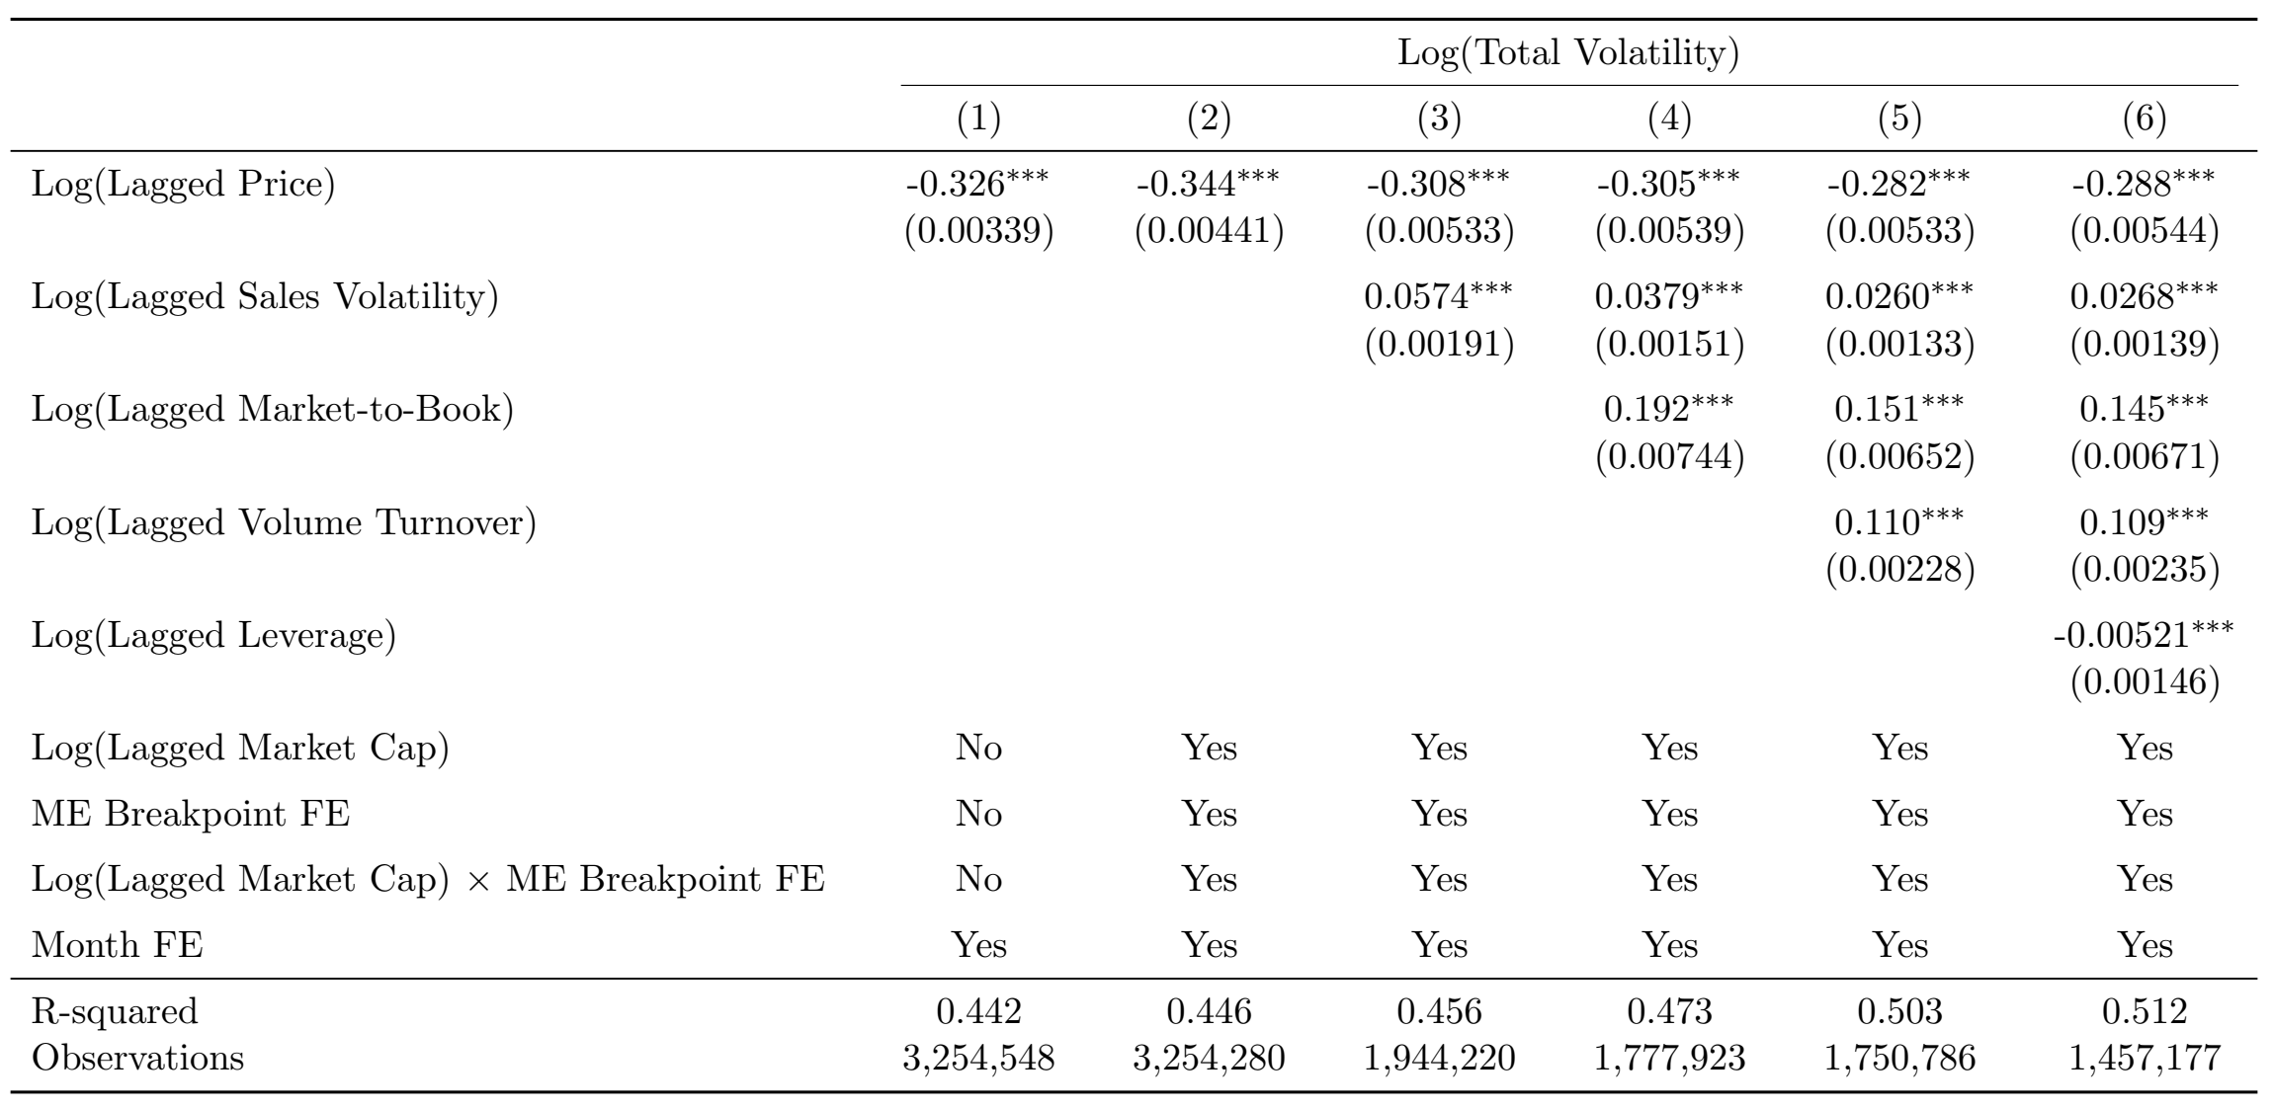
Similar results with additional control variables

Slide 45
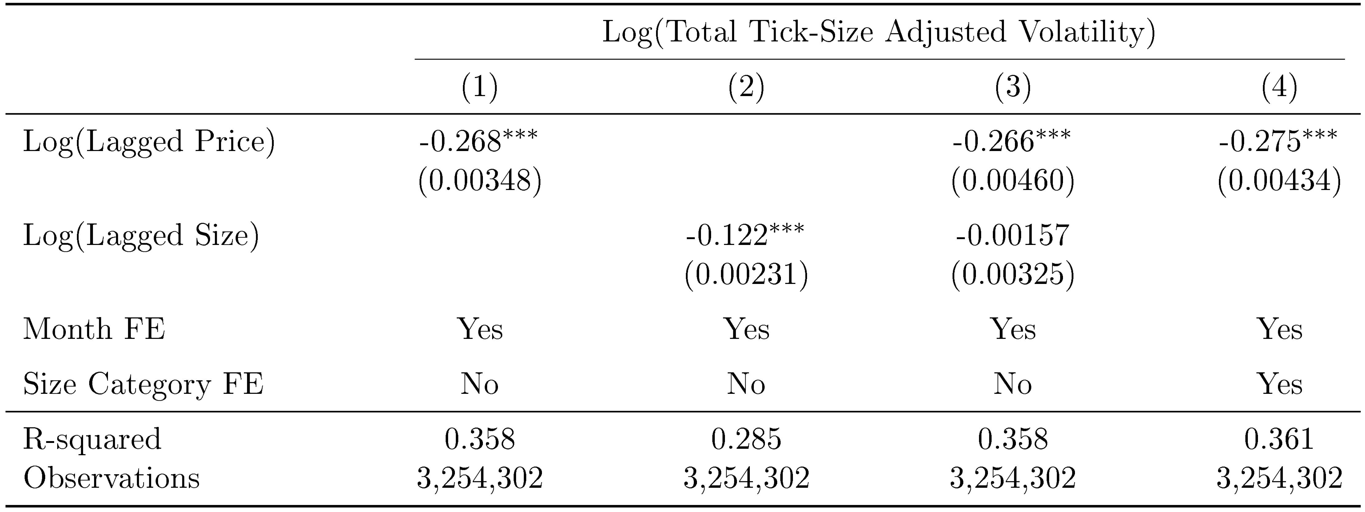
Adjusting for tick-size distortions
Subtract half a tick if price is up, and add half a tick if price is down
  These artificial prices round to actual prices but compress returns
  → Lower bound for true volatility absent tick-size constraints
  Difference between true volatility and lower bound is largest for low priced stocks
If tick-size effects drive our results, the price-volatility relation should disappear using this alternative volatility measure

Slide 46
Related literature
Thinking about value in the wrong units
  Birru and Wang (2015, 2016): Investors mistakenly believe that low-priced stocks have more room to grow
  Shue and Townsend (2017): Thinking about the number rather than value of options contributed to the rise in CEO pay
  Baker and Wurgler (2004a,b), Baker et al. (2007), Hartzmark and Solomon (2017, 2018): Investors think about dividends and capital gains separately instead of total returns
  Money illusion with respect to nominal and real value of: Fisher (1928); Benartzi and Thaler (1995)
We offer a new explanation of some known facts/puzzles regarding volatility, e.g. Dubofsky (1991), Dhar et al. (2004)

Slide 47
Change in investor base
Splits are not associated with discontinuous changes in retail investor characteristics e.g. income and net worth
(data from Barber and Odean, 2000)

Slide 48
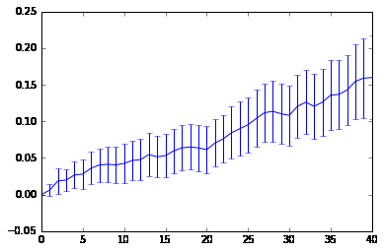
Trading strategy: buy straddles on split date
Average 15 percent return within 40 days after split (does not account for transaction costs)

Slide 49
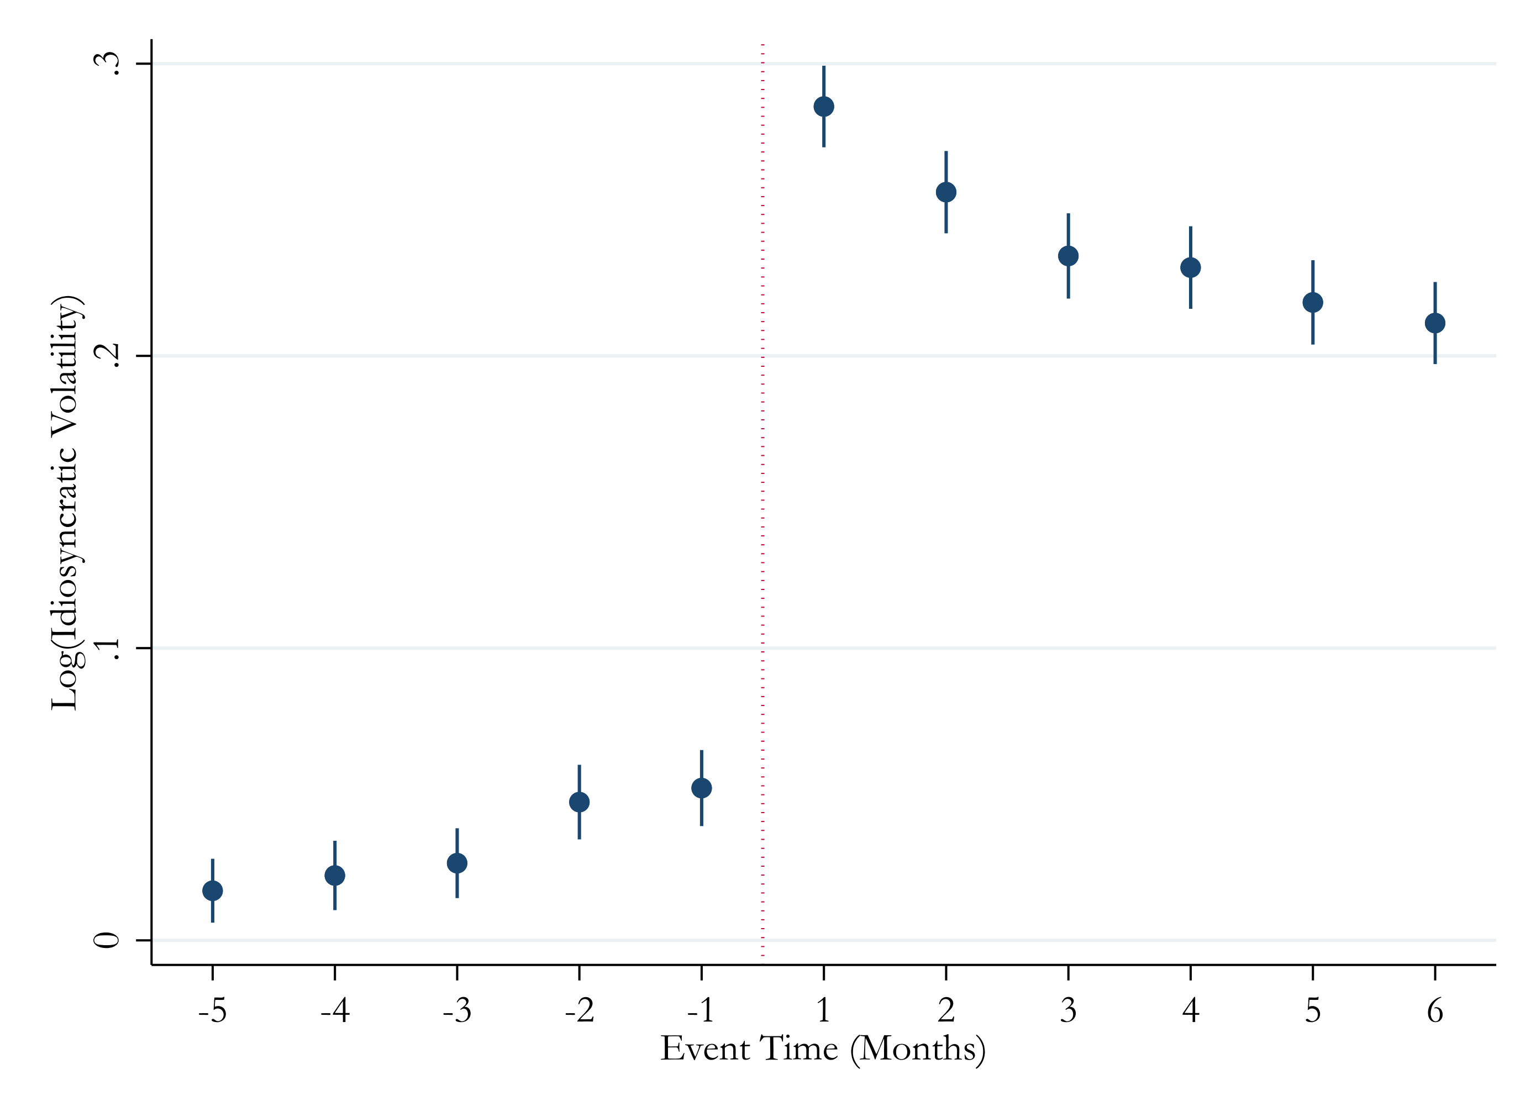
Splits (idiosyncratic volatility)

