Slide 1
2018 RSF Behavioral Summer Camp:
Behavioral Development Economics
Gautam Rao, Harvard University
(with Michael Kremer, Harvard
For Handbook of Behavioral Economics, Vol 2)
July 3, 2018
Notes:
This is joint work with Gautam Rao, we’re preparing a handbook chapter, would love feedback

Slide 2
A history of views of human behavior (implicit) in development economics
Modernization theory tradition in social science, prominent in 1950s
  Tradition vs. rationalism (Weber), fatalism vs. agency
  Sees traditional society as not capitalist – feudal or peasant
  Role of state was to force savings, education, secularism (e.g. Ataturk, Soviets), urbanization, villagization (Tanzania)
Much of development economics was a movement against this view: “Poor but efficient” (Schultz 1964)
But this view may have gone too far. Pendulum has swung again:
  Development has embraced some ideas from psych & econ
    With a certain level of sloppiness
  Almost always using field and lab-in-the-field experiments
  Policy influence, e.g. World Development Report 2015: “Mind, Society and Behavior”

Slide 3
Outline
  Part 1: Behavioral perspectives on some issues from development economics
  High rates of return without rapid growth; Euler equation puzzle
  Health behavior
  Technology adoption
  Insurance
  Trust, cooperation and culture
  Part 2: What’s special about behavioral economics in poor economies?
  Size distribution of firms; behavioral firms
  Psychology of poverty

Slide 4
Outline
  Part 1: Behavioral perspectives on some issues from development economics
  High rates of return without rapid growth; Euler equation puzzle
  Health behavior
  Technology adoption
  Insurance
  Trust, cooperation and culture
  Part 2: What’s special about behavioral economics in poor economies?
  Size distribution of firms; behavioral firms
  Psychology of poverty

Slide 5
Returns to Capital and Lack of Growth
Puzzle:
High returns to capital in many contexts (Banerjee and Duflo, 2005)
High marginal returns to fertilizer (Duflo et al. 2008)
Grants to small businesses (deMel et al., 2008)
High returns to inventories (Kremer, Lee, Robinson, Rostapshova, 2013)
Predictable increases in prices between seasons (Bergquist et al., 2014)
Borrowing at very high rates
70 - 100% annual rates and more
Small-time fruit vendors in Chennai who borrow at daily rates of 5% ≈ 54,000,000 % annual interest (Karlan, Mullainathan and Roth, 2018)
Low take-up of apparently high expected return investments
Notes:
Karlan and Mullainathan (2011) randomized paying off the loans of fruit vendors in Chennai. These vendors generally managed to stay out of debt for several weeks, but then fell back into debt, generally after a health shock or unexpected expense. Once that happened, they failed to pay off their debt on their own.

Slide 6
Euler equation implies counterfactually rapid growth rates, even in absence of any capital market
Suppose production function F(K) where F'' ≤ 0
u' (c_{t} )= δ F' (K_{t} ) u' (c_{t + 1} )
If log utility, F' (K ) = 50% annually, and δ = 4%, then ċ/c = 46%
Need high “tax” or discount rate to resolve puzzle
Credit constraints? Suggests transformative effects of credit
Seems counterfactual: limited uptake, limited transformation
(Banerjee, Karlan, and Zinman, 2015)

Slide 7

Stochastic income and risk aversion?
Maybe people don’t invest because investments are risky? e.g. fertilizer
Suppose income in period t is:
where n assets/capital goods, arbitrary pattern of correlation.
Stochastic Euler equations:
u' (c_{t} )= δE_{t} [ μ_{i,t} F_{i}' (K_{i,t} ) u' (c_{t + 1} )], i=1, 2 ,..., n
Notes:
Note:
-this allows for arbitrary correlation between the μ s and the ε s
-F function gives the value of the output in the next period including any remaining value of the capital.

Slide 8
Stochastic income and risk aversion?
Given initial capital stock, risk aversion will
Reduce investment in assets which covary positively with consumption
But standard theory predicts agents will save up buffer stocks (Deaton 1991; Carroll 1997). Then, consumption should not move with:
high-frequency income shocks
predictable income changes (e.g. seasons)
Returns to fertilizer only modestly correlated with lifetime income
Beta of fertilizer investment will be modest, and risk aversion will only modestly reduce fertilizer investment

Slide 9
Standard model seems counterfactual
In fact,
Liquid buffer stocks are often modest,
Consumption covaries with income, including predictable income
Karlan et al. (2014) find that rainfall insurance increases fertilizer use
All these predictions can emerge if agents are present biased
With either deterministic or stochastic Euler equation, matching the data requires a high effective discount rate
Notes:
(Insurance could also increase fertilizer use if loss averse and bracket together fertilizer use and insurance.)
The gap between F’(K) and delta could also be narrowed if there is a very high tax on the return on capital. Taxation by family members, etc.

Slide 10
Present biased consumers will…
(Laibson 1997; Angeletos et al., 2001)
Rapidly spend down liquid assets, becoming effectively liquidity constrained
Build up (or hold) a stock of illiquid assets that pay off in distant future
Leave high rate of return investments on the table, if effectively liquidity constrained
Not be able to smooth consumption; consumption will co-move with income shocks, even with predictable income variation
Procrastination
Demand for commitment (if sophisticated)
Notes:
Bangladesh

Slide 11
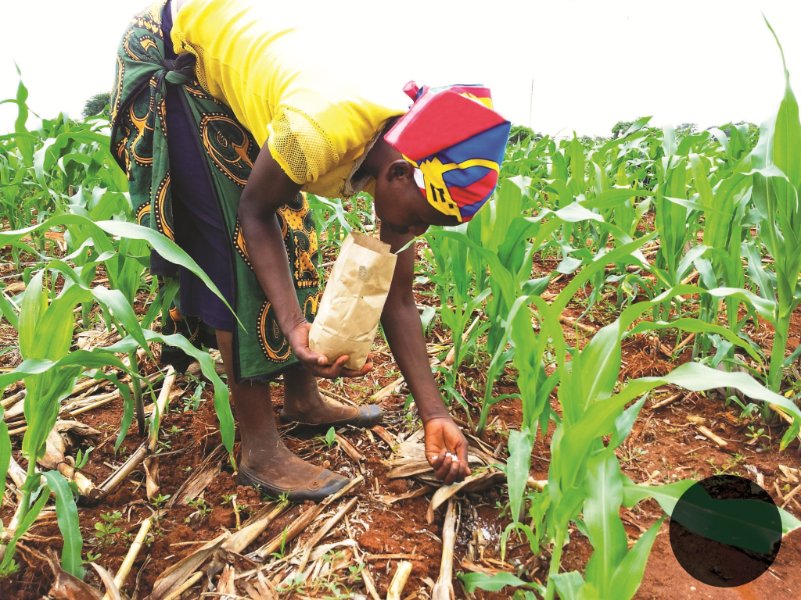
Duflo, Kremer and Robinson
(2011 AER)
Fertilizer use in Kenya
  Previous work experimentally establishes high
  returns to use, but low usage rates
  Not a lumpy investment
Usual solution: price subsidies by government
  Expensive! E.g. India spends 0.5% of gdp on fertilizer subsidies
DKR 2011: Offer purchase in advance: Tiny discount + Deadline
  After harvest, when farmers cash rich
  25% increase in fertilizer use (Duflo Kremer Robinson 2011)
  Substantially larger than effect of a 50% price discount
  Calibrate model of stochastic present bias with naivete

Slide 12
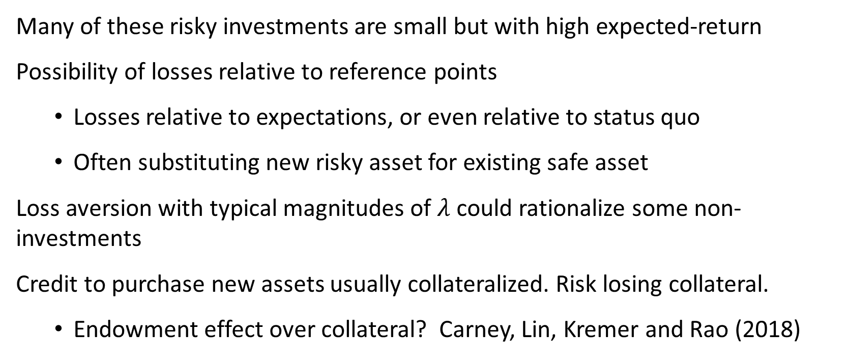
Loss aversion and non-adoption
Many of these risky investments are small but with high expected-return
Possibility of losses relative to reference points
  Losses relative to expectations, or even relative to status quo
  Often substituting new risky asset for existing safe asset
Loss aversion with typical magnitudes of $λ$ could rationalize some non-investments
Credit to purchase new assets usually collateralized. Risk losing collateral.
  Endowment effect over collateral? Carney, Lin, Kremer and Rao (2018)

Slide 13
Carney, Lin, Kremer and Rao (2018)
Idea:
  Endowment effect: drive down demand for loan
  Projection Bias: Endowment effect stronger if collateral is already-owned asset vs. the new asset being purchased (as in mortgage or car loan)
Field experiment with dairy farmers in Kenya
  Randomly endow participants with one of two assets
  Offer loan to finance purchase of other asset
  Vary whether collateral is endowed asset or new asset
Substantial preference (8% per month) for collateralizing using new asset being purchased.
Misprediction of future loan take-up and future WTA

Slide 14
Behavioral perspectives on some issues in development economics
  High rates of return without rapid growth; Euler equation puzzle
  Health behavior
  Technology adoption
  Insurance
  Trust, cooperation and culture
  Size distribution of firms; behavioral firms

Slide 15
Health behavior
Two empirical regularities from development health literature:
Apparent under-adoption of cost-effective preventive health and treatment for chronic conditions (e.g. vaccinations, deworming, bednets, water treatment, hypertension).
High price-sensitivity: Deworming medication (Kremer and Miguel, 2007); mosquito nets (Cohen and Dupas, 2010); water treatment (Ashraf, Berry, and Shapiro, 2010).
Implied value of life from standard revealed preference methods is very low
Lack of information does not seem to explain under-adoption.
Notes:
Glennerster and Kremer (2012) argue that behavioral factors play a large role in health decisions. Dupas and Miguel (2016) more cautious
It’s clear that liquidity constraints play a role but it seems like that those arise endogenously due at least in part to present-biased preferences.

Slide 16
Likely Importance of Present Bias
Channels:
Procrastination: hassle and psychic costs of going to doctor, walking to farther-away water source, using chlorine solution, changing diet, learning painful news about health status, taking medication
Liquidity constraints
Consistent with:
Large effect of time-limited incentives: e.g. Banerjee et al., Duflo et al.
Large effect of reducing hassle costs: e.g. water dispensers
Evidence on effects of increased liquidity (Dupas and Robinson, 2013)
Discounted fertilizer offer soon after harvest (Duflo et al. 2011)
Mostly indirect evidence for present bias, rather than theory-based tests
Notes:
Without severe liquidity constraints, upfront monetary costs would not themselves generate procrastination. Instead, it is utility costs that matter.
The naivete required for present bias is usually thought of as overconfidence about future self control. But sometimes it could also be overconfidence about future availability of time, or even overconfidence about not forgetting in the future.

Slide 17
Commitment devices
Lots of studies of commitment in development economics
(Ashraf et al., 2006; Gine et al., 2010; Duflo et al., 2011; Schilbach, 2017, etc.)
But commitment contracts only work well with high degree of sophistication
Naivete → low demand for commitment
Partial naivete → systematic failure of commitment, with plausibly negative effects on welfare if people incur the costs without the intended benefit (John 2017; Bai et al., 2017)
Uncertainty also implies low demand for commitment (Laibson, 2015; Amador, Werning, and Angeletos, 2006)
More promising approach may be to reduce hassle costs, provide direct time-limited incentives, ease liquidity constraints
Notes:
Ashraf, Karlan, and Yin (Tying Odysseus to the Mast): 28% takeup of a commitment savings device in the Philippines; women who exhibited more present bias in hypothetical time preference questions were more likely to take up the contract. This suggests some sophistication. The commitment offer increased savings by 81 percentage points.
Xiné, Karlan, and Zinman: 11% takeup among smokers of a commitment device (CARES) that allowed smokers to deposit money for six months, after which they would take a urine test for nicotine and cotinine. Failing the test forfeited the money. ITT: 3 percentage point increase in passing this test.
Duflo, Kremer, and Robinson: Small, time-limited discounts help present biased farmers commit to using fertilizer in the future.
Schilbach: Striking result: More than a third of subjects preferred incentives for sobriety to unconditional payments, even when the unconditional payments were strictly higher than the maximum amount they could earn with the incentives.
Bai et al. (paper by Gautam, Ted, Ben Handel and Liang Bai): Hypertension patients in rural India. Moderate take-up of commitment, where individuals will put money on the line. But poor follow-through. Offering commitment makes consumers worse off on average, consistent with partial naivete.

Slide 18
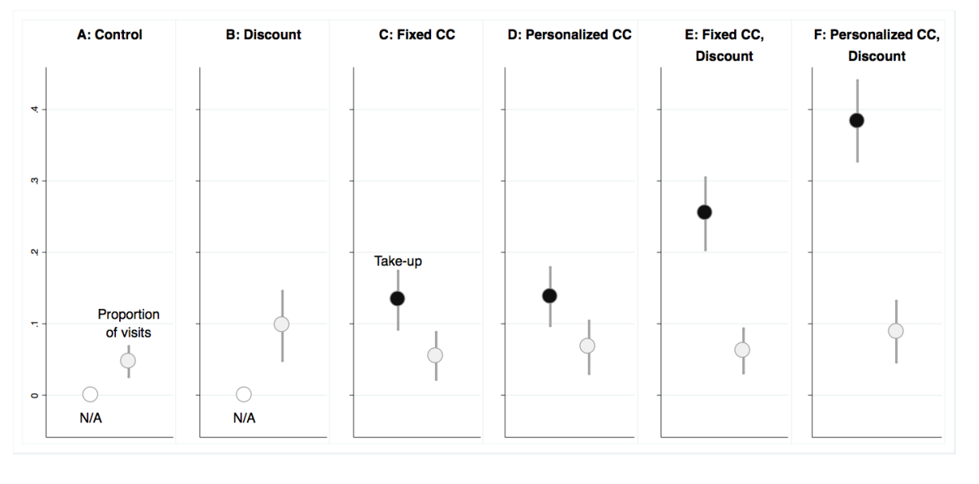
Bai, Handel, Miguel and Rao (2017)
Hypertension patients in India
Test a number of pre-payment style commitment contracts
Take-up of contracts 15-40%, but very high rates of failure to follow through
Evidence of partial naivete

Slide 19
Schilbach (2018 AER)
Experiment with rickshaw-drivers in Chennai
High rates of baseline daytime alcohol consumption (5+ drinks per day)
Randomizes:
  Incentives for daytime sobriety
  Costly commitment (choose between unconditional and strictly dominated conditional payment)
  Commitment savings devices
Findings:
  Incentives reduce daytime drinking (but not overall drinking)
  40-60% choose conditional payments
  Savings increase as a result of incentives for sobriety (not income effect)
  Savings and sobriety commitment devices are substitutes for increasing savings

Slide 20
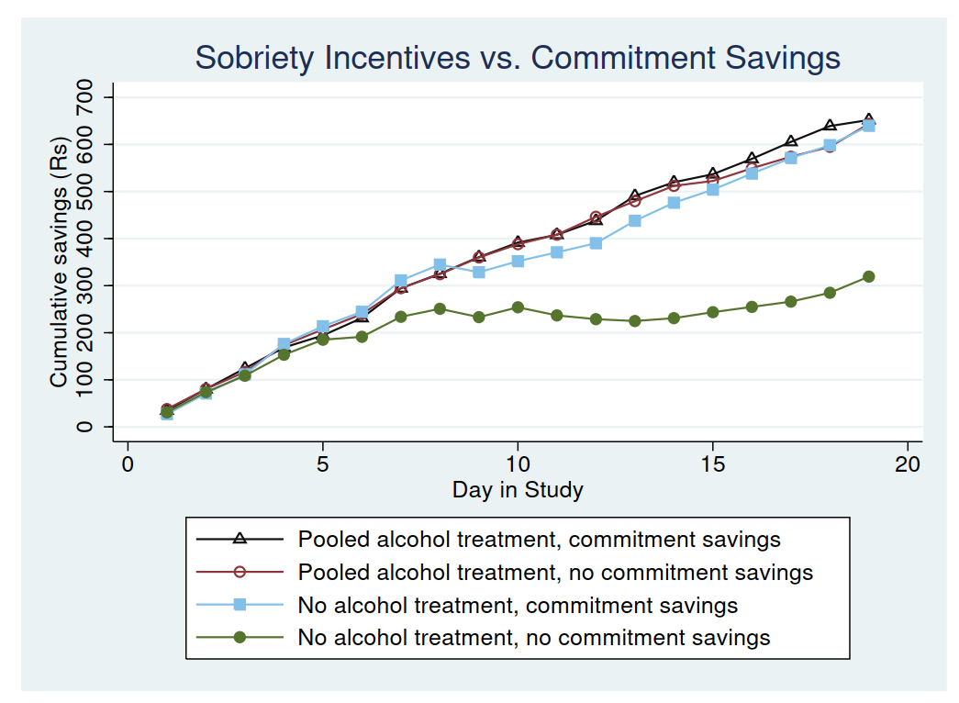
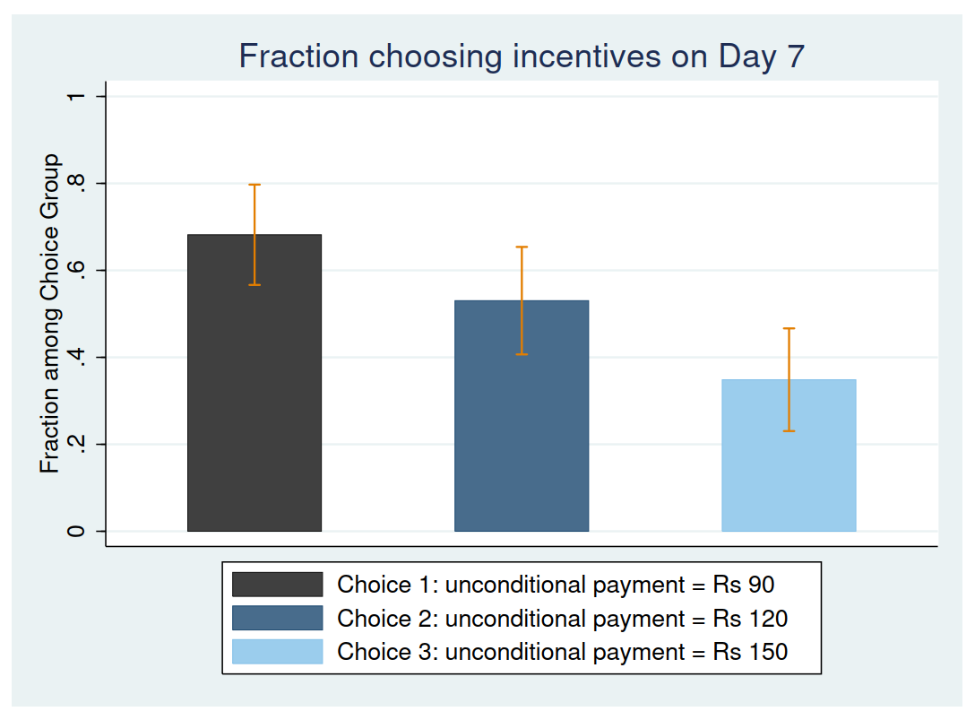
Schilbach (2017)
Demand for commitment

Slide 21
Attention
Inattention to health can have large costs.
Many reminder interventions in health. Effects mixed.
(Pop-Eleches et al., 2011; Raifman, et al., 2014; Lester et al., 2010).
Potential negative externalities if attention is a limited resource.
Ask if people want reminders?
Little understanding of long-term effectiveness or of optimal frequency and design of reminders.
Little understanding of underlying theory
Notes:
Pop-Eleches et al. and Lester et al. show that SMS reminders can increase adherence to antiretroviral therapy. Raifman, et al., show that text message reminders can increase adherence to antimalarial treatment.
Reminders: cognitive bandwidth literature (Mullainathan and Shafir, 2013; Schilbach, Schofield, and Mullainathan, 2016) suggests that there may be negative externalities to text message reminders. May be useful to ask people whether they want reminders to avoid overload.

Slide 22
Behavioral perspectives on some issues in development economics
  High rates of return without rapid growth; Euler equation puzzle
  Health behavior
  Technology adoption
  Insurance
  Trust, cooperation and culture
  Size distribution of firms; behavioral firms

Slide 23
Technology Adoption
Various examples with apparently non-optimal technology choice:
Pineapple farming in Ghana, HYV seeds, seaweed pod size, fertilizer, contraceptives, soccer ball manufacturing techniques, layout of equipment in textile factories
Do external analysts correctly understand payoffs?
Do decision makers have information?
Notes:
(Foster and Rosenzweig, 2010).

Slide 24
Technology adoption: attention and complexity
Inattention and wrong mental models (Hanna et al. 2014)
Production function is complex and attention is costly
Individuals will pay attention to the dimensions they think are important
If start off thinking something is not important (wrong mental model), will not pay attention and will never learn
Even with infinite data available
Complexity of information
Provision of simplified information about seaweed pod size (Hanna et al. 2014), water safety (Bennear et al., 2011) or business practices (Drexler et al., 2011) may be more effective than providing full information
Notes:
Hanna et al. 2014: Experienced seaweed farmers in Indonesia do not attend to pod size when planting seaweed. In the baseline, they cannot report the size they use or the optimal size. This is even though their existing plots provide plenty of unintentional experiments: variation in initial pod size which affects final size and profits. The theory is that they do not think pod size is important, so they do not pay attention to it, so they never learn even though in principle have all the data they need.
When they are presented with the data in full detail, they still do not change their behaviors. But when they are presented with simple summary results of the trial on their plot, they do change behavior.
LAST POINT IS A CHALLENGE FOR US. RATES OF RETURN TO EDUCATION?

Slide 25
Behavioral Social Learning
Rational social learning will often lead society to right long-run choice if some can get past initial experimentation costs
Imitating common sources without accounting for redundancy in the signals received can create confident and incorrect beliefs (Eyster and Rabin, 2014).
People may overweight the beliefs and actions of others.
Empirical evidence of naïve, non-Bayesian updating, e.g. Enke and Zimmerman, (2017); Chandrasekhar, Larreguy, and Xandri (2016)
Notes:
Foster and Rosenzweig (1995) suggests rapidly adopt green revolution technology
but this was a very beneficial technology
Banerjee (1992): Herding would not go through if each person’s choice was a sufficient statistic for their information.

Slide 26
Redundancy neglect
  This may create information traps, making it hard to encourage adoption of technologies that go against conventional wisdom.
  Limited field evidence on how non-Bayesian social learning influences technology adoption. Ripe for exploration.

Slide 27
Behavioral Social Learning
Social image/preferences
The degree of communication between people may be endogenous—giving and soliciting information is a decision.
People may be hesitant to ask for or provide information when doing so signals their ability (Chandrasekhar, Golub, and Yang, 2017; Banerjee, Breza, Chandrasekhar, and Golub, 2017).
Implies seeding info more broadly can reduce learning
People may not be willing to provide information to others for free if they paid for it or put in effort to get it (Fabregas, 2017)

Slide 28
Behavioral perspectives on some issues in development economics
  High rates of return without rapid growth; Euler equation puzzle
  Health behavior
  Technology adoption
  Insurance
  Trust, cooperation and culture
  Size distribution of firms; behavioral firms

Slide 29
Low take-up of insurance
Risk-sharing is a major topic in development economics
Large literature on informal risk sharing
Literature on how risk considerations affect crop choice, migration choice, marriage….
Many people in developing countries exposed to very risky income streams (e.g. farming)
Yet low take up of actuarially fair weather insurance (Cole et al., 2012)
Basis risk? (Mobarak & Rosenzweig 2012 , Gine et al. 2008)
Low take-up of health insurance (Thornton et al., 2010)
Notes:
Little social insurance provided by the government
Under most plausible utility functions, sharply diminishing marginal utility of income at very low consumption levels, so particularly strong need for insurance.
Thornton et al. (2010): Nicaragua - voluntary health insurance scheme made available to informal workers through MFIs. Initial take up only 20%. Less than 10% of initial vendors still enrolled after one year.

Slide 30
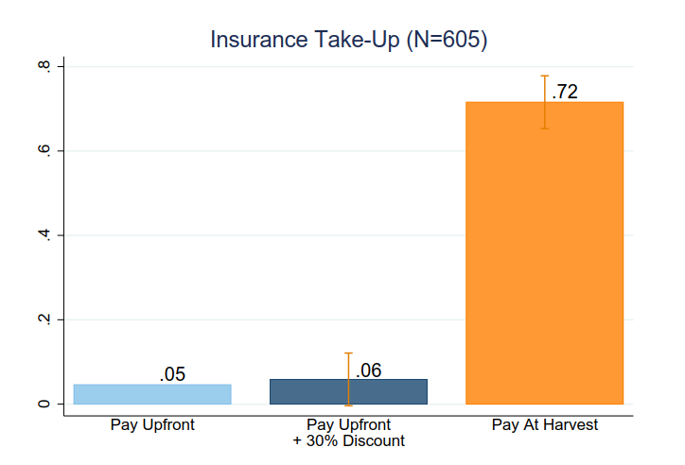
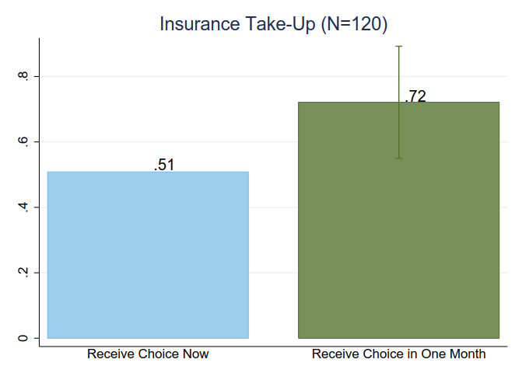
Potential Explanations: Casaburi and Willis
Casaburi and Willis (2017) intertemporal exchange part of most actual insurance contracts; eliminating this increases insurance take up dramatically
Important role for liquidity constraints, present bias
Notes:
Casaburi and Willis (2017): Takeup of insurance where the premium is deducted at harvest time is 72%, compared to 5% for the standard contract with upfront payment of the premium. They argue that this is present bias for two reasons: (1) when people were given cash to cover the premium, finding that this did not substantially increase take up of the up front contract (suggesting that there’s more to their result than just liquidity constraints), and (2) takeup of insurance where the premium delayed by a short amount of time (one month) was also high (21 percentage point above the standard contract). This effect size cannot be rationalized by standard exponential discounting, suggesting present bias.
Ambiguity aversion:
-Note: Here, “ambiguity” refers to the ambiguity in the insurance contracts (e.g. unknown basis risk) rather than the items being insured. (The demand for insurance would increase if the item being insured has higher ambiguity.)
-Biener et al. 2017: They conducted a behavioral experiment with rural villagers from the Philippines, focusing on the role of contract nonperformance
risk and its ambiguity for insurance demand. They find that a 10 percent contract nonperformance risk reduces insurance demand by 17.1 percentage points even when premiums are adjusted accordingly. Ambiguity about this contract nonperformance probability further decreases demand by 14.5 percentage
points.
Loss aversion:
reference points are important in determining the relationship between loss aversion and insurance demand:
-If a prospect theory individual uses initial wealth as his reference point, under certain condition, he would demand less insurance than a non-prospect-theory agent
-If a prospect theory individual uses initial wealth minus the premium as his reference point, he will demand a higher level of insurance than a non-prospect-theory individual

Slide 31
Insurance take-up: Potential explanations
Ambiguity aversion
Ambiguity in insurance contracts reduces demand; ambiguity aversion magnifies the effect
e.g. basis risk (Bryan 2013), nonperformance risk (Biener et al. 2017)
Could loss aversion / prospect theory play a role?
If premiums are seen as losses (Eckles & Wise 2011, Hwang 2016)
Diminishing sensitivity away from reference point leads to risk-seeking behavior in loss domain

Slide 32
Behavioral perspectives on some issues in development economics
  High rates of return without rapid growth; Euler equation puzzle
  Health behavior
  Technology adoption
  Insurance
  Trust, cooperation and culture
  Size distribution of firms; behavioral firms

Slide 33
Trust, Cooperation and Development
Trust and cooperation important for economic and political outcomes
e.g. Algan and Cahuk (2013) review
Developing countries have lower levels of trust and positive reciprocity
Falk et al (2017) using global survey
Is this a cause or consequence of development?

Slide 34
Trust, Cooperation and Development
Good reasons to think that variation in trust and reciprocity have deep historical roots
Enke (2017): historical tightness of kinship predicts modern-day in-group favoritism, willingness to cheat on and distrust outsiders, local rather than broader institutions.
Nunn and Wantchekon (2011) on long-term consequences of slave trade
Henrich et al. on how the evolution of fairness and punishment facilitated trust and cooperation, allowing for large-scale societies
  E.g., moralizing gods and cooperation with strangers
  Market integration and fairness; community size and punishment
But likely also in part a consequence of development, e.g. market exposure and well-functioning legal institutions might themselves increase trust
Notes:
Henrich (with different coauthors) has argued that the emergence of large-scale societies required the ability to cooperate with strangers in one-shot settings.
He argues that this was facilitated by cultural evolution which favored prosociality, norm adherence and the willingness to punish norm violations.
The emergence of moralizing gods, for instance, was a cultural tool which helped people cooperate with strangers. The evidence is hard to evaluate, since they try to explain tens of facts rather than through any one clear test.
Henrich et al (2010) show that market integration (measured as the percentage of purchased calories) positively covaries with fairness while community size positively covaries with punishment.

Slide 35
Shaping social preferences and norms
Important to understand policies which can improve intergroup behaviors
Rao (2015) on integration in schools
Blouin and Mukund (2017) on post-conflict Rwanda
Miguel (2004) on national identity in Tanzania
Role of policy and culture (Miguel and Gugerty, 2005)
And policies which can influence certain social norms
La Ferrara et al. (2002) and Jensen and Oster (2009): TV effects on fertility and gender attitudes
Bursztyn and Yanagizawa-Drott (2018) on female labor force participation in Saudi Arabia
Notes:
Gautam shows how integration of rich and poor children in schools reduces discrimination and increases willingness to socialize, generosity and inequity-aversion.
Blouin and Mukund show that govt radio in Rwanda changes how people categorize others. It makes them less likely to categorize others using ethnicity -- measured by how likely they are to misattribute a fact about Person A to being about Persons B or C, depending on the ethnicity match between the individuals. They also show some evidence that trust between Hutus and Tutsis increases due to the radio channel.
La Ferrara et al show that telenovelas in Brazil reduced fertility for the exposed cohorts in the exposed regions. Jensen and Oster show that cable TV changes stated gender attitudes.
Bursztyn and Yanagizawa-Drott are studying what whether male support for female labor force participation in Saudi Arabia can be changed by debiasing second-order beliefs. The idea is that men state in private that they do not mind their wives working, but believe that other men mind. Thus, they may try to keep their wives from working, fearing social disapproval. Once you inform them that “80% of men actually say they do not mind”, one might be able to rapidly change the social norm.

Slide 36
Moral attitudes across cultures
Psychology and behavioral econ has focused excessively on WEIRD -- Western, Educated, Industrialized, Rich, Democratic -- populations (Henrich et al. 2010)
Have conceptualized morality as being solely about harm and fairness
Haidt 2012: Outside of WEIRD population, much broader conception, including not just harm and fairness, but also deeply held belief in morality of:
Loyalty
Authority / respect
Purity and sanctity
Implications for economic and political behavior are ripe for exploration

Slide 37
Outline
  Part 1: Behavioral perspectives on some issues from development economics
  High rates of return without rapid growth; Euler equation puzzle
  Health behavior
  Technology adoption
  Insurance
  Trust, cooperation and culture
  Part 2: What’s special about behavioral economics in poor economies?
  Size distribution of firms; behavioral firms
  Psychology of poverty

Slide 38
Outline
  Part 1: Behavioral perspectives on some issues from development economics
  High rates of return without rapid growth; Euler equation puzzle
  Health behavior
  Technology adoption
  Insurance
  Trust, cooperation and culture
  Part 2: What’s special about behavioral economics in poor economies?
  Size distribution of firms; behavioral firms
  Psychology of poverty

Slide 39
Behavioral firms in the informal economy
Chicago critique of behavioral economics: Even if only 5% do not have behavioral biases, they are the ones who will become the CEOs of Walmart etc…
Distortions in developing countries prevent efficient firms from growing and displacing less efficient ones
People in developing countries are not just behavioral consumers, they are behavioral firms. Or at least behavioral managers.
Most poor people in developing countries operate a “firm”
  Most rural poor operate a farm.
  Many additionally run a non-agricultural business
  About 50% of the urban poor run a business (Banerjee and Duflo 2007)
  Comparison: 12% self-employed in OECD

Slide 40
Labor in poor countries
Self-employment is high
Wage labor is usually casual, in short spells, w/ low predictability
Regular employment may be costly:
Loss of flexibility in scheduling, loss of autonomy
Low hours in many contexts
High teacher absence not only in public schools, but also private schools
Evidence that people move in and out of the formal sector
Blattman and Dercon (2017) randomly assign industrial jobs in Ethiopia, finding that workers quickly quit and move to different sectors.
Wage premia for many formal jobs. Strategic complementarities in regular employment?
Notes:
Regular employment is costly relative to self employment, but not relative to feudal subservience, and plenty of people are in semi feudal subservience as maids, security guards, etc.
But maybe people who are able and educated want to get out of feudal subservience and into self employment, or at least don't want to work for someone of similar or lower status.
Banerjee, Galiani, Levinsohn, McLaren, and Woolard (2007): Discusses rising unemployment in South Africa. Mentions that the pattern of transition from informal to formal sector jobs does not hold: an equal proportion transition from informal sector to unemployed and searching as transition into the formal sector.
Blattman and Dercon (2017): Tradeoff: volatile and risky self employment vs. poor working conditions of industrial jobs. People who were offered industrial jobs accepted but left quickly, using them as an income source while looking for other work. Workers seemed to understand the risks, but found the industrial jobs unpleasant. When the barriers to entry were alleviated, people preferred entrepreneurial work to industrial work.
Mas and Pallais (2017) show that most workers in the U.S. do NOT value flexible scheduling, and that most people want to work 40 hours per week. People are particularly averse to jobs with employer discretion in scheduling, and are willing to take a (on average) 20% pay cut to avoid this arrangement.

Slide 41
Factory discipline as commitment device
Clark (1994) argues workers want factory discipline as a commitment device
Much rosier view
Kaur, Kremer, Mullainathan (2015)
Find many data entry workers choose dominated commitment contract over piece rate contract
However, also find substantial heterogeneity
With asymmetric information, firms may screen out undesirable workers with factory discipline or steep incentives, reducing overall welfare

Slide 42
Weak political and market institutions imply difficult decision environments
Weak governments result in absence of quality assurance, consumer protection
Implies choice sets include more bad options than in rich countries
  Does this “doctor” have any medical training?
  Should I treat my water to make sure it is safe?
With poorly set defaults
  e.g. no social security withholding, no chosen-by-employer health plan
Lacking the commitment and perhaps social norms provided by (say) a formal employer
In information poor environments with few debiasing efforts
  (Likely rational) lack of trust in many sources of information, including governments.
  Missing markets for experts

Slide 43
Outline
  Part 1: Behavioral perspectives on some issues from development economics
  High rates of return without rapid growth; Euler equation puzzle
  Health behavior
  Technology adoption
  Insurance
  Trust, cooperation and culture
  Part 2: What’s special about behavioral economics in poor economies?
  Size distribution of firms; behavioral firms
  Psychology of poverty

Slide 44
Psychological poverty traps?
(Seemingly) sub-optimal behaviors among the poor
Why?
  Structural conditions
  Selection / omitted variables (e.g. education)
  Treatment effect of poverty
A `psychological poverty trap’?
  Poverty impedes cognition, decision-making, and productivity
  his in turn affects future poverty

Slide 45
Four approaches
Scarcity (Mullainathan and Shafir 2013)
  Poverty impedes cognitive function
Stress: Haushofer et al.
  Poverty causes stress
Sleep deprivation, pain, hunger, alcohol
  The poor are more likely to be tired, in pain etc.
Mental health: depression, lack of hope, low aspirations

Slide 46
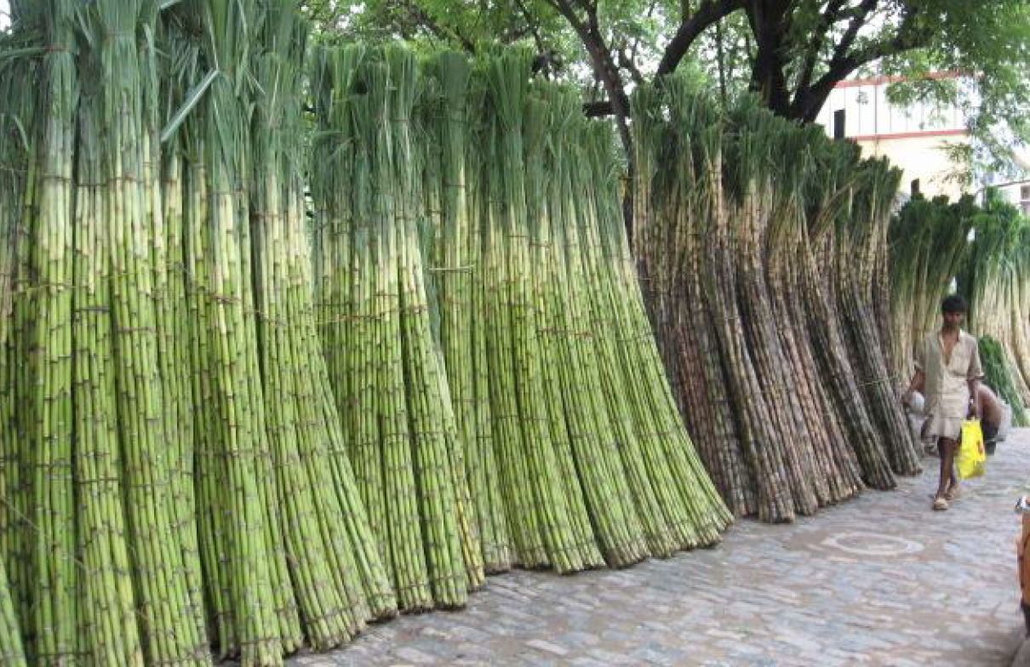
Mani et al. (2013): Scarcity
Before Harvest: Cash Poor
After Harvest: Cash rich

Slide 47
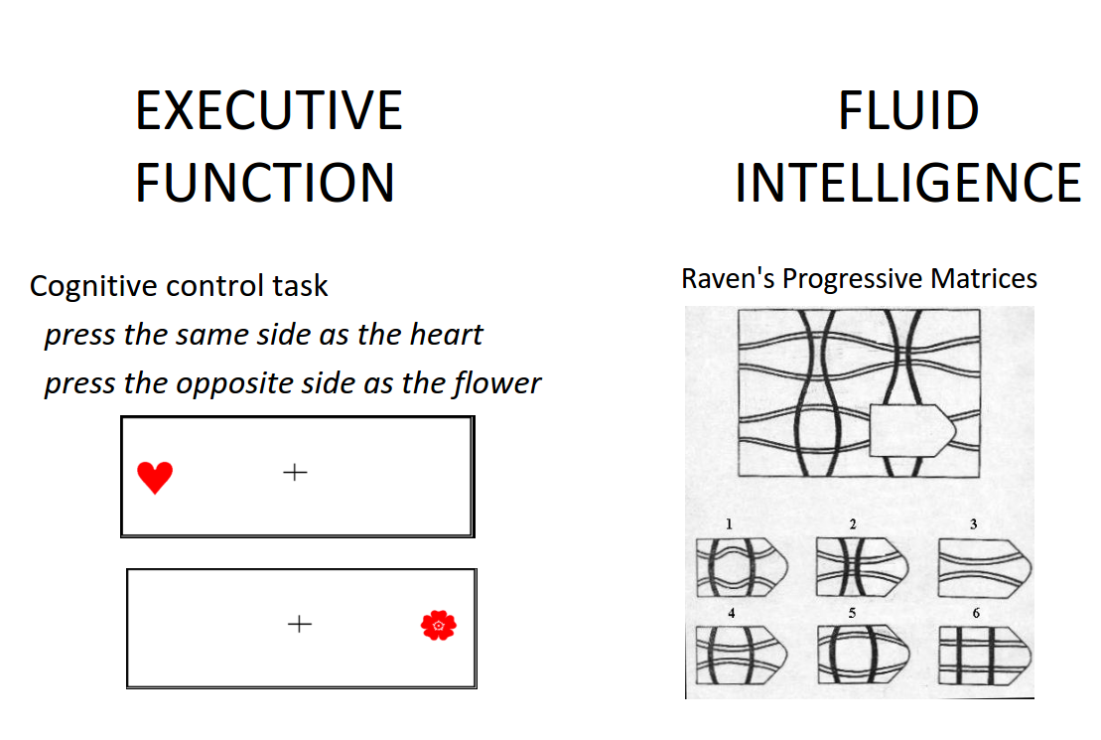
Conduct these tests before vs. after harvest

Slide 48
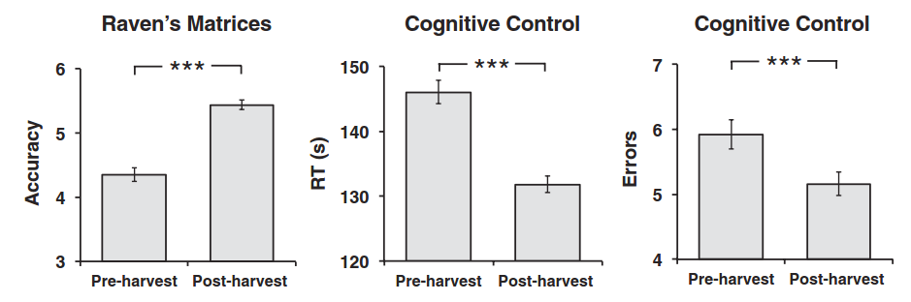
Worse cognitive function when cash-poor
Post-harvest vs. Pre-harvest: 1 standard deviation increase in “IQ”
(Mani et al. 2013)

Slide 49
Comparing rich and poor individuals
In a New Jersey mall, shoppers asked to think about the following scenario
“Your car is having some trouble and requires $X to be fixed. You can pay in full, take a loan, or take a chance and forego the service at the moment... How would you go about making this decision?”
Two conditions: Easy (X small = $150) and Hard (X big = $1500).

Slide 50
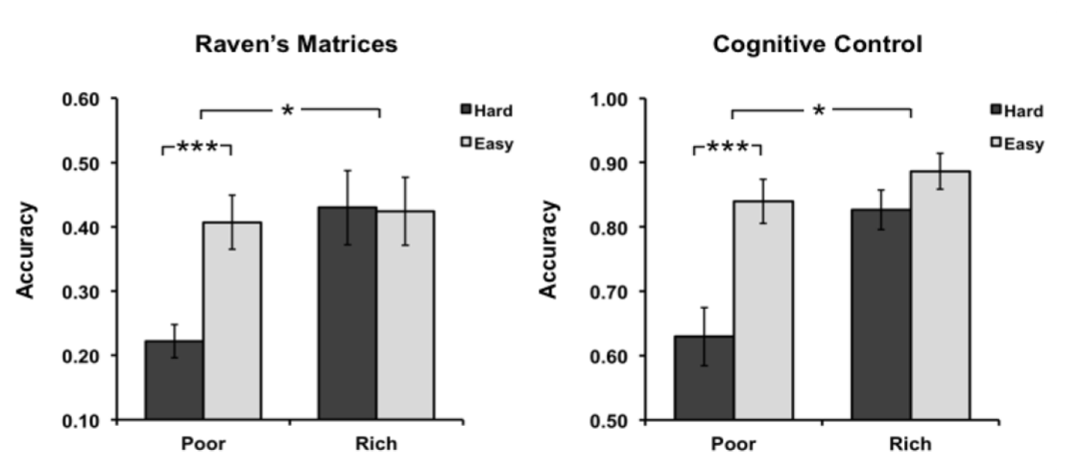
Thinking about difficult financial tradeoff hurts the cognitive function of the poor, but not the rich
No difference when not faced with tough financial tradeoff
(Mani et al. 2013)

Slide 51
Other recent work on psychology of poverty
Dean (2017): Noise pollution reduces cognitive function and productivity
Schofield (2014): Increased calorie consumption increases productivity, inter-temporal choice (work now vs. later), some aspects of cognitive function
Group-based Cognitive Behavioral Therapy trying to foster self-regulation and prosocial values reduced self-reported impulsivity and reward responsiveness, criminal and violent behavior in at-risk Liberian men, especially when coupled with cash transfers (Blattman et al. 2015)
Ongoing work: effects of sleep deprivation, depression, pain, noise pollution
So far most “psychology of poverty” evidence is on effects on basic cognitive function. Need more evidence on actual economic outcomes

Slide 52
Opportunistic behavioral economics
Empirical behavioral economics relies heavily on running experiments
Experiments in developing countries are inexpensive
  Large-scale and large-stake experiments possible
  Can do things like set up firms, hire subjects as full-time “employees” over long periods (Kaur et al. 2015; Breza et al. 2016; Rao et al. 2016)
Development has embraced both field and lab experiments (Cameron et al. 2016; Imas and Gneezy, 2016)
Infrastructure for running experiments: JPAL, IPA, Busara, experienced staff, streamlined recruitment and training of staff and subjects, etc.
Caveat: Depending on setting, literacy and numeracy can be issues

