Slide 1
Nudging in Practice: Retirement Saving and Health Insurance
Richard H. Thaler
Booth School of Business
University of Chicago

Slide 2
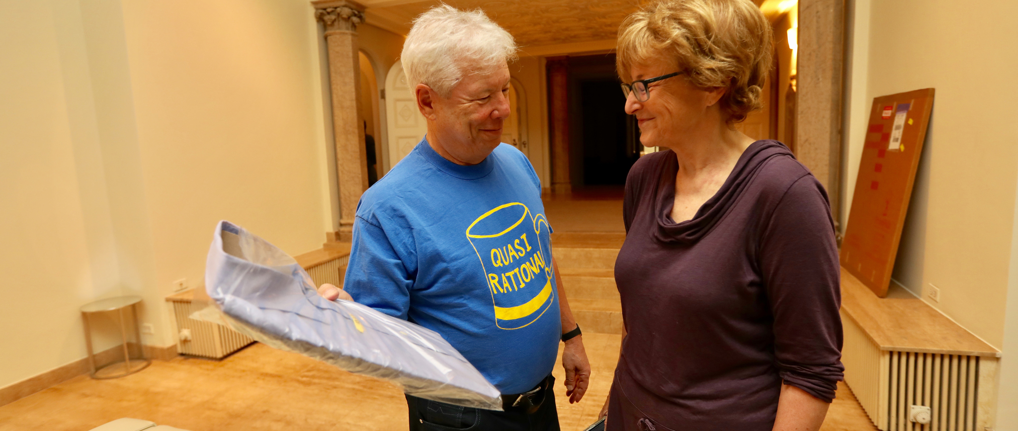
What to wear after a 4:00am wake up call from Sweden

Slide 3
When Nudges are Forever:
Inertia in the Swedish Premium Pension Plan
Henrik Cronqvist
University of Miami School of Business Administration
Richard H. Thaler
University of Chicago Booth School of Business
Frank Yu
China Europe International Business School

Slide 4
Background
Sweden has a 16% payroll tax to fund its Social Security Program.
In 2000 it introduced a new Premium Pension Plan which diverted 2.5% of the payroll tax into individual accounts. (Similar to a proposal by George W. Bush in 2005.)
Any fund that had the correct E.U. regulatory approval and applied to be included in the program was accepted. This led to 450 options when the program started.

Slide 5

What is “Choice Architecture”?
Nudge (2008) Thaler & Sunstein
A choice architect creates the environment in which people make decisions:
  Menus
  Web sites (e.g. Amazon, Expedia, etc.)
Research shows that choice architecture has strong effects.
  For example, automatic enrollment achieves 90%+ enrollment in pension plans.
But how long do nudges last?
Our study of the Premium Pension Plan shows that in some environments the effects of choice architecture can be large and long-lasting.

Slide 6
The Battle of the Nudges
Nudge #1. In the 2000 launch, a default fund was selected (AP7) for anyone not wishing to make a choice or for those who did not actively choose. We will call those who take the default fund Delegators.
Nudge #2. The government encouraged citizens to form a portfolio themselves. We will call these people Do-It-Yourselfers (DIYers).
Both the government and private funds advertised widely. The government urging people to actively choose, the funds to choose their fund.
The ads from individual funds were primarily uninformative.

Slide 7

Harrison Ford Offers Investment Advice

Slide 8
Which Nudge Won?
The Do-It-Yourself Nudge won: Two-thirds (66.6%) of citizens chose to form their own portfolios.
In subsequent years, as new people joined the system (mainly younger people + immigrants), an increasing proportion chose the default fund.

Slide 9
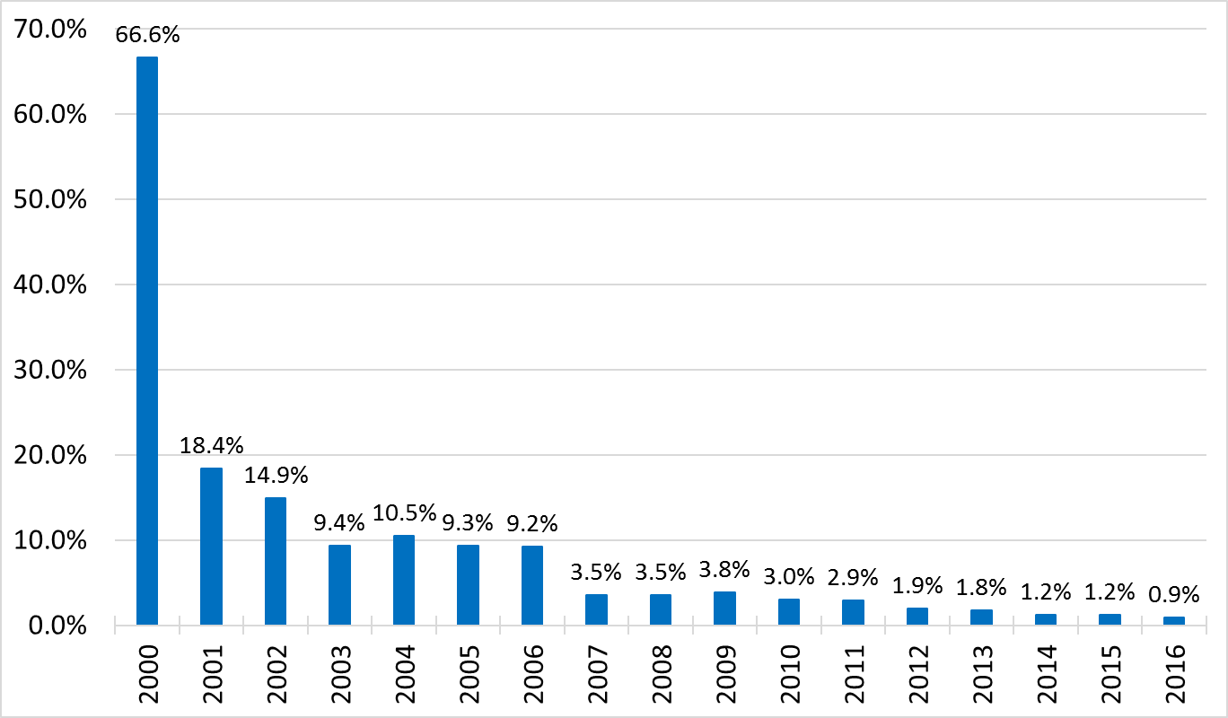
Investor Behavior: Initial Choices
Two-thirds of those who joined in 2000 picked their own portfolios.
But in recent years, almost no one is electing to be DIYer.

Slide 10
Do Investors Change their Minds?
Initial DIYers were not allowed to switch to the default fund until 2009.
Even after that, only 3% move.

Slide 11
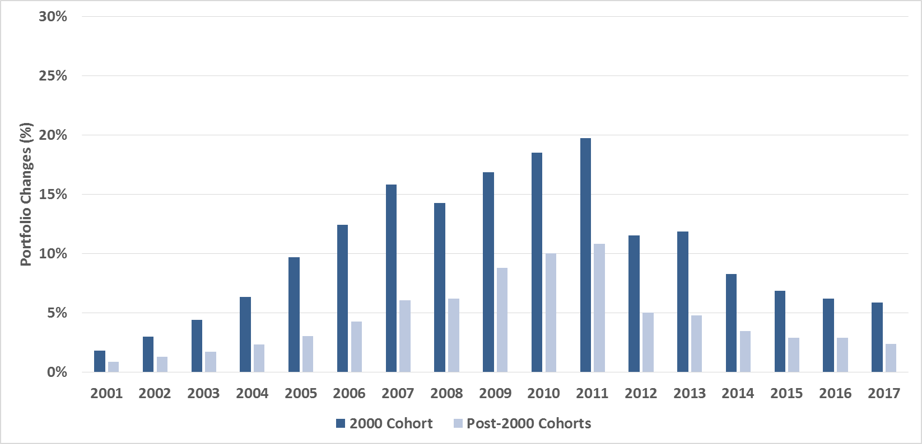
DIYers are Not Very Active
Initially the DIYers were more active but in both cohorts more than 80% make ZERO trades in a year

Slide 12
Extreme Inertia
There is nothing wrong with inertia in retirement savings plans, per se. But can anything cause people to make changes?
Leveraging the Default Fund.
Alleged Fraud in a Fund Company.

Slide 13
Features of Current AP7 Default Fund
Global diversification.
Indexed to avoid various political pressures. Correlation of holdings with MSCI-ACWI index: 0.99
Low fees.
Target date structure (i.e., equity exposure falls with age).
Leverage permitted up to 50% at the discretion of AP7, but the fund has chosen only 25% since 2015.

Slide 14
Leverage
To implement the 50% leverage the fund borrows money (at a very low rate—essentially zero) and uses that money to buy options on the index.
The key fact: with 50% leverage if the market goes up 10% your return will be 15%, and if the market falls by 10% your return will be minus 15%.
Question: what will investors do when the default fund becomes so much riskier?
Note: a fund that was essentially identical to the default fund (r=.99) without the leverage was available as an option for similar fees.

Slide 15
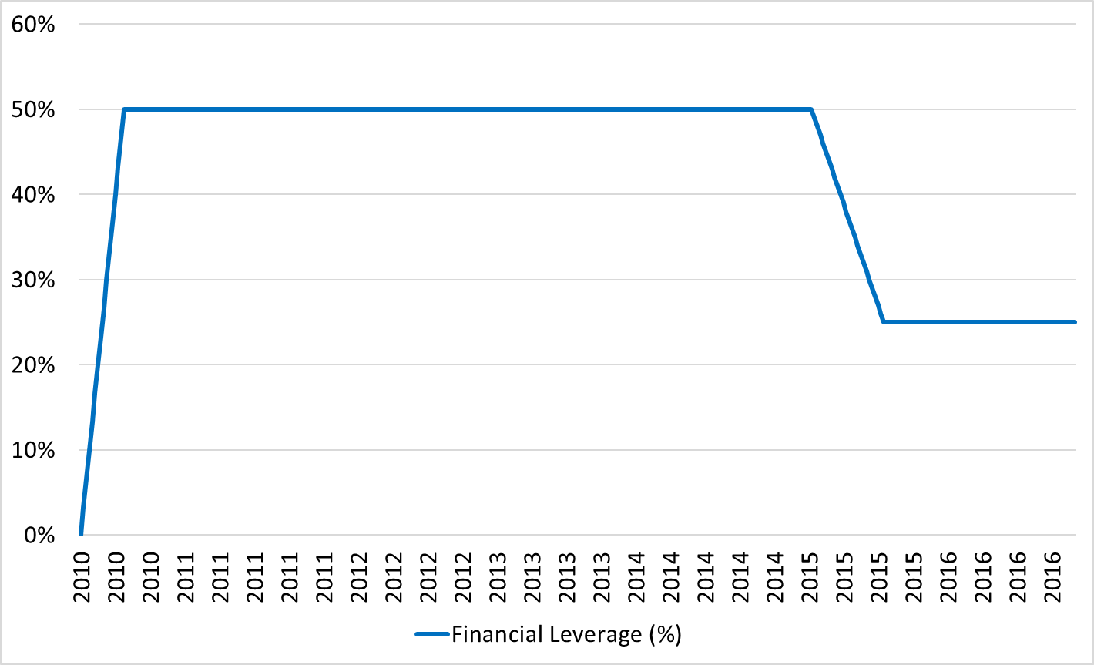
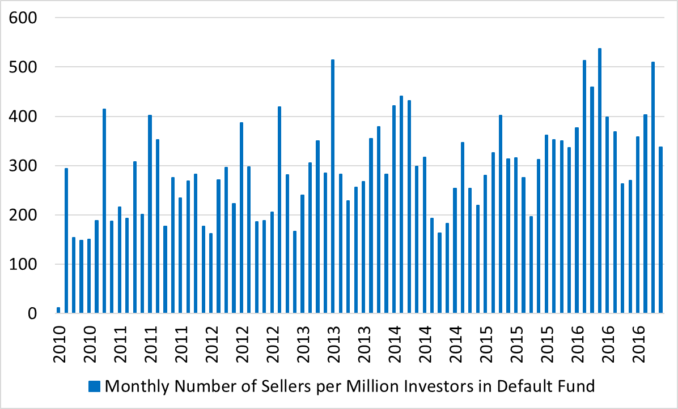
We cannot reject the hypothesis that 3.5 million
Swedish investors in the default fund are asleep.
Leverage over time
Volume of investors who sold AP7

Slide 16

Allra Funds Scandal
A fancy house (with a swimming pool in Sweden!) and a helicopter caught the eyes of journalist (with dragon tattoo?)

Slide 17
Investors in Allra are Slow to React
New articles launched on 1/30/17
# of Investors in Allra Fund
Purchases of funds were halted on 2/14/17
v
Audit reported Allra to police and the fund was deregistered from the platform on 3/16/17
Allra turned all accounts to Ålandsbanken on 5/5/17
Ålandsbanken started terminating Allra’s accounts on 6/12/17

Slide 18
Reforms?
In light of what we have observed, what changes to the choice architecture would be advisable?

Slide 19
Let’s do a Pre-Mortem
Ask yourself: “There has been a disaster, how did it happen?”
One scenario: A repeat of Global Financial Crisis of 2006-9.
What is the effect of leverage?

Slide 20
Scenario Simulation
What if the Great Recession (2006-9) repeats itself?
And this time the Swedish economy suffers too.
What would be the effect on the general public?
On Parliament?
Default Fund Return If Leverage Is…
Would there be pressure to reimburse losses if this leverage was seen to have been “imposed”?

Slide 21
Another Pre-Mortem
What if more funds were caught cheating?
Should the funds be more closely monitored?
If so, by whom?
Who should bear the costs?
Any implicit guarantees against fraud? Pressure by government to make good? Of course, the same concerns apply to the AP7 funds.

Slide 22
Recommended Changes
Choice Architecture
Restart
Number of funds

Slide 23
Alternative Choice Architectures
Default Fund
Default Fund
Default Fund
Alternative #1
Default Fund
Alternative #2
Default Fund
Alternative #3
Fund
Square
Fund
Square

Slide 24
The Fund Platform
There are now almost 900 funds. Top 100 controls 79% of AUM.
Roughly 200,000 people enter the system each year and only about 1,000 are choosing from the Fund Platform.
Can it make sense to have more funds than there are people selecting them?
How many funds can Sweden effectively monitor?

Slide 25
When in Doubt: Re-boot
Investors in this environment are inactive.
Most DIYers are those who were nudged to do so in 2000.
Very few people seem to know about the leverage in the default fund.
Conclusion: if reforms are adopted they should be accompanied by a highly publicized reboot in which everyone is encouraged to consider their portfolio and the default for everyone will be the unleveraged default.

Slide 26
When do nudges last forever?
There are many different types of nudges:
  Defaults
  Advertising campaigns
  Text reminders
  Flies in urinals …
Which nudges will be fleeting and which will be enduring? An empirical question.
This is an example of the type of situation in which nudges are most likely to last—an initial nudge then switch to autopilot.
In such situations, defaults need to be constructed with extreme care, and should be revisited periodically.

Slide 27
And now for something completely different
How do people choose among health insurance plans?

Slide 28
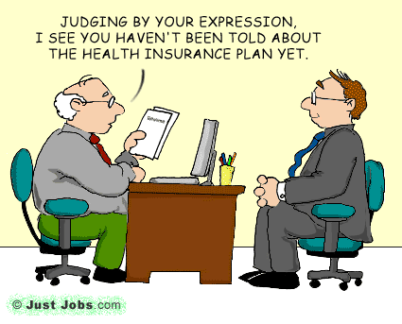
Do Individuals Make Sensible Health Insurance Decisions?
Evidence from a Menu with Dominated Options
Saurabh Bhargava
Carnegie Mellon University
George Loewenstein
Carnegie Mellon University
Justin Sydnor
University of Wisconsin

Slide 29
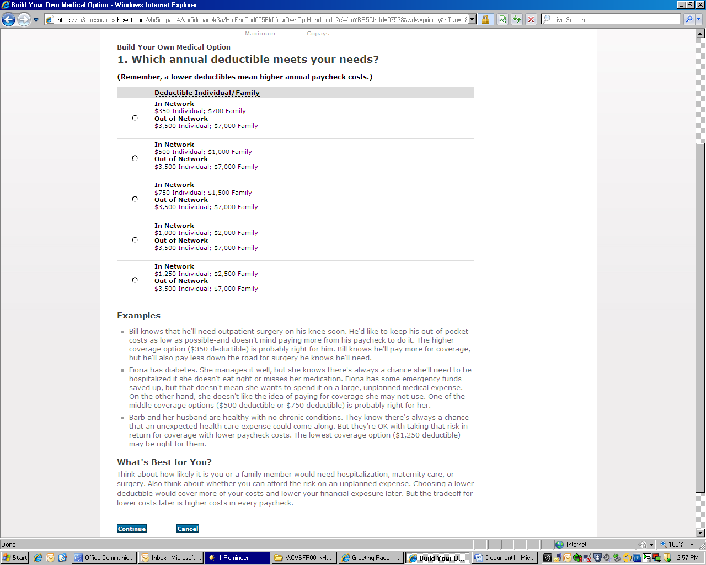
Build Your Own Policy (if you dare!)

Slide 30
The Menu of 48 Plan Options (shaded ≈ dominated )

Slide 31
Health Insurance Decisions—Far from Optimal!
A majority of the 23,894 employees selected financially dominated plans (even though there was a default plan which was a non-dominated plan!
  The dominated plans are low deductible (LD) compared to high deductible (HD).
  Not moral hazard—one would expect that employees would be motivated to spend less under the high deductible plan p11
  On average a switch to a $1000 deductible plan leads to a saving of $372 ex post

Slide 32
Poor Decisions Continued…
For the 13% of employees who selected plans with a deductible of $750, they are essentially paying $528 to avoid a maximum of $250 in out of pocket costs.
In contrast, a majority of employees chose the 20% co-pay rather than the 10%.
Shows that inferring risk attitudes from such choices is doubly crazy (though standard in the literature).

Slide 33
The Costs of Inertia (Ben Handel 2013 AER)
Studies a firm that made everyone switch with no default (so active choosing).
Then prices change but the plan from last year is the default. This is costly. Inertia causes an average employee to forgo $2032 annually (average family expenditure is $4500 per year)
Year 0 is the active choice year. In year 1 the prices go up for the 250D plan and it becomes dominated for many.
  Of the 1897 who enrolled in 250D in year 0 and remain at the firm in year 1, 29% had the plan become dominated in year 1 but only 11% switch plans to an undominated plan.
  Even in year 2 only 126 have switched.
  Minimum cost of not switching was $374 in year 1 and $396 in year 2.

Slide 34
More On Inertia..
Implied “cost” of switching (inertia) is $1729 for single employees and $2480 for “families”. An employee who enrolls in a flexible spending account is estimated to forgo $551 less due to inertia. (They have their shit together!)
Employees (or their dependents) who have chronic medical conditions or a recent large change in med expenditures have slightly more inertia, going against salience as an explanation.

Slide 35
“What does a deductible do?”
(Goldberg, Chandra, Handel and Kolstad )
Studies a company where everyone is switched from zero deductible to HD.
Total firmwide spending goes down 12-14%.
But, even after 2 years no evidence of learning to shop. The reduction in spending is not chosen wisely. They cut back on necessary and unnecessary. “Behavioral Hazard.”
Consumers respond to “spot” prices. They reduce their spending 42% during the period in which they have not hit the deductible.
90% of all spending reductions occur in the months that consumers began under the deductible, with 49% of all reductions coming from the ex ante sickest half of consumers under the deductible, despite the fact that these consumers have quite low shadow prices. Again no learning in year 2.

Slide 36
Example: University of Chicago
Health Insurance Plans (some details omitted)
Two PPOs and two HMOs. I will concentrate on the former.
For a family with income > $175,000 two options: $1000 (LD) and $4000 (HD)
LD comes with a flexible spending account (FSA), which is “use it or lose it” with cap of $2750. Claims must be filed. A pain in the butt.
HD plan offers a health savings account (HSA) which can be carried over forever tax free. No claims to file, just swipe a debit card. UC contributes $1000 to this account.
HSA is rationally identical to a retirement savings account in the long term. (But people seem to treat them as separate mental accounts.)

Slide 37
U of C PPO Prices (more simplifying assumptions)
HD annual premiums are $3204 – 1000 (HSA contribution) = $2204;
LD premiums $5928 so a difference of $3724.
Note: premiums quoted monthly but deductibles annually. Multiplication required!!!
So if an employee puts $3724/12 = $310/mo into the HSA, that plus the UofC contribution gets you to $4724 per year, more than deductible. And you keep what you don’t spend!
**2017 prices

Slide 38
Comparing the PPO Plans?*
* warning: some details omitted.

Slide 39
Do Employees get it right?
 | <$47k | $47-74k | $75-99k | $100-174 | >$175k
Low Deduct | 212 | 518 | 250 | 456 | 620
High Deduct | 75 | 203 | 151 | 158 | 118
Guess which plan is newer?

Slide 40
Annoying Details
The FSA is funded immediately on January 1. If an employee leaves in mid year takes the money with her. This is required by law.
The HSA: The University contribution is funded on January 1, the rest as contributions come in. Don’t know whether it could be changed. There are potential liquidity problems here for those who incur high medical costs early in the year.

Slide 41
Proposed Better Plan
Two plans with same premiums of $500 per month (to make math easy). Adjust Max OOPCs to be the same.
Plan A (for annoying): $1000 deductible plus nasty “use it or lose it” FSA
Plan B (for better) Keep the Savings Plan [save for tomorrow plan? Better name???]. Key: at least $4000 of HSA is funded Jan 1 to solve liquidity problems. The debit card makes things easy.

Slide 42
Propaganda (aka marketing)
If you choose the LD plan the first $1000 plus copays etc. are on you. Good luck submitting your claims to the FSA.
If you choose the BETTER plan the first $4000 of expenses plus copays etc. are taken from your debit card account. If you do not spend $4000 you keep the rest for yourself! After that, the insurance company pays.
In future years, if you have built up a balance in excess of your maximum out of pocket costs you can either reduce your monthly premia or use it as an additional retirement account.

Slide 43
Ideal Framing
Goal is to reduce the pain of out of pocket spending both psychologically and in terms of hassles but also retain the incentive to economize since you get to pocket the savings yourself.
A significant worry: “Behavioral Hazard” (Baiker, Mullainathan, Schwartzstein, QJE 2015) “Much high-value care is underused even when patient costs are low.” Co-pays etc. need to be optimized.

Slide 44
Conclusion
Choice architecture matters!

