Slide 1
2018 Behavioral Summer Camp:
Behavioral Labor Economics
Stefano DellaVigna, UC Berkeley and NBER
(with Alex Mas, Princeton and NBER
for Handbook of Behavioral Economics, Vol. 2)
June 27, 2018

Slide 2
Behavioral Economics by Field
Fields of applications of Behavioral Economics
1980s and 1990s
  Behavioral Finance (Asset Pricing)
  Behavioral Household Finance
2000 on
  Behavioral Corporate Finance
  Behavioral Development Economics
  Behavioral Industrial Organization
Last 5-10 years
  Behavioral Public Finance
  Behavioral Health Economics
  Behavioral Political Economy
  Behavioral Education Economics

Slide 3
Behavioral Labor Economics: History
What about Behavioral Labor Economics?
Work since early days of behavioral econ:
  Inter-industry wage differentials (Thaler, 1989)
  Fairness constraints (Kahneman-Knetsch-Thaler, 1986)
  Gift Exchange (Akerlof, 1982, 1984)
  Yet, did not quite pick up pace
Surprising because of deep psych roots in labor econ
  Institutionalists influenced by Veblen
  Richard Ely: “exploring the human problem by the psychological method”
  Albert Rees / John Dunlop: key role of fairness in labor negotiation

Slide 4
Five Main Areas
Five main areas of research:
  Worker Effort
    Present bias
    Horizontal / vertical social preferences
  Wage Setting
    Wage compression
    Nominal wage rigidity
  Job Search
    Present bias / overconfidence / ref dep in search effort
  Labor Supply
    Reference dependence and income targeting
    Gender norms
  Education
    College attendance
    Present bias / social norms / info / complexity of forms

Slide 5
Five Main Areas
Five main areas of research:
  Worker Effort
    Present bias
    Horizontal / vertical social preferences
  Wage Setting
    Wage compression
    Nominal wage rigidity
  Job Search
    Present bias / overconfidence / ref dep in search effort
  Labor Supply
    Reference dependence and income targeting
    Gender norms
  Education
    College attendance
    Present bias / social norms / info / complexity of forms

Slide 6
Worker Effort
What determines effort at the workplace?
  Explicit and implicit incentives (e.g., promotions)
  But also motivation and social preferences
Factor 1: Present bias
  Work entails immediate effort costs and delayed benefit
  Present bias →Not work hard enough
Key point, with remarkably little evidence
Kaur, Kremer, Mullainathan (JPE) set up factory so as to:
  Randomize timing of pay (relative to effort)
  Offer commitment device to work harder
Notes:
6

Slide 7
Worker Effort: Present Bias
Effort relative to pay identifies time preferences
Not quite beta-delta, but close
Notes:
7

Slide 8
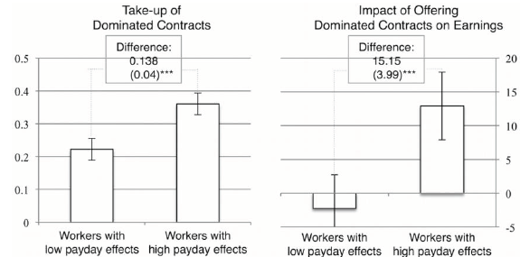
Worker Effort: Present Bias
Commitment device:
  High take-up and enhances production
Notes:
8

Slide 9
Worker Effort: Present Bias
Also on effort and present bias: Augenblick, Niederle, Sprenger (QJE)
  Online experiment, allocate effort now versus later
  Methodological break-through to identify beta-delta, compared to money now- money later choices
  Significant present bias
  Limited demand for commitment if costly
With same design, evidence on:
  Naivete’ vs. sophistication (Augenblick-Rabin RES)
  Present-bias already within hours (Augenblick WP)
  Naïve about self, not others (Fedyk WP)
  High take-up and enhances production
Notes:
9

Slide 10
Worker Effort: Social Preferences
Second key component: motivation
  If motivation important for effort, may justify paying higher wages to trigger reciprocity (Akerlof 1981)
Two dimensions of motivation:
  Vertical Social Preferences (toward employer)
  Horizontal Social Preferences (toward co-employees)
Two dimensions of effort:
  Extra effort that helps the employer (e.g., fix production defect)
  Boycott that hurts employer (e.g., stealing stationery)
Notes:
10

Slide 11
Worker Effort, Model
Notes:
11

Slide 12
Worker Effort, Vertical Preferences
Notes:
12

Slide 13
Worker Effort, Vertical Preferences
Notes:
13

Slide 14
Worker Effort, Vertical Preferences
Notes:
14

Slide 15
Worker Effort, Vertical Preferences
Notes:
15

Slide 16
Worker Effort, Horizontal Preferences
Notes:
16

Slide 17
Worker Effort, Horizontal Preferences
Notes:
17

Slide 18
Worker Effort, Horizontal Preferences
Notes:
18

Slide 19
Worker Effort, Horizontal Preferences
Notes:
19

Slide 20
Worker Effort, Horizontal Preferences
Notes:
20

Slide 21
Worker Effort, Horizontal Preferences
Notes:
21

Slide 22
Worker Effort, Horizontal Preferences
Notes:
22

Slide 23
Worker Effort, Horizontal Preferences
Notes:
23

Slide 24
Worker Effort, Horizontal Preferences
Notes:
24

Slide 25
Worker Effort, Other
Other behavioral determinants of effort:
Non-financial rewards as motivators (eg Akerlof and Kranton; Besley-Ghatak; Ashraf, Bandiera and Jack)
  Evidence mixed on importance
Crowd-out of motivation from financial rewards (Gneezy and Rustichini QJE)
  Not much evidence
Overconfidence of workers, matters for eg, retention of truckers (Hoffman and Burks)

Slide 26
Five Main Areas
Five main areas of research:
  Worker Effort
    Present bias
    Horizontal / vertical social preferences
  Wage Setting
    Wage compression
    Nominal wage rigidity
  Job Search
    Present bias / overconfidence / ref dep in search effort
  Labor Supply
    Reference dependence and income targeting
    Gender norms
  Education
    College attendance
    Present bias / social norms / info / complexity of forms

Slide 27
Wage Setting Implications
Implications of effort findings for wage setting
Present bias → Commitment devices
  Why so uncommon? (Laibson AEA)
Vertical social preferences →
  Gift exchange / efficiency wages maybe
  Constraints on Manager pay (Mas, 2015)
Horizontal social preferences →
  Pay compression / wage differentials across firms (Card, Heining, Kline QJE)
  Drives outsourcing (Goldschmidt and Schmieder QJE)
Overconfidence of workers → Stock options (Bergman and Jenter, 2007; Cowgill and Zitzewitz, 2015)

Slide 28
Wage Setting Implications, Outsourcing
Pay compression:
  Some firms pay more than others
  This applies also to low skill workers
  As competition strengthens → save $ by outsourcing low-skill workers (Goldschmidt and Schmieder QJE)
Germany : Share of outsourced workers much increased

Slide 29
Wage Setting Implications, Outsourcing
More outsourcing in firms with higher pay, controlling for all else
Preferences for equity have indirect effects

Slide 30
Wage Setting, Nominal Wage Rigidity
Kahneman, Knetsch and Thaler (1986) Telephone surveys in Canada in 1984 and 1985 --> Ask questions on fairness
A real and nominal wage cut is not fair (Question 4A)
A real (but not nominal) wage cut is fair (Question 4B)
Notes:
30

Slide 31
Wage Setting, Nominal Wage Rigidity
Bewley (1999) interviews of managers and workers
  They hate nominal wage cuts
→ Expect employers to avoid nominal wage decreases
Card and Hyslop (1997): Early evidence on this
Notes:
31

Slide 32
Wage Setting, Nominal Wage Rigidity
Hipsman (2011) and Hipsman and Laibson (2015)
Administrative data from several firms (Hewlett)
Base pay % increase among employees in 2007 and 2008
0.36% pay cuts, 54.58% pay freezes, 45.06% pay raises
Implications when low inflation: firings? Less hiring?
Notes:
32

Slide 33
Five Main Areas
Five main areas of research:
  Worker Effort
    Present bias
    Horizontal / vertical social preferences
  Wage Setting
    Wage compression
    Nominal wage rigidity
  Job Search
    Present bias / overconfidence / ref dep in search effort
  Labor Supply
    Reference dependence and income targeting
    Gender norms
  Education
    College attendance
    Present bias / social norms / info / complexity of forms

Slide 34
Job Search
Notes:
34

Slide 35
Job Search, Present Bias
Notes:
35

Slide 36
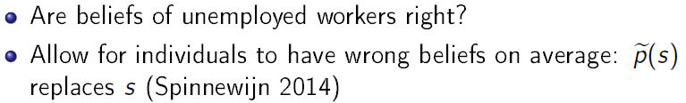
Job Search, Overconfidence
Notes:
36

Slide 37
Job Search, Overconfidence
Clear evidence for the first form of overconfidence
Very little known about the second (control overconfidence, Spinnewijn, JEEA 2015)
Notes:
37

Slide 38
Job Search, Reference Dependence
Notes:
38

Slide 39
Job Search, Reference Dependence
Notes:
39

Slide 40
1. Job Search, Reference Dependence
UI reform in Hungary displays patterns in hazards after 270 days strongly suggestive of reference dependence
Notes:
40

Slide 41
Job Search, Reference Dependence
Standard model Reference-dependent model
Estimate of two models:
  Standard model with unobserved heterogeneity (3 cost types)
  Model with reference dependences (and 2 cost types)
  Hold constant number of parameters
  Return to this tomorrow
Notes:
41

Slide 42
Job Search, Reference Dependence
Alternative approach: collect survey on search effort over time for a person → Control for heterogeneity
Krueger and Muller (BPEA) did it for UI recipients in NJ
BUT find seasaw pattern (survey fatigue)
DellaVigna, Heining, Schmieder, Trenkle: survey in Germany
  Weekly SMS question on search effort for 10k unempl.
Notes:
42

Slide 43
Five Main Areas
Five main areas of research:
  Worker Effort
    Present bias
    Horizontal / vertical social preferences
  Wage Setting
    Wage compression
    Nominal wage rigidity
  Job Search
    Present bias / overconfidence / ref dep in search effort
  Labor Supply
    Reference dependence and income targeting
    Gender norms
  Education
    College attendance
    Present bias / social norms / info / complexity of forms

Slide 44
Labor Supply
(High-frequency) Labor Supply
Target earnings and Reference dependence
  When wages are higher, work less
  Cab drivers (Camerer et al., 1997; Farber, 2005, 2015; Crawford and Meng, 2011; Farber, 2015)
  Bike Messengers (Fehr and Goette, 2008)
  Literature was a mess
  Enter Thakral and To (WP) that clarifies facts:
    Yes, drivers more likely to stop when they earned more income
    Effect size moderate overall
    Importantly: only recent earnings (last 2-3 hours) matter, not earnings very early on in day
Notes:
44

Slide 45
Labor Supply
  Thakral and To (WP) key finding:
    Consistent with backward-looking reference points or form of KR reference points
Notes:
45

Slide 46
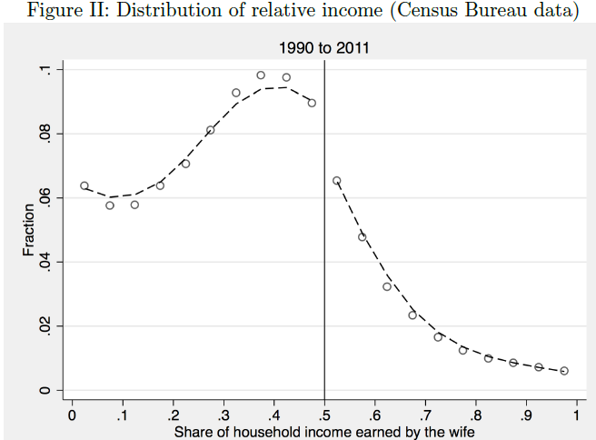
Labor Supply
Gender norms in Labor Supply (Bertrand, Kamenica, Pan QJE)
  Husband dislikes if spouse earns more
  Marriages less likely to occur if wife earns more
  Important follow up: ask Johannes Hermle!
Notes:
46

Slide 47
Five Main Areas
Five main areas of research:
  Worker Effort
    Present bias
    Horizontal / vertical social preferences
  Wage Setting
    Wage compression
    Nominal wage rigidity
  Job Search
    Present bias / overconfidence / ref dep in search effort
  Labor Supply
    Reference dependence and income targeting
    Gender norms
  Education
    College attendance
    Present bias / social norms / info / complexity of forms

Slide 48
Educational Choices
Facts on benefits of attending school:
  Returns to school are high (10%-12%/yr of school)
  If anything, college premium has increased over time
Then why doesn’t (nearly) everyone go?
Active debate. Relevant behavioral factors:
  Excessive discounting (Oreopoulos, 2007)
  Poor information, misperceived returns to college (Jensen, 2010; Wiswall and Zafar, 2015)
  Complexity. FAFSA forms too hard (Bettinger, Long, Oreopoulos, Sanbonmatsu, 2012)
  Social norms. Acting white (Fryer and Austen-Smith; Bursztyn, Jensen)
Notes:
48

