Slide 1
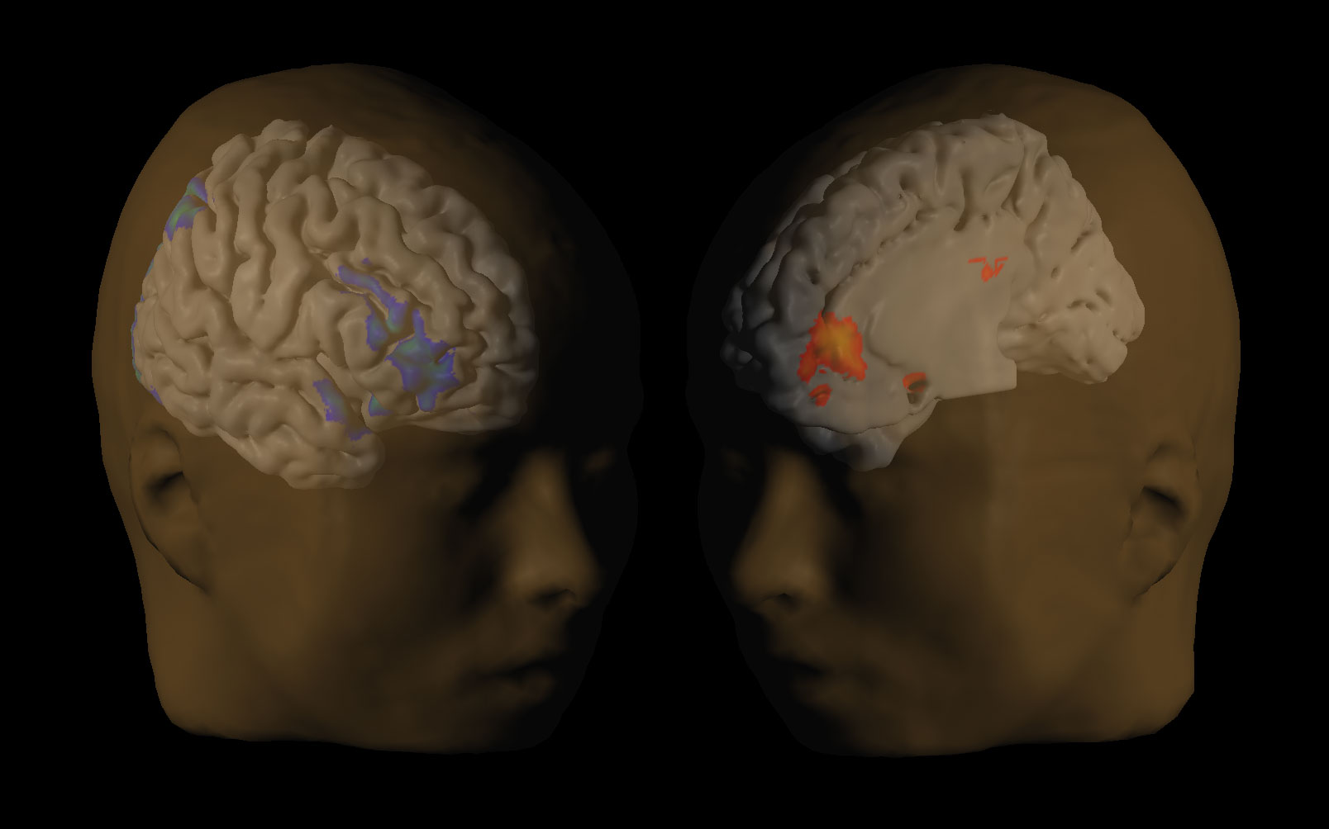
David Laibson
July 7, 2016
Biosocial Science

Slide 2
Outline:
Biosocial science: definition
Neuroeconomics
  E.g., Multiple Systems Hypothesis
Genoeconomics

Slide 3
I. Biosocial science: definition.
Definition: Biosocial science is the study of the biological microfoundations of economic cognition and economic behavior.
Biological microfoundations are neurochemical mechanisms and pathways, like brain systems, neurons, neurotransmitters, genetics, and epigentics.
Economic cognition is cognitive activity that is associated with economic perceptions, beliefs and decisions, including mental representations, emotions, expectations, learning, memory, preferences, and decision-making.

Slide 4
II: A neuroeconomics example
The Multiple Systems Hypothesis
Statement of Hypothesis
Variations on a theme
Caveats
Neuroimaging

Slide 5
Statement of
Multiple Systems Hypothesis (MSH)
The brain makes decisions (e.g. constructs value) by integrating signals from multiple systems
These multiple systems process information in qualitatively different ways and in some cases differentially weight attributes of rewards (e.g., time delay)

Slide 6
An (oversimplified) multiple systems model
System 1
Integration
System 2
Behavior

Slide 7
An uninteresting example
What is 6 divided by 3?
Addition
Integration
Division
Behavior

Slide 8
A more interesting example
Would you like a piece of chocolate?
Abstract
goal:
diet
Integration
Visceral
reward:
pleasure
Behavior

Slide 9
A more interesting example
Would you like a piece of chocolate?
Abstract
goal:
diet
Integration
Visceral
reward:
pleasure
Behavior

Slide 10
Variations on a theme
Charioteer’s two horses (Socrates/Plato, The Phaedrus, 370 BC):
“First the charioteer of the human soul drives a pair, and secondly one of the horses is noble and of noble breed, but the other quite the opposite in breed and character. Therefore in our case the driving is necessarily difficult and troublesome.”
Interests vs passions (Smith)
Superego vs Ego vs Id (Freud)
Controlled vs Automatic (Schneider & Shiffrin, 1977; Benhabib & Bisin, 2004)
Cold vs Hot (Metcalfe and Mischel, 1979)
System 2 vs System 1 (Frederick and Kahneman, 2002)
Deliberative vs Impulsive (Frederick, 2002)
Conscious vs Unconscious (Damasio, Bem)
Effortful vs Effortless (Baumeister)
Planner vs Doer (Shefrin and Thaler, 1981)
Patient vs Myopic (Fudenburg and Levine, 2006)
Abstract vs Visceral (Loewenstein & O’Donoghue 2006; Bernheim & Rangel, 2003)
PFC & parietal cortex vs dopamine reward system (McClure et al, 2004)

Slide 11
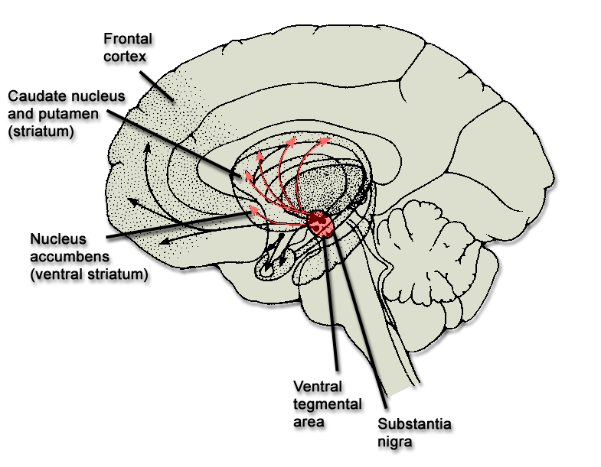
Affective vs. Analytic Cognition
Frontal
cortex
mPFC
mOFC
vmPFC
Dopamine
reward system

Slide 12
Relationship to quasi-hyperbolic model
Hypothesize that the fronto-parietal system (PFC) is patient
Hypothesize that dopamine reward system (DRS) is impatient.
Then integrated preferences are quasi-hyperbolic
 |  | now | t+1 | t+2 | t+3
PFC |  | 1 | 1 | 1 | 1 | …
DRS |  | 1 | 0 | 0 | 0 | …
Total |  | 2 | 1 | 1 | 1 | …
Total normed |  | 1 | 1/2 | 1/2 | 1/2 | …

Slide 13
Relationship to quasi-hyperbolic model
Hypothesize that the fronto-parietal system is patient
Hypothesize that dopamine reward system is impatient.
Here’s one implementation of this idea:
U_{t} = u_{t} + β [δu_{t+1} + δ²u_{t+2} + δ³u_{t+3} + ...]
(1/β)U_{t} = (1/β)u_{t} + δu_{t+1} + δ²u_{t+2} + δ³u_{t+3} + ...
(1/β)U_{t} =(1/β−1)u_{t} + [δ⁰u_{t} + δ¹u_{t+1} + δ²u_{t+2} + δ³u_{t+3} + ...]
DRS fronto-parietal cortex

Slide 14
Commonalities between classification schemes
Affective system
fast
unconscious
reflexive
myopic
Analytic system
Effortful
slow
conscious
reflective
forward-looking
(but still prone to error: heuristics may be analytic)

Slide 15
Patience tracks PFC development
PFC develops more slowly than other brain regions
The willingness to delay gratification is compromised during adolesence as a consequence of the interplay between mature affective/emotional systems and immature top-down control systems (e.g., PFC).
  Neuroimaging evidence shows that among adolescents, mature neural systems below the cerebral cortex (e.g. the accumbens) become disproportionately activated during decision tasks relative to later-maturing top-down control systems, thereby biasing the adolescent's action toward immediate over long-term rewards (Galvin et al 2006; Casey, Getz, and Galvan 2008; Casey, Galvan, and Hare 2005).
Green, Fry, and Myerson (1994) show that patience is correlated with age.

Slide 16
Cross-species evidence
Non-human species have a disproportionately smaller PFC
Sated monkeys have a 50% discount rate for juice rewards delayed 10 seconds (Livingstone 2009)
Patience increases as the subject population switches from pigeons, to rats, to human children, to human adults (Tobin and Logue, 1994).

Slide 17
Neural activity in fronto-parietal regions differentiated from neural activity in dopamine reward system regions
At least seven relevant studies:
  McClure et al (2004) – supportive
  McClure et al (2007) – supportive
  Kable and Glimcher (2007) – critical
  Hariri et al (2007) – supportive
  Hare, Camerer, and Rangel (2009) – integration
  Fehr et al (2009) – supportive
  Albrecht et al (2010) – supportive
And one other study that is related (and supportive):
  Tanaka et al (2004): different behavioral task

Slide 18
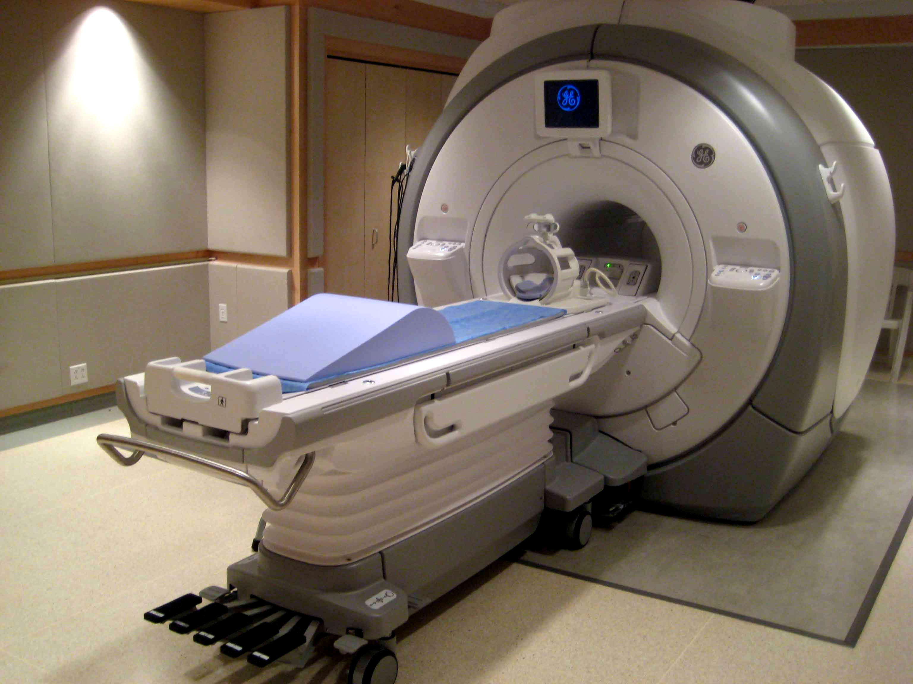
Functional Magnetic Resonance Imaging (fMRI)

Slide 19
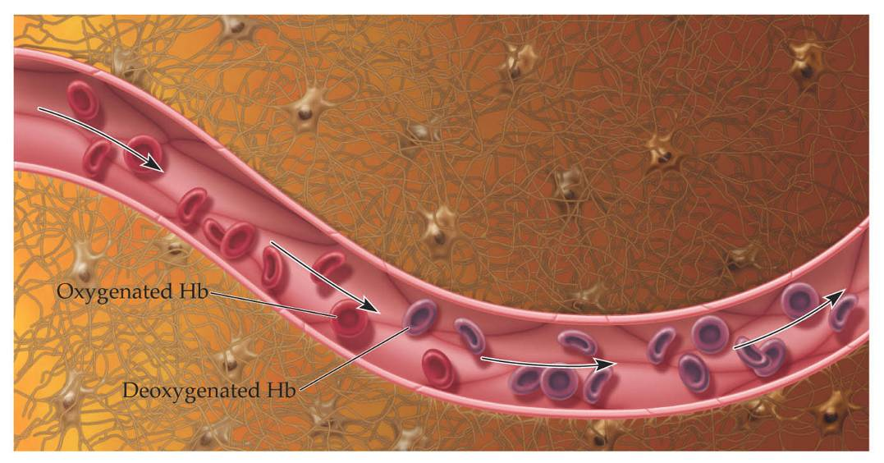
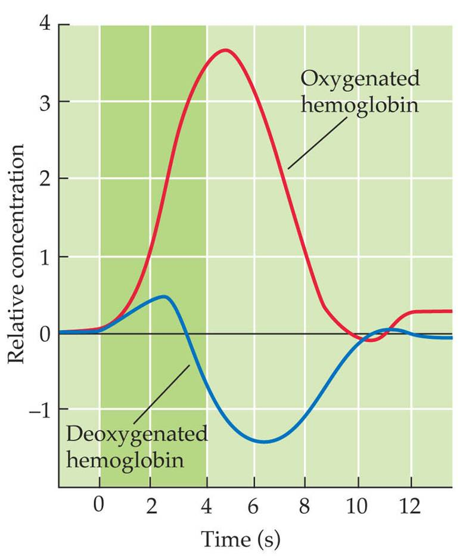
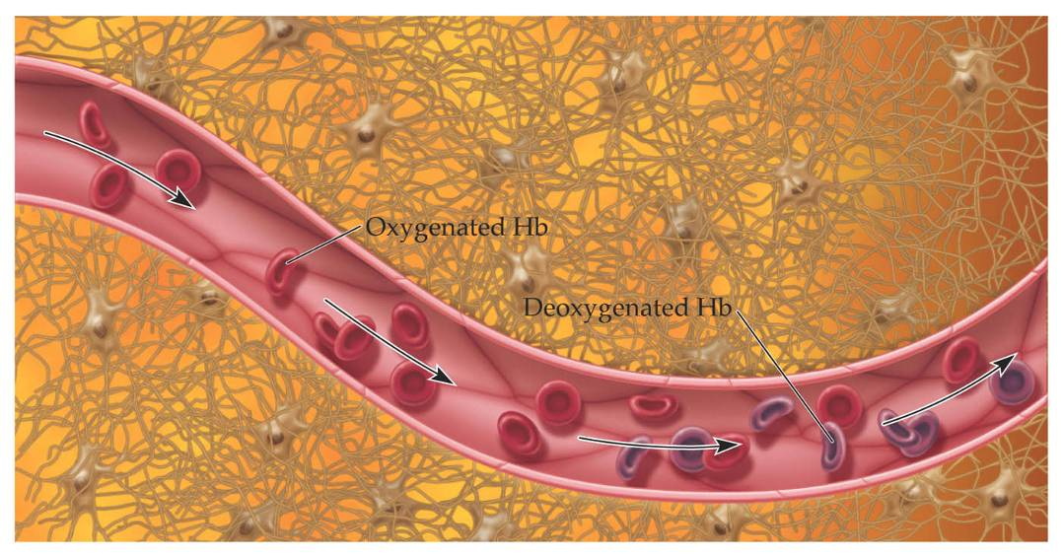
The fMRI Blood-Oxygenation-Level-Dependent (BOLD) Response
Increased neuronal activity results in increased MR (T₂*) signal
BASELINE
ACTIVE
Source: Scott Huettel

Slide 20
Basic methodology
Divide brain into 30,000+ voxels (cubes 2 mm on edge)
Measure blood flow at the voxel level (BOLD signal)
Relate blood flow to experimental task
Run “regressions” (general linear model) relating BOLD signal to covariates:
BOLD_{v,i,t} = FE_{i} + controls_{t} + task dummy_{t}
Indexes for voxel (v), subject (i), and time (t)
Controls: time in scanner, lagged reward event, etc.
event dummy: decision, experience, event, etc.
Analogous method: “contrast”

Slide 21
Basic experimental design
Task
A
Task
B
Task
C
Time
Rest
12 sec
Rest
12 sec
Rest
12 sec
Rest
12 sec

Slide 22
Basic econometric methodology
Run “regressions” (general linear model) relating BOLD signal to covariates:
BOLD_{v,i,t} = FE_{i} + controls_{t} + task dummy_{t}
Indexes for voxel (v), subject (i), and time (t)
Controls: time in scanner, lagged reward event, etc.
Task dummy: decision, experience, event, etc.
Analogous method: “contrast”

Slide 23
Multiple-testing problem (cf Vul et al 2010)
Don’t worry:
Strict thresholds (α = 0.001 and 5-voxel contiguity)
Pre-specification of hypothesis (ROI)
Replication
Converging lines of evidence (fMRI, single neuron measurement, knock-outs, legions, rTMS)
This is the same multiple testing problem that hangs over all empirical research
Worry:
Are all significant voxels reported?
Were the specification searches reported?
Are all GLM’s (regressions) reported?
Is the neuroscientific explanation of the data post-hoc?
Shouldn’t the effect size be adjusted for multiple testing

Slide 24
McClure, Laibson, Loewenstein, Cohen (2004)
Intertemporal choice with time-dated Amazon gift certificates.
Subjects make binary choices:
$20 now or $30 in two weeks
$20 in two weeks or $30 in four weeks
$20 in four weeks or $30 in six weeks

Slide 25
Dopamine reward system
Fronto-parietal cortex
$20
$30
Fronto-parietal cortex
$20
$30
Fronto-parietal cortex
$20
$30

Slide 26




Regions that respond “only” to immediate rewards
7
T₁
0
x = -4mm
y = 8mm
z = -4mm
VStr
MOFC
MPFC
PCC
BOLD Signal
Time
Delay to earliest reward = Today
0.2%
Delay to earliest reward = 2 weeks
Delay to earliest reward = 1 month
2 sec

Slide 27


Regions that respond “equally” to all rewards
VCtx
PMA
RPar
x = 44mm
DLPFC
VLPFC
LOFC
0.4%
x = 0mm
2s
0
T₁
15
Delay to earliest reward = Today
Delay to earliest reward = 2 weeks
Delay to earliest reward = 1 month

Slide 28
Brain activity in the frontoparietal system and dopamine reward system predict behavior
(Data for choices with an immediate option.)
0.05
Fronto-parietal cortex
Brain Activity
0.0
DRS
-0.05
Choose
Immediate
Reward
Choose
Delayed
Reward

Slide 29
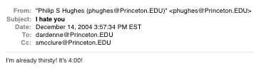
McClure, Ericson, Laibson, Loewenstein, Cohen
(2007)
Subjects water deprived for 3hr prior to experiment
(a subject scheduled for 6:00)

Slide 30
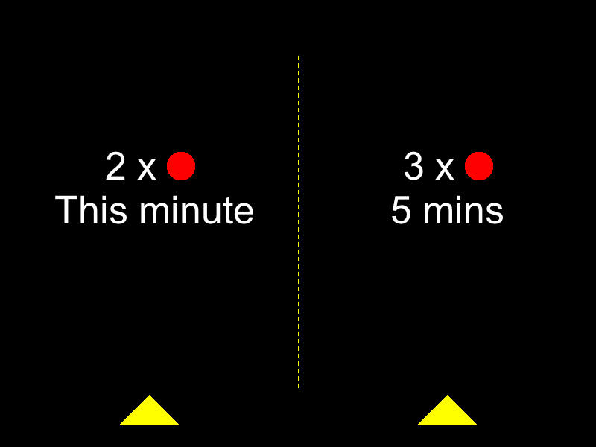
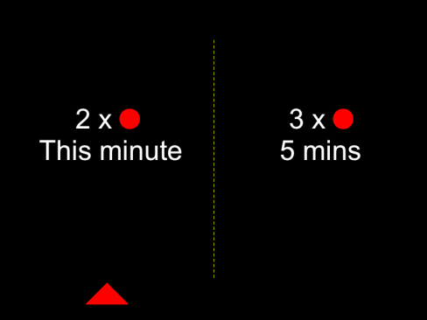


A
15s
10s
5s
Time
i
ii
iii
…
iv. Juice/Water squirt (1s )
B
(i) Decision Period
(ii) Choice Made
(iii) Pause
(iv) Reward Delivery
Free (10s max.)
2s
Variable Duration
Free (1.5s Max)
15s
Figure 1

Slide 31
Experiment Design
d
d'-d
(R, R')
∈ { This minute, 10 minutes, 20 minutes }
∈ { 1 minute, 5 minutes }
∈ {(1,2), (1,3), (2,3)}
d = This minute
d'-d = 5 minutes
(R, R') = (2,3)

Slide 32




Relationship to Amazon experiment:
δ areas (p<0.001): respond to all rewards
x = 0mm
x = -48mm
β areas (p<0.001): respond to immediate rewards
x = 0mm
y = 8mm
Juice
only
Amazon
only
Both
Figure 5

Slide 33


Hare, Camerer, and Rangel (2009)
Health Session
Taste Session
Decision Session
4s
food item
presentation
Rate Health
Rate Taste
Decide
fixation
+
+
+
Rate Health
Rate Taste
Decide
Notes:
Subjects fast for 3 hours
Come and first rate health and taste for each food (counterballanced)
One reference item that is neutral on both scales is identified
Subjects shown the reference food
Then shown each food item again and must decide whether or not to eat what is currently on the screen or the reference item
One trial randomly selected and the choice implemented

Slide 34
Details
Taste and health ratings made on five point scale:
  -2,-1,0,1,2
Decisions also reported on a five point scale: SN,N,0,Y,SY
“strong no” to “strong yes”
Subject choices sometimes reflect self control
  Rejection of an unhealthy, good tasting food, OR
  Consumption of a healthy, bad tasting food
Notes:
On slide

Slide 35
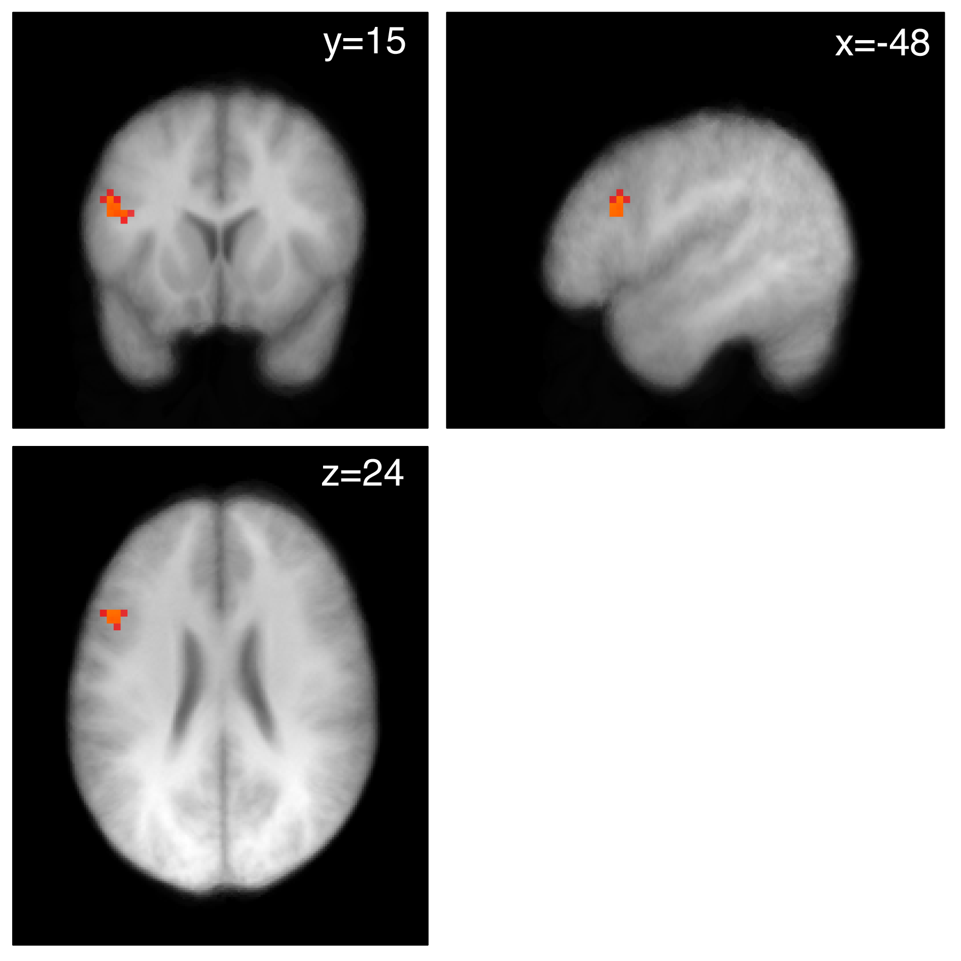
More activity in DLPFC in successful self control trials than in failed self control trials
L
p < .001
p < .005
Notes:
Model: R1 = SC trials, R2 = Non SC trials, R3 = Failed SC trials
Contrast: SC group R1 - NSC group R1
Masked by Contrast of SC group R1+ FWE corrected to .05 -could also think of it as a conjunction (dlpfc only)
Current image MC corrected to P< .05 at cluster level using CorrClus from Tom Nichols (21 voxels at p=.005)
Red = .005
Yellow = .001

Slide 36
Figner, Knoch, Johnson, Krosch, Lisanby, Fehr and Weber (2010)
Disruption of function of left, but not right, lateral prefrontal cortex (LPFC) with low-frequency repetitive transcranial magnetic stimulation (rTMS) increased choices of immediate rewards over larger delayed rewards.
rTMS did not change choices involving only delayed rewards and did not change valuation judgments of immediate and delayed rewards.
Causal evidence for a neural lateral-prefrontal cortex–based self-control mechanism in intertemporal choice.

Slide 37
Albrecht, Volz, Sutter, Laibson, and von Cramon (2011)
An immediate reward in a choice set elevates activation of the ventral striatum, pregenual anterior cingulate cortex and anterior medial prefrontal cortex.
These dopaminergic reward areas are also responsive to the identity of the recipient of the reward.
Even an immediate reward does not activate these dopaminergic regions when the decision is being made for another person.
Results imply that participants show less affective engagement (i) when they are making choices for themselves that only involve options in the future or (ii) when they are making choices for someone else (even if it involves rewards in the present)
Also find that behavioral choices reflect more patience when choosing for someone else.

Slide 38
Part II:
Genoeconomics
David Laibson
Economics Department, Harvard University
October 20, 2013

Slide 39
Heritabilities for Economic Outcomes
(estimated by comparing concordance between MZ & DZ twins)
Psychological traits: 0.20 - 0.80. (Plomin et al., 2008)
Economic preferences/outcomes: roughly similar, but less reliably measured. Examples:
  Years of schooling: ~0.40
    Taubman (1976), Behrman and Taubman (1976), Ashenfelter and Krueger (1994), Miller, Mulvey, and Martin (1995), Rouse (1999).
  Income: ~0.40
    Ibid.
    Or higher, if income is better measured.
Notes:
There’s 100 years of research in psych establishing that…We take as given that genes as a whole…and we look for specific genes that individually have a strong enough effect that…

Slide 40
When Taubman (1976) found that income has heritability ~40%, Hans Eysenck was quoted in the Times of London:
These results “really tell the [Royal] Commission [on the Distribution of Income and Wealth] that they might as well pack up.”

Slide 41
Arthur Goldberger (1979) wrote
(with heavy sarcasm):
“A powerful intellect was at work. In the same vein, if it were shown that a large proportion of the variance in eyesight were due to genetic causes, then the Royal Commission on the Distribution of Eyeglasses might as well pack up. And if it were shown that most of the variation in rainfall is due to natural causes, then the Royal Commission on the Distribution of Umbrellas could pack up too.”

Slide 42
What Heritability Does Not Imply
Major Fallacy: Over the years, high heritability often (mis)interpreted as indicating little scope for policy to affect the outcome.

Slide 43
What Heritability Does Not Imply
Major Fallacy #2: Over the years, higher heritability often (mis)interpreted as indicating less variance attributable to environment.
Heritability + prop. variance explained by env. = 100% ??
In fact, generally sum to > 100%. (Jencks, 1980)
Because genetic effects may be mediated by environmental factors.
E.g.: Genes → curiosity → reading books → educational attainment.
  This channel is both genetic and environmental.

Slide 44
What Heritability Does Imply
There exist genes that are predictive of behavior, and thus these genes could be identified.
A variable constructed from genetic data could, in principle, have non-trivial predictive power (up to the level of heritability).
Identifying genes and constructing “polygenic scores” are central goals of genoeconomics.

Slide 45
Potential for Social Science
Biological mechanisms for behavior
    Complementary with neuroeconomics.
Non-genetic empirical work
  Empirical proxies for structural parameters (preferences, abilities, internal prod’n fns.)
  Instrumental variables
  Control variables
Studying G×E and targeting interventions
    E.g., older individuals with at-risk cognitive health.

Slide 46
Outline
Conceptual Framework
GWAS and Educational Attainment

Slide 47
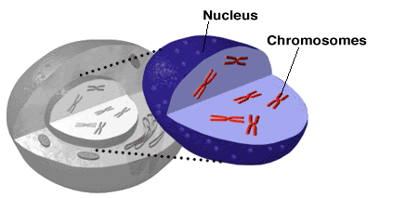

Slide 48
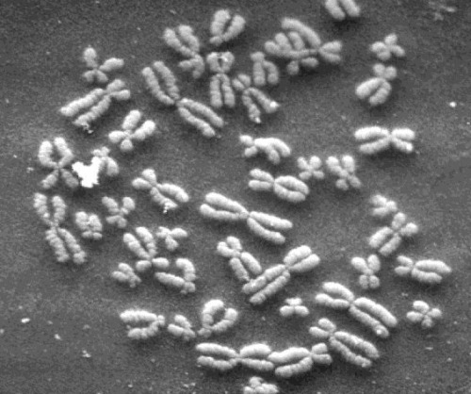

Slide 49
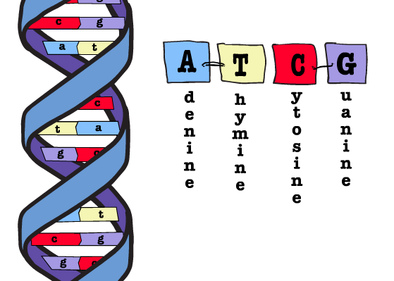

Slide 50
Genetics Primer
Human DNA is a sequence of ~3 billion nucleotide molecules (spread across 23 chromosomes).
This human genome has 20,000-25,000 subsequences called genes.
Genes provide instructions for building proteins that in turn affect body function.
At the vast majority of locations, there is no variation in nucleotides across individuals.

Slide 51
Single-nucleotide polymorphisms (SNPs): Nucleotides where individuals differ (a small % of all nucleotides).
(There are also other types of variation.)
At vast majority of SNP locations, there are only 2 possible nucleotides:
  major allele (more common)
  minor allele (less common).
From each parent, may inherit either allele; SNP unaffected by which received from whom.
Genotype for each SNP: #minor alleles (0,1,2).

Slide 52

February, 2001

Slide 53
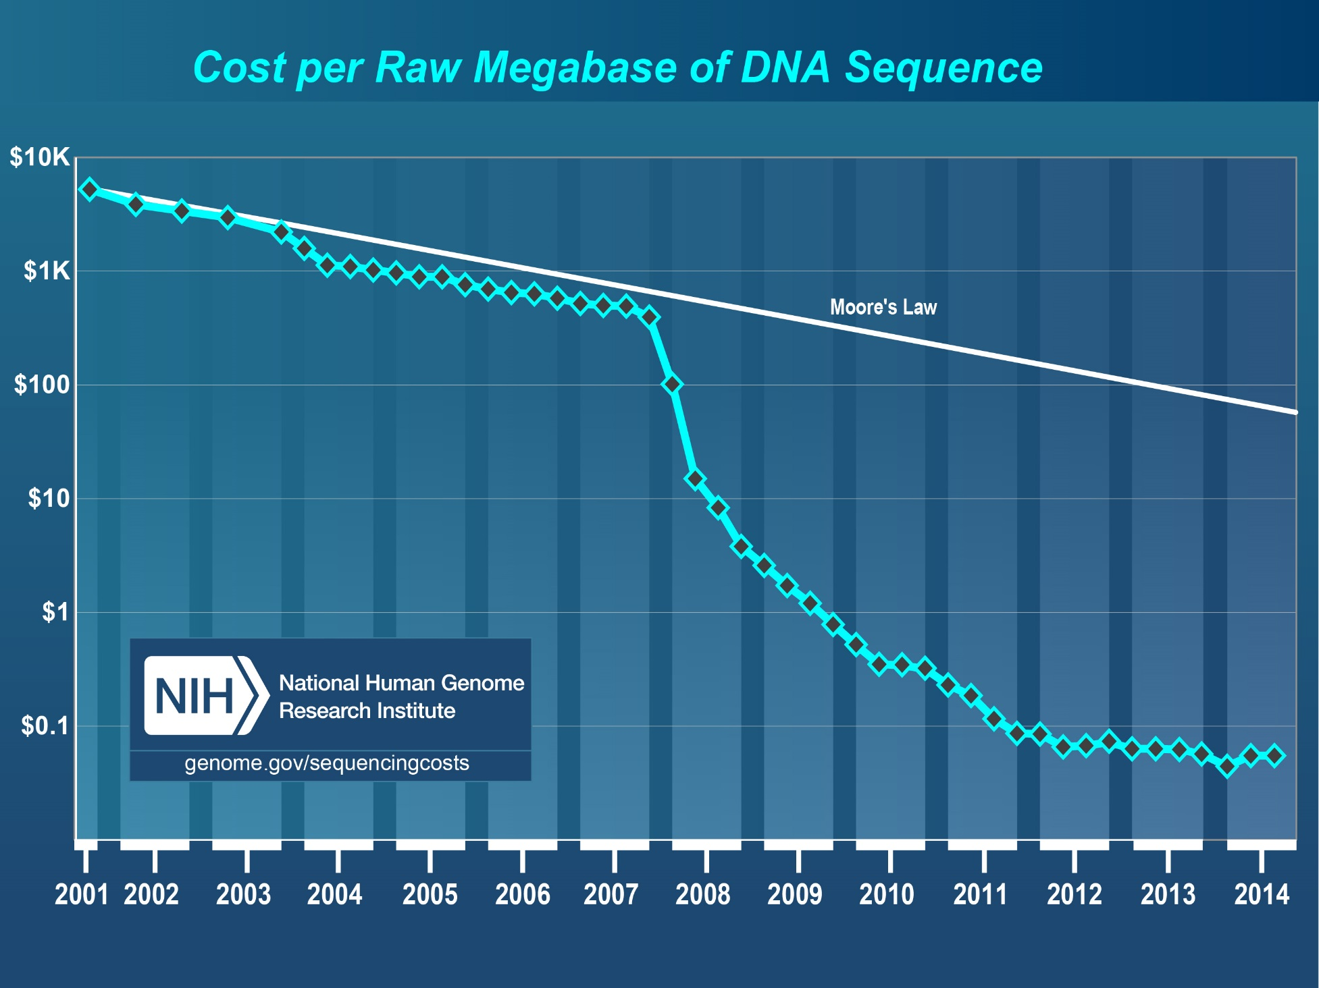

Slide 54
Interpreting Genetic Effects
β_{j} is the average treatment effect from changing an individual’s SNP at conception.
  Average over distribution of genotypes and environments.
    If include G×G and G×E interactions, combinatorial challenges.
    Our view: To limit hypotheses tested, find “main effects” first.
  Experiment is done in animals; hypothetical in humans.
  Not necessarily a structural parameter:
    Environmental mediation.
  Intervention can change effect.
  (Same points hold for polygenic scores.)

Slide 55
Outline
Conceptual Framework
Discovering Genetic Effects
GWAS and Educational Attainment

Slide 56
Discovering Genetic Effects
A naïve approach would be to run the regression
If one could measure all J SNPs in the genome, would fail the rank condition.
It is standard to instead run K << J separate regressions,
for each of K SNPs.
  If SNPs uncorrelated, get unbiased estimates.
  In fact, issue of identifying causal SNP.

Slide 57
Candidate-Gene Study (K small)
Specify ex ante hypotheses about small set of SNPs based on believed biological function.
Set significance threshold α = .05 / K.
Virtually all existing work in social-science genetics. (Reviews: Ebstein, Israel, Chew, Zhong, and Knafo, 2010; Beauchamp et al., 2011; Benjamin et al., 2012)
Eminently reasonable and has worked in some cases. (e.g., APOE and Alzheimer’s)
But social-science results often fail to replicate.
  Weak hypotheses (except for highly proximal behaviors).
  Low power (in the small samples typically used).
  Population stratification.
  Uncorrected multiple hypothesis testing / publication bias.

Slide 58
Outline
Conceptual Framework
Discovering Genetic Effects
GWAS and Educational Attainment

Slide 59
The Power Problem
Existing studies reporting significant gene-behavior associations usually relied on samples in the range 50 to 3000. (Ebstein et al., 2010; Beauchamp et al., 2011; Benjamin et al., 2012)
Implicit assumption: SNPs have explanatory power R² ≥ 2%.
  But would be found in N ≈ 60,000 GWASs of cognitive performance (Davies et al., 2015) and personality (De Moor et al., forth.).
What effect sizes are reasonable to expect? Well-powered evidence from physical and medical literature:
  Smoking and CHRNA3: R² ≈ 0.5%.
  BMI and FTO: R² ≈ 0.3%.
  Largest identified SNP for height: R² ≈ 0.4%.
Therefore, it seems likely that many existing studies in social-science genetics are underpowered, implying a high false discovery rate. (Beauchamp et al., 2011; Benjamin et al., 2012)

Slide 60
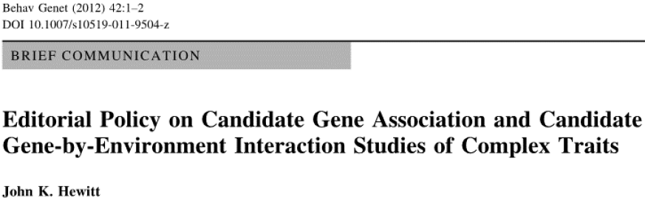
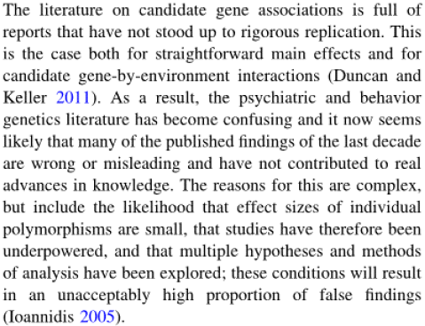
A Problem in Social-Science Genetics

Slide 61
Calibration: Power Analysis
Two alleles: High and Low.
Outcome distributed normally.
Either there is a true association or not.
If associated, R² = 0.02%.
Sample size for 80% power:
Next, suppose significant association at α = .05.
39,240.

Slide 62

Bayesian Analysis of a Candidate-Gene Study
(based on Wacholder et al., 2004; Ioannidis, 2005; Benjamin et al., 2012)
Given significant at α = .05, posterior probability of true association with effect size R² = 0.02%.
 |  | Sample size
 |  | N = 100 (power = .05) |  | N = 10,000 (power = .29) |  | N = 100,000 (power = .99)
Prior prob-ability | 0.1% | 0.1% |  | 0.6% |  | 2%
 | 1% | 1% |  | 6% |  | 17%
 | 5% | 5.2% |  | 24% |  | 51%
 | 10% | 10.4% |  | 39% |  | 69%
Calculated by Bayes’ Rule:

Slide 63
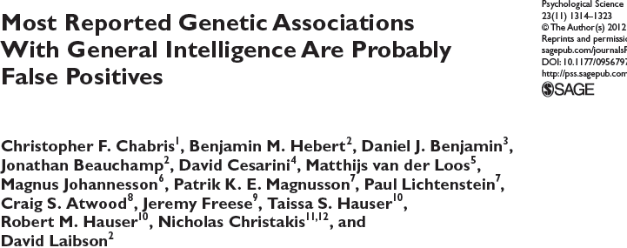

Slide 64
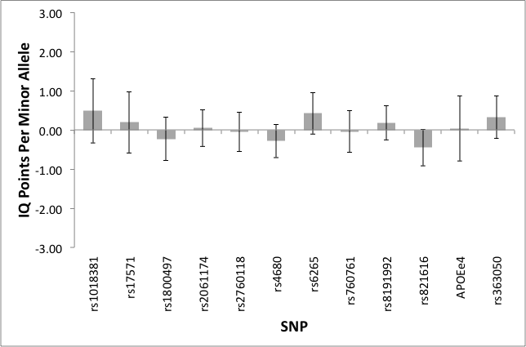
Pooled estimates (11 SNPs + APOE)
Notes:
This figure shows the pooled estimated regression coefficients from the three studies, weighted by the inverse by the variance of the estimate. We have followed the convention of standardizing the dependent variable so that its standard deviation is sixteen, and as you can see we can usually rule out effects larger than 1/16 SD. This graph illustrates a pattern of results that are all too common in the candidate gene literature. It used to be the case that the talk ended with pessimistic news, leaving our audiences disappointed and frustrated and wanting more, but fortunately… we think we have recently turned a corner.

Slide 65
Outline
Conceptual Framework
GWAS and Educational Attainment

Slide 66
Genetic Effects
Let i index individuals; j index SNP.
Let y_{i} denote some outcome of interest.
Linear approximation to true model:
μ : population mean of the outcome.
x_{ij} : genotype ∈ {0,1,2} of person i for SNP j.
β_{j} : effect of SNP j.
ε_{i} : effect of residual factors.

Slide 67
Genome-Wide Association Study (GWAS)
Atheoretical testing of all SNPs measured on the chip (typically 0.5-5 million).
Set significance threshold α = 5 × 10⁻⁸ (since ≈1 million independent SNPs in genome).
Hypothesis-free design makes the need to correct for multiple hypothesis testing transparent.
It is standard practice to control for principal components of the GWAS data—helps with population stratification.

Slide 68
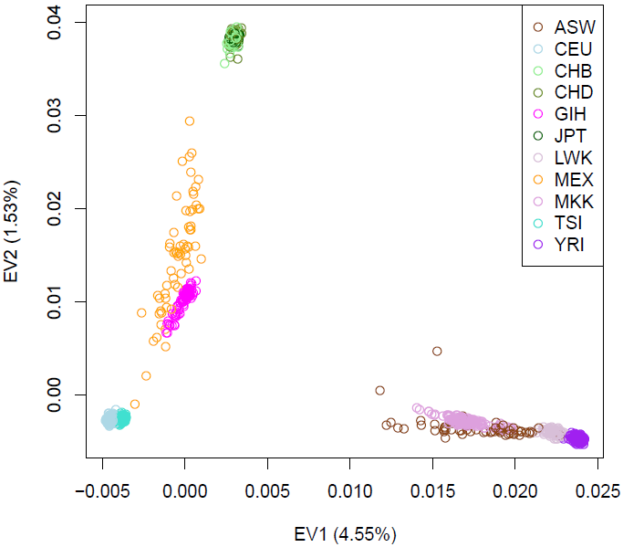
First 2 PCs in HapMap3 (N = 1230)
Source: HRS Quality Control Report (2012).

Slide 69
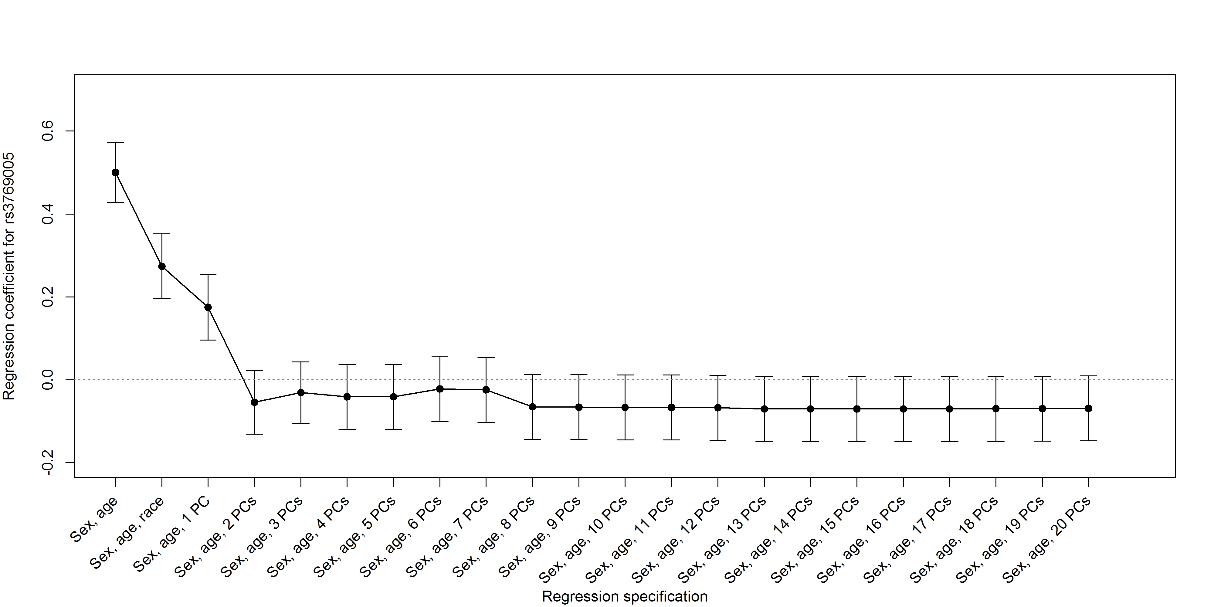
Reducing a Spurious Association: LCT and Educational Attainment in HRS
(N = 12,403)

Slide 70
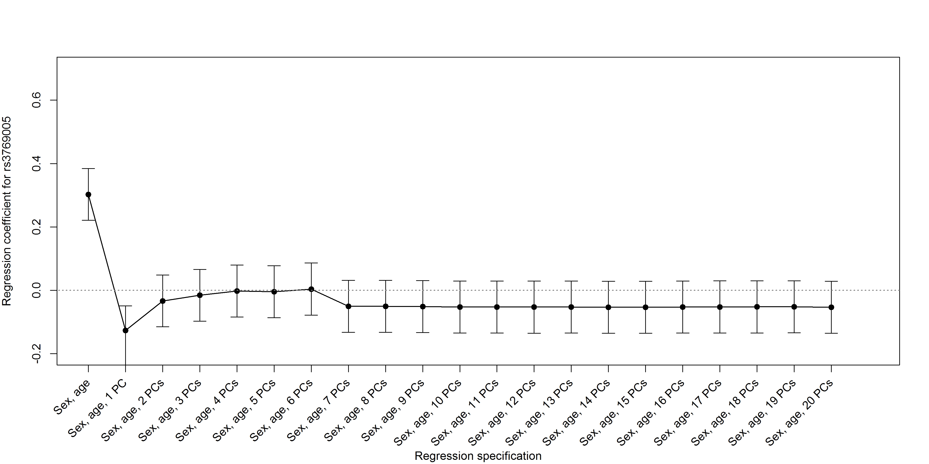
Restricting to Self-Reported “Whites” May Not Be Sufficient
(N = 10,187)

Slide 71
Genome-Wide Association Study (GWAS) (K large)
Atheoretical testing of all SNPs measured on the chip (typically 0.5-2.5 million).
Set significance threshold α = 5 × 10⁻⁸ (since ≈1 million independent SNPs in genome).
Hypothesis-free design makes the need to correct for multiple hypothesis testing transparent.
It is standard practice to control for principal components of the GWAS.
Vast reduction in false positives.

Slide 72
Bayesian Analysis of a GWAS
(based on Benjamin et al., 2012, Annual Reviews of Economics)
Given significant at α = 5 × 10⁻⁸, posterior probability of true association with effect size R² = 0.02%.
 |  | Sample size
 |  | N = 100 (power = .00) |  | N = 10,000 (power = .00) |  | N = 100,000 (power = .16)
Prior prob-ability | 0.1% | 0.13% |  | 36% |  | 100%
 | 1% | 1.3% |  | 85% |  | 100%
 | 5% | 7% |  | 97% |  | 100%
 | 10% | 13% |  | 98% |  | 100%
Calculated by Bayes’ Rule:
α

Slide 73
The SSGAC
Medical genetics literature: for novel gene discovery, require very large samples (> 100,000) and genome-wide significance (p < 5 × 10⁻⁸).
  “Consortia” meta-analyze results from GWASs in many samples.
Dan Benjamin, David Cesarini, and Phil Koellinger formed a consortium: the SSGAC.
What outcomes to study?
  In tradeoff between larger sample and higher-quality measure, given plausible effect sizes, larger sample gives more power. (Chabris et al., 2013)
Proof-of-concept: education attainment, available in many medical datasets.
Notes:
One can imagine a number of constructive responses to the power problem, and here I want to focus on one. In the medical world, researchers have responded to the reality that most genetic effects on medical traits are small by encouraging data pooling to increase sample size and statistical power. With Dan and David, and Philipp Koellinger at Erasmus University, I have tried to create a similar research infrastructure for social science outcomes. We call this infrastructure the SSGAC and it is run under the auspices of the CHARGE consortium. Our first ongoing project is on educational attainment, not because we think it is the ideal phenotype, but because it is available in a large sample.

Slide 74
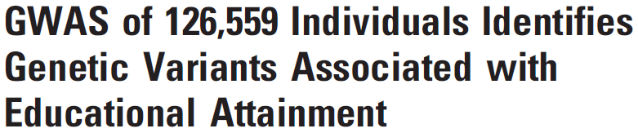

Social Science Genetics Association Consortium:
Dan Benjamin, David Cesarini, Philipp Koellinger

Slide 76
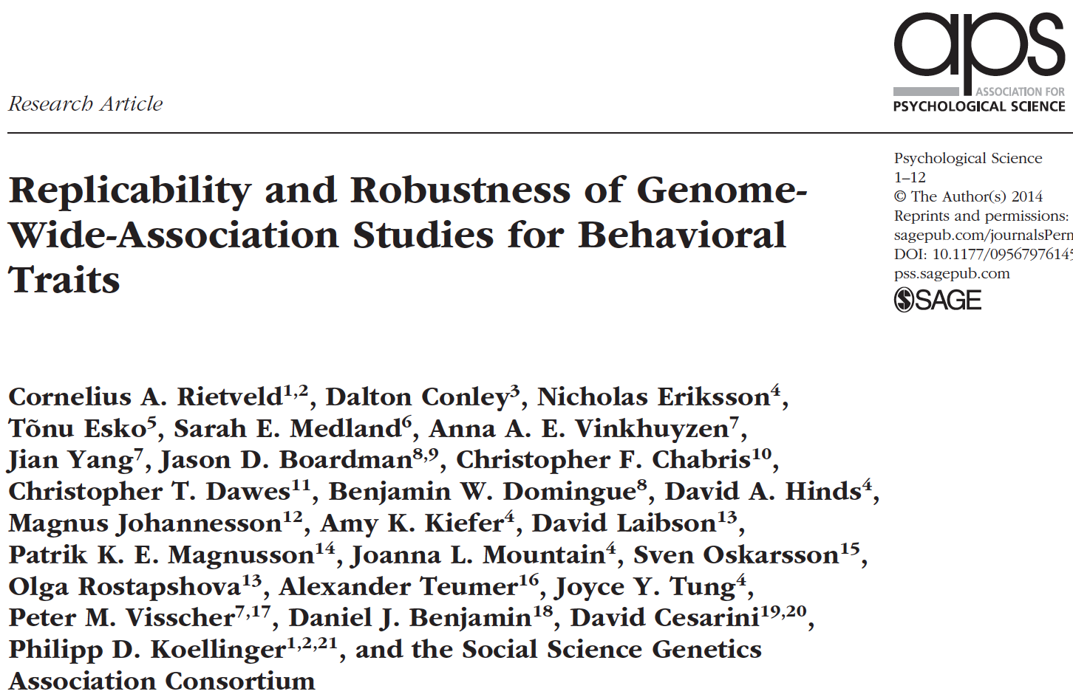

Slide 77
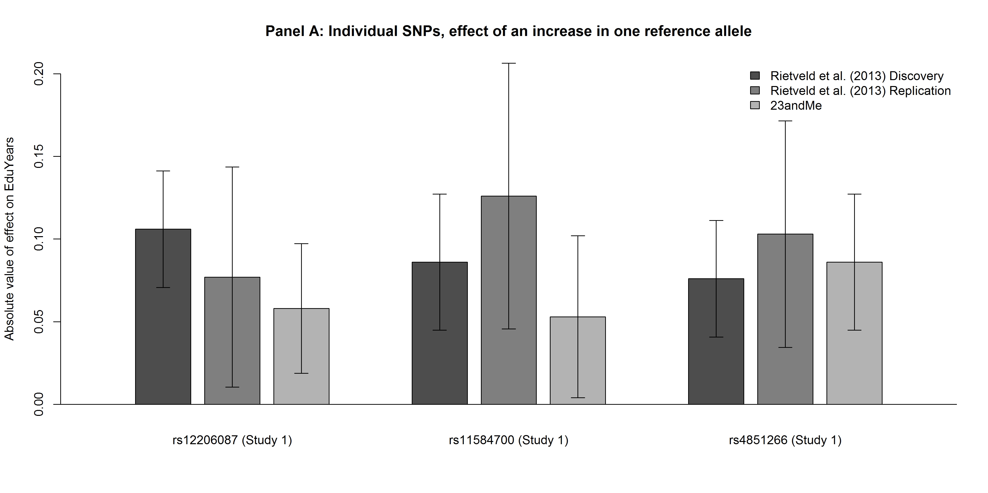
Effect size R² ≈ 0.02% an order of magnitude smaller than for complex physical / medical traits.

Slide 78
EA2.0: Okbay et al (Nature 2016)
Social Science Genetics Association Consortium
63 datasets with sample size of N = 293,723.
Similar analysis plan as EA1.0, except:
  Newer reference panel (1000G instead of HapMap2).
  Controlled for 10 PCs (rather than 4).
  No replication phase (as in recent very large GWAS: Wood et al., 2014; Ripke et al., 2014; Locke et al., 2015).
  Focus on years of schooling.
Found 74 approximately uncorrelated genome-wide significant SNPs.
Notes:
One can imagine a number of constructive responses to the power problem, and here I want to focus on one. In the medical world, researchers have responded to the reality that most genetic effects on medical traits are small by encouraging data pooling to increase sample size and statistical power. With Dan and David, and Philipp Koellinger at Erasmus University, I have tried to create a similar research infrastructure for social science outcomes. We call this infrastructure the SSGAC and it is run under the auspices of the CHARGE consortium. Our first ongoing project is on educational attainment, not because we think it is the ideal phenotype, but because it is available in a large sample.

Slide 79
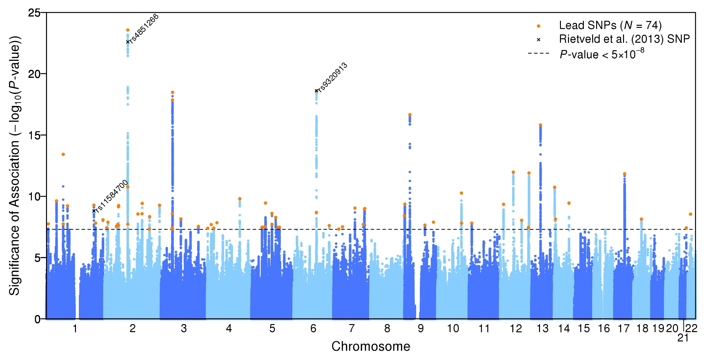

Slide 80
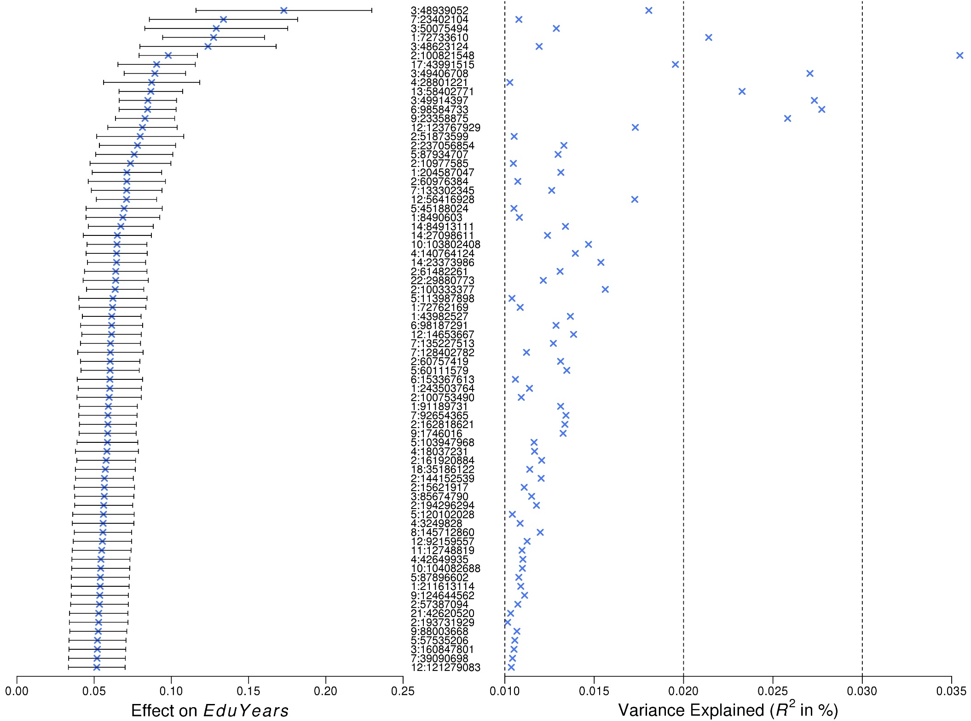

Slide 83
Polygenic Scores
Some uses of genetic data only require prediction.
Cumulative predictive power of all SNPs (including non-significant SNPs) could be substantial.
If true model were known, R² would equal heritability.
If linear-model coefficients for SNPs were known, R² would equal “SNP heritability.”
  Can be estimated. (Yang et al., 2012)
  For educational attainment: ~0.20.

Slide 84
Polygenic Scores
From GWAS estimates, can construct “polygenic score”:
(Typically use coefficients from regression that controls for correlated SNPs.)
As N → ∞, better estimates β_{j}, and hence R² → SNP heritability.
EA1.0 (N ≈ 120,000): R² ≈ 2.5%.
EA2.0 (N ≈ 300,000): R² ≈ 4%.

Slide 85
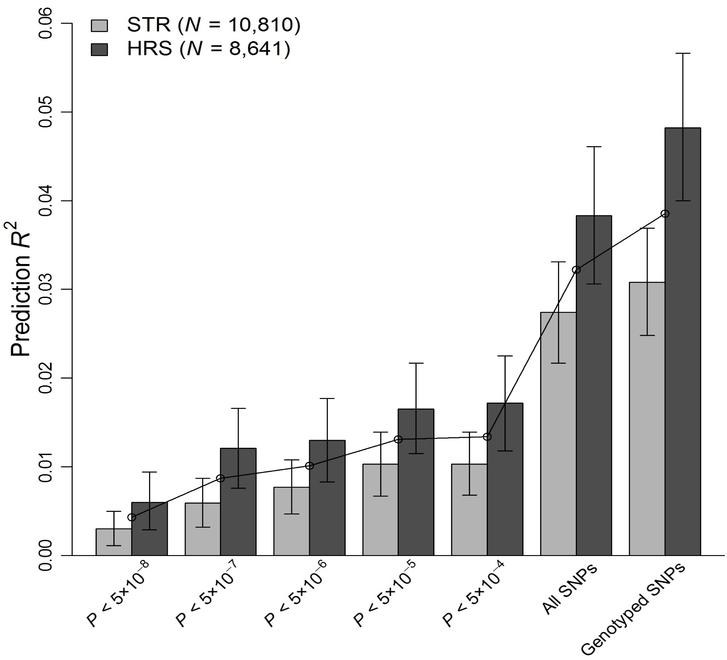

Slide 86
SSGAC Ongoing Projects
GWAS meta-analyses:
  Educational attainment 3.0 (N ≈ 650,000).
  Subjective well-being (N ≈ 300,000).
  Fertility (N ≈ 200,000): #children, age at first birth.
Growing N for GWAS of risk aversion, altruism, trust, and optimism.
Notes:
One can imagine a number of constructive responses to the power problem, and here I want to focus on one. In the medical world, researchers have responded to the reality that most genetic effects on medical traits are small by encouraging data pooling to increase sample size and statistical power. With Dan and David, and Philipp Koellinger at Erasmus University, I have tried to create a similar research infrastructure for social science outcomes. We call this infrastructure the SSGAC and it is run under the auspices of the CHARGE consortium. Our first ongoing project is on educational attainment, not because we think it is the ideal phenotype, but because it is available in a large sample.

Slide 87
Future Possibilities
Personalized medicine.
Planning for one’s own cognitive and health trajectory?
  Should some genetic data not be revealed? Huntington’s? APOE status?
Planning when to have children based on genetically predicted fertility?
Parents targeting learning environment and activities to children’s genes?
Differential taxes?

Slide 88
Outline:
Neuroeconomics: definition
Multiple Systems Hypothesis
Genoeconomics

