Slide 1
Behavioral Summer Camp
Structural Behavioral Economics
Stefano DellaVigna, UC Berkeley and NBER
July 4, 2016

Slide 2
Overview
Overheard in economics departments:
  “Is it best to do reduced-form or structural work?”
  “Structural estimation is hard but shows off skill”
  “Structural papers are just smoke-filled black boxes”
Today: I am going to try to argue
  Some form of structural estimation has real value
  It embodies some key messages from behavioral econ
  It is already more common than you think
  More is likely coming

Slide 3
Overview
What do we mean with structural?
  “Estimation of a model on data that recovers parameter estimates (and c.i.s) for some key model parameters”
Bad and good reasons to do structural BE
Two bad reasons to do structural BE:
  It sells well on the job market.
    -> Probably true, but don’t do it for that reason. There are much better reasons
  It makes up for poor identification and/or lack of power.
    -> Definitely a bad idea. You will need identification AND adequate power. Read cautionary tale of NIT experiments (e.g., Card, DellaVigna, and Malmendier JEP 2013)

Slide 4
Overview
Five good reasons to do Structural BE:
  (Calibration) It builds on, and expands, great behavioral tradition of calibrating models: Are magnitudes right?
  (Stability) Are key behavioral parameters stable across settings?
  (Model and Design) It leads to understand models better and can lead to better experimental design
  (Welfare and Policy) It allows for welfare evaluation and policy counterfactuals
  (Not so complex) It can be pretty straightforward

Slide 5
1. Calibration
Importance of calibrating models is lesson ONE from behavioral economics
Example 1: Inertia in retirement savings
  410k enrollment goes from 45% to 90% from opt-out to opt-in (Madrian-Shea 2001; Choi, Laibson, Madrian, Metrick 2002)
  Standard model can explain qualitative pattern given switching costs k
  But magnitudes? Costs would need to be ridiculous (O’Donoghue and Rabin, 1998)
  Instead, procrastination plausible for naïve β-δ model even with β very close to 1 (O’Donoghue and Rabin, 1999; 2001)
Example 2: Rabin (EMA 2000) calibration theorem on risk

Slide 6
1. Calibration
OK, Calibration is great. Why do we need estimation?
  (Estimation ≠ Calibration because pins down estimate, as opposed to range, and provides standard errors)
One reason: Hard to calibrate realistic (and complex) models
Return to example 1: Inertia in retirement savings
  O’Donoghue and Rabin (1998-2001) calibrations based on deterministic switching cost k
  But more realistic that switching cost k varies day-to-day (e.g., DellaVigna and Malmendier, 2006; Carroll et al., 2009)
  → Need to solve dynamic programming problem
  Changes result on beta calibration for procrastination

Slide 7
1. Calibration
Great example of estimate of inertia: Handel (AER 2013)
  Administrative data on health insurance choice within a company
  Analyze choice only among PPO plans, all by same insurer
  Only difference is premia and co-pay
  Year t: firm introduces new plans and require active choice
  Year t+1: some plans change, choice by default
  Estimate individual risk characteristics using year t-1 data → Can use to estimate (quite accurately) how much an employee loses (or gains) from a plan choice

Slide 8
1. Calibration
Great example in data: for a group, PPO_250 is dominated in year t+1 (but not in year t)
Do employees still choose it at t+1? 80% do!

Slide 9
1. Calibration
Structural estimation
  Assumes individuals have value for insurance based on previous risk at t-1
  Models the switching cost as cost k to pay when switch (no cost in year t when active choice)
  Maximum likelihood estimation: $2,000!
  Clearly unlikely to capture administrative costs
  More likely captures procrastination or inattention
  (Precise) estimate of $2,000 drives home the point also to non-behavioral economists
  Needed structural estimation

Slide 10
1. Calibration
Other example: Ref.-dep. job search (DellaVigna et al.)
Last lecture: Ref.-dep. fits the exit from unemployment better (assuming hand-to-mouth)
BUT red.-dep. Workers are aware of loss utility at benefit decrease → Should save in anticipation
Important to endogenize consumption
  Estimate model with choice of s* and c* ( with log utility)
  Estimate also time preferences δ and β
  Model with estimated δ (and β=1)
  Model with estimated β (and δ =.995)

Slide 11
1. Calibration
  Fit of ref. dep. Model similar with β model and δ model
  BUT δ model has 15-day δ=.9 (implausible impatience)
  β model instead has β =.6 (in range of other estimates)
  This “calibration” could only be done with full estimation

Slide 12
2. Stability
  Behavioral economics has advantage of broad agreement on some key models:
    Beta-delta model of time preference (Laibson, 1997)
    Reference-dependence model of time preferences (Kahneman and Tersky, 1979)
    k levels of thinking?
  Key validation for these models: Is there reasonable degree of agreement in key parameters across settings?
  → Structural estimation of models in different settings
  We start to have that for beta-delta model
  Example: One of earliest examples of Structural BE: Laibson, Repetto, and Tobacman (2007) on consumption-savings (now Laibson, Maxted, Repetto, Tobacman, 2016)

Slide 13
Empirical Moments used in Method of Simulated Moments
 | % Visa 21-30 | 0.815
 | % Visa 31-40 | 0.782
 | % Visa 41-50 | 0.749
 | % Visa 51-60 | 0.659
 | mean Visa 21-30 | 0.199
 | mean Visa 31-40 | 0.187
 | mean Visa 41-50 | 0.261
 | mean Visa 51-60 | 0.276
 | wealth 21-30 | 1.23
 | wealth 31-40 | 1.86
 | wealth 41-50 | 3.24
 | wealth 51-60 | 5.34

Slide 14
STRUCTURAL ESTIMATION RESULTS
 |  | Present Biased | Exponential | Data
Parameter estimates
 |  | 0.5054 | 1 | -
 |  | (0.1481) | - | -
 |  | 0.9872 | 0.8926 | -
 |  | (0.0089) | (0.0083) | -
 | CRRA | 1.2551 | 1.0047 | -
 |  | (0.1564) | (0.2857) | -
Second-stage moments
 | % Visa 21-30 | 0.598 | 0.704 | 0.815
 | % Visa 31-40 | 0.607 | 0.693 | 0.782
 | % Visa 41-50 | 0.588 | 0.654 | 0.749
 | % Visa 51-60 | 0.569 | 0.601 | 0.659
 | mean Visa 21-30 | 0.232 | 0.204 | 0.199
 | mean Visa 31-40 | 0.237 | 0.225 | 0.187
 | mean Visa 41-50 | 0.217 | 0.210 | 0.261
 | mean Visa 51-60 | 0.196 | 0.193 | 0.276
 | wealth 21-30 | 1.299 | 0.441 | 1.23
 | wealth 31-40 | 1.819 | 0.015 | 1.86
 | wealth 41-50 | 2.925 | -0.047 | 3.24
 | wealth 51-60 | 5.020 | -0.035 | 5.34

Slide 15
STRUCTURAL ESTIMATION RESULTS
 |  | Present Biased | Exponential | Data
Parameter estimates
 |  | 0.5054 | 1 | -
 |  | (0.1481) | - | -
 |  | 0.9872 | 0.8926 | -
 |  | (0.0089) | (0.0083) | -
 | CRRA | 1.2551 | 1.0047 | -
 |  | (0.1564) | (0.2857) | -
Second-stage moments
 | % Visa 21-30 | 0.598 | 0.704 | 0.815
 | % Visa 31-40 | 0.607 | 0.693 | 0.782
 | % Visa 41-50 | 0.588 | 0.654 | 0.749
 | % Visa 51-60 | 0.569 | 0.601 | 0.659
 | mean Visa 21-30 | 0.232 | 0.204 | 0.199
 | mean Visa 31-40 | 0.237 | 0.225 | 0.187
 | mean Visa 41-50 | 0.217 | 0.210 | 0.261
 | mean Visa 51-60 | 0.196 | 0.193 | 0.276
 | wealth 21-30 | 1.299 | 0.441 | 1.23
 | wealth 31-40 | 1.819 | 0.015 | 1.86
 | wealth 41-50 | 2.925 | -0.047 | 3.24
 | wealth 51-60 | 5.020 | -0.035 | 5.34

Slide 16
STRUCTURAL ESTIMATION RESULTS
 |  | Present Biased | Exponential | Data
Parameter estimates
 |  | 0.5054 | 1 | -
 |  | (0.1481) | - | -
 |  | 0.9872 | 0.8926 | -
 |  | (0.0089) | (0.0083) | -
 | CRRA | 1.2551 | 1.0047 | -
 |  | (0.1564) | (0.2857) | -
Second-stage moments
 | % Visa 21-30 | 0.598 | 0.704 | 0.815
 | % Visa 31-40 | 0.607 | 0.693 | 0.782
 | % Visa 41-50 | 0.588 | 0.654 | 0.749
 | % Visa 51-60 | 0.569 | 0.601 | 0.659
 | mean Visa 21-30 | 0.232 | 0.204 | 0.199
 | mean Visa 31-40 | 0.237 | 0.225 | 0.187
 | mean Visa 41-50 | 0.217 | 0.210 | 0.261
 | mean Visa 51-60 | 0.196 | 0.193 | 0.276
 | wealth 21-30 | 1.299 | 0.441 | 1.23
 | wealth 31-40 | 1.819 | 0.015 | 1.86
 | wealth 41-50 | 2.925 | -0.047 | 3.24
 | wealth 51-60 | 5.020 | -0.035 | 5.34

Slide 17
STRUCTURAL ESTIMATION RESULTS
 |  | Present Biased | Exponential | Data
Parameter estimates
 |  | 0.5054 | 1 | -
 |  | (0.1481) | - | -
 |  | 0.9872 | 0.8926 | -
 |  | (0.0089) | (0.0083) | -
 | CRRA | 1.2551 | 1.0047 | -
 |  | (0.1564) | (0.2857) | -
Second-stage moments
 | % Visa 21-30 | 0.598 | 0.704 | 0.815
 | % Visa 31-40 | 0.607 | 0.693 | 0.782
 | % Visa 41-50 | 0.588 | 0.654 | 0.749
 | % Visa 51-60 | 0.569 | 0.601 | 0.659
 | mean Visa 21-30 | 0.232 | 0.204 | 0.199
 | mean Visa 31-40 | 0.237 | 0.225 | 0.187
 | mean Visa 41-50 | 0.217 | 0.210 | 0.261
 | mean Visa 51-60 | 0.196 | 0.193 | 0.276
 | wealth 21-30 | 1.299 | 0.441 | 1.23
 | wealth 31-40 | 1.819 | 0.015 | 1.86
 | wealth 41-50 | 2.925 | -0.047 | 3.24
 | wealth 51-60 | 5.020 | -0.035 | 5.34

Slide 18
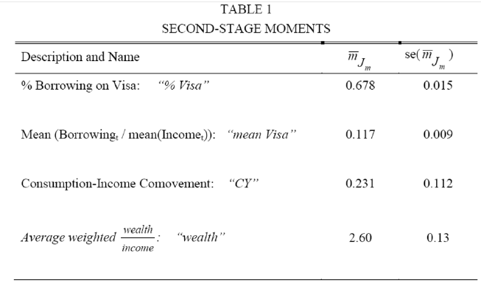
2. Stability
Start from set of moments
Very different precision; not much weight on third moment
Notes:
18

Slide 19
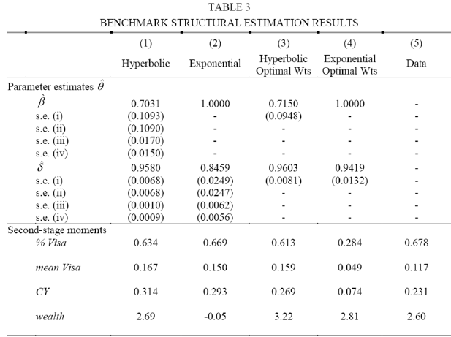
2. Stability
Notes:
19

Slide 20
2. Stability
  Compare to other estimates
  Paserman (EJ 2008) – Estimate beta-delta model of job search decisions for unemployed workers from DellaVigna and Paserman (JOLE) [maximum likelihood]
  Augenblick, Niederle and Sprenger (QJE 2015) – Estimate beta-delta from real-effort decision over time
  Augenblick and Rabin (2015) – Estimates beta and beta hat from real effort over time [maximum likelihood]
  Augenblick (2016) – Estimate beta at different time distances using real effort over time [maximum likelihood]

Slide 21
3. Model and Design
Structural estimation forces to take model more seriously
  Sketch of model will not suffice
  Full specification in order to do estimation
  Forces to work out details
For experiments, important to set up estimation as much as possible before running experiment
Benefit of model-based experiment (Card, DellaVigna, and Malmendier JEP 2011) → Will lead to improved design
Example: DellaVigna, List, and Malmendier (QJE 2012) for charitable giving
Notes:
21

Slide 22
3. Model and Design
Assume donor asks money and I give
  Did I give because it increased my utility (altruism/warm glow)?
  O did I give because I felt bad saying no, even though I wanted to avoid the ask (social pressure)?
Step 1. Idea for field experiment design:
  Do door-to-door field experiment
  Run treatment group with flyer
  Run control group with no flyer
  Estimate effect on % answering and % giving
  Both should go up with altruism, down with social pressure
Notes:
22

Slide 23
3. Model and Design
Step 2. Write simple model
  Altruism a for charity
  Social pressure cost S if say no to giving in person
  No cost if not at home
  Individuals can sort in/out at a convex cost c
Insights from writing model:
  New outcome variable: Different effects for small and large donations
  New treatment 1: Add opt-out treatment to design to facilitate sorting out
  New treatment 2: If only we could estimate sorting cost c, could identify altruism and social pressure parameters
Notes:
23

Slide 24
3. Model and Design
Effect of flyers (with opt-out) on fund-raising is to lower small giving → Social pressure
Could one use this to identify key parameters?
Notes:
24

Slide 25

3. Model and Design
  Obstacle to identification: Hard to pin down key parameters -- altruism and social pressure --, unless we control for nuisance parameter -- cost of sorting
  Thought experiment: If flyers lower share at home by 10 percent, is that a 3c or $5 gain from sorting?
  Need extra treatments to identify cost of sorting
  Observational data: You’d be stuck!
  Field experiments: You can, in fact should, design extra treatments when needed for identification
  Still in design phase, we added survey treatments to estimate elasticity with respect to $ and time
Notes:
25

Slide 26
3. Model and Design
Survey experiments that give elasticity
Notes:
26

Slide 27
3. Model and Design
Survey experiments that give elasticity
Notes:
27

Slide 28
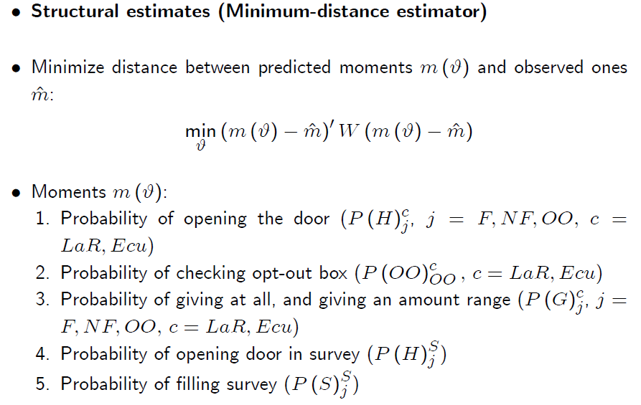
3. Model and Design
Notes:
28

Slide 29
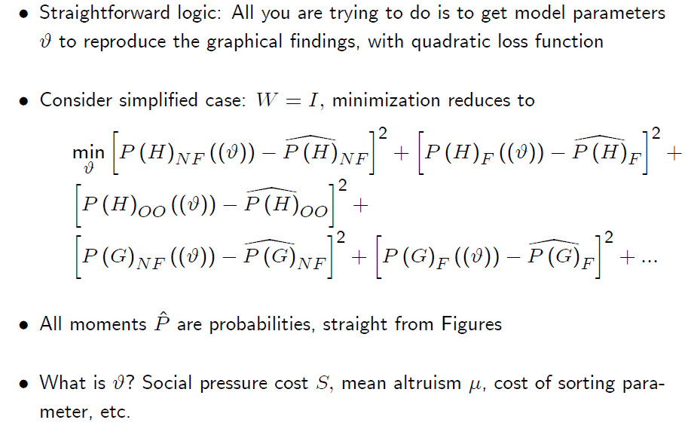
3. Model and Design
Notes:
29

Slide 30
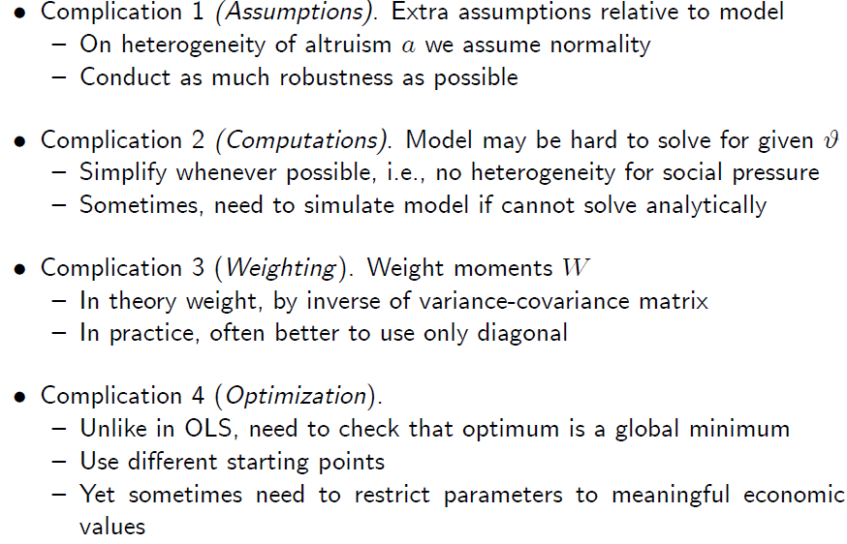
3. Model and Design
Notes:
30

Slide 31
Notes:
31

Slide 32
4. Welfare and Policy
  Advantage of estimating model is… you can use it!
    Compute welfare of setting versus counterfactuals
    Estimate effect of potential policies
  Return to previous papers:
    DellaVigna, List, and Malmendier (QJE 2012) on charity
    Handel (AER 2013) on health insurance

Slide 33
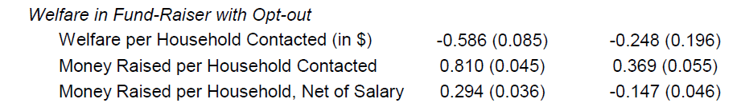
4. Welfare and Policy: Charity
Welfare effect in DLM: Do fund-raisers raise welfare?
  With only altruism: Yes, of course!
  With social pressure: No, welfare effect can be negative
    All non-donors pay social pressure cost
    Only few donors get warm glow
  Does that mean that fund-raisers should be limited? No
    Can introduce opt-out option as a win-win solution
Notes:
33

Slide 34
4. Welfare and Policy: Health Insurance
Handel (AER 2013) considers welfare effect of policy that reduces switching costs from k to .25k
Partial equilibrium: average gain of $100
General equilibrium
  Need to take into account effects on pricing
  Lowering inertia will worsen adverse selection
  Health insurance firms need to raise price
Notes:
34

Slide 35
Structural Behavioral Economics - More
Other examples of Structural Behavioral economics
  Conlin, O’Donoghue, Vogelsang (AER 2007) – Estimate projection bias parameter in decision to return cold weather items [maximum likelihood]
  DellaVigna, List, Malmendier, and Rao (2012) – Estimate why people vote, and why people lie about voting, using field experiment [minimum distance]
  Lacetera, Pope, and Sydnor (AER forthcoming) – Inattention to left-digit bias for odometer readings [OLS!]
Notes:
35

Slide 36
5. Structural and Complexity
Structural work does require longer time generally:
  Set up a (full) model
  Organize and analyze data
  Estimate model on data, often with lengthy computer runs
BUT structural model can be simple
  Especially if rich data provides necessary variation
  OR if data collection / experiment is set up to make estimation simple
Notes:
36

Slide 37
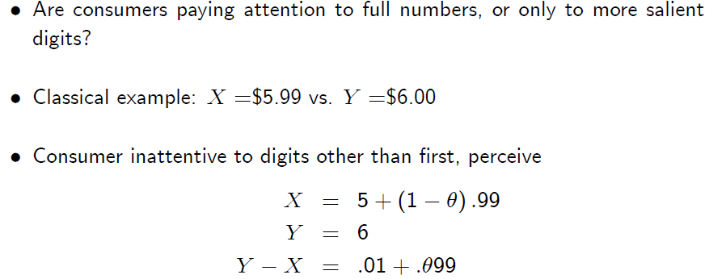
5. Structural and Complexity
Lacetera, Pope, and Sydnor (AER 2012) – Inattention to left-digit bias for odometer readings
Estimate how value of a used car is affected by mileage, and inattention to second digit (e.g., 19,900 miles vs. 20,010 miles)
Notes:
37

Slide 38
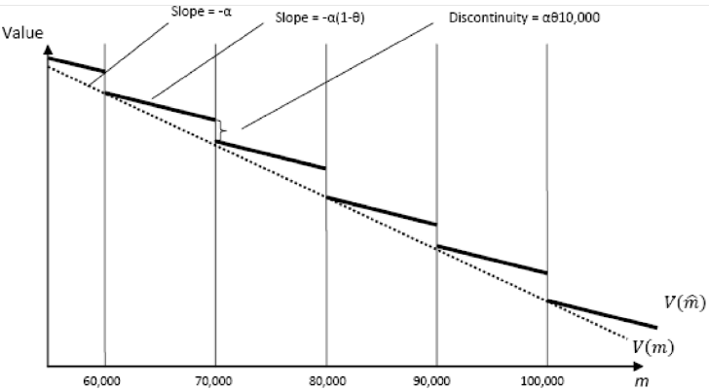
5. Structural and Complexity
Model of impact of odometer reading on value
Notes:
38

Slide 39
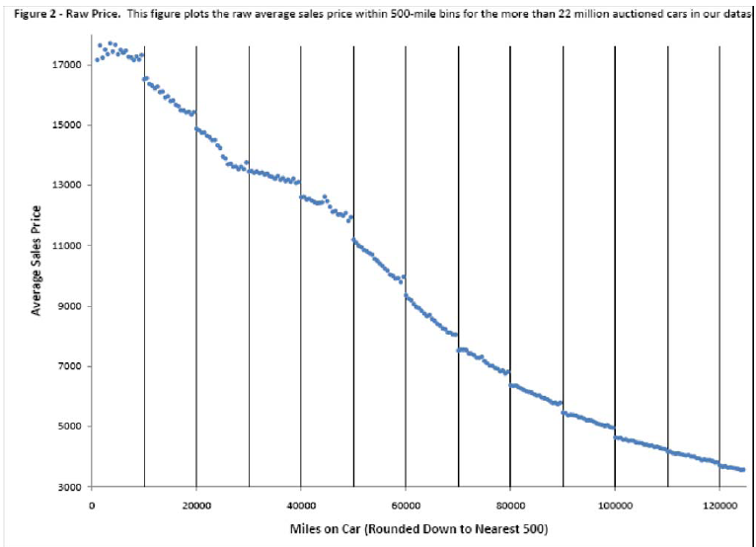
5. Structural and Complexity
Using 22 million (!) used car auction transactions
Notes:
39

Slide 40
5. Structural and Complexity
Estimate of inattention coefficient
  Use OLS regressions to obtain slope
  Use regression discontinuity design to obtain discontinuity at round number
  Divide the coefficients and transform to obtain estimate of limited attention parameter (use delta method for s.e.s):
  Θ = 0.31 (s.e. 0.01)
  Much better precision, but similar estimate relative to previous limited attention papers (e.g. DellaVigna, JEL 2009)
  Structural estimation can be as simple as OLS
  Also, return to yesterday’s lecture: NLS in gift exchange easy (DellaVigna, List, Malmendier, and Rao 2016)
Notes:
40

Slide 41
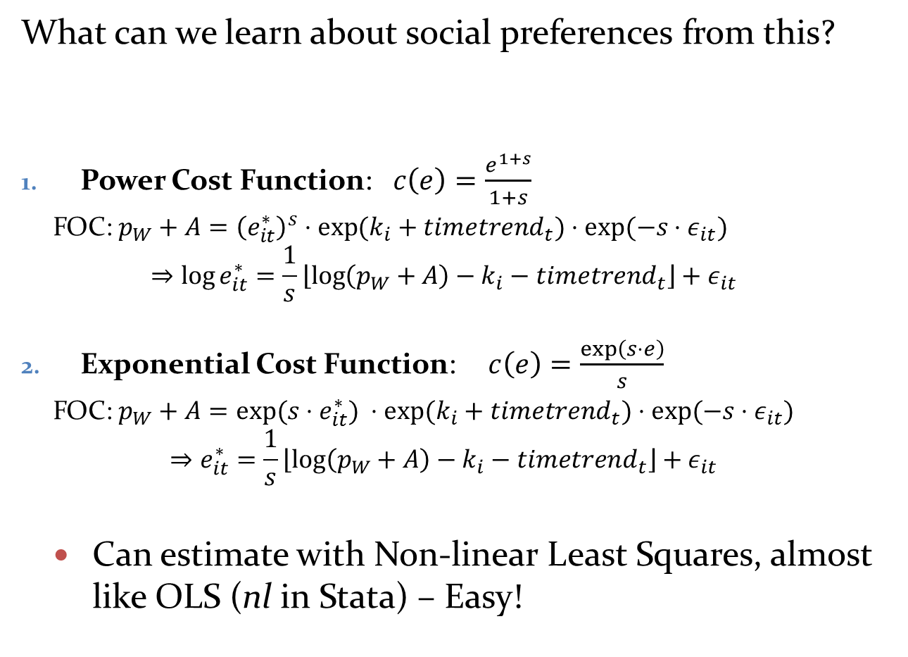
5. Structural and Complexity
What can we learn about social preferences from this?
Power Cost Function: $c\left(e\right)=\frac{e^{1+s}}{1+s}$
  FOC: $p_{W}+A={\left(e_{it}^{∗}\right)}^{s}⋅{\exp{(k}}_{i}+timetrend_{t})⋅exp⁡(−s⋅ε_{it})$
  $$⇒\log{e_{it}^{∗}}=\frac{1}{s}\left\lfloor \log\left(p_{W}+A\right)−k_{i}−timetrend_{t}\right\rfloor +ε_{it}$$
Exponential Cost Function: $c\left(e\right)=\frac{\exp\left(s⋅e\right)}{s}$
  FOC: $p_{W}+A=exp⁡(s{⋅e}_{it}^{∗}) ⋅{\exp{(k}}_{i}+timetrend_{t})⋅exp⁡(−s⋅ε_{it})$
  $$⇒e_{it}^{∗}=\frac{1}{s}\left\lfloor \log\left(p_{W}+A\right)−k_{i}−timetrend_{t}\right\rfloor +ε_{it}$$
  Can estimate with Non-linear Least Squares, almost like OLS (nl in Stata) – Easy!
Notes:
41

Slide 42
5. Structural and Complexity
Notes:
INSERT 8 period model here
→ Uses date from first 8 rounds
42

Slide 43
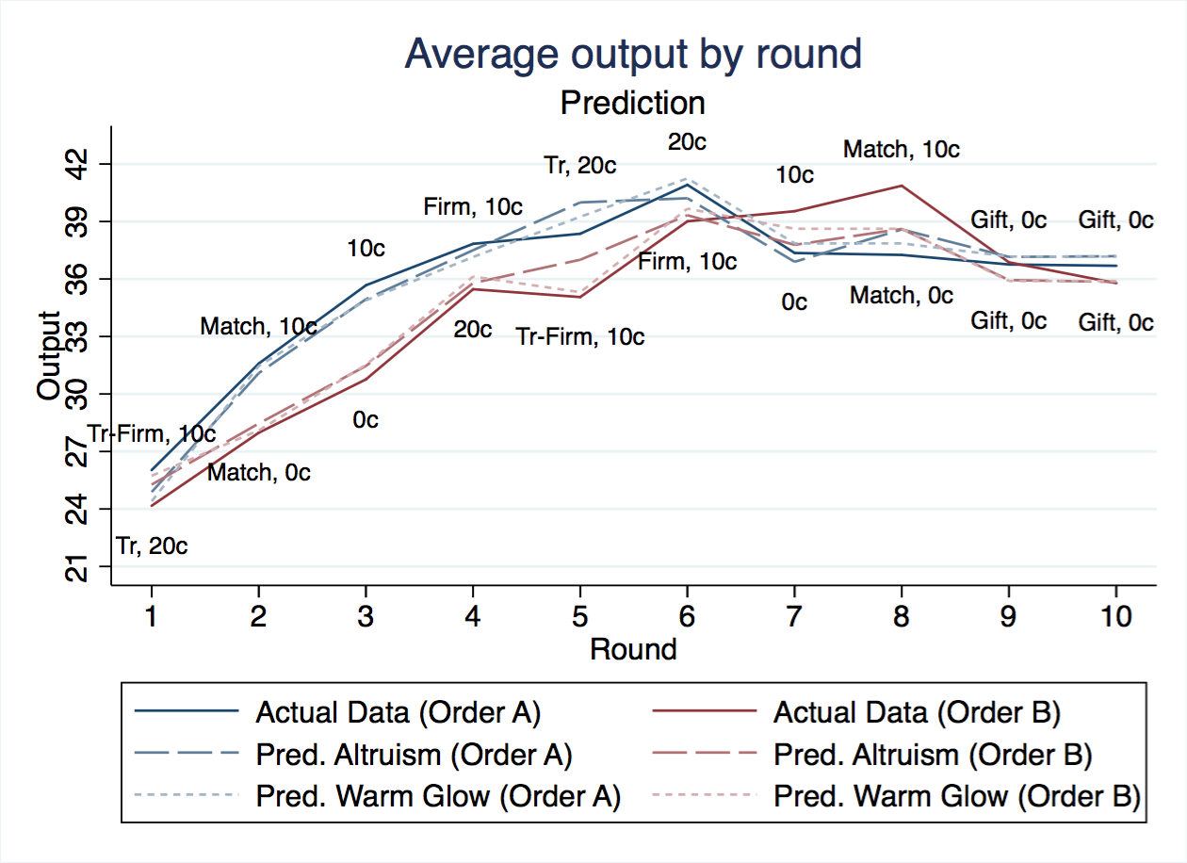
5. Structural and Complexity
Overall, very good fit of data

Slide 44
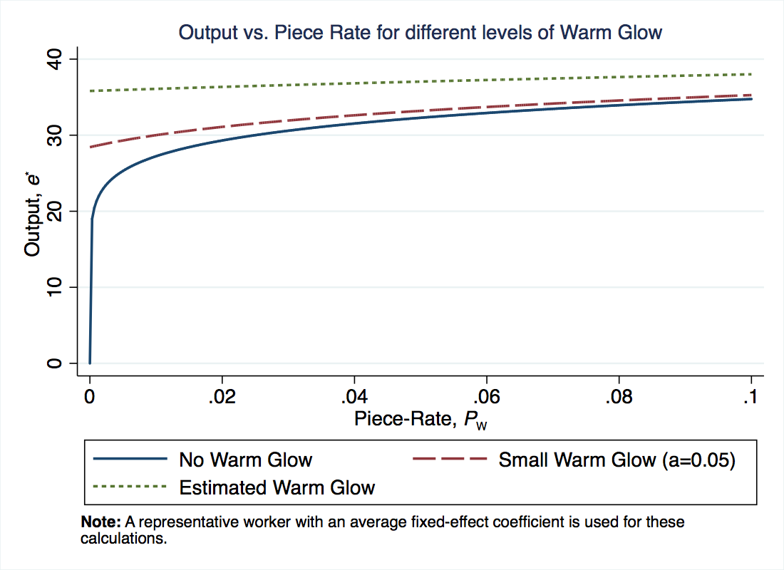
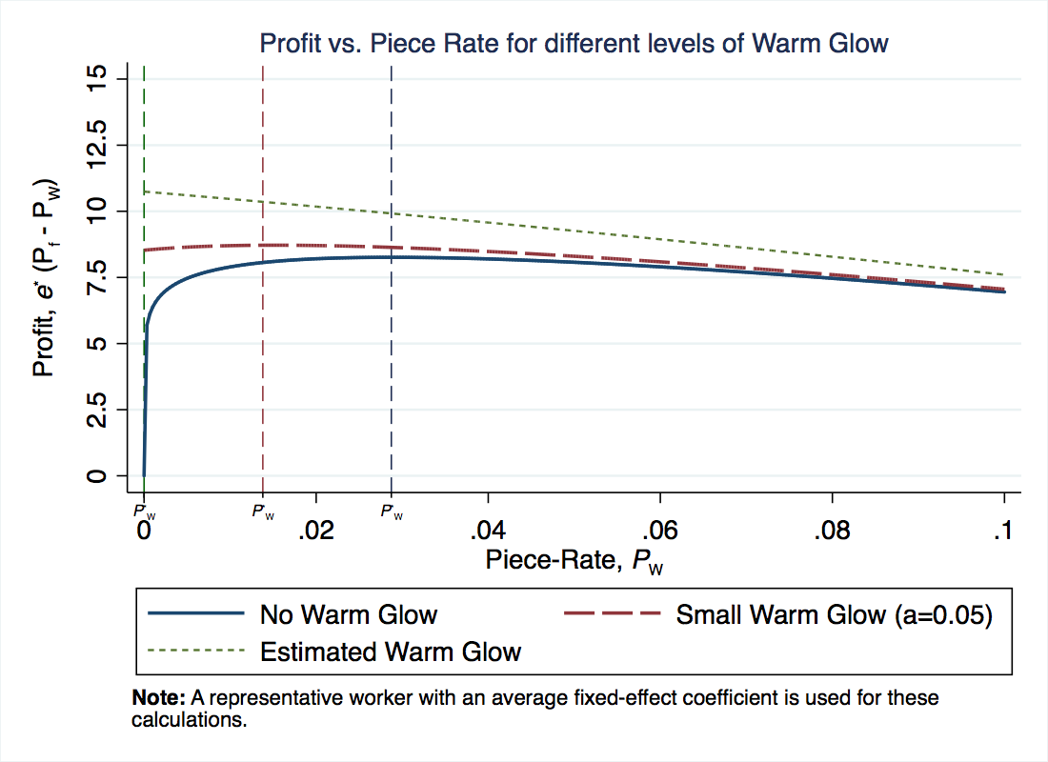
5. Structural and Complexity
What does this imply for optimal incentives?
  Consider effect of piece rate increases (for fixed flat pay)
  With no warm glow, steep increase in output and profit
  With warm glow, only marginal increases in output → Optimal incentive is no piece rate
  Social preferences substitute for piece rate incentives

Slide 45
Conclusion
Some important caveats
  (Time) Papers do generally take longer
  (Length) Papers also get longer and harder to read
  (but AER is finally removing page limit)
  (Identification) Risk that one loses track of identification
Summary: Behavioral economics is normal science
As such, we should see a variety of approaches used in empirical work, including structural estimates
Notes:
45

