Slide 1
Behavioral Summer Camp
Behavioral Labor Economics
Stefano DellaVigna, UC Berkeley and NBER
July 5, 2016

Slide 2
Behavioral Economics by Field
1980s on
Behavioral Finance (Asset Pricing)
  Violations of efficient markets, later models
1990s on
Behavioral Household Finance
  Retirement Savings, Inertia, Underdiversification
2000 on
Behavioral Corporate Finance
  Market Timing, Overconfidence managers

Slide 3
Behavioral Economics by Field
Early 2000s on
Behavioral Development Economics
  Social preferences, self-control
Behavioral Industrial Organization
  Firms best responding to consumer self-control, inattention, reference dependence

Slide 4
Behavioral Economics by Field
Last 5 years
Behavioral Public Finance
  Taxation and limited attention/self-control, benefit (non-)take up
Behavioral Health Economics
  Insurance choice, co-pay effects
Behavioral Political Economy
  Voters with social preferences, ref. dep., limited attent.
Behavioral Education Economics
  SMS messaging

Slide 5
Behavioral Economics by Field
Behavioral Labor Economics?
  Work since beginning
  Understanding inter-industry wage differentials (Thaler, 1989)
  Fairness constraints (Kahneman-Knetsch-Thaler, 1986)
  Wage Bargaining (Babcock-Loewestein, 1997)
  Yet, did not quite pick up pace
  Happening now!
Discuss three main areas:
  Job Search
  Worker Effort
  Nominal Wage Rigidity

Slide 6
Job Search
Notes:
6

Slide 7
Job Search, beta-delta
Notes:
7

Slide 8
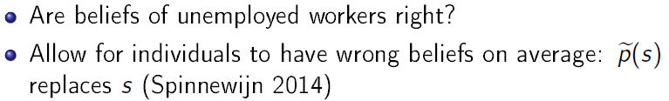
Job Search, overconfidence
Notes:
8

Slide 9
Job Search, overconfidence
Clear evidence for the first form of overconfidence
Very little known about the second (control overconfidence, Spinnewijn, 2015)
Notes:
9

Slide 10
Job Search, reference dependence
Notes:
10

Slide 11
Job Search, reference dependence
Notes:
11

Slide 12
Job Search, reference dependence
Notes:
12

Slide 13
Job Search, reference dependence
Notes:
13

Slide 14
Job Search, reference dependence
UI reform in Hungary remarkably similar to envisioned benefit change
Add one more step at 90 days
Keep generosity constant
Compare year before and year after reform
Notes:
14

Slide 15
Job Search, reference dependence
UI reform in Hungary displays patterns in hazards after 270 days strongly suggestive of reference dependence
Notes:
15

Slide 16
Job Search, reference dependence
Standard model Reference-dependent model
Estimate of two models:
  Standard model with unobserved heterogeneity (3 cost types)
  Model with reference dependences (and 2 cost types)
  Hold constant number of parameters
  Return to this tomorrow
Notes:
16

Slide 17
Job Search, reference dependence
Alternative approach: collect survey on search effort over time for a person → Control for heterogeneity
Kruger and Muller (2011) did it for UI recipients in NJ
BUT find seasaw pattern (survey fatigue)
DellaVigna and Schmieder: survey in Germany
  Weekly SMS question on search effort for 10k unempl.
Notes:
17

Slide 18
Worker Effort
What determines effort at the workplace?
  Explicit and implicit incentives (e.g., promotions)
  What about motivation and social preferences?
If motivation important for effort, may justify paying higher wages to trigger reciprocity (Akerlof 1981)
Two dimensions of motivation:
  Vertical Social Preferences (toward employer)
  Horizontal Social Preferences (toward co-employees)
Two dimensions of effort:
  Extra effort that helps the employer (e.g., fix production defect)
  Boycott that hurts employer (e.g., stealing stationery)
Notes:
18

Slide 19
Worker Effort
Notes:
19

Slide 20
Worker Effort
Notes:
20

Slide 21
Worker Effort
Notes:
21

Slide 22
Worker Effort
Notes:
22

Slide 23
Worker Effort
Notes:
23

Slide 24
Worker Effort
Notes:
24

Slide 25
Worker Effort
Notes:
25

Slide 26
Worker Effort
Notes:
26

Slide 27
Worker Effort
Notes:
27

Slide 28
Worker Effort
Notes:
28

Slide 29
Worker Effort
Notes:
29

Slide 30
Worker Effort
Notes:
30

Slide 31
Worker Effort
Notes:
31

Slide 32
Worker Effort
Notes:
32

Slide 33
Worker Effort
Notes:
33

Slide 34
Worker Effort
Notes:
34

Slide 35
Worker Effort
Notes:
35

Slide 36
Worker Effort
Notes:
36

Slide 37
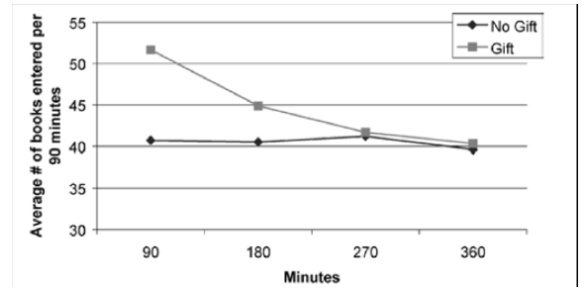
Worker Effort
Vertical and social preferences at work matter
But what if one wanted to pin down the model of worker effort and social preferences?
Designing experiment to identify reciprocity to employer
First in laboratory: Gift exchange (Fehr, Kirchsteiger, Riedl QJE)
Gift Exchange Field Experiments: (Gneezy & List EMA 2006)
  Workers hired for one-time 6-hour task
  Gift group receives surprise wage increase
  Short-lived positive reciprocity
Notes:
37

Slide 38
Worker Effort
Consider these experiments with simple model
Notes:
38

Slide 39
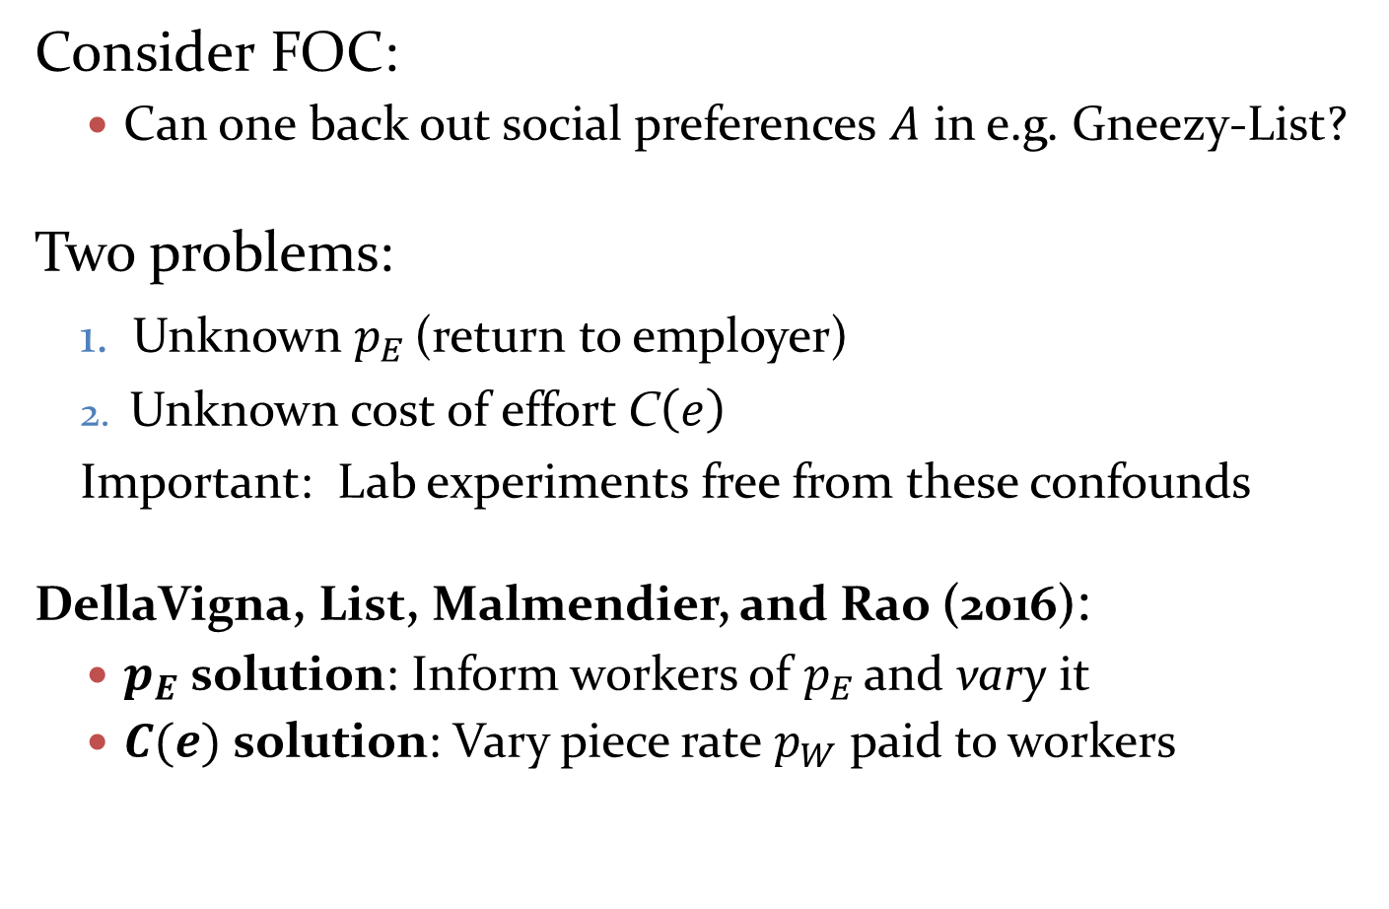
Worker Effort
Consider FOC:
  Can one back out social preferences $A$ in e.g. Gneezy-List?
Two problems:
Unknown $p_{E}$ (return to employer)
Unknown cost of effort C$\left(e\right)$
Important: Lab experiments free from these confounds
  DellaVigna, List, Malmendier, and Rao (2016):
  $p_{E}$ solution: Inform workers of $p_{E}$ and vary it
  $C(e)$ solution: Vary piece rate $p_{W}$ paid to workers
Notes:
39

Slide 40
Design
N=446 workers, recruited via Craigslist for one-time employment
Task: Stuff envelopes for charities (Becker Center as intermediary)
  Can inform them truthfully of average return
  Ten 20-minute rounds of work with 10-minute breaks
  Work for different employers in different rounds, to plausibly vary the pay scheme
Hybrid between- and within-design
  Between subjects: Gift exchange treatments at the end
  Within subjects: Vary piece rate, return to employer
Notes:
Dates of experiment?
40

Slide 41
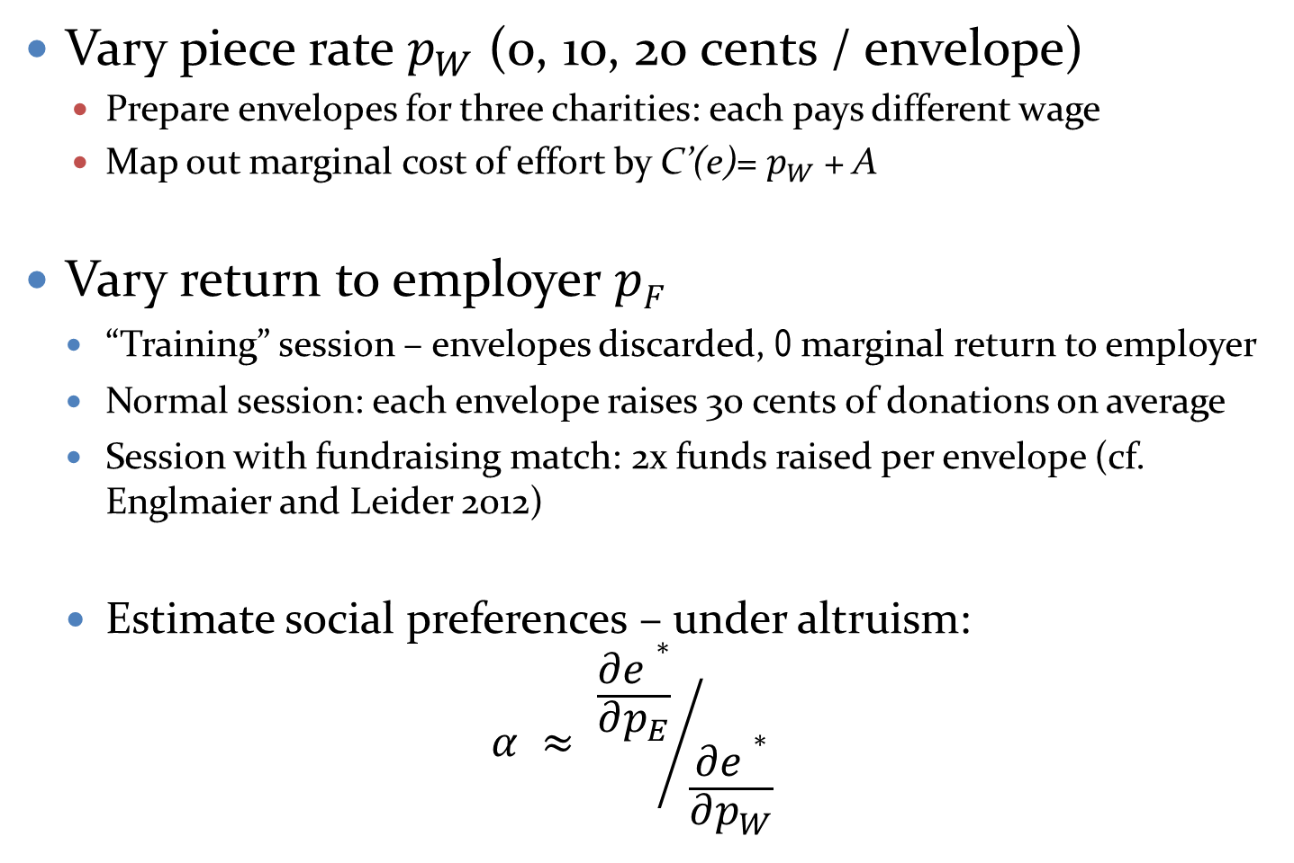
Within-Subject Variation
Vary piece rate $p_{W}$ (0, 10, 20 cents / envelope)
  Prepare envelopes for three charities: each pays different wage
  Map out marginal cost of effort by C’(e)= $p_{W}$ + A
Vary return to employer $pF$
    “Training” session – envelopes discarded, 0 marginal return to employer
    Normal session: each envelope raises 30 cents of donations on average
    Session with fundraising match: 2x funds raised per envelope (cf. Englmaier and Leider 2012)
    Estimate social preferences – under altruism:
    $α ≈ {\frac{∂e∗}{∂p_{E}}}/{\frac{∂e∗}{∂p_{W}}}$
Notes:
Dates of experiment?
41

Slide 42
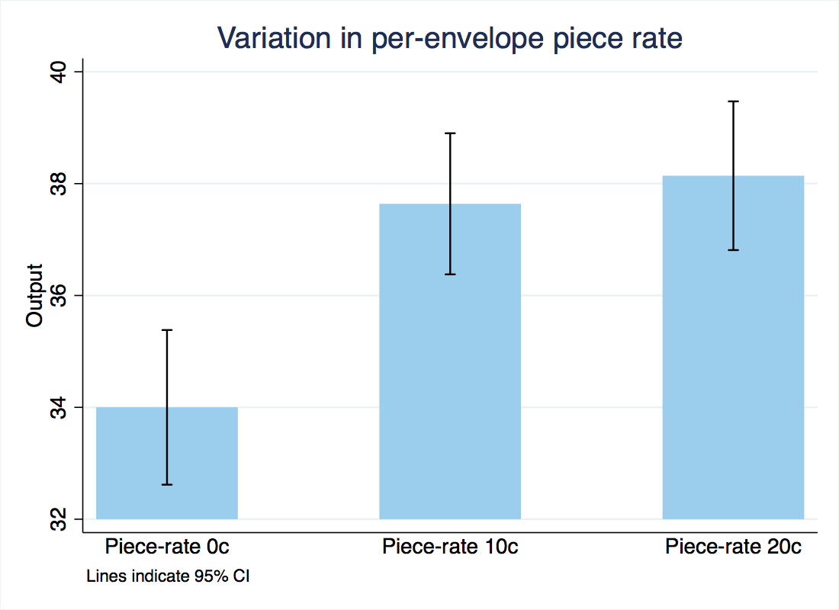

Effect of Piece Rate
Finding 1. Significant response to piece rate
  20 cent/envelope increase in $p_{W}$→ 4 envelope (12%) increase
  Identifies curvature of cost of effort function
“Charity X will be paying for your work. The pay is $7 with no per-envelope payment, as noted on your
schedule.”
“…The pay is $3.50 plus $ __0.10_per envelope completed…”
“…The pay is $ 0.20 per envelope completed…”
Notes:
42

Slide 43
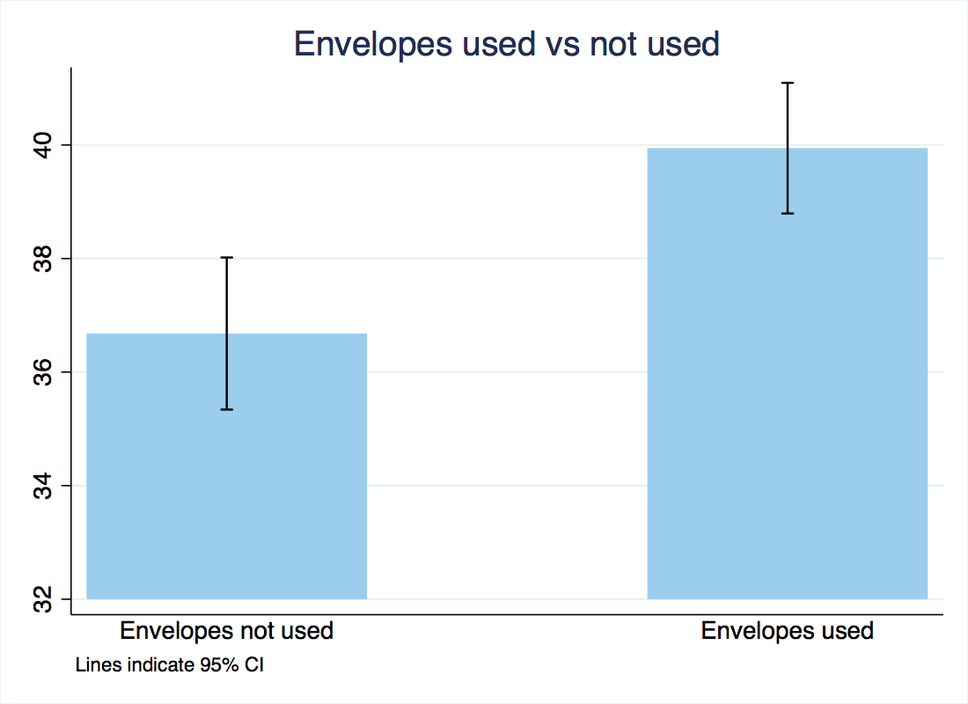
Training vs “Real” Session
Finding 2. Significant increase when letters are used
  Envelope used →3.5 envelopes (10%) increase
  Consistent with positive altruism/warm glow
Training round: “As part of our agreement with the organizations mentioned before, the Becker Center will provide two paid training sessions….The training is paid for by the Becker Center. We will be discarding all of the envelopes prepared in this training session.”
Notes:
* Flag that always biased in reduced form
43

Slide 44
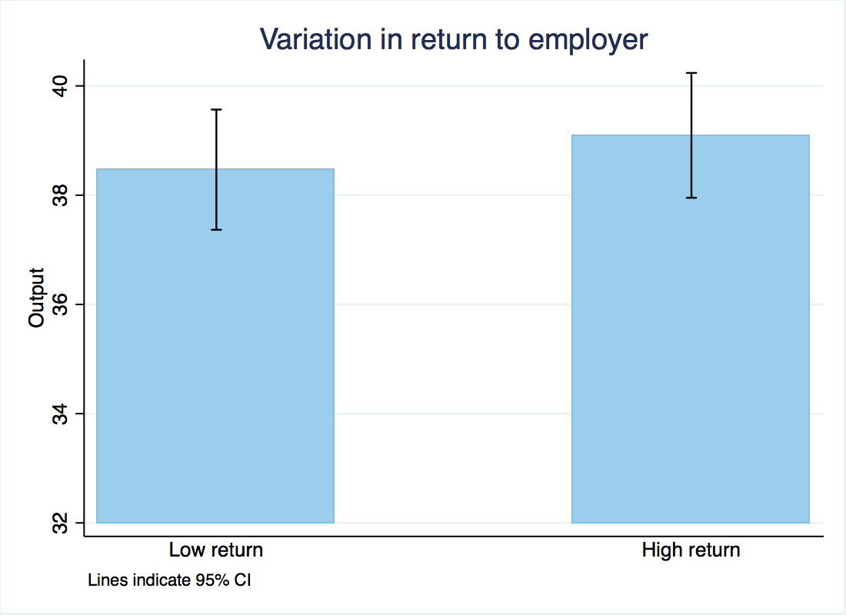

Varying the Return to Employer
Finding 3. Very small impact of increasing return to employer
  30 cent/envelope increase in $p_{E}$→ 0.6 envelope (1.6%, not sig.) increase
  Inconsistent with pure altruism
“Thanks to an anonymous donor, Charity 1 has received a matching grant that will match every dollar raised by these letters 1 to 1 up to $2,000 total.”
“A number of such matching grant campaigns have been run by charities similar to Charity 1, and historically have yielded roughly $___0.60____ per mailer with such campaigns, including the match.”
Notes:
44

Slide 45
Gift Exchange
Now we turn to the effects of unanticipated gifts on effort and underlying social preferences (Gift exchange)
In last 2 sessions, we introduce a gift
  Work for same employer as a previous session, but possibly at a different fixed pay (“TBA” in schedule)
Treatments:
  Control ($7 fixed pay as previously)
  Negative ($3) – (Kube, Puppe, and Marechal AER 2012)
  Positive ($14)
  Positive In-Kind ($7 + thermos) (Kube, Puppe, and Marechal JEEA 2013)

Slide 46
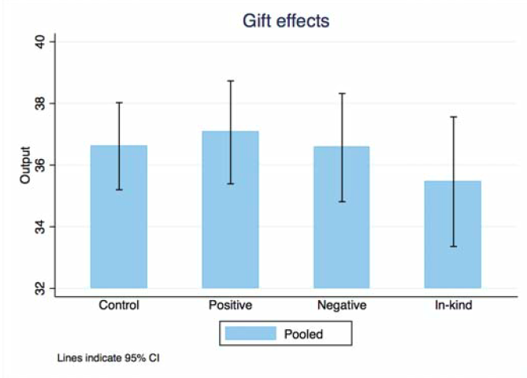
Effects of Gifts
Finding 4: Small (negative), non-significant effects of gifts
Notes:
46

Slide 47
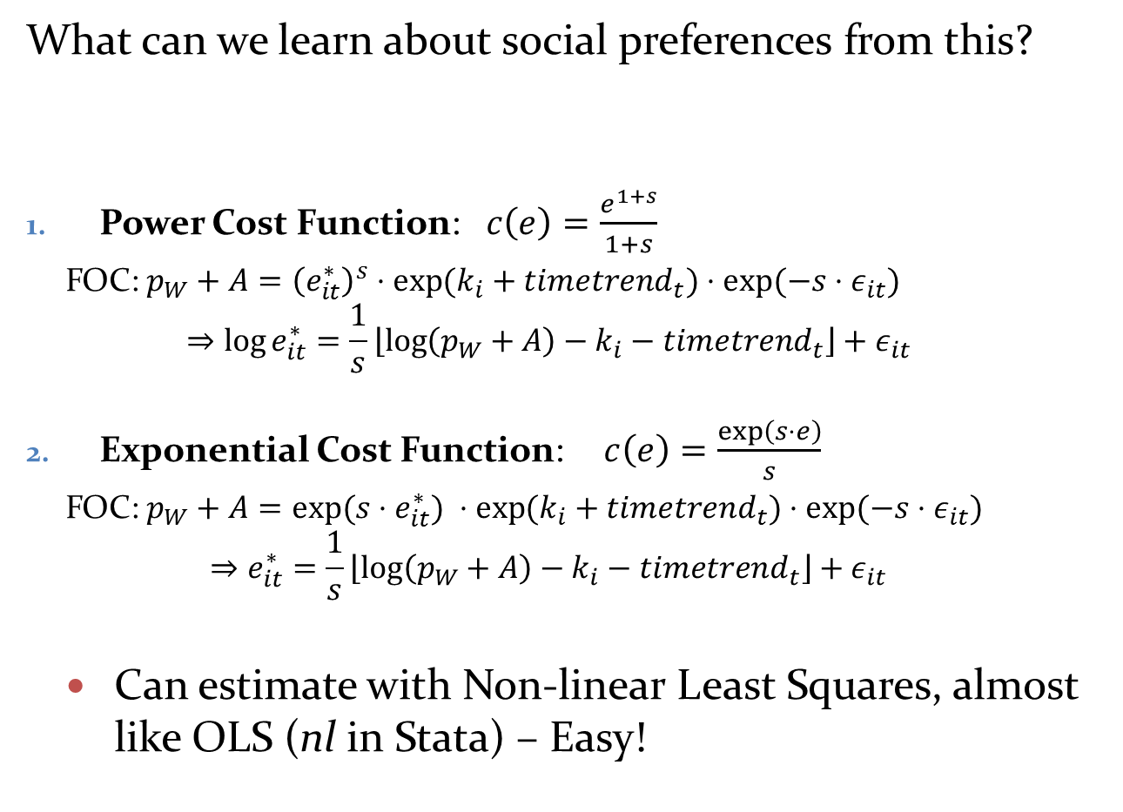
Worker Effort
What can we learn about social preferences from this?
Power Cost Function: $c\left(e\right)=\frac{e^{1+s}}{1+s}$
  FOC: $p_{W}+A={\left(e_{it}^{∗}\right)}^{s}⋅{\exp{(k}}_{i}+timetrend_{t})⋅exp⁡(−s⋅ε_{it})$
  $$⇒\log{e_{it}^{∗}}=\frac{1}{s}\left\lfloor \log\left(p_{W}+A\right)−k_{i}−timetrend_{t}\right\rfloor +ε_{it}$$
Exponential Cost Function: $c\left(e\right)=\frac{\exp\left(s⋅e\right)}{s}$
  FOC: $p_{W}+A=exp⁡(s{⋅e}_{it}^{∗}) ⋅{\exp{(k}}_{i}+timetrend_{t})⋅exp⁡(−s⋅ε_{it})$
  $$⇒e_{it}^{∗}=\frac{1}{s}\left\lfloor \log\left(p_{W}+A\right)−k_{i}−timetrend_{t}\right\rfloor +ε_{it}$$
  Can estimate with Non-linear Least Squares, almost like OLS (nl in Stata) – Easy!
Notes:
47

Slide 48
Baseline Social Preferences NLS Estimation
Notes:
INSERT 8 period model here
→ Uses date from first 8 rounds
48

Slide 49
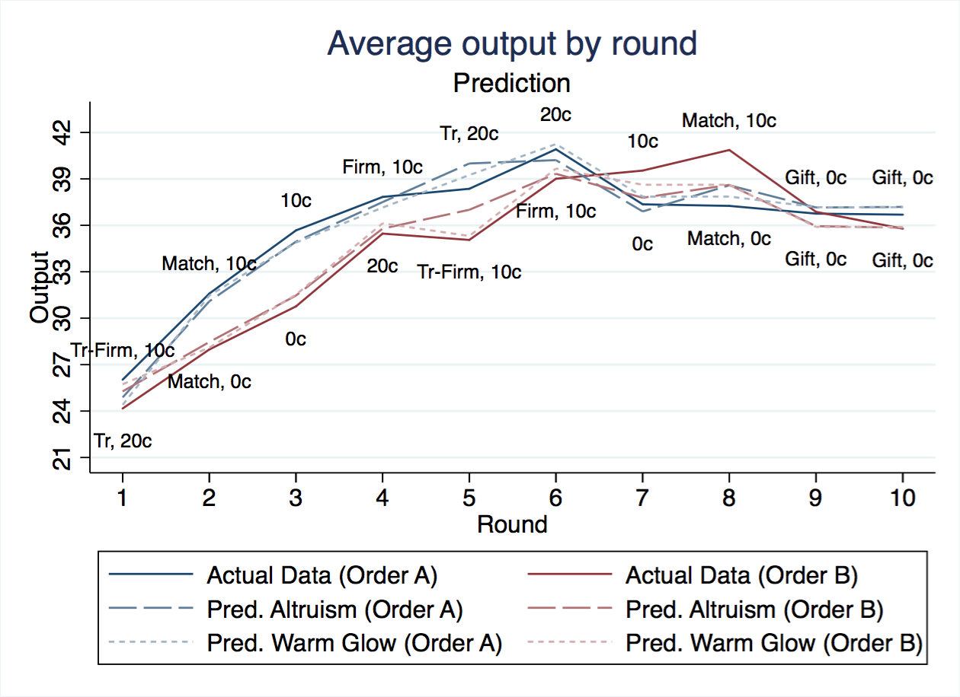
Model fit
Overall, very good fit of data

Slide 50
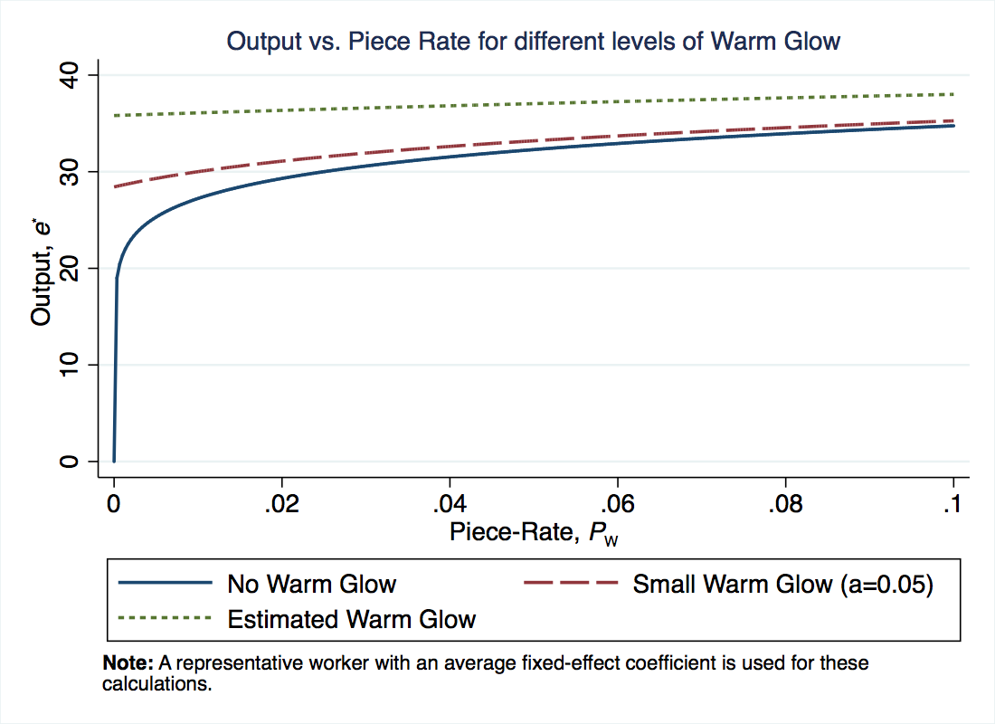
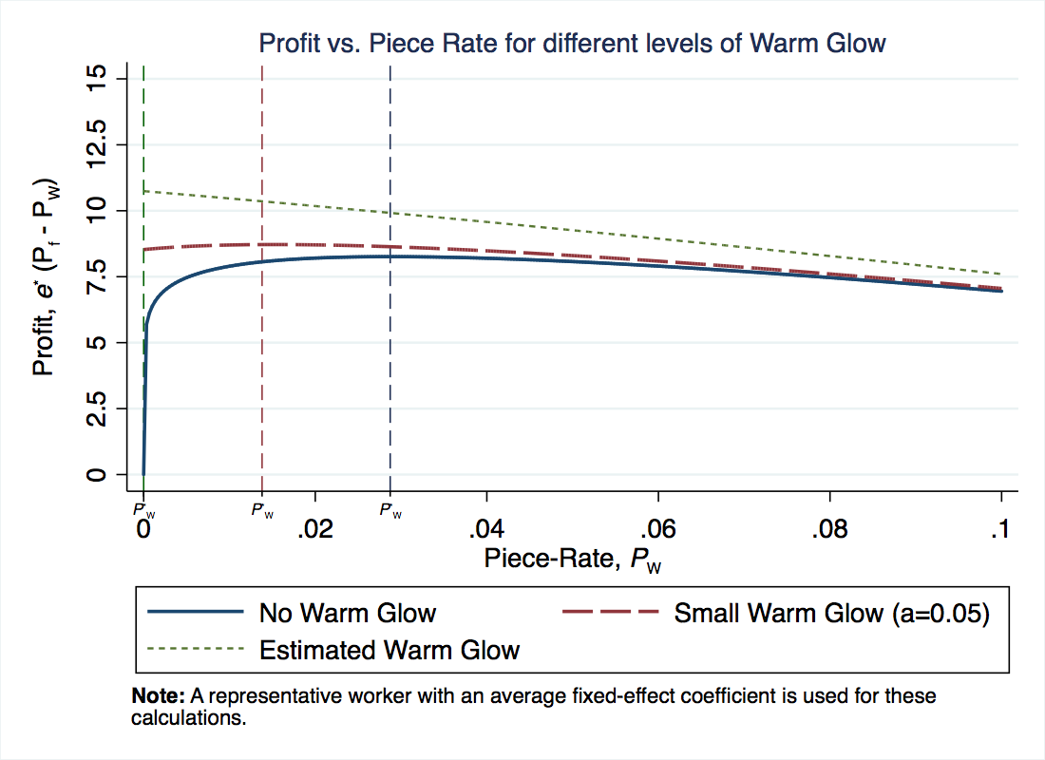
Optimal (Profit-Max) Piece Rate
What does this imply for optimal incentives?
  Consider effect of piece rate increases (for fixed flat pay)
  With no warm glow, steep increase in output and profit
  With warm glow, only marginal increases in output → Optimal incentive is no piece rate
  Social preferences substitute for piece rate incentives

Slide 51
Nominal Wage Rigidity
Return to Kahneman, Knetsch and Thaler (1986) Telephone surveys in Canada in 1984 and 1985 --> Ask questions on fairness
A real and nominal wage cut is not fair (Question 4A)
A real (but not nominal) wage cut is fair (Question 4B)
→ Expect employers to avoid nominal wage decreases
Notes:
51

Slide 52
Nominal Wage Rigidity
Card and Hyslop, 1997: Early evidence on this
Hipsman (2011) and Hipsman and Laibson (2015)
  Administrative data from several firms (Hewlett)
  Base pay % increase among employees in 2003 and 2004
  0.34% cuts, 10.18% freezes, 88.18% raises
Notes:
52

Slide 53
Nominal Wage Rigidity
Hipsman (2011) and Hipsman and Laibson (2015)
Base pay % increase among employees in 2007 and 2008
0.36% pay cuts, 54.58% pay freezes, 45.06% pay raises
Notes:
53

Slide 54
Nominal Wage Rigidity
Card and Hyslop (1997) had underestimated the degree of nominal rigidity
Important implications for labor markets when low inflation
If no pay cut, what margin of adjustment?
  Firing?
  Less hiring?
Key under-researched topic in behavioral labor economics
Notes:
54

