Slide 1
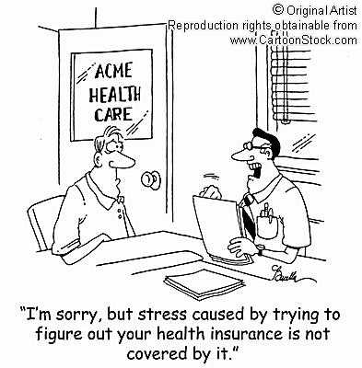
Behavioral Economics of Risk and Insurance
Justin Sydnor
University of Wisconsin

Slide 2
Fast-growing literatures on insurance markets
WHY IS IT SURGING AS A TOPIC?
Rapid rise in healthcare spending
Big policy topic with health insurance expansions
Increasing access to data
TWO KEY ISSUES WITH INSURANCE MARKETS FOR ECONOMISTS
Selection patterns
  Adverse selection and market unraveling/inefficiency?
  Distributional welfare concerns
Response to insurance incentives
  Moral hazard and role in shaping overall health spending

Slide 3

Standard model of insurance choice
Chose plan that maximizes:
$$U_{k}=\sum_{s}{π_{s}u(w−p_{k}−θ_{s,k})}$$
Probability of loss shock s
Uninsured loss for shock s with plan k (e.g., deductible)
Premium for plan k

Slide 4
How does this model shape what people do?
IMPLICIT FRAMEWORK BEHIND EXPANSION OF INSURNACE CHOICES
Choice presumed to be beneficial if people are well-informed
  Though GE effects in insurance make that less clear to begin with
USE OBSERVED INSURANCE CHOICES TO ESTIMATE RISK AVERSION
Cohen and Einav (AER 2007)
  Choice of deductibles + Individual claim-rate estimates
  Yields distribution of parameter of absolute risk aversion
USE THESE ESTIMATES FOR COUNTERFACTUALS AND WELFARE ANALYSIS
Handel, Hendel and Whinston (Econometrica 2015)
  Like Cohen and Einav using health insurance choice
  Simulate adverse selection dynamics in health exchange and predict unraveling to lower-coverage plans.

Slide 5
Behavioral evidence
ISSUE 1: WHAT IS THE “RISK AVERSION” WE ARE MEASURING?
Crucial if we want to use insurance to speak to risk prefs broadly
Crucial when doing counterfactuals as they rely on functional forms
May be welfare relevant drivers of risk-aversion we need to understand
ISSUE 2: ARE PEOPLE ACTUALLY INFORMED CONSUMERS HERE?
Insurance complexity and choice overload
Inertia! (Handel (AER 2013); Ericson (AEJ:Pol 2014)

Slide 6
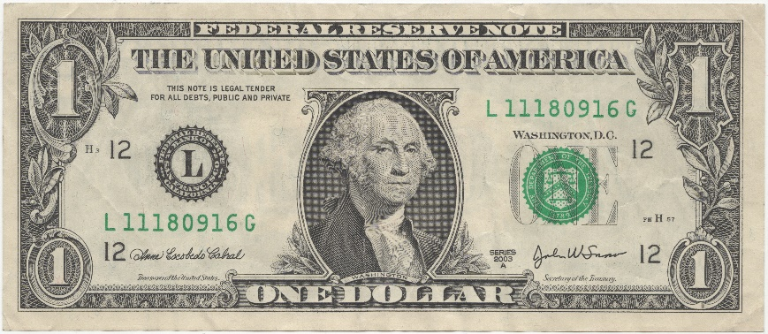

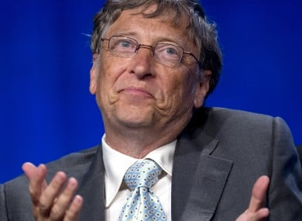
What is “risk aversion”?

Slide 7
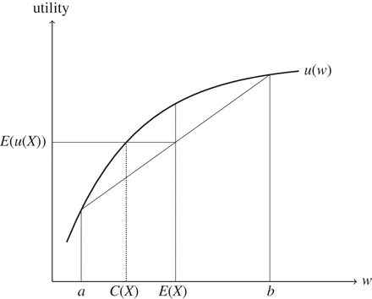
Diminishing Marginal Utility of Wealth and RA

Slide 8
Rabin (2000): Calibration Theorem

Slide 9
Rabin (2000): Calibration Theorem

Slide 10
Rabin (2000): Calibration Theorem
u(w)
Find gain that gives equivalent increase?
Drop in utility from loss of $1,000
Meaningfully risk averse over scale of $500
w
w⁰ -1k
w⁰

Slide 11
Sydnor (2010): Calibration Issue in Home Insurance Choice
Empirical Claim Rate = 4 to 5%
Risk Neutral Claim Rates?
100/500 = 20%
87/250 = 35%
133/150 = 89%
* Means with standard deviations in parentheses

Slide 12
Majority choose low deductibles at high cost

Slide 13
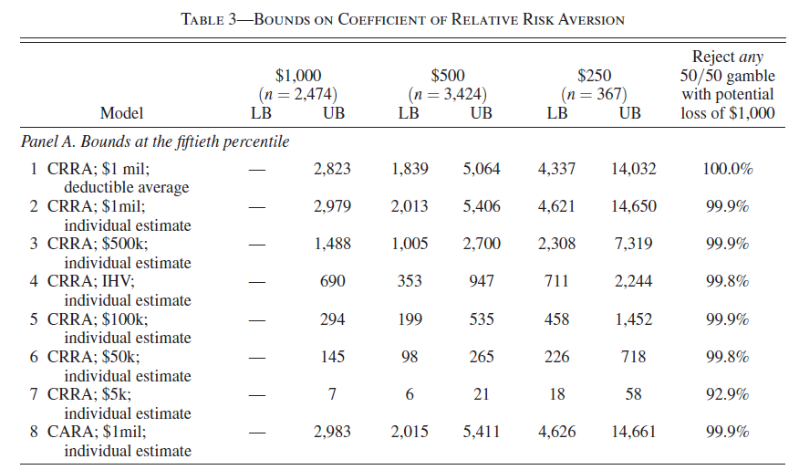
These choices imply implausible degrees of risk aversion

Slide 14



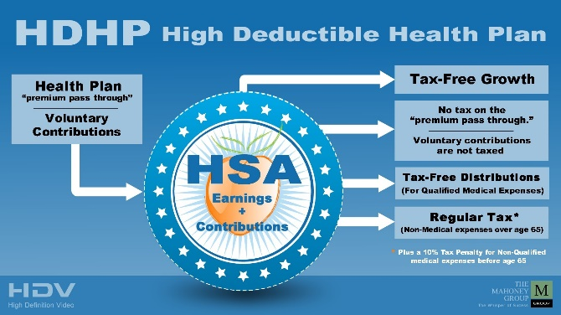
People have increasing choices about health insurance
Are they able to choose well?
How can we tell?

Slide 15

Analyses of senior’s choices from rich array of drug plans
Abaluck & Gruber (AER 2011): Not on efficient frontier
Kling et al (QJE 2011): Providing info increases switching
… But Ketcham et al. (2013, 2015, forthcoming): Argue many sensible patterns in choices and switching.

Slide 16
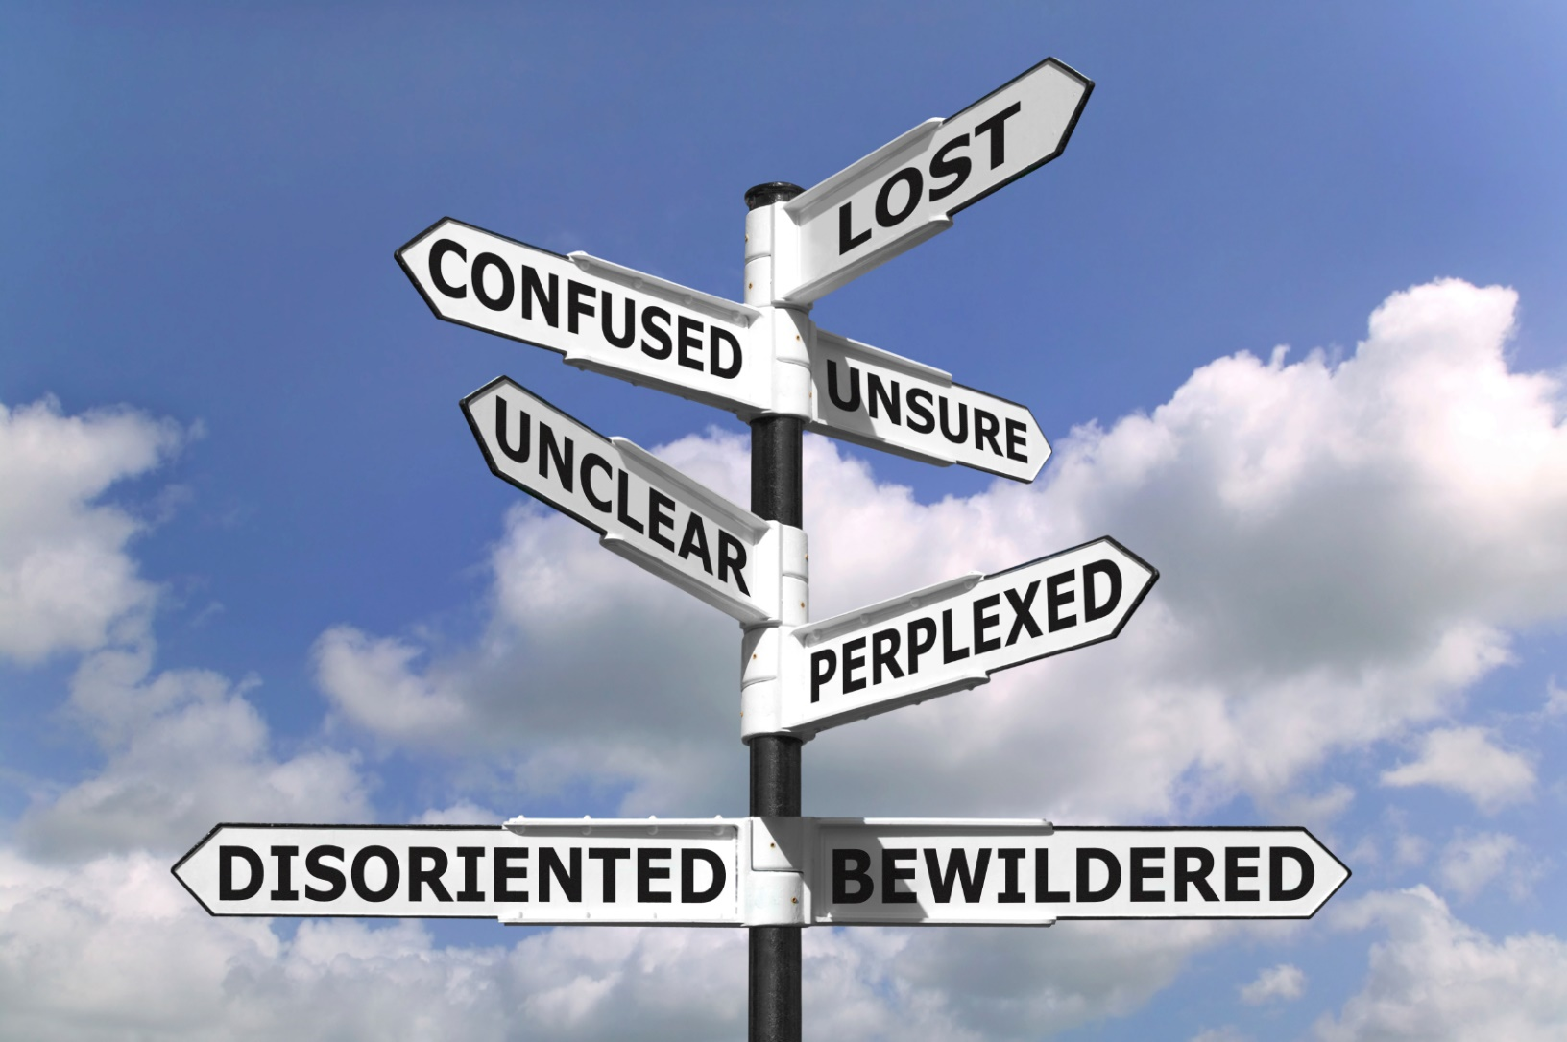
Loewenstein et al (J Health Econ 2013):
- 78% understand deductible
- 34% understand coinsurance

Slide 17
Handel and Kolstad (AER 2015): Health Insurance for “Humans”

Slide 18
Incorporating “frictions” dramatically lowers estimates of RA

Slide 19
Which option would you choose?
Option | Annual Deductible | Annual Premium
A | $1,000 | $817
B | $750 | $1,321
C | $500 | $1,419
D | $250 | $1,957

Slide 20
Bhargava, Loewenstein and Sydnor (2015)
FORTUNE 500 COMPANY CHANGED EMPLOYEE OPTIONS
Requires active choice.
MANY PLAN OPTIONS WITH SAME NON-FINANCIAL FEATURES
Vary only on cost-sharing
Network, etc… held transparently fixed.
MOST OF THE OPTIONS WERE FINANCIALLY DOMINATED BY OTHERS
Choosing them cannot be rationalized within canonical model
Handel (2013) also examines cases with financially dominated options, but there the issue was inertia not active choice.

Slide 21
Example of dominated payment schedule

Slide 22
Example of dominated payment schedule

Slide 23
Example of dominated payment schedule

Slide 24
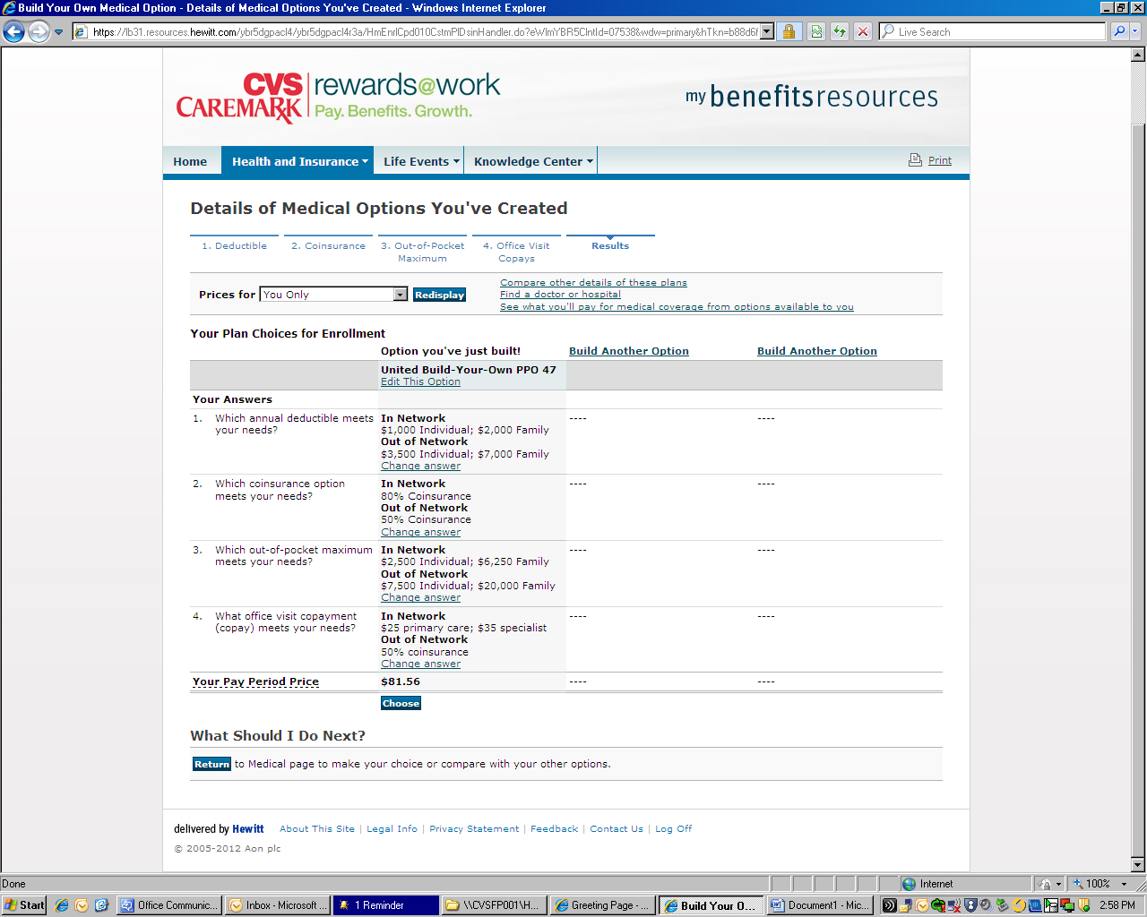
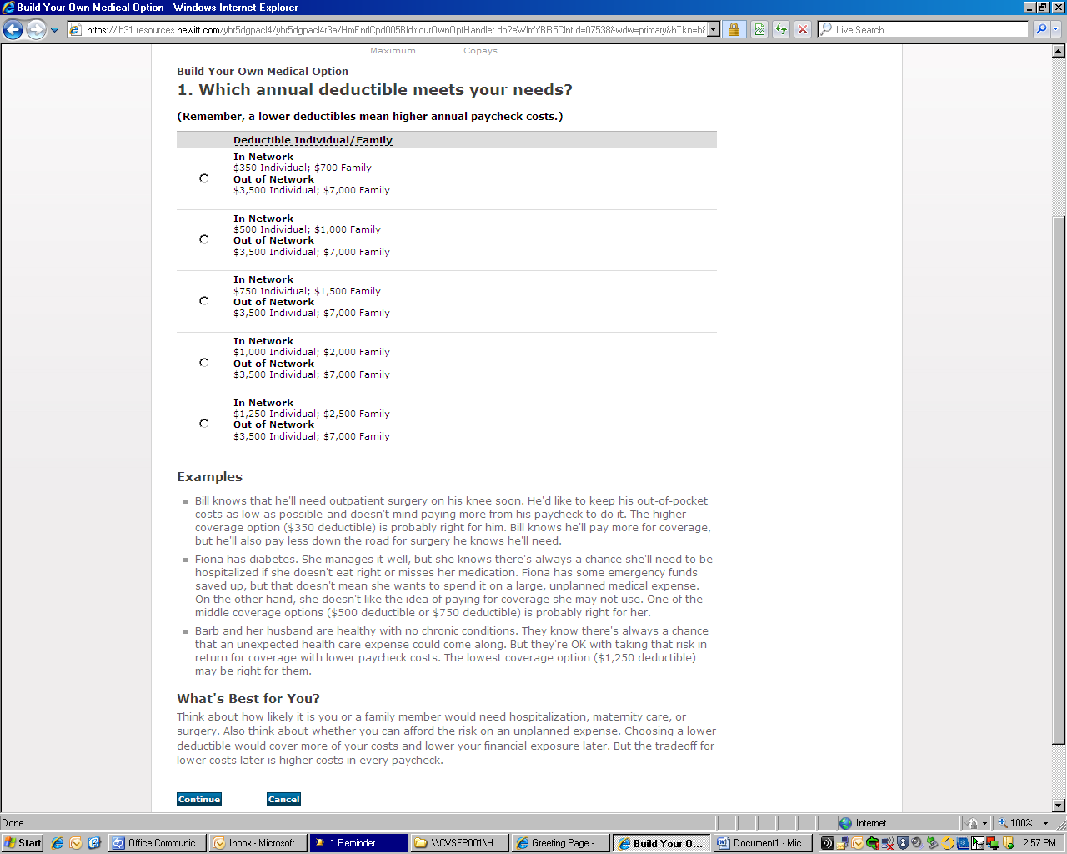
Build Your Own Platform

Slide 25
Majority of employees selected a dominated plan
55% chose dominated plan (adjusting for taxes)
Average excess spending of $372 for the year relative to switch to same plan with $1,000 deductible.

Slide 26
Dominated plan share by annual salary bin

Slide 27
Dominated plan share by annual salary bin
Also more likely for:
Older employees
Those w/ chronic condition
Women

Slide 28
Broad classes of explanations for dominated choices
1. NOT MAXIMIZING ON FULL CHOICE SET -- SEARCH COMPLEXITY
2. CONFUSION ABOUT CONSEQUENCES -- INSURANCE COMPLEXITY
3. EXTREME PREFERENCE FOR AVOIDING OUT-OF-POCKET COSTS

Slide 29
Broad classes of explanations for dominated choices
1. NOT MAXIMIZING ON FULL CHOICE SET -- SEARCH COMPLEXITY
Test by reducing and simplifying options
2. INCORRECT DISTRIBUTION OF OUTCOMES -- INSURANCE COMPLEXITY
Test by clarify final-wealth consequences of choices
3. EXTREME PREFERENCE FOR AVOIDING OUT-OF-POCKET COSTS
The “residual” after 1 + 2
Other attempts at direct elicitation,
Other consistency checks in firm data.

Slide 30
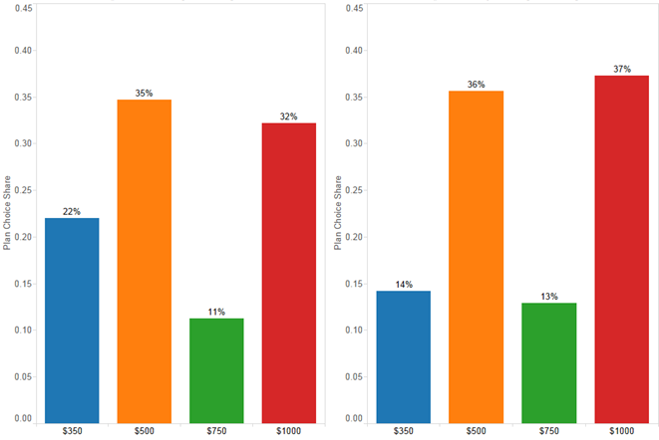
Comparison of deductible choices experimental vs employee sample
Pooled Experiment 1 Data
Employee Data
N = 2,317 Qualtrics Panels
N = 23,894 Employee Choices

Slide 31
Comparison of deductible choices experimental vs employee sample
Pooled Experiment 1 Data
Employee Data
N = 2,317 Qualtrics Panels
N = 23,894 Employee Choices

Slide 32
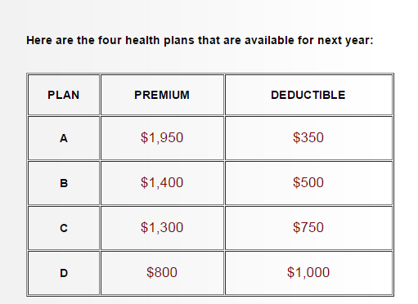
Experiment 2: What if you make consequences clear?
N = 600 on MTurk

Slide 33
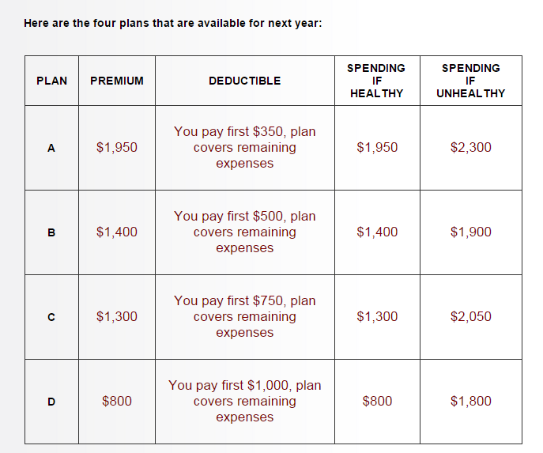
Experiment 2: What if you make consequences clear?

Slide 34
Fraction choosing $1,000 Deductible rises from 52% to 82%
p = 0.02
p = 0.13
p = 0.19
p = 0.19
Deductible Choice
Deductible Choice

Slide 35
Broad classes of explanations for dominated choices
1. NOT MAXIMIZING ON FULL CHOICE SET -- SEARCH COMPLEXITY
Test by reducing and simplifying options
Does not have much of an effect
2. INCORRECT DISTRIBUTION OF OUTCOMES -- INSURANCE COMPLEXITY
Test by clarify final-wealth consequences of choices
Big effect on choice patterns
3. EXTREME PREFERENCE FOR AVOIDING OUT-OF-POCKET COSTS
The “residual” after 1 + 2
Can’t alone explain the average patterns
… but even small share (maybe 10%?) could be crucial for welfare implications of cost-sharing.

Slide 36
Behavioral implications for insurance choice
INSURANCE COMPLEXITY IS IMPORTANT
Need for decision aids and/or simplification
Distributional impacts – variation in insurance savvy can have big $ impact
“Shrouded attributes” nature of insurance markets (e.g., Ericson 2014).
STRUCTURAL MODELS ARE MISSPECIFIED
Need more work to understand how to enrich models
  Heuristic processes?
BEHAVIORAL BIASES RESHAPE ADVERSE SELECTION IMPACTS
Markets unravel less with behavioral agents
Nudging and decision aids can have negative welfare effects in general equilibrium
  Handel (2013); Handel and Kolstad (2015); Spinnewijn (forthcoming)

Slide 37
Behavioral implications for understanding moral hazard
“BEHAVIORAL HAZARD”: Baicker, Mullainathan and Schwartzstein (QJE 2015)
Behavioral biases often lead people to underuse rather than overuse care
  Medication adherence for chronic diseases is classic example
  Elasticities with respect to cost-sharing are similar for high & low value
Welfare cannot be established from demand response to $ cost-sharing changes
Changes optimal co-pay design
PERVERSE EFFECTS OF HIGH DEDUCTIBLE PLANS
Brot-Goldberg, Chandra, Handel and Kolstad (2015)
Move to HDHP with money put in HSA (no liquidity problem) led to big drop in spending … but also for high-value care and those with chronic conditions

