Slide 1
Misunderstanding and Mispredicting Preferences
George Loewenstein

Slide 2
What are preferences?
Traditional economics: revealed preference (preferences correspond to choices)
  little content other than consistency (e.g., Sen, 1977)
  and consistency makes little sense
Kahneman, Wakker & Sarin (1997): Decision Utility versus Experience Utility
  Decision utility: close to Hicks/Allen/Samuelson economic conception
  Experience utility: related to happiness/life-satisfaction/well-being (Benthamite)

Slide 3
Distinction between decision and experience utility opens door to many interesting questions:
Can people predict their own decision utility (what they will choose in the future)?
Can people predict their own experience utility (happiness, what will make them happy)?
Do two types of utilities correspond; do decisions maximize well-being?
My focus today: predictions of decision utility
  Do people know what they will want/choose (not what will make them happy) in the future?

Slide 4
Many important decisions require predicting future preferences – e.g.,
  Choosing a job
  Deciding where to live
  Committing to having a baby
  Buying a durable good
One major cause of misprediction: projection¹
Cognitive projection:
  Hindsight bias (exaggerating degree to which whatever happened could have been foreseen)
  Curse of knowledge (overestimating the degree to which other people know whatever you know)
Preference projection:
  Preferences are state-dependent: u(x,s) (states include all factors that exert a transitory influence on preferences)
  People ‘project’ their current state-dependent preferences on themselves in the future – they assume that these preferences will be more similar to their current preferences than will be the case
¹Projection: concept proposed by Freud in which humans defend themselves against thoughts or feelings they find unacceptable by attributing them to others
Loewenstein, O'Donoghue & Rabin (2003). Projection bias in predicting future utility. Quarterly Journal of Economics, 118, 1209-1248.
Van Boven & Loewenstein (2003). Social projection of transient drive states. Personality and Social Psychology Bulletin, 29(9), 1159-1168.
Loewenstein (2005). Projection bias in medical decision-making. Medical Decision Making, 25, 96-105.

Slide 5
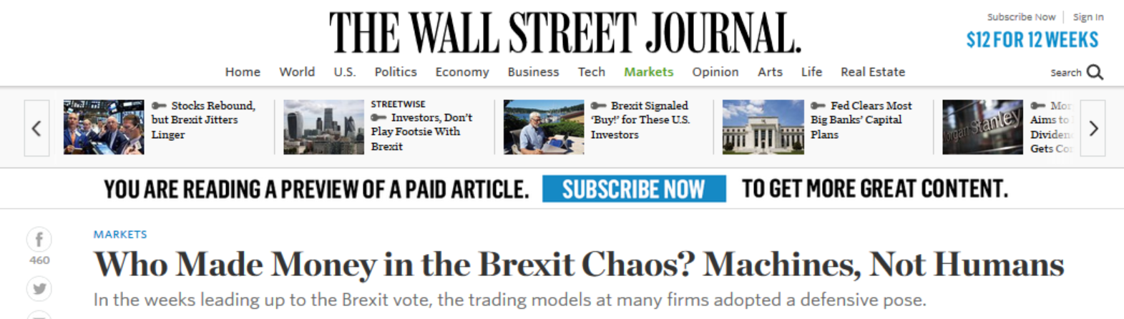
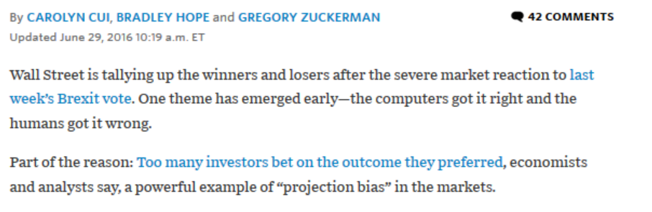
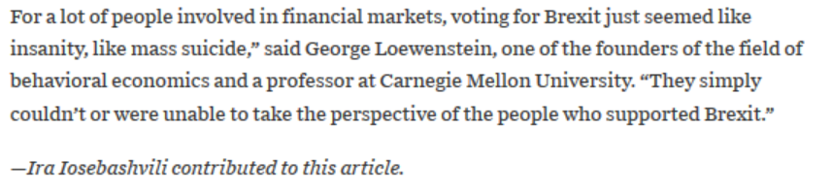

Slide 6
One important state: object ownership
Let u(c,s), where c=1 if the individual owns the object in the current period (and 0 otherwise); s=1 if individual owns object in the previous period (and 0 otherwise):
    u(1,1)-u(0,1) > u(1,0)-u(0,0) (due to loss-aversion)
Can people anticipate how object ownership will affect their preferences?

Slide 7
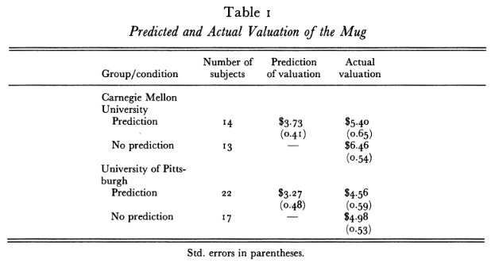
Are people aware of the endowment effect?
Subjects 27 CMU undergraduates & 39 Pitt MBAs
Procedure: 1. All shown mug
        2. Half predict how much they would sell it for
3. All given a mug and opportunity to sell
Loewenstein, G. & Adler, D. (1995). A bias in the prediction of tastes. Economic Journal, 105, 929-937.
Notes:
stopped

Slide 8
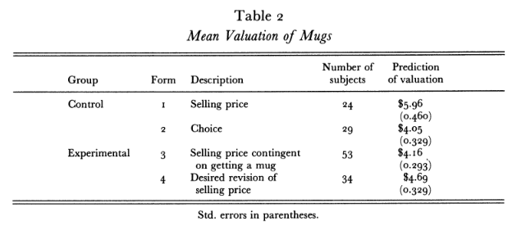
Study 2 (n=106 Northwestern executive students)
Randomly assigned to 2 conditions isolated in 2 rooms:
  Control: half of subjects get mugs; give selling price; others give choice prices
  Experimental: told there is a 50% chance of getting a mug; elicited prices they were told would apply if they got the mug
  Those who got a mug give (hypothetical) revised prices
All prices elicited with BDM

Slide 9
“Buyer’s agent study” (31pairs of Cornell undergrads)
Procedure:
  Owners given mugs and asked for minimum selling prices
  Buyer’s agents given $10 with which to purchase mug. If their offer is accepted they can keep the difference, but not the mug. If rejected, they get nothing.
Results:
  mean minimum selling price: $6.98 (EV-maximizing offer= $7.00
  mean offer: $5.54 (p<.01). Only 29% of offers accepted.
  average earnings of agents: E.V.=$.85
  At offer of $7.00: E.V. of agent earnings=$2.00
  66% of offers would be accepted.
VanBoven, L., Dunning, D. & Loewenstein, G. (2000) Egocentric empathy gaps between owners and buyers: Misperceptions of the endowment effect. Journal of Personality and Social Psychology, 79(1), 66-76.

Slide 10
Debiasing study
(study 5 from paper)
n=53 Cornell undergrads
Same as other buyers’ agents studies, except that half of buyers' agents owned a mug, and all introspected about what price they would sell those mugs at.

Slide 11
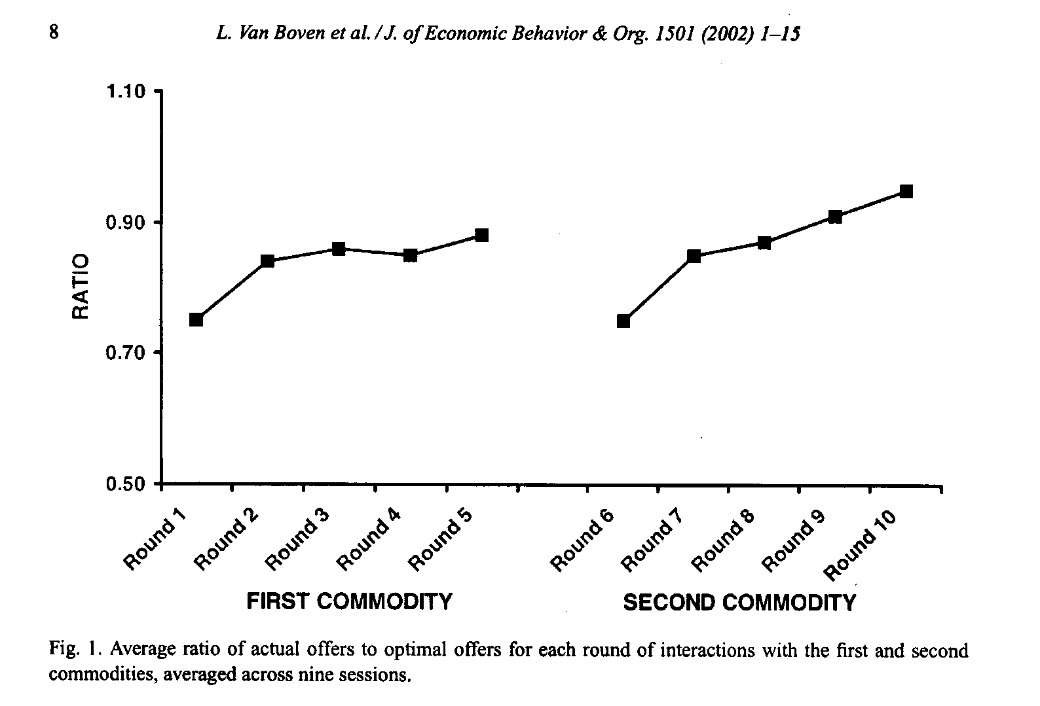
Repeated markets study; learning from experience?
Owners given Cornell object
Five rounds of buyer’s agent procedure, one of which counted
- After 5th round, repeated with new object
Van Boven, L., Loewenstein, G., & Dunning, D. (2003). Mispredicting the endowment effect: underestimation of owners’ selling prices by buyer’s agents. Journal of Economic Behavior and Organization, 51, 351-365.

Slide 12
Three field studies documenting projection bias..
Catalog orders and cold
Convertibles and heat
Health insurance and air pollution

Slide 13
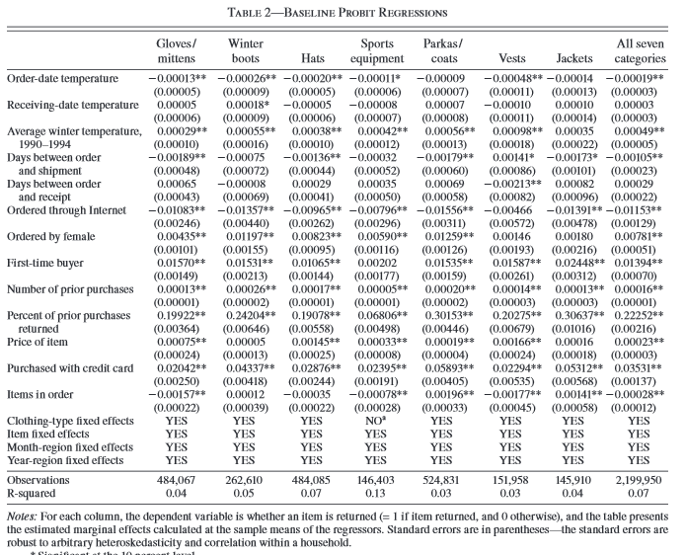
Conlin, M., O’Donoghue, T. & Vogelsang, T.J. (2007). Projection Bias in Catalog Orders AER, 97(4): 1217-1249
Data: 12 million orders of weather-related items, including zip code of buyer, date of order, and whether item was returned; merged with weather data
Dependent variable: returns (indicative of order having been a mistake)
Decline in order-date temperature of 30ºF leads to 3.95% increase in return rate

Slide 14
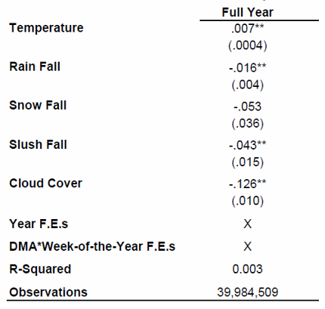
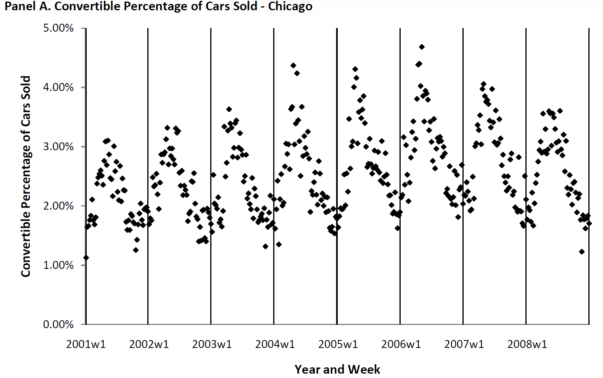
Busse, Pope, Pope & Silva-Risso (working paper) “The psychological effect of weather on car purchases.”
Automobile transactions from a sample of 20% of all dealerships in the U.S. between 2001 and 2008 (~40M transactions).
Cars are both new and used (~50/50).
Data contain detailed information about each car type and the MSA where the dealership is located.
data merged with MSA-level weather data
Dependent variable: indicator = 1 if purchase was convertible
10 degree higher than average temperature → .07 percentage point increase in the percentage of cars sold that are convertibles (2.7% difference)(in all seasons)
Similar effects for cold weather and 4-wheel drive vehicles

Slide 15
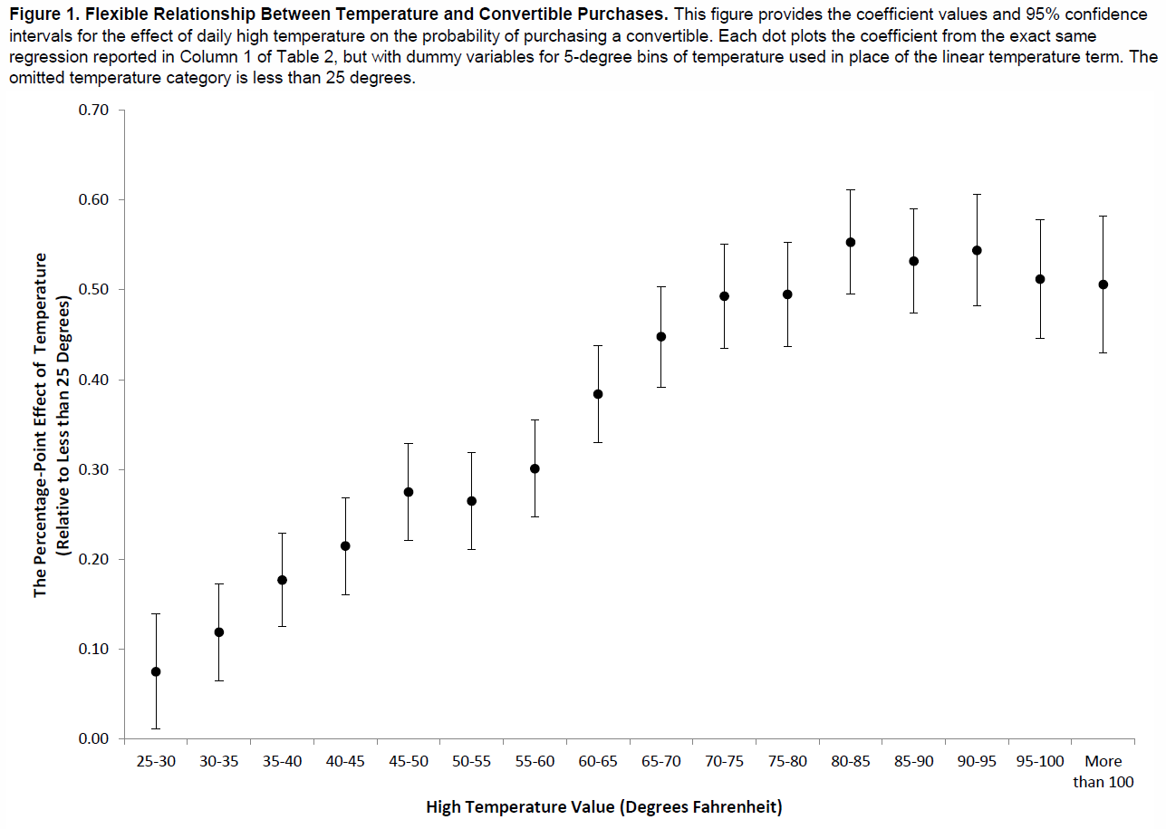

Slide 16
Chang, Huang & Wang (working paper; 2016). “Projection Bias and the Demand for Insurance.”
Detailed information on purchases of over one million health insurance contracts from one of the largest Chinese insurers (and cancelations during mandatory 10 day ‘regret period’ during which policies can be costlessly canceled)
Merged with data set of hourly measures of air quality in major cities
A 1 s.d. increase in air pollution on a day leads to a 9% increase in contracts sold that day.
Contracts purchased during high pollution days more likely to be canceled, and cancelations more likely on low pollution days (1 s.d. decrease in air pollution during cooling off period increases cancelation probability by 4.1%)

Slide 17
In sum.. lots of lab and field evidence of projection bias

Slide 18
Arguably, most important source of preference-altering states: Affects
    Includes emotions (e.g., anger, fear), drives (e.g., hunger, thirst, sex, sense-making(?)), motivational feeling states (e.g., pain)
  “Emotions constitute 'superordinate programs' that orchestrate a concerted psycho-physiological response to recurrent situations of adaptive significance in our evolutionary past, such as fighting, falling in love, escaping predators and experiencing a loss in status.”
  Emotions, according to this perspective, .. can and typically do involve a wide array of physiological and psychological changes, including effects on perception, attention, inference, learning, motivation, and physiology.
→ Emotions reprogram us fundamentally
Cosmides, L. & Tooby, J. (2004). "Evolutionary Psychology and the Emotions" In M. Lewis & J. M. Haviland-Jones, Eds. Handbook of Emotions. NY: Guilford.

Slide 19
Emotions, buying and selling
Conditions (n=204 students):
Ownership:
  Sellers given a highlighter set; give us the minimum price at which they will sell it back to us
  Buyers shown, not given, identical sets; give us the maximum price they would pay to get highlighter set
Emotion:
  Control: watch bland film clip
  Sadness: watch sad film clip (from The Champ)
  Disgust: watch toilet scene from Trainspotting
(Lerner, Small & Loewenstein, G. (2004). Heart strings and purse strings: Carryover effects of emotions on economic decisions. Psychological Science, 15(5), 337-341.)

Slide 20
Notes:
Note $2.00 difference between neutral and disgust in sell condition

Slide 21
Sexual Arousal
Subjects: n=34 Berkeley male undergrads. All subjects run in both conditions. Both orders run.
Arousal condition: subjects answer questions while sexually stimulating themselves
Control condition: non-stimulated subjects answer same questions
Issues:
  What’s appealing
  What would you do for sex?
  Safe sex?
  Time preference
  Risk preference
Ariely, D. & Loewenstein, G. (2006). The heat of the moment: The effect of sexual arousal on sexual decision making. Journal of Behavioral Decision Making, 19(2), 87-98.

Slide 23
Selected findings
What would you do for sex?

Slide 24
Safe sex
Use a condom even if afraid woman will change her mind when you go to get it?
Always use a condom if you don’t know partner’s sexual history?

Slide 25
Impatience
% choosing $50 now over $60 in one week

Slide 26
Risk-taking
% choosing to play 50-50 chance to win $150 or lose $100

Slide 27
The evolutionary account of emotion, and idea that emotions reprogram us, has a second important implication:
When in one emotional state it is almost impossible to imagine how one will feel or behave in a different emotional state
-- ‘hot-cold empathy gap’ (one specific form of projection bias)
Loewenstein, G. (1996). Out of control: Visceral influences on behavior. Organizational Behavior and Human Decision Processes, 65, 272-92.

Slide 28
Varieties of hot-cold empathy gaps...
Cold predicting hot and hot predicting cold
Prospective, retrospective and interpersonal
Examples:
Prospective cold predicting hot
  plans (made right after lunch) to eschew dessert after dinner
Prospective hot predicting cold
  shopping on an empty stomach
Interpersonal
  “Ran’s foot was much worse. Ever since the graft had broken down it had been getting worse and a deep ulcer was now eroding his forefoot. In the mornings it gave him hell, particularly when we had just started, and although he would generally steel himself and say nothing, occasionally even he would have to say something about the pain -- try to share a part of it.. I could do nothing but reassure him that I understood, though I didn’t really. Pain is a problem that cannot be shared.” Stroud, 1993
Notes:
Ranulph Fienes, Mike Stroud

Slide 29
Thirst
(prospective & interpersonal)
Subjects: n=47 visitors to a private gym
Upon entering, asked if they would complete short survey
To qualify, must be planning a vigorous cardiovascular workout lasting at least 20 minutes.
Randomly assigned to two conditions after agreeing to participate:
Not thirsty: complete survey before exercising
Thirsty: complete survey immediately after exercising
(Van Boven, L. & Loewenstein, G. (2003). Social Projection of transient drive states. Personality and Social Psychology Bulletin, 29(9), 1159-1168.)

Slide 30
Main measures
Imagine that three vacationers in Colorado this past August embarked on a short, 6 mile hike…As the day wore on, they realized that they were hopelessly lost… Worse, because they had packed lightly for a short hike, they had not carried much in the way of food or water…
In the space below, please take the perspective of one of the three hikers and describe your situation—how you got into it, how you feel now, both physically and mentally, and what you are hoping will happen. ____________________________________________
Which do you think is most unpleasant for the lost hikers, their hunger or thirst?
Which do you think the hikers regretted not packing more, water or food?
If you were in the hikers’ shoes, which would be most unpleasant to you?
If you were in the hikers’ shoes, which do you think you would regret not packing?
How hungry are you right now? (1-10 scale)
How thirsty are you right now? (1-10 scale)
How warm are you right now? (1-10 scale)

Slide 31
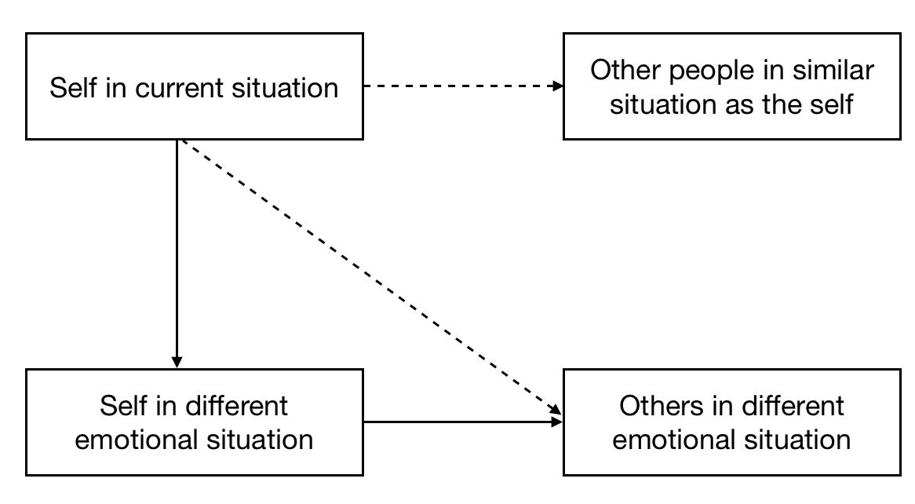

Slide 32
Results
 | before (cold) | after (hot) | significance of difference
Mentioned thirst before hunger in essay | 19% | 50% | p<.05
thirst more unpleasant | 61% | 92% | p<.02
would regret more not packing water | 61% | 88% | p<.05
thirst more unpleasant for hikers | 57% | 88% | p<.02
hikers would regret more no packing water | 52% | 92% | p<.01
Replicated with preschool children by researchers at the University of Oregon:
Atance, C.M. and Meltzoff, A.N. (2006). Preschoolers' Current Desires Warp Their Choices for the Future. Psychological Science, 17(7), 583-587.

Slide 33
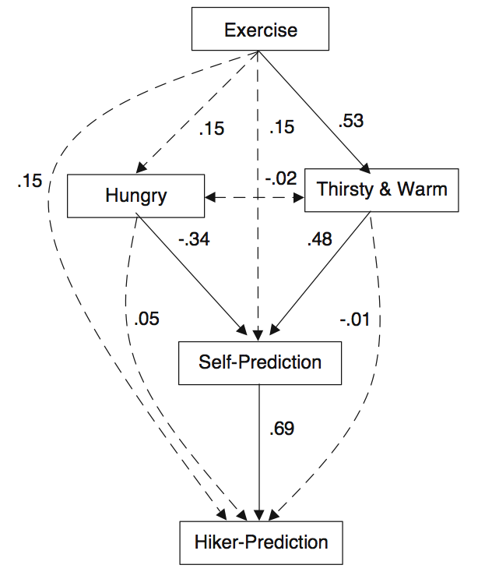

Slide 34
Hot-cold empathy gaps: Fear
Students given opportunity to tell joke in front of the class one week later for $2.00.
Half decided immediately after watching scary film-clip
One week later allowed to change their minds (in either direction)
No film Film sig. (unafraid) (afraid) of diff.
Agree to tell joke one week
beforehand 32%
Agree to tell a joke just
before joke would be told 13%
(n=30)
Van Boven, L., Loewenstein, G., Welch, E. & Dunning, D. (2012). The Illusion of Courage in Self-Predictions: Mispredicting One’s Own Behavior in Embarrassing Situations. Journal of Behavioral Decision Making, 25, 1-12.

Slide 35
Hot-cold empathy gaps
Fear
(with Leaf Van Boven, Ned Welch and David Dunning)
Students given opportunity to tell joke in front of the class one week later for $2.00.
Half decided immediately after watching scary film-clip
One week later allowed to change their minds (in either direction)
No film Film sig. (unafraid) (afraid) of diff.
Agree to tell joke one week
beforehand 32% 10% p<.03
Agree to tell a joke just
before joke would be told 13% 0% n.s. (n=30) (n=32)

Slide 36
Applications

Slide 37
Badger, G.J, Bickel, W.K., Giordano, L.A., Jacobs, E.A. Loewenstein, G. (2007). Altered States: The Impact Of Immediate Craving On The Valuation Of Current And Future Opioids. Journal of Health Economics. 26(5), 865-876.
Addiction
Procedure (simplified):
n=13 addicts receiving Buprenorphine (BUP) (methadone-like maintenance drug)
made repeated choices (8 times over a period of weeks) between extra dose of BUP or different money amounts, either to be received immediately or 5 days later
Made some choice right before receiving BUP (i.e., when deprived) and others right after (when satiated)
Prediction: Addicts will value delayed BUP more highly if choosing when they are currently craving than when they are not currently craving

Slide 38
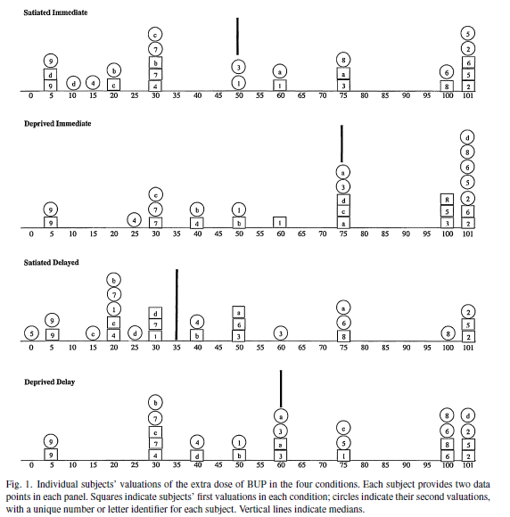
No evidence of learning over time; difference between first and second valuations in specific conditions (e.g., deprived, delayed choice):
(F1,84=.1, p=0.85).

Slide 39
Results
Similar results for smokers… Sayette, M. A., Loewenstein, G. Griffin, K. M. & Black, J. J. (2008). Exploring the cold-to-hot empathy gap in smokers. Psychological Science, 19, 926-932.

Slide 40
Helps to explain..
over-optimism about quitting among smokers
  University of Michigan’s Monitoring the Future longitudinal study (Johnston, O’Malley, & Bachman, 1993) found that among respondents who were occasional smokers (less than one cigarette per day), only 15% predicted that they might be smoking in 5 years, but 5 years later 43% were, in fact, smoking
why people begin taking addictive drugs in the first place
Intolerance and lack of empathy toward addicts

Slide 41
e.g., Stanton Peele(1987) “A Moral Vision of Addiction: How People's Values Determine Whether They Become and Remain Addicts.”
  “I sat with an older woman watching a program in which a woman who directed a prominent treatment program described how, as an alcoholic in denial, she drank alcoholically throughout her years as a parent, thus raising six children who all either became substance abusers or required therapy as children of an alcoholic. The woman's argument was that she had inadvertently inherited her alcoholism from her two alcoholic grandfathers (a model of genetic transmission of alcoholism, incidentally, which no one has actually proposed). The woman I was sitting with clucked about how insidious the disease was that it could make a mother treat her children this way. I turned to her and asked: "Do you really think you could ever have gotten drunk and ignored your children, no matter how delightful you found drinking or how it relieved your tension or however you reacted to alcohol genetically?" Neither she nor I could imagine it, given her values as a parent. “

Slide 42
Suicide
Considerable fraction of suicide is impulsive, especially among the young
Lots of (albeit mixed) research examining link between suicide and impulsivity
However, hopelessness is a consistent predictor of suicide
Hot-cold empathy gaps helps to explain why hopelessness → suicide – because it feels like one will never recover
  "When you are depressed, the past and the future are absorbed entirely by the present. You can neither remember feeling better nor imagine that you will feel better" Solomon, 1998

Slide 43
Friend (2003) reports that “survivors [of Golden Gate Bridge jumps] often regret their decision in midair” -- e.g.
    Ken Baldwin “hurdled over the railing, afraid that if [he] stood on the chord [he] might lose courage” On the bridge, Baldwin counted to ten and stayed frozen. He counted to ten again, then vaulted over. As he crossed the chord in flight, Baldwin recalls, “I instantly realized that everything in my life that I’d thought was unfixable was totally fixable—except for having just jumped.
Seiden (1978) found that of 515 people who were prevented from jumping between 1937 and 1971and followed up an average of 26 years, 94% still alive or had died of natural causes:
    “the findings confirm previous observations that suicidal behavior is crisis-oriented and acute in nature.”

Slide 44
End of life decision making
Lots of evidence that people don’t experience the kind of death they want
But, do people know what they want?
  Underprediction of desire for "heroic measures“ (Slevin et al., 1990):
    % who say they'd accept a grueling course of chemotherapy for 3 extra months of life
      radiotherapists 0%
      oncologists 6%
      healthy persons 10%
      current cancer patients 42%
  Chochinov (1999; Lancet):
  168 cancer patients receiving end-of-life care rated themselves twice a day on pain, nausea, appetite, activity, drowsiness, sense of well-being, depression, anxiety, and will to live.
    Over 12 hour periods, patients' will to live often fluctuated by 30 percent or more.
  → "These large fluctuations suggest that will to live is highly unstable."

Slide 45
Bryce, Loewenstein, Arnold, Schooler , Wax & Angus (2004). Quality of death: Assessing the importance placed on end-of-life treatment in the intensive-care unit. Medical Care, 42, 423-431
Tested whether people would trade healthy life expectancy for better EOL
Computerized survey instrument describing hypothetical patient experiences in the ICU
General population sample (n=104) recruited in Pittsburgh, Pennsylvania.
Life expectancy traded (from a baseline of 80 healthy years followed by a one-month fatal ICU stay) for improving ICU care in 4 domains: pain and discomfort, daily environment, treatment decisions, family support, and all of these together.

Slide 48
Torture
Torture is banned by numerous international treaties signed by most countries of the world
But what is torture?
Torture almost invariably defined by the degree of pain an interrogation technique imposes
  e.g., UN Convention Against Torture—ratified by over 150 countries—defines torture as the “infliction of severe physical or mental pain or suffering.”
Nordgren, L.F., Morris, M., & Loewenstein, G. (2011). Psychological Impediments to an Objective Evaluation of Modern Interrogation Tactics. Psychological Science, 22(5) 689–694.

Slide 49
4 experiments show that people who experience even a mild version of the specific pain produced by an interrogation tactic are more likely to classify that tactic as torture, and view it as unethical, than are those who are not experiencing pain.
  social pain manipulation → opposition to use of prolonged solitary confinement
  sleep deprivation (based on when survey collected during exam time) → sleep deprivation viewed as less acceptable method of interrogation
  submersion of hand in ice water → view of “cold cell” interrogation tactics being defined as ‘torture’ rather than ‘interrogation’
  addressed question of whether those who are experiencing pain overestimate it, or those who are not experiencing pain underestimate it (as we conjecture)
Morris McDonnell, M., Nordgren, L.F. and Loewenstein, G. (2011). Torture in the Eyes of the Beholder: The Psychological Difficulty of Defining Torture in Law and Policy. Vanderbilt Journal of Transnational Law, 44

Slide 50
Open questions..
Is there anything special about mispredicting preferences (or is it just one manifestation of cognitive projection)?
Is there anything special about affect?
Do people mispredict how they will feel, or the impact of how they will feel on their preferences (on how they will behave)?
Why do we make this systematic mistake?

Slide 51
Slide 3 revisited
Some related well-researched issues..
Can people predict their own experience utility (happiness, what will make them happy)?
Do two types of utilities correspond; do decisions maximize well-being?
Should decisions maximize well-being? Do people want to maximize well-being?

Slide 52
Slide 3 revisited
Some related well-researched issues..
Can people predict their own experience utility (happiness, what will make them happy)?
Do two types of utilities correspond; do decisions maximize well-being?
Should decisions maximize well-being? Do people want to maximize well-being?

Slide 53
Hedonic misprediction..
Many patients report a high quality of life
  Wortman and Silver (1987): quadriplegics reported no greater frequency of negative affect than control respondents!
  Tyc (1992): “no difference in quality of life or psychiatric symptomatology” in young patients who had lost limbs to cancer compared with those who had not.
Healthy people don’t appreciate that they will adapt (note difference from projection bias)
  Chronic dialysis (Sackett and Torrance, 1978)
    Nonpatient predictions .39
    Patient reports .56
  Colostomies
    Nonpatient predictions .80
    Patient reports .92

Slide 54
Possible causes of the discrepancy
Methodological problems:
  Mismatch between subject populations?
  Renorming of scales
Explanations that implicate patients:
  Dissonance reduction
Explanations that implicate non-patients:
  Misconstrual of medical condition?
  'Focusing illusion'
  Underappreciation of adaptation

Slide 55
Test of mismatch: within-subject study of kidney transplant and dialysis
(n=127 dialysis patients who ultimately received transplants; all numbers on 0-100 quality of life scale)
Reported well-being
pre-transplant 64.16
Predicted well-being
one year later (post-transplant) 91.19
Reported well-being
one year later (post-transplant) 76.81
Recalled well-being 47.19
Notes: - all means significantly different from one-another
- those not transplanted over-predicted their own misery
difference≈30
difference≈30

Slide 56
Evidence of misconstrual
Measure | Pre-transplant | Prediction of 1 year post-transplant | Actual post-transplant
Hospital days in past year | 9.50* (17.67) | 1.85 (4.56) | 7.15**** (10.69)
Travel days in past year | 6.92** (12.49) | 26.78 (38.87) | 11.40**** (23.24)
Hours working per week | 12.91 (18.51) | 30.66 (18.33) | 12.02**** (18.35)
* p<.10; ** p<.05; *** p<.01; **** p<.001 (all ps: difference from post-transplant prediction)

Slide 57
bad scales?
Classic criticism is that patients renorm the scales based on their own experiences or on new points of social comparison

Slide 58
Baron, J. Asch, D.A., Fagerlin, A., Jepson, C., Loewenstein, G., Riis, J., Stineman, M.G. and Ubel, P.A. (forthcoming). The effect of Assessment method on the discrepancy between judgments of health disorders people have and do not have: A Web study. Medical Decision Making, 123(5), 422-434.
Web-based; n=99 (ages 16-68; median 36; 22% male)
Rated series of health conditions
  With vague or better-defined scale
    Vague – e.g., "100 is a very good quality of life"
    Better-defined – e.g., "100 is as good as that of someone with a meaningful job, friends, family, and good health"
  For self or other
Then stated whether they had the condition
Conditions
  Asthma
  Back pain
  Insomnia
  Shortness
  Overweight
  Nearsightedness
  Acne
  Smoking habit
  Arthritis
  Heart disease

Slide 59
results…
Self-ratings consistently higher than other ratings
Have/have not discrepancy was larger with better-defined scale than with vague scale

Slide 60
Scale recalibration in lung disease:
Asked patients and non-patients to rate QoL of 30 health and non-health related conditions
  Dandruff, nasty boss, long commute, asthma, etc.
Had them rate moderate shortness of breath from lung disease
  1 flight of stairs
Lacey, H.P., Fagerlin, A., Loewenstein, G., Smith, D.M., Riis, J. and Ubel, P.A. (2008). Are they really that happy? Exploring scale recalibration in estimates of well-being. Health Psychology, 27(6), 669-675.

Slide 61
Possible results 1: Recalibration

Slide 62
Possible results 2:
No Recalibration

Slide 63
Lung scenario ratings: sick patients and health public
Mean rating of lung scenario (0-100 scale)
  patients (subset) = 69
  public = 57
    p = <0.05
Mean ranking of lung disease (1 to 27)
  patients = 13
  public = 16
    p = 0.006

Slide 64
Are they using the scale differently?
Mean rating of all items
  patients = 55
  public = 56
    p = .71
Standard deviation of all ratings
  patient = 16.5
  public = 15.2
    Test for equality of variance = 0.22

Slide 65
Self-deception by patients?
Palm Pilots given to 49 end stage renal patients dialysis 3 times per week.
49 matched (age, gender, educ., race) healthy controls
Palms carried for 7 days; beeped randomly in each 90 minute segment of day
On each beep, respondent asked 12 questions, including…
Riis, J., Loewenstein, G., Baron, J., Jepson, C., Fagerlin, A. & Ubel, P.A. (2005). Ignorance of hedonic adaptation to hemodialysis: A study using ecological momentary assessment. Journal of Experimental Psychology: General, 131(1), 3-9.

Slide 66
Please tap the button below that best describes the mood you were feeling just before the Palm Pilot beeped:
2 … Very pleasant
1 … Slightly pleasant
0 … Neutral
-1 … Slightly unpleasant
-2 … Very unpleasant
When Palms returned, subjects estimated mood distributions on the above scale:
Last Week (during which they carried the palm)
Typical Week
Dialysis Scenario
  Controls: (Following presentation of a dialysis scenario … "Imagine that you had dialysis")
  Patients: As in the scenario; no other health problems.
Other Person (Someone else your age with same health)
Healthy
  Controls: In perfect health
  Patients: If never had kidney trouble

Slide 67
Main results
 | patients | nonpatients | Diff?
actual mood | ave=.70 pos=58% | ave=.75 pos=65% | n.s. n.s.
predicted (scenario) | ave=.49 pos=54% | ave=-.01 pos=41% | p<.01 p<.12
if no dialysis | ave=.98 pos=70% | (“grass is greener” Effect)

Slide 68
Summary
Patients seem to be about as happy as controls
Healthy people mispredict the happiness of patients
Patients themselves think that medical conditions have made them unhappy
Other research we have done dismisses ‘focalism’ as the explanation for the discrepancy, but supports a failure to anticipate adaptation..
Ubel, P., Loewenstein, G., Hershey, J., Baron, J. Mohr, T. Asch, D.A. & Jepson, C. (2001). Do nonpatients underestimate the quality of life associated with chronic health conditions because of a focusing illusion? Medical Decision Making, 21, 190-199.
Notes:
Future:
Longitudinal
Other estimation measures.

Slide 69
Disability ratings are influenced by a failure to consider adaptation
Adaptation exercise
Think about one emotionally difficult life experience that happened to you at least 6 months prior to now
At the end of those 6 months would say you felt
  Much worse
  About the same
  Much better than you would have predicted
Ubel, P.A., Loewenstein, G., Jepson, C. (2005). Disability and sunshine: Can hedonic predictions be improved by drawing attention to focusing illusions or emotional adaptation? Journal of Experimental Psychology: Applied, 11(2), 111-123.

Slide 70
Adaptation Results
QoL Rating (0 - 100)
Disability N Before After P
Paraplegia 123
Paraplegia 56
47
-
52
62
.003
.001

Slide 71
Slide 3 revisited
Some related well-researched issues..
Can people predict their own experience utility (happiness, what will make them happy)?
Do two types of utilities correspond; do decisions maximize well-being?
Should decisions maximize well-being? Do people want to maximize well-being?

Slide 72
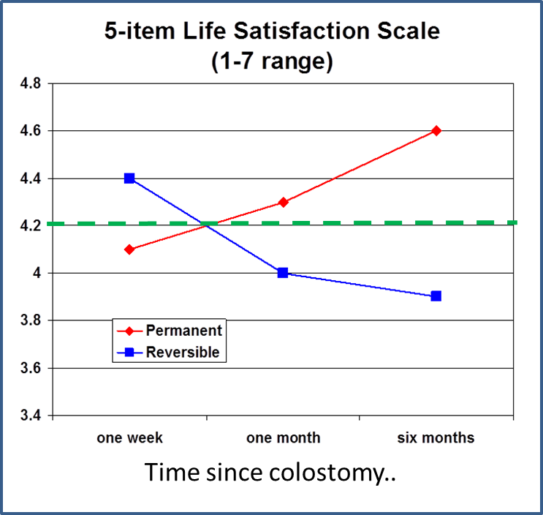
One piece of evidence that they do not and should not
71 patients who received permanent or potentially reversible colostomy
Interviewed three times:
    1 week after release from the hospital
    one month after release
    six months after release
Smith, D. M., Loewenstein, G., Jankovich, A., & Ubel, P. A. (2009). Happily hopeless: Adaptation to a permanent, but not to a temporary, disability. Health Psychology. 28(6): 787-791.

Slide 73
In sum..
Preferences are extremely state-dependent
We make decisions (often long-term) based on predictions of future preferences
We mispredict future preferences due to projection bias – because we project our current states on our future (and also past, and also other people’s) states
Transformative nature of states (most importantly affects) + Loss of perspective→ Long-term decision-making is powerfully influenced in a non-normative fashion by transient factors
  “It is always thus, impelled by a state of mind which is destined not to last, that we make our irrevocable decisions.”
Marcel Proust, Remembrance of Things Past

